Slide 1

Welcome to MassHire
Notes:
SCRIPT
Welcome to Masshire – our mission is to connect businesses and job seekers through a statewide network of employment experts. It’s our job to help people find meaningful employment, and to help businesses find qualified candidates.

Slide 2



MASSHIRE CAREER CENTERS
Helping take the fear and confusion out of finding a job!
MassHire supports YOU and helps get YOU back to work
Notes:
SCRIPT
Our career counselors at MassHire are here for you and understand searching for a job can feel confusing, frightening, lonely, and frustrating. We’ll help you get through this process and help you get back to work as soon as possible.
Please pay close attention to the information given throughout this presentation, as we walk you through what you can expect in terms of career support.

Slide 3
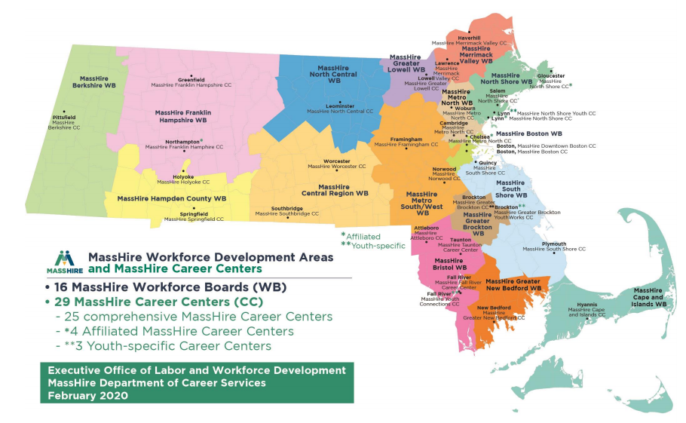
MassHire Locations
https://www.mass.gov/how-to/find-a-masshire-career-center
FIND A CAREER CENTER
Notes:
SCRIPT
There are several MassHire Career Centers across Massachusetts that are working to strengthen our online services. The services described in this presentation will be accessible online, with the opportunity to work with career counselors remotely.
Please call your nearest career center to learn more about these services.
Go to www mass gov how to find a masshire career center to find the MassHire Career Center closest to you.
If you have questions about any of the content in this slide deck, please visit the link and contact your local career center over the telephone.

Slide 4






MassHire Partnerships
Department of Unemployment
Assistance (DUA)
www.mass.gov/DUA
Department of Transitional Assistance (DTA)
www.mass.gov/DTA
Mass Rehabilitation Commission (MRC)
www.mass.gov/MRC
Mass Commission for the Blind (MCB)
www.mass.gov/MCB
Senior Community Service Employment Program (SCSEP)
https://www.mass.gov/senior-community-service-employment-program-scsep
Notes:
SCRIPT
MassHire partners with other government agencies to help connect you with social services and support needs while you are looking for employment.

Slide 5
How can MassHire Help You?
Specialized Programs and Services
Job Search Pathway
Training Pathway
Unemployment Insurance
Notes:
SCRIPT
How can MassHire help you?
A career counselor can help you learn about job search, training opportunities and to evaluate your barriers and goals. You’ll receive customized job search counseling to find immediate next steps and plan for the future.
Explore your training options. Learn about HiSET (also known as GED) and certificate training programs. You may be eligible to get paid while learning skills on the job!
MassHire Career Centers can even assist with helping you meet your unemployment insurance requirements.
But, first, we want to begin with showing you the many specialized programs and services that MassHire Career Centers have to offer!

Slide 6

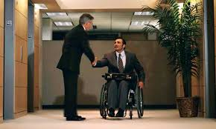

Specialized Programs and Services
Notes:
SCRIPT
MassHire offers many specialized services and programs to assist job seekers on their pathway to employment.

Slide 7

Veteran Services
Veteran Customers and Eligible Spouses
  We proudly serve those who proudly served our country!
Notes:
SCRIPT
Veteran Services include veteran job seekers and eligible spouses who are entitled to priority of service.
Each MassHire Career Center has a Veterans’ representative on site to provide information and referrals to access other services and Benefits.

Slide 8

Customers With Disabilities
Customers can self-identify and receive individual assistance if you have a disability
Reasonable accommodations are available upon request
Notes:
SCRIPT
If you are a person who has a disability, please know that you can self-identify, and receive individual assistance at any MassHire Career Center.
Adaptive equipment and reasonable accommodations are available upon request, along with
Referrals to relevant agencies, such as
Massachusetts Commission for the Blind; and
Massachusetts Rehabilitation Commission

Slide 9

Young Adults
Eligibility Requirements Apply
Notes:
SCRIPT
Our young adults program which ranges from ages 14 – 24 provides work readiness workshops, financial literacy programs, Career Pathway Programs including HiSET (also known as the GED), job training and higher education.
We also work with youth for year-round and summer jobs as well as individual job search assistance and placement.

Slide 10


Multilingual Services
To access translated publications and documents, visit our Multilingual webpage at:
https://www.mass.gov/orgs/office-of-multilingual-services
Notes:
SCRIPT
Should you need assistance with translation or interpretation services for multiple languages including American Sign Language, MassHire Career Centers can help.
Please contact the Multilingual Unit at 1-888-822-3422.

Slide 11


Trade Adjustment Assistance (TAA),
Trade Readjustment Allowances (TRA)
If your job has moved overseas or been affected by foreign competition, you may be eligible for
benefits including:
  Financial assistance for job training
  Cash benefits
Deadlines apply
Notes:
SCRIPT
If your job has been adversely affected by foreign competition or the service you provided moved overseas, you may be eligible for benefits which include financial assistance for job training and/or an extension of unemployment benefits.
Strict deadlines apply – contact your nearest MassHire Career Center to find out if you are Trade eligible.

Slide 12



National Dislocated Worker Grants (NDWGs)
National Dislocated Workers Grants assist customers who are affected by large scale layoffs caused by unexpected economic events.
Notes:
SCRIPT
MassHire career centers have federal grants available, such as National Dislocated Worker Grants or NDWGs.
This grant offers assistance to customers who have been affected by large scale layoffs caused by an unexpected economic event. These grants may also assist by providing funding assistance for training, career development and job placement

Slide 13

Services to Migrant Seasonal Farm Workers (MSFWs) and Agricultural Employers
Staff assisted services and referrals for Support Services.
Notes:
SCRIPT
If you are a person who has been employed in temporary agricultural work and travels to different farms there are services available for you!
Migrant Seasonal Farm Workers or MSFWs may receive staff assistance such as job referrals and placement, skills development training and career guidance.

Slide 14
Where Do I Start? Job Search or Training
Your new job!
Assessment
Develop a Career Action Plan – Job Search or/and Training?
Research the labor market
Apply for jobs or begin training
Notes:
SCRIPT
Career Centers work with you in a variety of ways, including job search and training.
The first step is an assessment of your skills and experience which can help you figure out if you need to upgrade your skills through training to get a job in your desired field. Assessments answer your the job search-related questions throughout the process.
Researching the job market can help you find answers to your job search and training questions such as: do I have the skills? Are there jobs for me and what are they paying? Where are the schools located and how much does training cost? Labor market research keeps you informed about what skills are most in demand and which employers are hiring.
Together with your career counselor, you will develop a Career Action Plan. Your eligibility for training programs and other special services will be determined during this process. You can update your resume, practice interviewing skills, work on your goals and determine barriers.
The job search process and labor market research prepares you to apply for jobs or begin a training program with the ultimate goal of becoming employed.

Slide 15
Assessments:
Job Search or Training?
How Can Assessments Help You Find a Job or Training?
  Determine strengths, challenges and barriers
  Identify goals and opportunities
  Facilitate decision-making
What Can Assessment Tools Measure?
  Knowledge, skills and abilities (KSAs)
  Aptitude/abilities
  Work and personal values
  Personality traits
  Occupational interests
marketing tools
job searching
market Analysis
skill building
Training Research
Assessment
Notes:
SCRIPT
MassHire Career Centers can help you with Assessments.
Effective job search and training begins with assessment – of yourself and the job market.
Career assessments are tools that are designed to help customers understand how a variety of personal attributes (values, preferences, motivations, aptitudes and skills), impact your potential success and satisfaction with different career and training options and work environments.
What Assessments can do:
Determine if you have marketable skills or need training or enhance your skill set
Identify gaps in your skills to make an informed decision about your need for training and what the training looks like

Slide 16
Labor Market Information:
Job Search or Training?
Identify training programs
Identify skill gaps
and wage information
Know what jobs are
growing or declining
Learn what jobs require certification
Find employers who are
filling jobs of interest
Narrow the job search
Make informed
decisions
Answers to your Job Search or Training Pathway Questions
Find the right job
Notes:
SCRIPT
How can labor market information help me with my job search or training?
It can help answer job search or training questions such as:
Can I get a job with my current skills?
Which employers are hiring?
What are employers paying?
Where are the schools located?
How long is the training program?
How much does training cost?
Answers these questions to help you make informed decisions for your job search or training needs

Slide 17
Online Tools for
Job Search or Training
Why use online tools to Explore Job Search or Training?
Make better, more informed decisions
Learn how assessing your knowledge, skills, abilities, values and interests relate to the training and job search process
These online tools can assist with Assessments, training, employment and much more
www.Onetonline.org
www.masscis.intocareers.org
www.careerinfonet.org
www.torqworks.com
WorkKeys
Notes:
SCRIPT
These online tools offer many types of assessments, as well as answering questions related to jump-starting your job search, training, employment needs, and much more.
Please contact your nearest career center for detail and assistance with your job search and training questions.

Slide 18
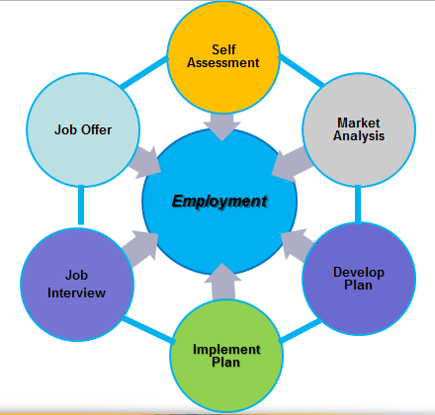
Job Search Pathway
Job Search Process
LMI
LMI
LMI
LMI
LMI
LMI
Notes:
Mass Hire Career centers can help demystify the job search process.
There are six major steps:
First is conducting a Self Assessment to answer some critical questions such as:
What do you want to do? What skills do you have or may be missing?
(Arrow pointing to Market Analysis)
Script: Next, take a look at the job market to understand what industries are in-demand and where are they located.
(Arrow pointing to Develop Plan)
Script: Once you obtained this information you can begin to develop a plan that includes a cover letter and a resume. Remember you want to highlight those skills so don’t be shy about your achievements!
(Arrow pointing to Implement Plan)
Script: Now it’s time to put that plan in to action! Research specific organizations you may be interested in; talk to friends, family, former coworkers and managers. You never know who knows who!
(Arrow pointing to Job Interview)
Script: Implementing your plan, prepares you for the job interview. It’s important to dress appropriately, practice in the mirror or with someone on how to answer common questions and don’t forget to follow up with thank you notes!
(Arrow pointing to Job Offer)
Script: By gathering research, understanding the job market, developing and implementing a plan, and being prepared for the job interview will likely lead to a job offer where you may want to negotiate salary.
These steps often don’t occur in this specific order and may have to be repeated a few times. Just keep in mind the ultimate goal is Employment.

Slide 19
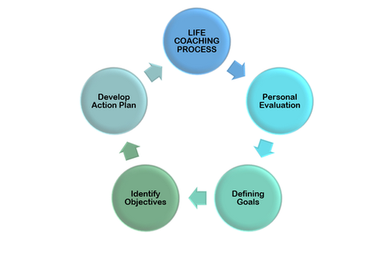
Training Pathway
Self Assessment
Complete Training or Certification Program
Labor Market Information
Employment
Develop Career Action Plan
Set Training Goals
Notes:
SCRIPT
Deciding if you need training is a process, and MassHire Career Centers can help. These steps can help you make informed decisions about if you need training or certification to become reemployed.
Self-assessment:
Helps you determine your strengths and weaknesses
Helps you to create a plan to meet your training and employment goals; and
Helps you determine what is possible and to set realistic goals
Labor Market Information:
What skills are needed for today‘s changing job market?
What types of jobs are available once I complete training?
Can I afford training or do I need to work while attending a training program?
Setting Goals:
Setting goals is important to give you direction to get to your desired employment
Goals help you prioritize, plan, and get organized
Developing a Career Action Plan:
Once you complete self-assessments, research the labor market, and set goals, you are ready to develop a career action plan.
Your plan may include training options, skills that you want to develop, or the types of jobs that you want to apply for after training.
Once you have successfully completed your training program, you are ready for the ultimate goal of your career action plan using your newly acquired knowledge and skills to get the job that you want!

Slide 20
Work-Based Learning
Registered Apprenticeships
  Traditional (Construction and the Trades)
  Non-Traditional (Tech, Manufacturing and Healthcare)
On the Job Training (OJT)
Customized training
Benefits for Veterans
Notes:
SCRIPT
Work-based learning are models that provide the opportunity to learn while you earn, and include, Registered Apprenticeships and On-the-Job Training (OJT)
Benefits of a Registered Apprenticeship include:
Being hired as permanent, full-time employee, including wages and benefits
Attending part-time , classroom training (4-5 weeks); and
Mentored training while on the job
Similar, is the OJT Program that enables employers to hire new employees and train them at their place of business. These benefits include:
Being hired as permanent, full-time employee, including wages and benefits
A training program created based on the job description and any missing skills; and
Job coaching during the period of training
Call your local career center to speak with a career counselor for additional details regarding work-based learning.

Slide 21
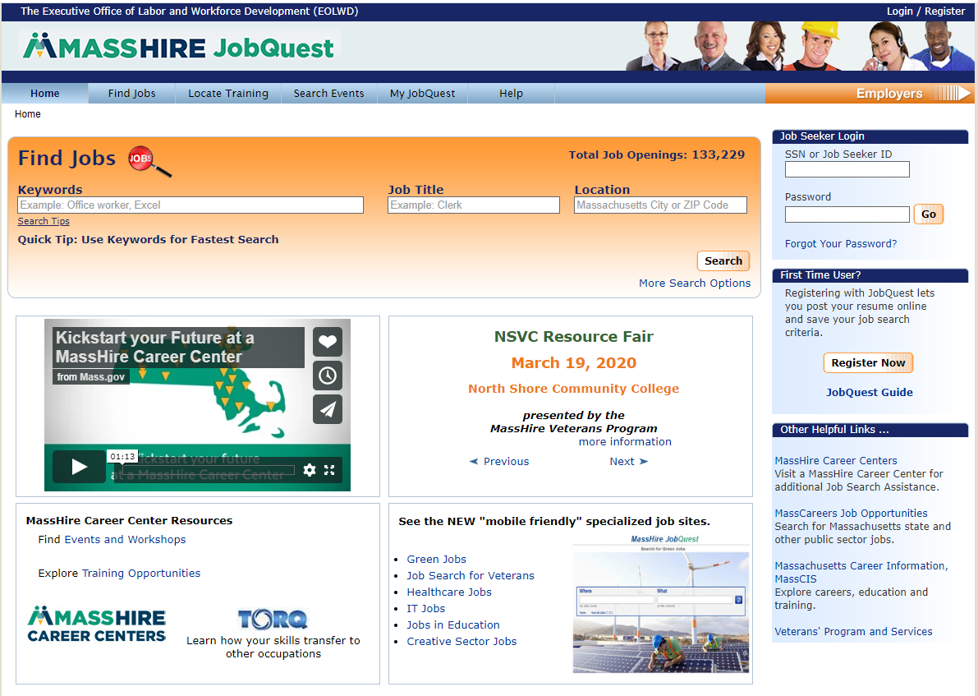
MassHire JobQuest
Search for:
Jobs
Training Schools
Events
Access to:
My Job Quest
Log In
First Time User
Registration
Event Announcements
www.mass.gov/jobquest
Notes:
SCRIPT
JobQuest is Massahusetts’ online database of job openings, and available job training programs with information on schools, cost and location. You can also learn about MassHire events where you might have the opportunity to network and meet with employers.
You’ll create a JobQuest profile which allows you to upload your resume, and job match based on your skill set.

Slide 22
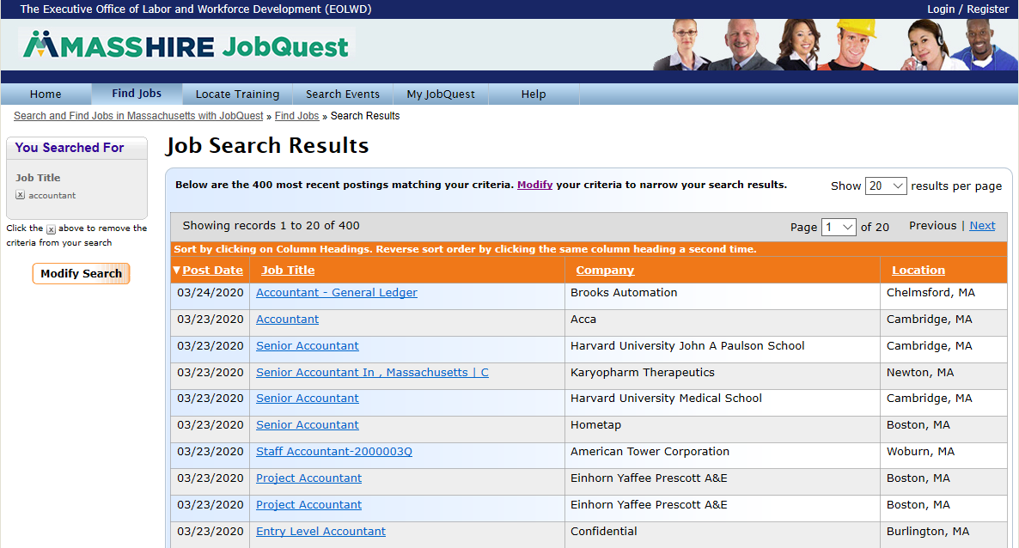
JobQuest – Job Matching
22
Notes:
SCRIPT
Job matching can help focus your job search by matching your skills to many jobs that have been posted by employers
JobQuest can also
Find training and certification programs; and
Locate employment related events all over the state; and
Link to Labor market information tools such as TORQ

Slide 23
Workshops
Assessments
Identifying Skills
WorkKeys
TORQ
Myers-Briggs Type Indicator
Resume
Resume Development
Cover letters
On-line Applications
Networking
Networking Works
LinkedIn
Job Search
Organizing your Job Search
Applicant Tracking Systems
Developing Your Self-Marketing Pitch
Mature Worker
Interviewing
Ace the Interview
Telephone Interviews
Salary Negotiation
Notes:
SCRIPT
Workshops
Participate in our workshops to assist in making informed decisions about your Career Path
Take a look at your interests, skills and abilities and assess your next step
Questions that attending Masshire career center workshops can answer:
How can I update my resume?
What are my skills?
What are my transferrable skills?
Do I need training or certification to get a job?

Slide 24

Workshops
Financial Literacy
Personal budgets
Savings plans
Credit, debt
Financial decision-making
Identity theft
Essential Skills Training
Workforce preparation
Job-readiness skills
Soft skills
These trainings are for Reentry, TANF/Public Assistance, and Long-term unemployed individuals
Notes:
SCRIPT
These Additional Workshops can help jobseekers with specialized topics needed to get into the workforce.

Slide 25

Training Opportunities Program (TOP)
Section 30
    You may be eligible for up to an additional 26 weeks of unemployment benefits while in approved training
    Your work search requirements may be waived while attending full-time, approved training
    Submit application to the Department of Unemployment Assistance (DUA) by the 20th paid week of benefits
    For more information:
      Refer to your UI online claimant inbox to request the TOP application; or
      Contact your local Career Center; or
      contact the TOP unit: (617)-626-5521 or http://www.mass.gov/dua/top
Notes:
Script:
The Training Opportunities Program (TOP, for short) allows you to collect unemployment benefits while you attend full-time training for new job skills. If you qualify,
All remaining info on the slide and voice over does not change except for this addition at the beginning

Slide 26
Unemployment Insurance
Unemployment Insurance (UI) provides temporary, partial wage replacement.
  You must be able, available and actively seeking work while collecting UI benefits.
Please contact the Department of Unemployment Insurance for questions about Unemployment Insurance:
call 877-626-6800 or visit the website below.
Visit https://www.mass.gov/orgs/department-of-unemployment-assistance
Notes:
SCRIPT
MassHire helps to make sure you are meeting your unemployment benefit requirements.
For questions about Unemployment Insurance, contact the Department of Insurance at 877-626-6800 or visit mass.gov/dua.

Slide 27
Re-Employment Services and
Eligibility Assessment (RESEA)
RESEA is a Federal grant program for customers receiving UI benefits.
If you are selected for the RESEA program, please pay close attention to the DUA notification letter with important information and DEADLINE DATES.
This RESEA notification will be sent to:
Your UI Online inbox; and
Received by US mail
You must take action and respond prior to the deadline dates stated within the letter.
Please contact your local MassHire Career Center if you have questions or concerns.
27
Notes:
Script is the slide.

Slide 28
Questions?
Contact your local MassHire
Career Center
https://www.mass.gov/how-to/find-a-masshire-career-center
Notes:
SCRIPT
These are some of the many resources and job search guidance that MassHire has to offer. We look forward to assisting you at a MassHire career center near you!
If you have any questions regarding your job search, training or next steps, please use the link on the screen to contact your local career center.

