Slide 1

Welcome to MassHire

Slide 2



MASSHIRE CAREER CENTERS
Helping take the fear and confusion out of finding a job!
MassHire supports YOU and helps get YOU back to work

Slide 3
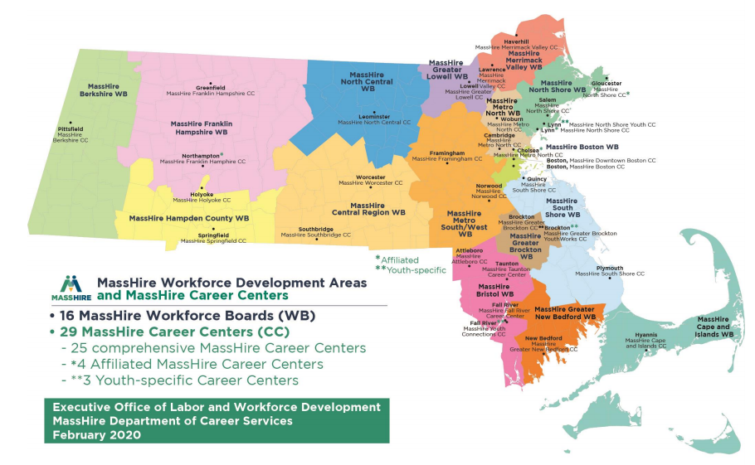
MassHire Locations
https://www.mass.gov/how-to/find-a-masshire-career-center
FIND A CAREER CENTER

Slide 4






MassHire Partnerships
Department of Unemployment
Assistance (DUA)
www.mass.gov/DUA
Department of Transitional Assistance (DTA)
www.mass.gov/DTA
Mass Rehabilitation Commission (MRC)
www.mass.gov/MRC
Mass Commission for the Blind (MCB)
www.mass.gov/MCB
Senior Community Service Employment Program (SCSEP)
https://www.mass.gov/senior-community-service-employment-program-scsep

Slide 5
How can MassHire Help You?
Specialized Programs and Services
Job Search Pathway
Training Pathway
Unemployment Insurance

Slide 6



Specialized Programs and Services

Slide 7

Veteran Services
Veteran Customers and Eligible Spouses
  We proudly serve those who proudly served our country!

Slide 8

Customers With Disabilities
Customers can self-identify and receive individual assistance if you have a disability
Reasonable accommodations are available upon request

Slide 9

Young Adults
Eligibility Requirements Apply

Slide 10


Multilingual Services
To access translated publications and documents, visit our Multilingual webpage at:
https://www.mass.gov/orgs/office-of-multilingual-services

Slide 11


Trade Adjustment Assistance (TAA),
Trade Readjustment Allowances (TRA)
If your job has moved overseas or been affected by foreign competition, you may be eligible for
benefits including:
  Financial assistance for job training
  Cash benefits
Deadlines apply

Slide 12



National Dislocated Worker Grants (NDWGs)
National Dislocated Workers Grants assist customers who are affected by large scale layoffs caused by unexpected economic events.

Slide 13

Services to Migrant Seasonal Farm Workers (MSFWs) and Agricultural Employers
Staff assisted services and referrals for Support Services.

Slide 14
Where Do I Start? Job Search or Training
Your new job!
Assessment
Develop a Career Action Plan – Job Search or/and Training?
Research the labor market
Apply for jobs or begin training

Slide 15
Assessments:
Job Search or Training?
How Can Assessments Help You Find a Job or Training?
  Determine strengths, challenges and barriers
  Identify goals and opportunities
  Facilitate decision-making
What Can Assessment Tools Measure?
  Knowledge, skills and abilities (KSAs)
  Aptitude/abilities
  Work and personal values
  Personality traits
  Occupational interests
marketing tools
job searching
market Analysis
skill building
Training Research
Assessment

Slide 16
Labor Market Information:
Job Search or Training?
Identify training programs
Identify skill gaps
and wage information
Know what jobs are
growing or declining
Learn what jobs require certification
Find employers who are
filling jobs of interest
Narrow the job search
Make informed
decisions
Answers to your Job Search or Training Pathway Questions
Find the right job

Slide 17
Online Tools for
Job Search or Training
Why use online tools to Explore Job Search or Training?
Make better, more informed decisions
Learn how assessing your knowledge, skills, abilities, values and interests relate to the training and job search process
These online tools can assist with Assessments, training, employment and much more
www.Onetonline.org
www.masscis.intocareers.org
www.careerinfonet.org
www.torqworks.com
WorkKeys

Slide 18
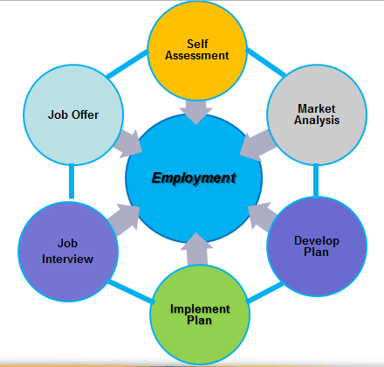
Job Search Pathway
Job Search Process
LMI
LMI
LMI
LMI
LMI
LMI

Slide 19

Training Pathway
Self Assessment
Complete Training or Certification Program
Labor Market Information
Employment
Develop Career Action Plan
Set Training Goals

Slide 20
Work-Based Learning
Registered Apprenticeships
  Traditional (Construction and the Trades)
  Non-Traditional (Tech, Manufacturing and Healthcare)
On the Job Training (OJT)
Customized training
Benefits for Veterans

Slide 21
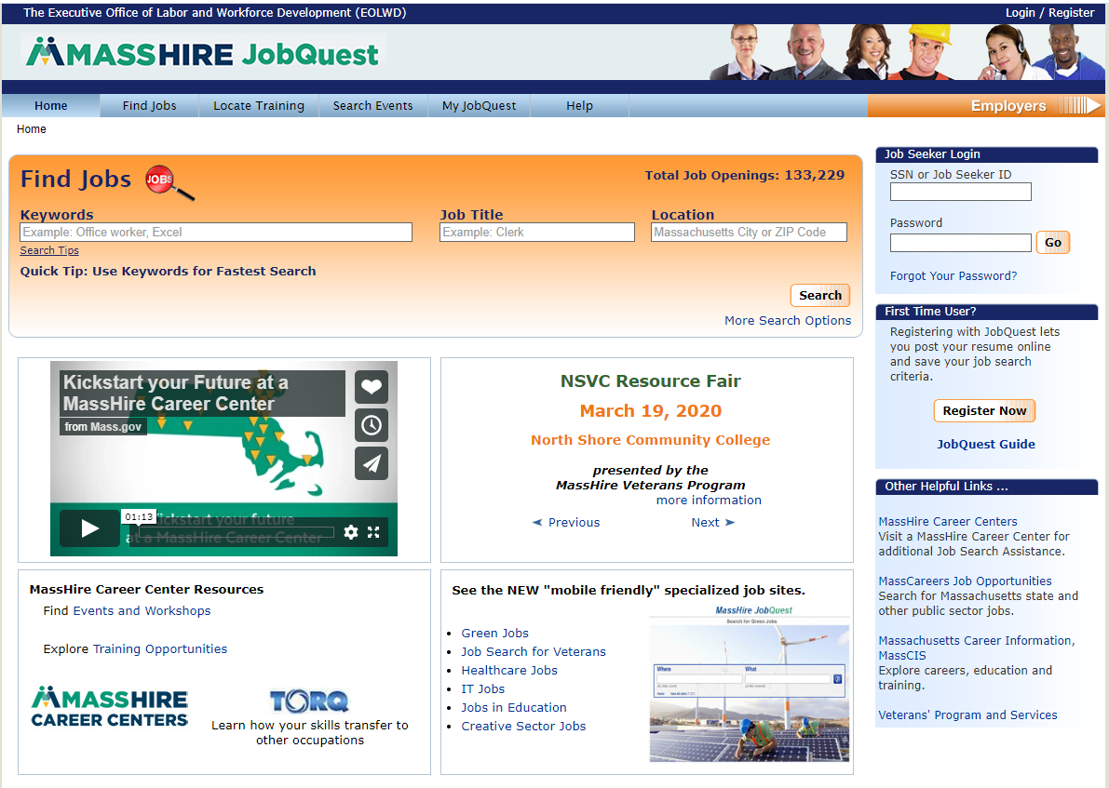
MassHire JobQuest
Search for:
Jobs
Training Schools
Events
Access to:
My Job Quest
Log In
First Time User
Registration
Event Announcements
www.mass.gov/jobquest

Slide 22
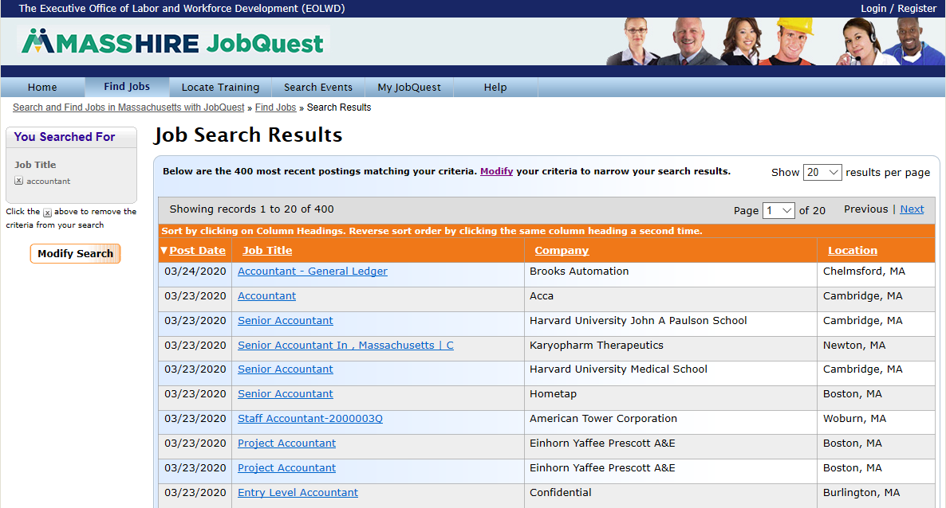
JobQuest – Job Matching
22

Slide 23
Workshops
Assessments
Identifying Skills
WorkKeys
TORQ
Myers-Briggs Type Indicator
Resume
Resume Development
Cover letters
On-line Applications
Networking
Networking Works
LinkedIn
Job Search
Organizing your Job Search
Applicant Tracking Systems
Developing Your Self-Marketing Pitch
Mature Worker
Interviewing
Ace the Interview
Telephone Interviews
Salary Negotiation

Slide 24

Workshops
Financial Literacy
Personal budgets
Savings plans
Credit, debt
Financial decision-making
Identity theft
Essential Skills Training
Workforce preparation
Job-readiness skills
Soft skills
These trainings are for Reentry, TANF/Public Assistance, and Long-term unemployed individuals

Slide 25

Training Opportunities Program (TOP)
Section 30
    You may be eligible for up to an additional 26 weeks of unemployment benefits while in approved training
    Your work search requirements may be waived while attending full-time, approved training
    Submit application to the Department of Unemployment Assistance (DUA) by the 20th paid week of benefits
    For more information:
      Refer to your UI online claimant inbox to request the TOP application; or
      Contact your local Career Center; or
      contact the TOP unit: (617)-626-5521 or http://www.mass.gov/dua/top

Slide 26
Unemployment Insurance
Unemployment Insurance (UI) provides temporary, partial wage replacement.
  You must be able, available and actively seeking work while collecting UI benefits.
Please contact the Department of Unemployment Insurance for questions about Unemployment Insurance:
call 877-626-6800 or visit the website below.
Visit: www.mass.gov/dua

Slide 27
Re-Employment Services and
Eligibility Assessment (RESEA)
RESEA is a Federal grant program for customers receiving UI benefits.
If you are selected for the RESEA program, please pay close attention to the DUA notification letter with important information and DEADLINE DATES.
This RESEA notification will be sent to:
Your UI Online inbox; and
Received by US mail
You must take action and respond prior to the deadline dates stated within the letter.
Please contact your local MassHire Career Center if you have questions or concerns.
27

Slide 28
Questions?
Contact your local MassHire
Career Center
https://www.mass.gov/how-to/find-a-masshire-career-center

