Slide 1
CCS Transition Services Operational Training
Provider Training Series 9-10-2026
Notes:
Adam

Slide 2
Welcome
Presenters:
Adam Garber, Senior Career Services Director​
Bronwen Lafferty, Business Improvement Partner​
Molly Eastman, Business Improvement Partner
Amelia DeGregorio, Business Improvement Partner
Rachel Reyes, Director of Career Services Operations
Notes:
Adam

Slide 3
overview
MassAbility has a long-standing history of supporting students with disabilities and helping those students transition from high school to postsecondary education, training, and employment
The Workforce Innovation and Opportunity Act (WIOA) strengthened the expectation that Vocational Rehabilitation agencies engage students with disabilities earlier - before they leave school and before they enter the adult service system
Under WIOA, one of MassAbility’s roles is to provide access to Pre-Employment Transition Services (Pre-ETS) for students with disabilities who are eligible or potentially eligible for VR services
The five required Pre-ETS activities are:
  Job Exploration Counseling
  Work-Based Learning Experiences
  Counseling on Postsecondary Education and Training Opportunities
  Workplace Readiness Training
  Instruction in Self-Advocacy
Notes:
Adam

Slide 4
Transition services
The CCS Transition Services Model is how MassAbility puts the WIOA mandate into action – with a strong focus on moving Pre-ETS beyond information and exposure toward meaningful experiences that help students explore careers, build skills, connect with employers, and prepare for adult employment
MassAbility was intentional when developing the CCS RFR to include both transition services and employment services in one RFR, as we saw the value of a continuum of services for students as they move from high school/college to the world of young adulthood and employment. Not all providers will offer both services, but all are encouraged help students understand MassAbility’s adult services model when a student will benefit from supports as they move from education to the world of employment
The CCS model has been developed to address the need for students with disabilities who are in mainstream programs, alternative education paths (home school, charter schools, GED/HiSet programs) and college and post-secondary training) that was generally underserved in the last model
Notes:
Adam

Slide 5
CCS Transition Services Ramp Up
MassAbility’s CCS Transition Services program is an evolution of the previous Pre-ETS Model
The new services start October 1, 2026
All providers will receive additional training and support and will be asked to participate in group support sessions to help ensure they fully understand and adopt the new model including Learning Communities and Community of Practice
Some providers are new to transition services and will receive extra support to get their program up and running
Each provider has been assigned a Business Improvement Partner and Area Director to support their program
Providers will receive start-up funding to assist in ramping up their new program including:
  Improving Outreach Materials to inform and recruit students/families/school referrals
  Support to develop employer partnerships for work-based learning sites
  Curriculum funding to purchase Pathful Explore, Explore-Work.com, CareerWork$ Youth
  Technology funding to provide laptops and iPads to utilize online tools
Notes:
Adam

Slide 6
CCS Transition Services Eligibility Criteria
This program is exclusively for students with disabilities ages 14 until their 22nd birthday
It is intended that most of the services will be provided to students who are within two years of high school graduation or enrolled in post-secondary education
“Student” means enrolled and participating in a secondary, post-secondary, or other recognized education program. This can include GED or HiSet programs, home school students approved by their local school system, alternative high schools, and accredited training programs
Services must cease when the student completes education/training or turns 22
Students may be on an IEP, or a 504 plan. Students who do not require special education but have a documented disability may also be eligible for the program
Providers will serve students who are either eligible for MassAbility services or potentially eligible
Potentially eligible students are students with documented disabilities who may receive Pre-ETS without applying for, or being determined eligible for, vocational rehabilitation services
Referrals for CCS Transition Services can come directly from MassAbility, self-referrals, school systems, state agencies such as DDS, DMH, DCF and DYS, and other community partners
Notes:
Amelia

Slide 7
CCS Transition Services General Guidelines
All students will participate in an intake meeting/call prior to the provision of services
Providers will complete a brief intake meeting prior to initiation of services and will gather the required details, as well as a copy of the student Pre-ETS application, signed by the student and parent/guardian prior to initiation of services for all Potentially Eligible Students
MassAbility Career Counselors will send referrals directly to providers. When received, providers should reach out to the student/family or referral source to complete the intake process. Student and their guardian will need to sign the referral form consenting to participation in the program. Providers do not add the MassAbility Eligible Student to the PE Portal.
All students must be approved for services prior to the provision of services
Once a Potentially Eligible Student’s intake is complete and the referral form signed, the student’s demographics must be entered into the MassAbility PE Portal. Student must be approved for services prior to initiative of services.
Students referred by MassAbility will be considered as approved, pending provider receiving signature of student/guardian
Note: providers can accept approval to participate in the program and attestation of disability via email from the student/guardian and can submit that document with the intake form
Notes:
Amelia Note: additional PE Portal Instruction will be shared with all providers and reviewed in the Contract Management and CCS Contract Requirement Trainings

Slide 8
Pre-ETS Service Plan General Guidelines
Providers will complete a Transition Services Plan (Pre-ETS service plan) with each student
Through conversation with the student, parent or guardian, or if a MassAbility Eligible student, the Career Services Counselor, the provider will develop a Service Plan for each student
The plan will describe each of the services that the student will receive with a start and end date. Providers can map out a continuum of services in one plan
Example: Self Advocacy Nov. 1- Dec. 15, Job Exploration Counseling Jan. 3-Feb. 15, Workplace Readiness Feb 26- March 31, Work-based Learning placement April 10-June 30
Example: Career Camp July 12- July 16 (Check all categories) Job Exploration Counseling, Counseling on Post-secondary Education and Training Opportunities, Instruction in Self-Advocacy, Work-Based Learning Experiences + Work-experience July 20- Aug. 22
For PE students, the service plan details need to be submitted with the student referrals into the PE Portal. The plan in the portal allows you to check off each service the student will participate in and enter the dates of services.
If there is potential to extend dates of service to plan for absences, snow days, etc., providers should use extended dates in the portal
Notes:
Amelia Note: additional PE Portal Instruction will be shared with all providers and reviewed in the Contract Management and CCS Contract Requirement Trainings

Slide 9
Additional Details
All students, regardless of whether they are a direct referral from MassAbility or a Potentially Eligible student will receive services equitably. There is no preferential treatment for VR eligible students.
All students must have a signed intake form and service plan submitted prior to initiation of services
PE Student’s demographics, intake form with signatures, documentation of disability or self declaration of disability, and the Pre-ETS service plan, must be submitted into the PE portal and approved prior to the start of services
When the student has been referred by MassAbility, the providers will email the intake form with signatures and the Pre-ETS Service plan to the MassAbility Career Services counselor who will update the Student’s IPE to include the services
Students who have a closed case with MassAbility can receive services as a PE student**** but students with an open VR case can not receive services as a PE student and must be referred by MassAbility
Students can be enrolled with two providers at the same time, but duplicate services can not be provided to the same student at the same time. Providers are encouraged to collaborate to ensure that they both are not trying to provide the same services at the same time. MassAbility staff can view if a student is enrolled with another provider. Providers can reach out to their managing office to ensure that are not duplicating services.
Notes:
Amelia Note: Discuss change in Closed Case to PE Eligible, discuss when a provider recruits a student then finds out they are CS eligible

Slide 10
CCS Transition Services Expectations
Providers will:
All five required Pre-ETS services will be provided through single session series and Career Camps
All providers will have a published schedule of their program modules with a planned number of sessions for the services, with posted start and stop dates for the sessions
All Providers will offer Career Camps in the summer and during school breaks
All providers will provide work-based learning opportunities to the majority of students who have successfully completed Career Camps and single service modules
To provide services in-person as well as remotely
  In-person is the priority
  Remote available to expand access for college students, students with busy afterschool schedules, and rural areas
Providers will offer all services after school, on weekends, evenings, and during school breaks
Notes:
Amelia

Slide 11
Curriculum Expectations
Providers are expected to use the technology-based curriculum that is funded by MassAbility to promote consistency across the state
Providers are encouraged to use the curriculum company’s resources to learn how to use the products, track student participation, etc.
Providers are being provided with all three products but may use them aligned to their students’ age, interests, skill level, and to align with their scheduled modules
Providers will enhance their training model with their own creativity and local programming
Providers are encouraged to tie in community partners to help make the sessions interesting:
  Bring students to a College Fair
  Invite a representative from the Disability Services Office or Admissions office of the local community college to speak to the students
  Have employers come in to speak about what they look for in an employee
  Arrange a tour of a large local employer that interests students
  Arrange an info session at the local MassHire office to help students understand how to use their services
  Have some local tradespeople come in and speak about the work they do
Notes:
Amelia

Slide 12
Purchasing Curriculum
Providers will receive funding, upon request, for the three online curriculum platforms being promoted for CCS Transition Services.
Providers should seek input from students and families to continually improve their services and curriculum
MassAbility welcomes feedback about the recommended curriculum and will request feedback in March 2027 to ensure curriculum is meeting the needs of providers and program recipients. Future funding will be determined based on feedback, utilization tracking, and direct input from students
Providers are encouraged to work directly with the curriculum providers to receive training materials and resources to ensure all staff are proficient in the use of the curriculum
Providers can supplement the curriculum with their own resources and platforms. Please ensure that your Contract Manager and Business Improvement Partner are aware of what additional tools you may be using
Notes:
Amelia

Slide 13
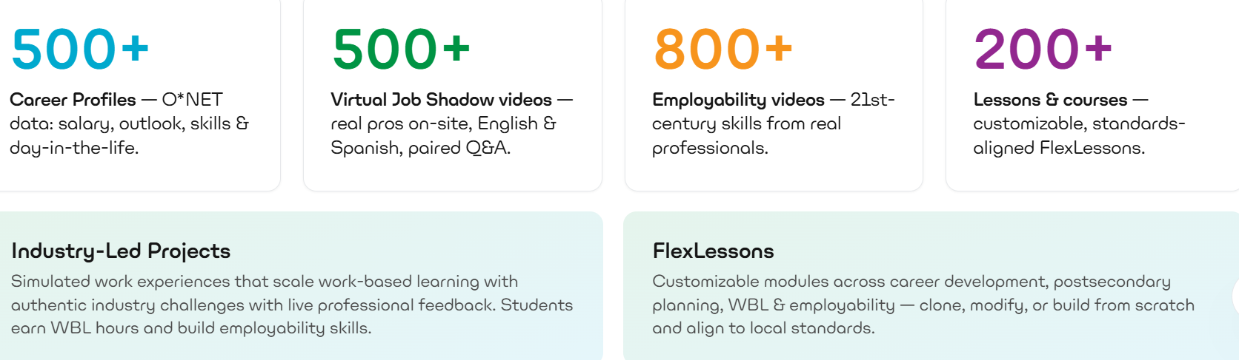

Pathful (Curriculum)
Who to Contact: Rebecca Pickens, Senior Regional Sales Manager Phone: (954) 326-0535 Email: rpickens@pathful.com
Notes:
Alternative Description:
An example of the dashboard interface that user would see. The example includes brightly colored text in four boxes.
Box one shows the number 500+ in a bright blue color followed by the text: Career Profiles- O*NET data: salary, outlook, skills and day-in-the-life.
Box two shows the number 500+ in a bright green color followed by the text: Virtual Job Shadow videos- real pros on-site, English and Spanish paired Q & A.
Box three shows the number 800+ in bright orange color followed by the text: Employability videos- 21st- century skills from real professionals.
Box four shows the number 200+ in bright purple color followed by the text: Lessons and Courses- customizable, standards-aligned Flexlessons.
Two light green boxes fall below.
The first light green box contains: Industry-Led Projects- Simulated work experiences that scale work-based learning with authentic industry challenges with live professional feedback. Students earn WBL hours and build employability skills.
The second light box contains: FlexLessons- Customizable modules across career development, postsecondary planning, WBL and employability- clone, modify, or build from scratch and align to local standards.

Slide 14
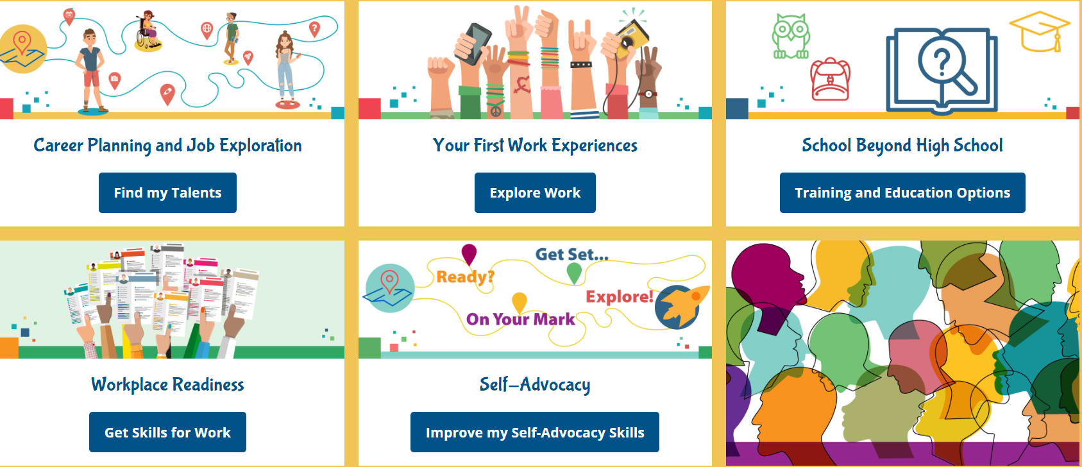

Explore Work (Curriculum)
For more Information, contact:
Theresa Kulow, Deputy Director, Employment Resources, Inc.
Phone: (608)906-2720
Email: kulow@eri-wi.org
Notes:
Alternative Text Description of picture:
A colorful dashboard with a white background and various neon colors and icons related to the categories. Dashboard includes the following five categories-
Career planning and job exploration with a button that says “find my talents”
Your first work experiences with a button that says “explore work”
School beyond high school with a button that says “training and education options”
Workplace readiness with a button that says “Get Skills for Work”
Self-Advocacy with a button that says “Improve my Self-Advocacy Skills”

Slide 15
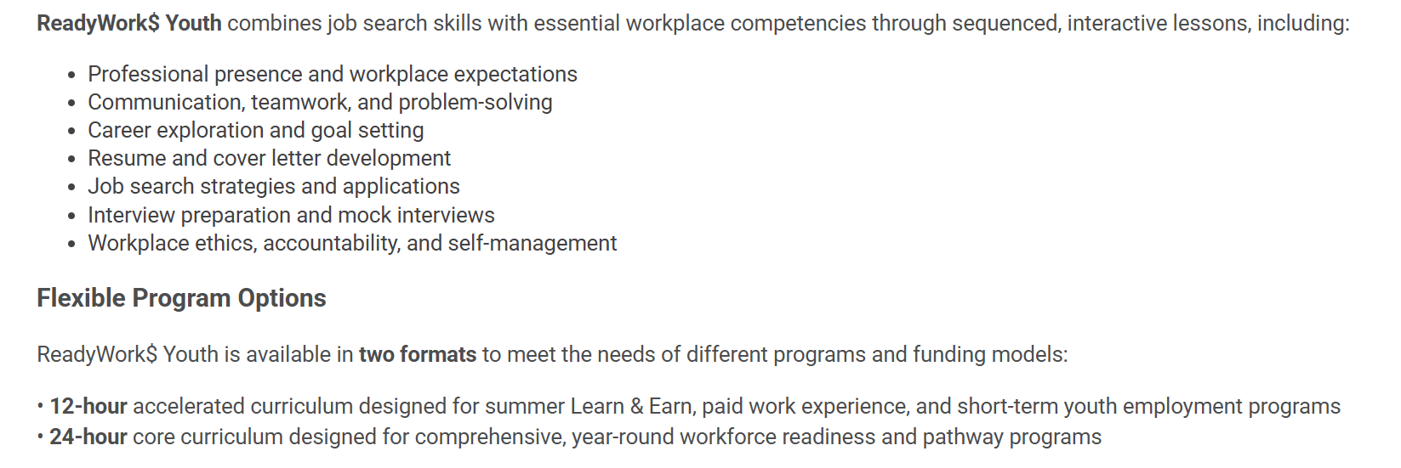

ReadyWork$ Youth (Curriculum)
For more Information, contact:
Latoya Edmond, Executive Director
Phone: (215) 664-6690
Email: latoya@careerworkstraining.org
Notes:
Amelia

Slide 16
Transition Services Outreach Planning
Providers are encouraged to have a robust outreach program which includes social media outreach, easy to navigate websites, brochures, fliers and posters for target markets with QR codes to drive families to their website
Providers are encouraged to:​
Maintain and expand their relationships with High Schools​, providing materials to guidance offices, special ed departments, school administrations, etc.
Connect with Charter, Private, and Alternative High Schools​
Develop relationships with public and private colleges​
Develop or expand relationships with local YMCAs, Boys and Girls Clubs, Independent Living Centers, disability advocacy groups, etc.​
Outreach and market their program to their local DDS, DMH, DCF, and DYS​
Reach Behavioral Health programs and other health care professionals​
Promote their program to Career Services area offices​ and counselors
Track their outreach efforts and outcome (enrollments) per events
Notes:
Molly

Slide 17
Promoting the Program
Outreach and marketing of the program is critical to the success of the program
Providers can cast a much wider net for students instead of receiving referrals from a limited number of school partners
Providers will publish their schedule on their website, in marketing materials, on social media, and to families, schools, MassAbility, and community partners on a regular basis
Ensure MassAbility is listed as a co-brand on all marketing materials
If using QR Codes, please ensure that they bring the student to updated information on the agency website that includes the registration process.
Providers can develop their own online registration format or drive students to the MassAbility Application for Transition Services webpage
Providers can publicly display the curriculum that they are using, but this is not required
Providers should ensure that they fully describe location of services, number of staff present in all single session and career camp programs, describe any field trips or offsite activities, declare if snacks or lunch will be provided, publish general expectations of the program, and, if providing transportation, ensure details of the service are available for student and family’s review
Notes:
Molly

Slide 18
Strategies for Student Recruitment
Ensure your marketing materials (online and print) are:
Proactive (calendar of events)
Dynamic (feature pictures of youth, bios of staff, youth success stories)
Accessible (plain language, accessibility check, multiple languages)
Appealing to youth
Social Media (Instagram, TikTok, Facebook, etc.)
Address the 5 Pre-ETS topics specifically
Emphasize this is NO cost to the family! (*Funded by MassAbility*)
Brochures for college students should focus on career preparation and paid work-based learning opportunities, clearly distinguishing these experiences from internships required by the college or academic program.
Brochures for high school students should be engaging and easy for students to understand, while also providing parents and families with clear information about the services and benefits.
Notes:
Molly

Slide 19
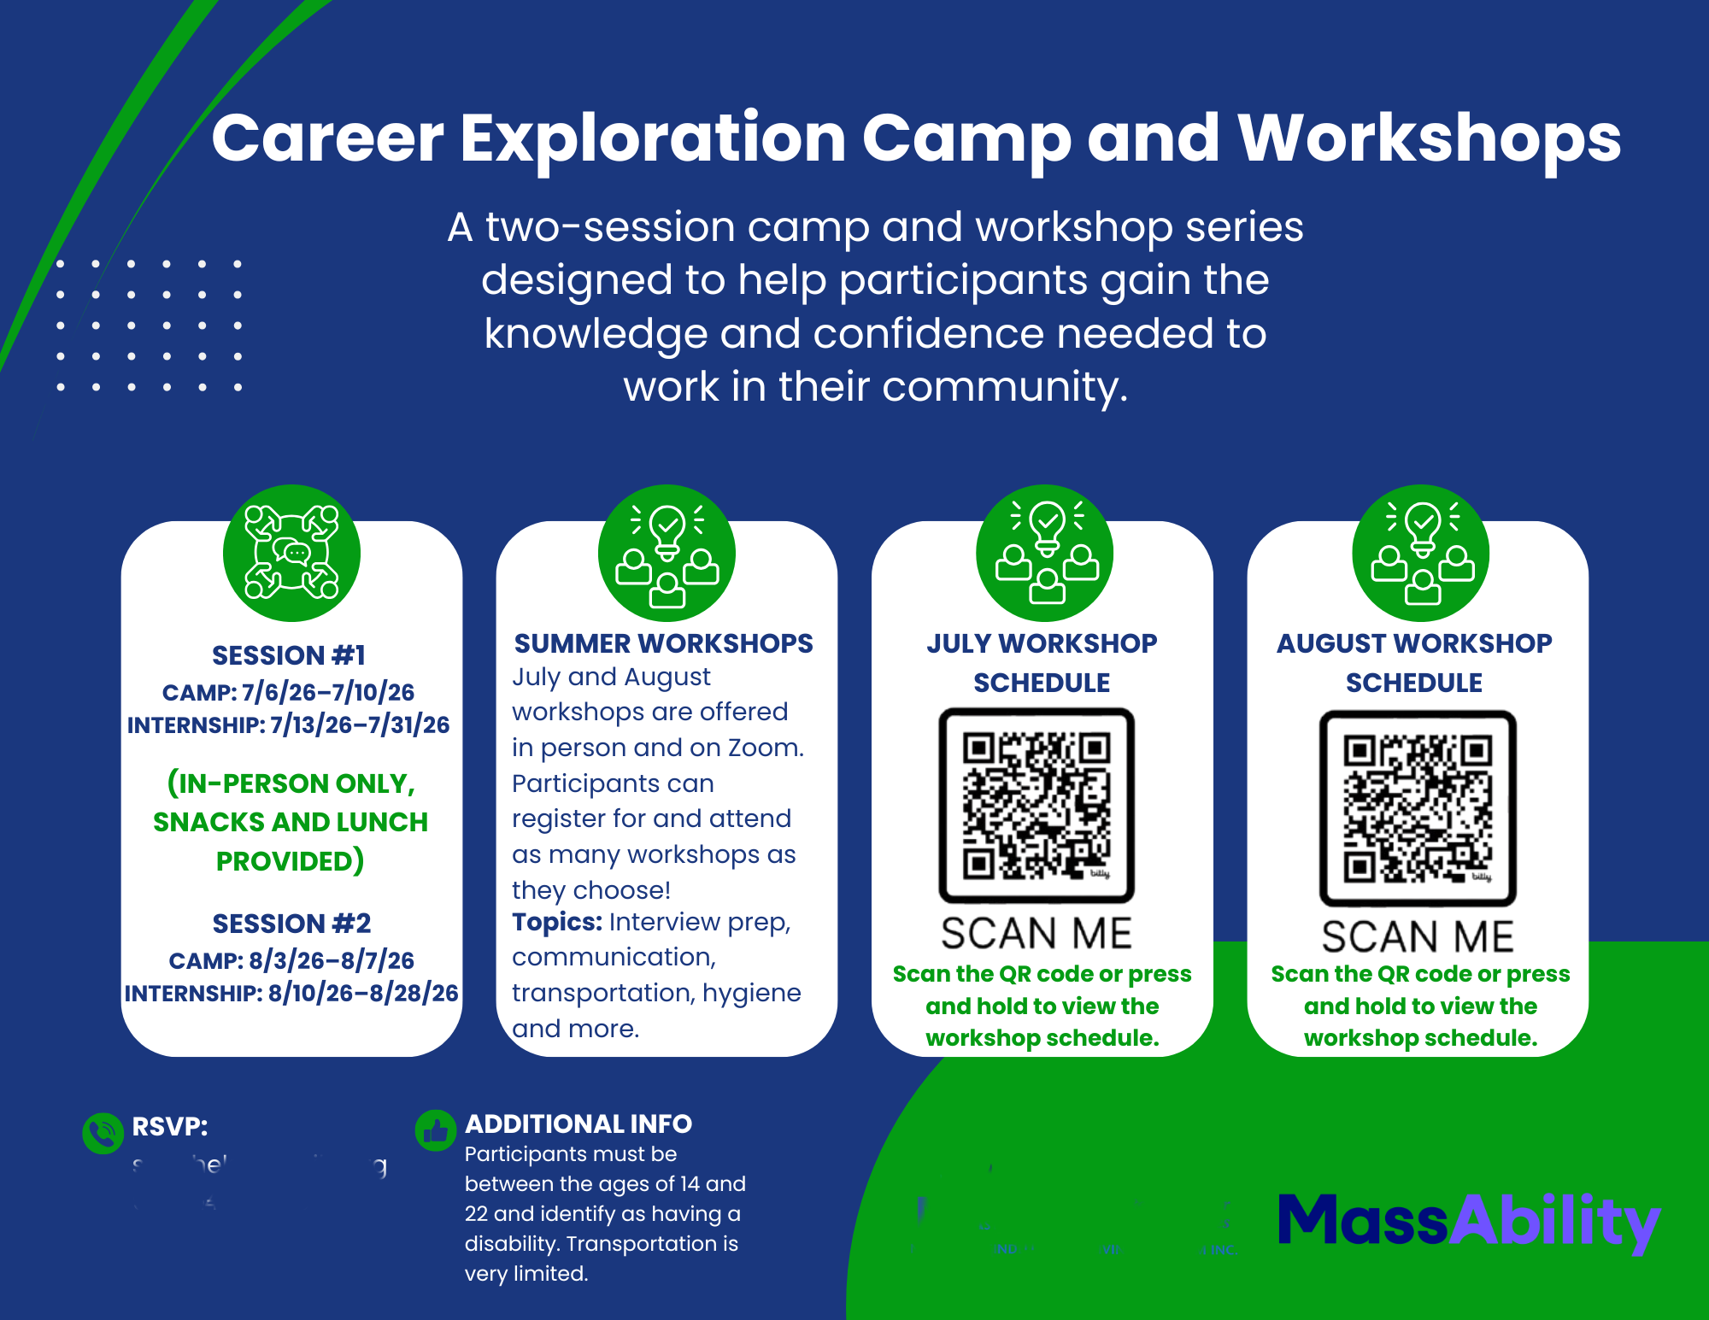
Example of a Transition Marketing flyer
Dates of Camp Weeks
QR Codes to Single Session Calendar and Sign up
Co-Brand MassAbility & Provider Logo
RSVP Contact and Deadline
Contact Name
Provider Name
Notes:
Alternative Text Description:
A colorful diagram illustrating the timeline of session one and two, summer workshops, the July workshop schedule and the August workshop. Both the July and August workshops contain scannable QR codes. Surrounding the outside of the diagram are decorative arrows pointing to context of each timeline.

Slide 20
Partnering with MassAbility
Pre-ETS has moved out of the school day but partnership with schools is critical
Each public High School in Massachusetts has a MassAbility Career Counselor assigned as its liaison
The local area office can provide you with contact information for the school
All Massachusetts Public High Schools have received notification of the changes of the Pre-ETS model from the Commissioners of DESE and MassAbility
All MassAbility Area Offices are sending out messages to their local school partners (Special Ed Teachers, Guidance Counselors, Special Ed Liaisons, Student Services Directors) notifying them of the changes in the model and providing a list of approved CCS providers available in their local communities
The Rehabilitation Services Administration has issued updated guidance reinforcing the requirement that Pre-ETS be provided in integrated settings, with services matching the student’s Pre-ETS plan or IPE. Moving services outside of the school system, with a focus on work-based learning in integrated, community settings aligns with RSA requirements
*** DESE Letter and link to RSA notice is included at end of this this presentation
Notes:
Molly

Slide 21
Know your Education Partners
There are approximately 408 public high schools in Massachusetts, including vocational and charter schools
There are 29 public colleges and universities in Massachusetts
There are 69 private colleges and universities in Massachusetts
All colleges have Student Services/Disability Services/Office of Accessibility. Additionally, many have specialized supports on campus
Academic Support Programs (LD/ADHD/ASD/ID)
Campus Counseling Services
Campus Medical Services
College Navigators
Notes:
Molly

Slide 22
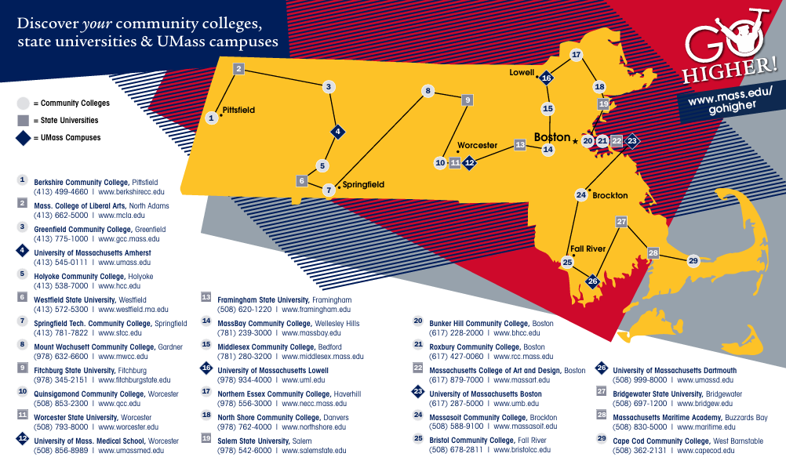
Notes:
Alternative text description:
A map of Massachusetts with twenty-nine marked college campuses throughout the state. Below the map are each individual college name listed with website and contact information.

Slide 23
Transition Services New Model
CCS Transition Services will be provided in group sessions
Curriculum should be adapted for learners of all abilities and individualized to align with students’ interests and abilities
Providers are asked to have a planned curriculum for each required service and utilize curriculum models funded by MassAbility. Curriculum can be augmented with provider generated materials, technology, and local community alignment
The program should be individualized, but not provided as a one-to-one service, except when identified as “Start up supports for student in work-based learning internship site / check-ins with student in work-based learning internship site”
Transportation is a reimbursable model now, using state funding to allow for both PE and CS students to access it. Providers who do not currently have the capacity to provide transportation may have options available in the near future. Additional guidance and support will be forthcoming from MassAbility
Business Improvement Partners will be working with you to support your program and will be facilitating Provider Learning Communities and planning Community of Practice sessions
Notes:
Bron
Note: We have had a number of questions about using Uber, Lift or vendors offering the service to other providers. We are seeking legal and procurement advise and will provide that as soon as possible.

Slide 24
Single Service Sessions
Single service sessions are group sessions supporting 4-12 students
The single service modules are paid by the session which is intended to be around an hour. (This is billed by the session and not by ¼ hour)
The session rate of $613.17 per session and is fully loaded (inclusive of prep time, materials, supervision, facilities, admin, etc.)
Providers can offer sessions that are two or three hours for special events such as tours of employment sites, college campuses, MassHire offices, etc. which can be multi-hour events
It is intended that there will be two provider staff present at each session
Each single service session series should focus on one service module: Self-Advocacy, Job Exploration, Workplace Readiness, or Post-Secondary and Training Exploration
Providers can provide transportation to and from single service sessions
Students receiving single service sessions after school can be transported home by provider
Single service sessions operate in a cohort model with the same students enrolled for a defined number of sessions.
Examples
  6-week self advocacy program in 1.5 hour sessions
  4-week job exploration program in 1 hour sessions with a three-hour job site tour on the 5th week
  8-week workplace readiness program in 1.5-hour sessions followed by work-based learning placement
Notes:
Bron
We will discuss single service WBL in a couple slides.

Slide 25
Single Service Sessions - cont.
Single service sessions should follow a planned progression around one of the five Pre-ETS topics (using a planned curriculum path)
Providers can provide single service sessions in-person or remotely. Hybrid models are allowable
Students are not paid to attend single service sessions, however paid work-based learning opportunities can follow single service sessions or occur concurrently
Providers should have planned curriculum and use the MassAbility approved technology-based platforms to augment their locally developed curricula
Providers will have publicly posted schedules of Transition Services; on their website, and shared with families, MassAbility, and schools
For CS Eligible students counselors should receive a Transition Services Plan from the provider before services start so that the IPE can be amended appropriately to include each single service
For PE students the Transition Services Plan will be completed in the PE Portal prior to the initiation of services
Notes:
Bron

Slide 26
Career Camps
Providers will offer 5-day Career Camps during school breaks and summer
Career camps will cover four of the five required services (Self Advocacy, Job Exploration, Work-Readiness, Post-Secondary Ed/Training)
Career camps should be followed by work-based learning opportunities for students who successfully complete the Career Camp
Career camps are intended to be 5-hour (two 2.5 hour sessions of actual learning) plus a lunch break
Providers can provide lunch using the Career Camp funding structure to support the cost
Alternative proposals such as career camps for five successive Saturdays can be approved by the managing office Area Director
Transportation to and from the career camp can be offered by the provider
Career Camps can occur on school grounds when schools are on break or in community settings like libraries, YMCAs, college campuses, provider’s offices, etc.
Career camps can not be held in provider day programs or combined with other programs such as Youth Works or DDS services
Notes:
Bron

Slide 27
Career Camps - cont.
For CS Eligible students counselors should receive a Transition Services Plan from the provider before the start of the Career Camp
The IPE shall be amended to include all five required Pre-ETS services for each student participating in career camps, with start date being start of career camp, and end date being the anticipated end of the work-based learning which should follow the Career Camp
  Example: Career Camp: July 5-10, WBL: July 15-Aug 30, Services: July 5-Aug 30
For PE Students, provider will choose all five services when submitting the student referral as the camp should include four of the five services, followed up by work-based learning placement
Students are not paid to participate in Career Camps
Career Camps should provide the students with the skills necessary to successfully move into work-based learning
Most WBL placements should be paid work-experiences
Any unpaid work experiences should be short-term and about exposure to work and exploring student interests
Some students may require additional single session work readiness training before placement
Notes:
Bron

Slide 28
Work-Based Learning
Work-based learning is intended to follow single service and Career Camps
Most students are expected to participate in work-based learning
Paid WBL will be paid at minimum wage by paycheck or direct deposit (no stipends or gift cards)
Social security student exemption is applicable for student internships (request support from MassAbility Student Benefits Counselors when needed)
Paid WBL should be between 40 and 60 hours, shorter sessions can be appropriate for some students or during the school year.
  During School Year Example: student may work in a WBL site 3 hours a week after school on Tuesdays for 10 weeks
  During Summer Example: student completes Career Camp on June 28, starts WBL July 6th and works 10 hours a week for 6 weeks
Unpaid WBL should meet the criteria for DOL volunteer work (non-profit)
Shorter term opportunities are acceptable based on student’s needs, schedules, and specific supports criteria (such as when an aid/para supports the student)
Providers will be expected to develop internship sites and will receive start-up funding upon request
MassAbility Counselors or Business Relations Specialists may be able to suggest sites
Notes:
Bron

Slide 29
Work-Based Learning - cont
Work-based learning is about exposure, while it's important that the site hold the interest of the student, this is not intended to result in direct job placement
Provider should ensure that employers understand the parameters of the program and that a hiring commitment is not necessary
Providers must carry worker’s comp insurance and liability insurance and provide coverage documentation to their employer partners for all internships (insurance company will provide binders specific to the WBL Employer)
Work-based Learning beyond 60 hours requires managing Area Director approval
Providers are encouraged to develop relationships with a wide range of employers and track all outreach to employers. A bank of potential employer locations will assist in placing students in a timely manner after completion of single session series and career camps
Notes:
Bron

Slide 30
Comprehensive Career Services - Wrap Up
CCS Transition Services is the New Pre-ETS for Massachusetts
MassAbility’s CCS Transition Services program is an evolution of the previous Pre-ETS service model (Pre-Employment Transition Services)
This new model seeks to expand the outreach of the program outside of the school environment and beyond the Special Education classroom settings
This model will be offered after school, in the evening, weekends, and during school breaks
Work-based learning (internships) is the cornerstone of the model and most students who successfully participate in single service sessions and Career Camps should be offered internship opportunities
Student and guardian signature is required on the Student Intake and Service Plan Form
PE students must be entered into the MassAbility PE portal before services begin
MassAbility Counselors will send a referral directly to providers for Career Eligible students indicating which services the provider should enroll the student in
Notes:
Bron

Slide 31
Resource Materials
DCL-26-04.pdf
https://rsa.ed.gov/sites/default/files/subregulatory/DCL-26-04.pdf
Letter from DESE and MassAbility Commissioner
Notes:
Rachel

Slide 32

On the Desktop
A message from Commissioner Pedro Martinez and the
Department of Elementary and Secondary Education
August 5, 2026
Transition Services Update
Dear Superintendents, Charter School Leaders, Directors of Education Collaboratives, Assistant Superintendents, Special Education Directors,
For decades, MassAbility and the Department of Elementary and Secondary Education (DESE) have proudly collaborated with schools across the Commonwealth to support students with disabilities. Today, we are sharing an important update on how our agencies will align resources to deepen student support while continuing to respect your vital classroom environment.
To protect this essential academic focus, MassAbility will no longer provide Pre-Employment Transition Services during regular school hours. Instead, MassAbility will support Pre-Employment Transition Services during non-school hours including evenings, weekends, and school vacations.
Notes:
Rachel

Slide 33
Please rest assured that our agencies’ collective partnership with you and our commitment to your schools remains as strong as ever. Even as MassAbility's service delivery format shifts, the agency’s relationships and on-site collaboration continue. MassAbility representatives will remain actively present to prepare youth for future pathways with a refined focus on:
Maintaining a collaborative school presence to guide and prepare youth for future transition programming through on-premises outreach
Work-based learning including internships
Aligning our resources to reach the greatest number of students with disabilities from diverse communities across the Commonwealth
This updated approach expands specialized community-based programming and summer career camps without duplicating IEP services or interrupting the school schedule.
We are deeply excited about how the new model will maximize both academic achievement and career readiness. We value your vital role in this work and appreciate your continued partnership and input as we set youth across the Commonwealth up for long-term success.
Sincerely,
Toni Wolf, Commissioner, MassAbility
Pedro Martinez, Commissioner, Department of Elementary and Secondary Education
Notes:
Rachel

Slide 34
Q & A
Thank you for joining us today!
If you have additional questions please forward them to:
MBY-DL-CCSINFO@mass.gov
Notes:
Rachel

