Slide 1
Intro to Special Commission on State Institutions
Emily Lauer, PhD, MPH
Associate Professor, Director of CDDER

Slide 2
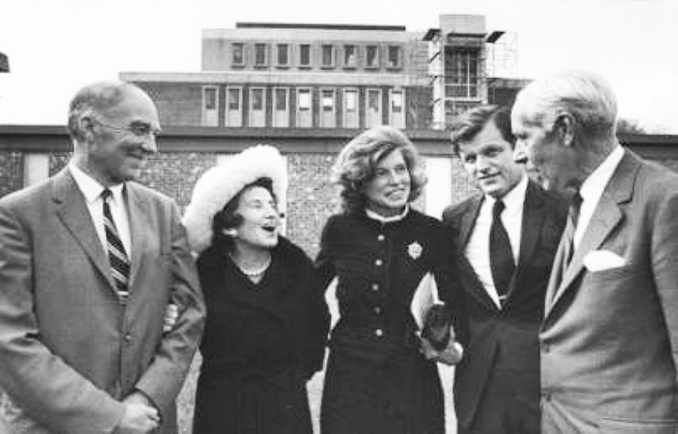
Eunice Kennedy Shriver Center
Part of the University of Massachusetts Chan Medical School
Dedicated to understanding and improving the challenges faced by individuals with intellectual and developmental disabilities (IDD) and/or behavioral health disorders as well as supporting their families.
Our comprehensive experience and expertise have established the Shriver Center as an international leader, devoted to supporting the full participation of people with disabilities in community life.

Slide 3
Our Mission
To transform systems, policy, and practice by engaging in innovative research, education, training, and service so that people with intellectual/developmental disabilities and/or behavioral health conditions may lead self-determining lives.

Slide 4
Examples of relevant prior work
Fostering Social Inclusion and Community Engagement among people with IDD
MA Healthy People 2020 Autism Roadmap Report: Understanding Needs & Measuring Outcomes
Experiences of Aging Caregivers in Supporting Family Members
Evaluation of new service models with Person-Centered Evaluation
Creation of advocacy tools for self-advocates and family members on preventive health screenings
Teaching medical students about the lived experiences of people with disabilities – including people with disabilities
Studying when and how people with IDD died

Slide 5
Areas we can support
Support in running commission
Meetings
Updates/Reporting
Lists of places where they were buried, information about cemeteries
Papers
Where are the papers? Who has them?
We can do as much as we can during the time we have
Process of requesting papers, what happens when you try, how do other places give access to papers

Slide 6
Areas that may be challenging
Legally-related processes to find papers and who has what; what papers are gone
It may take a long time to get this information (after report is due)
You asked to find:
Tell us how people were buried when they died. What were the rules? Were their families told? Did they get a gravestone with their name? Was there a funeral?
Find out if anybody was buried in a place they were not supposed to be buried.
This may be up to where the info is, who has it, how we can get it, and whether we need the help of lawyers to do so.

