Slide 1
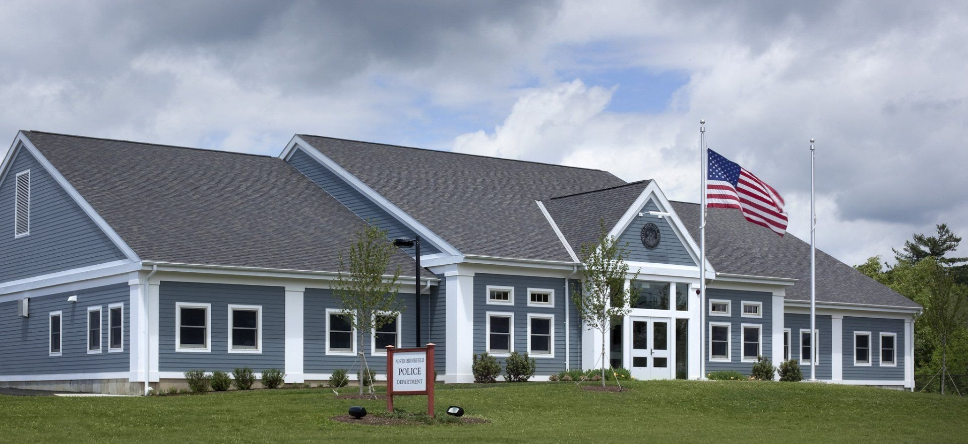

Brownfields Success Story: N. Brookfield, MA
Massachusetts Virtual Brownfields Roundtable, September 9, 2025

Slide 2
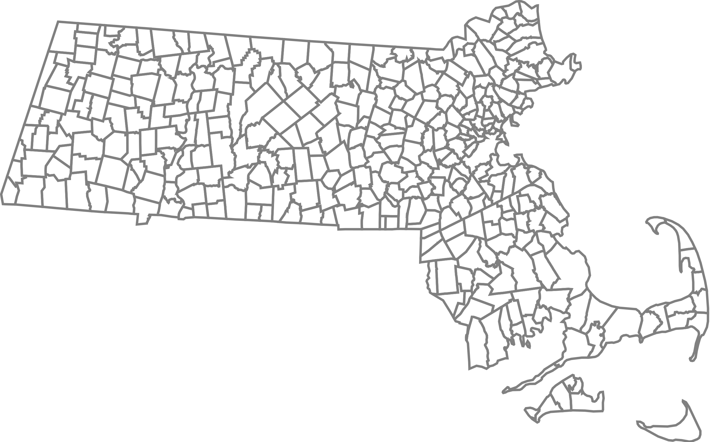

Central Massachusetts Regional Planning Commission Region

Slide 3


Kerrie Salwa
Downtown Clinton
State House
City of Leominster Economic Development Coordinator
CMRPC
Director of Economic Development
CMRPC

Slide 4
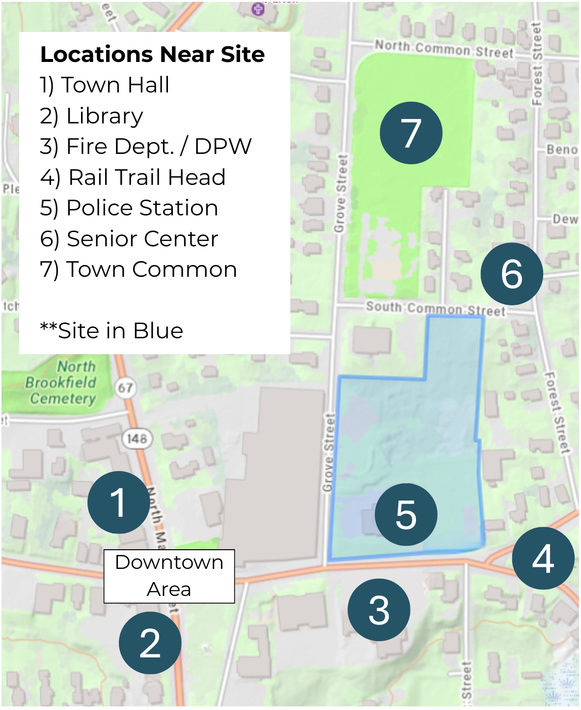

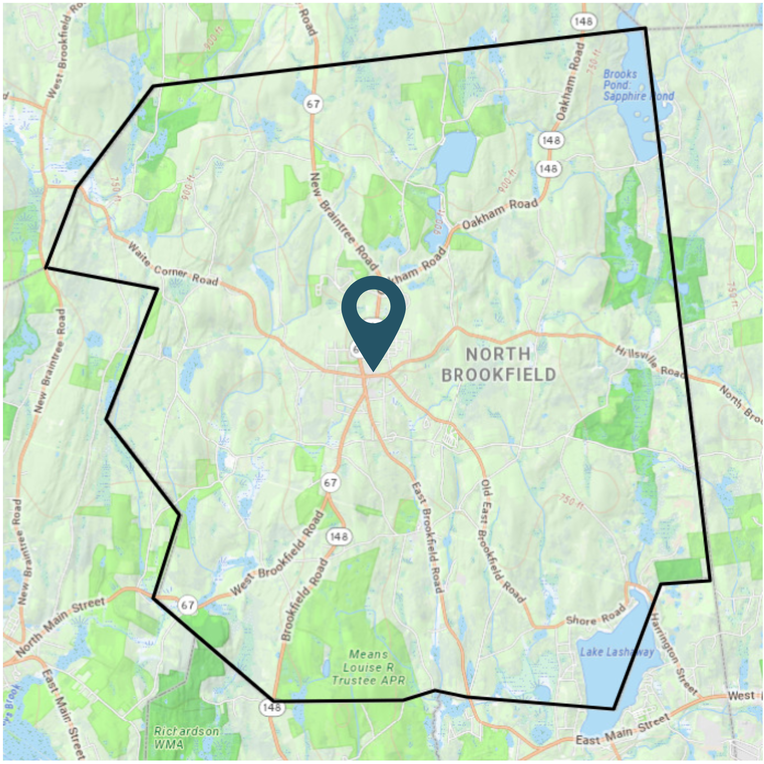
Downtown Development Project
North Brookfield, MA

Slide 5

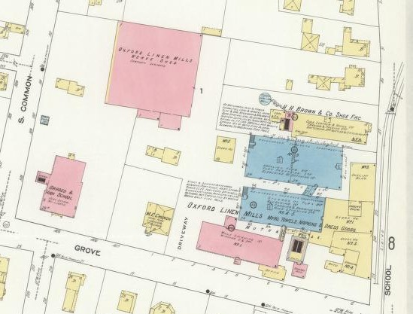
Industrial History of the Site
Location of various industrial activities since the late 1800s
Boot and shoe manufacturing as early as 1892
Asbestos manufacturing since 1919
“Aztec Industries Property:” Aztec Industries owned and operated the site from the mid-1940s to the mid-1980s
Town acquired site in 2000 through tax foreclosure
1913 Sanborn Fire Insurance Map

Slide 6
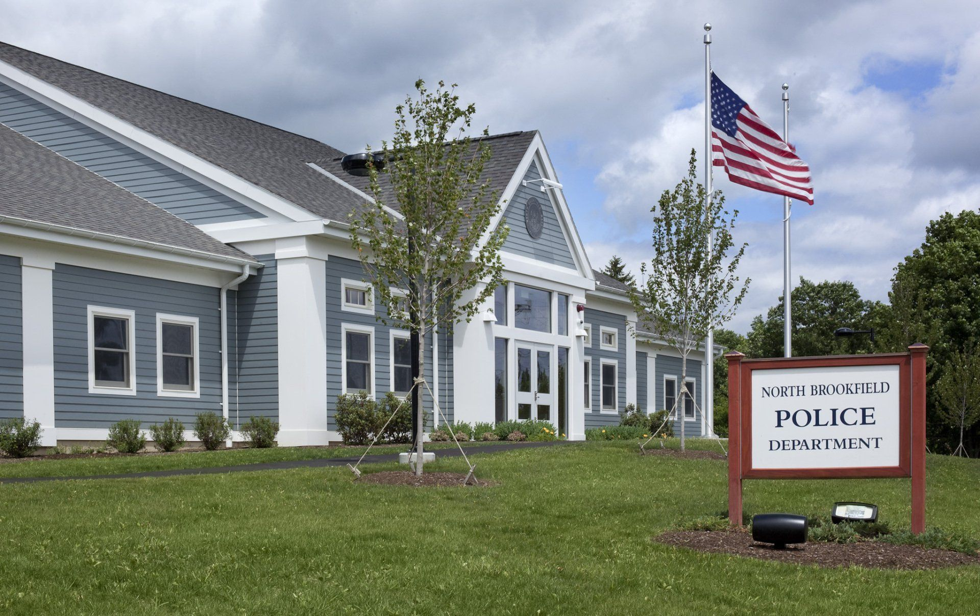
New Police Station (55 School St.)
Project Details:
Cleanup activities initiated in late 1990s by US EPA and MassDEP; completed in 2010
Suite of federal and state funding sources helped pay for cleanup activities and construction
New police station opened in June 2010

Slide 7
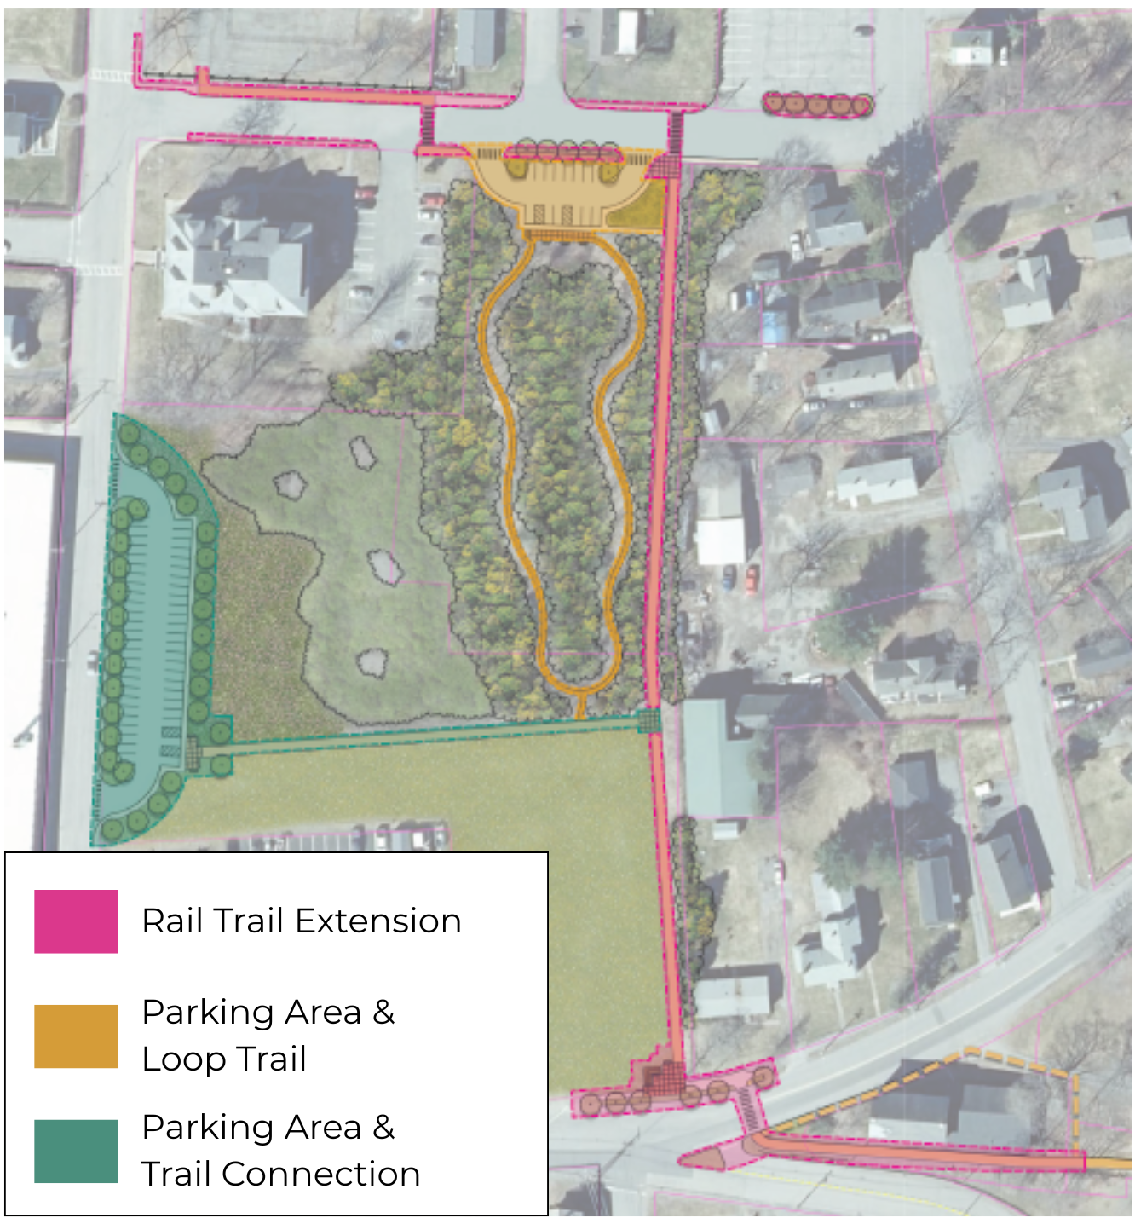
Unimproved Parcels (14 S Common St. and 10 Grove St.)
Two parcels on site have yet to be reused / redeveloped
Presence of asbestos in the soil requires further assessment and cleanup
Town coordinating with US EPA and MassDEP on these efforts
Future concept uses for site include a rail trail expansion, loop trail through the woods, and parking areas

Slide 8




Takeaways
Challenge / Opportunity
The site presented both a challenge and opportunity for North Brookfield in the areas of public health and economic development.
Progress Takes Time
Efforts to remediate and reuse the site have been ongoing for around 30 years now. The building of the police station represented an important early success, but more work remains to be done on the rest of the site.
Commitment
The sustained commitment of the Town of North Brookfield and public officials has been indispensable to seeing cleanup and reuse of the site through to fruition.
Collaboration
Cleanup and reuse of the site could not have occurred without federal, state, and municipal entities partnering to share their capabilities and resources.

Slide 9
Sources
Environmental Protection Agency. “Brownfields Success in New England: Former Aztec Industries: North Brookfield, MA.” July 2011.
Fuss & O’Neill. “Limited Environmental Review and Recreational Development Concept: 14 S Common Street and 10 Grove Street, North Brookfield, MA.” September 23, 2023.
Image Sources
Fuss & O’Neill.
MassMapper.
Sanborn Map Company (via Library of Congress Geography and Map Division).
Tecton Architects.

Slide 10


Kerrie Salwa
KSalwa@CMRPC.org
CMRPC.org
978-549-5648
Director of Economic Development
CMRPC

Slide 11
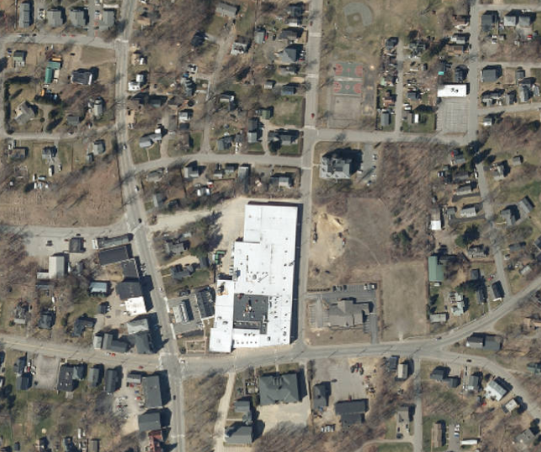
Questions?

