Slide 1

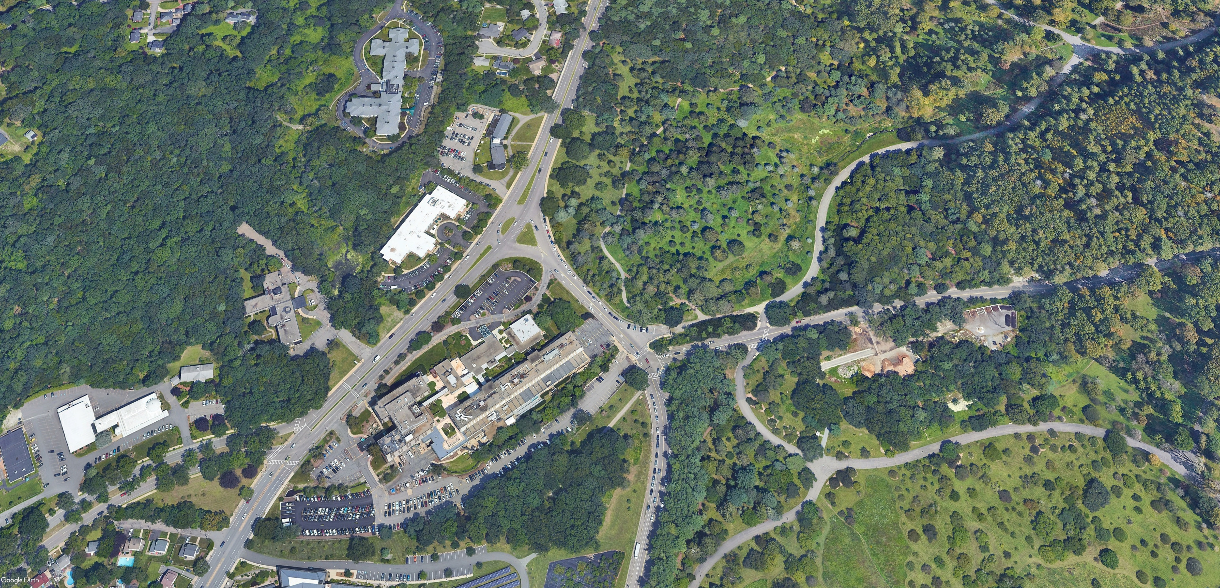
Centre Street at Walter Street
Intersection Improvement Project
Pre-Construction Presentation
May, 2025

Slide 2

Commonwealth of Massachusetts
Governor
Maura Healey
Lieutenant Governor
Kim Driscoll
Energy and Environmental Secretary
Rebecca Tepper
Department of Conservation and Recreation Commissioner
Brian Arrigo

Slide 3
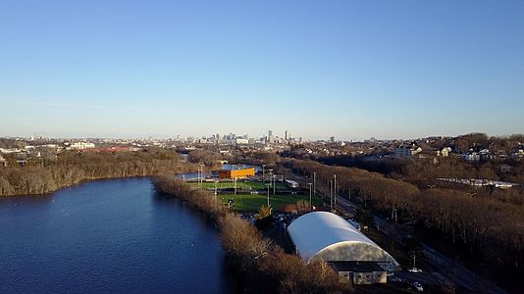
DCR MISSION
To protect, promote and enhance our
common wealth of natural, cultural
and recreational resources
for the well-being of all.
Notes:
DCR staff created the Strategic Readiness Roadmap in June 2022. The intent of the roadmap is to build the foundation for DCR's future by establishing principles that will guide decision making and planning. The roadmap lays the groundwork for future big ideas as well as immediate operational improvements. The Strategic Readiness Roadmap articulates DCR’s mission and core principles: On your screen now, you will see DCR’s Mission Statement: [read DCR Mission Statement] --- and DCR’s Core Principles [push Slide]

Slide 4
Meeting Logistics
Two ways to ask questions during the meeting
  Use chat feature
  Raise your hand using the Zoom function, and you will be given permissions to unmute and speak.
Please note that this public meeting will be recorded; the recording will be a public record.

Slide 5
Meeting Agenda
Final Approved Design to be constructed
Traffic Management Plan
Schedule and hours of work
Questions & Answers

Slide 6

Centre Street at Walter Street - Design to be constructed

Slide 7
Centre Street at Walter Street - Design to be constructed

Slide 8
Centre Street at Walter Street - Design to be constructed

Slide 9
Traffic Management Plan - Phases
Phase 1 –Circular Median Removal
Phase 2 –Triangular Median Removal
Phase 3 – Centre Street Medians Reconstruction
Phase 4 – Hebrew Rehabilitation Centre Corner and Walter Street Reconstruction
Phase 5 – Arboretum Corner and Walter Street Reconstruction
Phase 6 – Centre Street Outbound Reconstruction

Slide 10
Traffic Management Plan – Phase 1

Slide 11
Traffic Management Plan – Phase 2

Slide 12
Traffic Management Plan – Phase 3

Slide 13

Traffic Management Plan – Phase 4

Slide 14
Traffic Management Plan – Phase 5

Slide 15
Traffic Management Plan – Phase 6

Slide 16
Construction Schedule & Hours of Work
Schedule: June 2025 – October 2026
  Substantial Completion – Anticipated August 2026
Hours of Work: 8:30 a.m. – 5:00 p.m.

Slide 17
Centre Street at Walter Street
Intersection Improvement Project
Questions & Answers
Pre-Construction Presentation
May, 2025
Notes:
DCR

Slide 18
Additional Information
Recording, chat and tonight’s slide deck will be available at:
  www.mass.gov/dcr/past-public-meetings
If you have comments on this project:
  Submit online: www.mass.gov/dcr/public-comment
  Deadline: Thursday, June 12th, 2025
  Please note: the contents of comments submitted to DCR, including your name, town and zip code, will be posted on DCR’s website. Additional contact information provided, notably email address, will only be used for outreach on future updates to the subject project or property.
If you wish to subscribe to a DCR general information or project-related listserv: contact DCR’s Office of Community Relations via email at mass.parks@mass.gov
Notes:
Note: This slide is at the end of the presentation

