Slide 1

Changes to TURA Reporting -
Reporting Year 2025
Megan Keene, MassDEP
May 2026

Slide 2
Reporting Year 2025
Guidance Documents Updates
TURA guidance documents have been updated to meet MassDEP accessibility standards
TURA Reporting Instructions Appendices
  Updated the PFAS guidance in Appendix B
  Seven new PFAS were added to Toxics Release Inventory (TRI) in 2024, now to be reported under TURA Individually
Complete List of TURA Chemicals
  Updated to include recently added TRI PFAS and other TRI Chemicals

Slide 3
Change to De Minimis Level for Anthracene
The de minimis exemption allows facilities to disregard certain minimal concentrations of a regulated chemical found in mixtures or trade name products. The de minimis quantity levels are:
  < 0.1% by weight for OSHA carcinogens
  < 1% by weight for other chemicals
Effective Reporting Year 2025 for reports due July 1, 2026, the TRI de minimis level for Anthracene (CAS # 120-12-7) has been changed from 1.0% to 0.1%
Anthracene was classified as a carcinogen by the International Agency for Research on Cancer

Slide 4
New TURA Reportable Chemicals
Reporting Year 2025
Seven new PFAS were added to the TRI list, with a 100-pound reporting threshold, for TRI RY2024
The TURA Administrative Council added these new PFAS to the TURA Chemical List effective RY2025, for reports due July 1, 2026
PFAS that are not TRI reportable should continue to be reported under the TURA Certain PFAS NOL category

Slide 5
List of New TURA Reportable
PFAS Chemicals – RY2025
CAS # | Chemical Name | Threshold (Lbs)
307-24-4 | Perfluorohexanoic acid | 100
422-64-0 | Perfluoropropanoic acid | 100
2923-26-4 | Sodium perfluorohexanoate | 100
21615-47-4 | Ammonium perfluorohexanoate | 100
82113-65-3 | 1,1,1-Trifluoro-N-[(trifluoromethyl)sulfonyl] methanesulfonamide | 100
90076-65-6 | Lithium bis[(trifluoromethyl)sulfonyl] azanide | 100
2816091-53-7 | Betaines, dimethyl(.gamma.-.omega.-perfluoro-.gamma.-hydro-C8-18-alkyl) | 100

Slide 6
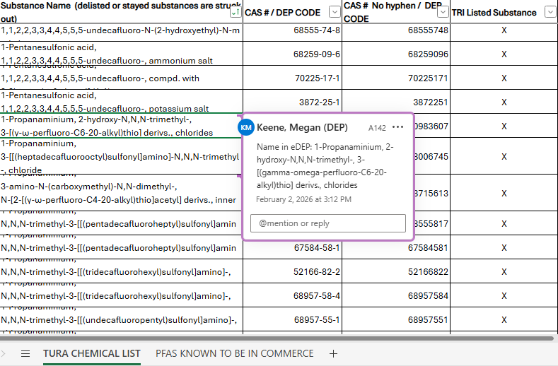
Changes to the Chemical List
eDEP does not allow for use of special characters
Chemicals that have special characters in their name, such as α, the reporting system will spell out the special character
The name within the online reporting site will be
found within the comments of the cell with the
chemical name.
  α = alpha
  ω = omega
  γ = gamma
  β = beta
  δ = delta

Slide 7
Looking Ahead to RY2026:
New TURA Reportable Chemicals
Nine new PFAS were added to the TRI list, with a 100-pound reporting threshold, for TRI Reporting Year 2025
These chemicals have been added to TURA, effective Reporting Year 2026, for reports due July 1, 2027
Until then, they remain reportable under the TURA Certain PFAS NOL Category for RY2025

Slide 8
List of New TURA Reportable
PFAS Chemicals – RY2026
CAS # | Chemical Name
377-73-1 | Perfluoro-3-methoxypropanoic acid
3108-42-7 | Ammonium perfluorodecanoate
3830-45-3 | Sodium perfluorodecanoate
27619-94-9 | 6:2 Fluorotelomer sulfonate sodium salt
27619-97-2 | 6:2 Fluorotelomer sulfonate acid
59587-38-1 | 6:2 Fluorotelomer sulfonate potassium salt
59587-39-2 | 6:2 Fluorotelomer sulfonate ammonium salt
425670-75-3 | 6:2 Fluorotelomer sulfonate anion
3030471-22-5 | Acetic acid, [(.gamma.-.omega.-perfluoro-C8-10-alkyl)thio] derivs., Bu esters

