Slide 1
Examining the Opioid Epidemic
Using Linked Data: MA Chapter 55
Presented to the Drug Formulary Commission
March 15th, 2018
Dana Bernson, MPH
Assistant Director, Office of Special Analytic Projects
Massachusetts Department of Public Health

Slide 2
Outline
The opioid crisis in Massachusetts
Chapter 55 background
Chapter 55 results
Questions

Slide 3
The Opioid Crisis in Massachusetts

Slide 4
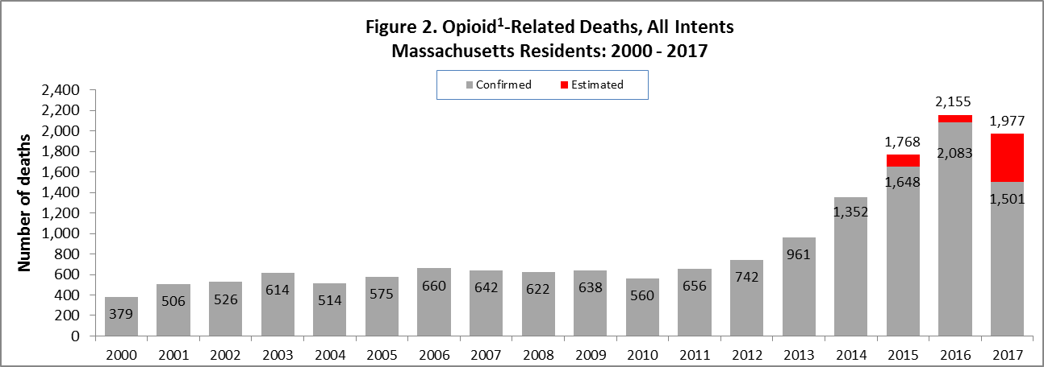
The Opioid Crisis in MA
¹ Opioids include heroin, opioid-based prescription painkillers, and other unspecified opioids.

Slide 5
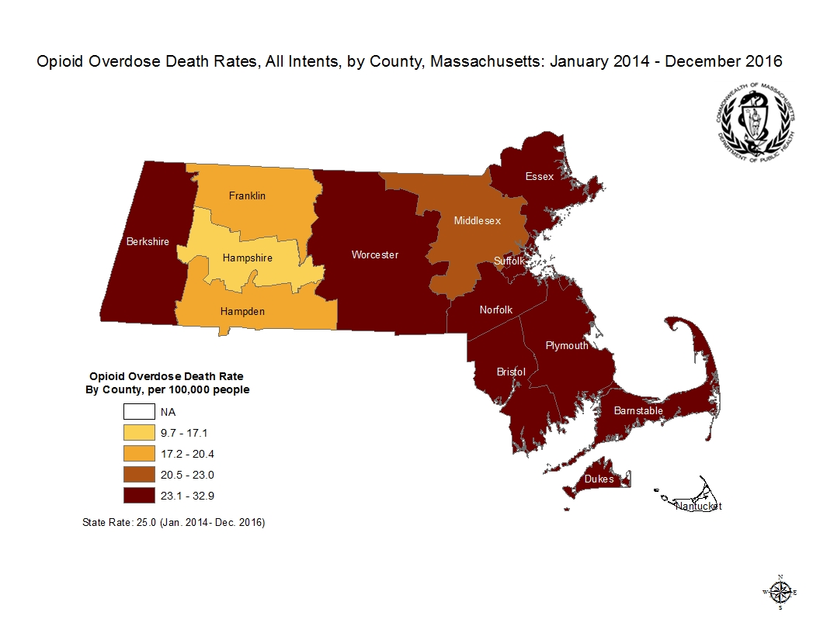
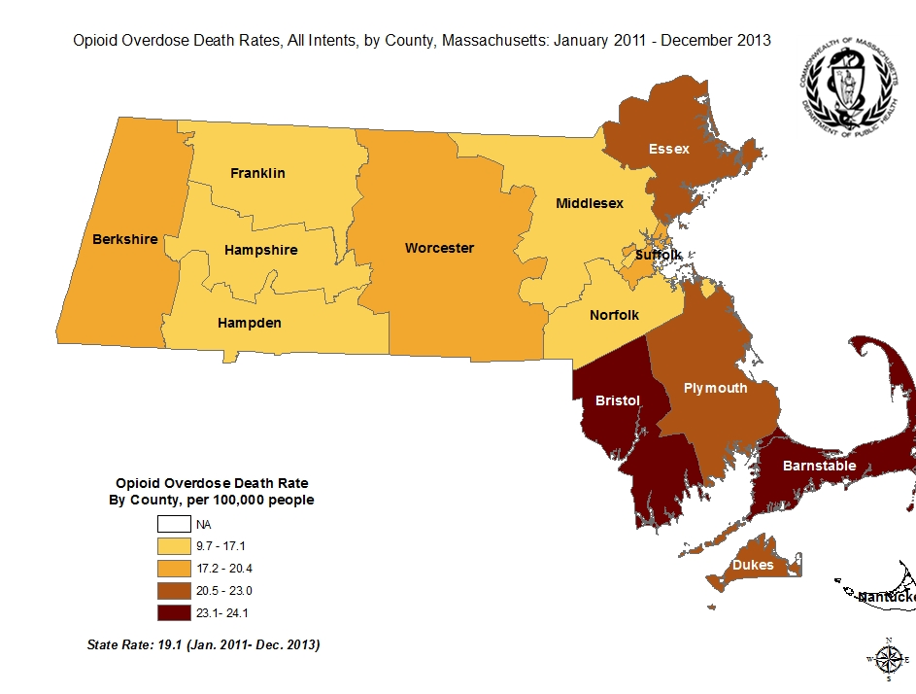
The Opioid Crisis in MA

Slide 6
Chapter 55 Background

Slide 7
Chapter 55: Legislative Mandate
Signed into law by Governor Baker in August 2015
Provides the legal basis for cross-agency collaboration to study the alarming trends in opioid-related deaths
Specifies some contributing data partners
Overcomes legal barriers for use of some data
Required the MA DPH to examine data related to opioid overdose deaths and to submit report addressing 7 specific questions
DPH determined that questions could not be answered without linking the data sources
Notes:
7

Slide 8
Chapter 55: Evolution
Phase 1: Look at fatal opioid-related overdoses. DPH answers 7 questions posed by legislature and conducts 4 additional analyses. Timeline: August 2015- June 2016
Phase 2: Expanded to included nonfatal opioid-related overdoses. DPH conducts several analyses and approves over 20 projects with external collaborators. Timeline: July 2016-June 2017
Phase 3: Expanded to “population health trends”. DPH to produce reports every 2 years. Timeline: July 2017 - ???
Notes:
8

Slide 9
Chapter 55: Phase 2 Data Structure
Data Sources
Public Health
Medical Claims & Hospital
MassHealth (Medicaid)
Mental Health
Public Safety
Jails & Prisons
DHCD (Homelessness)
Veterans’ Services
Service Flags
Aggregate
Chapter 55 Data Structure
System Attributes
Linkage at individual level
Longitudinal (5 years)
Data encrypted in transit & at rest
Limited datasets, unlinked at rest
Linking and analytics “on the fly”
No residual files after query completed
Analysts can’t see data
Automatic cell suppression
PDMP
Toxicology
BSAS Treatment
Death Records
OCME Intake
MATRIS (EMS)
State Police Heroin
APCD Spine
Birth Records
MA Prisons
Service Indicator Flags
Cancer Registry
MA Jails
Community Level Data
Children & Families
Transitional Assistance
NARCAN Enrollment
I.C.E. Measures
Medical Claims
MassHealth
Dept Dev Services
Town & Zip Census Data
Youth Services
Commission for Blind
NARCAN Refills
Hospital and ED
Veterans’ Services
DMH
DHCD
NARCAN Rescues
Drug Seizure Data
First Responder NARCAN

Slide 10
Chapter 55
Results

Slide 11
Estimation of the Prevalence of Opioid Use Disorder (OUD) in Massachusetts, 2011-2015
Motivation:
Poor quality data on OUD prevalence
Unclear relative contribution of increasing OUD prevalence versus increasing mortality to increasing death rates
Objective:
Estimate the annual prevalence of OUD in Massachusetts from 2011-2015 using a capture-recapture analysis
Notes:
11

Slide 12
Estimation of the Prevalence of Opioid Use Disorder (OUD) in Massachusetts, 2011-2015
Methods
Identified markers of opioid use disorder (OUD) in seven databases:
All payer claims: Diagnosis of OUD
PMP: OUD treatment with buprenorphine
BSAS: Opioid detoxification, methadone or other OUD treatment
Ambulance encounter: nonfatal opioid overdose
Hospital encounter: nonfatal opioid overdose
Birth records: mothers of infants with neonatal abstinence syndrome
Death records: fatal opioid overdose
Notes:
12

Slide 13
Estimation of the Prevalence of Opioid Use Disorder (OUD) in Massachusetts, 2011-2015
Methods (continued)
Contingency tables for each permutation of capture among seven datasets
Stratified by year, age, gender, and county
Multivariable models to estimate “unknown” population
Log-linear models with interaction terms to account for lack of independence among datasets
Notes:
13

Slide 14
Estimation of the Prevalence of Opioid Use Disorder (OUD) in Massachusetts, 2011-2015
59% increase

Slide 15
Estimation of the Prevalence of Opioid Use Disorder (OUD) in Massachusetts, 2011-2015
339% increase

Slide 16
Estimating the Number of Nonfatal Overdoses (NFO)
Motivation:
Some research has estimated that there are 20 nonfatal opioid-related overdoses (NFO) for every fatal overdose. This estimate predates the influx of fentanyl into the drug supply system.
Objective:
Estimate the annual incident of NFO in Massachusetts from 2011-2015 using linked datasets and statistical modeling
Notes:
16

Slide 17
Estimating the Number of Nonfatal Overdoses (NFO)
Methods
Overdoses captured in EMS and Case Mix data – need to link to de-duplicate in instance were EMS transported OD to the ED
These need to be linked to deaths to ensure that the OD was not fatal
DPH’s Bureau of Substance Abuse Services tracks some overdose reversals by community, which may not have had EMS or hospital involvement
All sources of data were used to develop a model of NFO that yielded a statistically reliable annual estimate of events in the state.
Notes:
17

Slide 18
Estimating the Number of Nonfatal Overdoses (NFO)
Notes:
18

Slide 19
Overdoses on Prescribed Opioids in Massachusetts, 2013-2015
Motivation:
Fatal opioid overdoses commonly attributed to prescribed opioids
Little data to support prescribed opioids as cause of overdose death
Objective:
Determine the proportion of opioid decedents:
with opioid prescriptions prior to death
with an active prescription for each opioid identified in postmortem toxicology

Slide 20
Overdoses on Prescribed Opioids in Massachusetts, 2013-2015
Methods
Cohort of 2,916 opioid overdose decedents from 2013-2015 with medical examiner toxicology data available.
Chapter 55 Data sources, individually linked :
Prescription monitoring program
State substance use treatment data
Vital statistics opioid-related death
Medical examiner toxicology

Slide 21
Overdoses on Prescribed Opioids in Massachusetts, 2013-2015
Prescribed opioids at and prior to overdose death
Opioid prescribed in lookback period prior to death

Slide 22
Overdoses on Prescribed Opioids in Massachusetts, 2013-2015
Opioids present in toxicology at death (n=2,916)
Active Rx on day of death:
Fentanyl – 1%
Oxycodone – 21%

Slide 23
Overdoses on Prescribed Opioids in Massachusetts, 2013-2015
Active opioid prescriptions at time of death for people with post-mortem toxicology: substance in toxicology vs. not in toxicology

Slide 24
Opioid and benzodiazepine prescriptions before and after overdose

Slide 25
Time from initial prescription to overdose death

Slide 26
Questions?
Dana Bernson
Assistant Director, Office of Special Analytic Projects
Massachusetts Department of Public Health
617-624-5669
dana.bernson@state.ma.us

