Slide 1
Charles River Task Force on
Equitable River Access
Fall Public Hearings | November 17, 2025
We will begin at 6:10pm. Please feel free to introduce yourself to your neighbor and briefly describe your favorite activity to do along Memorial Drive.

Slide 2

Interpretation Logistics
Language Interpretation is being offered in: Spanish, Brazilian Portuguese, Haitian Creole, Mandarin, Cantonese, and Arabic.
  To participate in your desired language, please visit the interpretation table for a receiver in your language of choice.
  Please speak slowly to accommodate the interpreters.

Slide 3
Agenda
6:10 – 6:45pm: Overview Presentation + Q&A
  DCR will give an overview of the Charles River Task Force purpose and goals, and activities done to date (~10 min) with time afterwards for clarifying questions
  Please hold comments for small group discussions
6:45 – 7:30pm: Small Group Discussion
  The room will split into smaller groups, each group will be facilitated by a team member from DCR, EEA, or MAPC, along with a note-taker
  Those using interpretation services, will remain in one group
7:30 – 8:00pm: Discussion Share-out & Close
  Regroup in the main space to share out key themes that came up in discussion
  Event close with information about next steps

Slide 4
Public Hearing Reminders
  Listen actively and respectfully to all participants
  Express disagreements constructively, focusing on ideas rather than individuals
  Minimize interruptions to ensure equitable participation
  Please share your thoughts in the small group discussions – we want to hear from you!

Slide 5
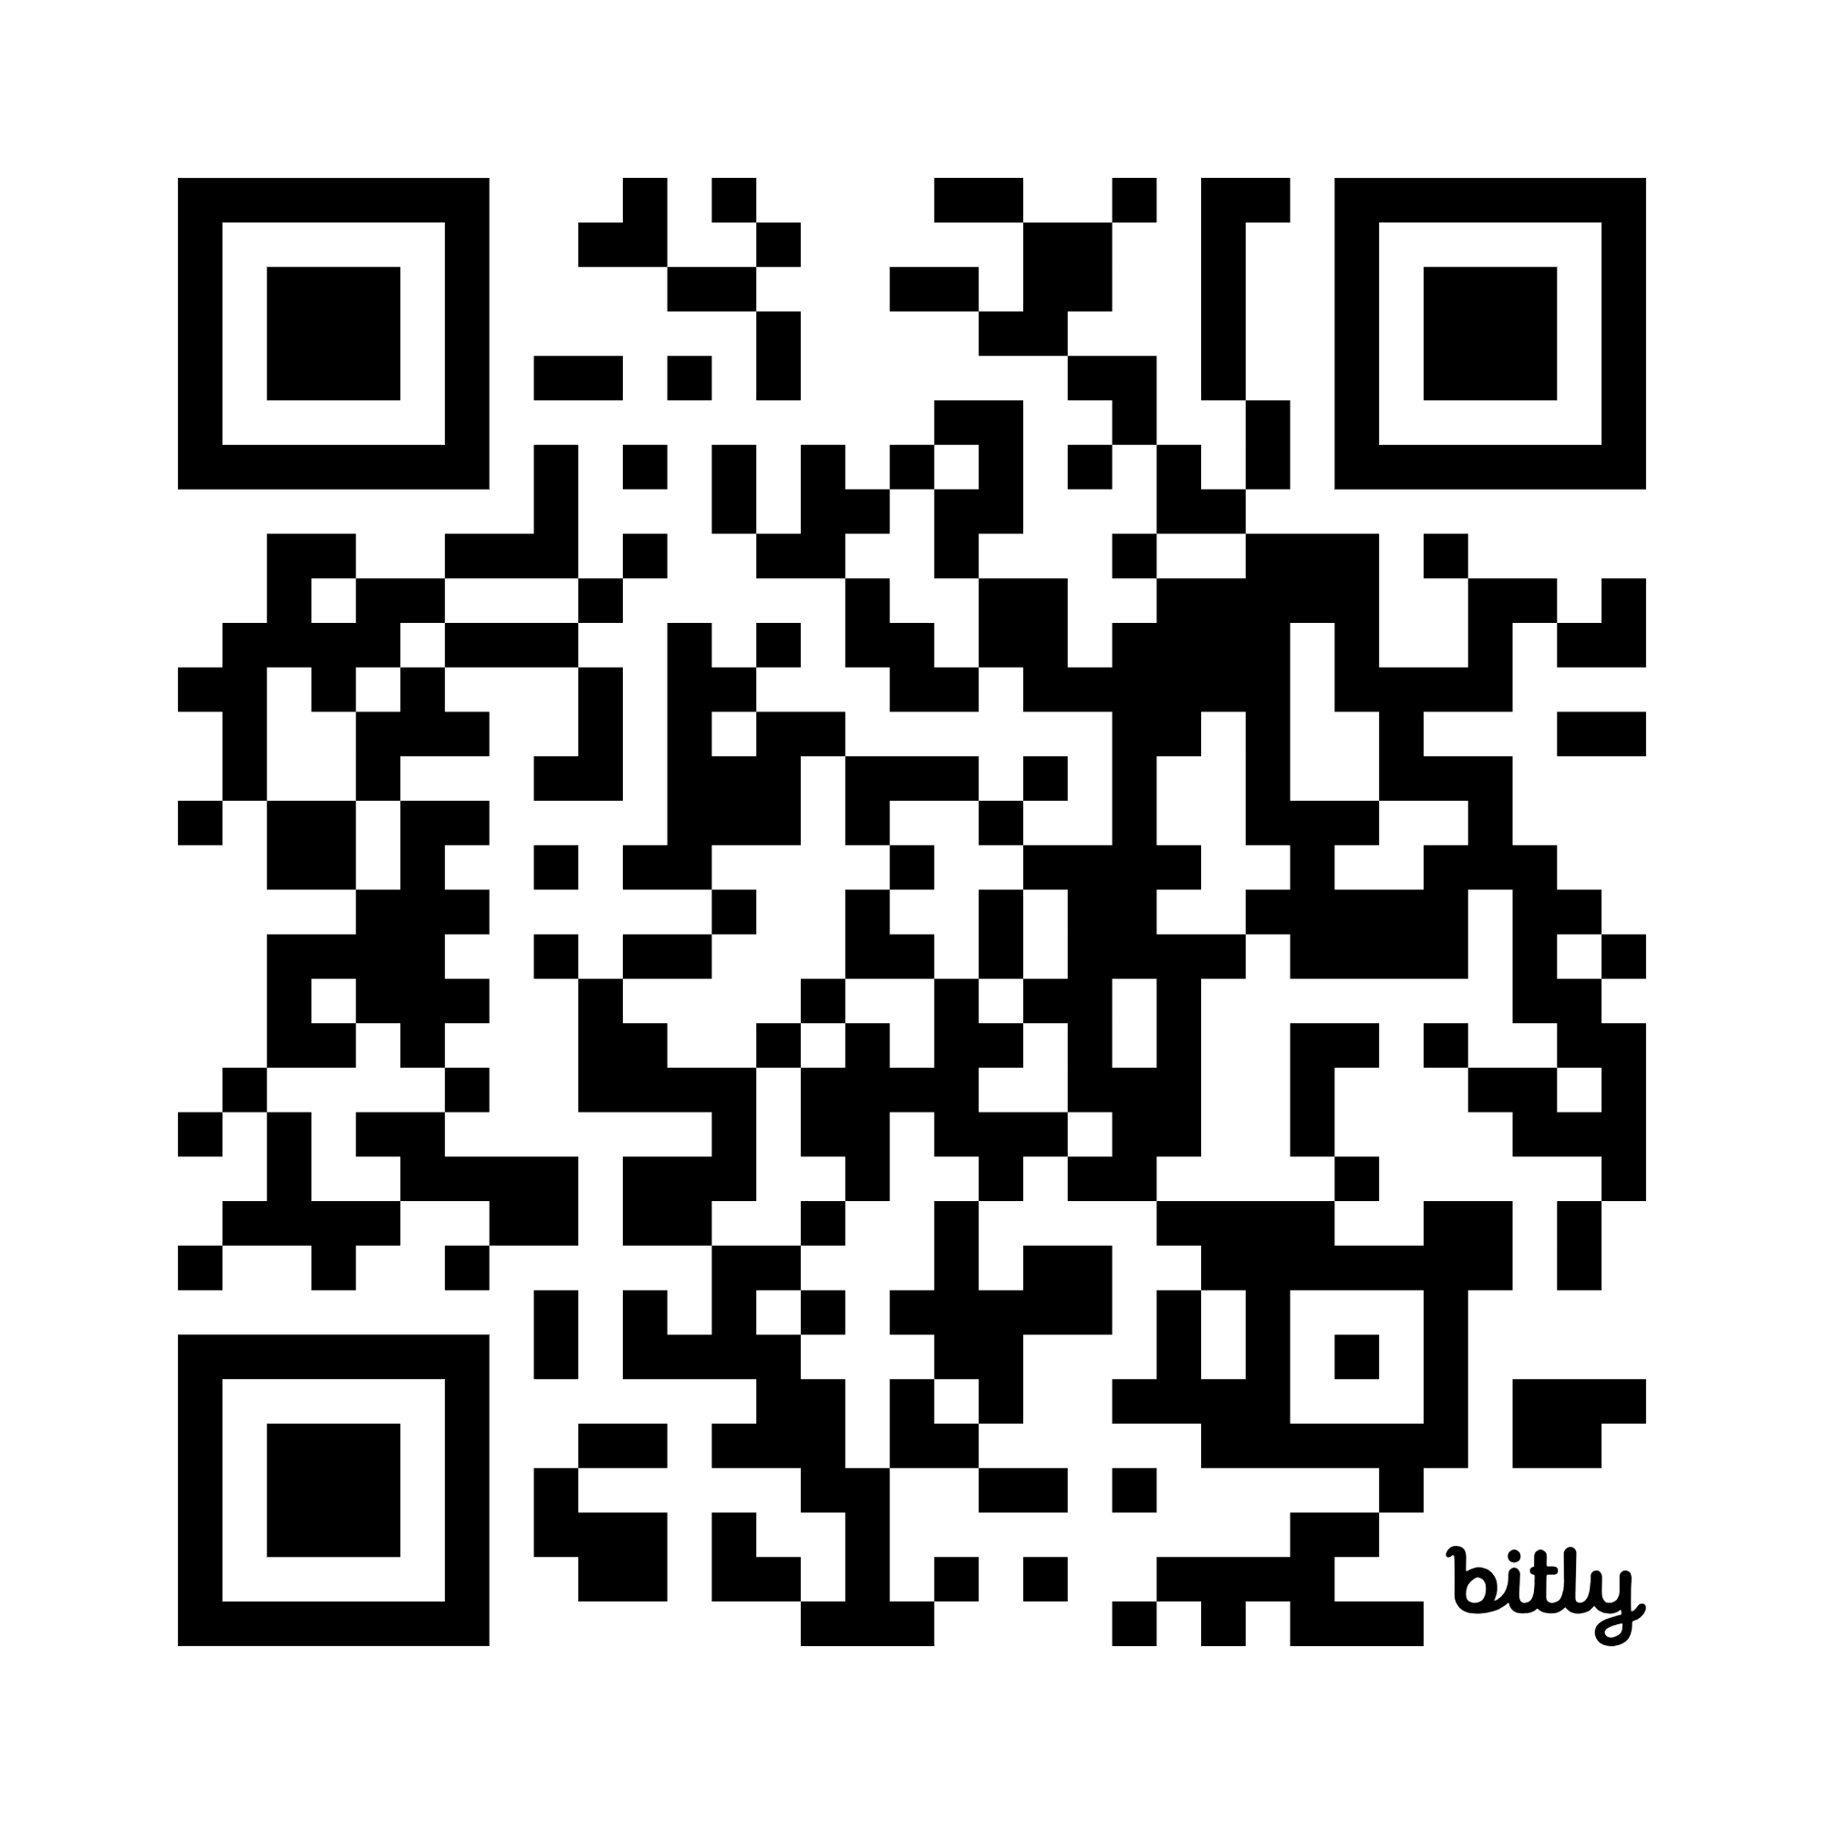
Overview of the Task Force
  The Task Force was created by Section 205 of the Fiscal Year 2025
  budget.
  This Task Force brings together agency leaders, advocates, and residents to:
  Address equitable access to the Charles river in the area between the Longfellow bridge and the Eliot bridge
  Ensure that inclusive processes are in place to engage all relevant stakeholders when decisions involving the Charles river area are made
  Improve communication with all involved stakeholders
https://mapc.ma/44d9yhW

Slide 6
Scope of Recommendations
From Section 205:
(c) The task force's recommendations pursuant to subsection (b) and report pursuant to subsection (g) shall include, but shall not be limited to, ways to: (i) ensure that the department considers environmental justice principles when making decisions involving the area of the Charles river between the Longfellow bridge and the Eliot bridge; (ii) ensure that all stakeholders are engaged when substantive decisions are made regarding closing or limiting access to Memorial drive; (iii) ensure that the residents of the abutting neighborhood receive proper notification when the department makes changes to access to Memorial drive; and (iv) improve programming along the Charles river that may be enjoyed by a wide variety of stakeholders.

Slide 7
Environmental Justice Principles
From the EEA Environmental Justice Strategy:
“Environmental Justice Principles” support people’s protection from environmental pollution and the ability to live in and enjoy a clean and healthy environment, regardless of race, color, income, class, handicap, gender identity, sexual orientation, national origin, ethnicity or ancestry, religious belief, or English language proficiency, which includes: (i) the meaningful involvement of all people with respect to the development, implementation, and enforcement of environmental laws, regulations, and policies, including climate change policies; and (ii) the equitable distribution of energy and environmental benefits and environmental burdens.

Slide 8

Map of the Memorial Drive in Scope

Slide 9
Task Force Members
EEA representative: Jonathan Guzmán, Director of Environmental Justice & Equity, Office of Environmental Justice and Equity
DCR representative: Monika Roy, Senior Director of Environmental Justice
Director of the Bureau of Climate and Environmental Health within the Department of Public Health, or a designee: Logan Bailey, Lead Scientist, Toxicology Division, Bureau of Climate and Environmental Health, Department of Public Health
Cambridge Health Alliance: Derrick Neal, Chief Public Health Officer, City of Cambridge
Cambridge Redevelopment Authority: Kyle Vangel, Director of Projects and Planning
Cambridge branch of the NAACP: Ken Reeves, President
Cambridge Black Pastors Alliance, Inc.: Jeremy D. Battle, Pastor, Western Avenue Church
Massachusetts Bicycle Coalition, Inc.: Galen Mook, Executive Director
Charles River Conservancy, Inc.: Laura Jasinski, Executive Director
Cambridge Mothers Out Front: Angela DeSousa, Member and Leadership
The People for Riverbend Park Trust: Franziska "Fran" Amacher, Trustee
Individual: Lawrence Adkins
Individual: Sheila Headley-Burwell
Individual: Steven Miller
Individual: Thomas Leonard
Individual: Denise Haynes
Individual: David English

Slide 10
Task Force Responsibilities
  As described in Section 205:
  Host three (3) public hearings
  Accept public comment before filing the final report
  Submit a report with recommendations to the clerks of the house of
  representatives and the senate

Slide 11
Project Timeline
Initial Assessment &
Engagement Preparation
Outreach and Engagement
Development of Recommendations
July - August
Initial informational meetings
Preliminary stakeholder mapping
Task Force Meeting 1
(August 14)
September
Task Force Meeting 2
(September 12)
Develop a Community Engagement Strategy
Develop the structure and content for the public hearings
October- November
Task Force Meeting 3 (October 6)
Conduct a series of 1:1 conversations, follow-up, focus groups, etc.
Task Force Meeting 4 (November 3)
Two (3) Public Hearings (November10 and 17)
December
Potential Task Force Meeting 5
Draft final report of findings and recommendations
2026
Task Force meeting 6 (January)
Get draft report ready for public comment period
Public Hearing 3 to review draft report
Public comment period
(1 month)
Task Force meeting 7
Finalize report and submit

Slide 12
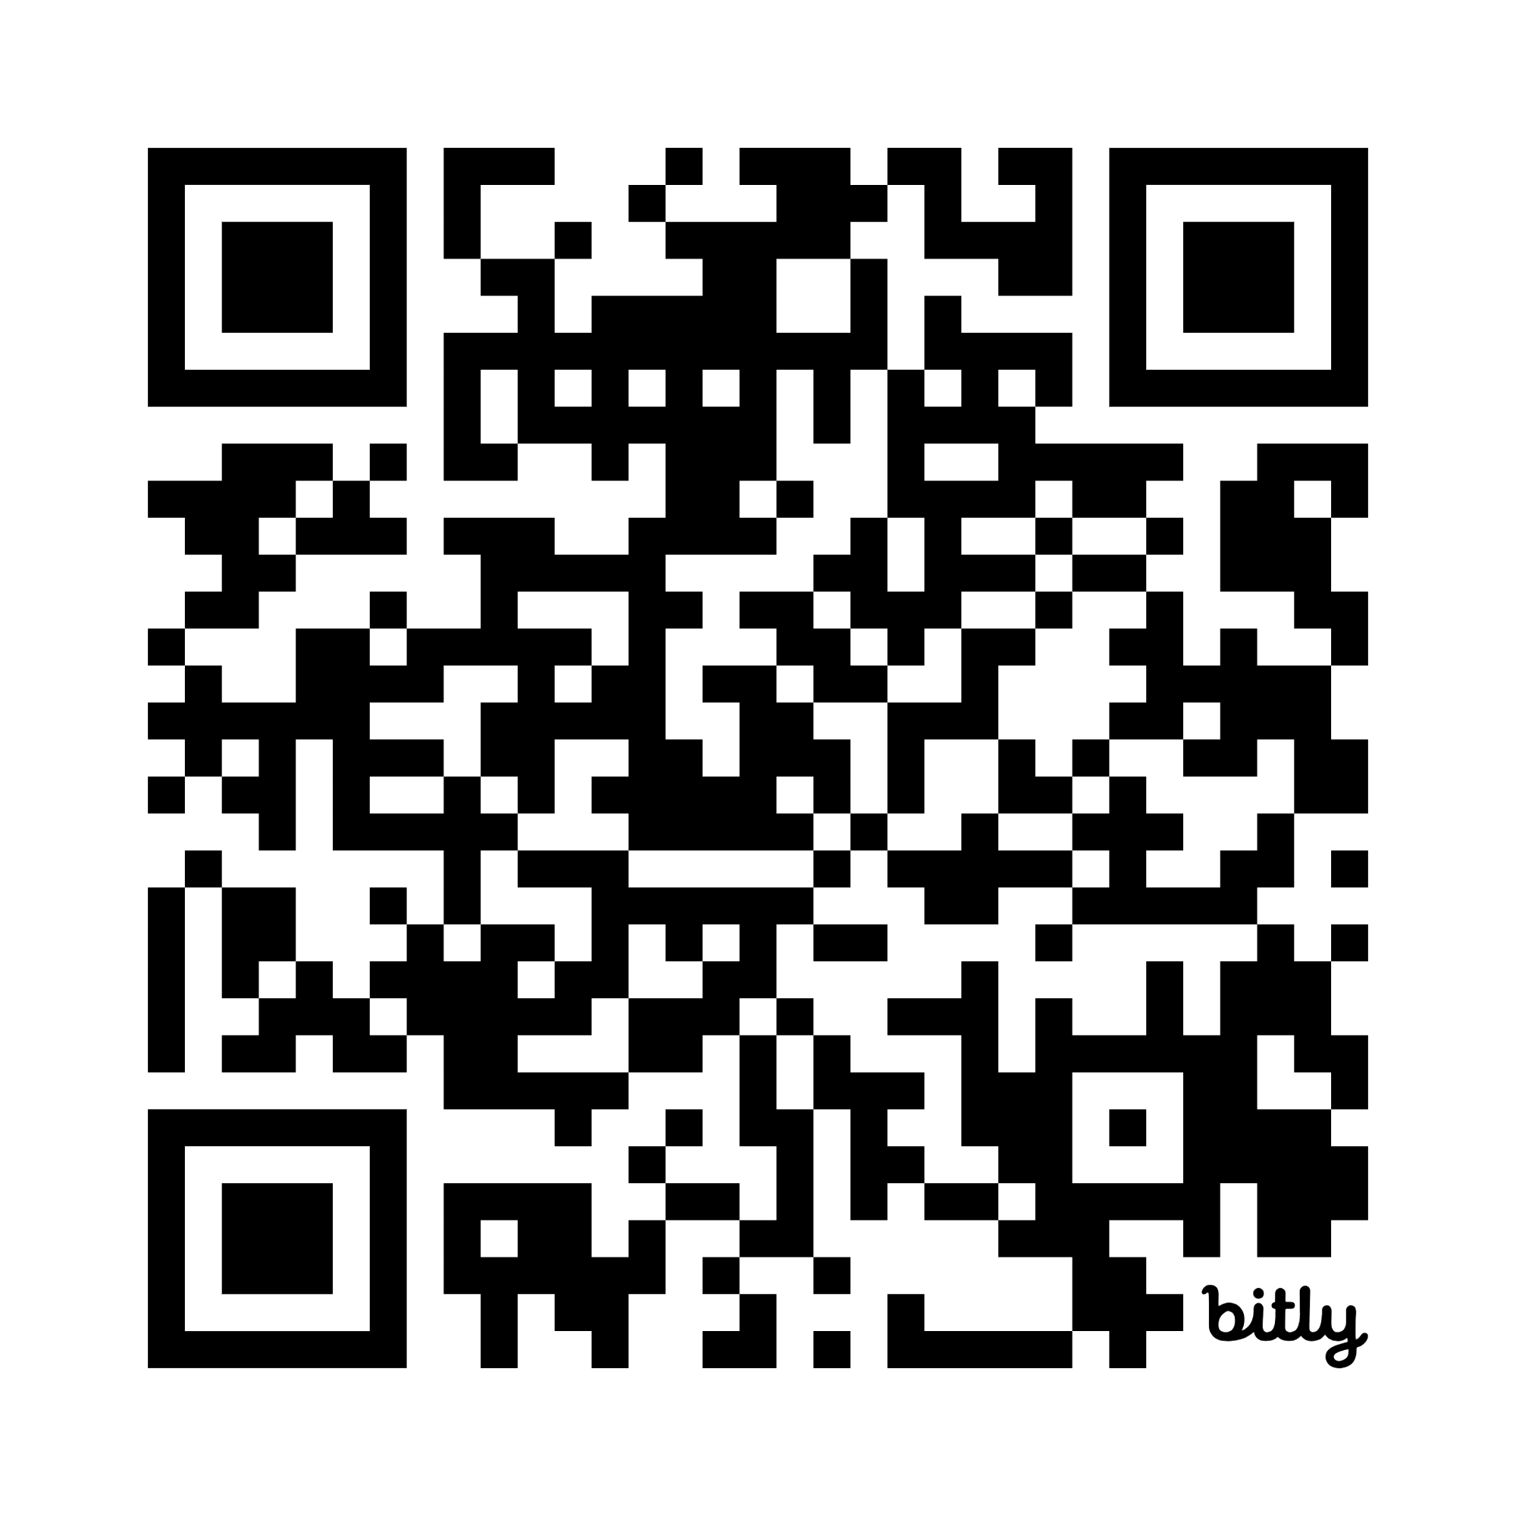

Engagement & Public Hearings Process
Scan here for online survey!
Engagement & Outreach
Public Hearings
Task Force Recommendations
Raise awareness of Task Force & Public Hearings
Gain input from community members on desired improvements to Memorial Drive
Activities:
  One on One conversations
  In language conversations
  Distribute flyers
  Door knocking
  Site walk
Gain input from community members on desired improvements to Memorial Drive within scope of the Task Force
Activities:
  2 Hearings in November
  Online survey option
Based on community input – develop recommendations from the Task Force that will inform equitable access and decision-making for Memorial Drive moving forward
Activities:
  1 Hearing in the Spring
  Review and finalize the report

Slide 13
Small Group Discussion Questions
How could DCR and the community work together more effectively to improve:
Public engagement, communication, and transparency around future capital projects?
The use of Memorial Drive and the riverfront?
Addressing challenges you face (access, safety, maintenance, traffic etc.)?
Changes that would make the area more welcoming and accessible?

Slide 14
Next Steps
  Receive public input at the Public Hearings on November 10 and 17
    Task Force email address: charlesrivertaskforce@mass.gov
    Task Force website: www.mass.gov/charlesrivertaskforce
    Online survey: https://mapc.az1.qualtrics.com/jfe/form/SV_86x2r4TFJ7DmKd8
  The public is welcome to attend Task Force meetings (upcoming meetings will be posted on the webpage)
  Public Hearing 3, date/time to be determined, most likely February to kick off the 30-day public comment period
  The Task Force will review and finalize the report
Scan here for online survey!

