Slide 1
Charles River Task Force on
Equitable River Access
Kick-off Meeting | August 14, 2025

Slide 2
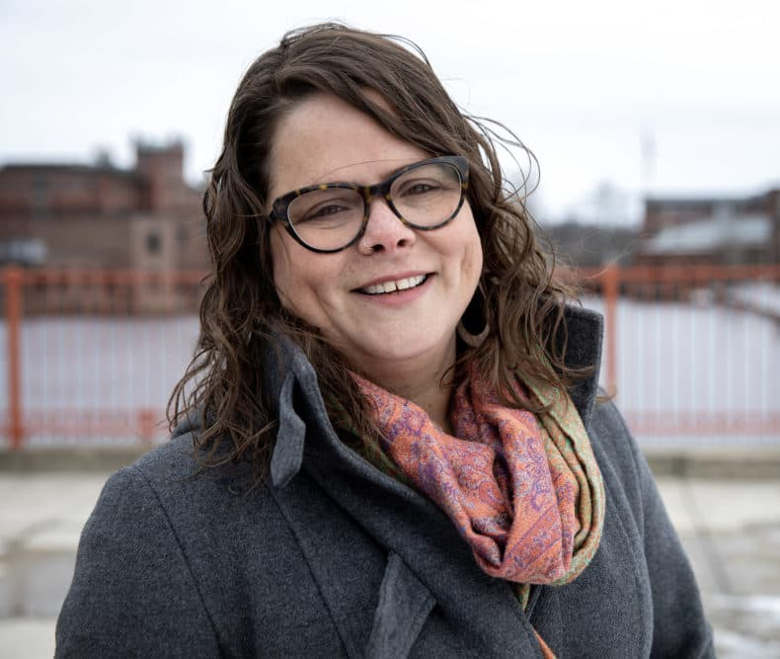

Undersecretary María Belén Power

Slide 3
Agenda
  Welcome
      Roll Call [Attendance Vote]
      Review of Meeting Agenda
      Task Force Introductions
      Task Force Norms
  Overview of the Charles River Task Force on Equitable River Access
      Scope of Work
      Review of Roles & Responsibilities
      Timeline
      Public Hearing Structure
  Questions from the Task Force Members and Next Steps
  Public Comments (as time is permissible)
  Adjourned [Vote]

Slide 4
Task Force Norms
  All meeting notices will be publicly posted in accordance with Open Meeting Law requirements.
  Agendas will be distributed at least 48 hours in advance and include clear discussion topics.
  Meeting minutes will be made publicly available within a reasonable timeframe.
  No deliberation or decision-making will occur outside of publicly posted meetings.
  Members will listen actively and respectfully to all speakers, including public comments.
  Disagreements will be expressed constructively, focusing on ideas rather than individuals.
  Interruptions will be minimized to ensure equitable participation by co-leads.
  Time will be allocated for public comment, with clear guidelines on duration and format.
  Members will acknowledge and consider public input as part of the decision-making process.

Slide 5
Task Force Norms (cont.)
  Language access and accommodations will be provided to ensure inclusive participation.
  Meetings will be held in accessible locations and/or virtually to accommodate diverse needs.
  Materials will be shared in plain language and translated.
  Members will strive to uplift voices from the frontline and historically marginalized communities.
  Members will review materials in advance and come prepared to engage thoughtfully.
  Attendance and punctuality are expected; members will notify the co-leads in advance if they are unable to attend. Members may send someone to attend the meetings in a public capacity, but that individual does not hold voting rights or formal standing within the task force.
  Conflicts of interest will be disclosed and managed in accordance with applicable guidance.
  Norms will be revisited periodically to reflect evolving needs and feedback.
  Members are encouraged to suggest improvements to meeting processes and accessibility.

Slide 6
Overview of the Task Force (1)
  Scope
  This Task Force brings together agency leaders, advocates, and residents to:
  Ensure that all communities, especially historically marginalized ones, have a voice in shaping the future of the river.
  Improve physical, linguistic, and cultural access to the river’s resources and spaces.
  Align environmental, recreational, and infrastructure initiatives across jurisdictions.
  Build inclusive frameworks for public input, education, and long-term stewardship.

Slide 7
Overview of the Task Force (2)
  Goals
  Make recommendations for the Department of Conservation and Recreation (DCR) to ensure:
  Equitable access to the Charles River, especially in the area between the
  Longfellow bridge and the Eliot bridge
  Inclusive engagement and decision-making processes
  Improved communication with all involved stakeholders

Slide 8
Overview of the Task Force (3)
  Roles and Responsibilities
  (As described in Outside Section 205 of FY25 Enacted State Budget)
  Host three (3) public hearings and gather public feedback
  Submit a report with recommendations to the clerks of the house of
  representatives and the senate

Slide 9


Overview of the Task Force (4)
  Support Team
  Serve as a resource to help inform the Task Force’s work (e.g., background information, context setting, etc.)
  Communicate the Task Force’s work to the public
  Provide meeting facilitation, gathering public comments, and supporting the Task Force with generating the final report of findings and recommendations

Slide 10
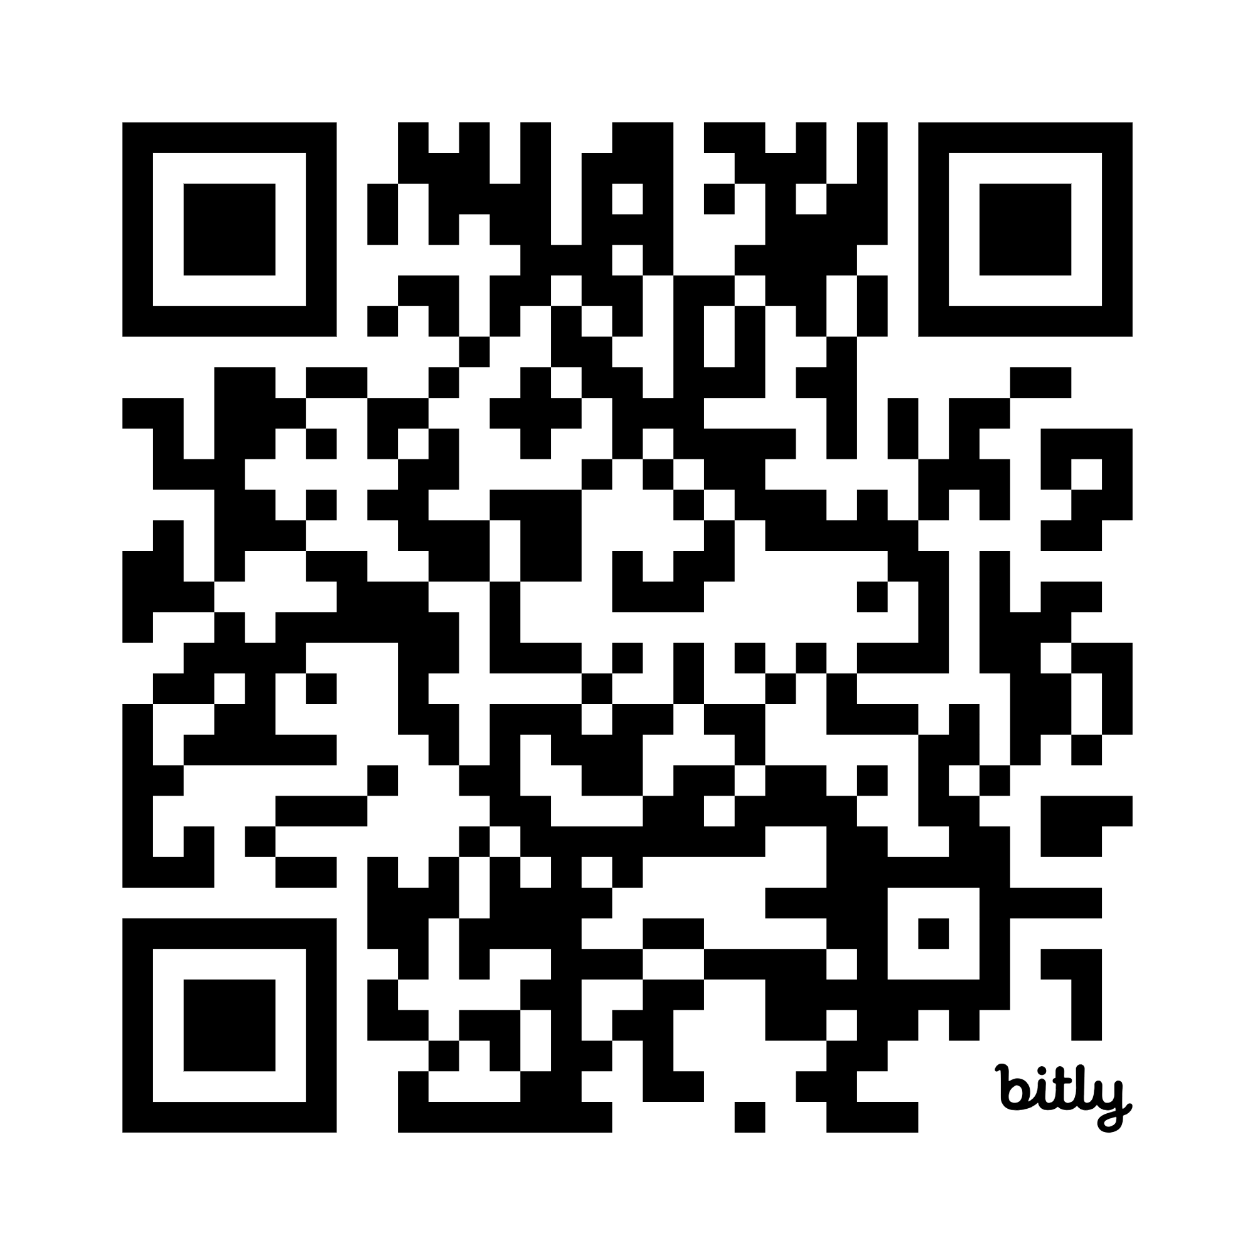
Overview of the Task Force (5)
All information about the Task Force will be available at:
https://www.mass.gov/info-details/charles-river-task-force-on-equitable-river-access
Contact email for Task Force:
charlesrivertaskforce@mass.gov

Slide 11
PROJECT TIMELINE
Initial Assessment &
Engagement Preparation
Outreach & Engagement
Development of Recommendations
July
Initial informational meetings
Preliminary stakeholder mapping
August
Task Force kick-off meeting (8/14)
Develop a Community Engagement Strategy
September - November
Task Force meeting 2
(early Sept)
Public Hearings
(Oct)
Conduct a series of 1:1 conversations, follow-up, focus groups, etc.
Task Force meeting 3
Draft final report of findings and recommendations
December
Task Force meeting 4
Get draft report ready for public comment period
January – March 2026
Public comment period
(1 month)
Task Force meeting 5
(mid-Feb)
Finalize report and submit

Slide 12
Engagement Components
  Translation of meeting materials & interpretation services available at TF meetings and public hearings
  Attending existing gatherings/community events to promote public
  hearings and gather input – suggestions?
  Facilitating 1:1 and small group conversations (with support of
  community partners) for residents who can’t attend public hearings – suggestions?
  Imagine yourself at the end of this project, in the ideal world, what engagement has happened, who have we spoken with, how did we connect with them?

Slide 13
Next Steps
  Next task force meeting, options (doodle poll)
    Friday, September 12, 11am-12:30pm
    Wednesday, September 17, 11:30am – 1pm
    Thursday, September 18, 12:30pm – 2pm
  Three public hearings: (dates coming soon!)

