Slide 1

Interpretation Logistics
Language Interpretation is being offered in: ASL, Spanish, Brazilian Portuguese, Haitian Creole, Mandarin, Cantonese, Arabic and Amharic.
  To participate in your desired language, please visit the interpretation table for a receiver in your language of choice.
  Please speak slowly to accommodate the interpreters.

Slide 2
Zoom Logistics
Kindly mute your microphone to minimize background noise unless you are participating in the Q&A section or the breakout room discussions
The chat is available for members to provide comments and pose questions (subject to public record)
Please do not use the private messaging function

Slide 3
Notification of Recording
This meeting will be recorded, and the Department of Conservation and Recreation and/or the Executive Office of Energy & Environmental Affairs may choose to distribute the video, still images, audio, and/or the chat transcript.
By continuing with this virtual meeting, you are agreeing to be part of a recorded event. The recordings and chat transcripts may be treated as public records.

Slide 4
Charles River Task Force on
Equitable River Access
Spring Public Hearings | May 5, 2026
We will begin at 6:05 pm. Please feel free to describe in the chat your favorite activity to do along the Charles River.

Slide 5
Agenda
6:05 – 6:15pm: Welcome Remarks by DCR Commissioner LaChapelle
6:15 – 6:55pm: Presentation and Q&A
  DCR will give an overview of the Charles River Task Force’s work to date
6:55 – 7:40pm: Small Group Discussion
  Will split into smaller groups in the cafeteria; each group will be facilitated by a team member from DCR, EEA, or MAPC, along with a note-taker
  Those using interpretation services, will remain in one group
  Regroup in the main space to share out key themes that came up in discussion
7:40 – 8:00pm: Discussion Share-out & Close
  Regroup in the main space to share out key themes that came up in discussion
  Event close with information about next steps

Slide 6
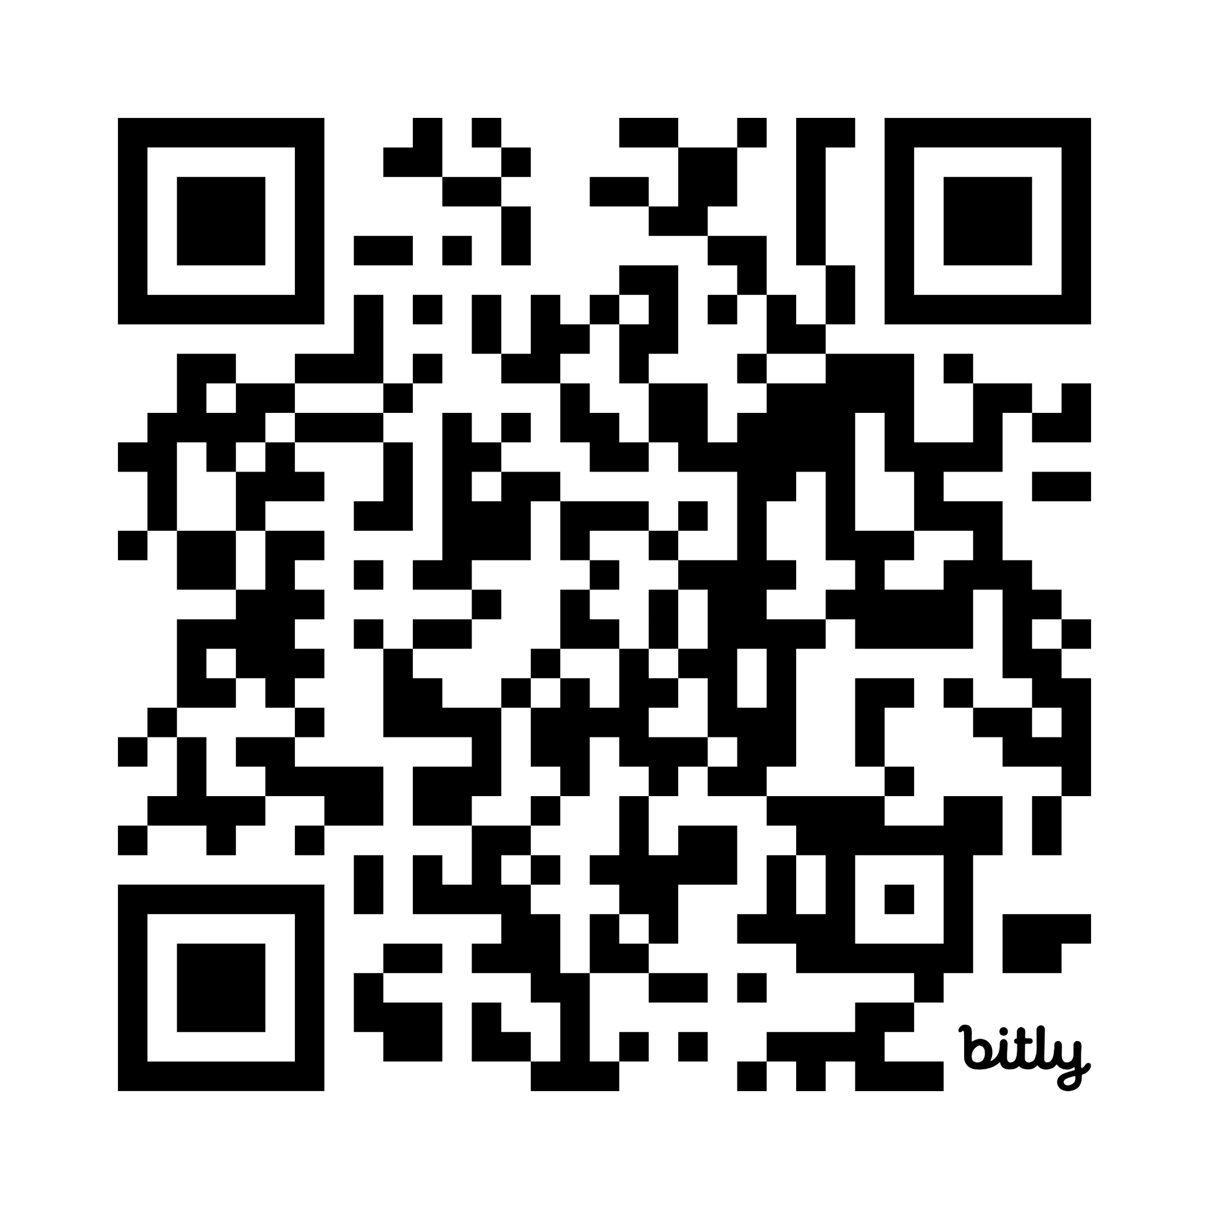
Overview of the Task Force
https://mapc.ma/44d9yhW
  The Charles River Task Force was created by Section 205 of the
  Fiscal Year 2025 budget.
  This Task Force brings together agency leaders, advocates, and residents to:
  Address equitable access to the Charles river in the area between the Longfellow bridge and the Eliot bridge
  Ensure that inclusive processes are in place to engage all relevant stakeholders when decisions involving the Charles river area are made
  Improve communication with all involved stakeholders

Slide 7

Map of the Charles River Area in Scope

Slide 8
Task Force Members
EEA Co-Chair: María Belén Power, Undersecretary of Environmental Justice & Equity ​
DCR Co-Chair: Nicole LaChapelle, Commissioner​
Director of the Bureau of Climate and Environmental Health within the Department of Public Health, or a designee: Logan Bailey, Lead Scientist, Toxicology Division, Bureau of Climate and Environmental Health, Department of Public Health
Cambridge Health Alliance: Derrick Neal, Chief Public Health Officer, City of Cambridge
Cambridge Redevelopment Authority: Kyle Vangel, Director of Projects and Planning
Cambridge branch of the NAACP: Ken Reeves, President
Cambridge Black Pastors Alliance, Inc.: Jeremy D. Battle, Pastor, Western Avenue Church
Massachusetts Bicycle Coalition, Inc.: Galen Mook, Executive Director
Charles River Conservancy, Inc.: Laura Jasinski, Executive Director
Cambridge Mothers Out Front: Vacant
The People for Riverbend Park Trust: Franziska "Fran" Amacher, Trustee
Individual: Lawrence Adkins
Individual: Sheila Headley-Burwell
Individual: Steven Miller
Individual: Thomas Leonard
Individual: Denise Haynes
Individual: David English

Slide 9
Task Force Responsibilities
  As described in Section 205:
  Host three (3) public hearings
  Accept public comment before filing the final report
  Submit a report with recommendations to the clerks of the house of
  representatives and the senate

Slide 10
Project Timeline
Initial Steps &
Engagement Preparation
Outreach and Engagement
Development of Recommendations
July - August
Task Force formation
Informational meetings
Preliminary stakeholder mapping
September 2025 – May 2026
Task Force Meetings (monthly)
Fall 2025 engagement activities
  Door knocking, interviews, focus group
  2 public hearings (November 10 & 17)
Synthesize key themes and input received from Fall engagement to begin developing draft recommendations
Spring 2026 engagement activities
  Focus groups at CHA and Senior Center
  2 public hearings (April 29, May 5)
Public comment period (April 29 – May 29) on the Task Force’s draft recommendations
June 2026
Task Force’s final meeting (June 17) to review all input on draft recommendations
Finalize report and submit

Slide 11
Feedback Themes from Fall Engagement
  The need to engage and include impacted neighborhoods early, often, and meaningfully
  Work more closely with the City of Cambridge and affiliated agencies to assist with outreach, engagement, communication, and programming
  The desire for more proactive and regular updates from DCR about proposed projects and project progress
  The need for clear explanation of closures and disruptions, especially for the residents who are most impacted/affected
  The need for infrastructure improvements and safety dialogue for more equitable access to the Charles River (e.g., safer speed limits, better stoplight coordination around crosswalks, pathway infrastructure upgrades and maintenance, etc.)

Slide 12
Review of Spring Focus Group Feedback
Outreach & Strategies
Having a central list of events that is up to date and in a consistent location people can easily find
Posting flyers in/around people's mailboxes or on doors
DCR to table more at events
Collaboration with City of Cambridge to promote events
Notifications repeatedly and months in advance so people can prepare accordingly
Use bulletin board to share updates (like the WBZ bulletin board)
Feedback was received via three (3) focus groups at Cambridge Housing Authority sites & Citywide Senior Center
Text & call notices
Remote participation options
Notices through schools, local TV channels, radio station, news outlets (Cambridge Day, etc.).
*Information dissemination should not all be technologically dependent.
Varying timing of engagement
Having a central way to share information about what's happening in Cambridge

Slide 13
Review of Spring Focus Group Feedback (cont.)
Activities of interest
Other Notable feedback
Religious & cultural programming
Ability to walk with family
Play space for children
Cookouts with family, community BBQs
Pool and water activities
Activities that generate more social cohesion
Marginalized communities to know and have the information at the same time as others
Need a mechanism to maintain communication and coordination with DCR, City, and other agencies for information and updates
Some people don't know if they should or can have a voice in the matter – how to frame the information so that people know they have a stake in it

Slide 14
Scope of Recommendations
From Section 205:
(c) The task force's recommendations pursuant to subsection (b) and report pursuant to subsection (g) shall include, but shall not be limited to, ways to:
  (i) ensure that the department considers environmental justice principles when making decisions involving the area of the Charles river between the Longfellow bridge and the Eliot bridge;
  (ii) ensure that all stakeholders are engaged when substantive decisions are made regarding closing or limiting access to Memorial drive;
  (iii) ensure that the residents of the abutting neighborhood receive proper notification when the department makes changes to access to Memorial drive; and
  (iv) improve programming along the Charles river that may be enjoyed by a wide variety of stakeholders.

Slide 15
Draft Recommendation 1 (Part 1):
Process and Communication Improvement
DCR to clarify and establish for implementation clear processes to foster proactive communication and engagement, while developing and employing responsive tools to meet community needs, especially in areas with active and/or upcoming projects. Processes should include transparent communication and collaboration with relevant city agencies.
Background context: Currently, community members are often confused about how and/or who they can reach out to at DCR when they have feedback and/or concerns. In some instances, community members don’t receive consistent communication updates, prompt responses, or follow-up from DCR.

Slide 16
Draft Recommendation 1 (Part 2):
Process and Communication Improvement
Suggested implementation strategies or actions:
Community outreach should prioritize directly impacted community members (abutters) as first point of contact for information about planned DCR activities (e.g. projects or closures)
Designate a point of contact within DCR/ Energy and Environmental Affairs (EEA) and the City of Cambridge (designated agencies) for community members to reach out to for inquiries and/or to provide feedback
Regularly communicate a simple, plain-language process for how community members can reach DCR, what types of inquiries go where, and what response timelines they can expect
Clarify the 311-style call line that exists, through which residents can leave questions, suggestions and/or complaints
Launch an info campaign to communicate about DCR’s current public input processes, as well as programs and activities in the neighborhoods
Create a feedback loop so residents receive follow-up on how their concerns were considered or resolved
Provide advance notice and clear explanations for closures, disruptions, and projects (e.g. zero phase projects, timelines and areas of impact). Information can be provided via various mediums (e.g. DCR Project site, City of Cambridge project sites, social media, etc.)

Slide 17
Draft Recommendation 2 (Part 1):
Project Planning Improvement
DCR to develop clear, consistent processes to effectively communicate planned projects, addressing both near-term and long-term initiatives.
Background context: This recommendation is built on the need for more regular and consistent approaches to communicating project work to community members in the impacted project area. A consistent theme which the Task Force heard from the community is the desire for more regular updates from DCR on project progress and next steps. Currently, the available mechanisms for which community members can provide comments or share concerns with DCR in any particular issue is limited. This recommendation will ensure more consistent processes for how DCR will communicate and provide updates to community members.

Slide 18
Draft Recommendation 2 (Part 2):
Project Planning Improvement
Suggested implementation strategies or actions:
Establish a consistent communication approach for project updates (i.e. sharing regular updates via designated channels)
Energy and Environmental Affairs (EEA) /DCR to integrate communications/stakeholder management technology for effective and timely project updates that include project goals, alternatives considered, anticipated impacts, and opportunities for community input.
Establish multiple modes of communication updates to ensure reaching those most impacted by project developments, including:
  Host a contact list tied to the project
  Post flyers near the physical location of the updates in advance of the project
  Use traditional media outlets such as newspapers, radio or local TV channel, as well as social media outlets
  Updates shared through trusted partner organizations, community groups, and local institutions such as local churches, cultural centers, senior centers, senior housing, public and affordable housing, among others.
Ensure equitable access to information
  Use plain-language materials and summaries
  Use accessible formats
  Translate materials
  Tailor outreach strategies to historically excluded communities

Slide 19
Draft Recommendation 3 (Part 1):
Centering Equity & Environmental Justice
DCR to establish clear processes and tools to proactively address the needs of marginalized communities and those historically been impacted by and excluded from its processes, ensuring that they have a meaningful and guaranteed role in DCR decision-making.
Background context: Community members expressed that in many instances, decision making at DCR does not reflect or include the voice of the immediately impacted community. Community members don’t feel that they are included in the planning and decision-making milestones, and as a result, are often left experiencing the repercussions (e.g., traffic congestion, safety-related issues, etc.) without enjoying the benefits. The Task Force believes that this recommendation will ensure equity is centered in all DCR’s planning and decision-making processes.

Slide 20
Draft Recommendation 3 (Part 2):
Centering Equity & Environmental Justice
Suggested implementation strategies or actions:
Build in as pre-planning: Conduct a process at the start of any project to determine who will be impacted by the changes of this project and determine what role they can or should play throughout this project lifetime. This can include coordination with local organizations and groups, such as community-based non-profits, faith communities, schools, community centers, senior center, public and affordable housing, neighborhood groups, etc.
Ensure that DCR’s Language Access Plan is integrated in these processes.
Establish and implement a DCR Public Involvement Plan.

Slide 21
Draft Recommendation 4 (Part 1):
Implementation
DCR to apply the communication and outreach recommendations above (Recommendations 1-3) to address physical infrastructure-related feedback received through this Task Force for the Charles River area between Longfellow and Eliot bridges, as a pilot for applying communication and outreach strategies for other DCR projects across the Commonwealth.
Background context: DCR should implement strategies/actions listed in the above recommendations to the Charles River area between Longfellow and Eliot bridges. Best practices and lessons learned in this pilot implementation effort can be replicated to other areas across the state that are facing similar challenges.

Slide 22
Draft Recommendation 4 (Part 2):
Implementation
Suggested implementation strategies or actions:
Provide a few examples of how different scenarios brought up during Task Force meetings, focus groups or public meetings related to infrastructure improvements in the area could be addressed via the recommendations above.
Develop a clear and transparent evaluation framework to track what communication strategies are effective, identify and address gaps and assess how community members experience the new process.

Slide 23
Q&A Section (~20 Minutes)
  Please ask clarifying questions related to the scope of work and save questions related to the recommendations for the small group discussion
  Listen actively and respectfully to all participants
  Express disagreements constructively, focusing on ideas rather than individuals
  Minimize interruptions to ensure equitable participation
  Please share your thoughts in the small group discussions – we want to hear from you!

Slide 24
Small Group Discussion (~40 Minutes)
  We will split into 3 groups: Group 1 (Main Zoom Room) and Groups 2-3 (Breakout Rooms)
  Each group will have a pre-assigned facilitator and a note-taker
  Listen actively and respectfully to all participants
  Express disagreements constructively, focusing on ideas rather than individuals
  Minimize interruptions to ensure equitable participation
  Please share your thoughts on the recommendations – the Task Force wants to hear from you!

Slide 25
Small Group Discussion Questions
To what extent do you agree with the four recommendations presented?
How can the language for this recommendation be clearer?
Do you have suggestions for additional implementation strategies/actions?

Slide 26
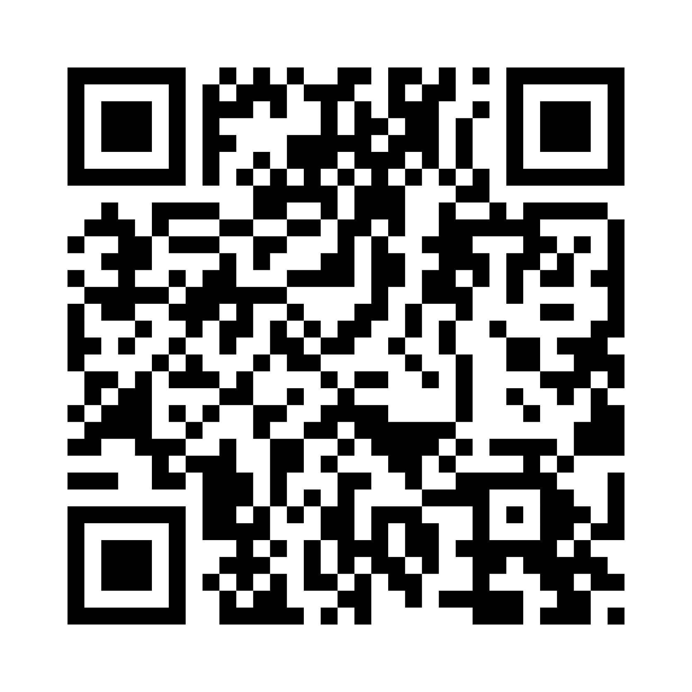
Next Steps
  Receive public input at the Public Hearings on April 29 and May 5
    Task Force email address: charlesrivertaskforce@mass.gov
    Task Force website: www.mass.gov/charlesrivertaskforce
    Online survey: https://mapc.az1.qualtrics.com/jfe/form/SV_6L3ME8i3JSpRJsO
  The public is welcome to attend Task Force meetings (upcoming meetings will be posted on the webpage)
  30-day public comment period: April 29 – May 29
  The Task Force will review and finalize the report
Scan here for online survey!

