Slide 1
List of exhibits in 2015 Cost Trends Report
Exhibit 1.1: Family premiums, cost-sharing, and family income in Massachusetts, 2005-2014
Exhibit 2.1: Annual growth in per-capita healthcare spending, Massachusetts and the U.S., 2002-2014
Exhibit 2.2: Massachusetts healthcare spending, by payer type, 2013 and 2014
Exhibit 2.3: Growth in per-capita spending, by broad payer type, 2013-2014
Exhibit 2.4: Annual growth in commercial spending per enrollee, 2010-2014
Exhibit 2.5: Family health insurance premiums, Massachusetts and the U.S., 2011-2014
Exhibit 2.6: Annual growth in commercial spending per enrollee, by spending category, 2010-2014
Exhibit 2.7: Medicare spending per beneficiary (Original Medicare) in Massachusetts and in the U.S., by category, 2013
Exhibit 2.8: MassHealth enrollment, January 2012-August 2015
Exhibit 2.9: MassHealth spending by program, 2012-2014
Exhibit 2.10: Cost-sharing as a percentage of total spending for individuals with given diagnosed conditions, 2013
Exhibit 3.1: Frequency of provider alignment types for which the HPC received material change notices, 2013-2015
Exhibit 3.2: Frequency of providers involved in Material Change Notices consisting of corporate or contracting affiliations
Exhibit 3.3: Percentage of primary care physicians affiliated with large provider systems, 2008-2014
Exhibit 3.4: Percentage of primary care physician revenue and visits by affiliation status, 2012
Exhibit 4.1: Distribution of retail prescriptions in Massachusetts and the U.S., by payer, 2014
Exhibit 4.2: Components of U.S. drug spending growth, 2013-2014
Exhibit 4.3: Massachusetts’ top 20 drug-therapy classes by spending, with growth rates, 2010-2014
Exhibit 4.4: Top therapy classes by contribution to 2014 drug spending growth in Massachusetts
Exhibit 5.1: Commercial spending per member per month in Massachusetts, by outpatient service category, 2011 – 2013
Exhibit 5.2: Shifts in settings to hospital outpatient departments
Exhibit 5.3: Differences in Medicare program payments and beneficiary cost sharing for outpatient office visits provided in freestanding practices and hospital-based entities, 2014
Exhibit 5.4: Change in volume for five major cross-over surgical procedures performed in acute care hospitals, 2011 – 2013
Exhibit 5.5: Changes in site of care for chemotherapy administration and E&M visits, 2011-2013
Exhibit 5.6: Comparison of spending per procedure between hospital outpatient and non-hospital settings, 2013
Exhibit 5.7: Prices for common lab tests by setting, 2012
Exhibit 7.1: Average spending for normal deliveries by hospital, selected hospitals, 2011-2012
Exhibit 7.2: Average spending for normal deliveries by hospital, all hospitals, 2011-2012
Exhibit 7.3: Average spending for normal deliveries by hospital type, all hospitals, 2011-2012
Exhibit 8.1: Hospital use in Massachusetts and the U.S., 2014

Slide 2
List of exhibits in 2015 Cost Trends Report
Exhibit 8.2: Massachusetts hospitals penalized for readmissions and assessment rate, FY 2016
Exhibit 8.3: Chronic preventable hospital admissions by income quartile, 2012-2014
Exhibit 8.4: Emergency Department visits by type, 2010-2014
Exhibit 8.5: Behavioral health-related emergency department visits per 1,000 residents, 2010 - 2014
Exhibit 8.6: Emergency Department visits by patient visit frequency, 2014
Exhibit 8.7: Avoidable Emergency Department use by proximity to retail clinic or urgent-care sites, 2014
Exhibit 9.1: Number of primary care providers per 10,000 Massachusetts residents, by primary care service area
Exhibit 9.2: Nurse practitioner state practice environment, 2014
Exhibit 10.1: Distribution of Massachusetts and U.S. discharge destination by payer, all DRGs, 2012
Exhibit 10.2: Adjusted percentage of discharges to post-acute care, all DRGs, 2010-2014
Exhibit 10.3: Post-acute care spending for commercial and Medicare enrollees, 2011-2013
Exhibit 10.4: Discharge destination by payer following joint replacement (DRG 470), Massachusetts and the U.S., 2012
Exhibit 10.5: Percentage of discharges to institutional post-acute care following joint replacement (DRG 470), by hospital, 2014
Exhibit 10.6: Discharge destination of patients following joint replacement (DRG 470), 2010-2014
Exhibit 10.7: Change in percentage of discharges to institutional post-acute care following joint replacement (DRG 470), by hospital, from 2010 to 2014
Exhibit 10.8: Percent of patients discharged to institutional post-acute care following joint replacement (DRG 470), by hospital type, 2010-2014
Exhibit 10.9: Post-acute care spending following joint replacement (DRG 470), for commercial and Medicare enrollees, 2011-2013
Exhibit 11.1: APM coverage by payer type, 2012-2014
Exhibit 11.2: APM coverage by HMO and PPO, commercial payers, 2014
Exhibit 12.1: A framework for demand-side incentives
Exhibit 12.2: Tiered and high-deductible products in Massachusetts, 2012-2014
Exhibit 13.1: Dashboard of key HPC system performance metrics

Slide 3
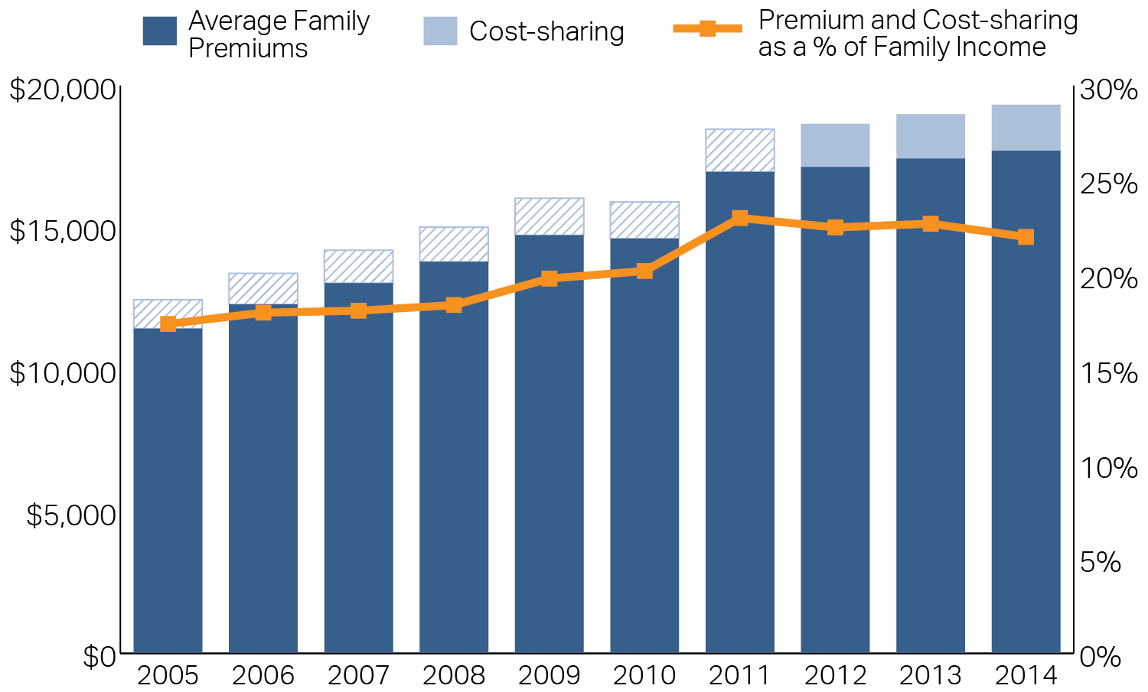
Exhibit 1.1: Family premiums, cost-sharing, and family income in Massachusetts, 2005-2014
Dollars are nominal in the year shown
Note: Cost-sharing amounts are approximate from 2005-2011.
Source: American Community Survey (income), Agency for Healthcare Research and Quality (premiums) and Center for Healthcare Information and Analysis (cost-sharing)

Slide 4
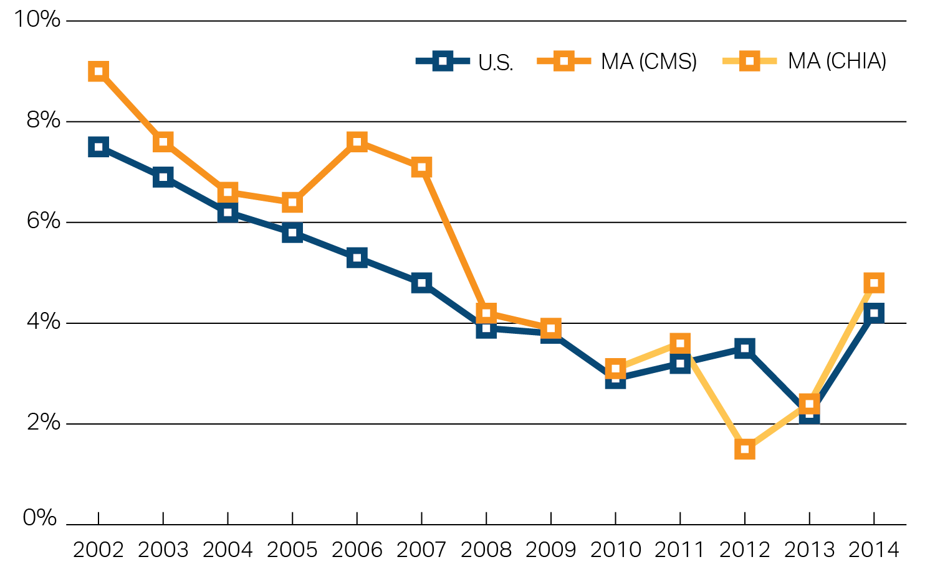
Exhibit 2.1: Annual growth in per-capita healthcare spending, Massachusetts and the U.S., 2002-2014
Note: U.S. data uses personal health expenditures (Centers for Medicare & Medicaid Services) divided by the U.S. population. Massachusetts data uses personal health expenditures (Centers for Medicare & Medicaid Services) through 2009, changes in total medical expenditures per member per year from the Center for Health Information and Analysis for 2010 and 2011, and changes in total health care expenditures per capita from the Center for Health Information and Analysis from 2012-2014.
Source: Centers for Medicare and Medicaid Services; Center for Health Information and Analysis

Slide 5
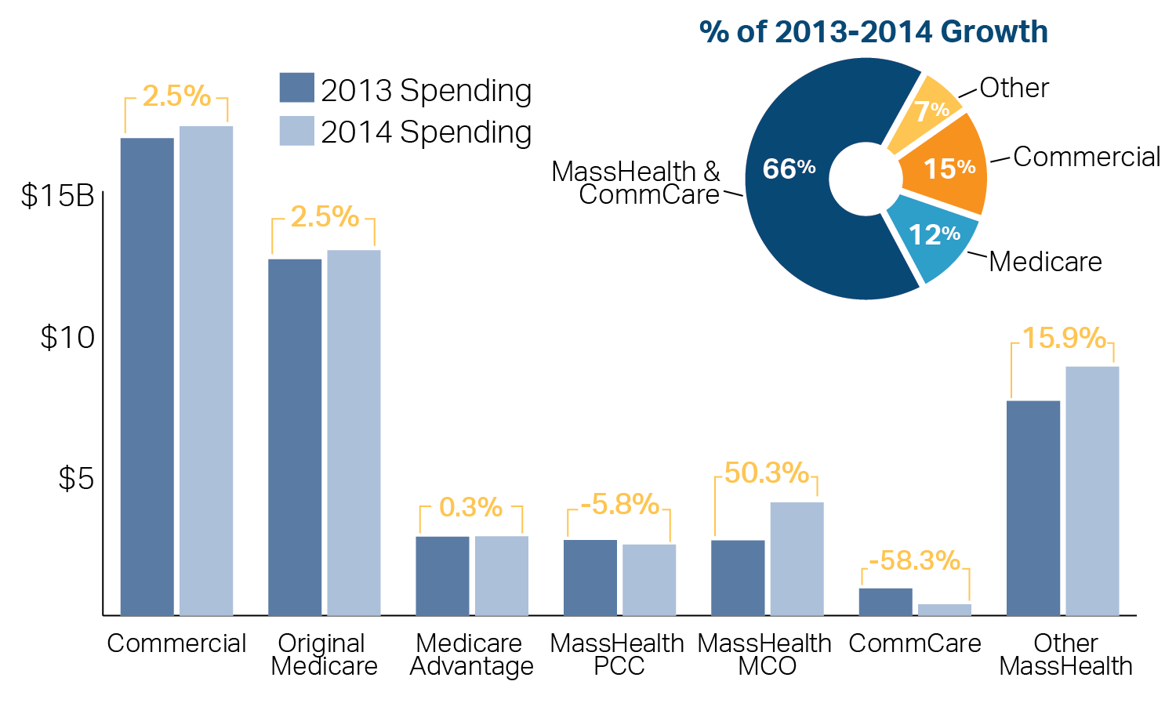
Exhibit 2.2: Massachusetts healthcare spending, by payer type, 2013 and 2014
Spending in billions of dollars
Source: Center for Health Information and Analysis

Slide 6
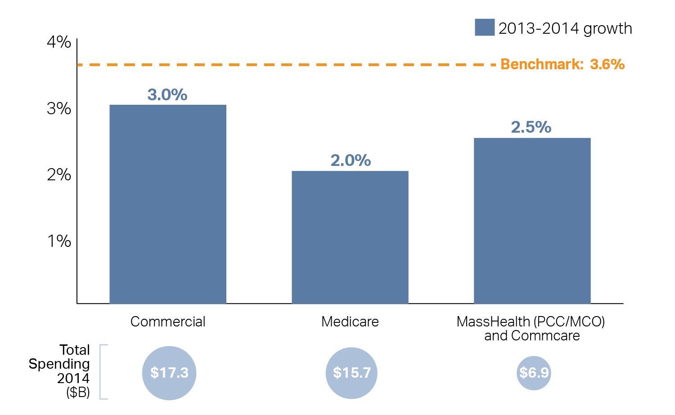
Exhibit 2.3: Growth in per-capita spending, by broad payer type, 2013-2014
Percentage growth per member from previous year
Note: Commercial spending excludes actuarial completion of partial-claims.
Source: Center for Health Information and Analysis

Slide 7
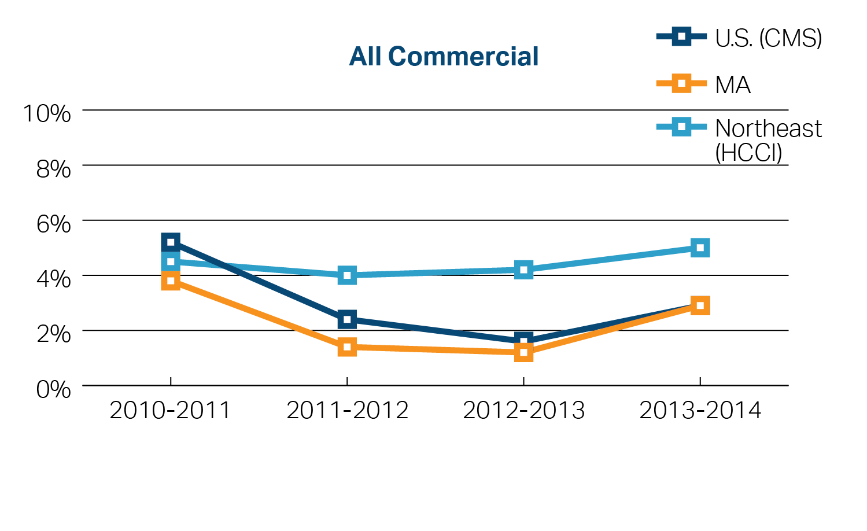
Exhibit 2.4: Annual growth in commercial spending per enrollee, 2010-2014
Source: Center for Health Information and Analysis (Massachusetts); Centers for Medicare and Medicaid Services (U.S.); and Health Care Cost Institute (Northeast)

Slide 8
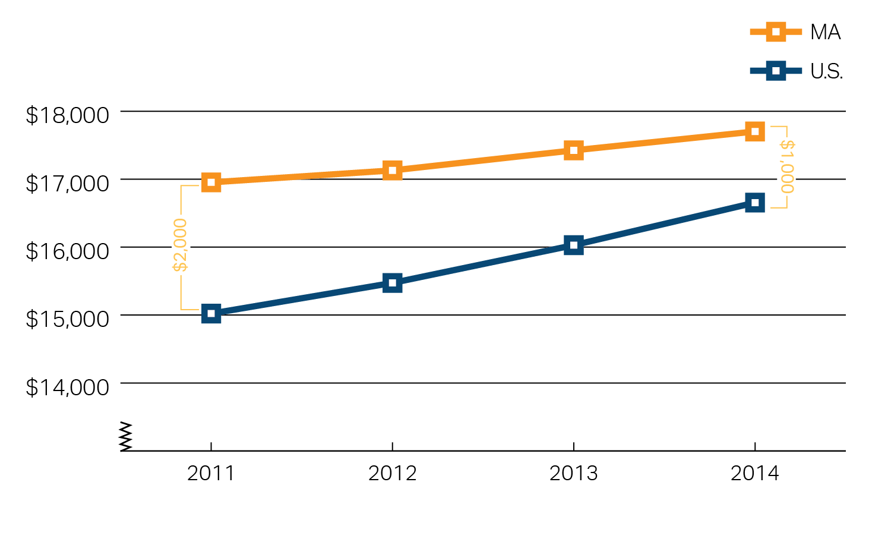
Exhibit 2.5: Family health insurance premiums, Massachusetts and the U.S., 2011-2014
Nominal dollars in the year shown
Note: Premiums for employer-sponsored health insurance. Cost-sharing is not included.
Source: Agency for Healthcare Research and Quality, Medical Expenditure Panel Survey

Slide 9
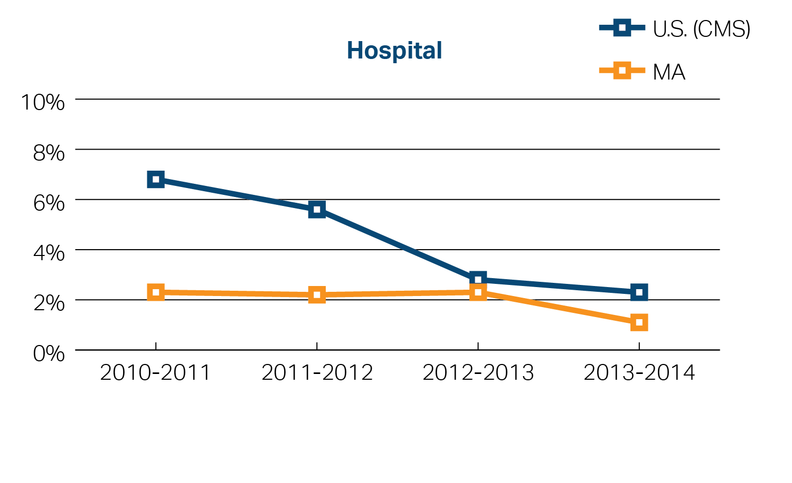
Exhibit 2.6: Annual growth in commercial spending per enrollee, by spending category, 2010-2014
Source: Centers for Medicare and Medicaid Services; Center for Health Information and Analysis

Slide 10
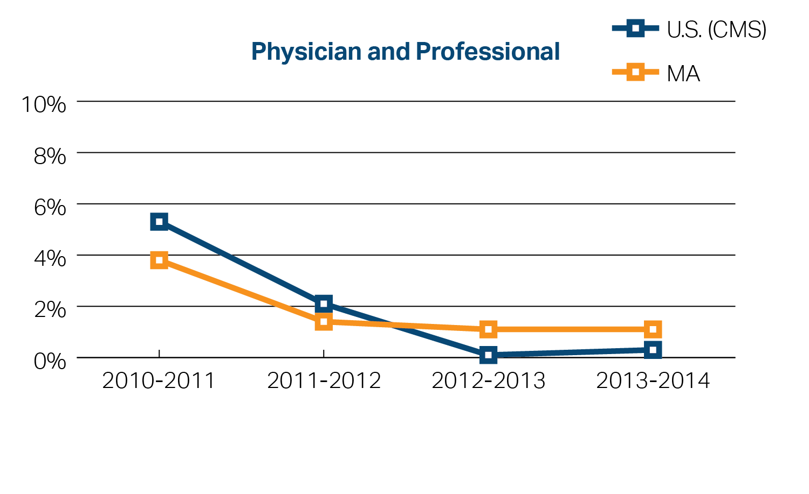
Exhibit 2.6: Annual growth in commercial spending per enrollee, by spending category, 2010-2014
Source: Centers for Medicare and Medicaid Services; Center for Health Information and Analysis

Slide 11
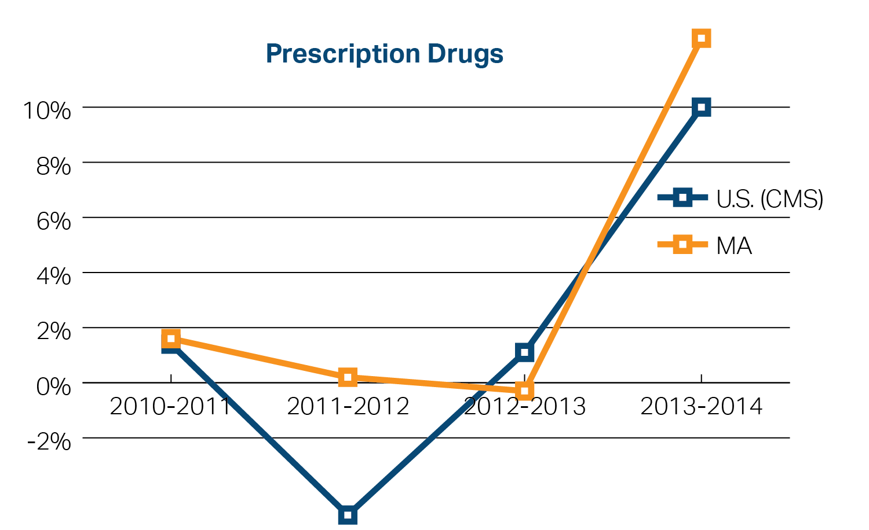
Exhibit 2.6: Annual growth in commercial spending per enrollee, by spending category, 2010-2014
Source: Centers for Medicare and Medicaid Services; Center for Health Information and Analysis

Slide 12
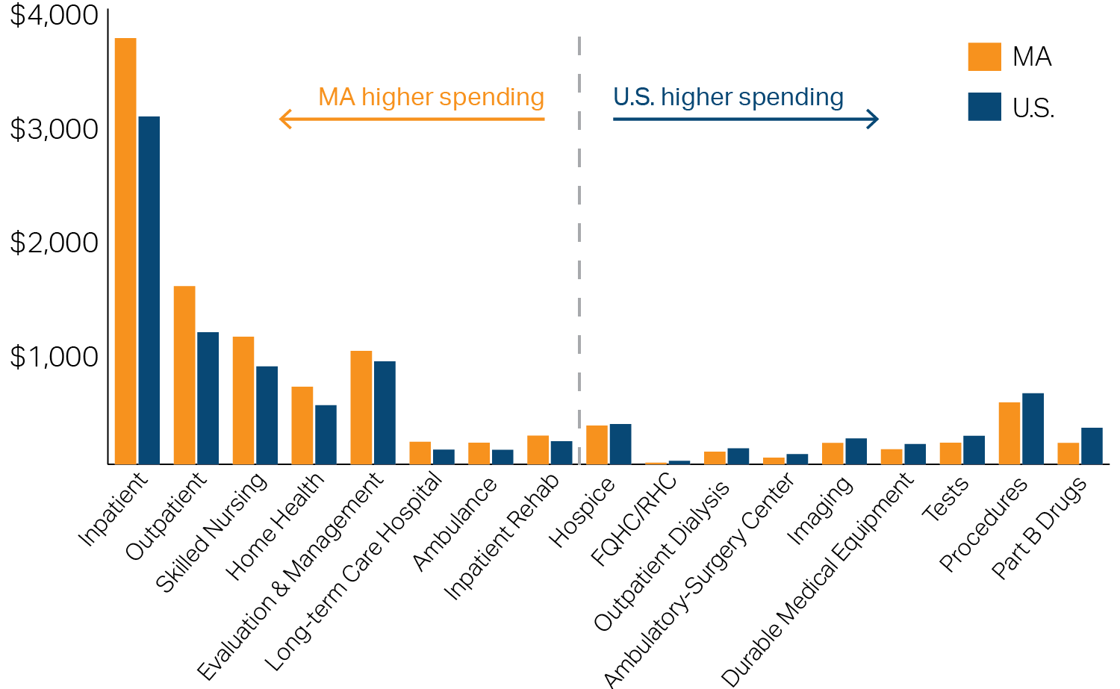
Exhibit 2.7: Medicare spending per beneficiary (Original Medicare) in Massachusetts and in the U.S., by category, 2013
Note: Categories are ordered from left to right by the amount by which spending in Massachusetts exceeds national spending.
Source: Centers for Medicare and Medicaid Services

Slide 13
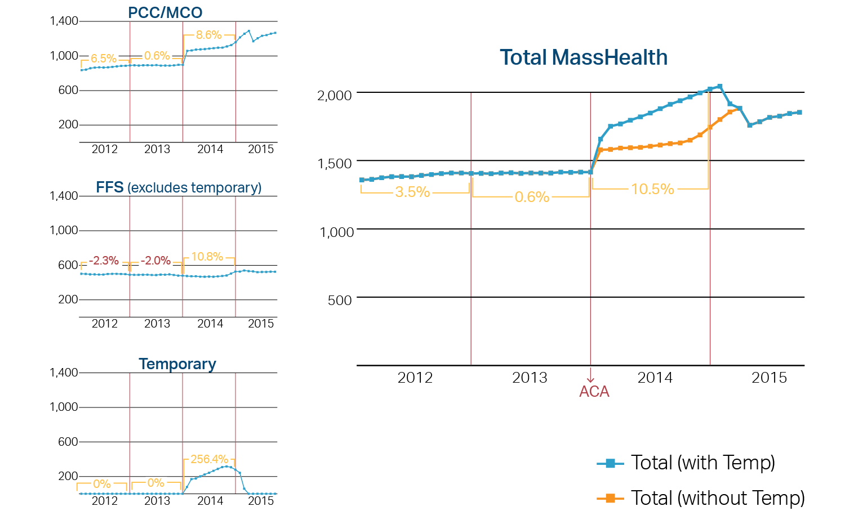
Exhibit 2.8: MassHealth enrollment, January 2012-August 2015
Thousands of enrollees per month
Source: Center for Health Information and Analysis

Slide 14
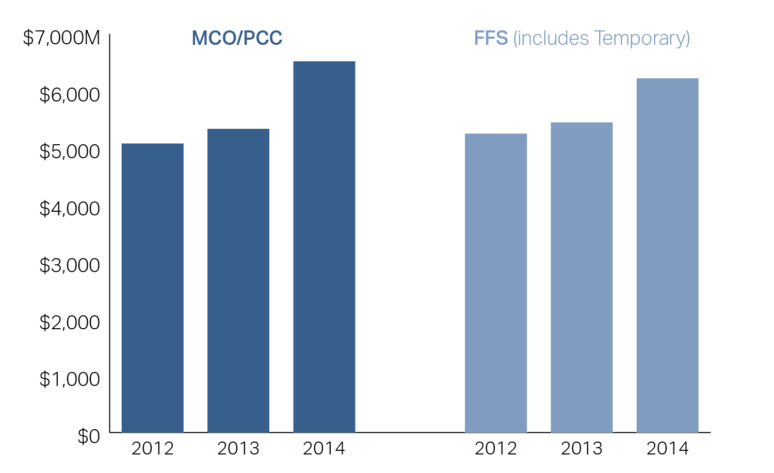
Exhibit 2.9: MassHealth spending by program, 2012-2014
Millions of dollars in calendar year shown
Note: Senior Care Option (SCO), Programs of All-Inclusive Care for the Elderly (PACE), and OneCare not included in Exhibit. These programs began as MassHealth managed care programs available to elderly, near elderly, and dual-eligible populations. For the SCO/PACE/OneCare program, spending was $727M (2012), $865M (2013), and $1.14B (2014). OneCare began in 2013.
Source: Center for Health Information and Analysis, Total Health Care Expenditures

Slide 15
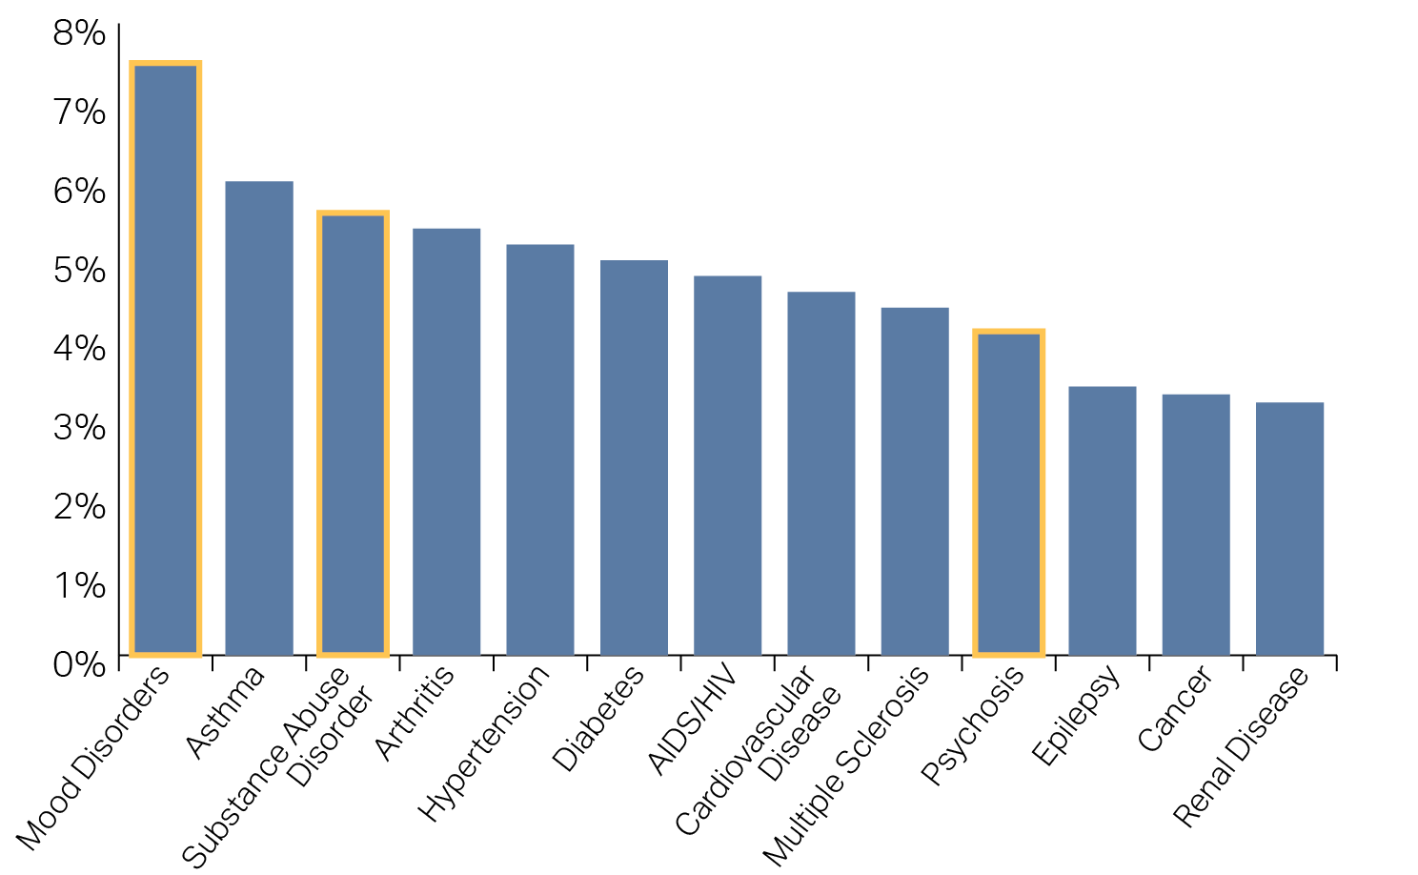
Exhibit 2.10: Cost-sharing as a percentage of total spending for individuals with given diagnosed conditions, 2013
Source: HPC analysis of Massachusetts All-Payer Claims Database

Slide 16
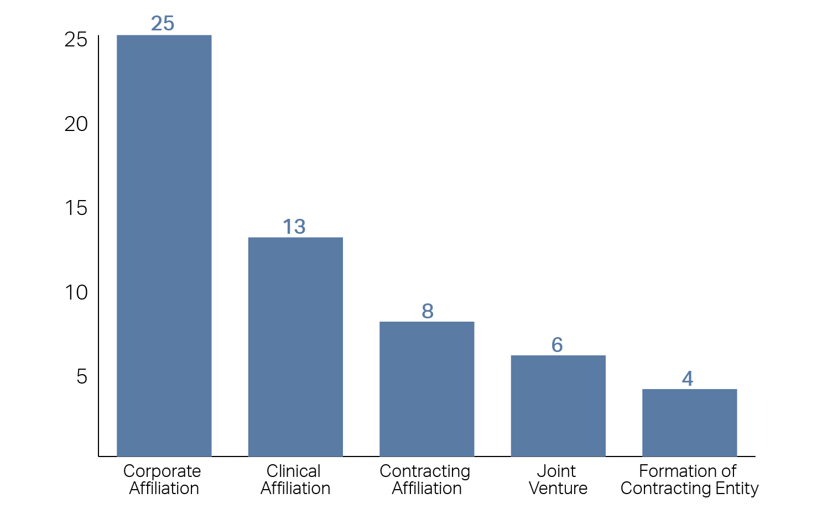
Exhibit 3.1: Frequency of provider alignment types for which the HPC received material change notices, 2013-2015
Source: HPC

Slide 17
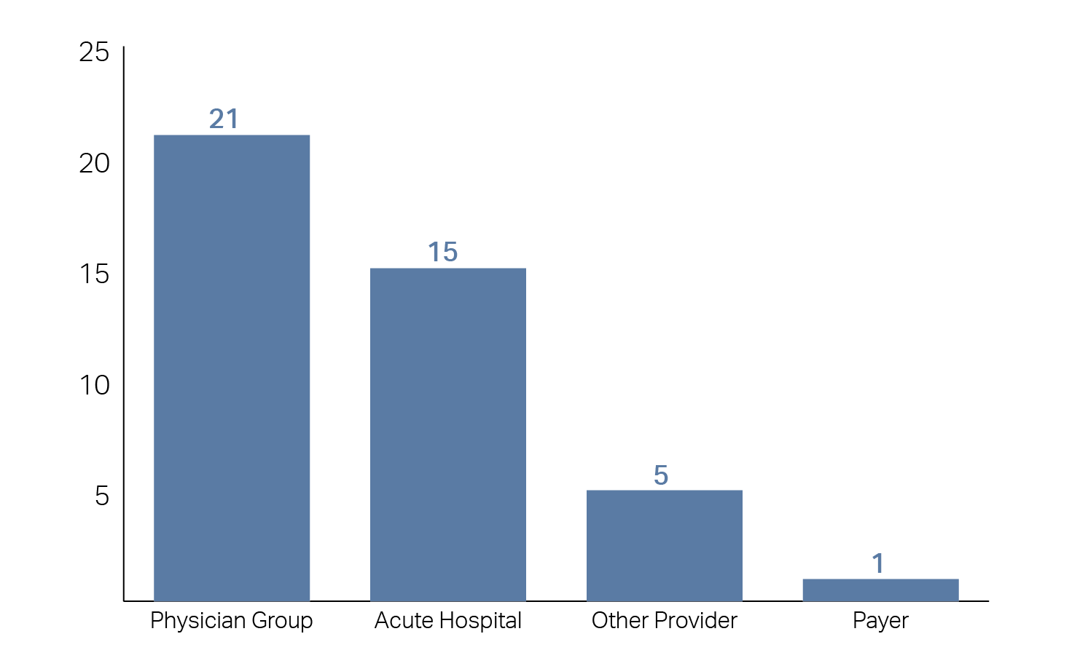
Exhibit 3.2: Frequency of providers involved in Material Change Notices consisting of corporate or contracting affiliations
Source: HPC

Slide 18
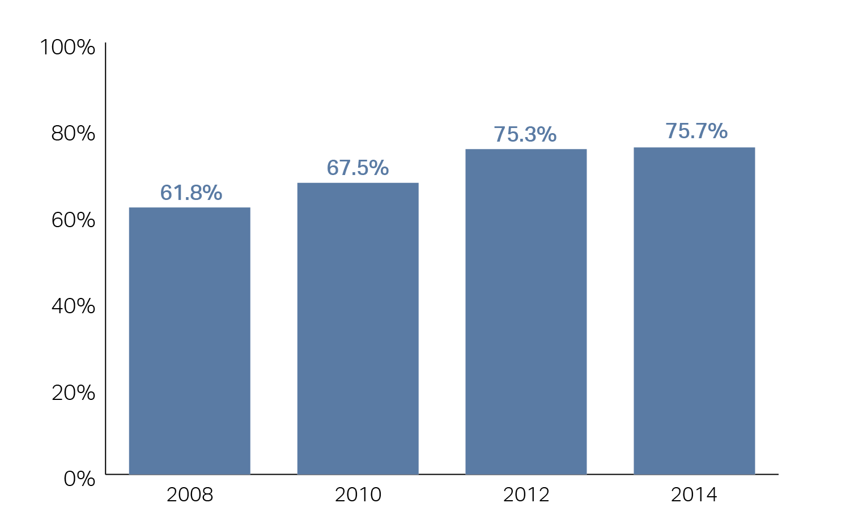
Exhibit 3.3: Percentage of primary care physicians affiliated with large provider systems, 2008-2014
Note: Reflects primary care physicians associated with Partners Community Health Care, Beth Israel Deaconess Care Organization, Steward Health Care Network, New England Quality Care Alliance, Atrius Health, UMass Memorial Health Care, Baycare Health Partners, and Lahey Health System.
Source: HPC analysis of data from Massachusetts Health Quality Partners

Slide 19
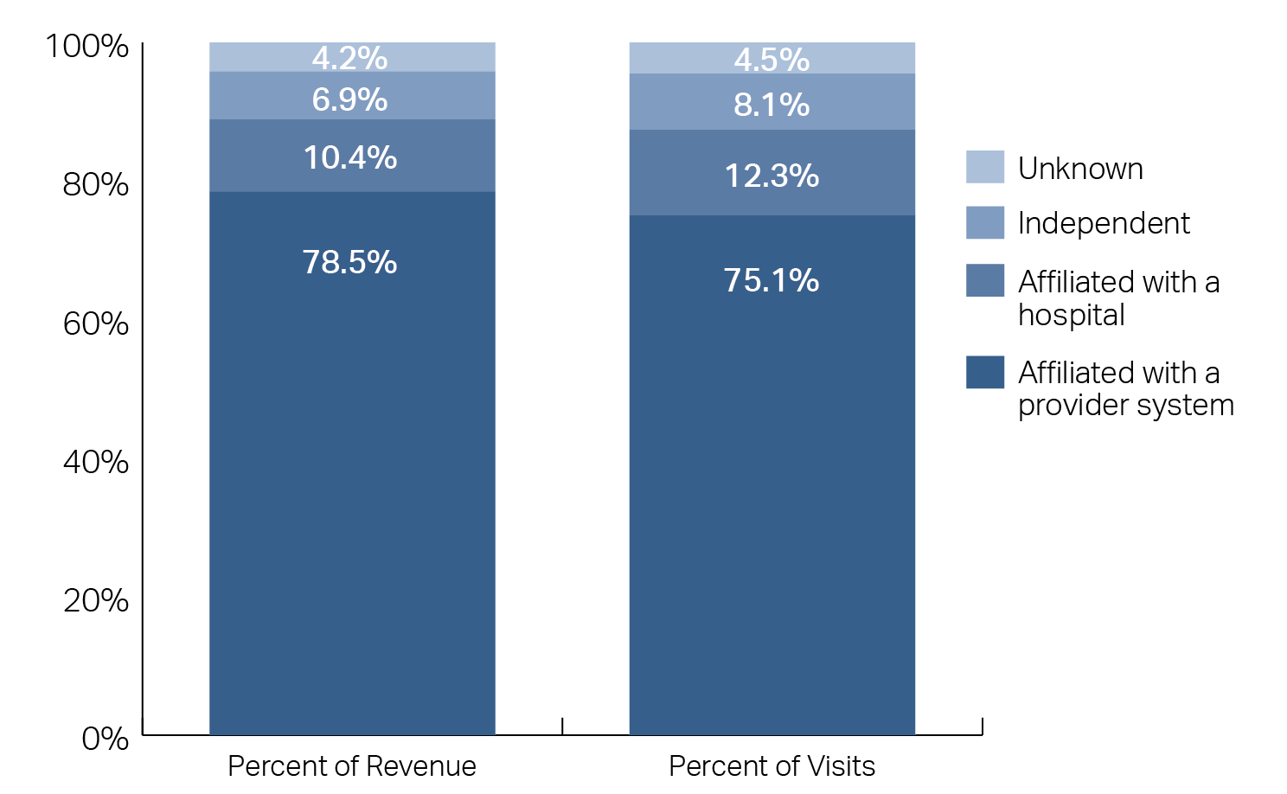
Exhibit 3.4: Percentage of primary care physician revenue and visits by affiliation status, 2012
Note: For the purposes of this analysis, major provider systems include Atrius Health, Baystate Health System, Beth Israel Deaconess Care Organization, Lahey Health System, New England Quality Care Alliance, Partners Community Health Care, Steward Health Care Network, and UMass Memorial Health Care. Primary care physicians affiliated with multiple systems are counted as being part of a major provider system.
Source: 2012 APCD claims for BCBS and HPHC, 2012 MHQP Master Provider Database

Slide 20
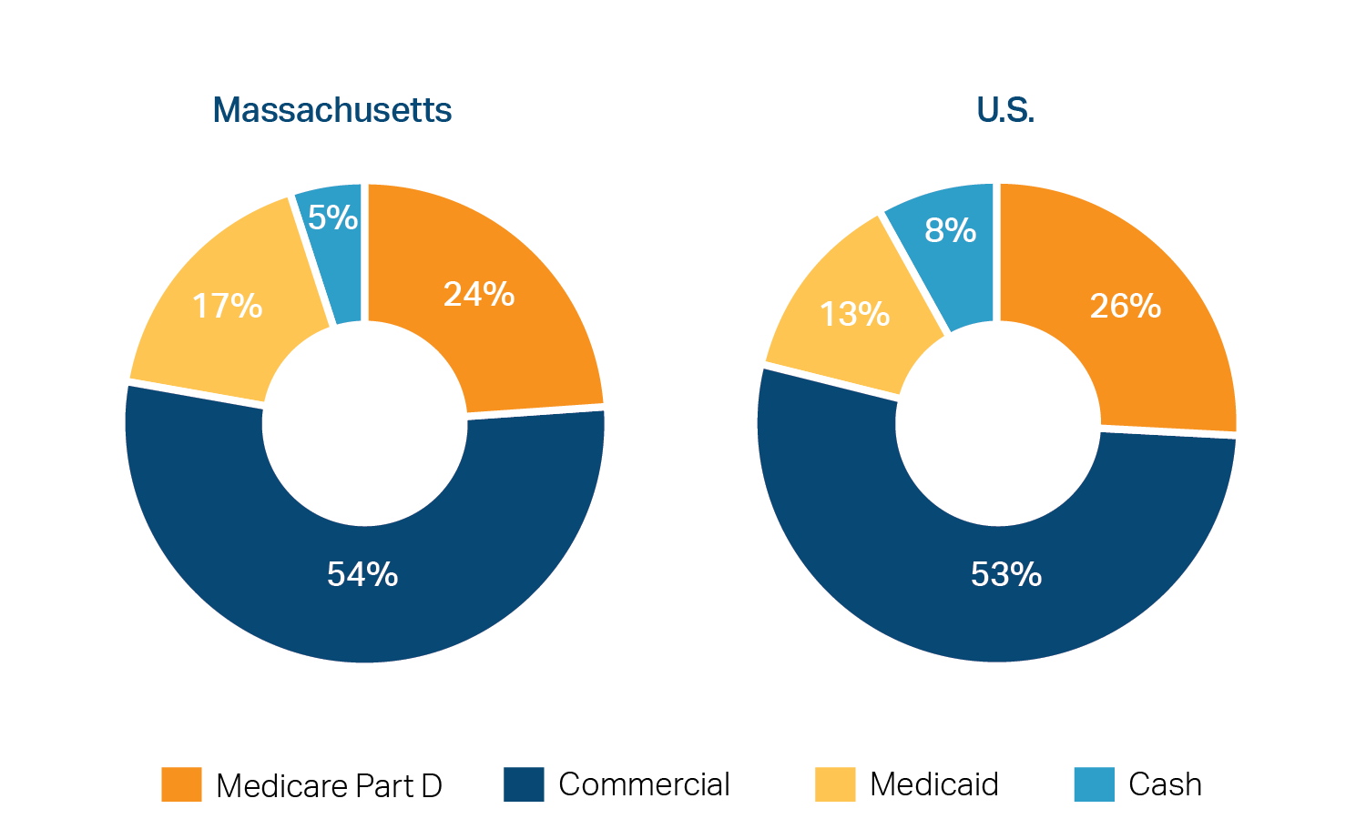
Exhibit 4.1: Distribution of retail prescriptions in Massachusetts and the U.S., by payer, 2014
Source: IMS Health Incorporated

Slide 21
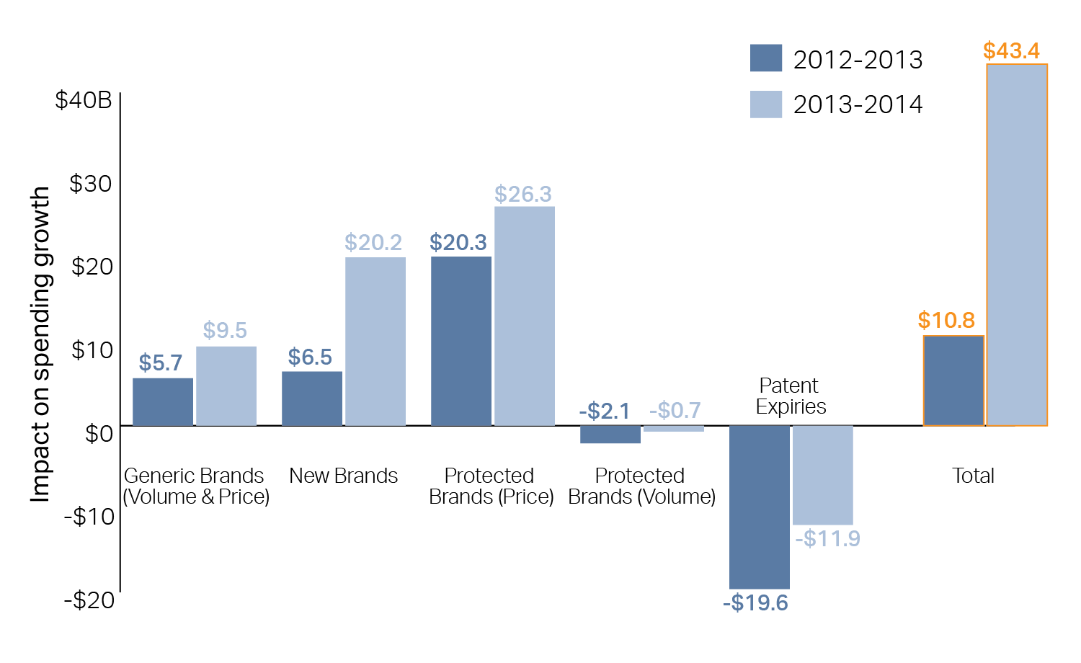
Exhibit 4.2: Components of U.S. drug spending growth, 2013-2014
Billions of dollars in year shown
Source: “Medicine use and shifting costs of healthcare: A review of the use of medicines in the United States in 2014”: IMS Institute for Healthcare Informatics, 2015

Slide 22
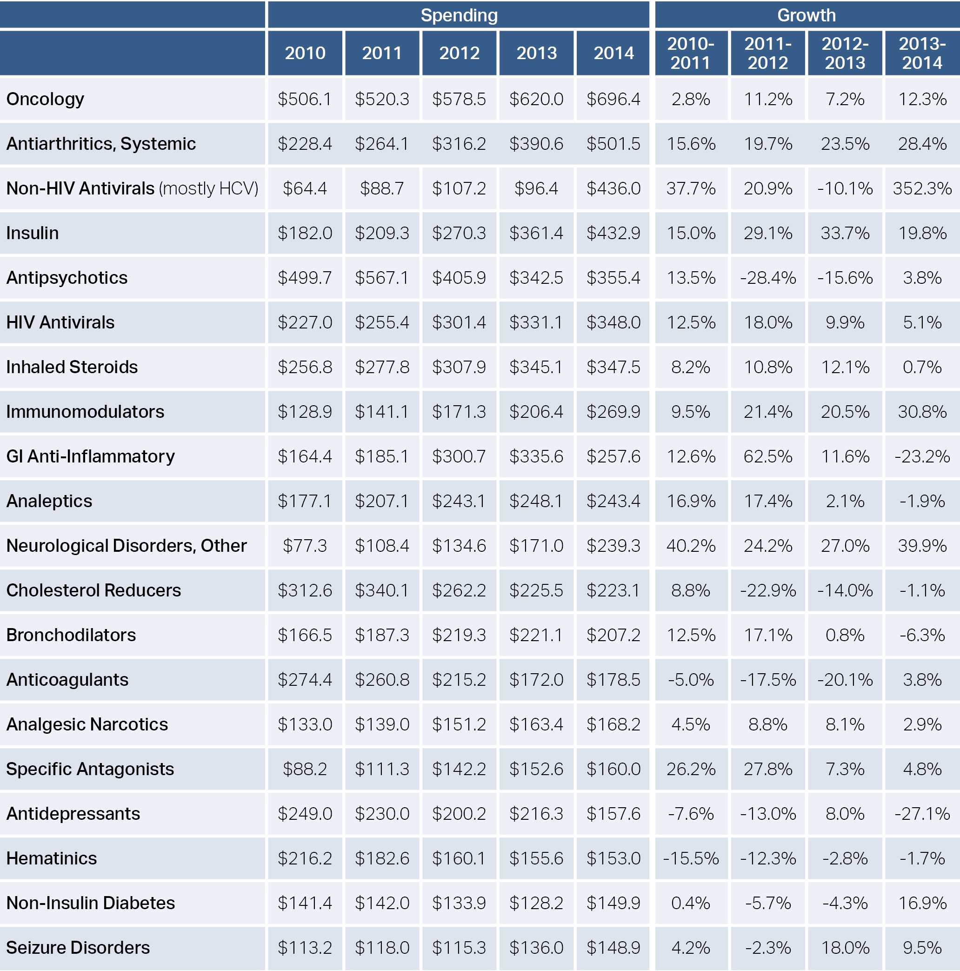
Exhibit 4.3: Massachusetts’ top 20 drug-therapy classes by spending, with growth rates, 2010-2014
Note: Drug spending figures do not account for manufacturer rebates, which can affect both level and trend.
Source: IMS Health Incorporated

Slide 23
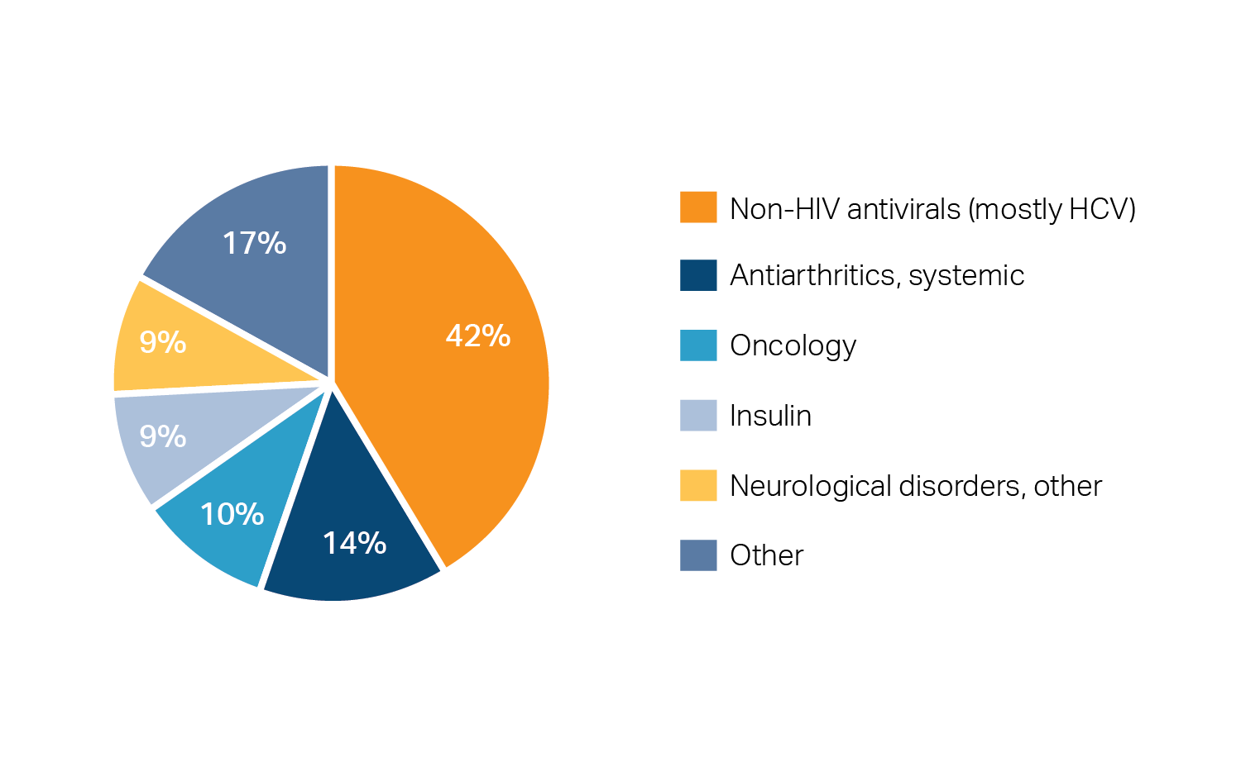
Exhibit 4.4: Top therapy classes by contribution to 2014 drug spending growth in Massachusetts
Note: Spending includes drugs provided in both pharmacy (prescription) and non-pharmacy (hospital and physician office) settings. IMS estimates are not directly comparable to Center for Health Information and Analysis methodology; top contributions may represent upper bound estimates.
Source: IMS Health Incorporated

Slide 24
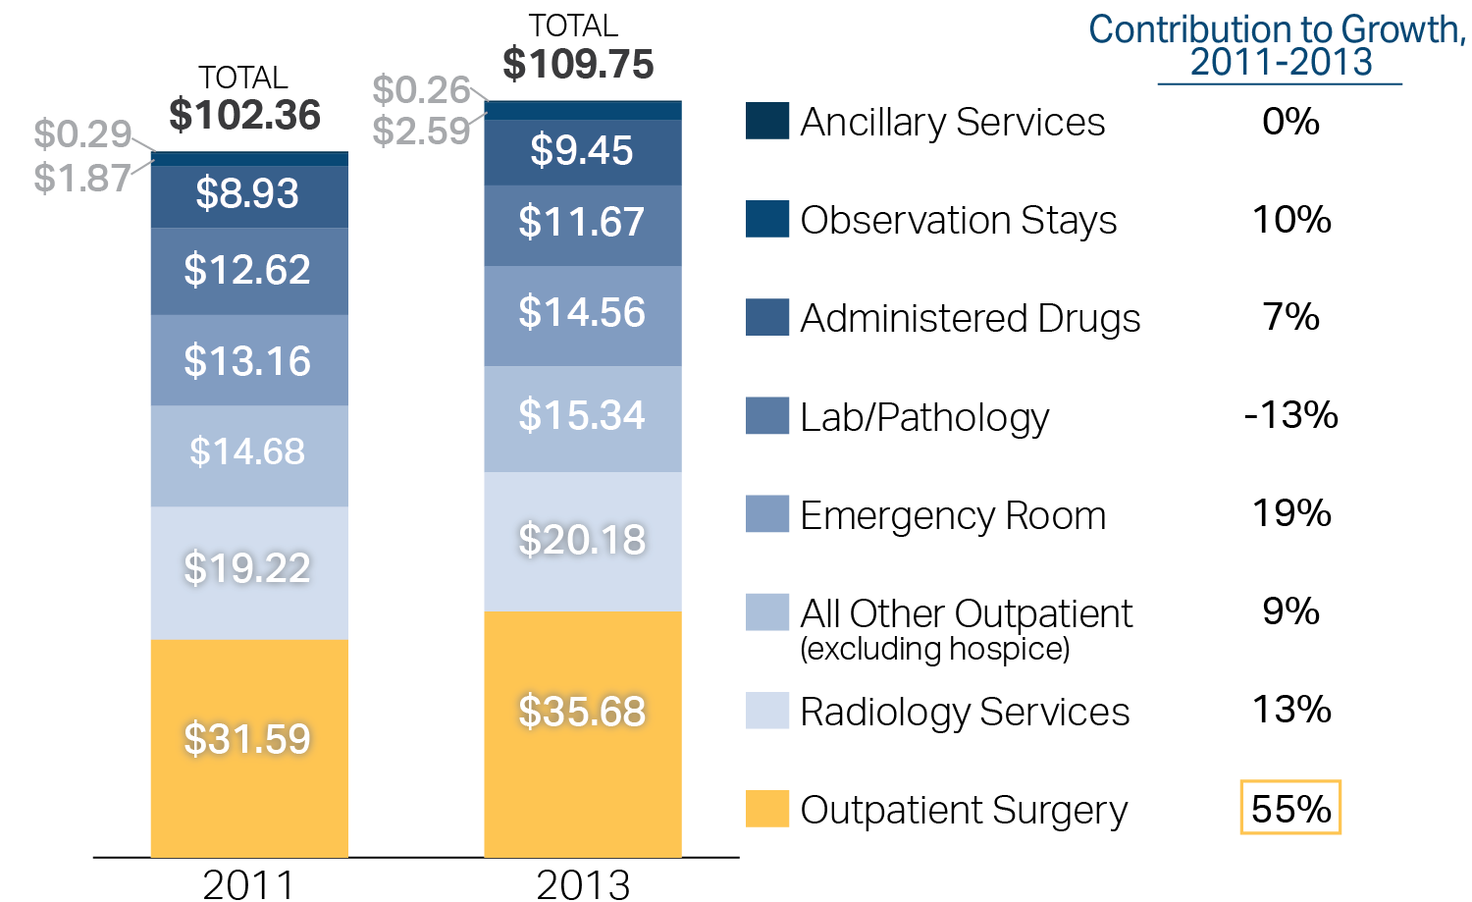
Exhibit 5.1: Commercial spending per member per month in Massachusetts, by outpatient service category, 2011 – 2013
Per member per month spending
Source: HPC analysis of Massachusetts All-Payer Claims Database, 2011-2013

Slide 25
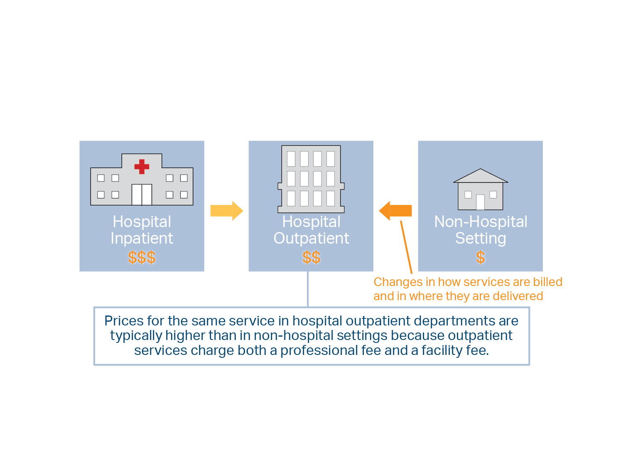
Exhibit 5.2: Shifts in settings to hospital outpatient departments

Slide 26
Exhibit 5.3: Differences in Medicare program payments and beneficiary cost sharing for outpatient office visits provided in freestanding practices and hospital-based entities, 2014
Note MPFS: Medicare physician fee schedule. OPPS: Outpatient Prospective Payment System. (a) Paid under the Medicare physician fee schedule. (b) Paid under the OPPS.
Source: Health Affairs. Health Policy Brief: Site-Neutral Payments, 2014. Medicare Payment Advisory Commission table updated by Health Affairs with 2014 payment rates from Centers for Medicare and Medicaid Services website. The Current Procedural Terminology code used for this example under the physician fee schedule is 99213. The Healthcare Common Procedure Code Set code used for this example under the outpatient prospective payment system (OPPS) is G0462

Slide 27
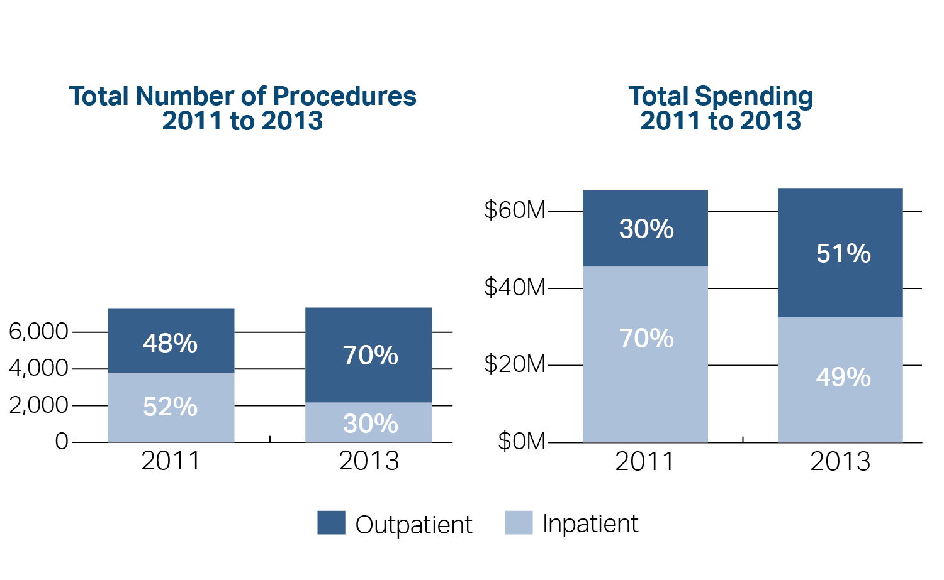
Exhibit 5.4: Change in volume for five major cross-over surgical procedures performed in acute care hospitals, 2011 – 2013
Volume and spending for laparoscopic cholecystectomy, laparoscopic appendectomy, arthrodesis, laparoscopic total hysterectomy, and laparoscopic vaginal hysterectomy
Note: The five major cross-over procedures were identified as the highest volume procedures billed by surgeons in 2013, where at least 10 percent of the surgeries occurred at an inpatient hospital and at least 10 percent occurred in an outpatient setting. Total spending includes insurer and enrollee payments for the facility portion of the surgical procedure. Commercial FFS spending does not include capitated payments (see Technical Appendix).
Source: HPC analysis of Massachusetts All-Payer Claims Database, 2011-2013

Slide 28
Exhibit 5.5: Changes in site of care for chemotherapy administration and E&M visits, 2011-2013
Percentage change in number of procedures per 1,000 member months
Note: * Median price. Procedures with a missing site of service or nonhospital outpatient site were excluded. Spending includes insurer and enrollee payments for both the facility and professional portion of the covered medical service, on all claim lines for the same patient on the same date with the same CPT procedure code. Commercial FFS spending does not include capitated payments. Non-hospital setting includes office, independent lab, urgent care, ambulatory surgical center, independent clinic, FQHC, public health clinic, walk-in retail health clinic, or rural health clinic (see Technical Appendix).
Source: HPC analysis of the Massachusetts All-Payer Claims Database, 2011-2013

Slide 29
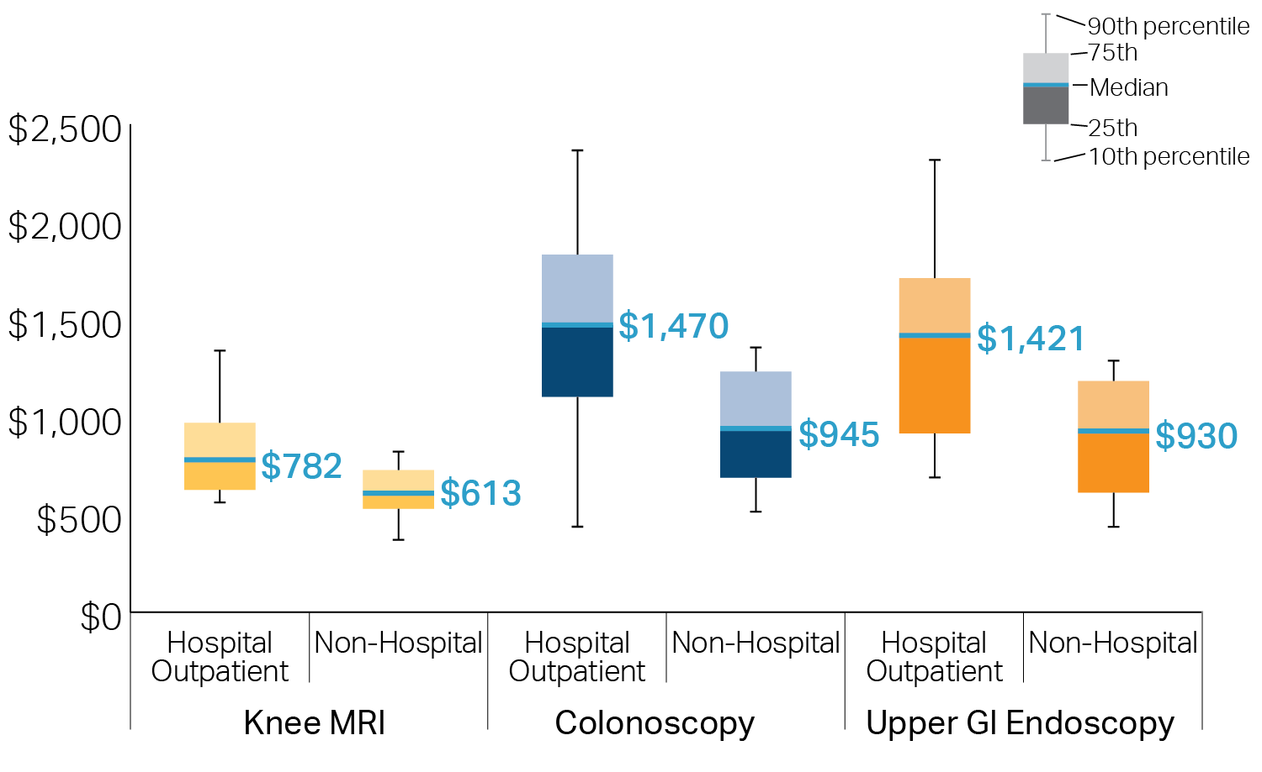
Exhibit 5.6: Comparison of spending per procedure between hospital outpatient and non-hospital settings, 2013
Note: Procedures with a missing site of service or non-hospital outpatient site were excluded. Spending includes insurer and enrollee payments for both the facility and professional portion of the covered medical service, on all claim lines for the same patient on the same date with the same procedure code. Commercial spending does not include capitated payments. See Technical Appendix
Source: HPC analysis of Massachusetts All-Payer Claims Database, 2011-2013

Slide 30
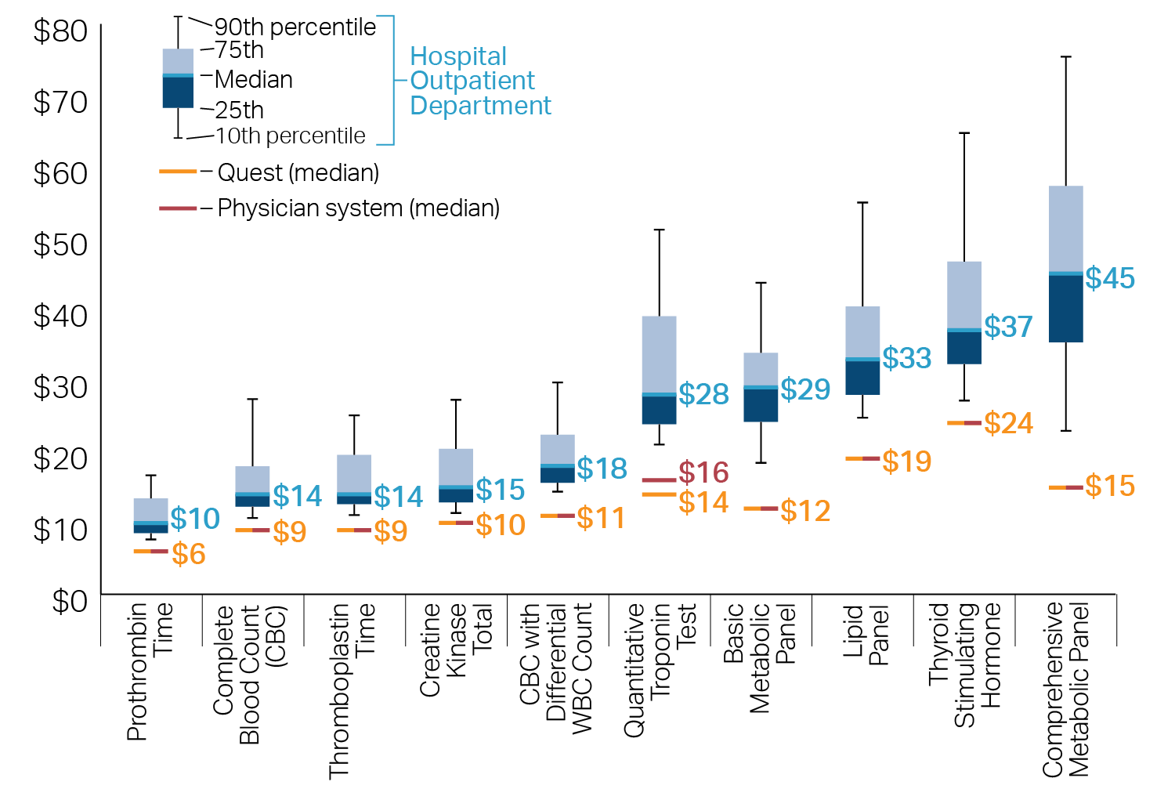
Exhibit 5.7: Prices for common lab tests by setting, 2012
Note: Tests in the hospital setting were only included if billed as an outpatient service. Providers are included if they performed at least 15 tests.
Source: HPC analysis of Massachusetts All-Payer Claims Database, 2012

Slide 31
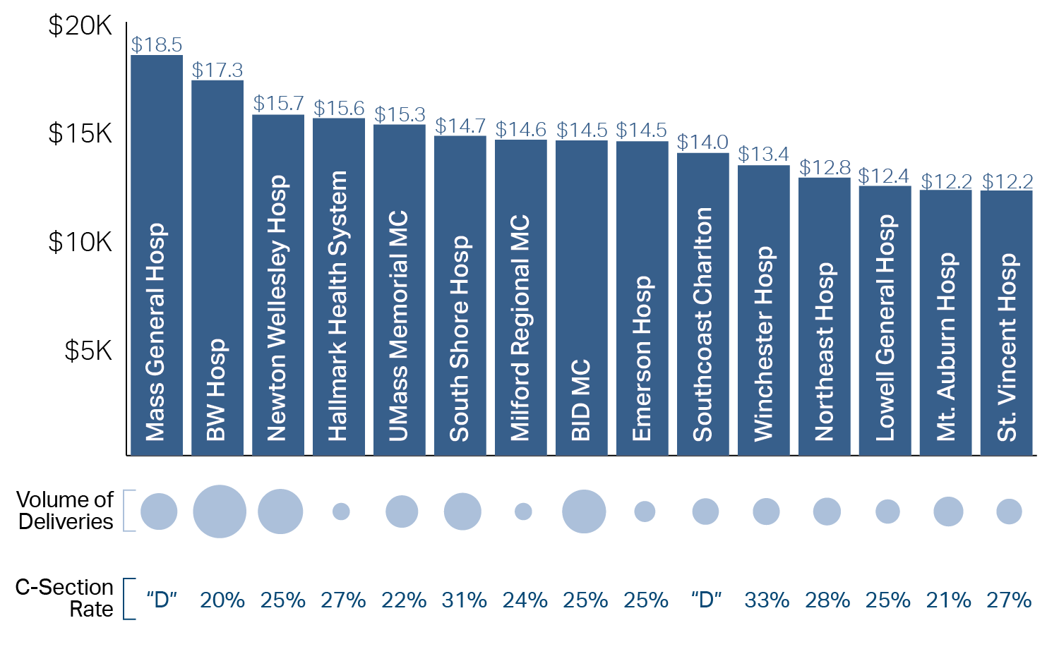
Exhibit 7.1: Average spending for normal deliveries by hospital, selected hospitals, 2011-2012
Spending per episode, “thousands of dollars”
Note: This chart is limited to the 15 hospitals with the greatest number of normal deliveries paid by commercial payers in 2014. Both vaginal and C-section deliveries are included. “D” indicates that the hospital declined to voluntarily submit rates. C-section rate is the nulliparous term singleton vertex (NTSV) C-section rate.
Source: HPC analysis of the Massachusetts All-Payer Claims Database, 2011-2012, HPC analysis of Center for Health Information and Analysis Hospital Inpatient Discharge Database, 2014; Leapfrog Group

Slide 32
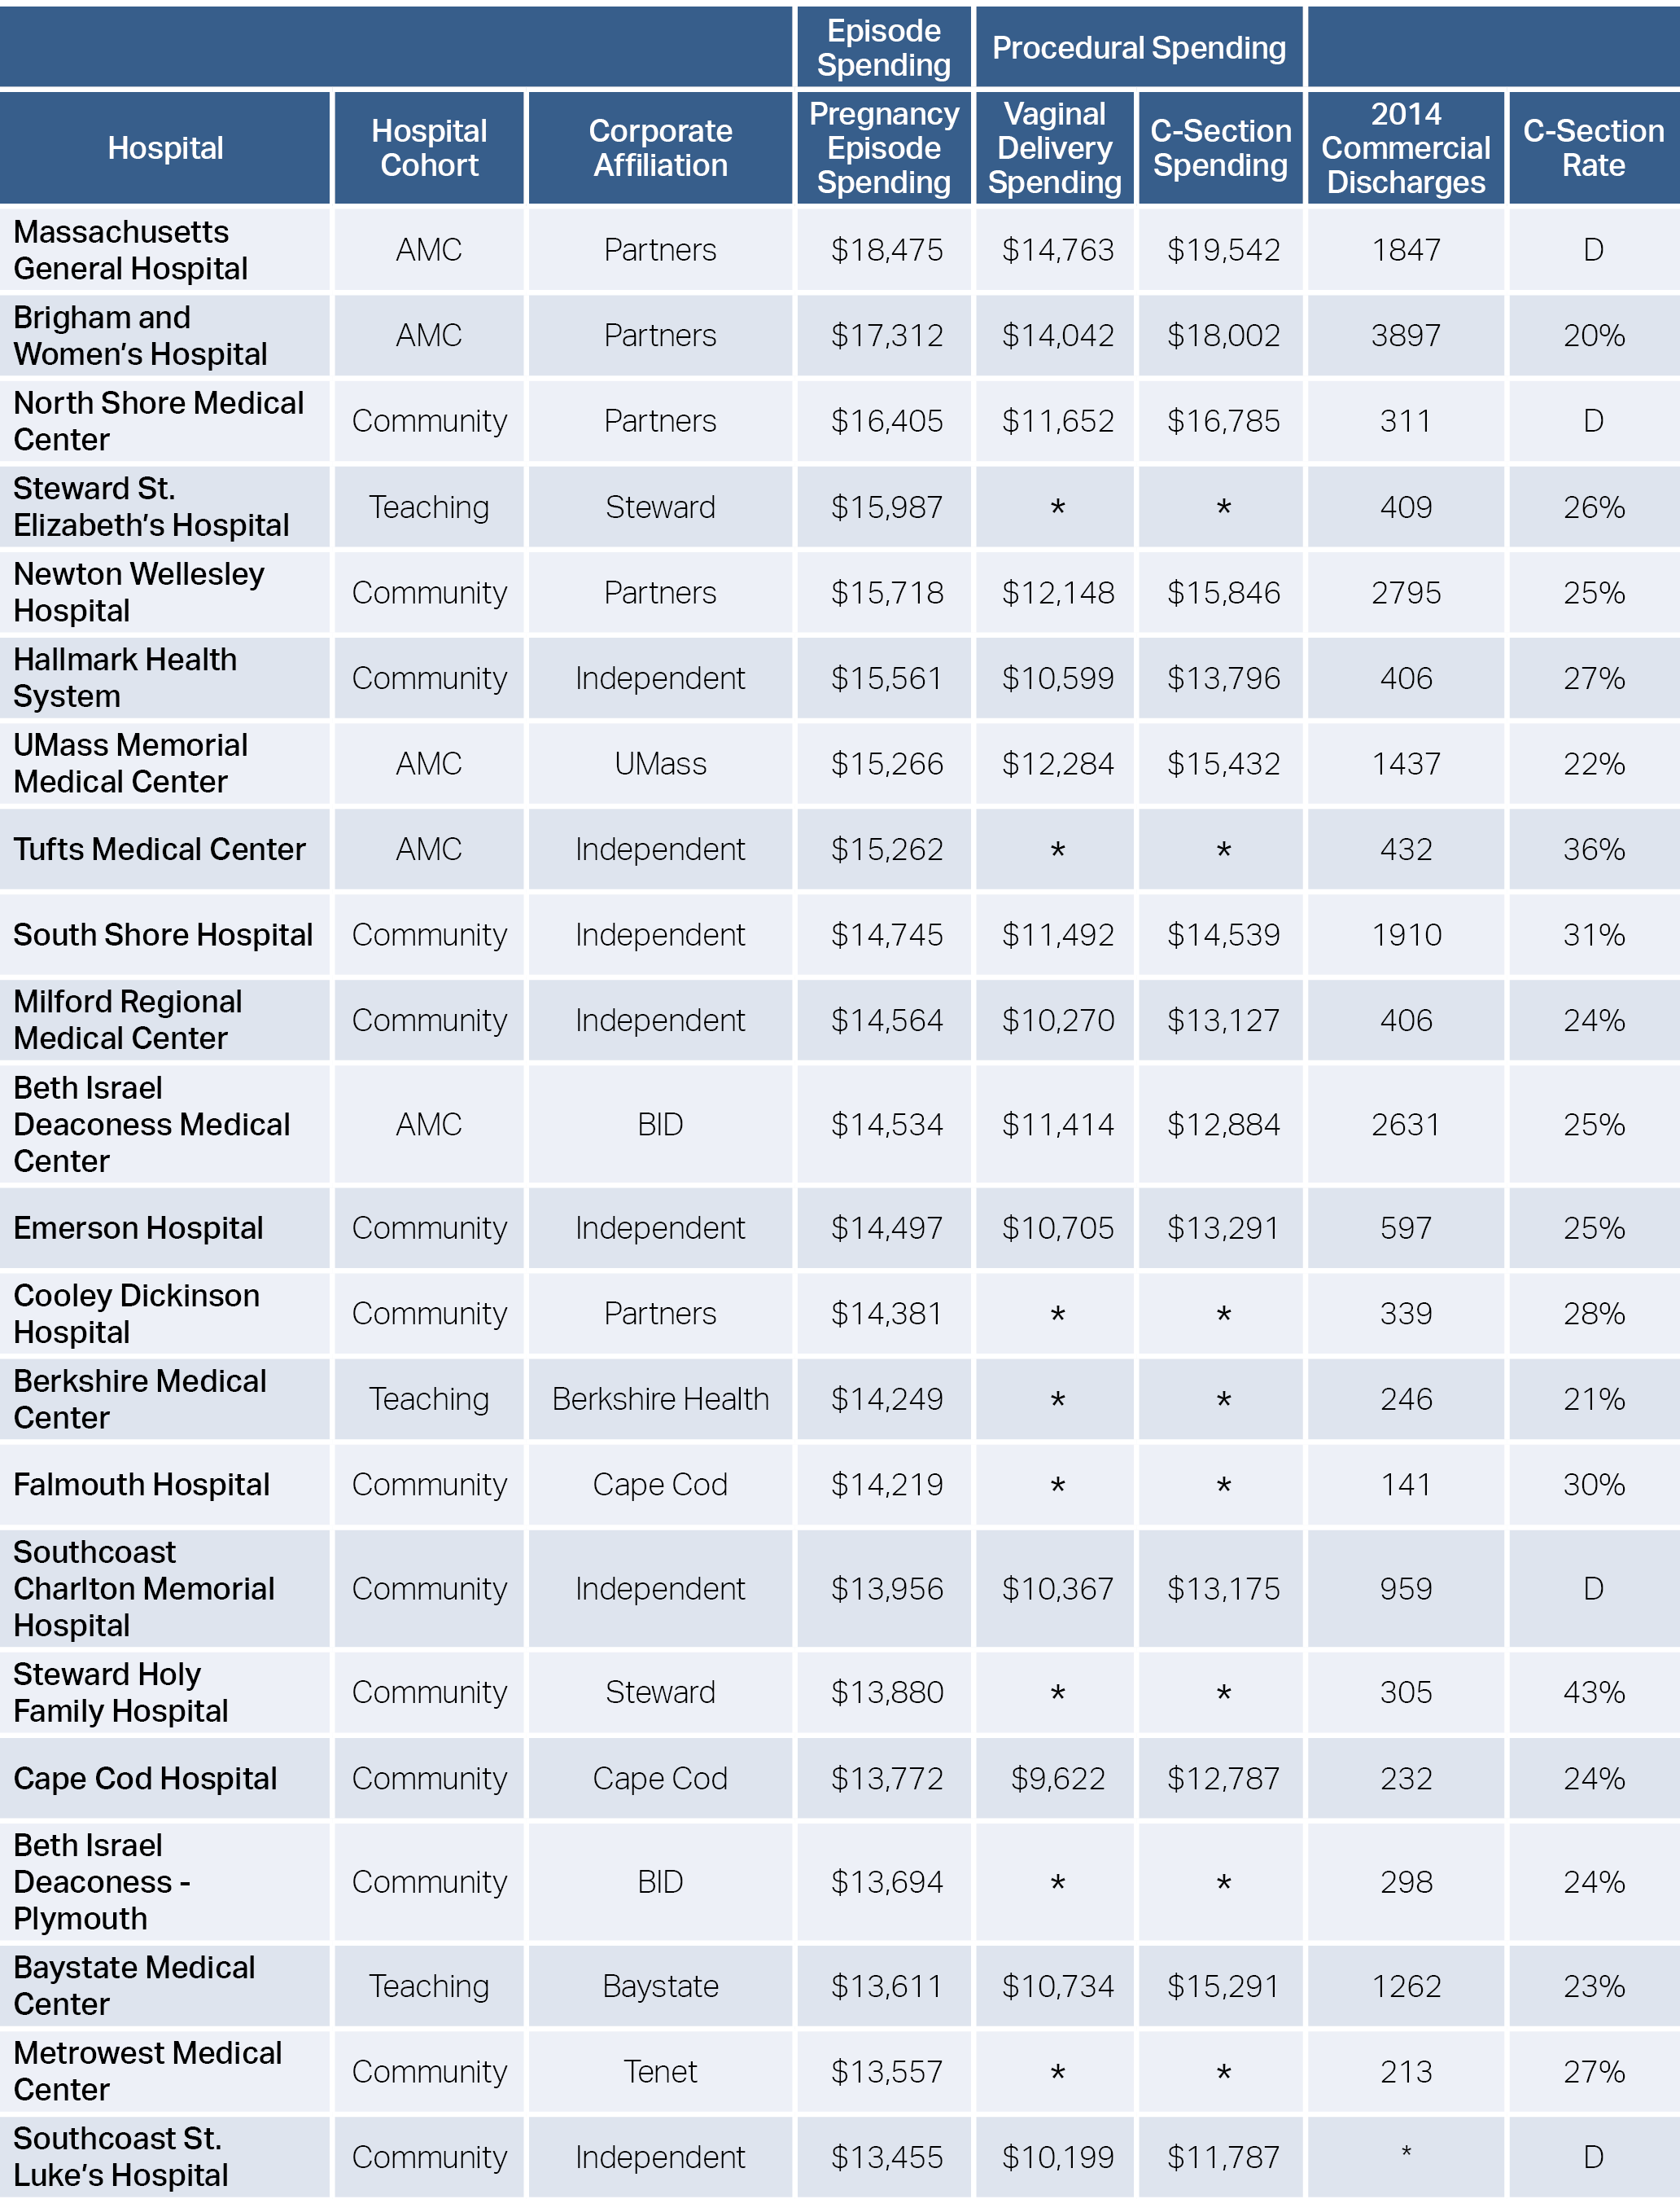
Exhibit 7.2: Average spending for normal deliveries by hospital, all hospitals, 2011-2012
Note: “D” indicates that the hospital declined to voluntarily submit rates. “N/A” indicates that the hospital was not eligible to submit rates. Both vaginal and C-section deliveries are included in episode spending. C-section rate is the nulliparous term singleton vertex (NTSV) C-section rate.
Source: HPC analysis of the Massachusetts All-Payer Claims Database, 2011-2012, HPC analysis of Center for Health Information and Analysis Hospital Inpatient Discharge Database, 2014; Leapfrog Group

Slide 33
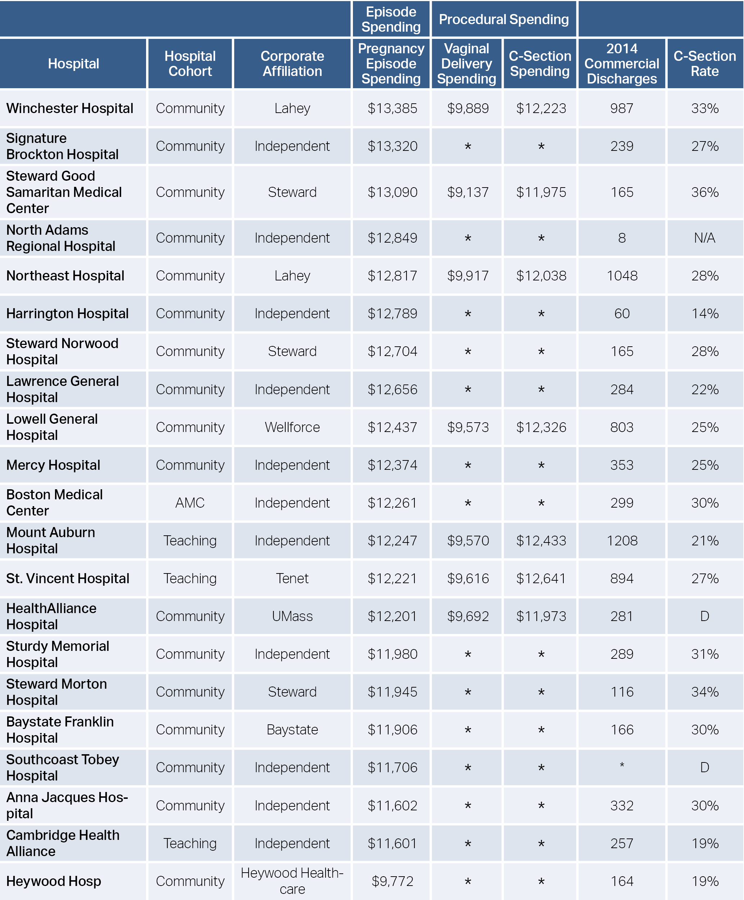
Exhibit 7.2: Average spending for normal deliveries by hospital, all hospitals, 2011-2012 (continued)
Note: “D” indicates that the hospital declined to voluntarily submit rates. “N/A” indicates that the hospital was not eligible to submit rates. Both vaginal and C-section deliveries are included in episode spending. C-section rate is the nulliparous term singleton vertex (NTSV) C-section rate.
Source: HPC analysis of the Massachusetts All-Payer Claims Database, 2011-2012, HPC analysis of Center for Health Information and Analysis Hospital Inpatient Discharge Database, 2014; Leapfrog Group

Slide 34
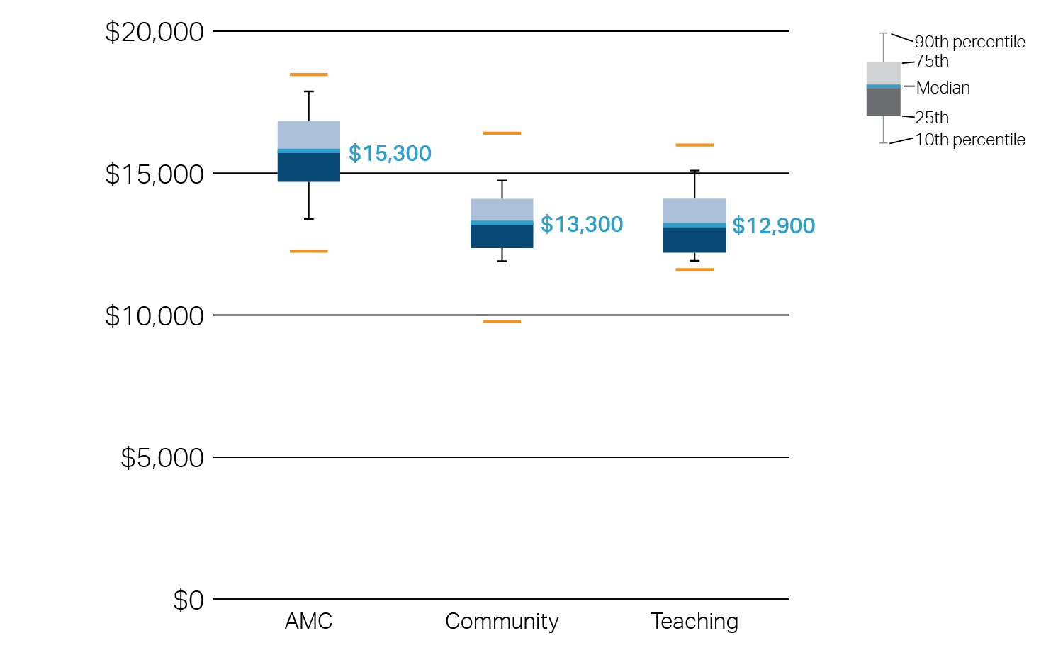
Exhibit 7.3: Average spending for normal deliveries by hospital type, all hospitals, 2011-2012
Spending per episode, dollars
Note: Both vaginal and C-section deliveries are included in episode spending.
Source: HPC analysis of the Massachusetts All-Payer Claims Database, 2011-2012

Slide 35
Exhibit 8.1: Hospital use in Massachusetts and the U.S., 2014
Source: Kaiser Family Foundation analysis of American Hospital Association data, Centers for Medicare and Medicaid Services

Slide 36
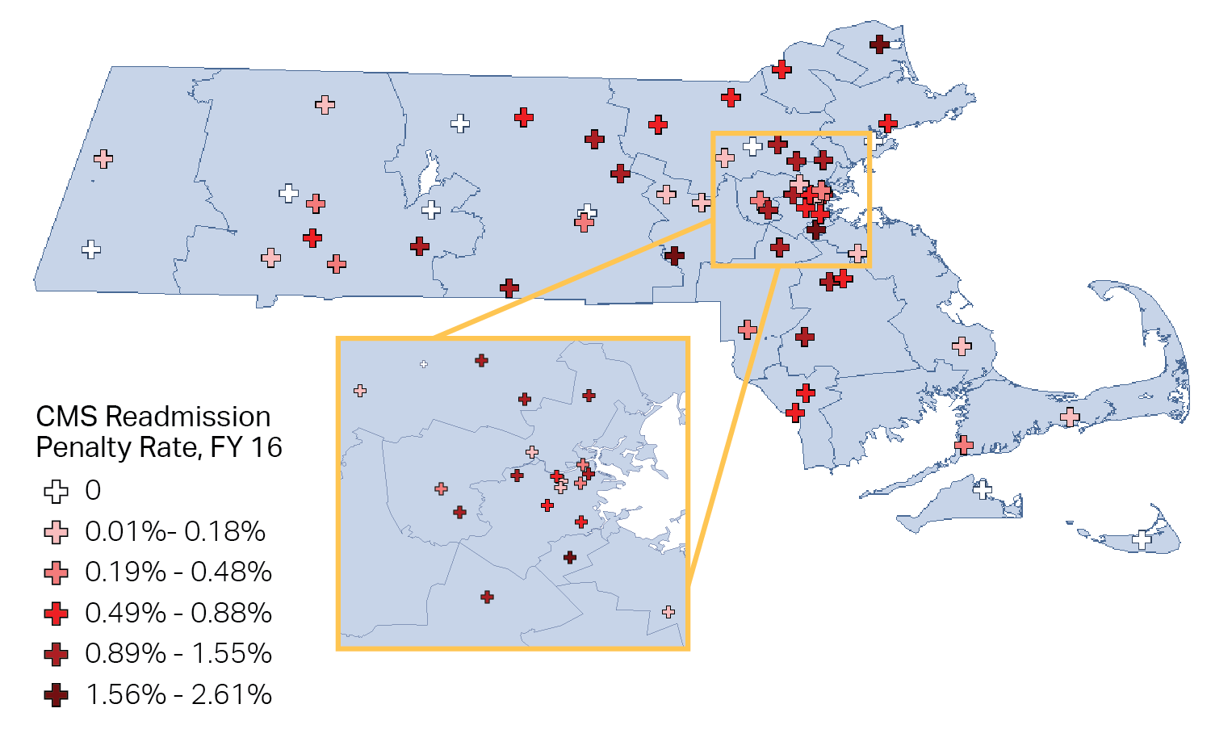
Exhibit 8.2: Massachusetts hospitals penalized for readmissions and assessment rate, FY 2016
Note: Excludes Specialty and VA Hospitals. Penalty rates apply to Original Medicare payments for inpatient care.
Source: Kaiser Family Foundation; analysis of Centers for Medicare and Medicaid Services data; Centers for Medicare and Medicaid Services data

Slide 37
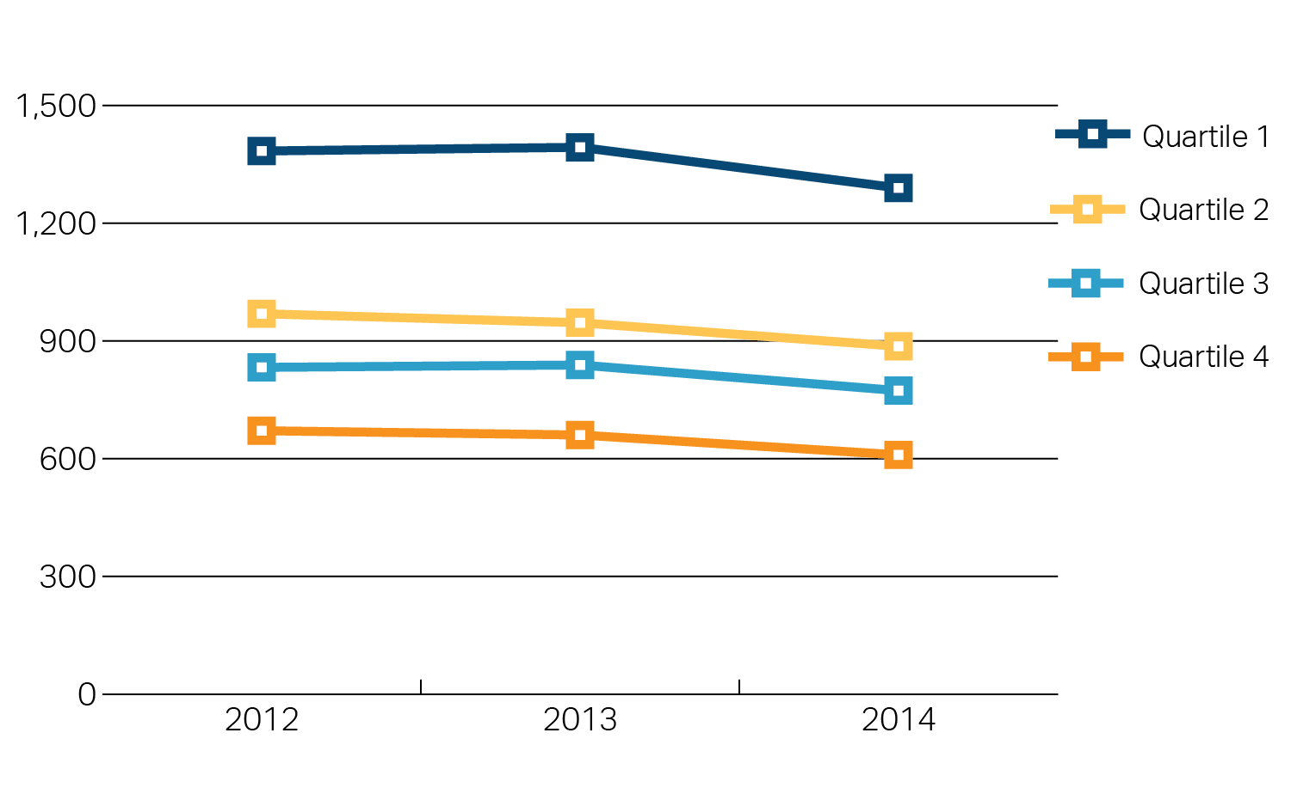
Exhibit 8.3: Chronic preventable hospital admissions by income quartile, 2012-2014
Age and sex adjusted hospitalizations per 100,000 residents
Note: Income Quartiles range from $0 - $52K, 52K - 69K, 69K - 87K, and 87K+.
Source: HPC analysis of Center for Health Information and Analysis Hospital Inpatient Discharge Database, 2012-2014

Slide 38
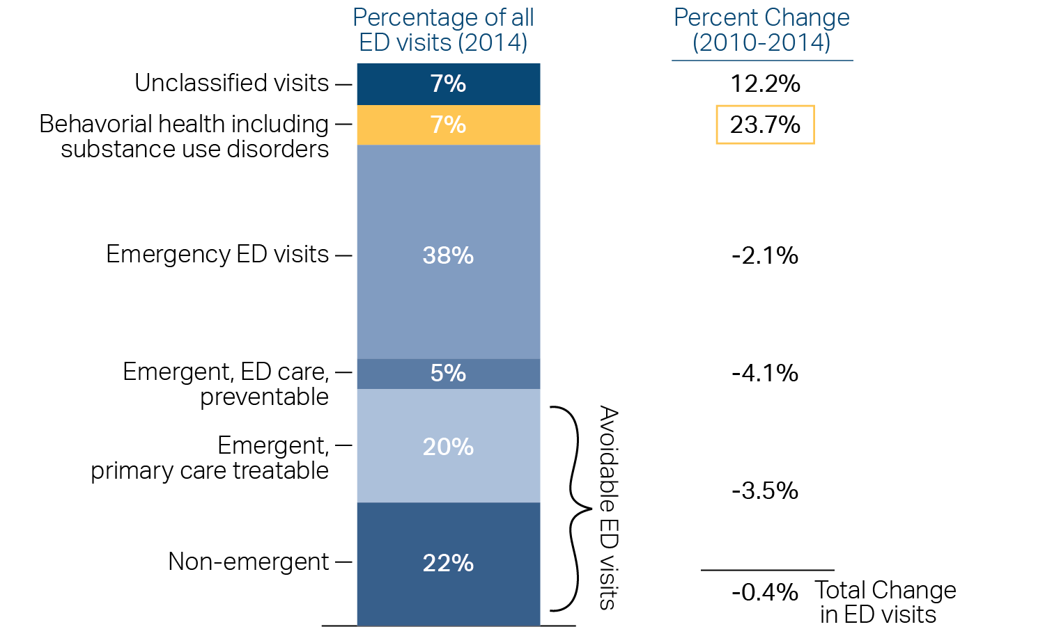
Exhibit 8.4: Emergency Department visits by type, 2010-2014
Note: Definition for avoidable ED visits based on NYU Billings Algorithm.
Source: NYU Center for Health and Public Service Research; HPC analysis of Center for Health Information and Analysis Hospital Inpatient Discharge Database, FY2010-2014

Slide 39
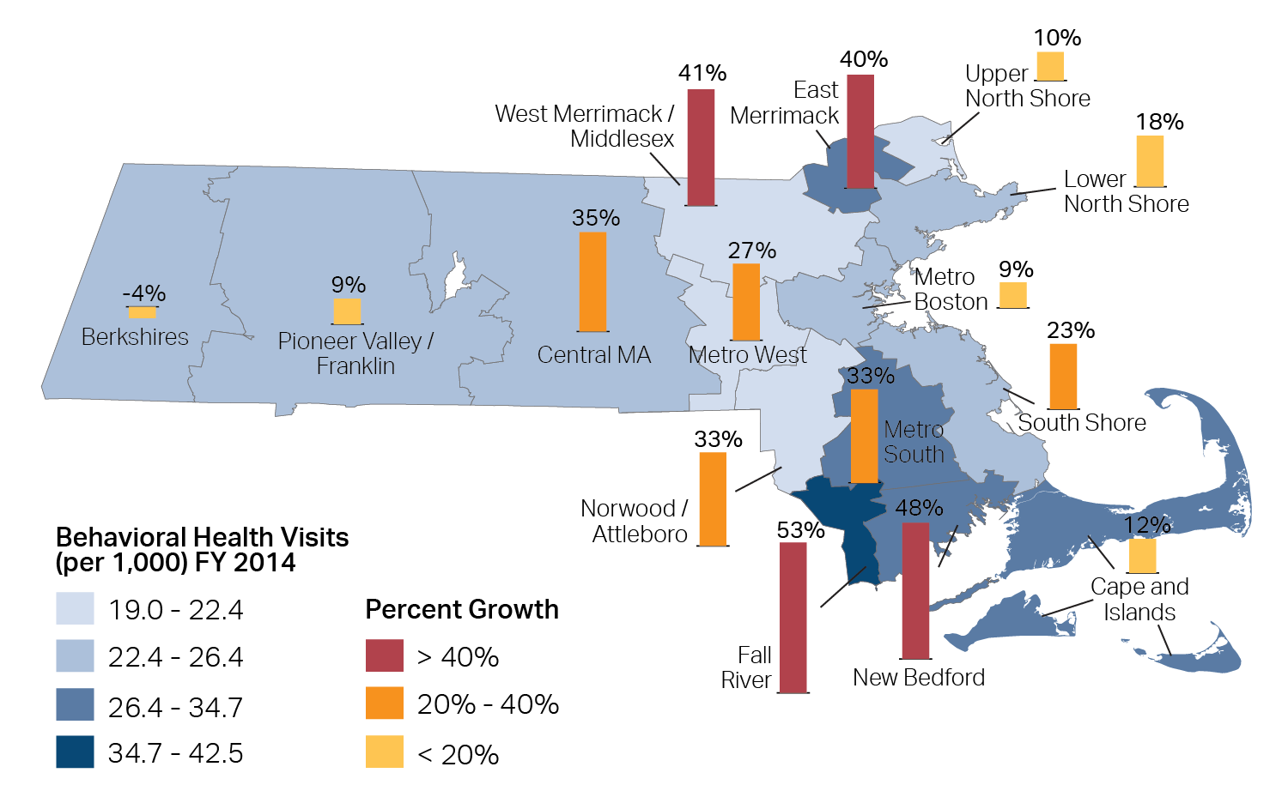
Exhibit 8.5: Behavioral health-related emergency department visits per 1,000 residents, 2010 - 2014
Vertical bars show growth in visits
Note: Behavioral health includes mental health and substance use disorders. All conditions are based on primary diagnosis. All rates are adjusted for age and sex.
Source: NYU Center for Health and Public Service Research HPC analysis of Center for Health Information and Analysis Hospital Inpatient Discharge Database, FY2010-2014

Slide 40
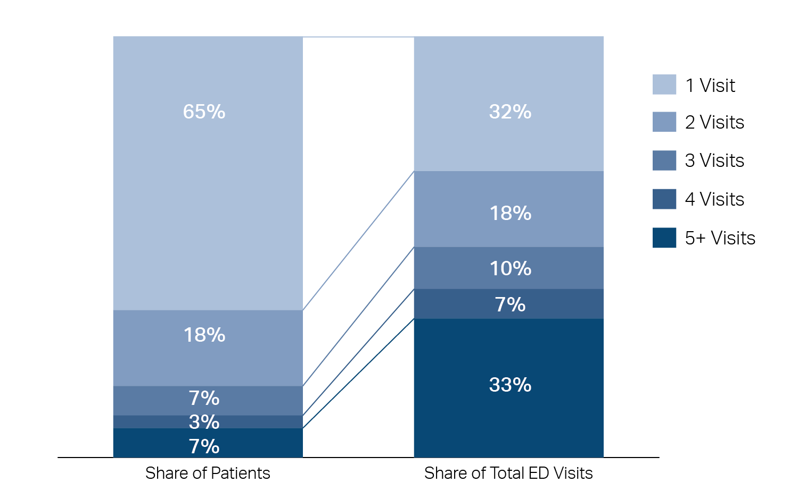
Exhibit 8.6: Emergency Department visits by patient visit frequency, 2014
Visits per year
Source: HPC analysis of Center for Health Information and Analysis Hospital Inpatient Discharge Database, FY2014

Slide 41
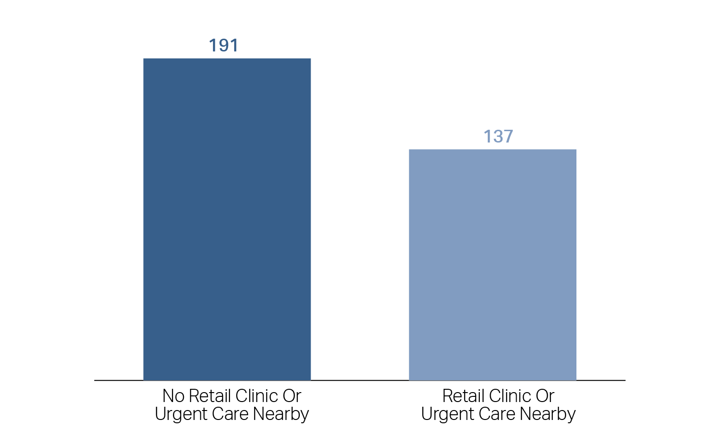
Exhibit 8.7: Avoidable Emergency Department use by proximity to retail clinic or urgent-care sites, 2014
Number of avoidable ED visits per 1,000 residents
Note: Residents shown all live within 5 miles of an ED. Residents who do not live within 5 miles of an ED are excluded from Exhibit.
Source: HPC analysis of Center for Health Information and Analysis Hospital Inpatient Discharge Database FY2014; Massachusetts Department of Public Health

Slide 42
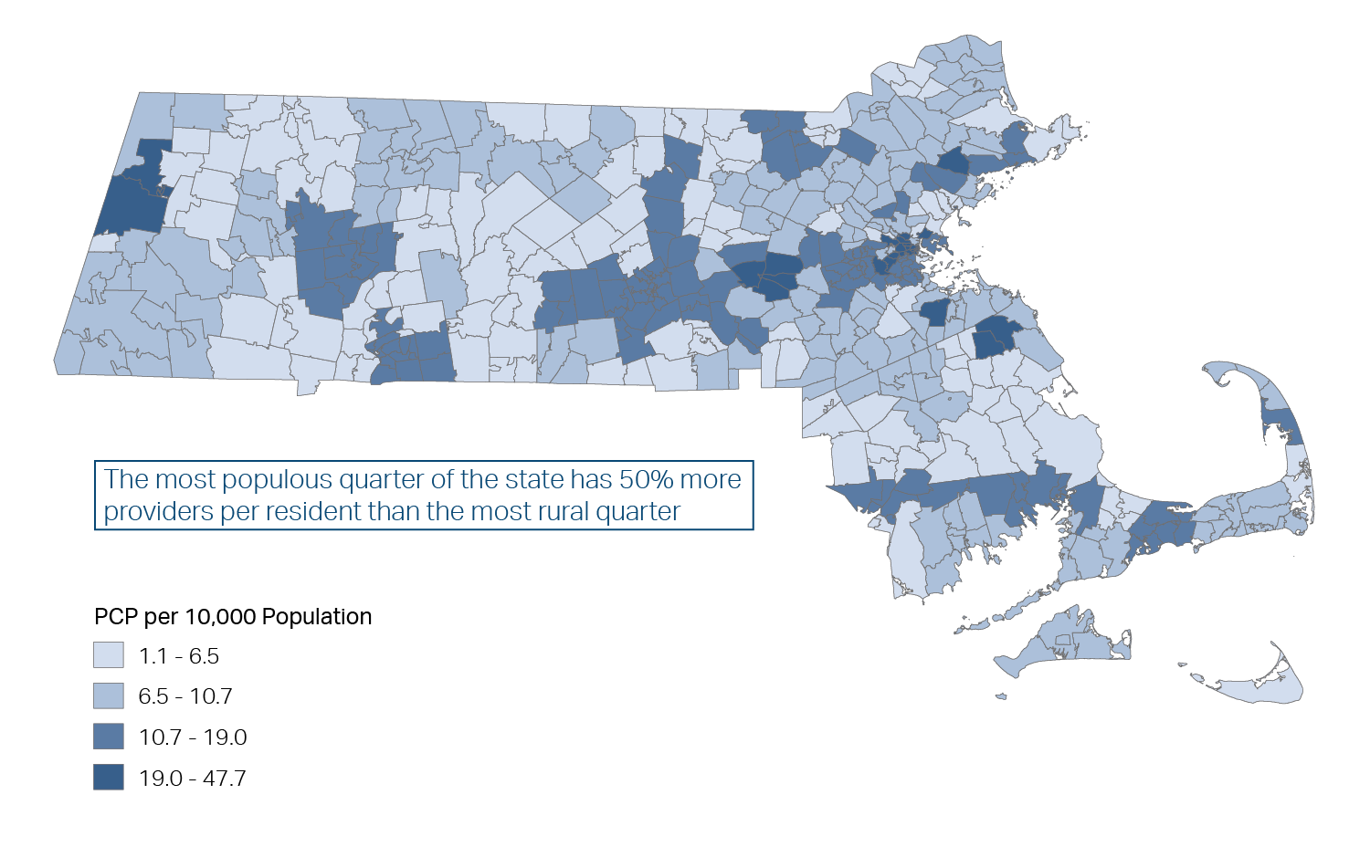
Exhibit 9.1: Number of primary care providers per 10,000 Massachusetts residents, by primary care service area
Full-time equivalent physicians, nurse practitioners and physician assistants
Note: Massachusetts is divided into 158 regions called Primary Care Service Areas (PCSAs). These areas were developed by researchers associated with the Dartmouth Atlas of Health Care and represent a geographic approximation of patients’ travel patterns to obtain to primary care services. According to common practice, Nurse Practitioners and Physician Assistants weighted as equivalent to .75 relative to a physician. See Technical Appendix .
Source: SK&A Office Based Physician Database, September 30, 2015; Massachusetts Department of Public Health: Health Care Workforce Center

Slide 43
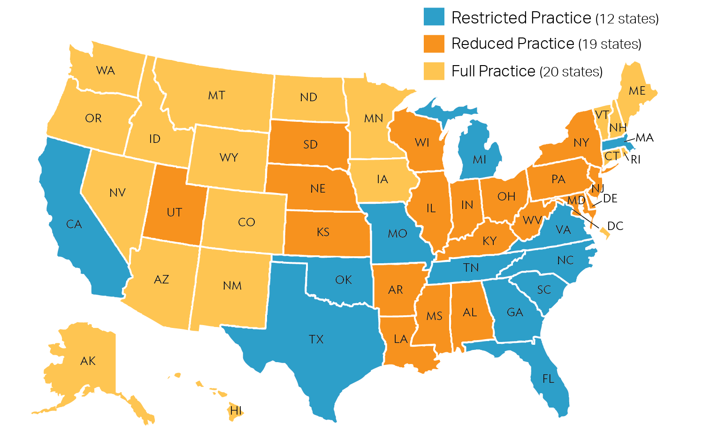
Exhibit 9.2: Nurse practitioner state practice environment, 2014
Note: States are defined primarily based on laws governing requirements surrounding physician collaboration and supervision.
Source: American Association of Nurse Practitioners

Slide 44
Exhibit 10.1: Distribution of Massachusetts and U.S. discharge destination by payer, all DRGs, 2012
Percentage of patients discharged to each category of care
Note: Institutional includes Skilled Nursing Facility; Short-term hospital; Intermediate Care Facility (ICF); and Another Type of Facility.
Source: HPC analysis of Healthcare Cost and Utilization Project (HCUPs) Massachusetts State Inpatient Database & Nationwide Inpatient Sample Survey, 2012

Slide 45
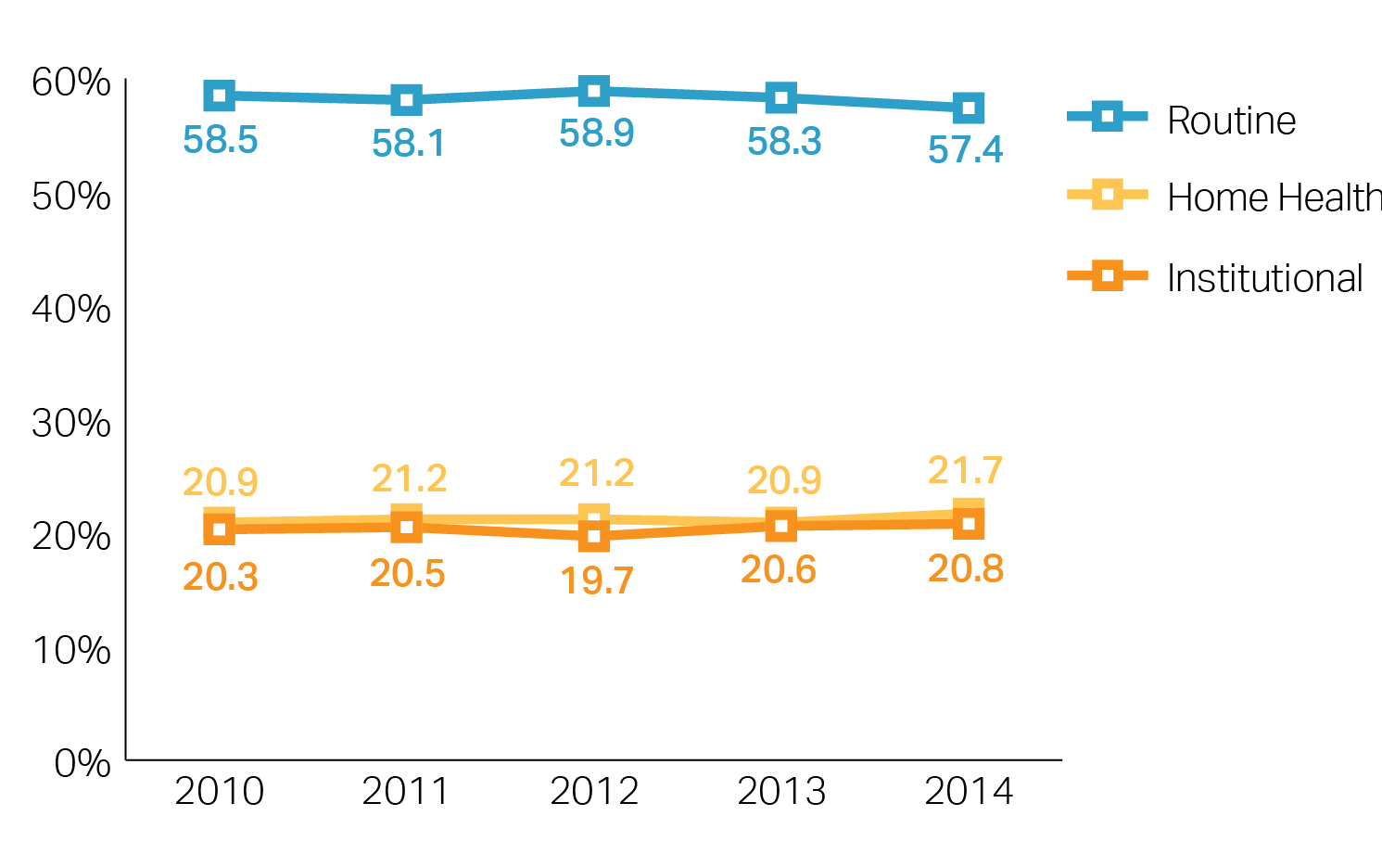
Exhibit 10.2: Adjusted percentage of discharges to post-acute care, all DRGs, 2010-2014
Note: Probabilities adjusted for changes in case mix over time. UMass is excluded due to coding irregularities in the database. Institutional includes skilled nursing facilities, inpatient rehabilitation facilities, and long-term care hospitals.
Source: HPC analysis of Center for Health Information and Analysis Hospital Inpatient Discharge Database, 2014 and Massachusetts Health Data Consortium Inpatient Discharge Database, 2010-2013

Slide 46
Exhibit 10.3: Post-acute care spending for commercial and Medicare enrollees, 2011-2013
Notes: Estimates include PAC utilization through December 31, starting within 60 days of an acute hospital discharge on or after January 1 of the calendar year. Spending includes insurer and enrollee payments for covered services.
Source: HPC analysis of the Massachusetts All-Payer Claims Database, 2011 and 2013

Slide 47
Exhibit 10.4: Discharge destination by payer following joint replacement (DRG 470), Massachusetts and the U.S., 2012
Percentage of discharges to each post-acute care setting
Note: Institutional includes Skilled Nursing Facility; Short-term hospital; Intermediate Care Facility (ICF); Diagnosis-related group (DRG); and Another Type of Facility.
Source: HPC analysis of Healthcare Cost and Utilization Project (HCUPs) Massachusetts State Inpatient Database & Nationwide Inpatient Sample Survey, 2012

Slide 48
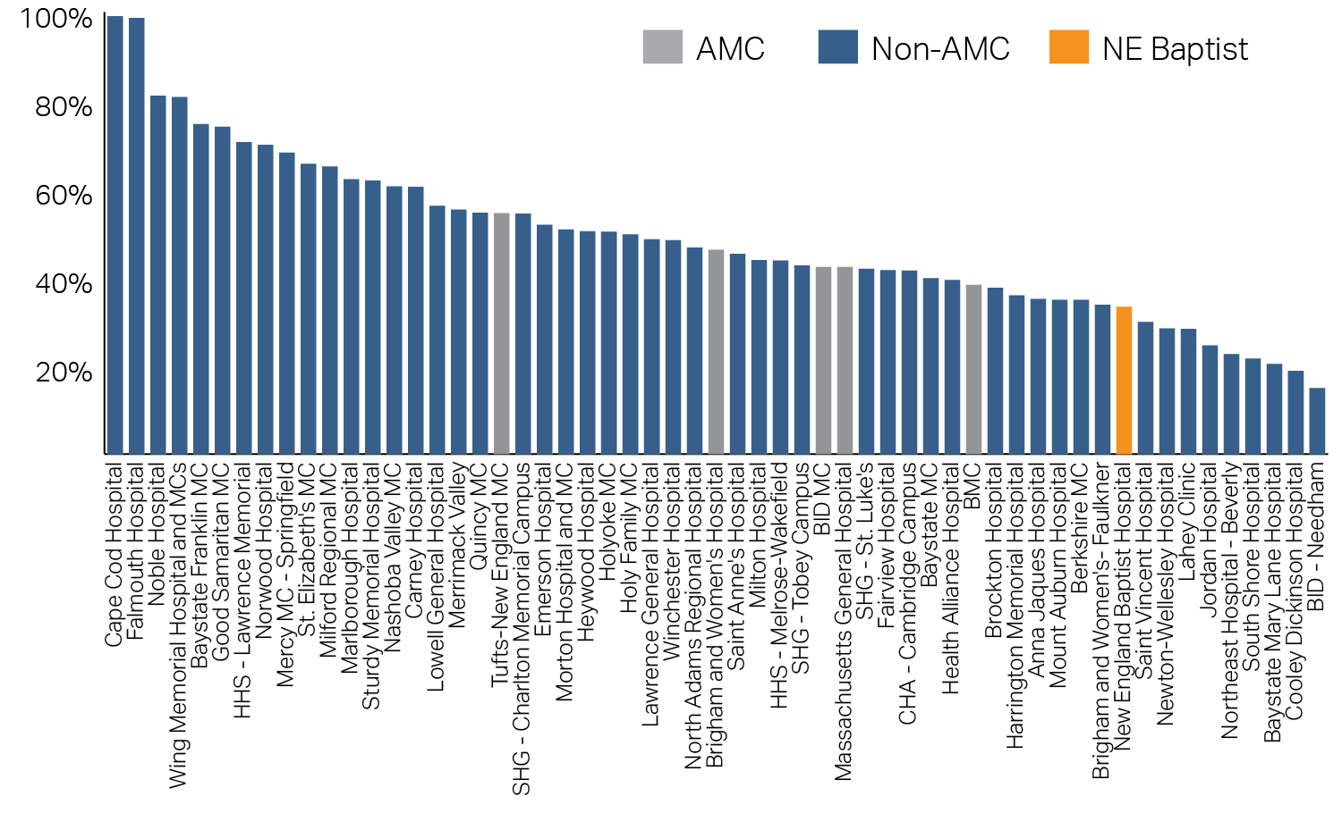
Exhibit 10.5: Percentage of discharges to institutional post-acute care following joint replacement (DRG 470), by hospital, 2014
Adjusted share of discharges to an institutional setting versus home health or routine care
Note: Probabilities for each hospital were calculated after adjusting for the following: age, sex, payer group, income, admission source of the patient, and length of stay. The agency’s sample included only adult patients who were discharged to routine care or some form of PAC. Specialty hospitals, except New England Baptist, were excluded from the display table and the average hospital rate. UMass is excluded due to coding irregularities in the database. Institutional includes skilled nursing facilities, inpatient rehabilitation facilities, and long-term care hospitals. DRG= diagnosis-related group; NE Baptist= New England Baptist; AMC= Academic Medical Center (see Technical Appendix).
Source: HPC analysis of Center for Health Information and Analysis Hospital Inpatient Discharge Database, 2014

Slide 49
Exhibit 10.6: Discharge destination of patients following joint replacement (DRG 470), 2010-2014
Percentage discharged to each setting
Note: UMass is excluded due to coding irregularities in the database. Institutional includes skilled nursing facilities, inpatient rehabilitation facilities, and long-term care hospitals.
Source: HPC analysis of Center for Health Information and Analysis Hospital Inpatient Discharge Database, 2014 and Massachusetts Health Data Consortium Inpatient Discharge Database, 2010-2013

Slide 50
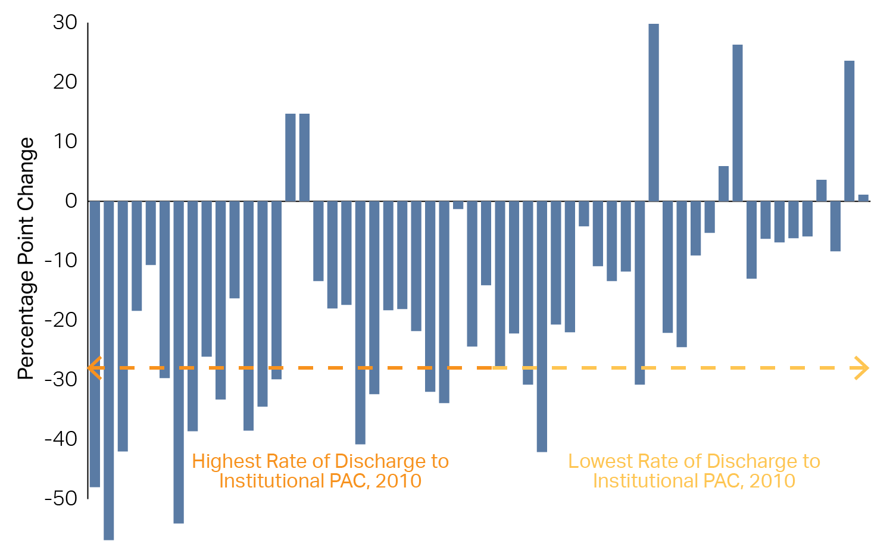
Exhibit 10.7: Change in percentage of discharges to institutional post-acute care following joint replacement (DRG 470), by hospital, from 2010 to 2014
Percentage point change
Note: Hospitals ranked by rate of institutional PAC use in 2010. Hospitals with fewer than 15 joint replacement discharges in 2010 were excluded. Probabilities for each hospital were calculated after adjusting for the following: age, sex, payer group, income, admission source of the patient, and length of stay. The agency’s sample included only adult patients who were discharged to routine care or some form of PAC. Specialty hospitals, except New England Baptist, were excluded. UMass is excluded due to coding irregularities in the database. Institutional includes skilled nursing facilities, inpatient rehabilitation facilities, and long-term care hospitals. DRG= diagnosis-related group; (see Technical Appendix).
Source: HPC analysis of Center for Health Information and Analysis Hospital Inpatient Discharge Database, 2014 and Massachusetts Health Data Consortium Inpatient Discharge Database, 2010-2013

Slide 51
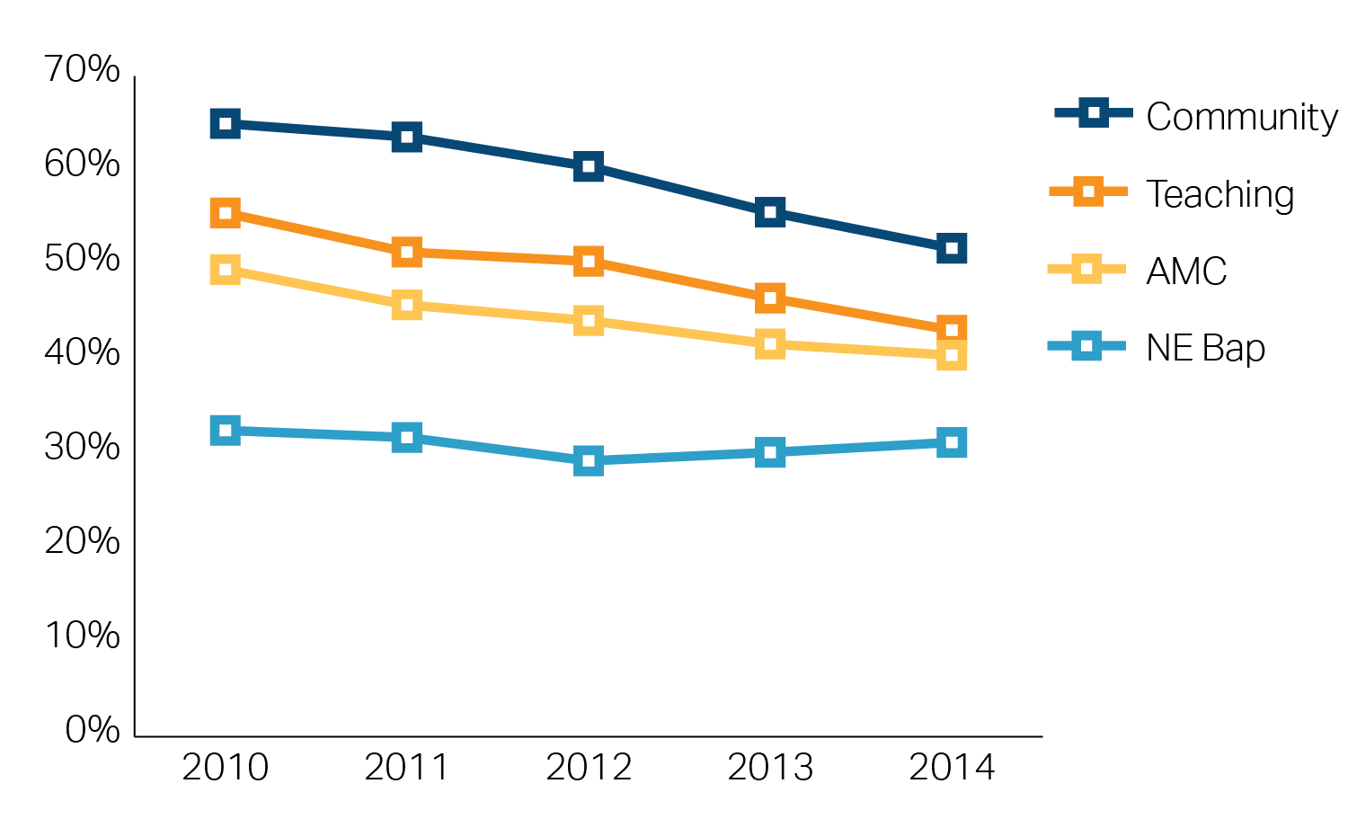
Exhibit 10.8: Percent of patients discharged to institutional post-acute care following joint replacement (DRG 470), by hospital type, 2010-2014
Note: The agency’s sample included only adult patients who were discharged to routine care or some form of PAC. Specialty hospitals, except New England Baptist, were excluded. UMass is excluded due to coding irregularities in the database. Institutional includes skilled nursing facilities, inpatient rehabilitation facilities, and long-term care hospitals. DRG = diagnosis-related group. AMC = academic medical center. NE Bap = New England Baptist. (See Technical Appendix).
Source: HPC analysis of Center for Health Information and Analysis Hospital Inpatient Discharge Database, 2014 and Massachusetts Health Data Consortium Inpatient Discharge Database, 2010-2013

Slide 52
Exhibit 10.9: Post-acute care spending following joint replacement (DRG 470), for commercial and Medicare enrollees, 2011-2013
Note: DRG = diagnosis-related group.
Source: HPC analysis of Massachusetts All-Payer Claims Database, 2011 and 2013

Slide 53
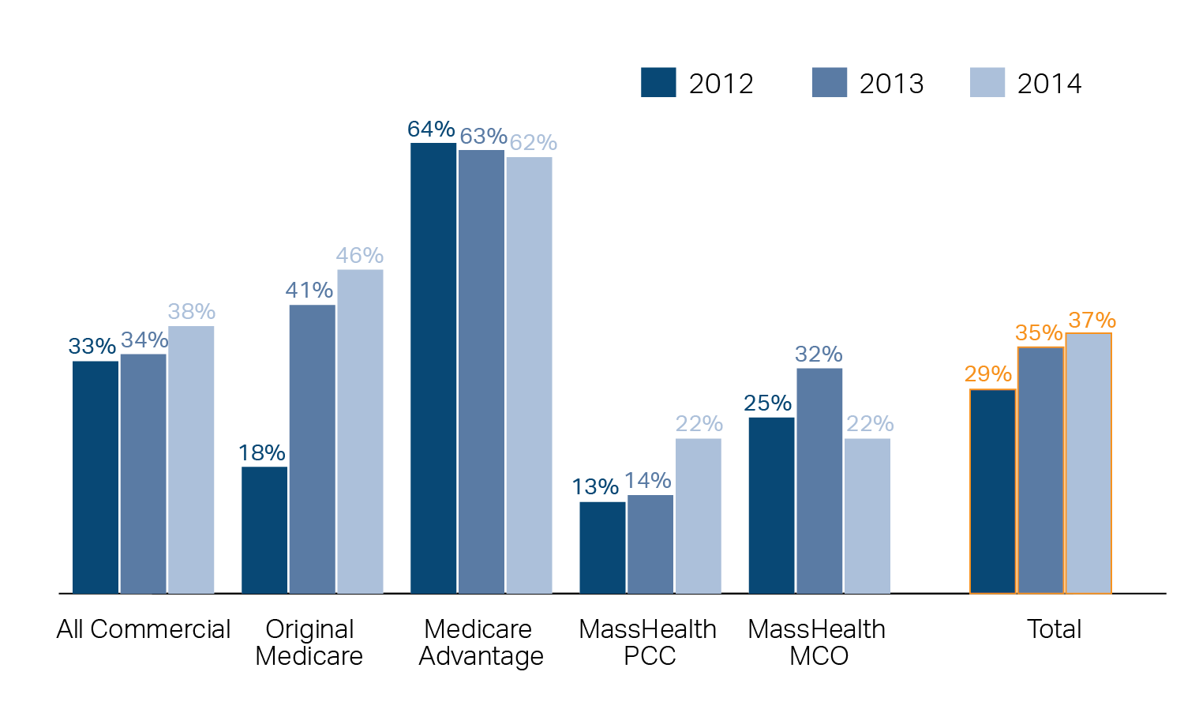
Exhibit 11.1: APM coverage by payer type, 2012-2014
Source: HPC analysis of Center for Health Information and Analysis Annual Report: Alternative Payment Methods Data Book; Centers for Medicare & Medicaid Services, 2012-2014

Slide 54
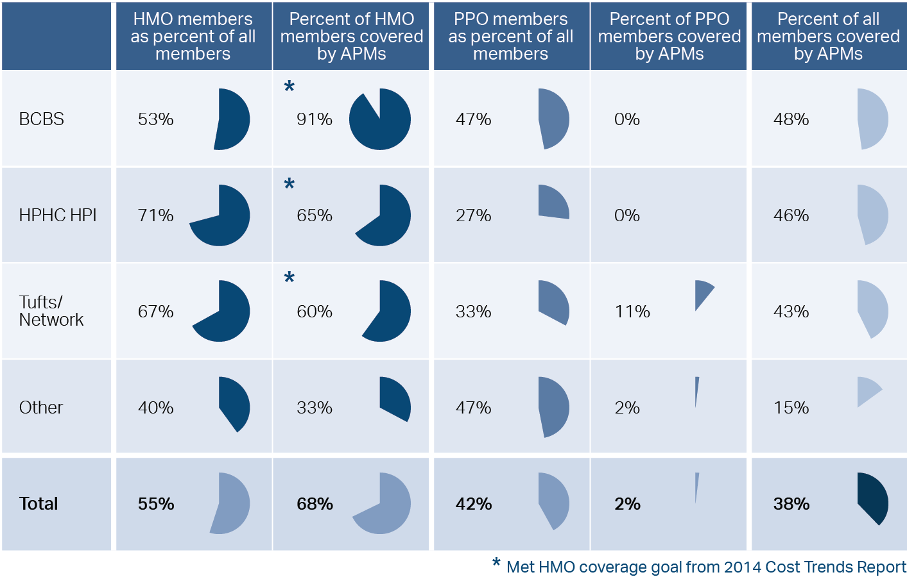
Exhibit 11.2: APM coverage by HMO and PPO, commercial payers, 2014
Source: HPC analysis of Center for Health Information and Analysis Annual Report: Alternative Payment Methods Data Book, 2014

Slide 55
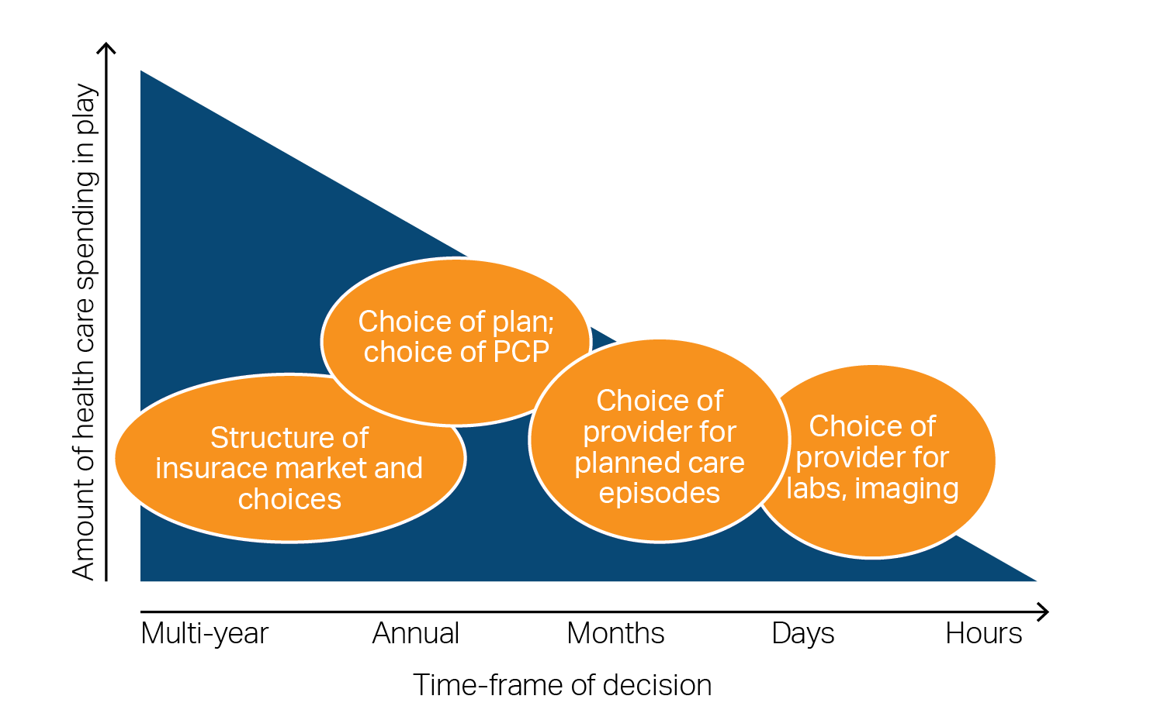
Exhibit 12.1: A framework for demand-side incentives

Slide 56
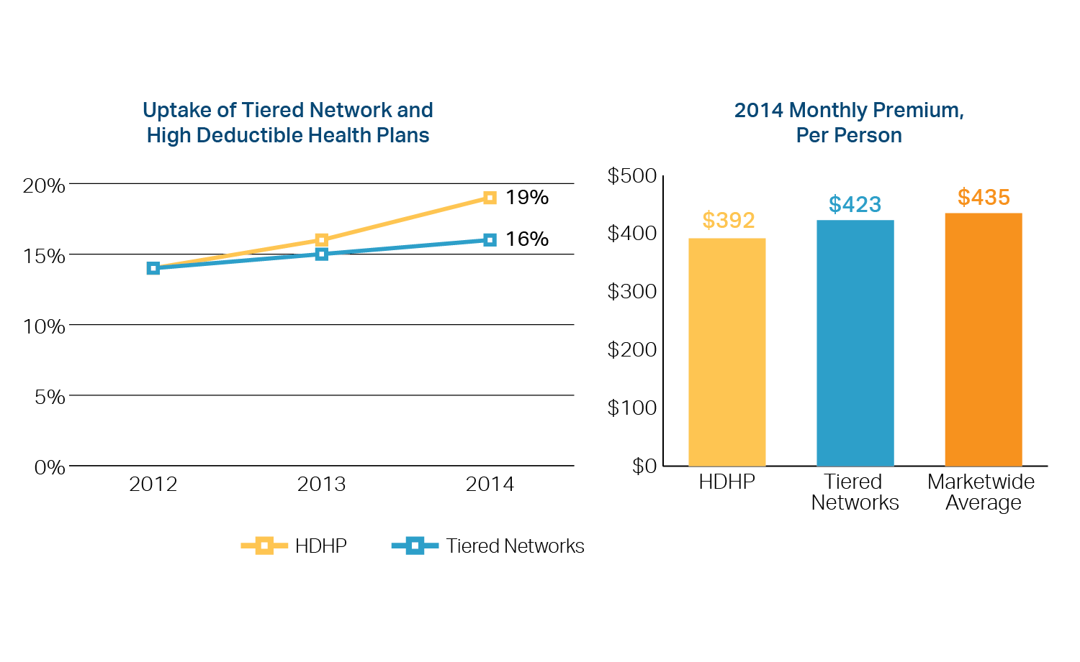
Exhibit 12.2: Tiered and high-deductible products in Massachusetts, 2012-2014
Note: Premiums include fully insured market only and are net of rebates and scaled to account for partial benefits. Market penetration percentages include both fully and self-insured markets.
Source: Center for Health Information and Analysis, 2015

Slide 57
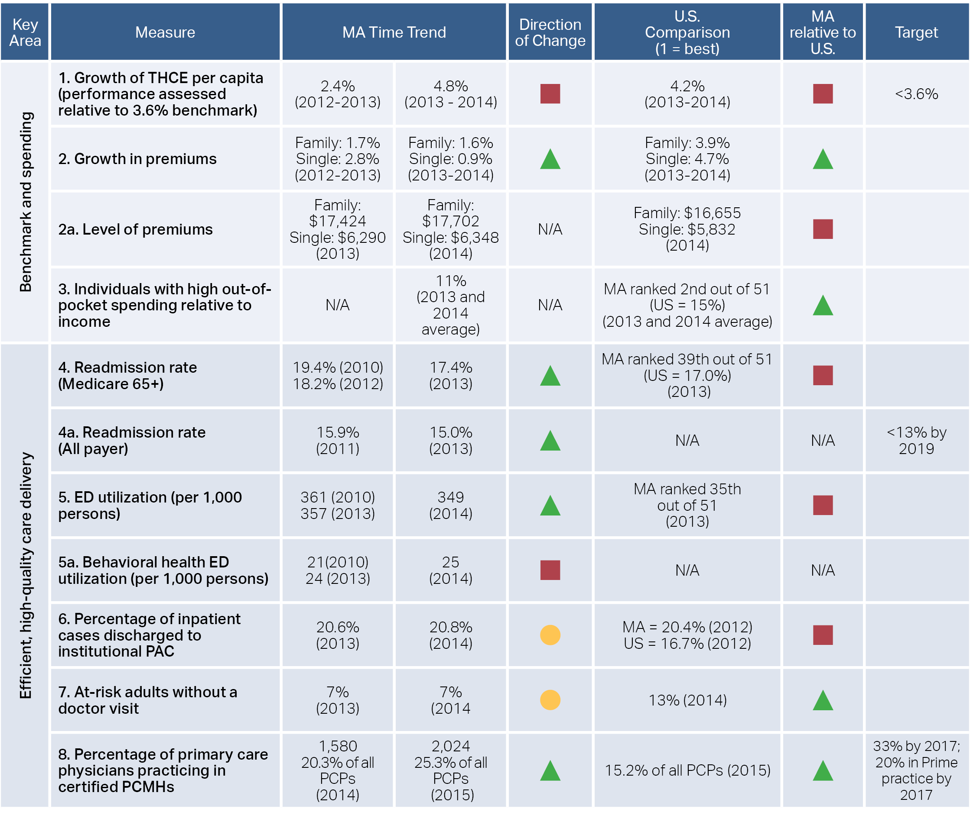
Exhibit 13.1: Dashboard of key HPC system performance metrics
Source: See next slide

Slide 58
Exhibit 13.1: Dashboard of key HPC system performance metrics (continued)
Note: THCE = total health care expenditures; ED = Emergency Department; HMO = health maintenance organization; PPO = preferred provider organization; APM = alternative payment method; PCMH = patient-centered medical home.
Source: Measure 1-MA: Centers for Health Information and Analysis Annual Report, 2015 Measure 1-US: Centers for Medicare and Medicaid Services National Health Expenditure Data, 2013-2014 Measures 2,2a: HPC analysis of Medical Expenditure Panel Survey data, 2012-2014 Measure 3: Commonwealth Fund Scorecard on State Health System Performance, 2015 Measure 4: Institute of Medicine analysis of CMS Medicare Geographic Variation Data Files, 2015 Measure 4a: Center for Health Information and Analysis Hospital-Wide Adult All-Payer Readmissions in Massachusetts: 2011-2013 (Report) Measures 5, 5a-MA: HPC analysis of Center for Health Information and Analysis Emergency Department Data Base , 2010-2014 Measures 5-US and MA comparison: Kaiser Family Foundation State Health Facts, accessed 2015 Measure 6-MA: HPC analysis of Center for Health Information and Analysis Hospital Discharge Database, 2013-2014 Measure 6-US and MA comparison: HPC analysis of HCUP Nationwide Inpatient Sample and State Inpatient Database, 2012 Measure 7: Commonwealth Fund Scorecard on State Health System Performance, 2015 Measure 8: HPC analysis of National Commission on Quality Assurance Clinician Directory and of American Association of Medical Colleges State Physician Workforce Database, 2014-2015 Measure 9: HPC analysis of Centers for Medicare and Medicaid Services ACO performance data , 2013-2014 Measure 10,11: HPC analysis of Center for Health Information and Analysis 2015 Annual Report: 2013-2014 Data Book Measure 12: MassHealth personal communication, 2014 and HPC analysis of Center of Health Information and Analysis 2015 Annual Report: 2013-2014 Data Book Measure 13: HPC analysis of Center for Health Information and Analysis 2015 Annual Report: 2013-2014 Data Book Measure 14: HPC analysis of Center for Health Information and Analysis Hospital Discharge Database , 2012-2014 Measure 15: HPC analysis of Center for Health Information and Analysis Relative Price Data Book, 2009-2014.

