Slide 1
List of figures in 2013 cost trends report by the Health Policy Commission
Figure A: State budgets for health care coverage and other priorities – FY01 vs. FY14
Figure 1.1: Personal health care expenditures relative to size of economy
Figure 1.2: Per capita personal health care expenditures compared to U.S. and other states
Figure 1.3: Per capita personal health care expenditures by category of service compared to U.S.
Figure 1.4: Per beneficiary personal health care expenditures by payer type compared to U.S.
Figure 1.5: Personal health care expenditures relative to size of economy
Figure 1.6: U.S. growth in personal health care expenditures in excess of economic growth
Figure 1.7: Discharges in Massachusetts hospital systems, 2002-2012
Figure 1.8: Prevalence of diabetes by region among Medicare beneficiaries
Figure 1.9: Prevalence of diabetes by region among commercial members
Figure 2.1: Inpatient operating expenses per discharge for all Massachusetts acute hospitals
Figure 2.2: Inpatient operating expenses per discharge for major teaching hospitals in Massachusetts
Figure 2.3: Quality performance relative to inpatient operating expenses per admission: excess readmission ratio
Figure 2.4: Quality performance relative to inpatient operating expenses per admission: mortality rate
Figure 2.5: Quality performance relative to inpatient operating expenses per admission: process-of-care measures
Figure 2.6: Aggregate U.S. hospital payment-to-cost ratios for commercial payers, Medicare, and Medicaid
Figure 2.7: Illustrative examples of margin differences driven by prices and operating expenses
Figure 2.8: Operating margins by payer type for hospitals at different operating expense levels
Figure 2.9: Breakdown of hospital operating expenses
Figure 3.1: Readmissions within 30 days for acute myocardial infarction for Massachusetts acute hospitals
Figure 3.2: Readmissions within 30 days for heart failure for Massachusetts acute hospitals
Figure 3.3: Readmissions within 30 days for pneumonia for Massachusetts acute hospitals
Figure 4.1: Persistence among high-cost Medicare and commercial patients in Massachusetts
Figure 4.2: Prevalence of multiple conditions among Medicare and commercial populations
Figure 4.3: Average spending per patient based on behavioral health and chronic condition comorbidities
Figure 4.4: Concentration of commercial high-cost patients
Figure 4.5: Concentration of Medicare high-cost patients
Figure 4.6: Concentration of commercial persistent high-cost patients
Figure 4.7: Concentration of Medicare persistent high-cost patients

Slide 2
Figure A: State budgets for health care coverage and other priorities - FY01 vs. FY14
Billions of dollars
+$5.4B
(+37%)
FY01
FY14
$15B
-$3.6B
(-17%)
$12B
$9B
-12.2%
$6B
-11.1%
-14.0%
-13.2%
$3B
-50.5%
-22.2%
-31.1%
$0B
GIC, MassHealth, and other coverage
Mental Health
Public Health
Education
Human Services
Infrastructure, Housing & Economic Development
Law & Public Safety
Local Aid
Note: Figures all adjusted for GDP growth
Source: Massachusetts Budget and Policy Center

Slide 3
Figure 1.1: Personal health care expenditures* relative to size of economy
Percent of respective economy†
MA (CMS NHE)
U.S.
MA (estimated)‡
15.2%
12.8%
12.3%
* Personal health care expenditures (PHC) are a subset of national health expenditures. PHC excludes administration and the net cost of private insurance, public health activity, and investment in research, structures and equipment.
† Measured as gross domestic product (GDP) for the U.S. and gross state product (GSP) for Massachusetts.
‡ CMS state-level personal health care expenditure data have only been published through 2009. 2010-2012 MA figures were estimated based on 2009-2012 expenditure data provided by CMS for Medicare, ANF budget information statements and expenditure data from MassHealth, and CHIA TME reports for commercial payers.
Source: Centers for Medicare & Medicaid Services; Bureau of Economic Analysis; Center for Health Information and Analysis; MassHealth; Census Bureau; HPC analysis

Slide 4
Figure 1.2: Per capita personal health care expenditures* compared to U.S. and other states
Dollars, 2009
36%
U.S.
MA
NY
PA
OH
IL
CA
TX
* Personal health care expenditures (PHC) are a subset of national health expenditures. PHC excludes administration and the net cost of private insurance, public health activity, and investment in research, structures and equipment.
Source: Centers for Medicare & Medicaid Services; Bureau of Economic Analysis; HPC analysis

Slide 5
Figure 1.3: Per capita personal health care expenditures* by category of service compared to U.S.
Dollars, 2009
Total expenditures
MA expenditures relative to U.S.
$2,463
per capita difference
$9,278
$6,815
+$1,030
+$771
MA
+$580
U.S.
+$77
+$5
Personal health care expenditures*
Hospital care
Long-term care and home health†
Professional services‡
Drugs and other medical non-durables
Medical durables
Percent of total difference | 42% | 31% | 24% | 3% | <1%
* Personal health care expenditures (PHC) are a subset of national health expenditures. PHC excludes administration and the net cost of private insurance, public health activity, and investment in research, structures and equipment.
† Includes nursing home care, home health care, and other health, residential, and professional care
‡ Includes physician and clinical services, dental services, and other professional services
Source: Centers for Medicare & Medicaid Services; HPC analysis

Slide 6
Figure 1.4: Per beneficiary personal health care expenditures* by payer type compared to U.S.
Dollars, 2009
+9%
U.S.
MA
+21%
Medicare
Medicaid
* Personal health care expenditures (PHC) are a subset of national health expenditures. PHC excludes administration and the net cost of private insurance, public health activity, and investment in research, structures and equipment.
Source: Centers for Medicare & Medicaid Services; HPC analysis

Slide 7
Figure 1.5: Personal health care expenditures* relative to size of economy
Percent of respective economy†
MA (CMS NHE)
U.S.
MA (estimated)‡
15.2%
12.8%
12.3%
* Personal health care expenditures (PHC) are a subset of national health expenditures. PHC excludes administration and the net cost of private insurance, public health activity, and investment in research, structures and equipment.
† Measured as gross domestic product (GDP) for the U.S. and gross state product (GSP) for Massachusetts.
‡ CMS state-level personal health care expenditure data have only been published through 2009. 2010-2012 MA figures were estimated based on 2009-2012 expenditure data provided by CMS for Medicare, ANF budget information statements and expenditure data from MassHealth, and CHIA TME reports for commercial payers.
Source: Centers for Medicare & Medicaid Services; Bureau of Economic Analysis; Center for Health Information and Analysis; MassHealth; Census Bureau; HPC analysis

Slide 8
Figure 1.6: U.S. growth in personal health care expenditures* in excess of economic growth
Percentage points of health care expenditure growth minus GDP growth
Nixon Executive Order freezing prices and wages
Health care industry voluntary effort on cost containment
Introduction of Medicare DRG payment system
Rise of managed care plans
* Personal health care expenditures (PHC) are a subset of national health expenditures. PHC excludes administration and the net cost of private insurance, public health activity, and investment in research, structures and equipment.
Source: Centers for Medicare & Medicaid Services; Bureau of Economic Analysis; HPC analysis

Slide 9
Figure 1.7: Discharges in Massachusetts hospital systems, 2002-2012
Percent of discharges
Medicare discharges
All-payer discharges
Major teaching hospitals*
40%
of Medicare discharges in Massachusetts were in major teaching hospitals* in 2011
Other hospitals in systems with major teaching hospitals
Other hospitals not in systems with major teaching hospitals
100
100
16%
of Medicare discharges nationwide were in major teaching hospitals* in 2011
68%
60%
43
47
2002
2012†
* Major teaching hospitals are defined as those with at least 25 residents per 100 beds.
† Based on systems in 2012. Does not include impact of Cooley Dickinson Hospital with Partners HealthCare System and Jordan Hospital with Beth Israel Deaconess Medical Center transactions completed in 2013.
Source: Center for Health Information and Analysis; Medicare Payment Advisory Commission; HPC analysis

Slide 10
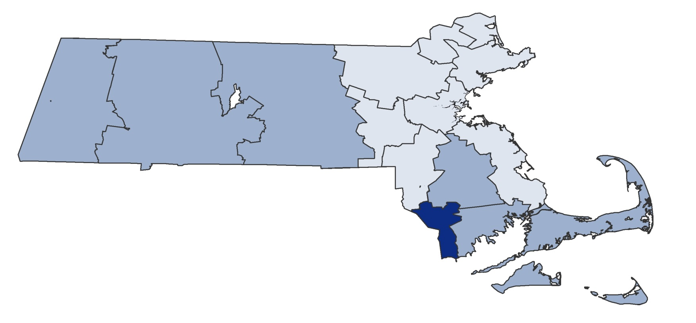
Figure 1.8: Prevalence of diabetes by region among Medicare beneficiaries
Medicare prevalence rate
Over 26.7% prevalence
Below 21.7% prevalence
Between 21.7% and 26.7% prevalence
Source: All-Payer Claims Database; HPC analysis.

Slide 11
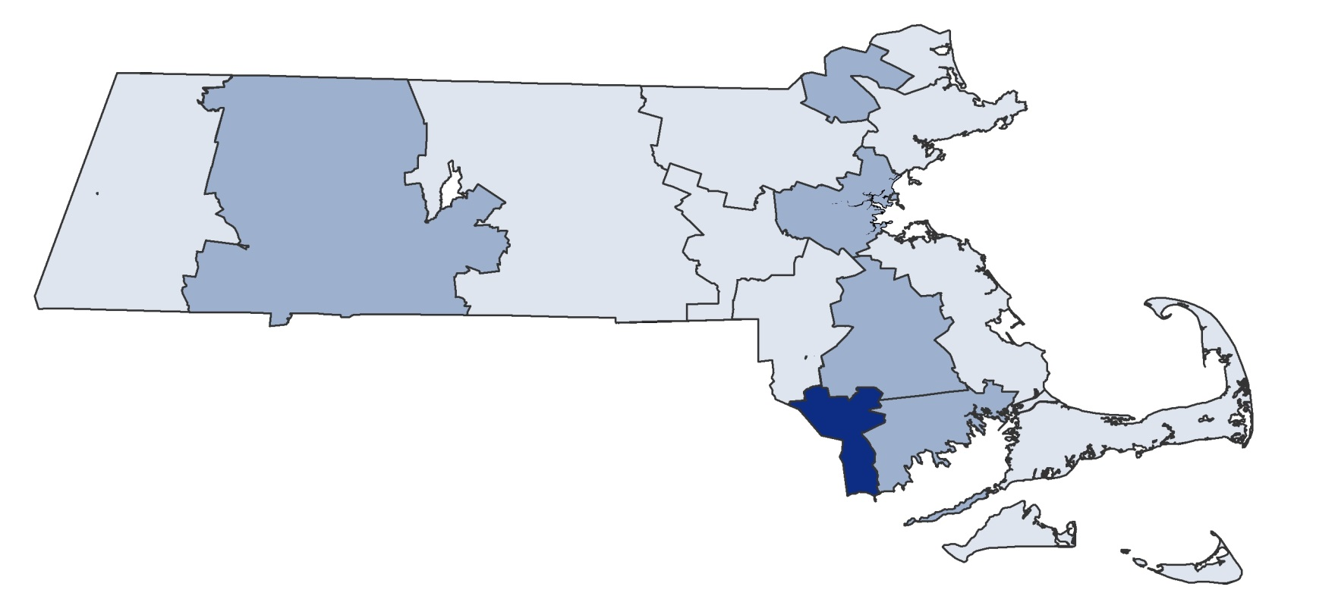
Figure 1.9: Prevalence of diabetes by region among commercial members
Commercial prevalence rate
Over 5.7% prevalence
Below 3.7% prevalence
Between 3.7% and 5.7% prevalence
Source: All-Payer Claims Database; HPC analysis

Slide 12
Figure 2.1: Inpatient operating expenses per discharge* for all Massachusetts acute hospitals
Dollars per case mix- and wage-adjusted discharge, 2012
23%
Highest:
$19,127
Expense difference between 25th and 75th percentiles
75th percentile:
$10,032
Median:
$9,053
25th percentile:
$8,157
Lowest:
$6,545
All acute hospitals
* Inpatient patient service expenses divided by inpatient discharges. Adjusted for hospital case mix index (CHIA 2011) and area wage index (CMS 2012).
Source: Center for Health Information and Analysis; Centers for Medicare & Medicaid Services; HPC analysis

Slide 13
Figure 2.2: Inpatient operating expenses per discharge* for major teaching hospitals in Massachusetts
Dollars per case mix- and wage-adjusted discharge, 2012
35%
Expense difference between 25th and 75th percentiles
Highest:
$14,395
75th percentile:
$11,933
Median:
$10,083
25th percentile:
$8,826
Lowest:
$8,146
Major teaching hospitals
* Inpatient patient service expenses divided by inpatient discharges. Adjusted for hospital case mix index (CHIA 2011) and area wage index (CMS 2012).
Source: Center for Health Information and Analysis; Centers for Medicare & Medicaid Services; HPC analysis

Slide 14
Figure 2.3: Quality performance relative to inpatient operating expenses per admission: excess readmission ratio
Excess readmission ratio versus dollars per case mix-adjusted discharge*
Median performance
60% above median
Lower efficiency
U.S. average performance
Inpatient operating expenses per discharge*
Median expenses
60% below median
Higher efficiency
60% worse than median
Excess readmission ratio†
60% better than median
* 2012 inpatient patient service expenses divided by inpatient discharges. Adjusted for hospital case mix index (CHIA 2011) and area wage index (CMS 2012).
† Composite of risk-standardized 30-day Medicare excess readmission ratios for acute myocardial infarction, heart failure, and pneumonia (2009-2011). The composite rate is a weighted average of the three condition-specific rates.
Source: Center for Health Information and Analysis; Center for Medicare & Medicaid Services; HPC analysis

Slide 15
Figure 2.4: Quality performance relative to inpatient operating expenses per admission: mortality rate
Composite mortality rate versus dollars per case mix-adjusted discharge*
Median performance
60% above median
Lower efficiency
Inpatient operating expenses per discharge*
Median expenses
U.S. average performance
60% below median
Higher efficiency
60% worse than median
Composite mortality rate†
60% better than median
* 2012 inpatient patient service expenses divided by inpatient discharges. Adjusted for hospital case mix index (CHIA 2011) and area wage index (CMS 2012).
† Composite of risk-standardized 30-day Medicare mortality rates for acute myocardial infarction, heart failure, and pneumonia (2009-2011). For each condition, mortality rates were normalized so that the Massachusetts average was 1.0. The composite mortality rate is a weighted average of the three normalized, condition-specific mortality rates.
Source: Center for Health Information and Analysis; Center for Medicare & Medicaid Services; HPC analysis

Slide 16
Figure 2.5: Quality performance relative to inpatient operating expenses per admission: process-of-care measures
Composite of process-of-care measures versus dollars per case mix-adjusted discharge*
Median performance
60% above median
Lower efficiency
100% adherence to process-of-care measures
Inpatient operating expenses per discharge*
Median expenses
60% below median
Higher efficiency
60% worse than median
Composite score on process-of-care measures†
60% better than median
* 2012 inpatient patient service expenses divided by inpatient discharges. Adjusted for hospital case mix index (CHIA 2011) and area wage index (CMS 2012).
† Average across 10 process-of-care measures (CMS 2012): SCIP-Inf-1; SCIP-Inf-2; SCIP-Inf-3; SCIP-Inf-9; SCIP-Inf-10; AMI 2; AMI 8-a; PN 6; HF 2; and HF 3. Detail on measures available in Technical Appendix A2: Hospital Operating Expenses.
Source: Center for Health Information and Analysis; Center for Medicare & Medicaid Services; HPC analysis

Slide 17
Figure 2.6: Aggregate U.S. hospital payment-to-cost ratios for commercial payers, Medicare, and Medicaid*
Percent of total expenses, 2011
Commercial
Medicaid
Medicare
* Medicaid and Medicare figures include Disproportionate Share payments.
Source: Avalere Health analysis of American Hospital Association Annual Survey data, 2011, for community hospitals

Slide 18
Figure 2.7: Illustrative examples of margin differences driven by prices and operating expenses
ILLUSTRATION: SAME OPERATING EXPENSES, DIFFERENT PRICES
Prices | Operating expenses | Margins
Prices | Operating expenses | Margins
ILLUSTRATION: SAME PRICES, DIFFERENT OPERATING EXPENSES
12
Prices | Operating expenses | Margins
Prices | Operating expenses | Margins

Slide 19
Figure 2.8: Operating margins by payer type for hospitals at different operating expense levels
Operating income as proportion of net patient service revenue*, 2012
Medicare
Commercial
Lowest quintile operating expenses
2nd quintile
3rd quintile
4th quintile
Highest quintile operating expenses
Operating expenses per discharge†
$7,559 | $8,287 | $9,011 | $9,871 | $12,090
* Operating income defined as total net patient service revenue less total patient service expenses. Payer-specific expenses are estimated by applying hospital-specific cost-to-charge ratios to hospital’s charges by payer.
† 2012 inpatient patient service expenses divided by inpatient discharges. Adjusted for hospital case mix index (CHIA 2011) and area wage index (CMS 2012).
Source: Center for Health Information and Analysis; HPC analysis

Slide 20
Figure 2.9: Breakdown of hospital operating expenses
Percent of expenses by category, 2012
100
Depreciation and amortization
5
Supplies
Labor*
53
* Labor expense category is composed of salaries and benefits, physician compensation paid directly by hospitals, and purchased services.
Source: Center for Health Information and Analysis; HPC analysis

Slide 21
Figure 3.1: Readmissions within 30 days for acute myocardial infarction for Massachusetts acute hospitals
Risk-standardized excess readmission ratio for Medicare beneficiaries by hospital, 2009-2011
Expected
rate (1.0)
Massachusetts acute hospitals
Source: Centers for Medicare & Medicaid Services

Slide 22
Figure 3.2: Readmissions within 30 days for heart failure for Massachusetts acute hospitals
Risk-standardized excess readmission ratio for Medicare beneficiaries by hospital, 2009-2011
Expected
rate (1.0)
Massachusetts acute hospitals
Source: Centers for Medicare & Medicaid Services

Slide 23
Figure 3.3: Readmissions within 30 days for pneumonia for Massachusetts acute hospitals
Risk-standardized excess readmission ratio for Medicare beneficiaries by hospital, 2009-2011
Expected
rate (1.0)
Massachusetts acute hospitals
Source: Centers for Medicare & Medicaid Services

Slide 24
Figure 4.1: Persistence among high-cost Medicare and commercial patients in Massachusetts
Claims-based medical expenditures (excluding pharmacy spending) in 2010 and 2011
2010
2011
MEDICARE
Commercial
Of patients who were high-cost in 2010…
… 29%
of patients remained high-cost in 2011
Medicare
COMMERCIAL
Of patients who were high-cost in 2010…
… 29%
of patients remained high-cost in 2011
Notes: (A) High-cost patients defined as 5% of patients with highest claims-based medical expenditures (excluding pharmacy spending) in a given year.
(B) The sample for analysis was limited to patients who had at least six months of enrollment in both 2010 and 2011 and costs of at least $1 in each year. Figures do not capture pharmacy costs, payments outside the claims system, Medicare cost-sharing, or end-of-life care for patients who died in 2010 or 2011.
Source: All-Payer Claims Database; HPC analysis

Slide 25
Figure 4.2: Prevalence of multiple conditions among Medicare and commercial populations
Number of clinical conditions*, 2010
High-cost patients
2.1x
Rest of population
2.7x
Medicare
Commercial
* Clinical conditions as defined by Lewin's ERG grouper. 23 clinical conditions selected to include common chronic conditions and conditions particularly prevalent among high-cost patients.
Notes: (A) High-cost patients defined as 5% of patients with highest claims-based medical expenditures (excluding pharmacy spending) in a given year.
(B) The sample for analysis was limited to patients who had at least six months of enrollment in both 2010 and 2011 and costs of at least $1 in each year. Figures do not capture pharmacy costs, payments outside the claims system, Medicare cost-sharing, or end-of-life care for patients who died in 2010 or 2011.
Source: All-Payer Claims Database; HPC analysis

Slide 26
Figure 4.3: Average spending per patient based on behavioral health and chronic condition comorbidities
Claims-based medical expenditures (excluding pharmacy spending) relative to average patient with no behavioral health or chronic condition comorbidity in 2010
Average patient with neither comorbidity
Behavioral health* comorbidity
Chronic condition† comorbidity
Both comorbidities
MEDICARE
Commercial
1x
2.2x
7.0x
2.8x
Medicare
COMMERCIAL
1x
1.6x
4.2x
2.1x
* Behavioral health comorbidity includes child psychology, severe and persistent mental illness, mental health, psychiatry, and substance abuse.
† Chronic condition includes arthritis, epilepsy, glaucoma, hemophilia, sickle-cell anemia, heart disease, HIV/AIDS, hyperlipidemia, hypertension, multiple sclerosis, renal, asthma, and diabetes.
Notes: (A) High-cost patients defined as 5% of patients with highest claims-based medical expenditures (excluding pharmacy spending) in a given year.
(B) The sample for analysis was limited to patients who had at least six months of enrollment in both 2010 and 2011 and costs of at least $1 in each year. Figures do not capture pharmacy costs, payments outside the claims system, Medicare cost-sharing, or end-of-life care for patients who died in 2010 or 2011.
Source: All-Payer Claims Database; HPC analysis

Slide 27
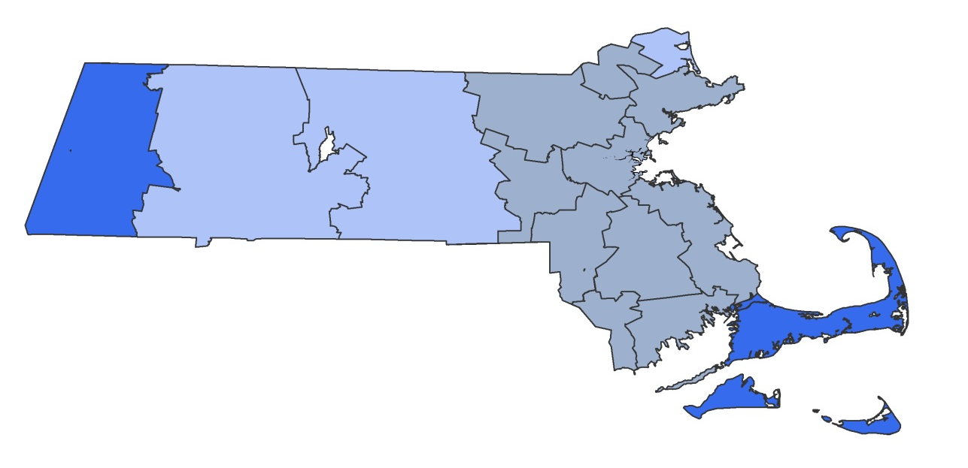
Figure 4.4: Concentration of commercial high-cost patients
Percent difference between region and statewide average, adjusted for age and sex
Greater than +20%
-10% to -20%
+10% to +20%
Less than -20%
±10%
Notes: (A) High-cost patients defined as 5% of patients with highest claims-based medical expenditures (excluding pharmacy spending) in a given year.
(B) The sample for analysis was limited to patients who had at least six months of enrollment in both 2010 and 2011 and costs of at least $1 in each year. Figures do not capture pharmacy costs, payments outside the claims system, Medicare cost-sharing, or end-of-life care for patients who died in 2010 or 2011.
Source: All-Payer Claims Database; HPC analysis

Slide 28
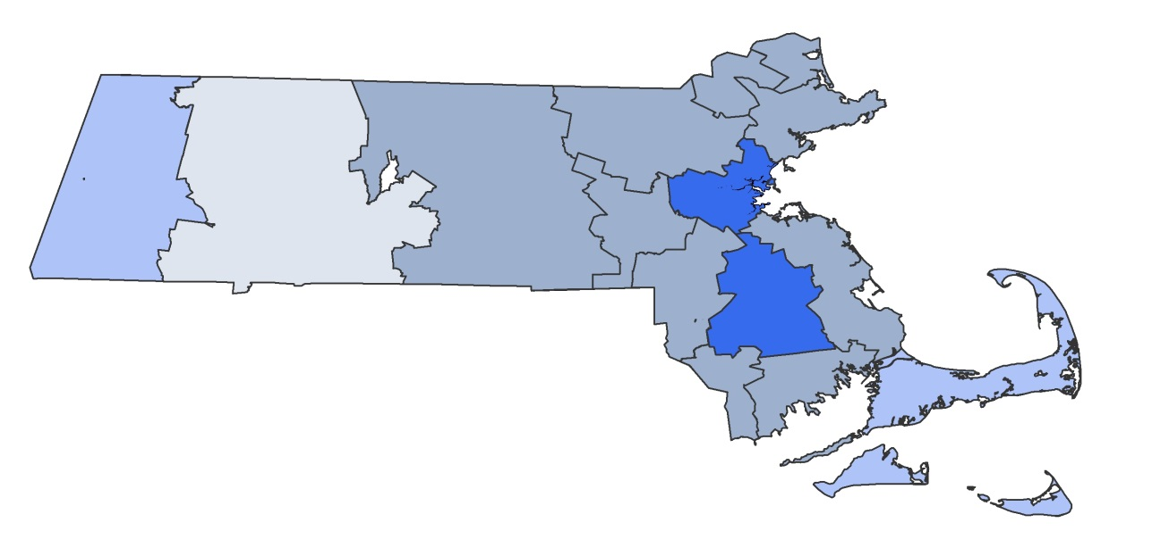
Figure 4.5: Concentration of Medicare high-cost patients
Percent difference between region and statewide average, adjusted for age and sex
Greater than +20%
-10% to -20%
+10% to +20%
Less than -20%
±10%
Notes: (A) High-cost patients defined as 5% of patients with highest claims-based medical expenditures (excluding pharmacy spending) in a given year.
(B) The sample for analysis was limited to patients who had at least six months of enrollment in both 2010 and 2011 and costs of at least $1 in each year. Figures do not capture pharmacy costs, payments outside the claims system, Medicare cost-sharing, or end-of-life care for patients who died in 2010 or 2011.
Source: All-Payer Claims Database; HPC analysis

Slide 29
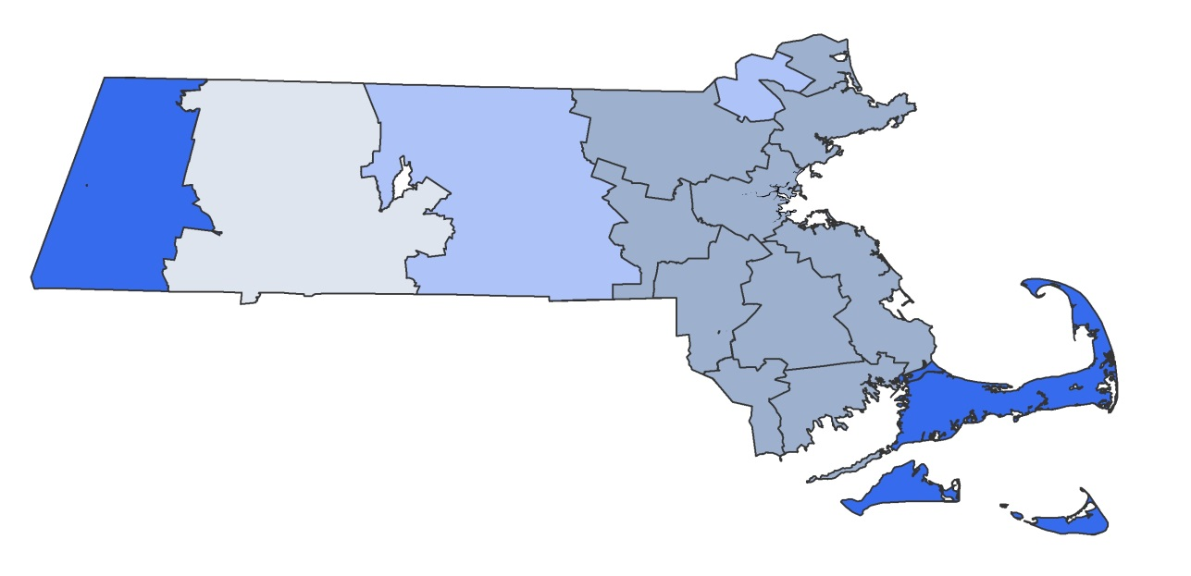
Figure 4.6: Concentration of commercial persistent high-cost patients
Percent difference between region and statewide average, adjusted for age and sex
Greater than +20%
-10% to -20%
+10% to +20%
Less than -20%
±10%
Notes: (A) High-cost patients defined as 5% of patients with highest claims-based medical expenditures (excluding pharmacy spending) in a given year.
(B) The sample for analysis was limited to patients who had at least six months of enrollment in both 2010 and 2011 and costs of at least $1 in each year. Figures do not capture pharmacy costs, payments outside the claims system, Medicare cost-sharing, or end-of-life care for patients who died in 2010 or 2011.
Source: All-Payer Claims Database; HPC analysis

Slide 30
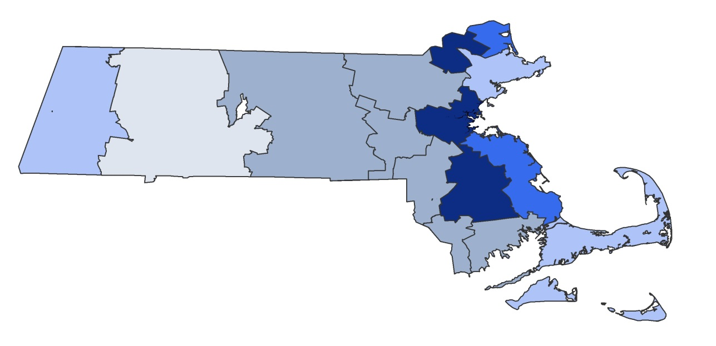
Figure 4.7: Concentration of Medicare persistent high-cost patients
Percent difference between region and statewide average, adjusted for age and sex
Greater than +20%
-10% to -20%
+10% to +20%
Less than -20%
±10%
Notes: (A) High-cost patients defined as 5% of patients with highest claims-based medical expenditures (excluding pharmacy spending) in a given year.
(B) The sample for analysis was limited to patients who had at least six months of enrollment in both 2010 and 2011 and costs of at least $1 in each year. Figures do not capture pharmacy costs, payments outside the claims system, Medicare cost-sharing, or end-of-life care for patients who died in 2010 or 2011.
Source: All-Payer Claims Database; HPC analysis

