Slide 1
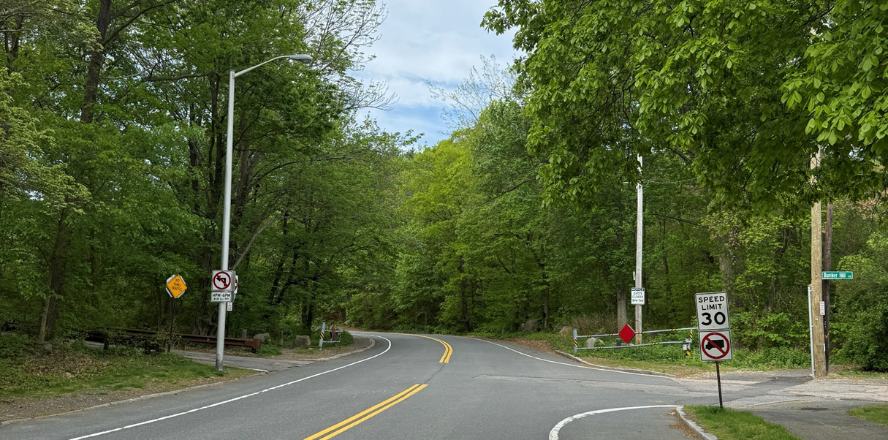
Chickatawbut Road and Wampatuck Road Closure Pilot in Blue Hills Reservation
Public Information Meeting
July 15, 2026 | 6 PM
Zoom
Notes:
Dan introduction

Slide 2
Commonwealth of Massachusetts
Notes:
Dan

Slide 3
DCR Mission and Core Principles
Notes:
Dan

Slide 4
Meeting Logistics
Notes:
Dan

Slide 5
Project Team
DCR
Jason Santos, P.E.
Director of Transportation
Eric Seaborn
Director of Natural Resources
Dan Lynch
Legislative and Partnership Coordinator, Boston Region
Daniel Cushing
Director of Public Engagement
Howard Stein Hudson
Emma Enteado, P.E., RSP1
Traffic Engineer
Nicole Sharma
Community Engagement Specialist
Notes:
Jason

Slide 6
Agenda
Share details of the upcoming road closure pilot with the public.
Project Background
Pilot Closure Details
Next Steps
How to Give Feedback
Q&A
Notes:
Jason

Slide 7
Project Background
Notes:
Jason

Slide 8
Goals
Address safety concerns on weekends.
Improve quality of life for abutters.
Conservation efforts for critically endangered species.
Notes:
Jason
- Primary goals of the pilot

Slide 9
Existing Conditions: Roadway
Community members have reported to local representatives and law enforcement about disturbing late night/early morning activities on Wampatuck and Chickatawbut Roads:
  Speeding/racing
  Loud music and late-night disturbances
  Revving of engines and screeching tires
Notes:
Jason
- Reports of disruptive activity

Slide 10
Existing
Conditions:
Endangered
Species
Mass Wildlife's Natural Heritage and Endangered Species Program reports of fatal strikes of endangered species.
  Blue Hills is one of only a handful of habitats for species.
  Mating season June through early October.
The species is at risk of being hit by vehicles both day and evening.
Notes:
Jason
- DCR’s obligation to protect endangered species that live in Blue Hills Reservation

Slide 11
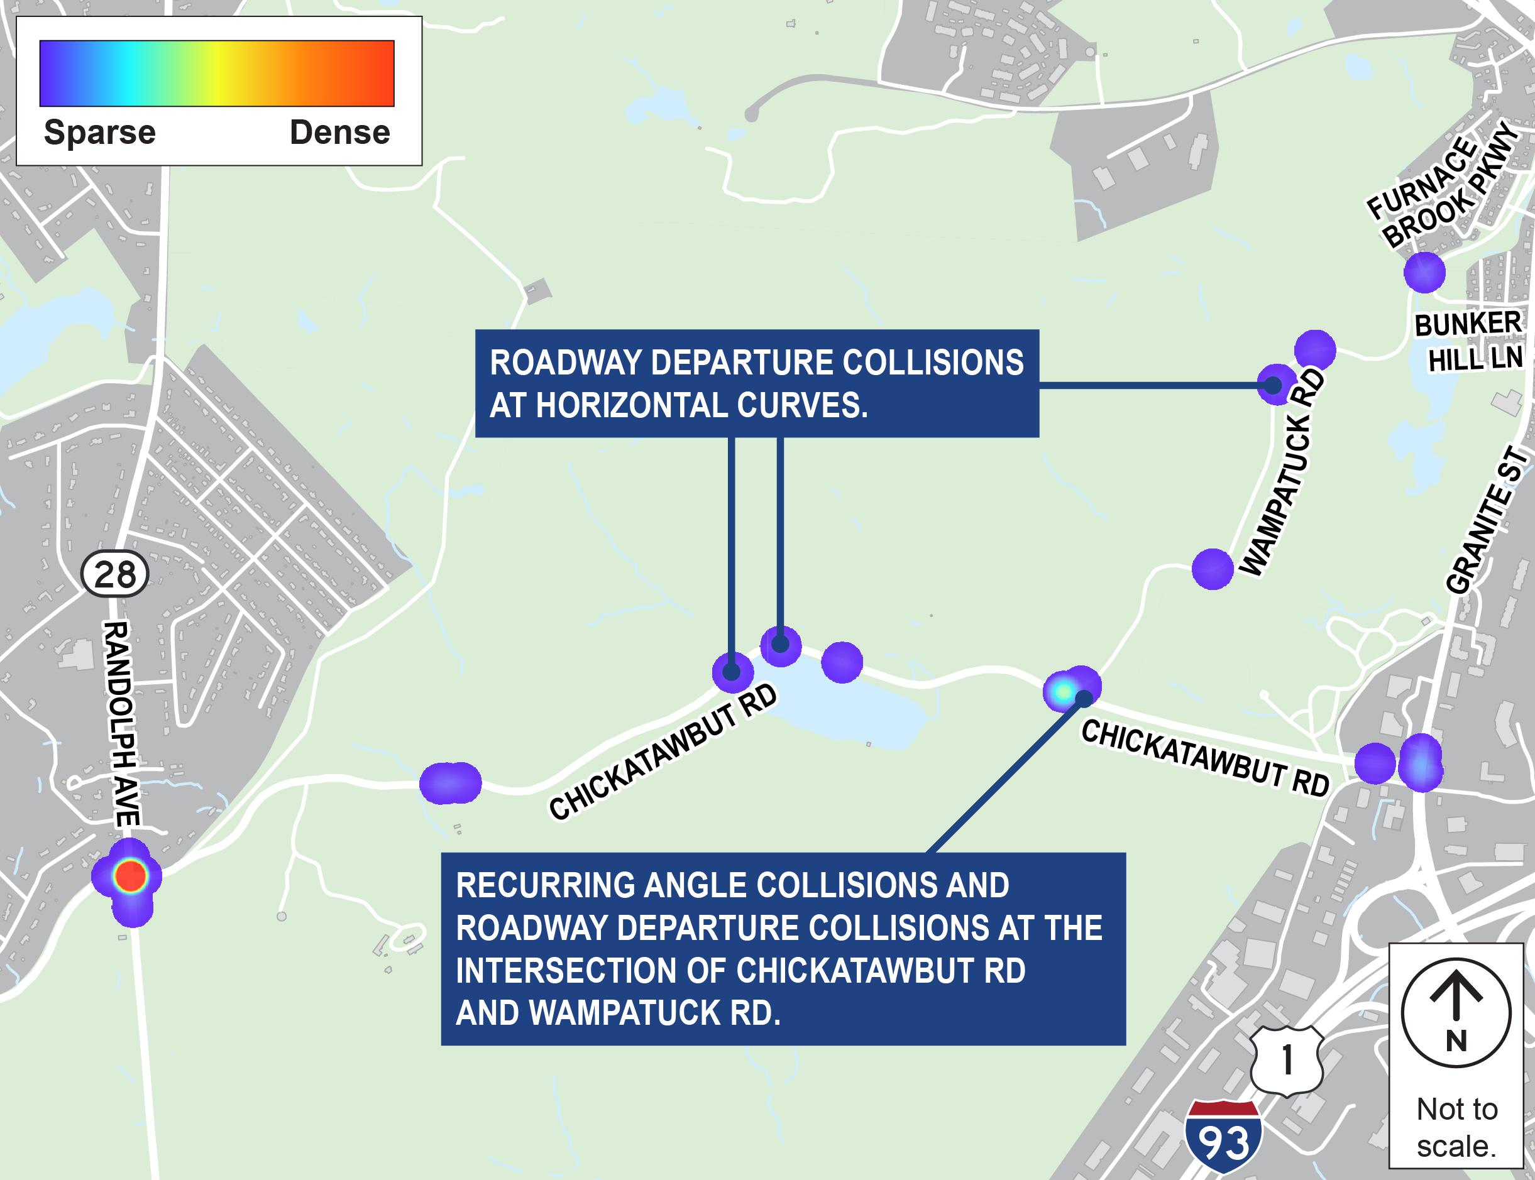
Existing Conditions: Safety
Notes:
Emma
- Speed data indicates a higher number of vehicles exceeding 50 mph on Chickatawbut Road on Saturdays despite lower overall volume, even though the posted speed limit within this area is 30 mph.
- The project team reviewed crashes within the area from 2018 to 2021 and found that the predominant collision type within the area was single vehicle collisions. Reports often indicated that these were associated with a driver losing control of a vehicle and striking a roadside object, which aligns with the speeding concern in the area.

Slide 12
Inter-Agency and Municipal Coordination
This road closure pilot plan has been coordinated with the following groups:
  Legislative Officials
  Public Safety Groups
    Police, Fire, EMS
  MassDOT
  MassWildlife
  Surrounding Municipality Representatives
  Massachusetts Water Resources Authority
  Mass Audubon
Notes:
Jason
- Highlight groups that have been coordinated with leading up to this point

Slide 13
Pilot Closure Details
Notes:
Jason
Provide details on the closure

Slide 14
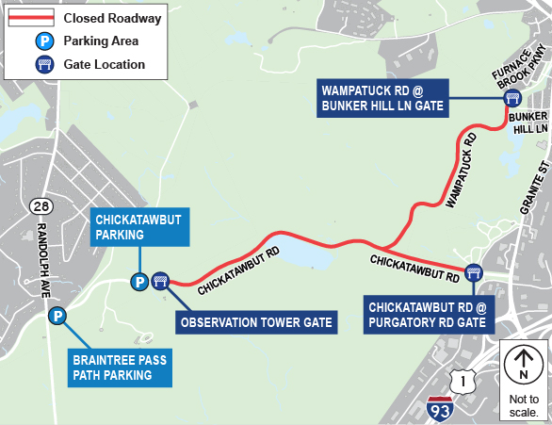
Closure Details
Weekend closure for general vehicular traffic from late July through early September.
  Gate closure begins Friday 5 p.m.
  Gates opened by Sunday 6 p.m.
GPS companies will be notified.
Signs and message boards will be posted ahead of the closure.
Notes:
Jason
The closure will be in effect on weekends from late July to labor day to general vehicle traffic
Gate closure will begin 5 pm on Fridays, and open by 6 pm on Sundays
GPS companies will be notified
Signs and message boards will be posted in advance of the closure to notify those in the area

Slide 15
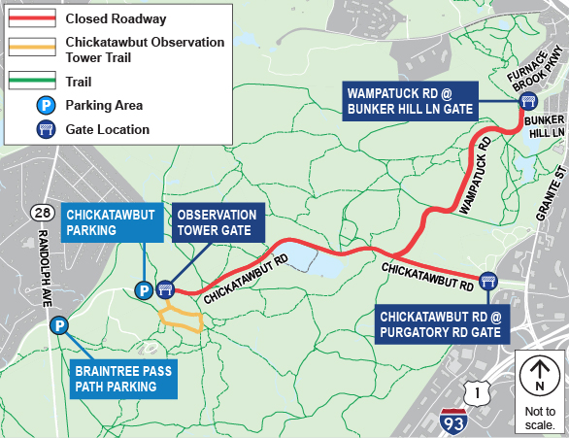
Parking and Trail Access
Hiker, pedestrian, bicyclist, and emergency services access maintained.
Notes:
Jason
Closure maintains access for peds, bikes, hikers
Parking lots remain open
Emergency services will have access to the area and all public safety groups are being given keys

Slide 16
Next Steps
Notes:
Jason

Slide 17
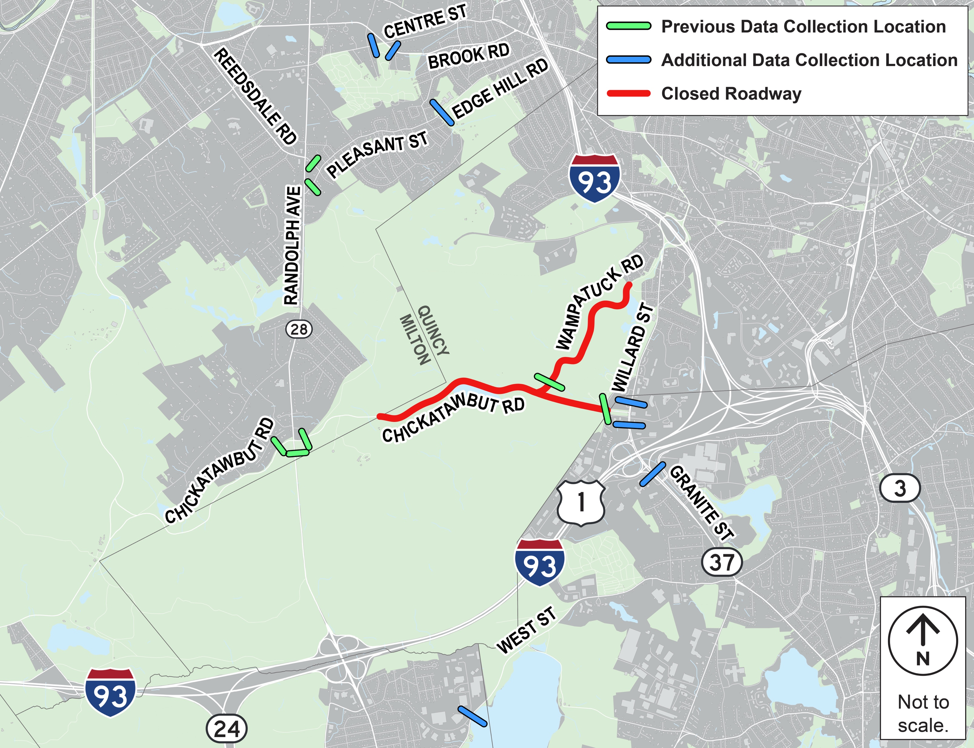
Traffic Counts
Before and during pilot traffic counts at these locations will help measure pilot impacts on surrounding streets.
Notes:
Emma
The team has been reviewing traffic count data in the area, and will be collecting additional data one weekend before the pilot and one weekend during the pilot to inform DCR on the impacts of the closure
The project team will also be collecting travel times on key corridors in the area to compare before and during the pilot to inform DCR on any travel time impacts on the surrounding corridors

Slide 18
Pilot
Evaluation
Coordination with Mass Wildlife on protection efforts of critically endangered species.
Recollect traffic count program to inform pilot detour impacts.
Create open forum for public comments throughout the pilot duration. Analyze key trends in September.
Continued coordination with public safety groups.
Notes:
Jason
Review all the aspects of the pilot evaluation:
Coordination on the conservation efforts
Collect the same traffic count program during the pilot
Public comment forum
Continued traffic monitoring in coordination with MassDOT
Coordination with public safety groups regarding response time

Slide 19
Project Timeline
2025 - 2026
Data collection and analysis
2027
MassDOT to install automated gates
Summer 2026
Pilot
Spring/Summer 2026
Public Safety, Legislative, and Municipality briefings; Public meeting
Fall 2026
Pilot Evaluation
Notes:
Jason
Timeline

Slide 20
How to Give Feedback
Notes:
Jason

Slide 21
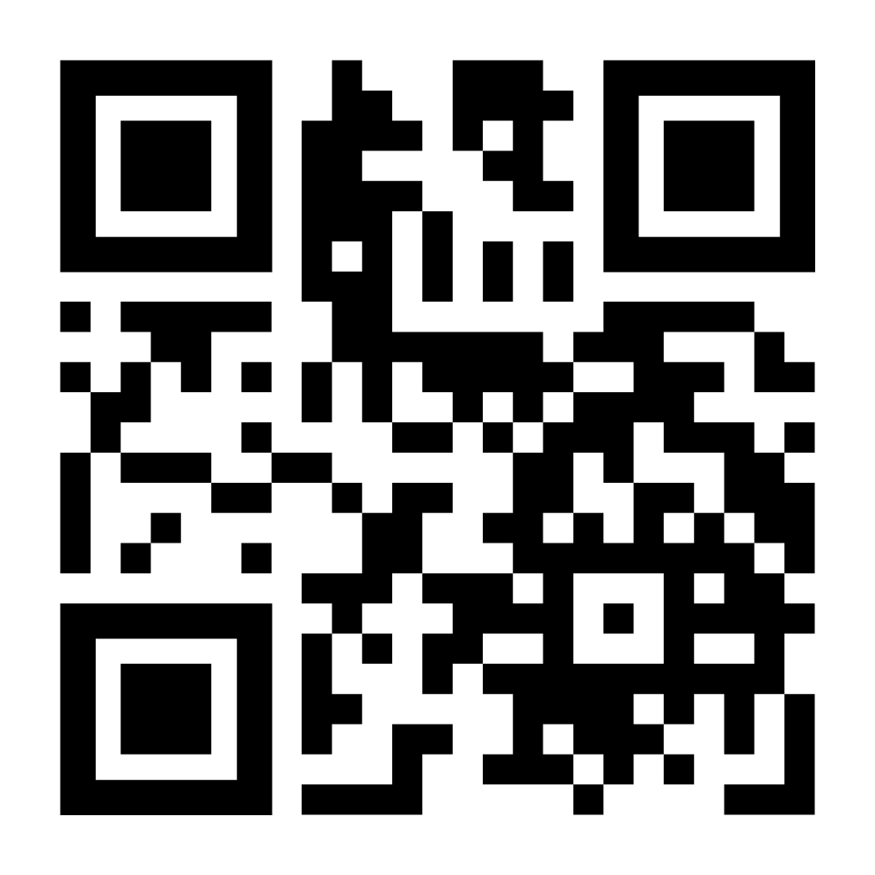
Public Feedback
If you have comments on this project:
Submit online: www.mass.gov/dcr/public-comment
Deadline: Early September
Please note: the contents of comments submitted to DCR, including your name, town and zip code, will be posted on DCR’s website. Additional contact information provided, notably email address, will only be used for outreach on future updates to the subject project or property.
Notes:
Jason
How feedback can be submitted

Slide 22
Chickatawbut Road Closure Pilot
July 15, 2026
Notes:
Dan can field Q&A

Slide 23
Additional Information
Recording and tonight’s slide deck will be available at:
www.mass.gov/dcr/past-public-meetings
If you have comments on this project:
Submit online: www.mass.gov/dcr/public-comment
Deadline: Early September
Please note: the contents of comments submitted to DCR, including your name, town and zip code, will be posted on DCR’s website. Additional contact information provided, notably email address, will only be used for outreach on future updates to the subject project or property.
If you wish to subscribe to a DCR general information or project-related listserv: contact DCR’s Office of Community Relations via email at: mass.parks@mass.gov

