Slide 1
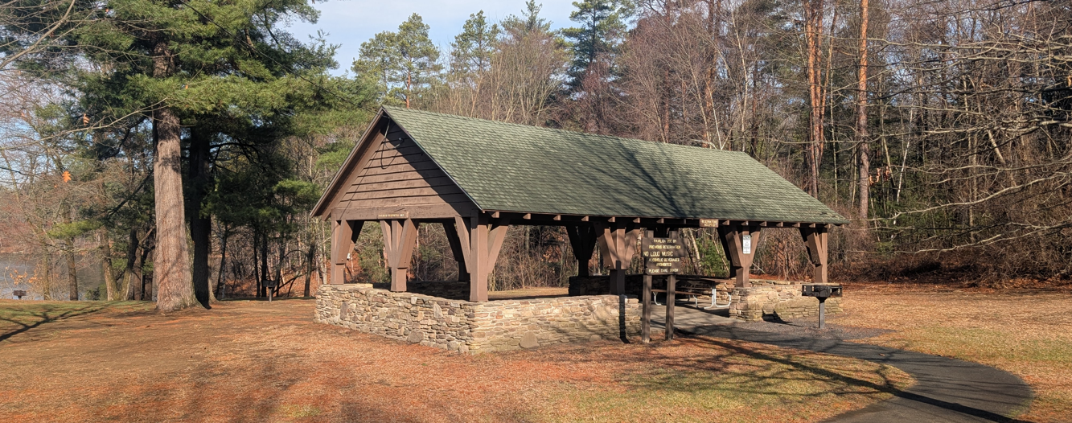
Project Shade | Chicopee Memorial State Park
PUBLIC MEETING 1
June 4, 2024
Notes:
Dan

Slide 2
COMMONWEALTH OF MASSACHUSSETTS
Governor
Maura T. Healey
Lieutenant Governor
Kimberley Driscoll
Energy and Environmental Secretary
Rebecca L. Tepper
Department of Conservation and Recreation Commissioner
Brian Arrigo

Slide 3
DCR MISSION STATEMENT
To protect, promote and enhance our common wealth of natural, cultural and recreational resources for the well-being of all.

Slide 4
MEETING LOGISTICS
You will have the opportunity to submit comments over the course of the next two weeks (June 18, 2025) at:
DCR Public Comments https://www/mass.gov/forms/dcr-public-comments
Two ways to ask questions during the meeting
Use chat feature
Raise your hand: Click “Reaction”, then click “Raise Hand” and you will be given permissions to unmute and speak.
Please note that this public information meeting will be recorded; the recording will be a public record.

Slide 5
AGENDA
Team Introductions
Project Overview
Next steps
Discussion / Q&A
Notes:
Speaker: Ginna

Slide 6
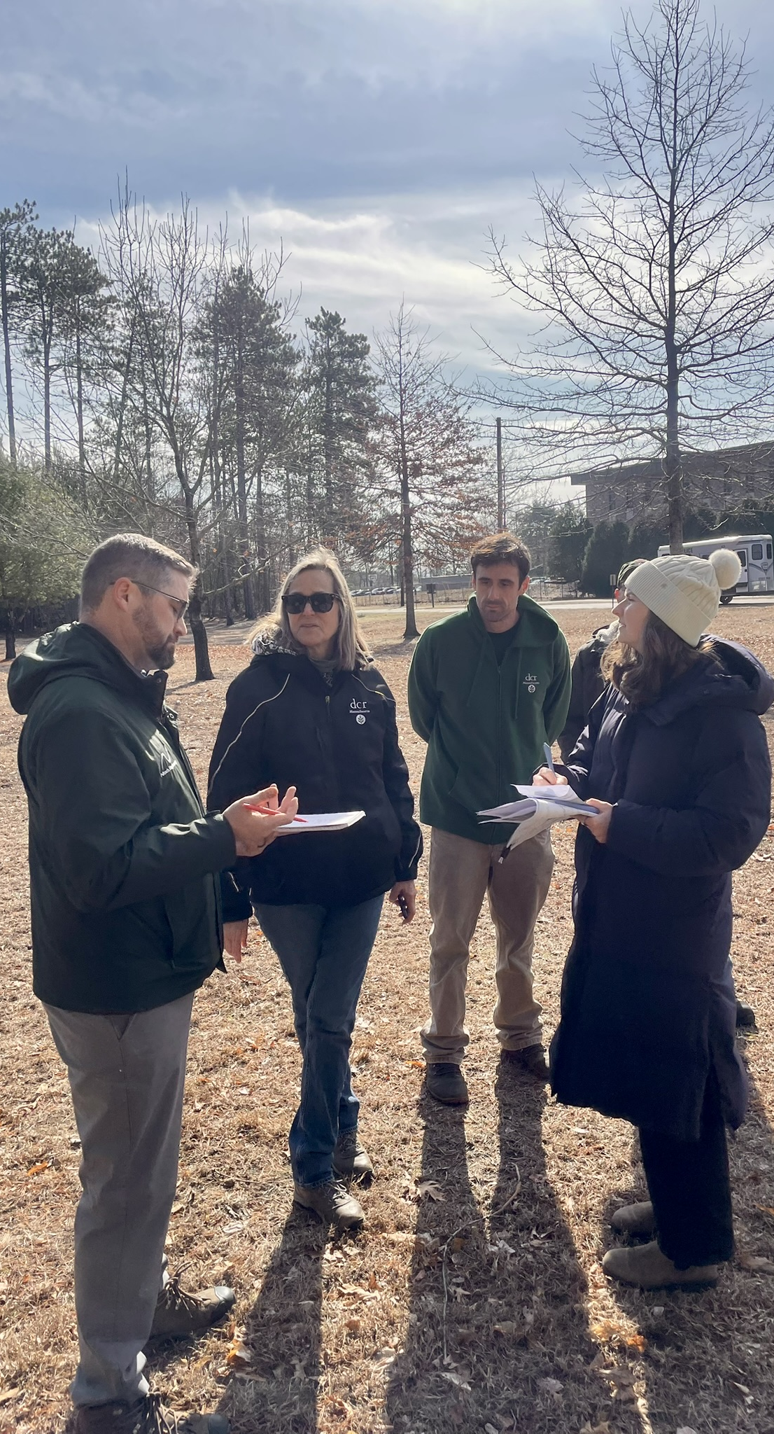
TEAM INTRODUCTIONS
1
CLIENT
Division of Design & Engineering
Department of Conservation & Recreation
DESIGN TEAM
Lead Consultant, Civil Engineering, Permitting
Nitsch Engineering
Landscape Architecture
Kyle Zick Landscape Architecture
Architecture
Dietz & Company Architects
Structural
Spring Line Design

Slide 7
PROJECT OVERVIEW
2
Project Goals
Existing Conditions
Shade Structure Concepts

Slide 8
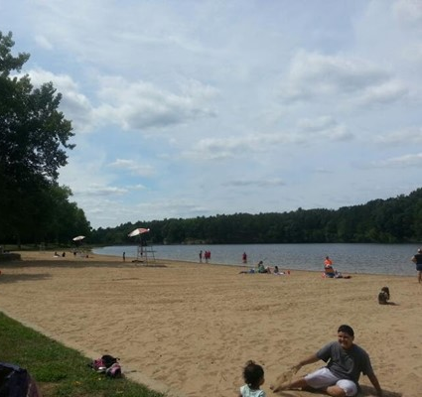
DCR PROJECT SHADE
Pilot project building resilience to extreme heat at State Parks by strategically installing shade structures and expanding tree canopy.
Additional Details and Information available at:
https://www.mass.gov/info-details/dcr-project-shade
Photo Credit: touristplaces.info
Notes:
Lake Wyola | Lake Wyola State Park | Heather Katsoulis | Flickr

Slide 9
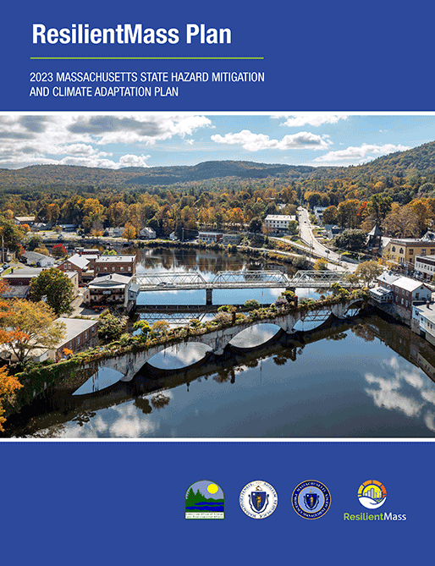
PROJECT CONTEXT
By 2050, Chicopee could see around 22 days each year with temperatures of 90°F or higher.
428

Slide 10
PROJECT GOALS
SHELTER
ACCESS
RECREATION
ENVIRONMENT
Provide shelter from heat and sun
Increase useability for vulnerable populations
Provide recreational and social amenities
Increase native tree canopy and awareness of heat safety
Notes:
Activating Spaces, increase recreational opportunities, and give visitors more spaces to enjoy

Slide 11
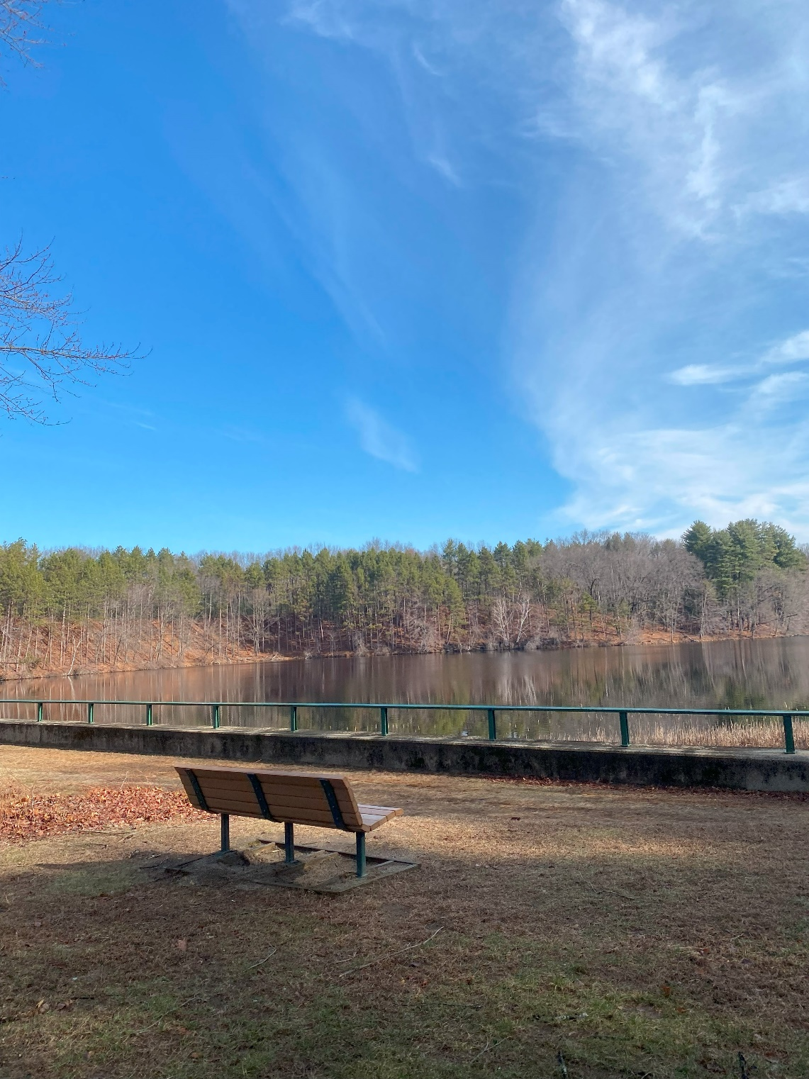
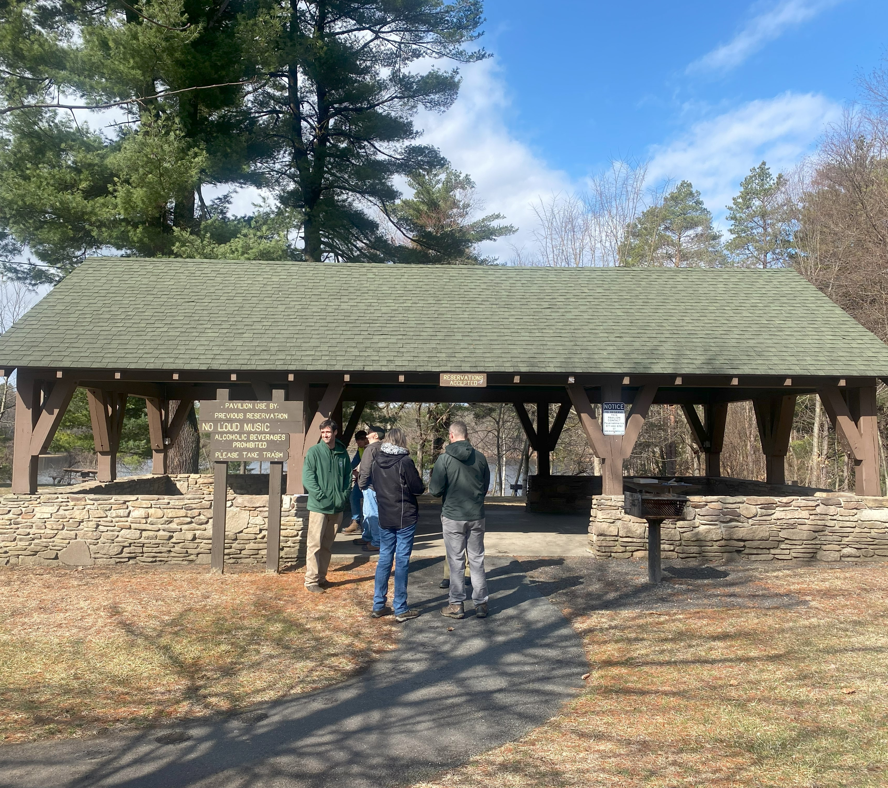
EXISTING CONDITIONS
Current seating options lack shade
Only one pavilion available

Slide 12
PROJECT SCHEDULE
Phase 1
Concept Design
Phase 2
Construction Documents and Outreach
Phase 3
Permitting
Phase 4
Bidding & Award
Phase 5
Construction
Site Analysis
Public Meeting #1
Conceptual Design
Chicopee Conservation Commission
MA Historic Commis- sion
Responses to questions
Conformed Set
Bidder selection
Site Remediation
Site Construction
Design Development
Construction Docs
Public Meeting #2
March – June 2025
June - August 2025
May-July 2025
Est. Fall 2025
Est. Spring 2026
PROJECT SHADE: CHICOPEE MEMORIAL STATE PARK
JUNE 2025

Slide 13
3
SHADE STRUCTURE CONCEPTS
Medium Pavilion (1)
Bench Shelters (2)

Slide 14
SHADE STRUCTURE CONCEPTS
Pavilion
Bench Shelters
PROJECT SHADE: CHICOPEE MEMORIAL STATE PARK
JUNE 2025

Slide 15
DCR LOCALLY-SOURCED WOOD
PROJECT SHADE: CHICOPEE MEMORIAL STATE PARK
JUNE 2025

Slide 16
SHELTER LOCATIONS
Existing Parking Area & Shelter
Chicopee Reservoir
Dam
Restroom Building
Existing Overflow Parking
Bench Shelter
Bench Shelter
Medium Pavilion
PROJECT SHADE: CHICOPEE MEMORIAL STATE PARK
JUNE 2025

Slide 17
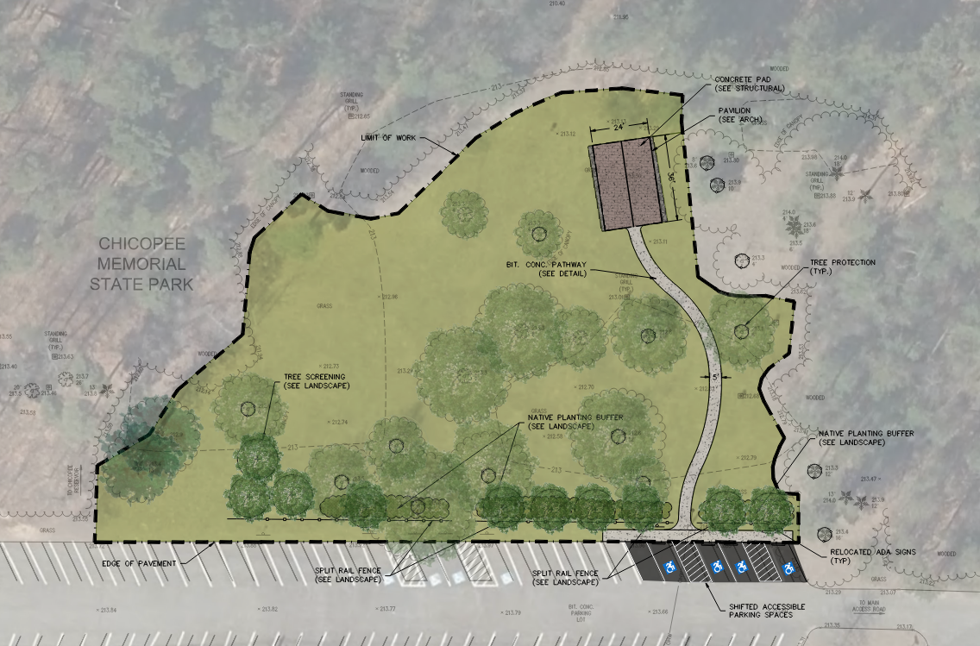
PLAN - MEDIUM PAVILION
Existing Overflow Parking
PROJECT SHADE: CHICOPEE MEMORIAL STATE PARK
JUNE 2025
Notes:
+ SCREENING PARKING AND NATIVE PLANTINGS HEDGEROW

Slide 18
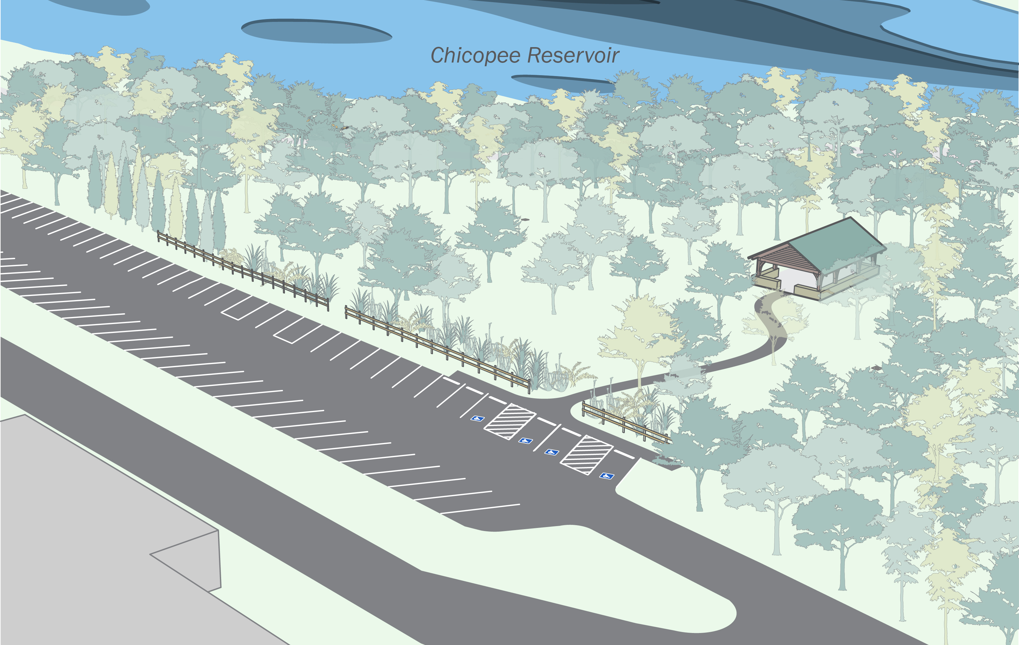
RENDERING – Medium Pavilion
PROJECT SHADE: CHICOPEE MEMORIAL STATE PARK
JUNE 2025

Slide 19
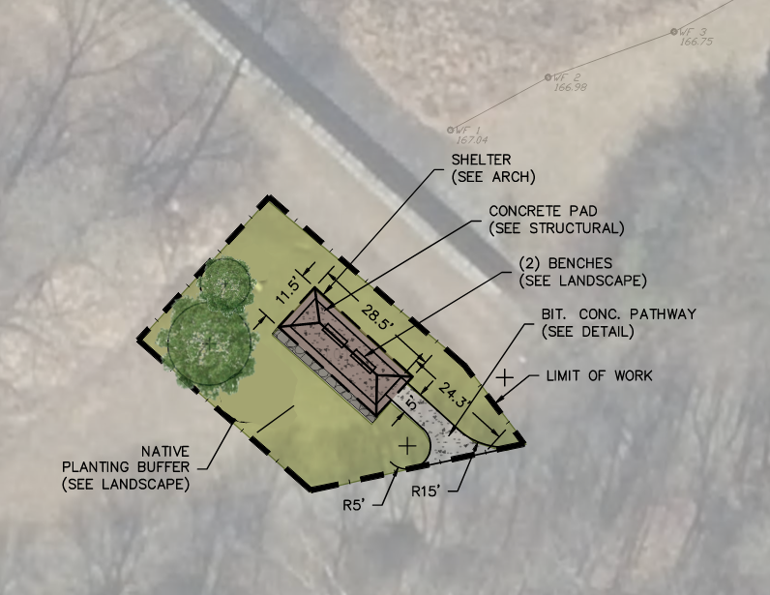
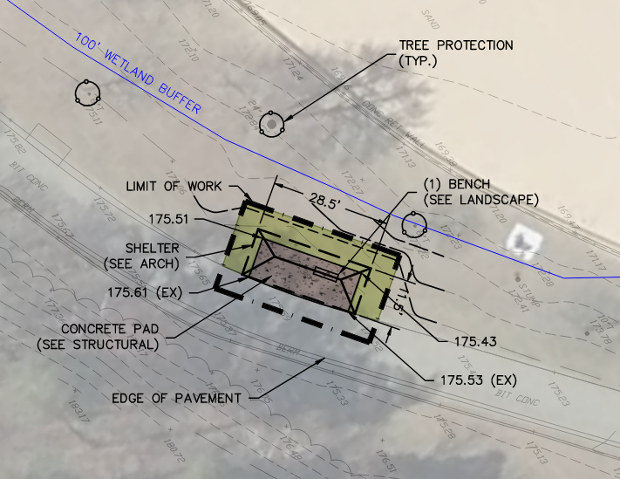
PLAN – BENCH SHELTERS
Existing Overflow Parking
Dam Location
Beach Location
PROJECT SHADE: CHICOPEE MEMORIAL STATE PARK
JUNE 2025

Slide 20
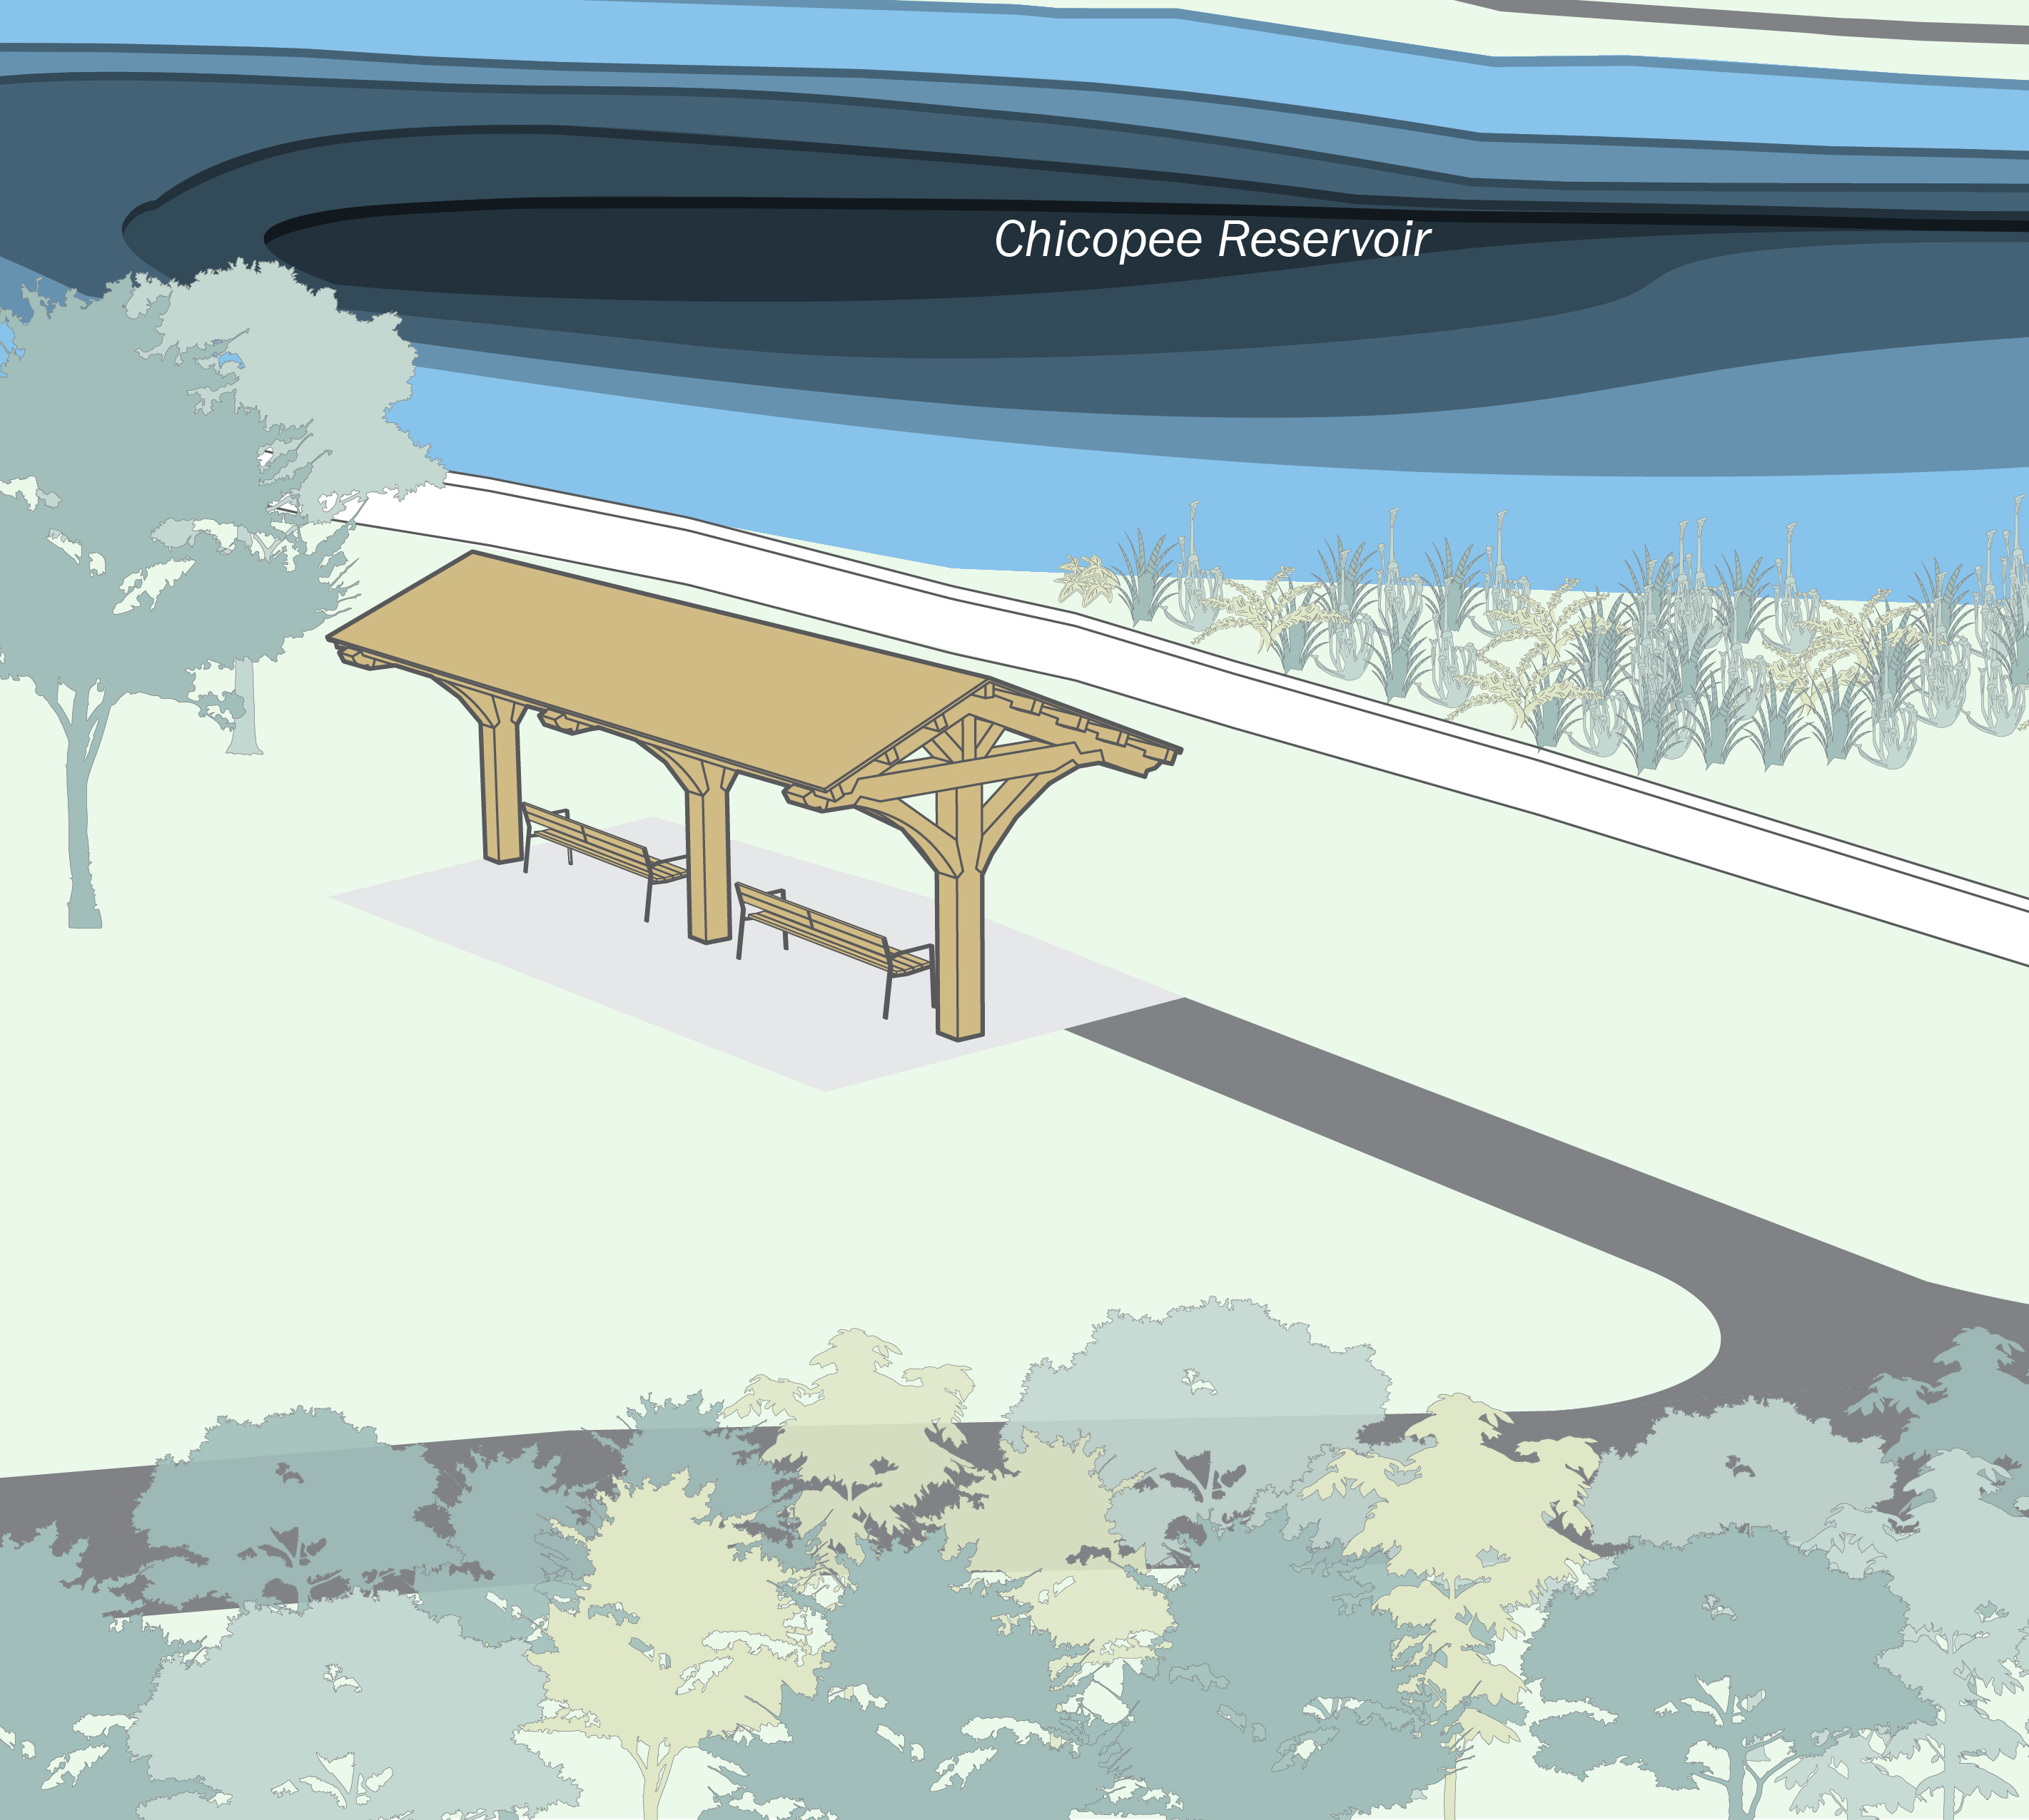
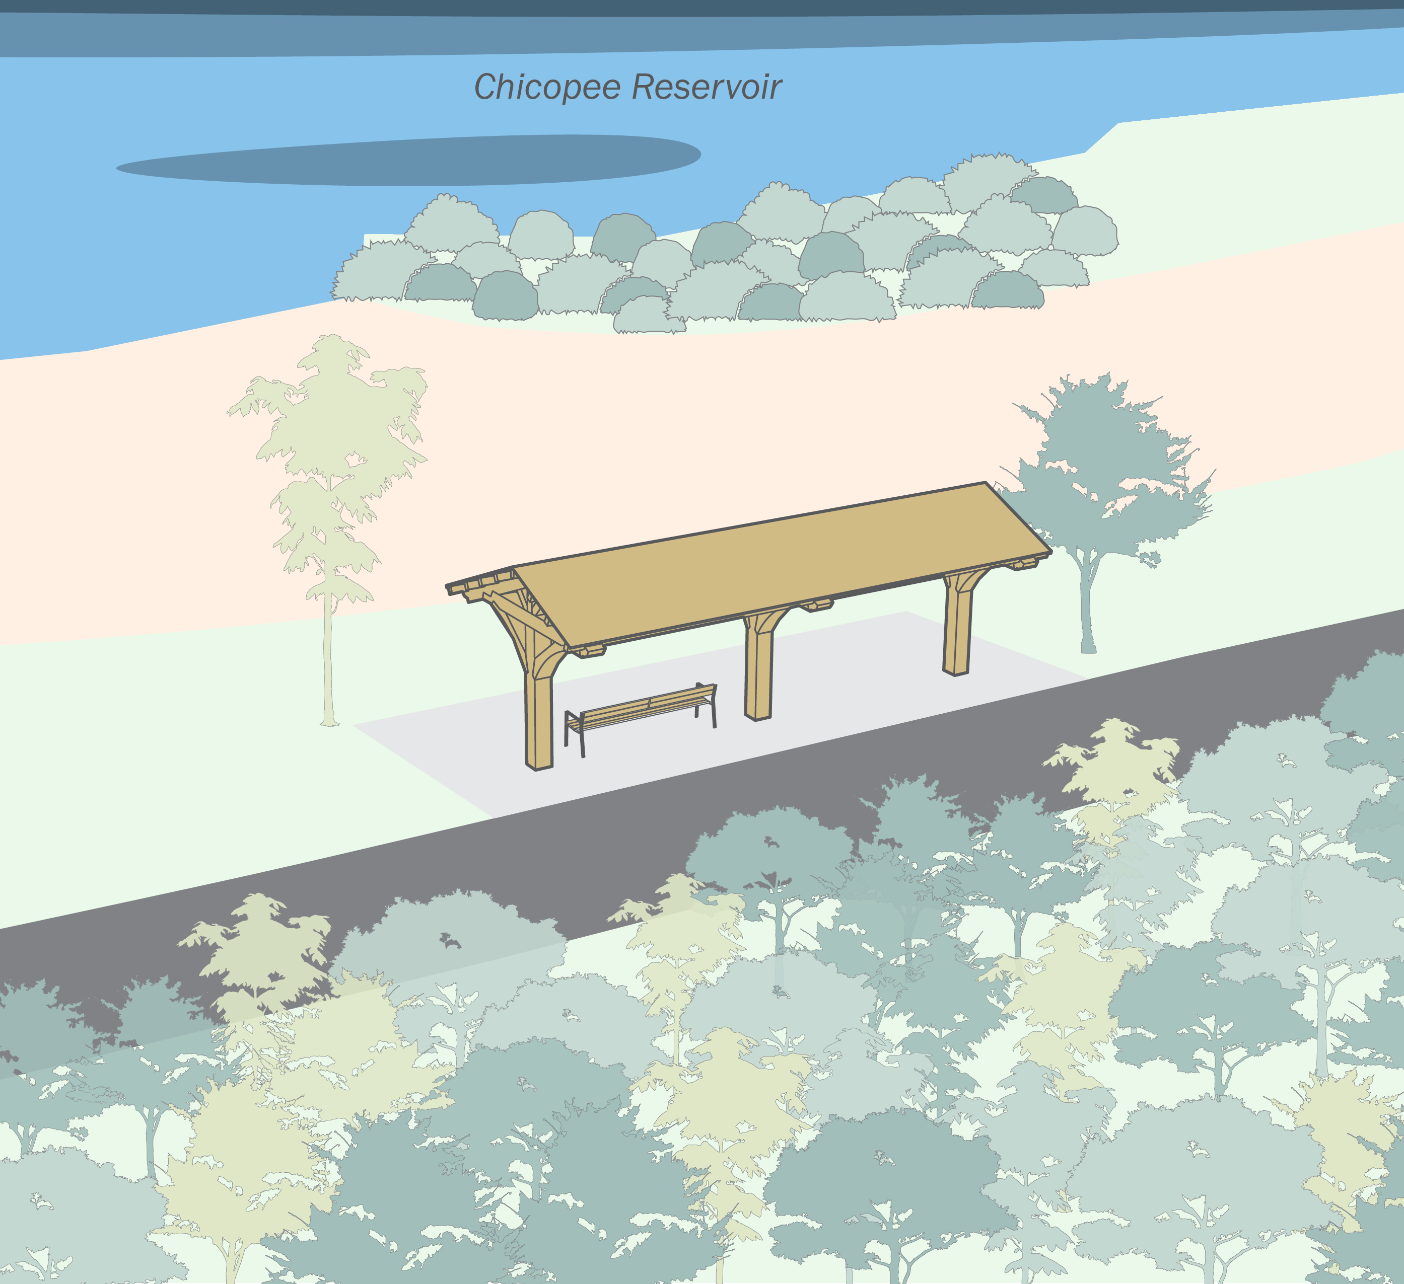
RENDERINGS – Bench Pavilions
REPLACE WITH UPDATED RENDERING
REPLACE WITH UPDATED RENDERING
PROJECT SHADE: CHICOPEE MEMORIAL STATE PARK
JUNE 2025

Slide 21
NEXT STEPS
1
2
3
4
5
Concept Design
& Engagement
Design Documentation
Regulatory Compliance
Bidding
Construction
Site Analysis
Public Meeting
Conceptual Design Options
Finalize Design Detailing, Specifications & Cost Estimate
Submit to Authorities having jurisdiction for approval
Responses to questions
Conformed Set
Bidder selection
Site Preparation
Shade Structure and Site Improvements Construction
Spring
Summer
Fall
Winter
Spring
Summer
2025
2026

Slide 22
4
DISCUSSION / Q& A
What do you like about the concept plans?
What would you like to see changed?
Are we enhancing Chicopee Memorial State Park?
Do you like the CCC Style?
How do you feel about the locations of the structures?
Are there any other features you would like to see on the structures?
PROJECT SHADE: CHICOPEE MEMORIAL STATE PARK
JUNE 2025

Slide 23
ADDITIONAL INFORMATION
Recording and tonight’s slide deck will be available at:
www.mass.gov/dcr/past-public-meetings
If you have comments on this project:
Submit online: https://www.mass.gov/forms/dcr-public-comments
Deadline: June 18th, 2025 (Two Weeks)
Please note: the contents of comments submitted to DCR, including your name, town, and zip code, will be posted on DCR’s website. Additional contact information provided, notably email address, will be used for outreach on future updates to the subject project of property.
If you wish to subscribe to a DCR general information on project- related listserv:
Contact DCR’s Office of Community Relations via email at mass.parks@mass.gov
PROJECT SHADE: CHICOPEE MEMORIAL STATE PARK
JUNE 2025
Notes:
Speaking: Dan

Slide 24
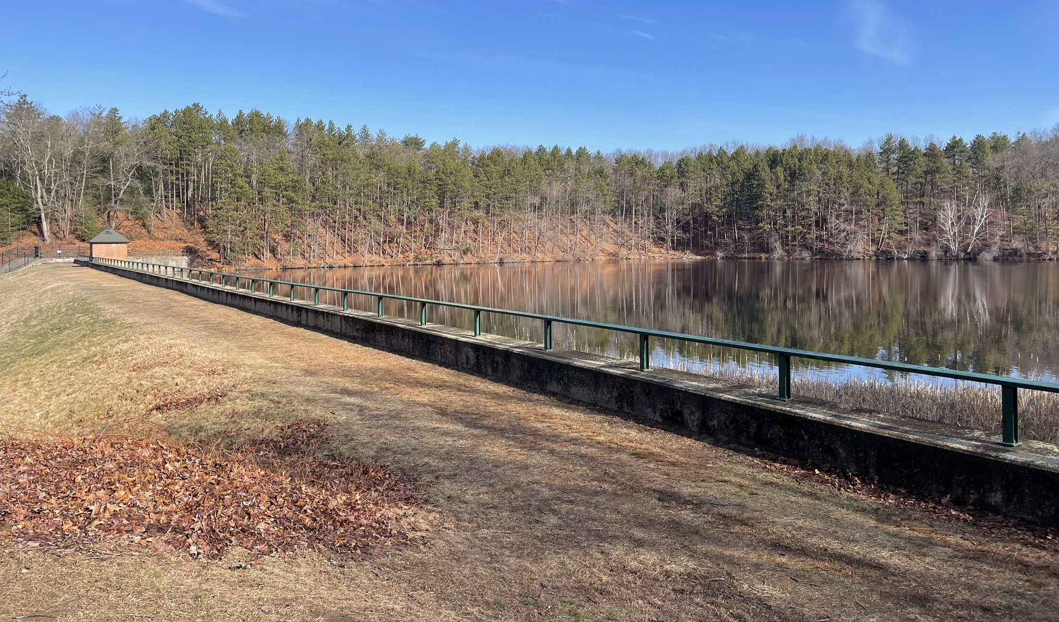
Thank You
DCR Project Shade Website: https://www.mass.gov/info-details/dcr-project-shade
PROJECT SHADE: CHICOPEE MEMORIAL STATE PARK
JUNE 2025

