Slide 1
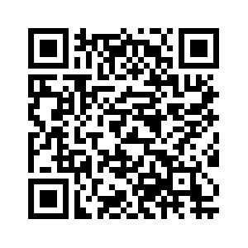
Welcome to the Listening Session!
Three ways to provide input
Sign up to speak during this session
Share your written feedback
Fill out our online input survey:
www.mass.gov/childcaretaskforce
1
2
3

Slide 2
Inter-Agency Early Education & Child Care Task Force
Listening Sessions
July and August 2024

Slide 3
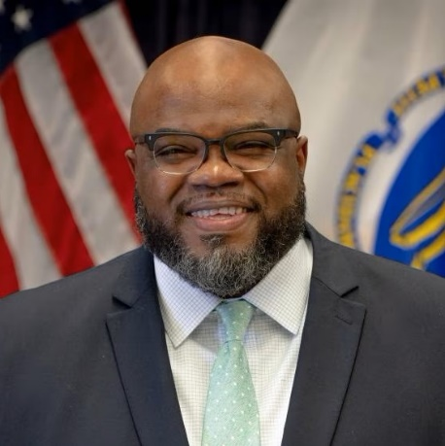
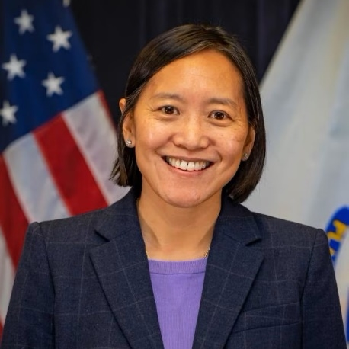
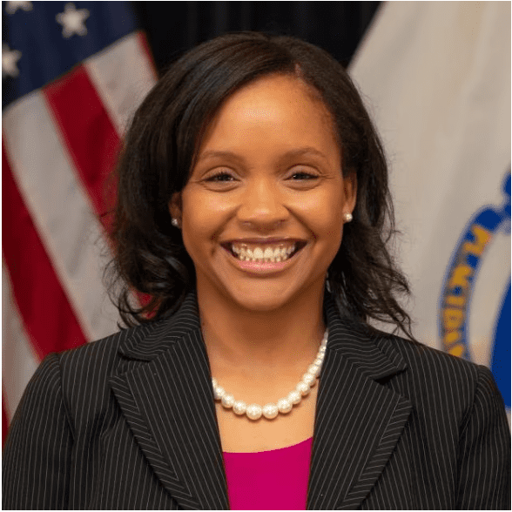
Welcome from the Task Force Co-Chairs
Secretary Tutwiler
Secretary of Education
Executive Office of Education (EOE)
Secretary Hao
Secretary of the Executive Office of Economic Development
Executive Office of Economic Development (EOED)
Secretary Jones
Secretary of Labor and Workforce Development
Executive Office of Labor and Workforce Development (EOLWD)

Slide 4
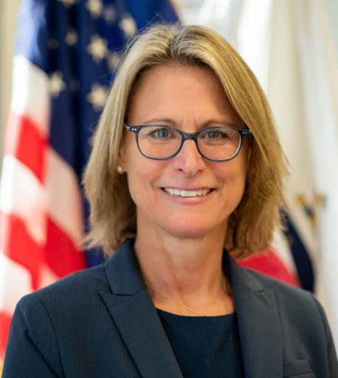
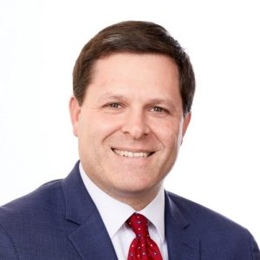
Task Force Support & Coordination
Commissioner Kershaw
Commissioner of the Department of Early Education & Care
Department of Early Education & Care (EEC)
Undersecretary Reilly
Task Force Coordinator
Undersecretary & Chief Operating Officer
Executive Office of Education (EOE)

Slide 5
About the Inter-Agency Task Force
The Task Force was established by Executive Order 625 to ensure that Massachusetts leads the nation in early education and child care access, affordability, equity, and quality.
The Task Force is comprised of the Secretary of Education, the Secretary of Labor and Workforce Development, and the Secretary of Economic Development, who shall serve as co-chairs.​ Additional members of the Task Force are the Secretaries of Administration and Finance, Energy and Environmental Affairs, Health and Human Services, Housing and Livable Communities, Public Safety and Security, Technology Services and Security, Transportation, and Veterans Services, or their designees. ​
​
​In developing its recommendations, the Task Force will engage with industry and business leaders, organized labor, health services stakeholders, housing and planning experts, working parents and caregivers, and child care providers and experts.
In developing and refining its recommendations, the Task Force may coordinate cross-secretariat pilot programs.

Slide 6
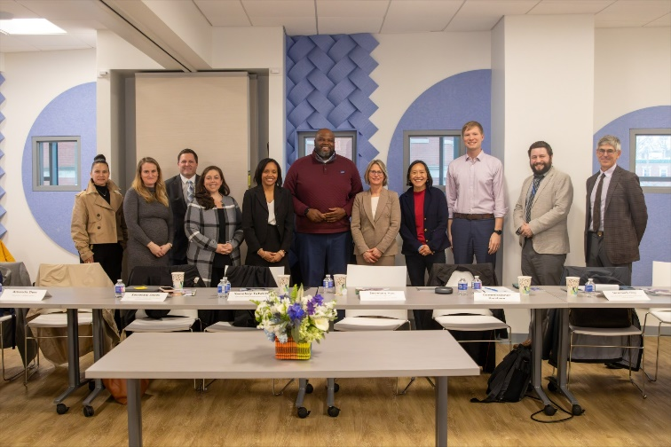
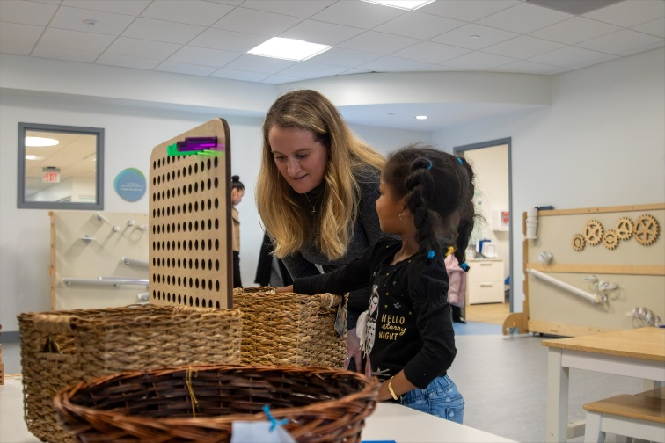
Values that guide the Task Force
Innovative
Child-Centered
Equitable
Results-Oriented
Are we welcoming out-of-the-box ideas to capitalize on fresh perspectives from all executive offices and stakeholders?​
Do the solutions advance academic and social-emotional development for our learners?​
​
Do the solutions address or exacerbate inequities?​
Are the solutions practical and able to
be piloted and implemented as early as next fiscal year?

Slide 7
Priorities of the Inter-Agency Task Force
Surveying practices of other states & nations​
Assessing how better coordination among state agencies could support families in accessing early education and child care
Identifying resources for building capacity and increasing affordability in the early education and child care system​
Identifying strategies to recruit, train, upskill, and retain members of the early education and child care workforce
Reviewing existing assets to identify potential locations to establish center-based early education and child care

Slide 8
Task Force Milestones and Deliverables
We are here
January
February
March
April
May-July
August
Aug-Oct
November
December
Executive Order Announcement
Task Force Co-Chairs Meeting & planning session
Task Force Kick Off​ and launch
5 Working Groups start
Catalogue current activities, best practices
Host listening sessions
Host listening sessions
Review findings
Completion of Task Force interim report
Identification of go-forward strategies
Summary of potential considerations
Review draft go-forward considerations
Final report draft shared with the Governor
Year 1 Report announced and released

Slide 9
Overview of Listening Sessions
The Early Education and Child Care Task Force is hosting a series of listening sessions across Massachusetts to inform recommendations and broader strategy towards accessible, affordable, high-quality early education and child care for all families
A total of 14 listening sessions are taking place throughout July and early August, including nine in-person sessions and five virtual sessions (one of which was led in Spanish)
The Task Force is eager to hear from working parents and caregivers, education and business leaders, early education and child care providers, and all others in the community on ideas to make early education and child care more accessible, affordable, and high quality across the state

Slide 10
Listening Session Dates
Session | Date | Time | Region | Location
1 | Tues, 7/16 | 1-3 | Northeast | North Shore Community College - Lynn Campus
2 | Wed, 7/17 | 6-8 | Virtual (PM)
3 | Thurs, 7/18 | 1-3 | Cape and Islands | Upper Cape Cod Regional Technical High School
4 | Sat, 7/20 | 10-12 | Virtual (Weekend)
5 | Mon, 7/22 | 7-9 | Virtual (PM)
6 | Tues, 7/23 | 12:30-2:30 | Southeast | Massasoit Community College - Brockton Campus
7 | Wed, 7/24 | 12:30-2:30 | Metro West | MassBay Community College - Framingham Campus
8 | Thu, 7/25 | 7-9 | Virtual (PM), Spanish Led
9 | Mon, 7/29 | 6-8 | Virtual (PM)
10 | Tues, 7/30 | 1-3 | Central | Worcester State University
11 | Wed, 7/31 | 12:30-2:30 | Berkshires | Berkshire Community College
12 | Mon, 8/5 | 10-12 | Pioneer Valley | Springfield Technical Community College
13 | Tues, 8/6 | 10-12 | Boston | Bunker Hill Community College - Charlestown Campus
14 | Wed, 8/7 | 1-3 | South Coast | Bristol Community College

Slide 11
Format of the Listening Sessions
Agenda for each session
Welcome, introductions, and overview (15 min)
Live comment and input (80-90 min)
Wrap up and close (15 min)
Three ways to provide input
Through verbal public participation at in-person or virtual sessions, during the "live comment and input" portion
Through anonymous written feedback at in-person or virtual sessions
Through our online input survey: www.mass.gov/childcaretaskforce
1
2
3

Slide 12
Key Questions for Community Feedback I/II
What are the biggest challenges you face or observe related to early education and child care?
¿Cuáles son los mayores desafíos que enfrenta u observa relacionados con la educación y el cuidado de la primera infancia?
What are the biggest opportunities to ensure high-quality early education and child care is accessible and affordable across the Commonwealth?
¿Cuáles son las mayores oportunidades para garantizar que la educación y la atención temprana de alta calidad sean accesibles y asequibles en todo el Commonwealth??
What are the biggest opportunities to ensure there is enough supply of high-quality early education and child care in multiple formats (e.g., home-based, center-based, employer-provided, district-based) across the Commonwealth?
¿Cuáles son las mayores oportunidades para garantizar que haya suficiente oferta de educación y atención temprana de alta calidad en múltiples formatos (por ejemplo, en el hogar, en el centro, proporcionada por el empleador, basada en el distrito) en todo el Commonwealth?
1
2
3
https://www.mass.gov/early-education-and-child-care-task-force

Slide 13
Key Questions for Community Feedback II/II
What are the biggest opportunities to ensure we have a properly certified, trained, and supported early education and child care workforce?
¿Cuáles son las mayores oportunidades para asegurar que contamos con una fuerza laboral debidamente certificada, capacitada y apoyada en educación y cuidado temprano?
Are there best practices from outside of Massachusetts that you believe are critical for the Task Force to consider as part of this work?
¿Existen mejores prácticas fuera de Massachusetts que usted cree que son críticas para que el Grupo de Trabajo considere como parte de este trabajo?
Is there anything else that you would like the Task Force to consider?
¿Hay algo más que le gustaría que el Grupo de Trabajo considerara?
4
5
6
https://www.mass.gov/early-education-and-child-care-task-force

Slide 14
Next Steps
Engage the community in 14 listening sessions to help guide the development of the Interim Report
Identify strategies and recommendations through research and community input, and present to Governor Healey
Share final report with the public by the end of 2024

