Slide 1

MassHire Career Information Systems 360
Part 2: Assessments and Careers
  MassHire Programs & Services are funded in full by US Department of Labor (USDOL) Employment and Training Administration grants. (Additional details furnished upon request.)

Slide 2
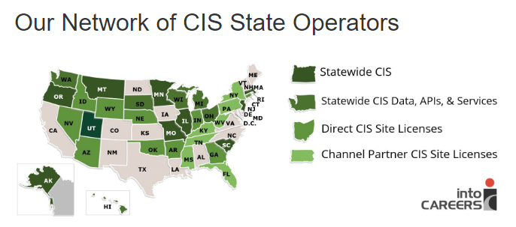
University of Oregon : into CAREERS

Slide 3

MassHire Career Information System
MassHire Career Information Systems 360 is purchased with grants by the US Department of Labor (USDOL) Employment and Training Administration, it is primarily procured for the use of the Department of Career Services Career Centers, it’s partners and Massachusetts constituents. As such the trainings focus is for career center staff usage.

Slide 4
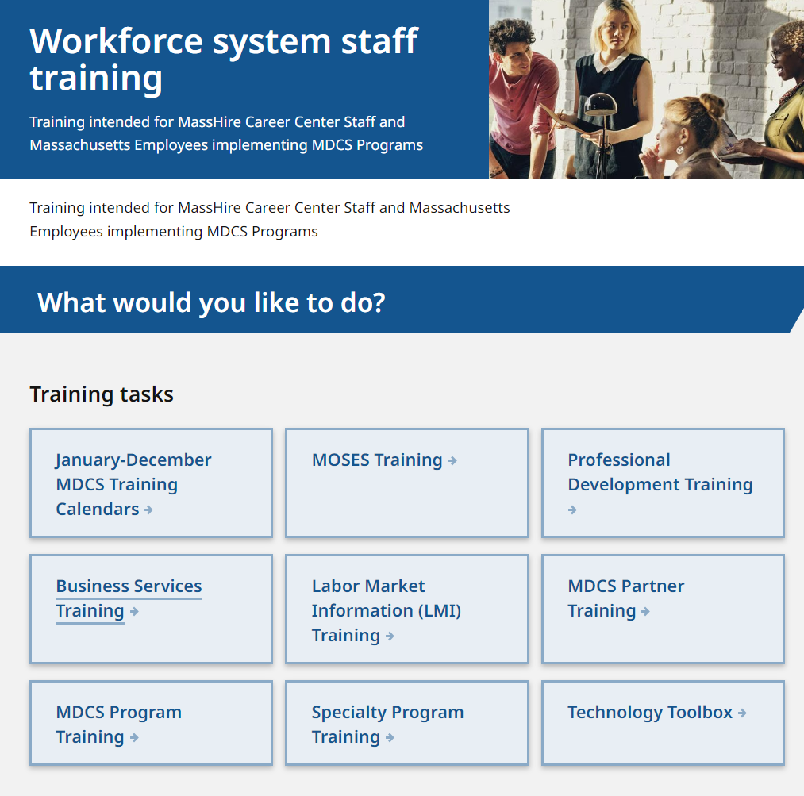
The MassHire CIS Training Calendar https://www.mass.gov/workforce-system-staff-training

Slide 5
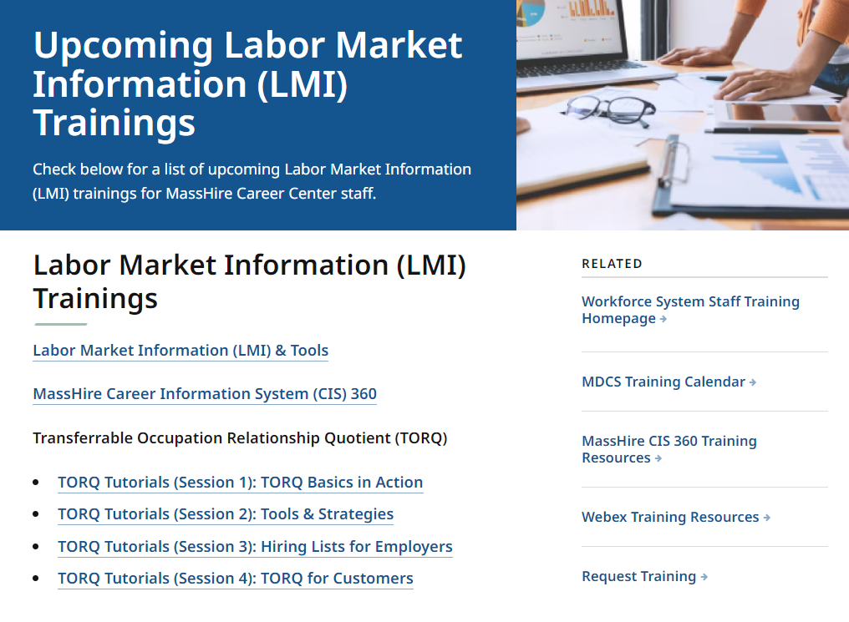
The MassHire CIS Training Calendar https://www.mass.gov/info-details/upcoming-labor-market-information-lmi-trainings

Slide 6
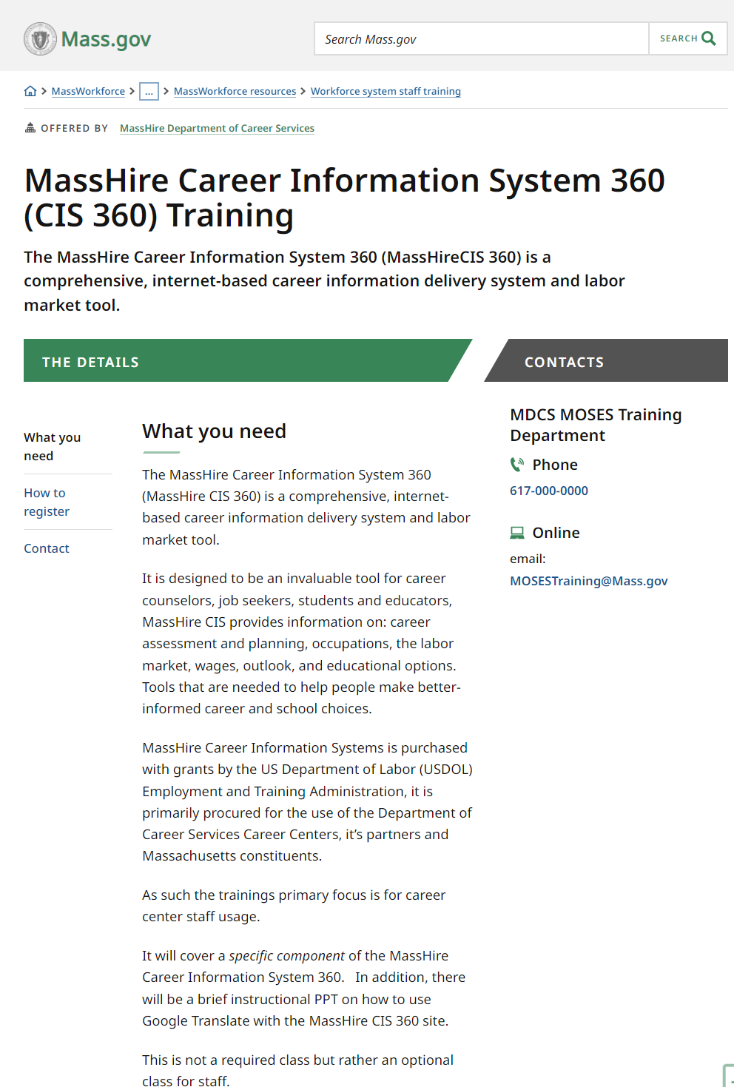
The MassHire CIS Training Calendar https://www.mass.gov/how-to/masshire-career-information-system-360-cis-360-training

Slide 7
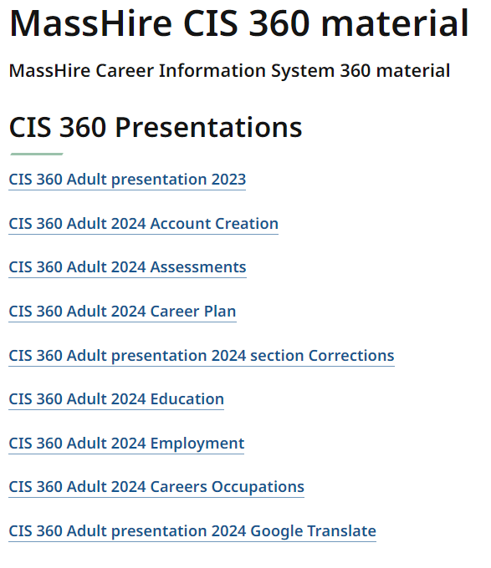
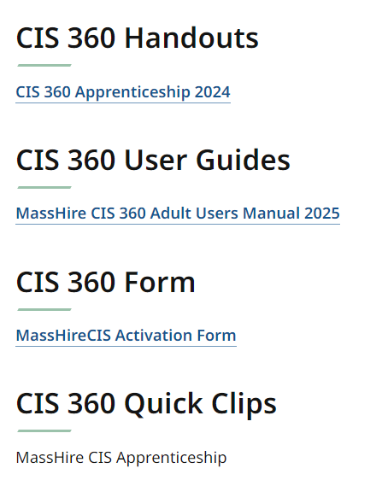
The MassHire CIS Resources https://www.mass.gov/info-details/masshire-cis-360-material

Slide 8
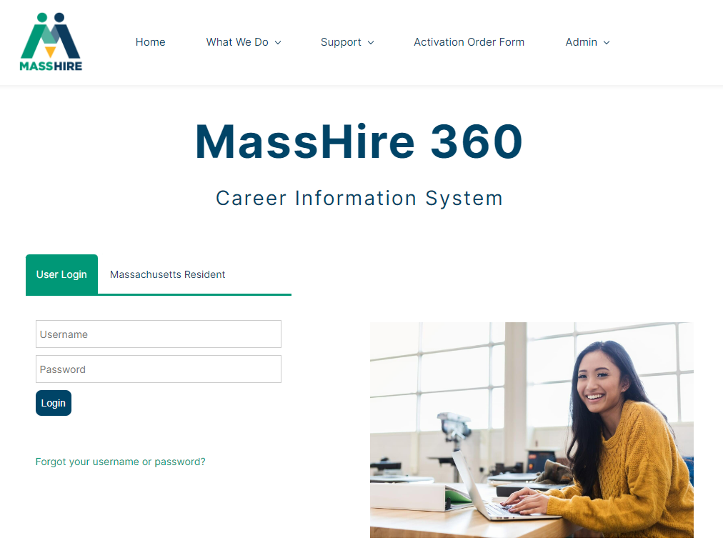
The MassHire Career Information System Portal https://portal.ma.cis360.org/

Slide 9
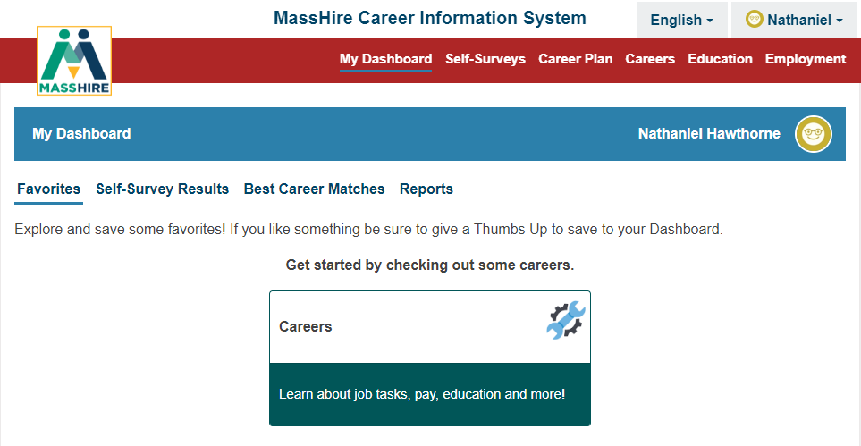
User Dashboard

Slide 10
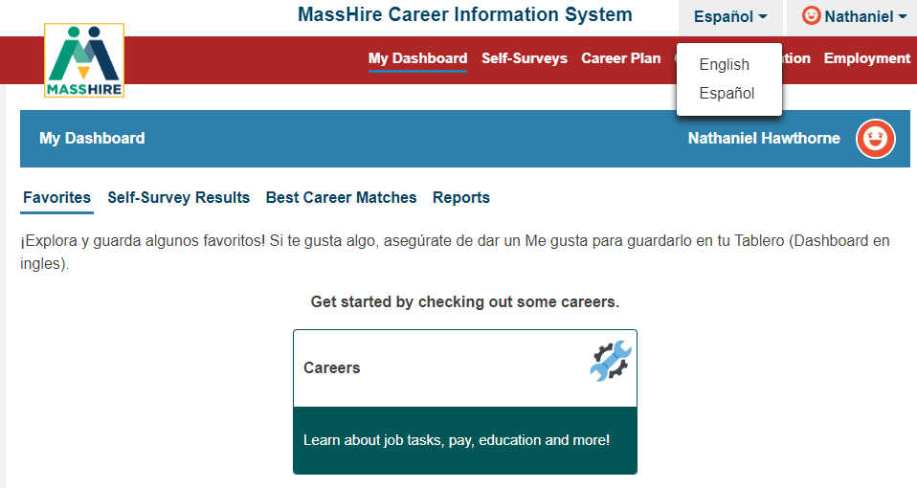
English / Español
Note:
Español version originally done by Texas translation affiliation using Mexican Spanish

Slide 11
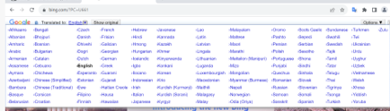

Translation

Slide 12
User Dashboard

Slide 13
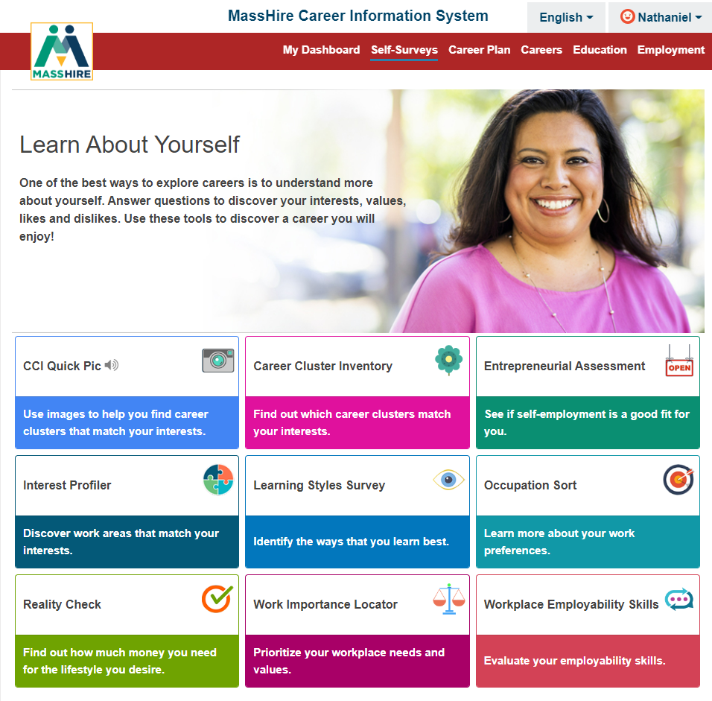
Self-Surveys / Assessments

Slide 14
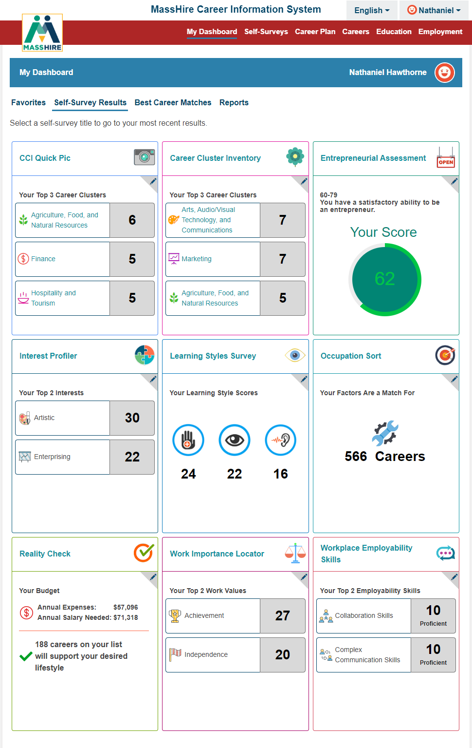
Self-Survey Results
Note:
Nine Surveys available to take in MassHire CIS 360.

Slide 15
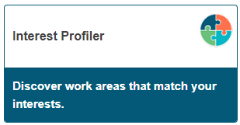
Interest Profiler
The O*NET Interest Profiler can help you find out what your interests are and how they relate to the world of work. You can find out what you like to do.
The O*NET Interest Profiler helps you decide what kinds of careers you might want to explore.
The Interest Profiler was introduced in 1999 as one of the U.S. Department of Labor’s (DOL) O*NET Career Exploration Tools. John Holland’s (1997) RIASEC theoretical model (Realistic-Investigative-Artistic-Social-Enterprising-Conventional) is the basis of the Interest Profiler scales.

Slide 16
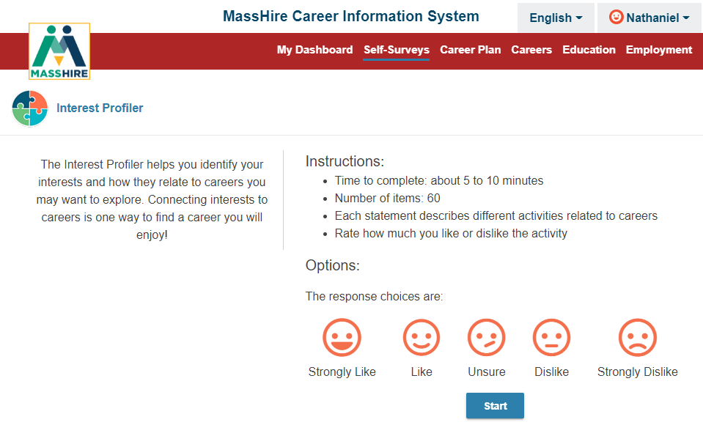
Interest Profiler
Note:
Sixty (60) questions about work activities.
You select / decide your interest on a sliding scale of Strongly Like to Strongly Dislike.

Slide 17
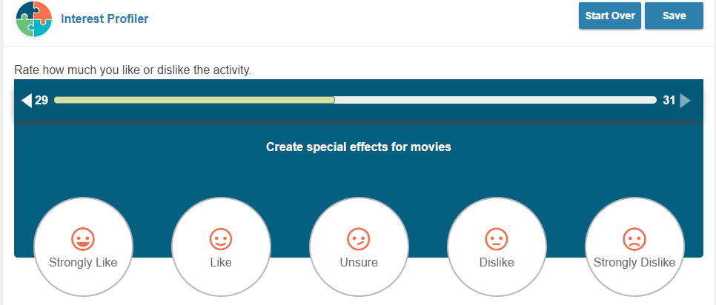
Interest Profiler: Sample Question
Note:
Sample work activity , you select your level of interest.
Bar above the activity keeps track of the questions answered and those still to be answered.

Slide 18
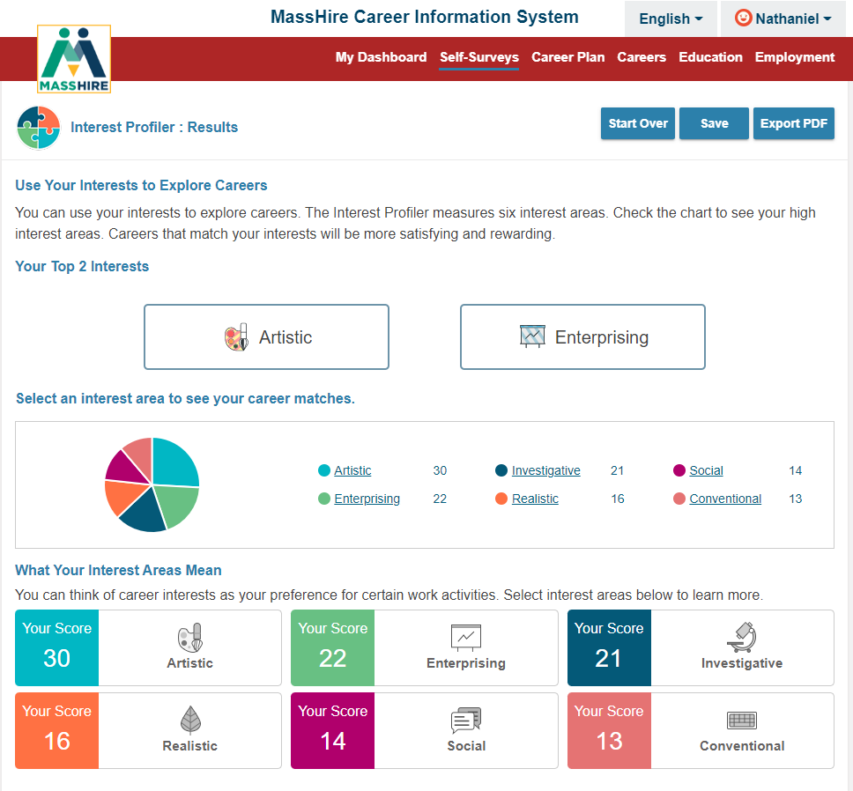
Interest Profiler : Results
Note:
John Holland’s RIASEC theoretical career model lists interest areas by highest score to lowest score.
Realistic
Investigative
Artistic
Social
Enterprising
Conventional

Slide 19
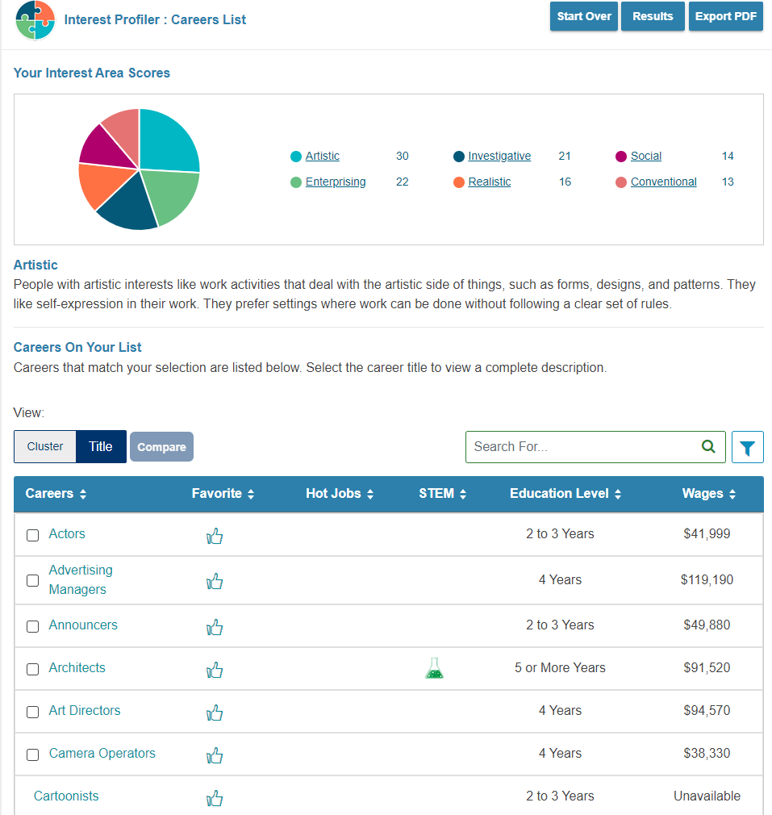
Careers from Results From Interest Profiler

Slide 20
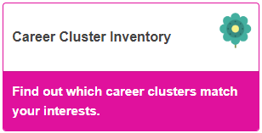
Career Cluster Inventory
This survey helps individuals to discover which of the 16 Career Clusters the majority of their career interests are in to help direct their vocation aspirations.
The Sixteen Career Clusters are:
Agriculture, Food & Natural Resources; Architecture & Construction; Arts, Audio/Video Technology & Communications; Business, Management & Administration; Education & Training; Finance; Government & Public Administration; Health Science; Hospitality & Tourism; Human Services; Information Technology; Law, Public Safety, Corrections & Security; Manufacturing; Marketing, Sales & Service; Science, Technology, Engineering & Mathematics; and Transportation, Distribution & Logistics

Slide 21
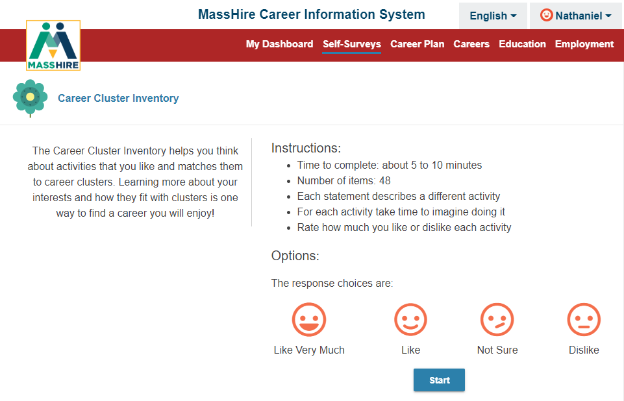
Career Cluster Inventory
Note:
Forty-Eight (48) questions about activities.
You select / decide your interest on a scale from Like Very Much to Dislike.

Slide 22
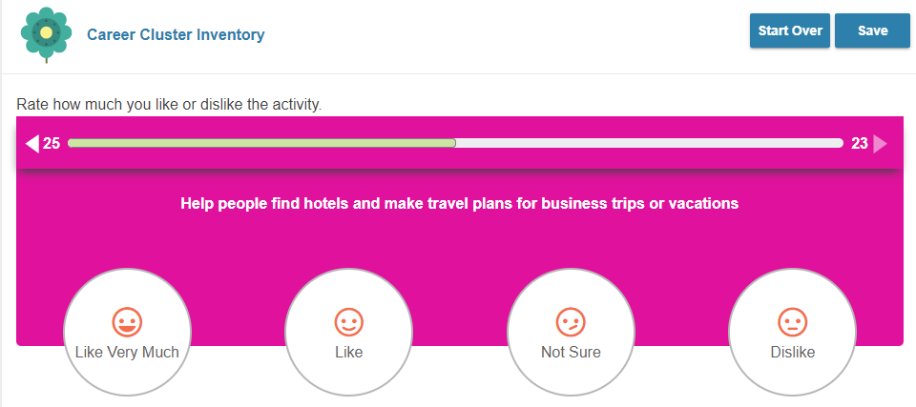
Career Cluster Inventory
Note:
Sample activity , you select your Likes and Dislikes.
The bar above the question keeps track of the questions answered and those still to be answered.

Slide 23
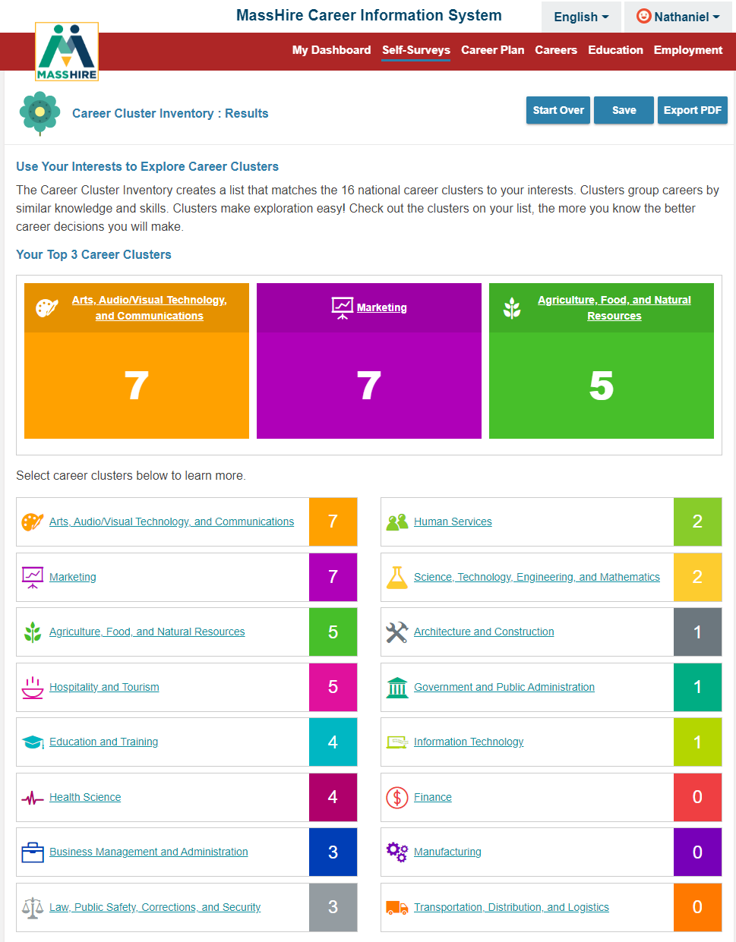
Career Cluster Inventory: Results
Lists results by highest score in the sixteen career clusters.

Slide 24
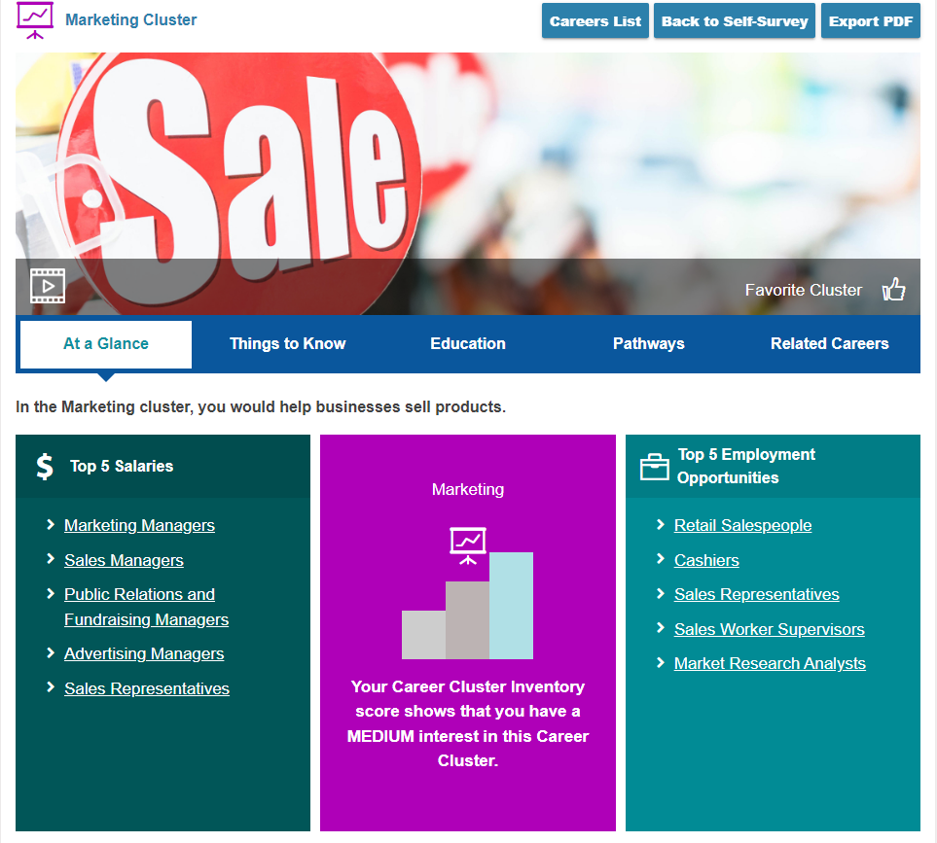
Career Cluster Inventory: Results more details
Can explore career options by selecting a specific career clusters.
In this example: Marketing
This is At a Glance overview

Slide 25
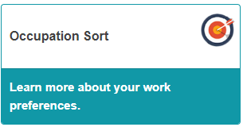
Occupation Sort
Occupation Sort Assessment is used to help clients clarify their skills, values, and occupational interests. (Oldie but goodie: Sometimes referred to as Card Sorts. )
Occupation sorts are believed to be as effective as standardized assessments in predicting career choice; but because they are subjective in nature and do not produce scores or have norms.
Occupation sorts have been a career counseling tool since the 1960s and have continued to be used to help individuals in the career decision-making process.

Slide 26
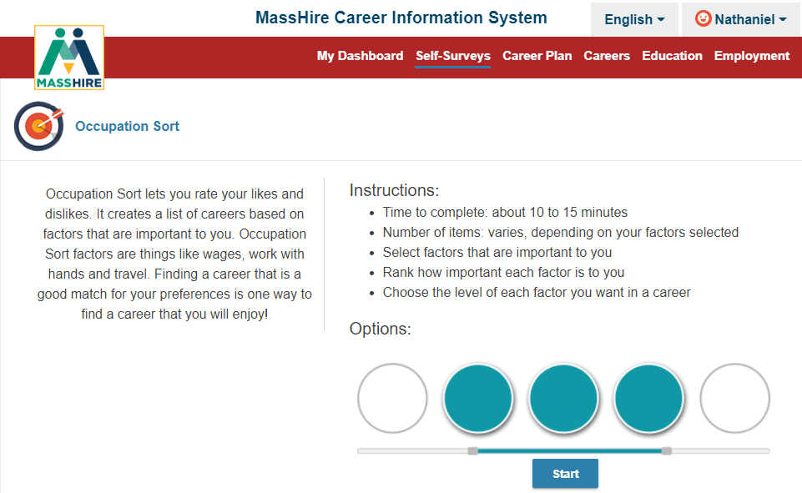
Occupation Sort
Note:
Twenty-Eight (28) career factors are provided.
You provide how important or not important it is in your work.
You are limited in your selection.

Slide 27
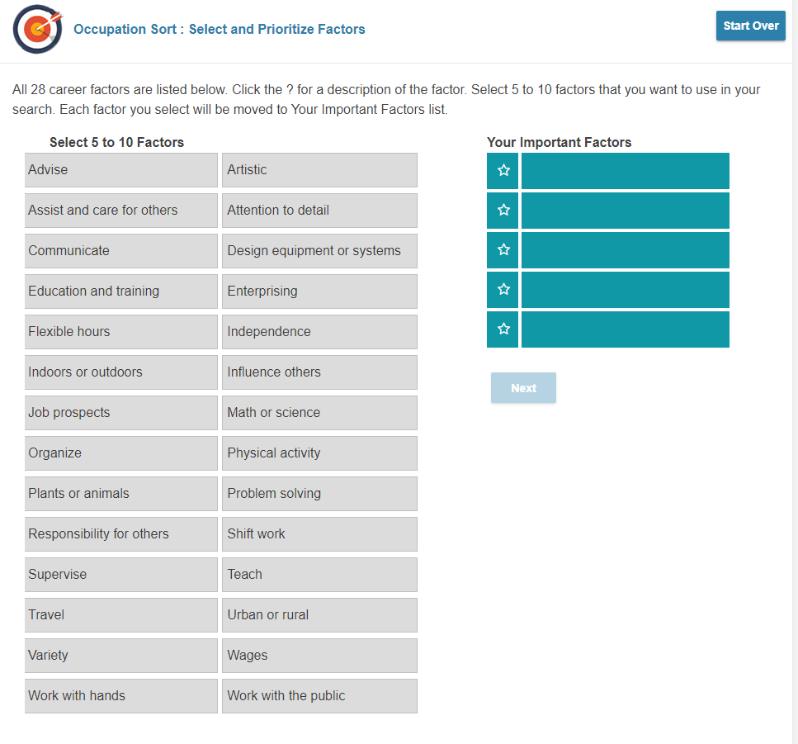
Occupation Sort
Select a minimum of five (5) to a maximum of ten (10) work factors that are important to you.
Select by clicking

Slide 28
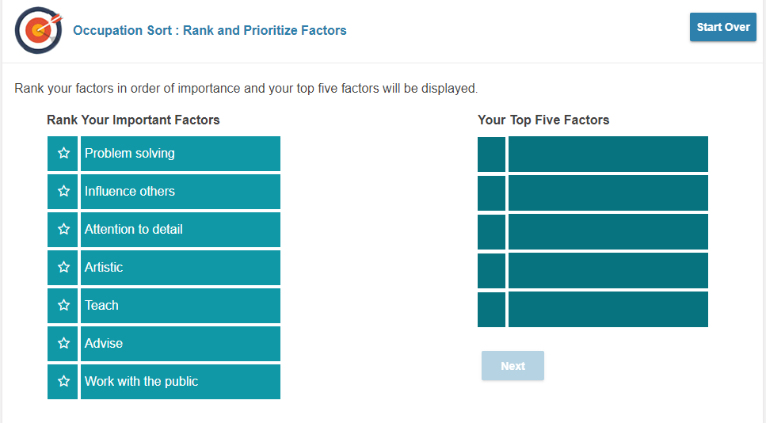
Occupation Sort
Now rank your TOP FIVE work factors.
Select by clicking

Slide 29
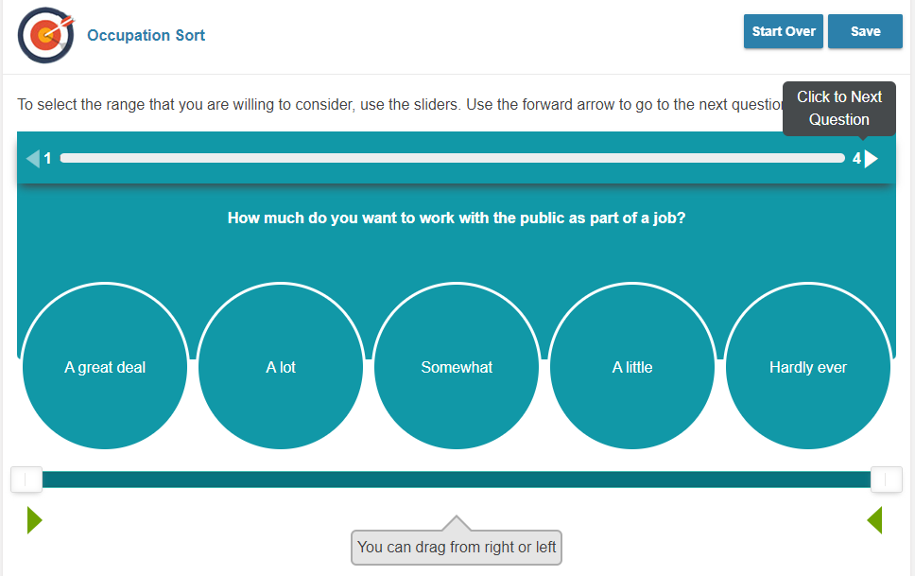
Occupation Sort
Now answer the questions based on the five factors you selected.
Note:
The scale is from A Great Deal to Hardly Ever
(try and be decisive!)

Slide 30
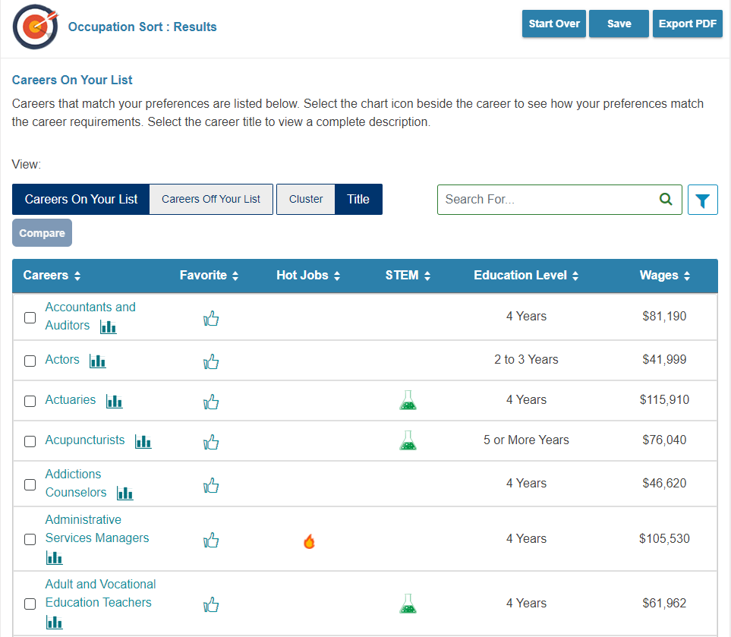
Occupation Sort
Results list Careers / Occupations that you closely match

Slide 31
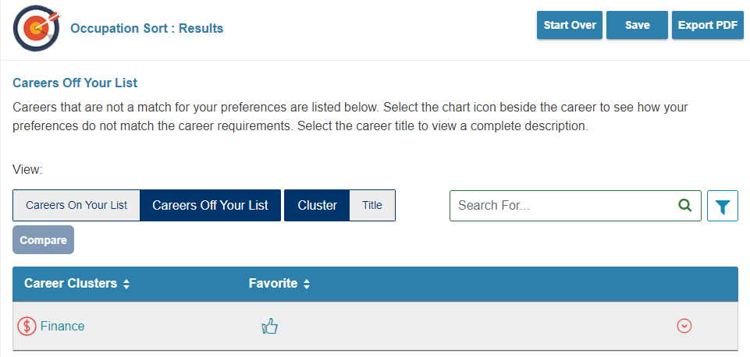
Not on list by Cluster
Note:
Not On List
can be as important as
On List
Can validate why not to chose a career

Slide 32
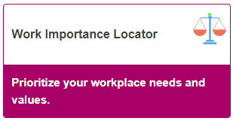
Work Importance Locator
The Work Importance Locator (WIL) is a self-assessment career exploration tool that allows clients to pinpoint what is important to them in a job.
It helps people identify occupations that they may find satisfying based on the similarity between their work values (such as achievement, independence, and conditions of work) and the characteristics of the occupations.

Slide 33
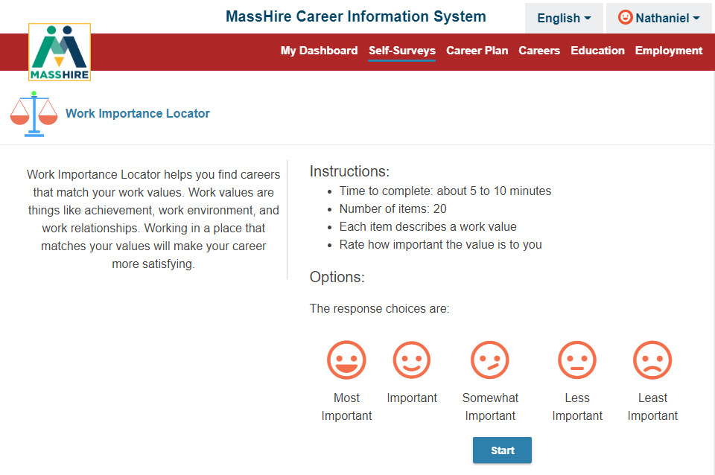
Work Importance Locator
Note:
Twenty (20) work values are provided.
You Rate how important each is to you.
Scale is:
Most Important
To
Least Important

Slide 34
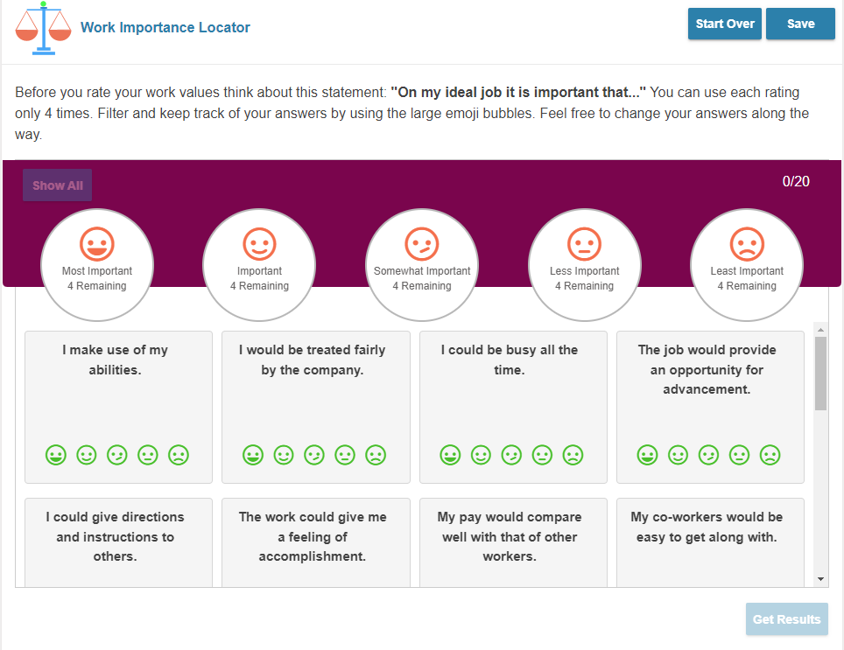
Work Importance Locator
Note:
You are only allowed to use the Ratings given four (4) times each.
So, only 4 Most Important values, only 4 Least Important values, etc…
You need to rate all the values.

Slide 35
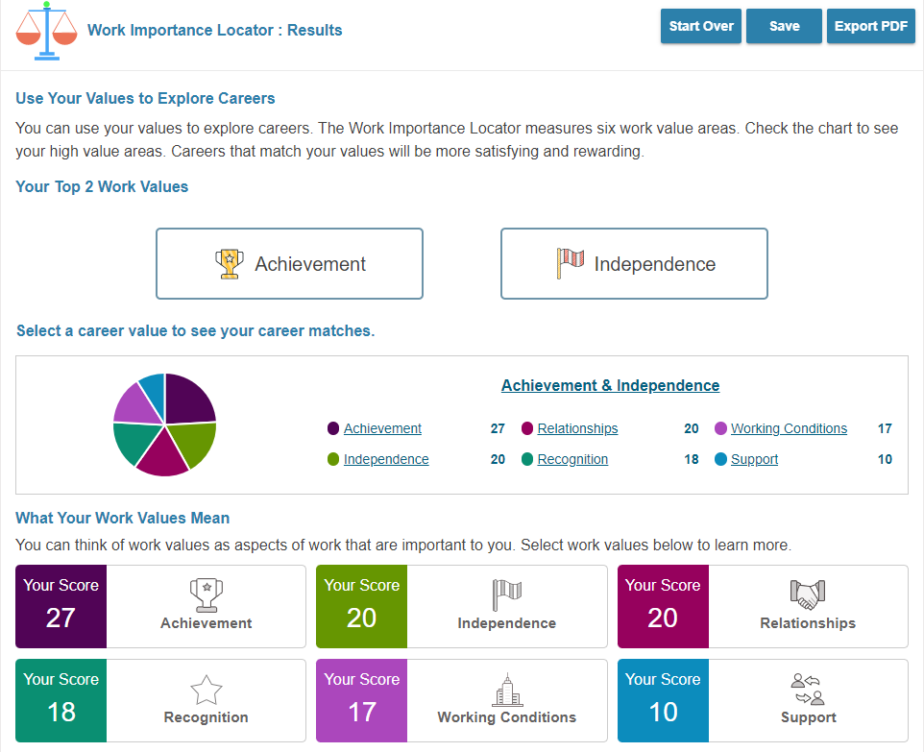
Work Importance Locator
Note:
RESULTS
Are broken out by Work Values Groups that you rated highest in

Slide 36
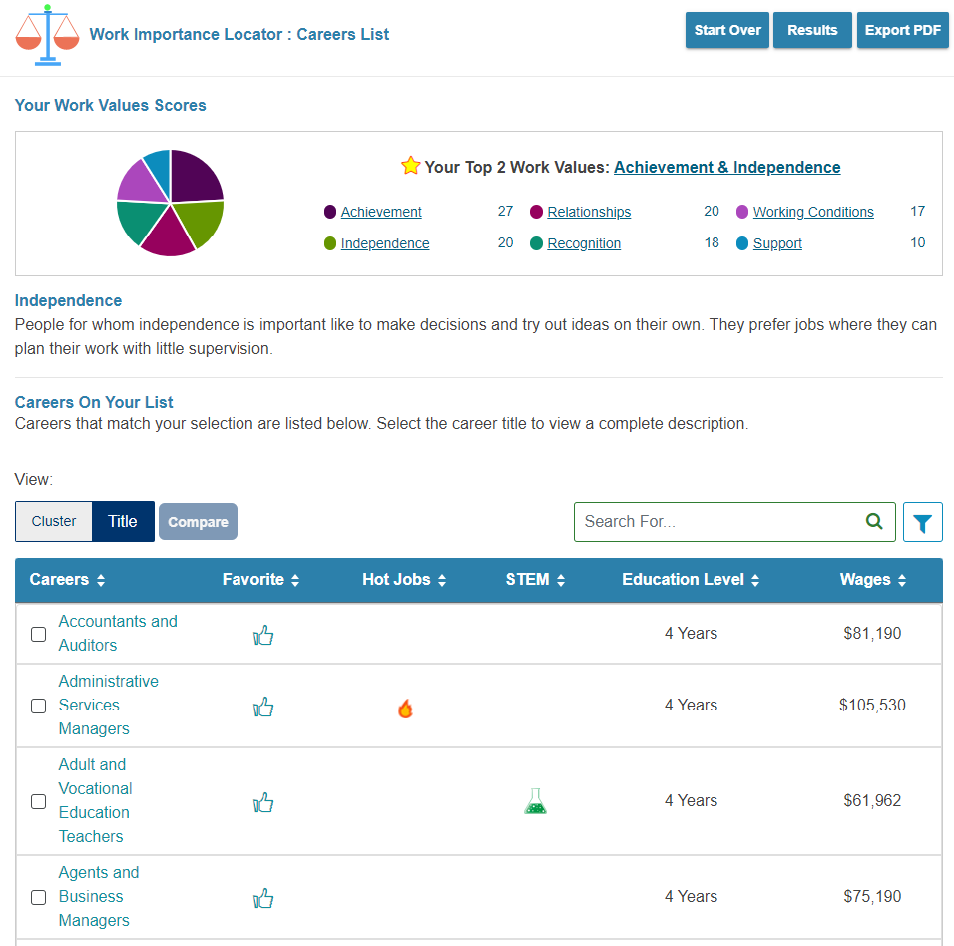
Work Importance Locator
Note:
RESULTS
Work Value Groups can then be broken out by Careers in that Group

Slide 37
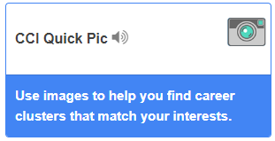
CCI Quick Pic
CCI Quick Pic uses pictures to help you think about activities you like. Quick and easy, after you rate your interests, they are matched to career clusters.
Can be helpful for people that are language skills deficient.

Slide 38
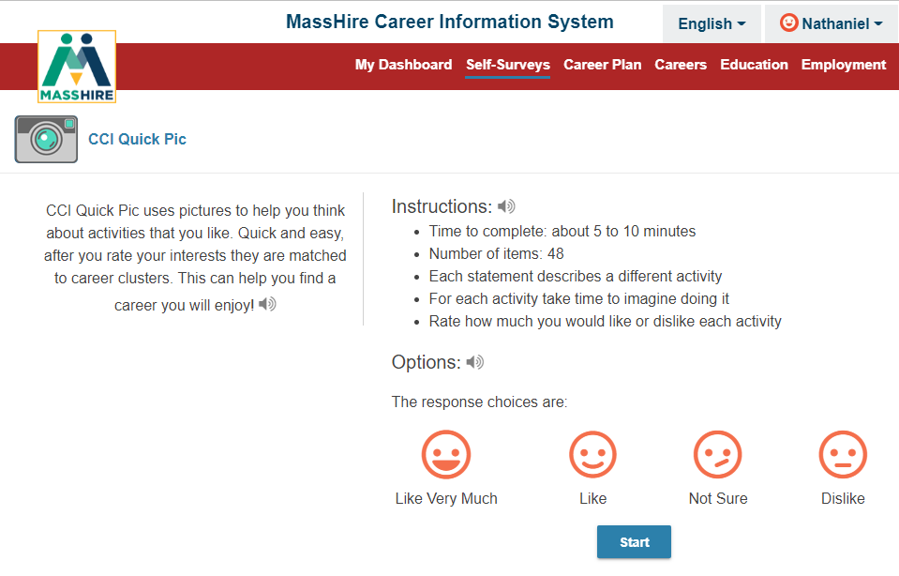
CCI Quick
Pic
Note:
View forty-Eight (48) photographs and rate how much you like or dislike that activity

Slide 39
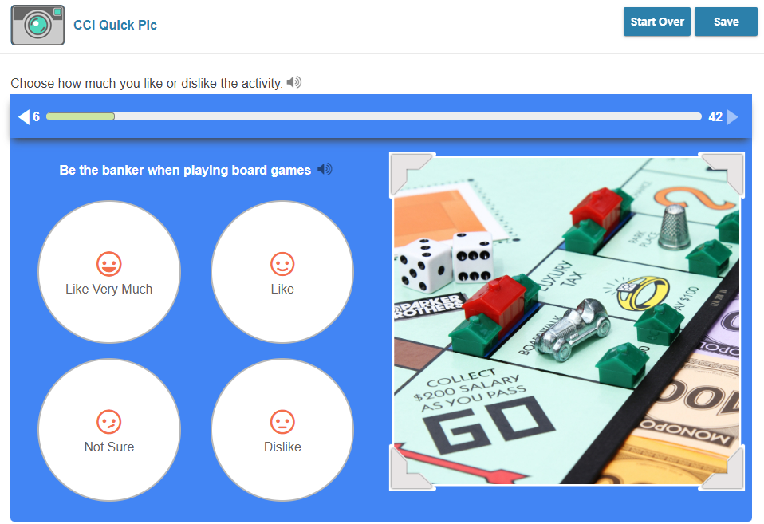
CCI Quick
Pic
Note:
Rate how much you like or dislike that activity
From
Like Very Much
To
Dislike

Slide 40
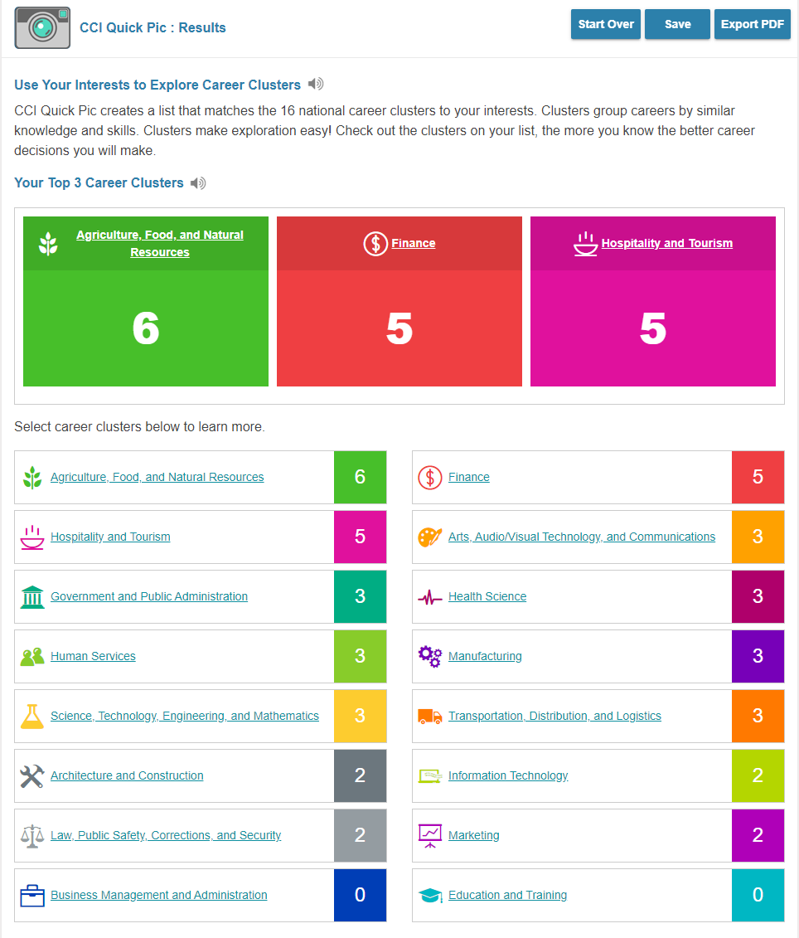
CCI Quick Pic Results
Note:
RESULTS
Broken out by the Sixteen (16) Career Clusters.
With highest scoring ones listed on top.
And all clusters listed on bottom with scores

Slide 41

CCI Quick Pic Results
Note:
RESULTS
Can be drilled down to specific career clusters
With associated careers / occupations listed
At a glance provides an overview of Cluster.

Slide 42
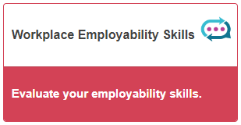
Workplace Employability Skills
This assessment measures nine skill areas.
Check the chart to see your strengths, as well as skills that need improvement. Knowing more about your skill levels will allow you to build on your strengths and work on things that need improvement.
Strong employability skills are important for a successful job search.

Slide 43
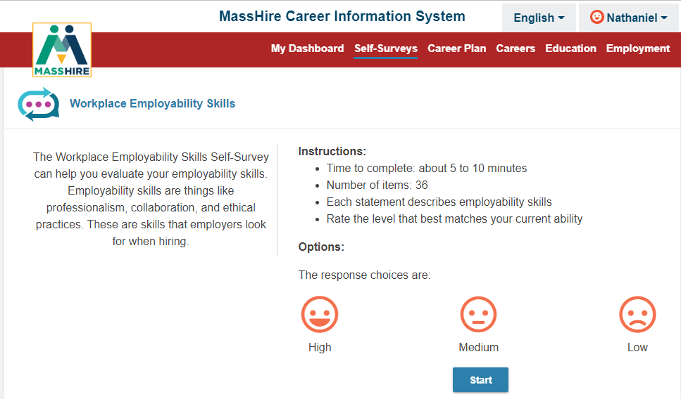
Workplace Employability Skills
Note:
Thirty-six (36) Employability factors to rate
Rating scale is from
High
To
Low

Slide 44
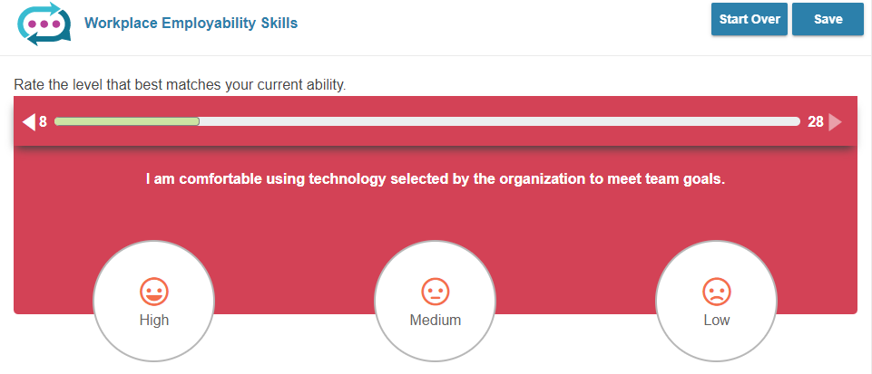
Workplace Employability Skills
Note:
Sample of a
Workplace Employability Skill,
you select your High and Low.
The bar above the question keeps track of the questions answered and those still to be answered.

Slide 45
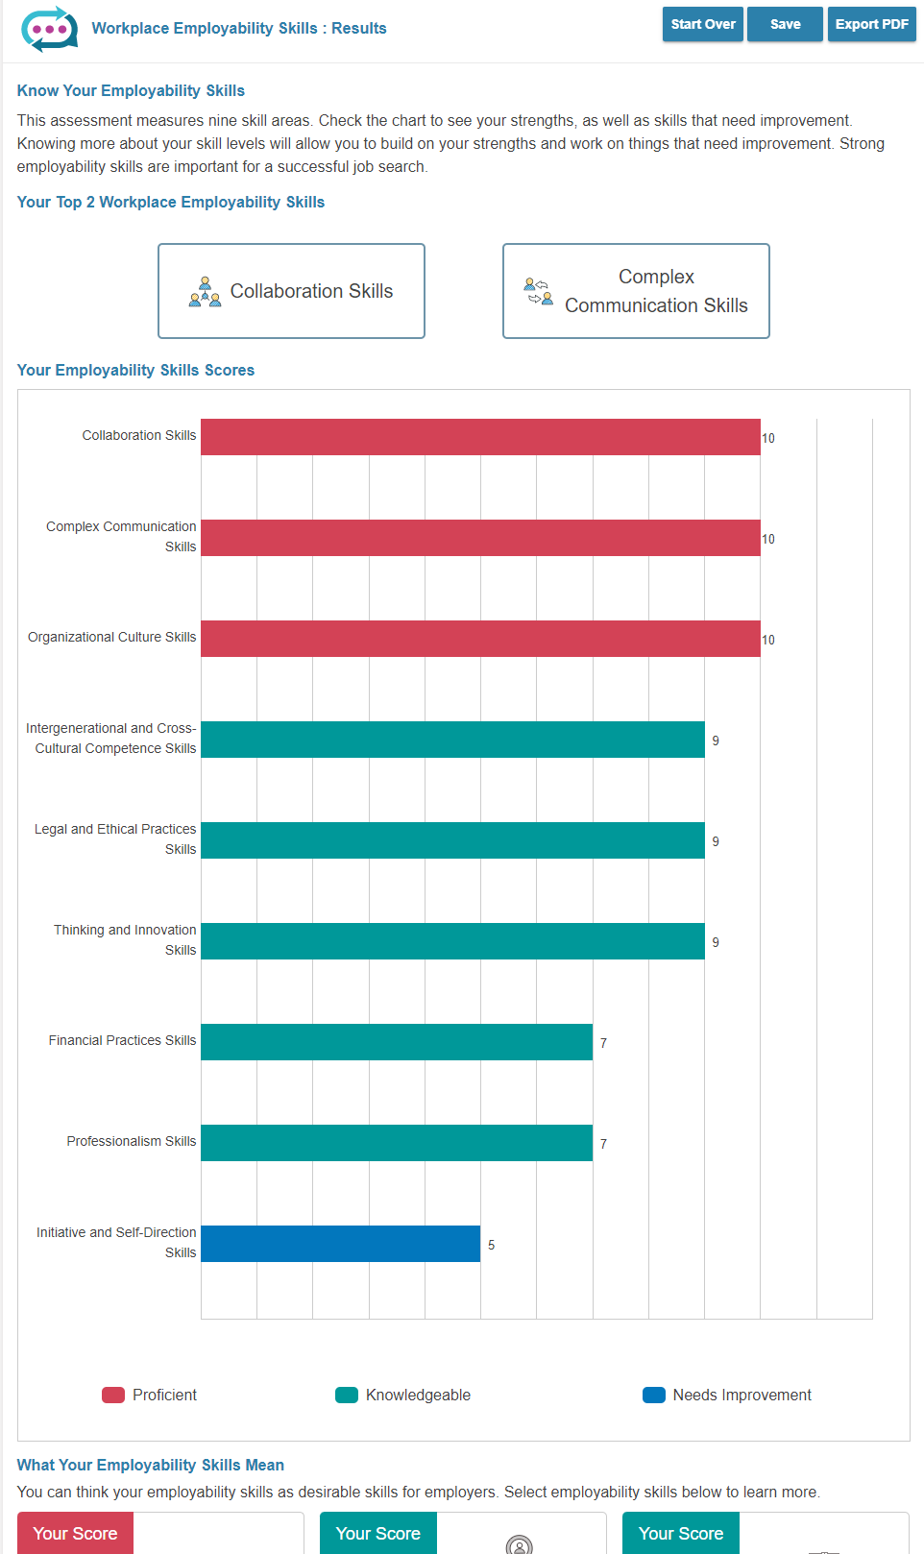
Workplace Employability Skills
Note:
RESULTS
Of the Nine Skills areas.
Your highest scoring skill area is on top

Slide 46
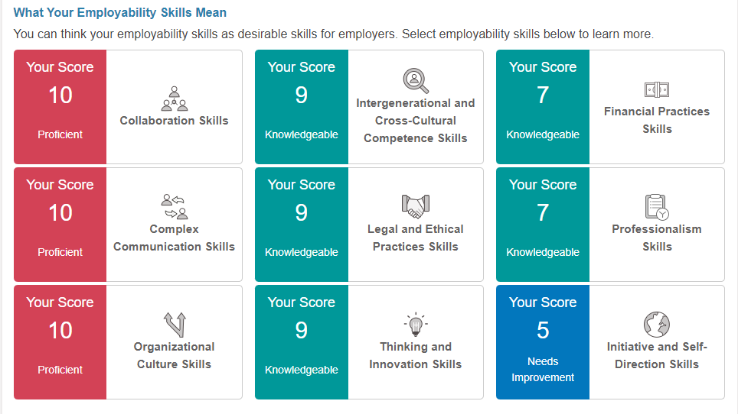
Workplace Employability Skills
Note:
RESULTS
(at bottom of previous page)
Of the Nine Skills areas.

Slide 47
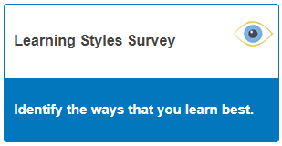
Learning Styles Survey
The Learning Style Survey is designed to assess your general approach to learning. It does not predict your behavior in every instance, but it is a clear indication of your overall style preferences.
And can provides a set of recommended learning strategies to help you study / train in a productive manner.

Slide 48
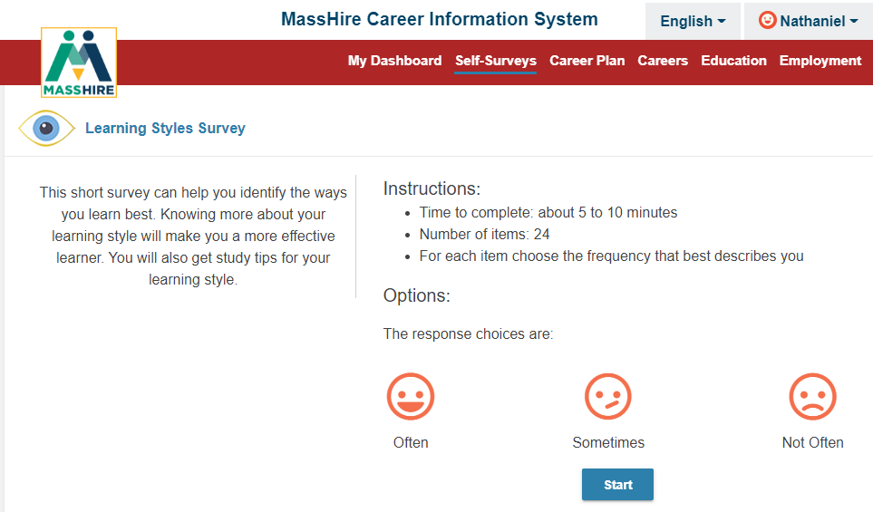
Learning Styles Survey
Note:
Twenty-four (24) Learning / Activities to rate
Rating scale is from
Often
To
Not Often

Slide 49
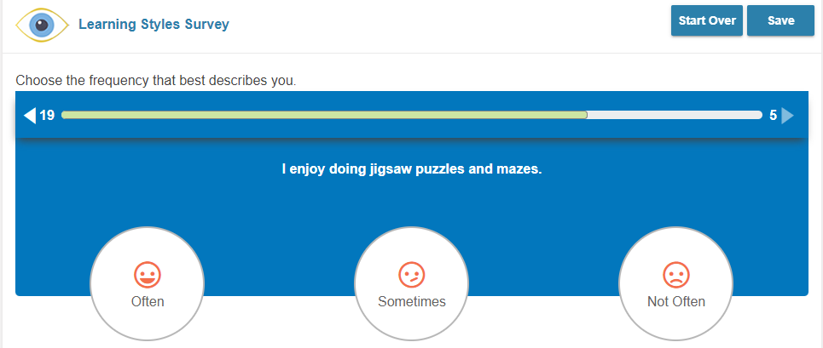
Learning Styles Survey
Note:
Sample of a
Learning style question,
you select your Often to Not Often response.
The bar above the question keeps track of the questions answered and those still to be answered.

Slide 50
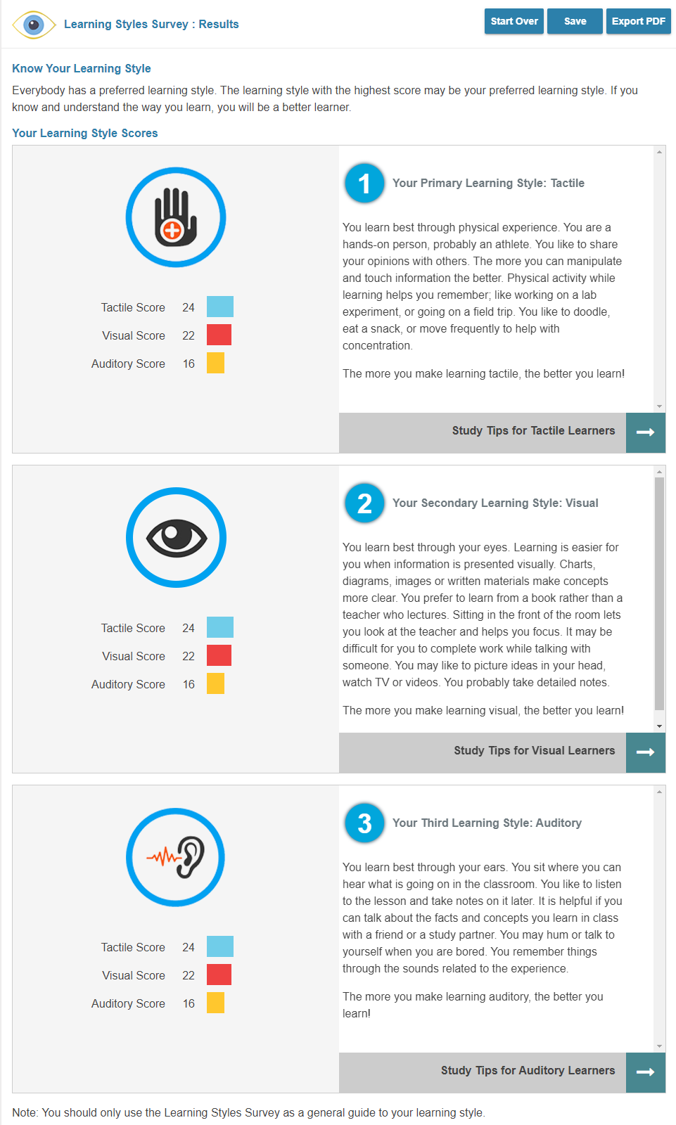
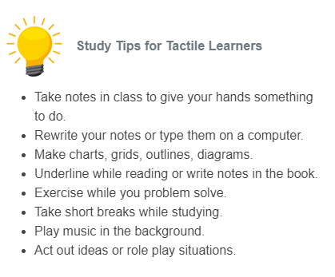
Learning Styles Survey
Note:
RESULTS
Lists your primary learning style
And the top three learning styles
Has Learning / Studying Tips

Slide 51
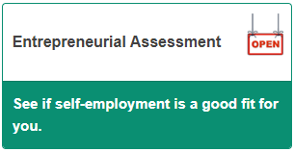
Entrepreneurial Assessment
The Entrepreneur Assessment identifies the necessary skills and entrepreneurial characteristics needed to start a new venture.
The assessment analyses key dimensions of personality, motivations, skills, and experiences required to be successful as an entrepreneur / business starter.
Commonwealth Corporation had done this previously for partner agencies.

Slide 52
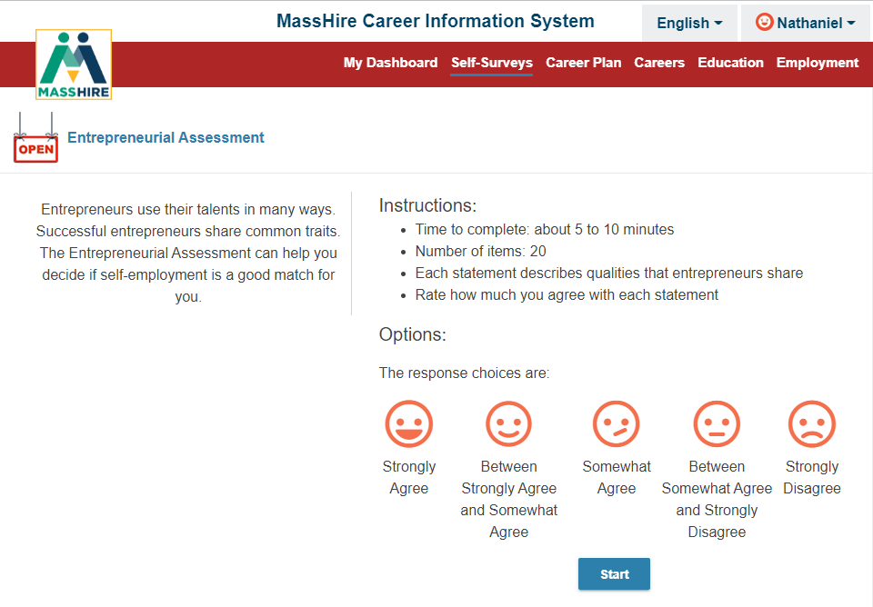
Entrepreneurial Assessment
Note:
Twenty (20) entrepreneurial questions to rate
Rating scale is from
Strongly Agree
To
Strongly Disagree

Slide 53

Entrepreneurial Assessment
Note:
Sample of a
Entrepreneurial question,
you select Strongly Agree to Strongly Disagree
as the response.
The bar above the question keeps track of the questions answered and those still to be answered.

Slide 54

Entrepreneurial Assessment
Note:
RESULTS
Provides a Score
With a gauge
It is a predictive indicator of how successful you could be as an entrepreneur.

Slide 55

Reality Check
Reality Check from CIS is an engaging online tool designed to estimate the income necessary to support your desired lifestyle.
You'll be asked questions about where you’d like to live in Massachusetts and how you spend your money (budget) . From there, you’ll be directed to jobs that meet your financial needs.
Reality Check will show you how much your living expenses will cost, and the amount of money you will need to earn to pay for them.

Slide 56

Reality Check
Note:
This assessment is a lifestyle assessment.
It has a minimum of twelve (12) living expenses.
You will select the various options under each expense.
From there the program will determine a needed budget and various career options that meet these expenses / budget.

Slide 57

Reality Check
Note:
Expenses under the various categories comes from a variety of documented sources.
Mass Real Estate information,
National costs for transportation (autos + insurance + upkeep),
national utility costs, etc.
Child expense are optional

Slide 58

Reality Check
Note:
Annualized Expenses are calculated + Taxes
And Itemized

Slide 59

Reality Check
Note:
Career Option can be extrapolated from Expenses.
Will list Occupations in your demographics that meet your expense.
Can adjust with Career Cluster filter

Slide 60

My dashboard

Slide 61

My dashboard
Note:
Self-Survey Results

Slide 62

My dashboard
Note:
Careers selected as Favorites and Self-Survey Results

Slide 63


Assessment
High School / College edition

Slide 64
Contact Information
Email: MassHireCIS@State.MA.US
Telephone: 617-626-6808
URL: https://portal.masscis.IntoCareers.org

Slide 65

?
?
?
Questions
?
?
?
?
?
?
?
?

Slide 66
Part 2: Careers in CIS 360

Slide 67

Occupations / Careers

Slide 68

Occupations / Careers
555 Occupations in MassHire Career Information Systems
Plus Alternative titles
  Clergy : Rabbi, Priest, Iman, or Minister
Break them out in the 16 Career Clusters
STEM and Green jobs listed

Slide 69

What are Hot Jobs?
The list of Hot Jobs in MH CIS 360 is based on the US 2022-32 projections.
The occupations coded as Hot Jobs in CIS are based on the following criteria:
  Rapid Growth: Projected to grow faster than average (employment increase of 8% or more)
  Numerous Job Openings: Projected to have 100,000 or more job openings
  Above Average Wage: Have a wage that is 20% above the median annual/hourly wage

Slide 70


Careers
Note:
Department of Unemployment Assistance
Section 30
Training Opportunities Program

Slide 71


Careers
Note:
Military Overview
Title: Including military careers by branch

Slide 72

Careers
Note:
Military Overview
Title : Including military careers by branch and type

Slide 73

Careers
Note:
Military Overview
Career Clusters

Slide 74

Careers
Note:
Military Overview
Clusters: Including military careers by occupational clusters

Slide 75


Occupations / Careers

Slide 76

Occupations / Careers

Slide 77


Careers
Note:
Careers by Title

Slide 78

Careers
Note:
Careers by Title
Careers search has been updated to include the O*NET alternate titles
https://www.onetcenter.org/dictionary/28.2/excel/alternate_titles.html

Slide 79

Careers
Note:
Careers by Title
Advanced Search feature

Slide 80

Careers
Note:
Careers by Title

Slide 81

Careers
Note:
At A Glance
  Wages
  Education & Training
  Employment Opportunities
  Job Tasks
  Work Settings
  Career Cluster category
Video

Slide 82

Careers
Note:
Job Description
  Overview
  Job Tasks
  Skills & Abilities
  Work Settings
  Physical Demands
Sub sections provide more details

Slide 83

Labor Market information
Note:
Wages
  Annual, Monthly, Hourly
Massachusetts default by NECTA
Select other states
Top five states

Slide 84

Labor Market information
Note:
Employment & Outlook
By sixteen (16) board areas , where sufficient data allows.
Growth rate projections

Slide 85

Labor Market information
Note:
Employment & Outlook
By sixteen (16) board areas , where sufficient data allows.
Bottom lists:
Major employers, Outlook, and link to NLx.

Slide 86

Other States / Territories

Slide 87

Careers
Note:
Education & Training
  Preparation
  Helpful High School Courses
  Knowledge
  Related Programs of Study
  Licensing / Certification
  (Apprenticeship)

Slide 88

Careers
Note:
Personal Qualities
Relates back to Assessments /
Self Surveys scores

Slide 89

Careers
Note:
Related Careers
Associated careers that could have minimal training to enter
Career Cluster

Slide 90

Careers
Note:
Related Careers
Associated careers that could have minimal training to enter
Career Cluster
Military Careers

Slide 91

Careers
Compare 2 Careers

Slide 92

Careers
Compare 2 Careers

Slide 93

Careers
Compare 2 Careers
Wages for the United States

Slide 94

Careers
Compare 2 Careers
Employment Projections United States

Slide 95

Apprenticeships

Slide 96


Apprenticeships

Slide 97


Apprenticeships
250 Registered
Apprenticeship careers/occupations

Slide 98

Apprenticeships

Slide 99

Apprenticeships
Education & Training
Apprenticeship
Shows when filter for Apprenticeship is on

Slide 100

Apprenticeships
Apprenticeship USA website

Slide 101


Apprenticeships

Slide 102

Careers
High School / College edition

Slide 103
Contact Information
Email: MassHireCIS@State.MA.US
Telephone: 617-626-6808
URL: https://portal.masscis.IntoCareers.org

Slide 104
?
?
?
Questions
?
?
?
?
?
?
?
?

