Slide 1

MassHire Career Information Systems 360
Fall / Winter 2024
What’s New!
  MassHire Programs & Services are funded in full by US Department of Labor (USDOL) Employment and Training Administration grants. (Additional details furnished upon request.)

Slide 2

University of Oregon : into CAREERS

Slide 3

MassHire Career Information System
MassHire Career Information Systems 360 is purchased with grants by the US Department of Labor (USDOL) Employment and Training Administration, it is primarily procured for the use of the Department of Career Services Career Centers, it’s partners and Massachusetts constituents. As such the trainings focus is for career center staff usage.

Slide 4
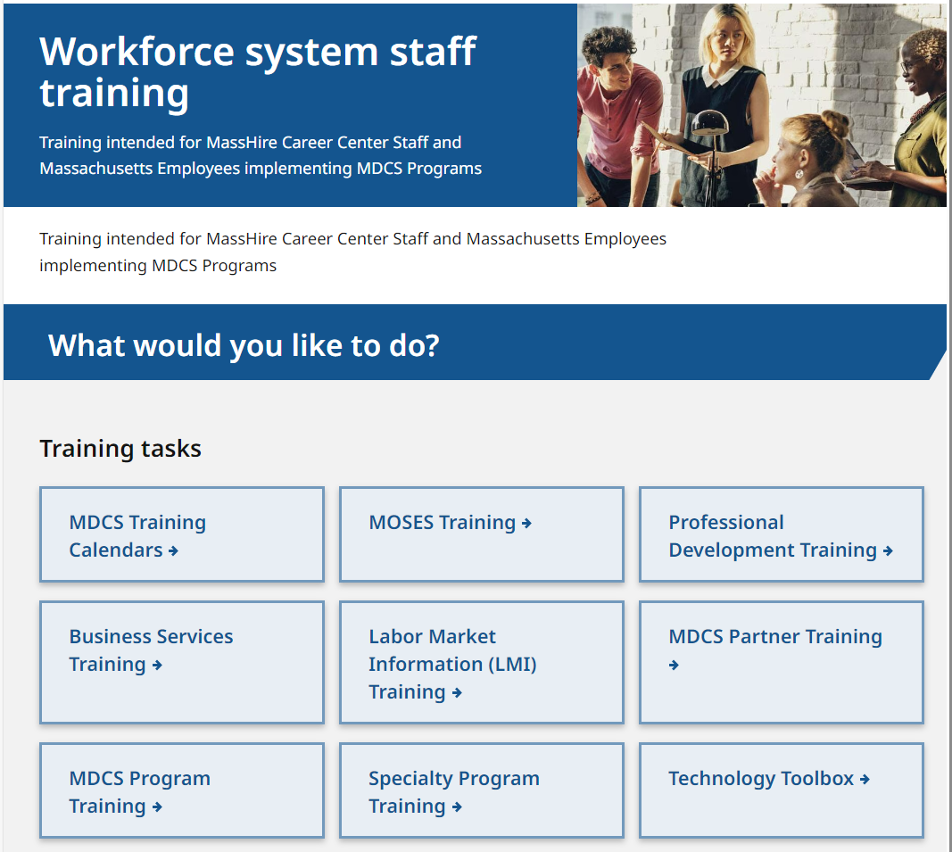
The MassHire CIS Training Calendar https://www.mass.gov/workforce-system-staff-training

Slide 5
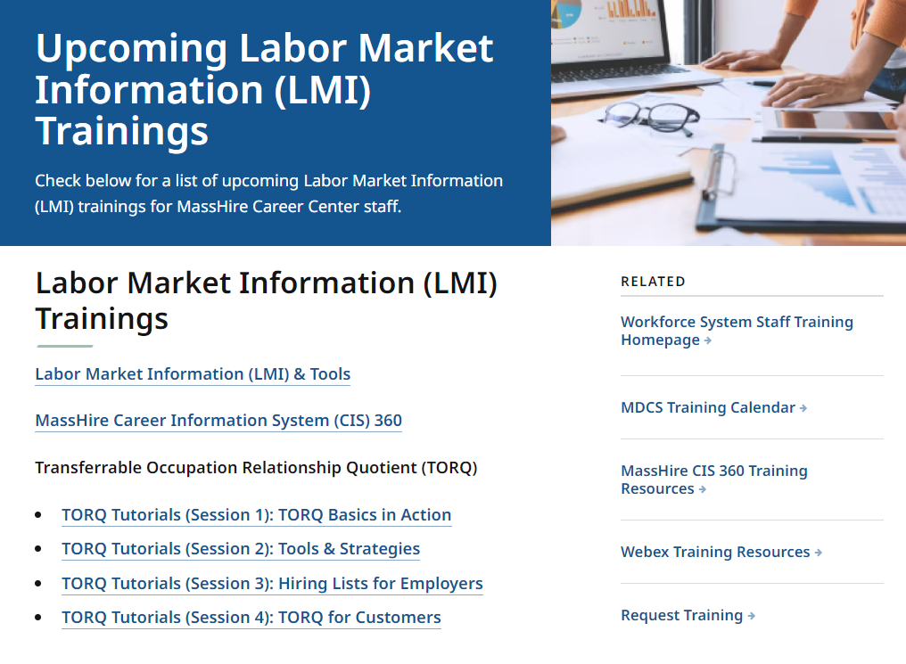
The MassHire CIS Training Calendar https://www.mass.gov/info-details/upcoming-labor-market-information-lmi-trainings

Slide 6
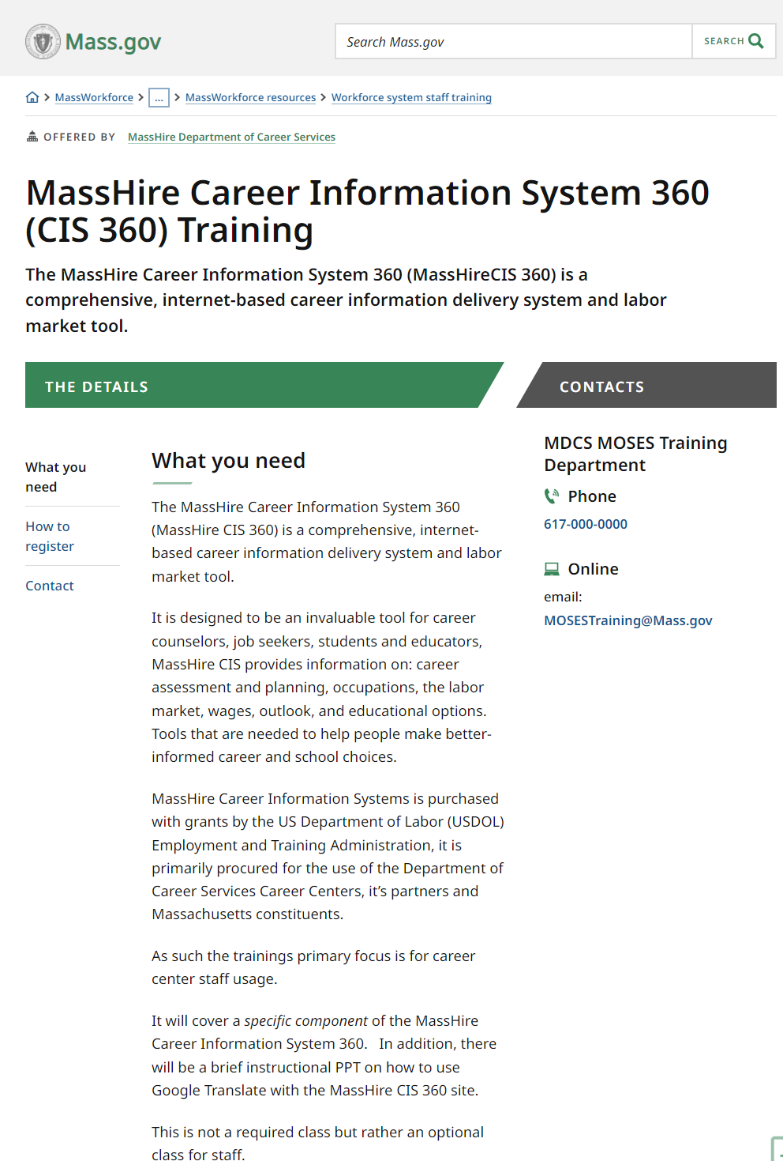
The MassHire CIS Training Calendar https://www.mass.gov/how-to/masshire-career-information-system-360-cis-360-training

Slide 7
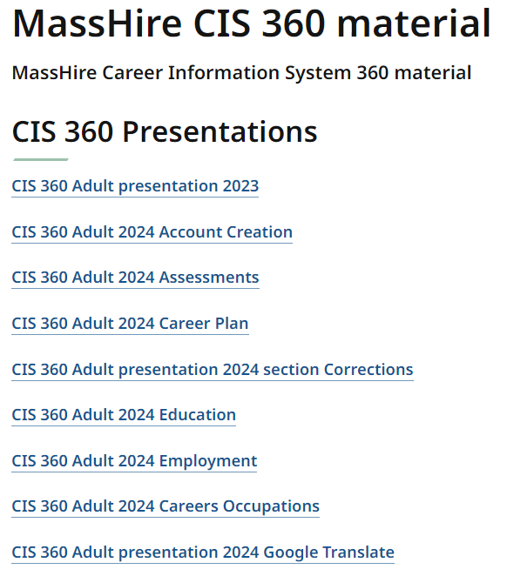
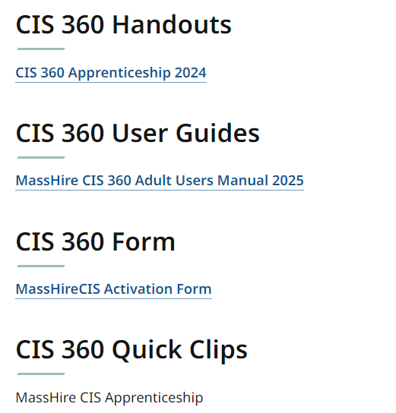
The MassHire CIS Resources https://www.mass.gov/info-details/masshire-cis-360-material

Slide 8
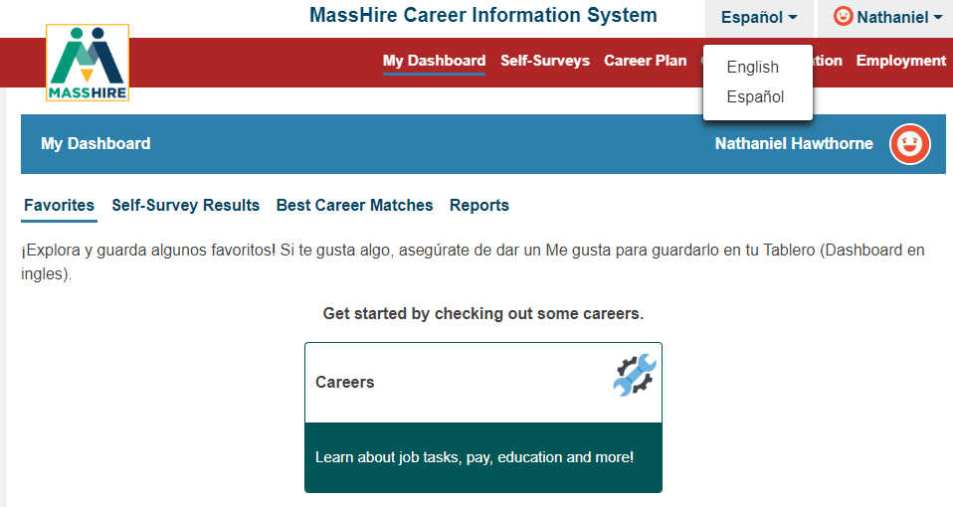
English / Español
Note:
Español version originally done by Texas translation affiliation using Mexican Spanish

Slide 9


Translation

Slide 10

The MassHire Career Information System Portal https://portal.ma.cis360.org/

Slide 11
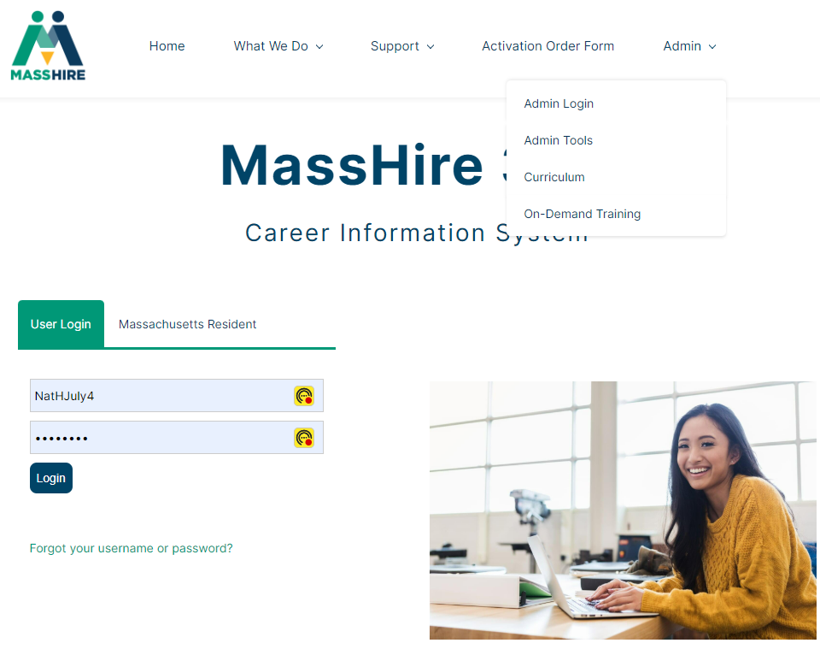
On-Demand Training Videos

Slide 12
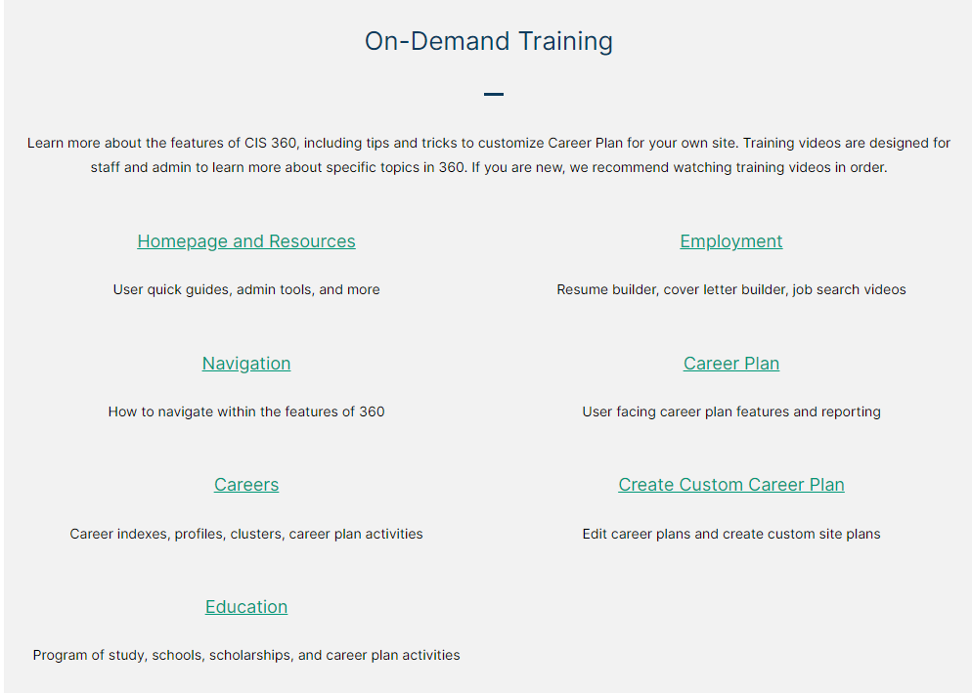
On-Demand Training Videos (Oregon / National versions)

Slide 13
On-Demand Training Topics
Homepage and Resources
Navigation
Careers
Education
Employment
Career Plan
Create Custom Career Plan

Slide 14
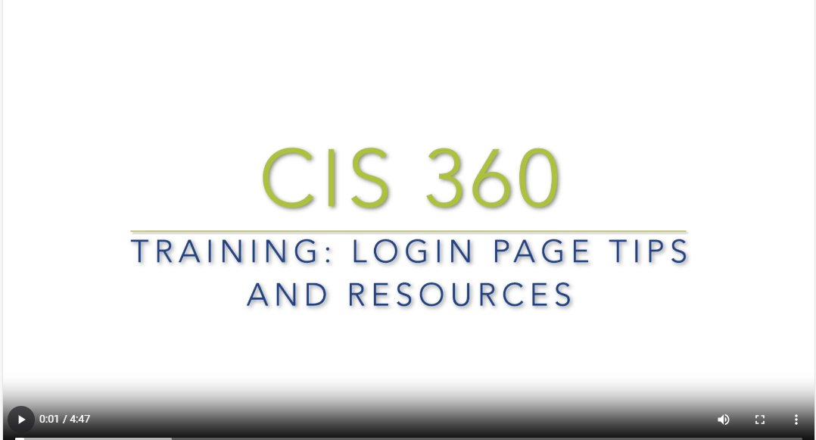
On-Demand Training Videos

Slide 15
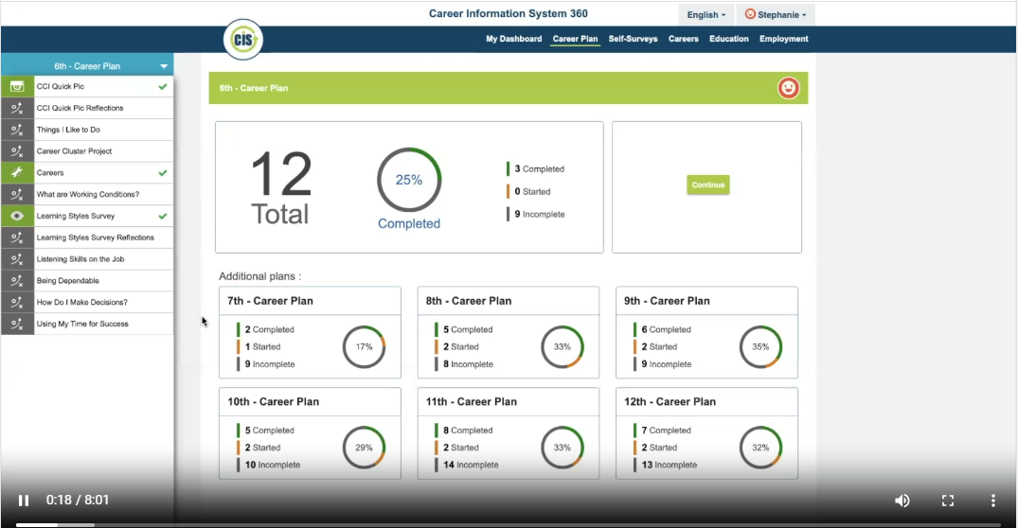
On Demand Training Videos

Slide 16
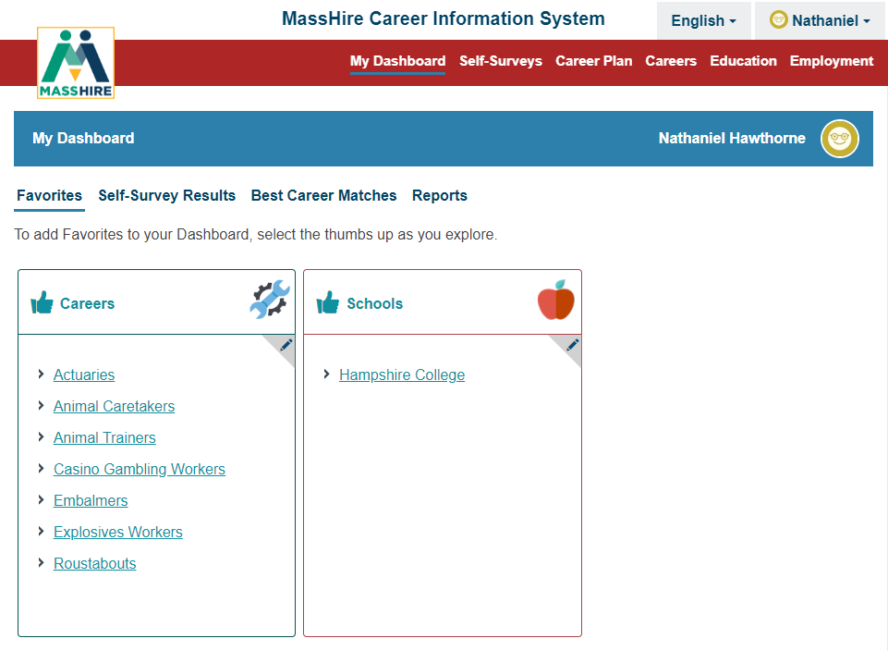
Account Dashboard

Slide 17
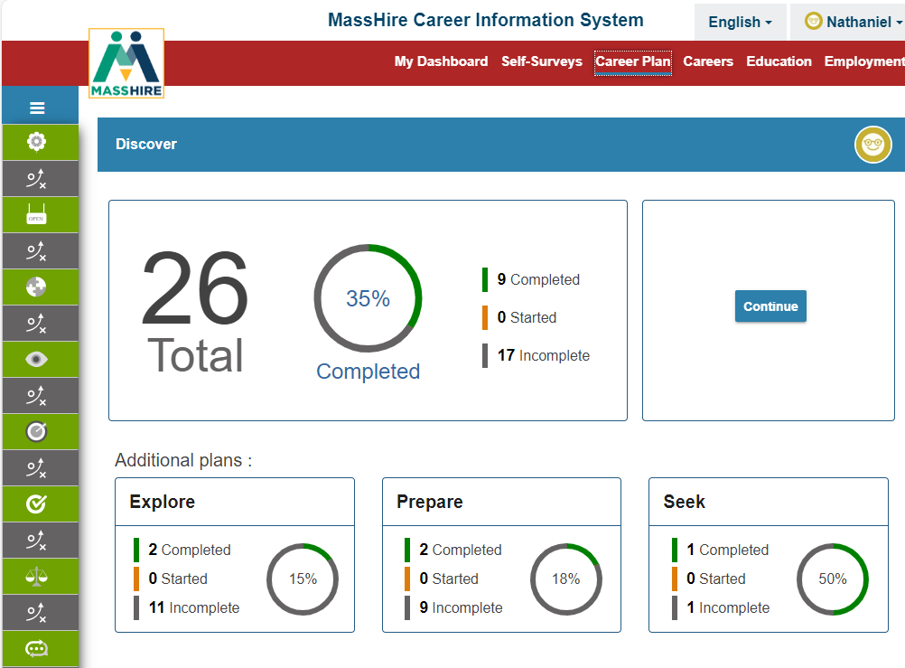
Career Plan Updates

Slide 18
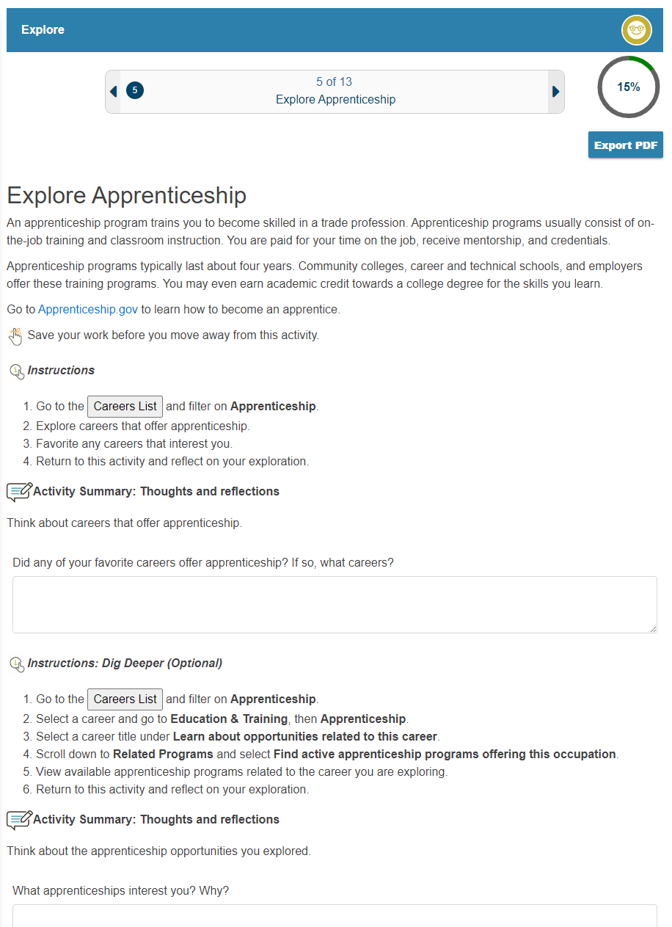
Career Plan Update - Explore
In the Career Plan
Under Explore
New: Explore Apprenticeship

Slide 19
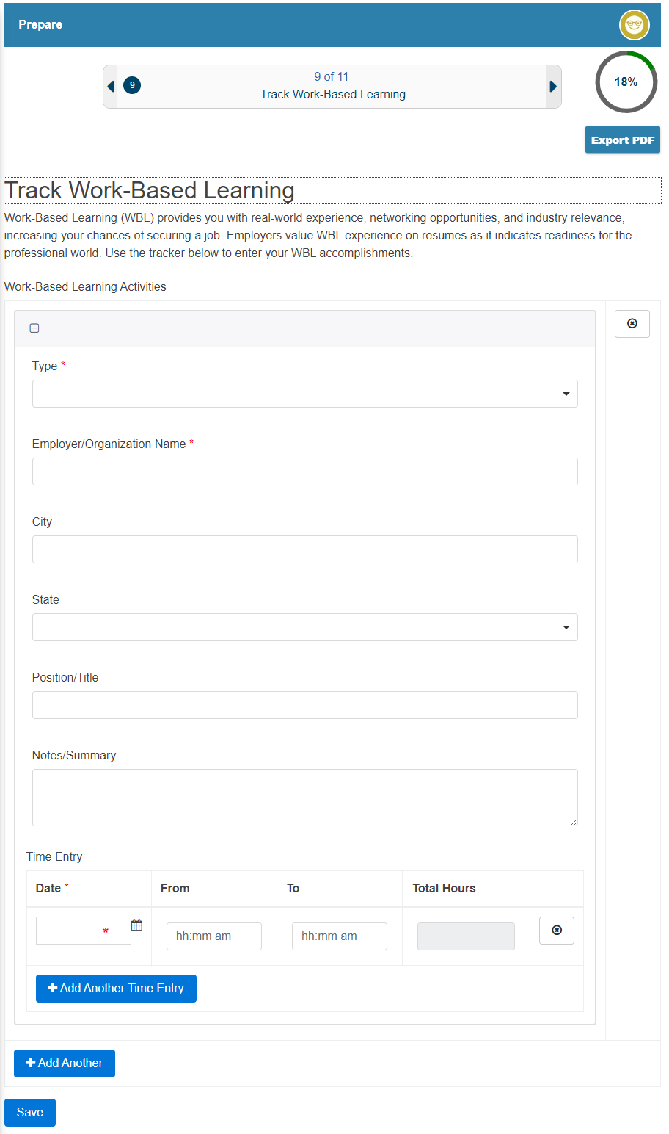
Career Plan Updates - Prepare
In the Career Plan
Under Prepare
New: Track Work-Based Learning

Slide 20
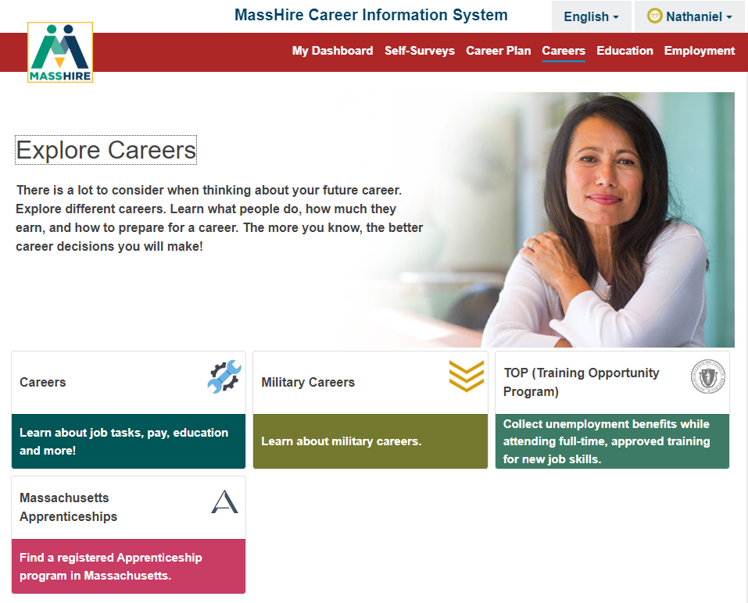
Careers Updates

Slide 21
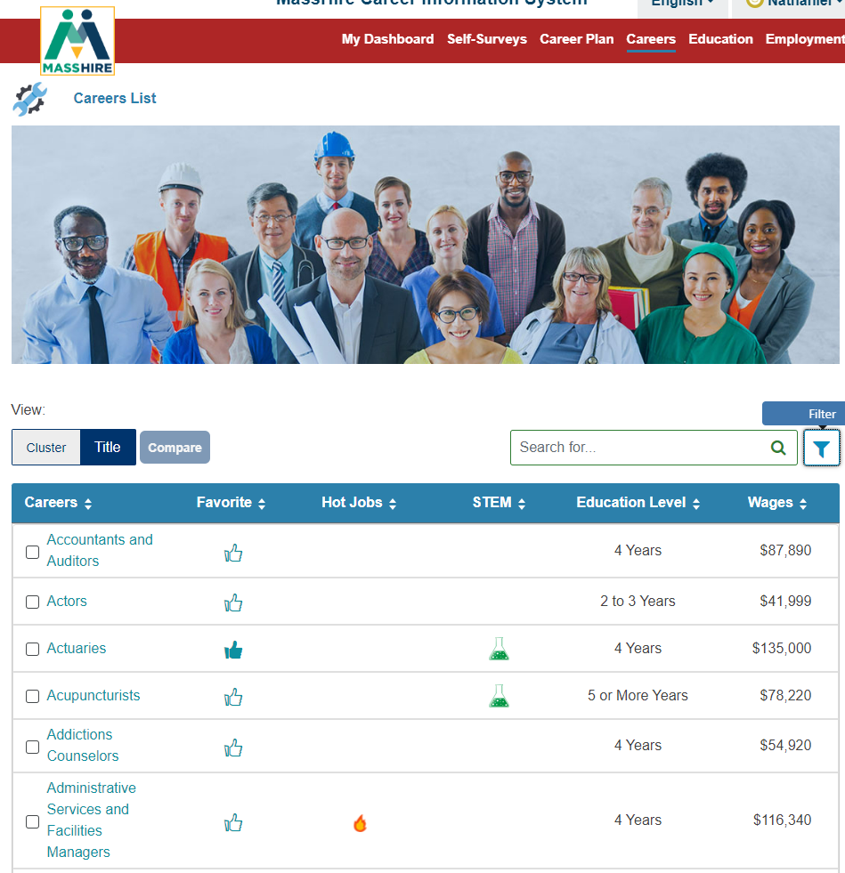
Careers Updates

Slide 22
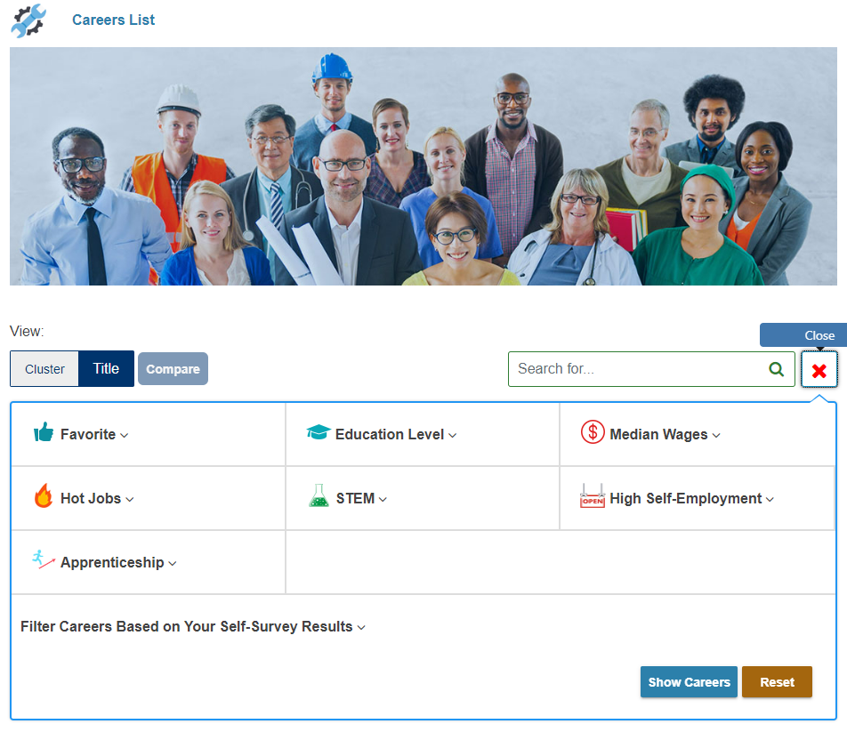
Careers - Filter
In Careers
Filters
New: Apprenticeship

Slide 23
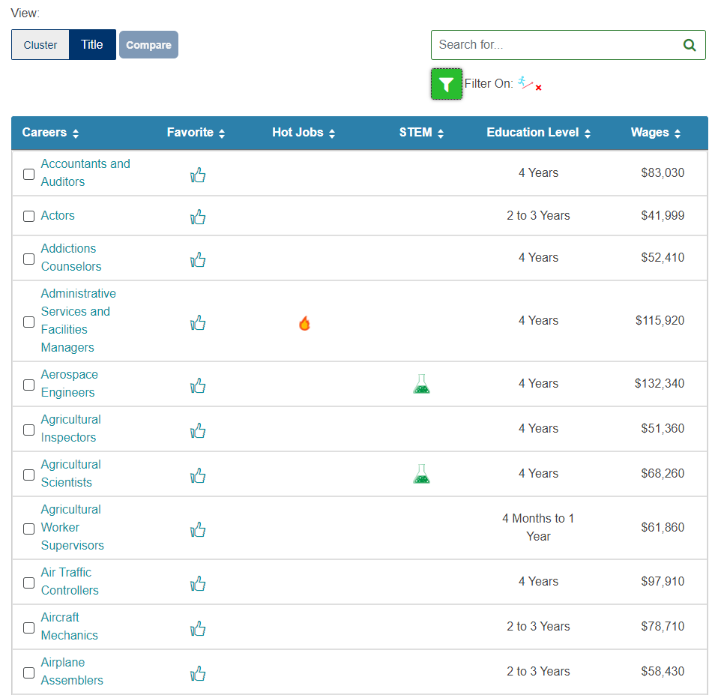

Apprenticeships
250 Registered
Apprenticeship careers/occupations

Slide 24
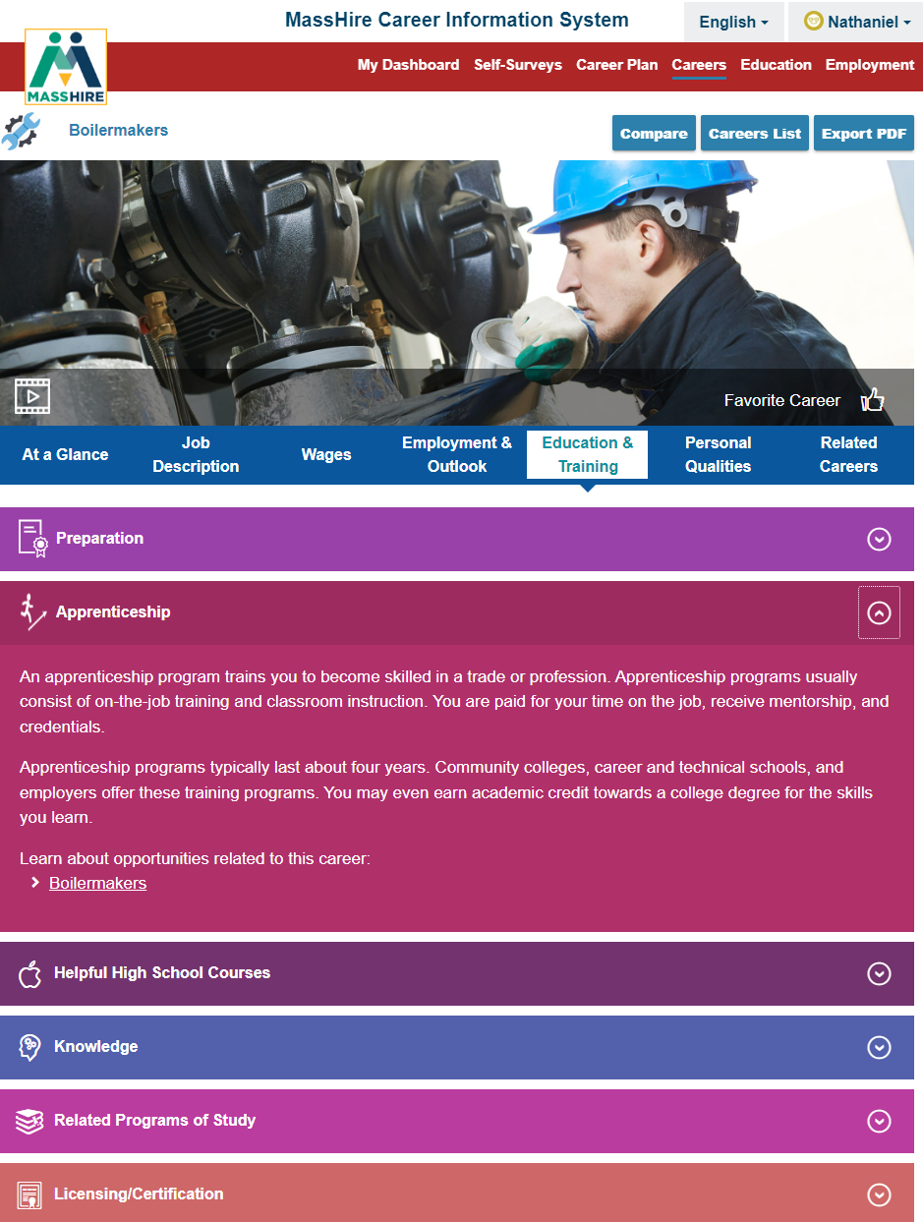
Apprenticeships
Careers
Education & Training
Apprenticeship
Shows when filter for Apprenticeship is on

Slide 25
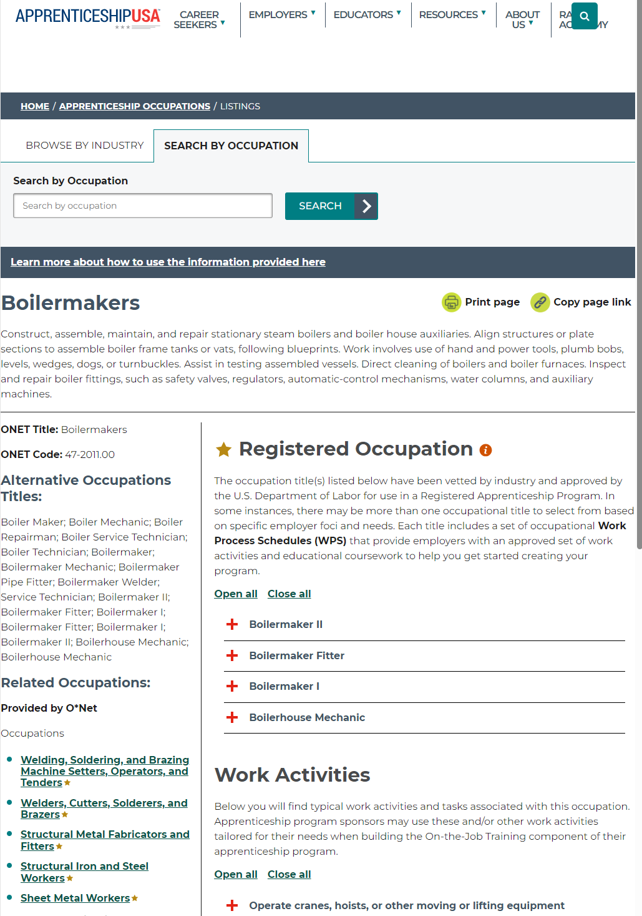
Apprenticeships
Apprenticeship USA website

Slide 26
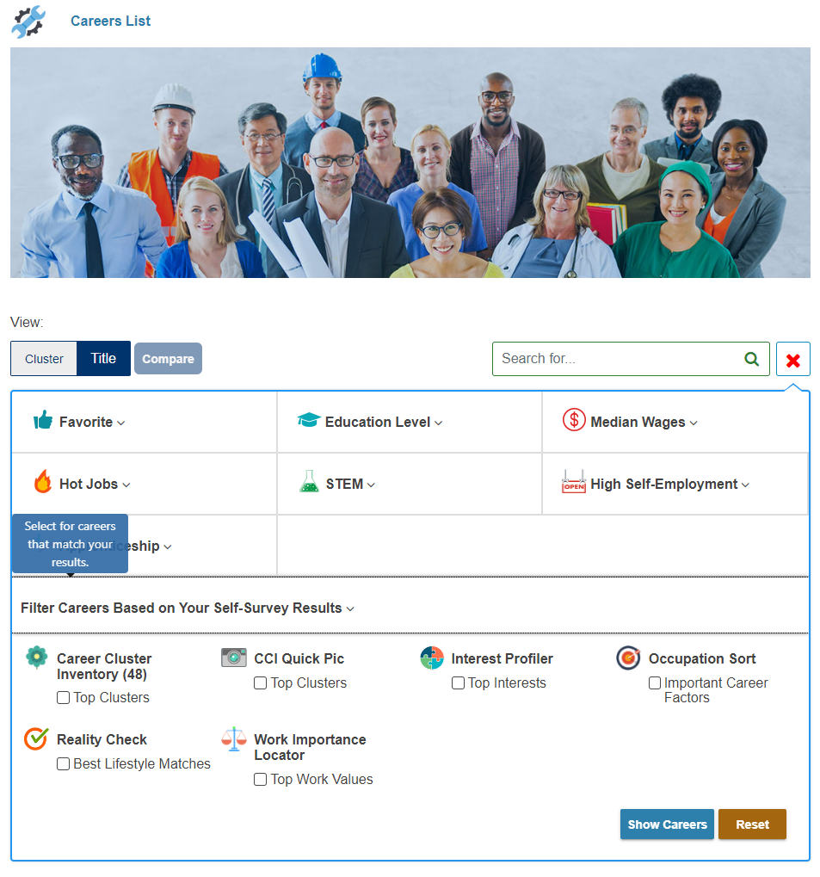
Careers Update
In Careers
Filters
New: Self-Surveys Results
available

Slide 27
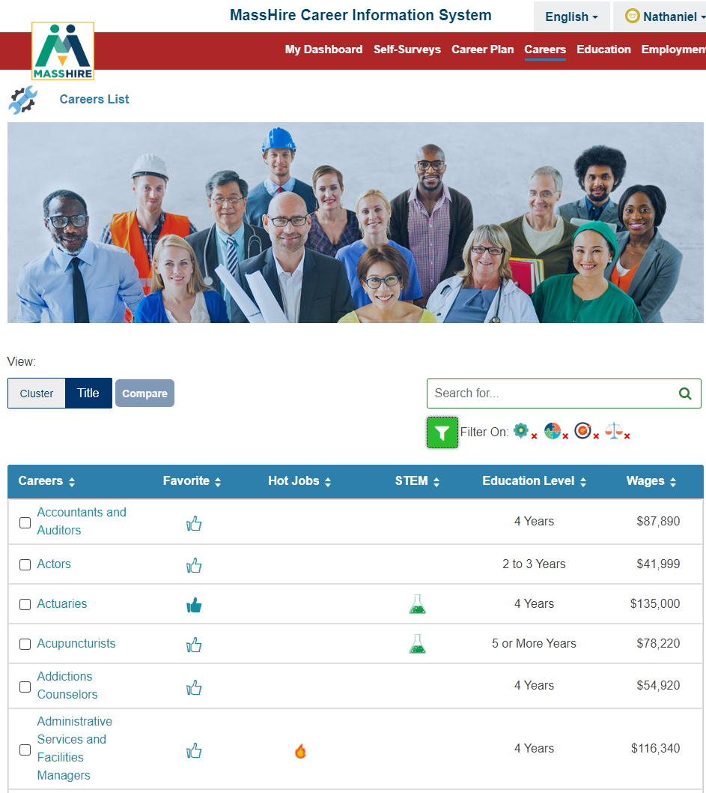
Careers Update
In Careers
Filters
New: Self-Surveys Results

Slide 28
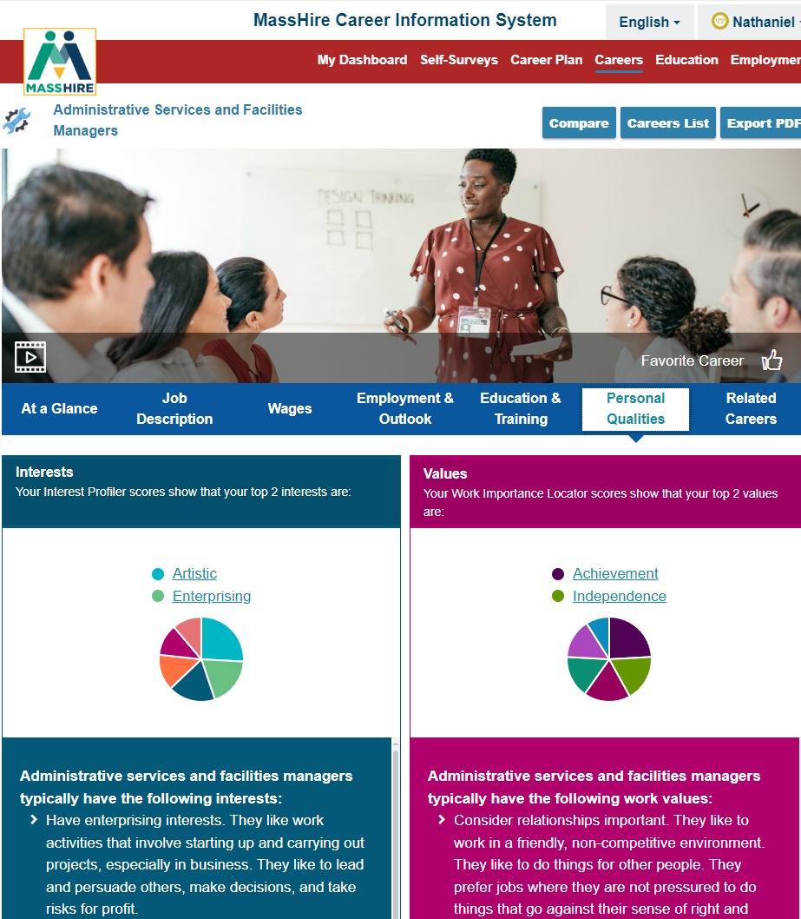
Careers
In Careers
Personal Qualities
Assessment Matching

Slide 29
Careers Updates

Slide 30
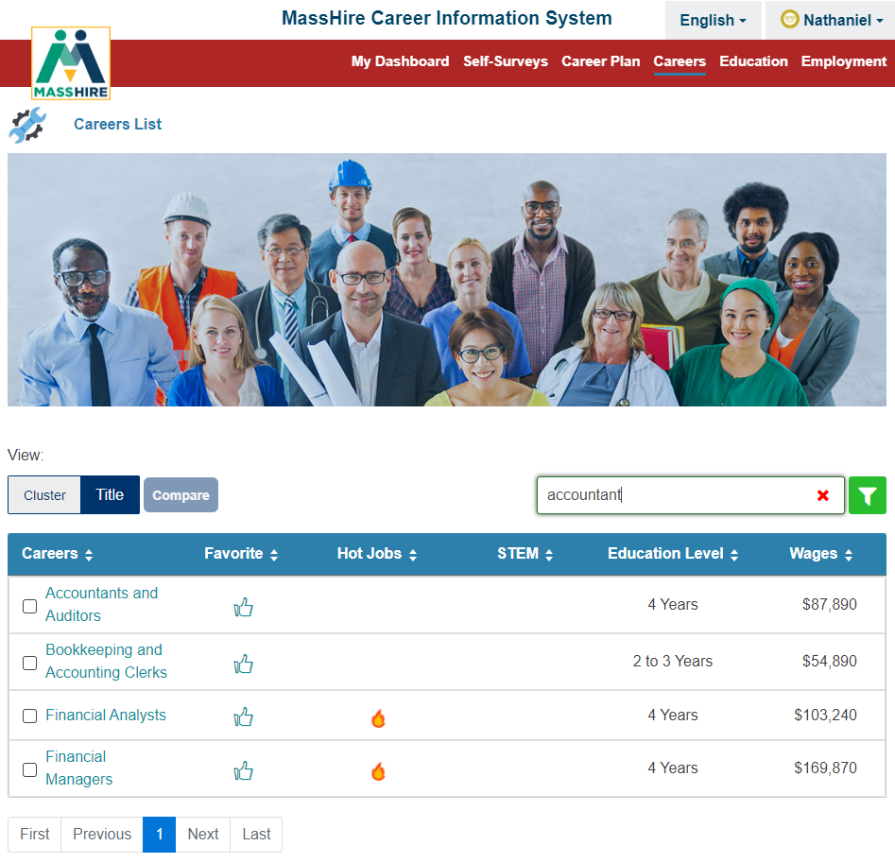
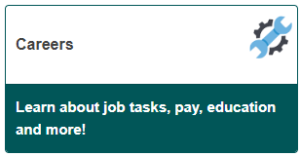
Careers
Note:
Careers by Title
Careers search has been updated to include the O*NET alternate titles
https://www.onetcenter.org/dictionary/28.2/excel/alternate_titles.html

Slide 31
Careers Updates

Slide 32
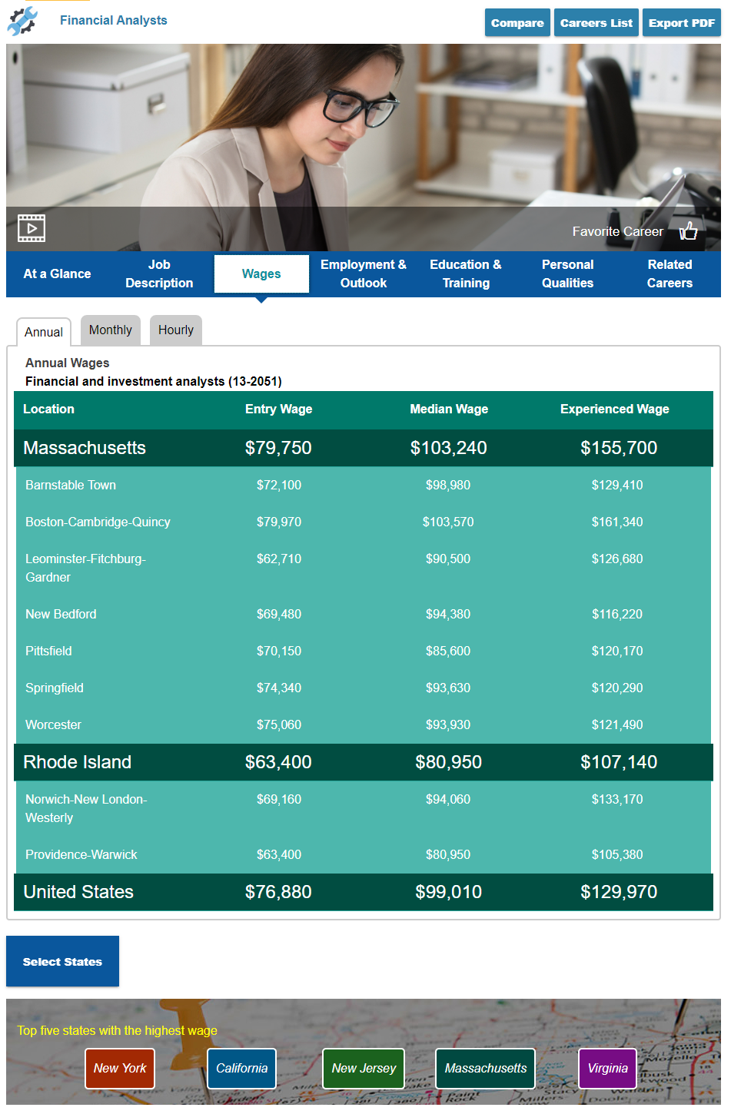
Careers Wages

Slide 33
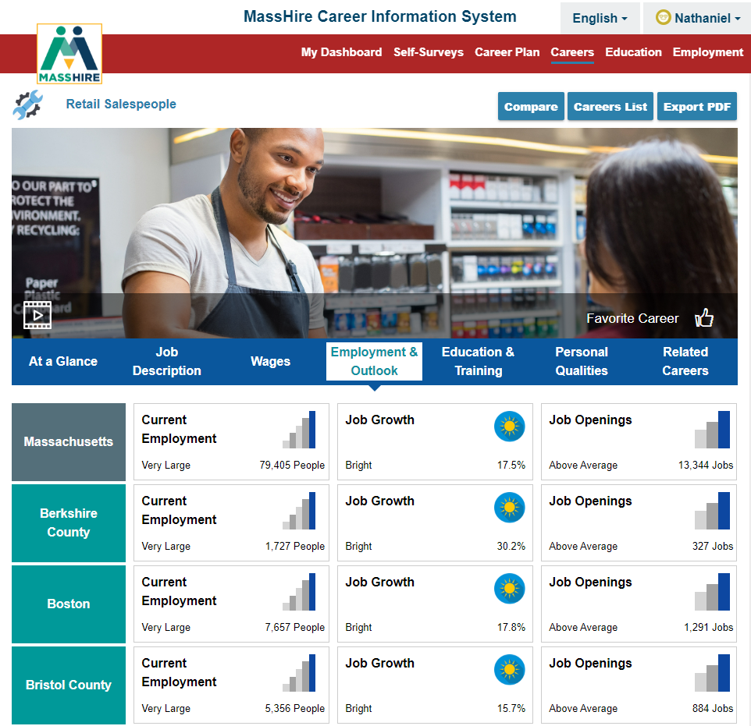
Employment & Outlook

Slide 34
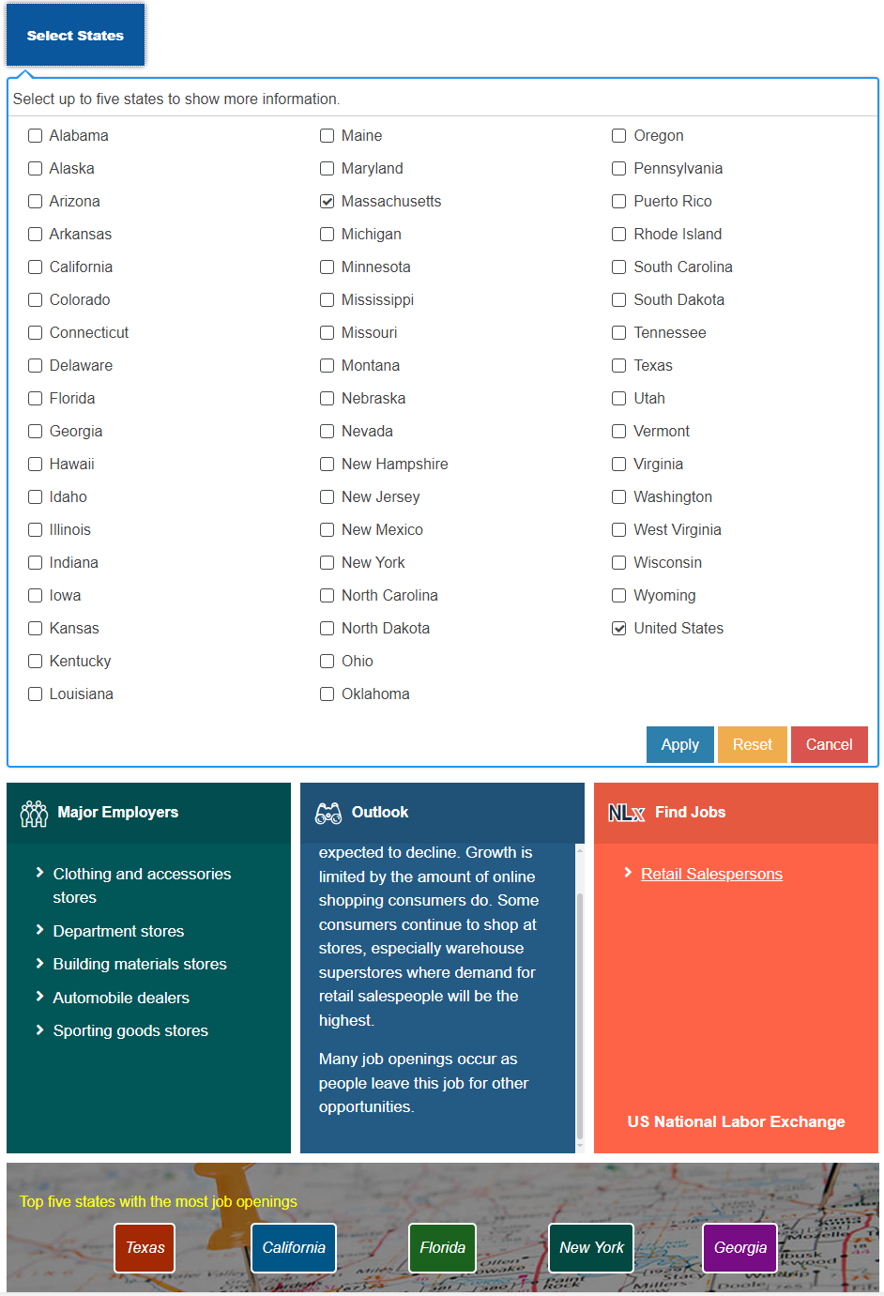
Employment & Outlook

Slide 35
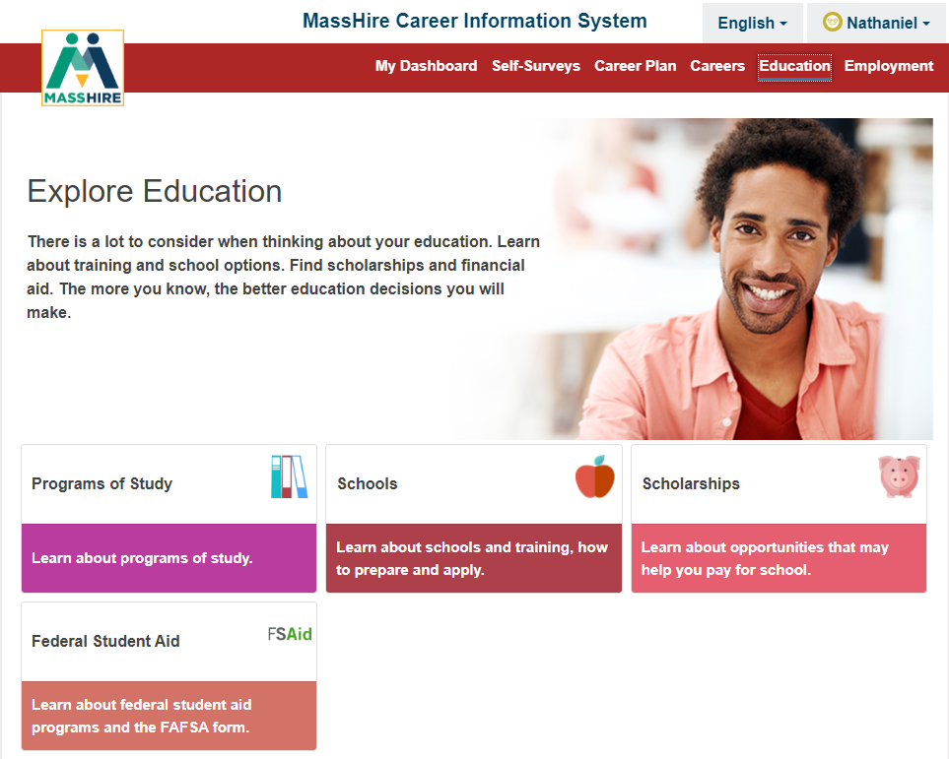
Education Updates

Slide 36
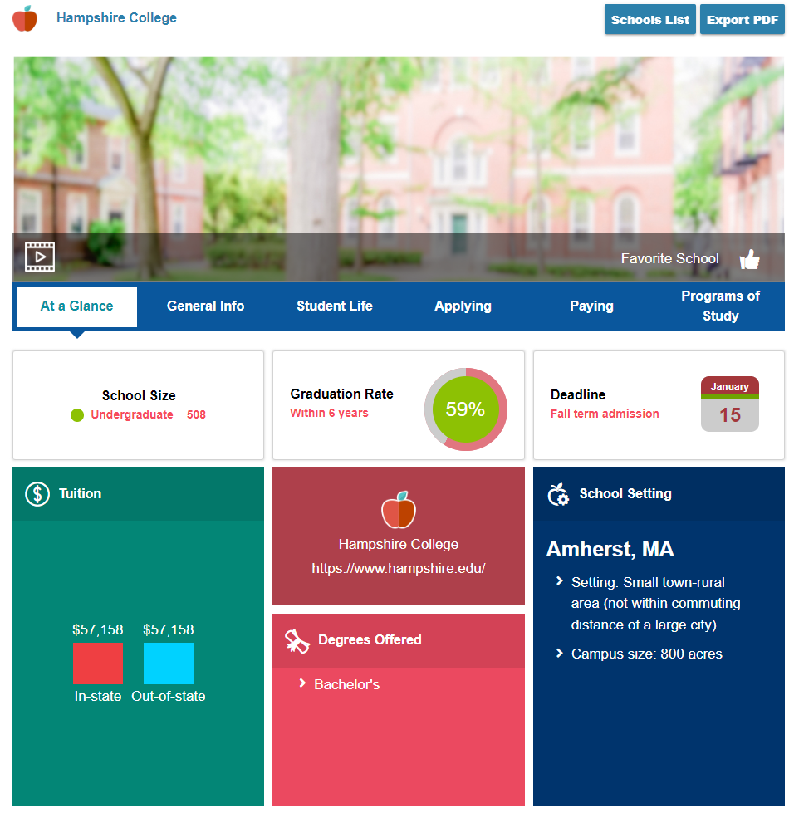
Education

Slide 37
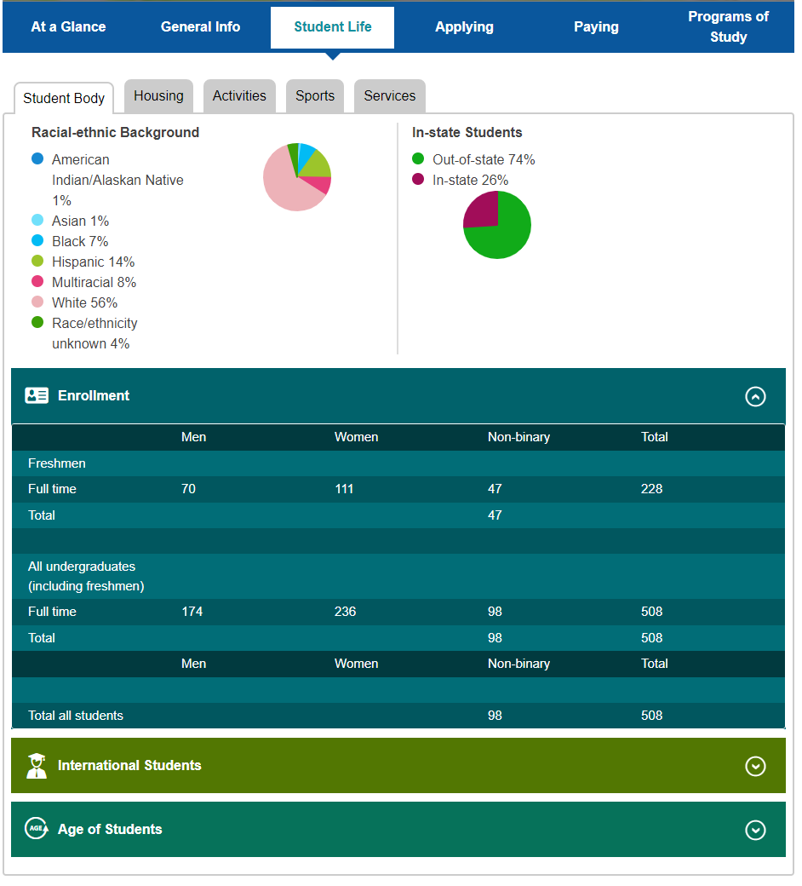
Education
In Education
Student Life
Student Body
Gender update

Slide 38
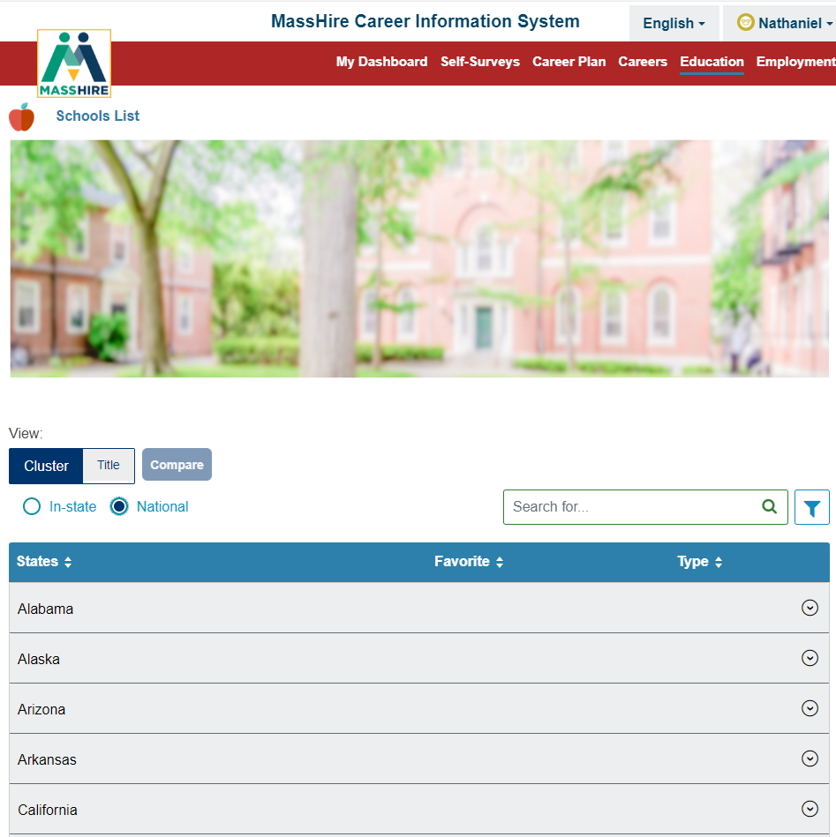

Education
In Education
National Schools

Slide 39
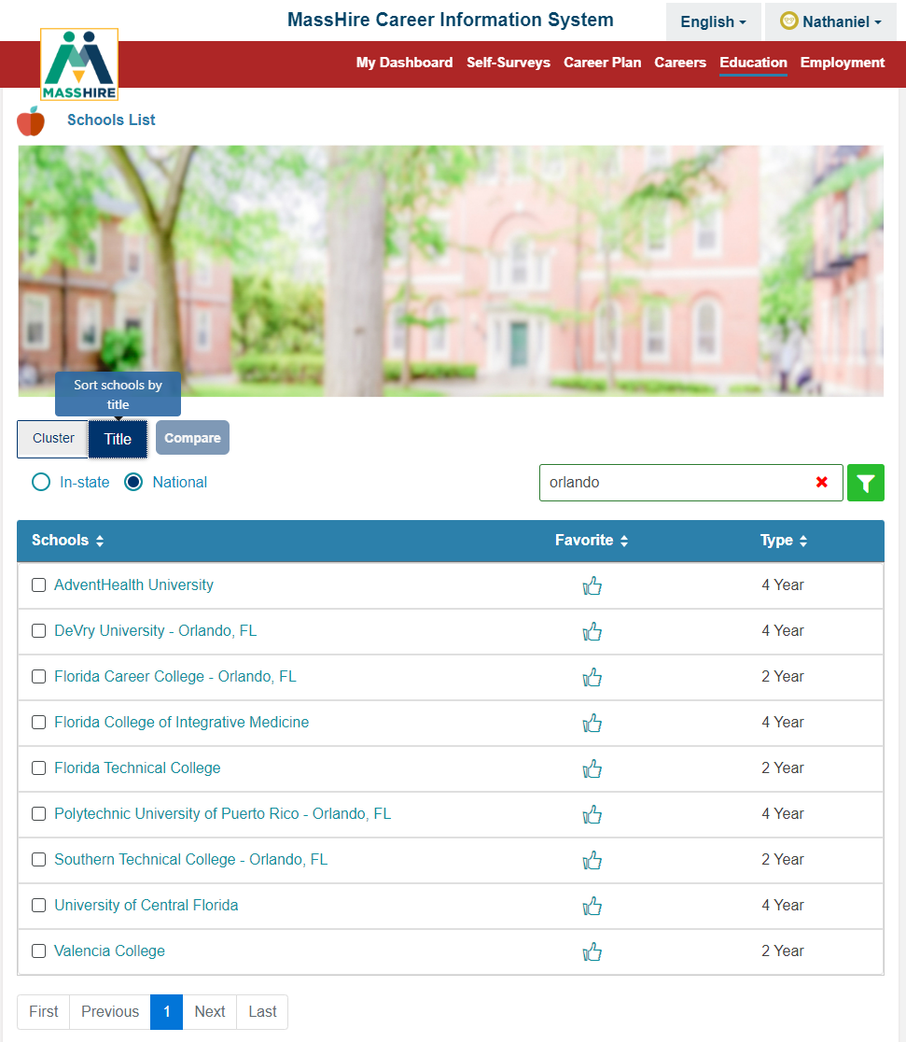
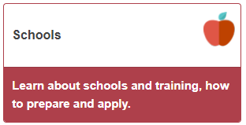
Education Update
Can now type a city title into the school search and be returned a list of schools in that city.

Slide 40
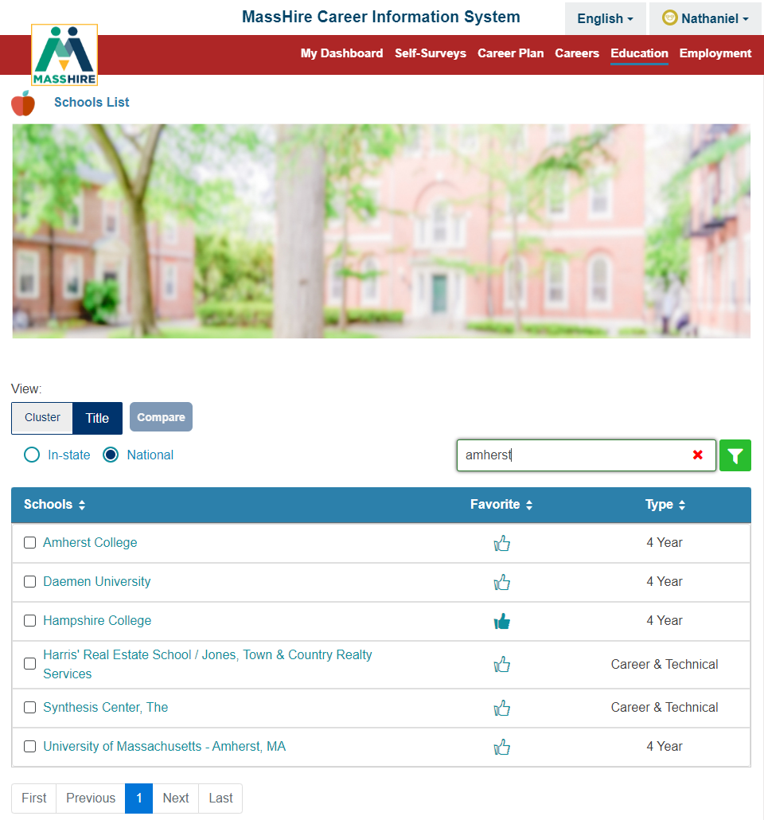
Education Update
Can now type a city title into the school search and be returned a list of schools in that city.

Slide 41
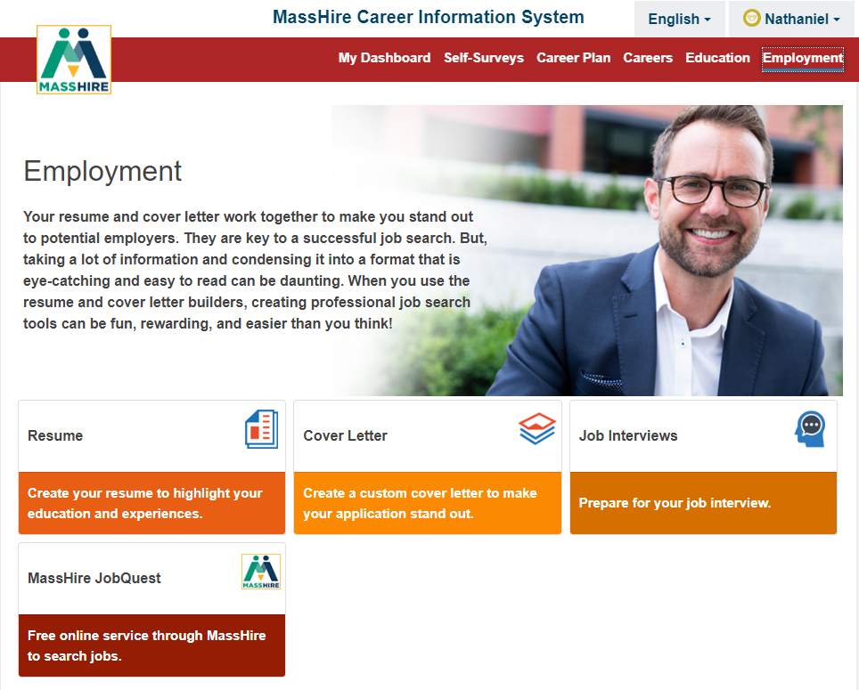
Employment Update

Slide 42
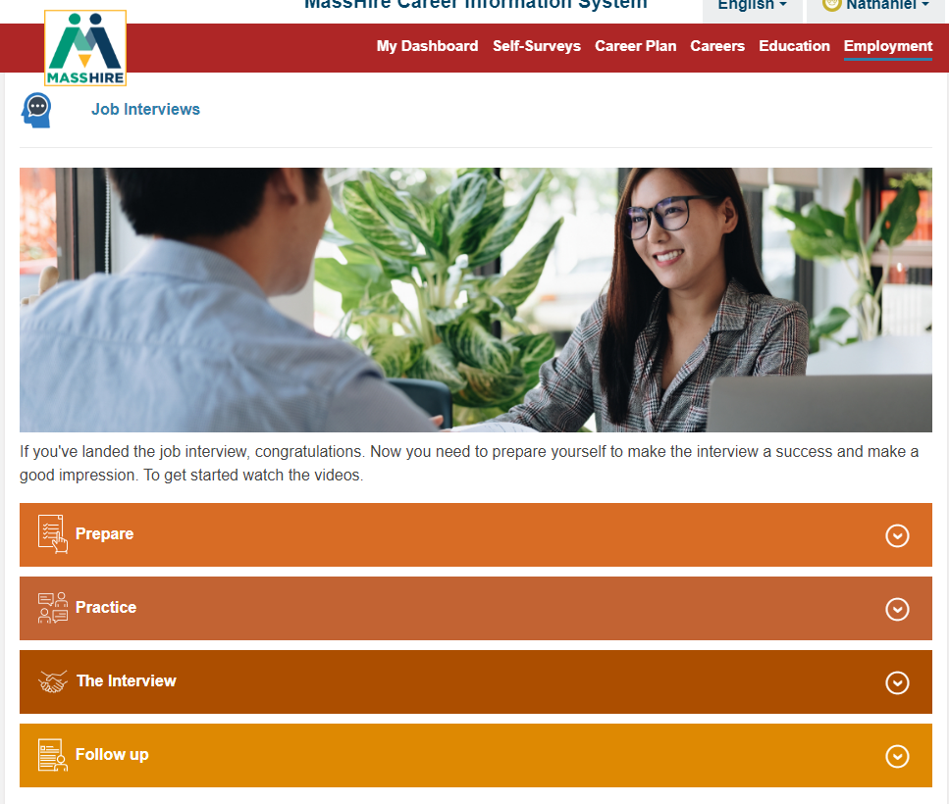
Employment
In Employment
The Interview
Videos added

Slide 43
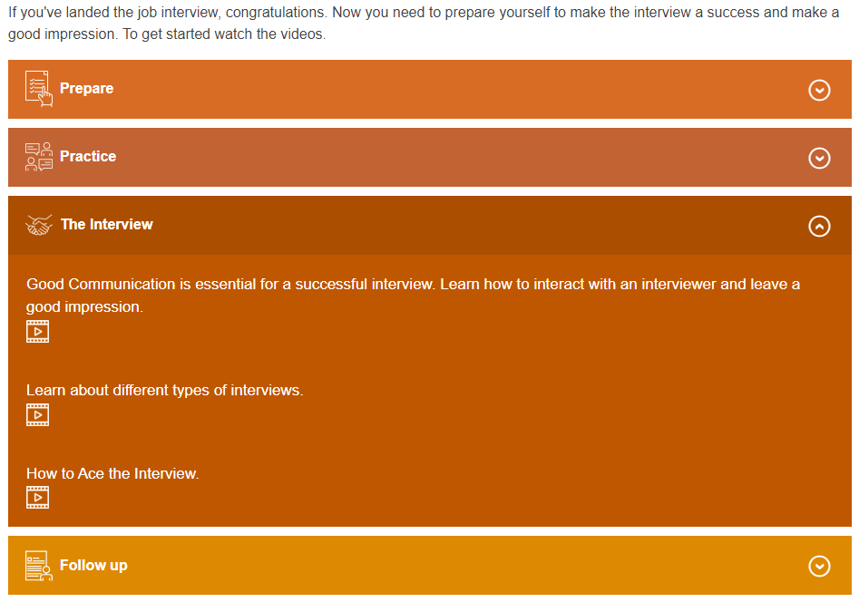
Employment

Slide 44
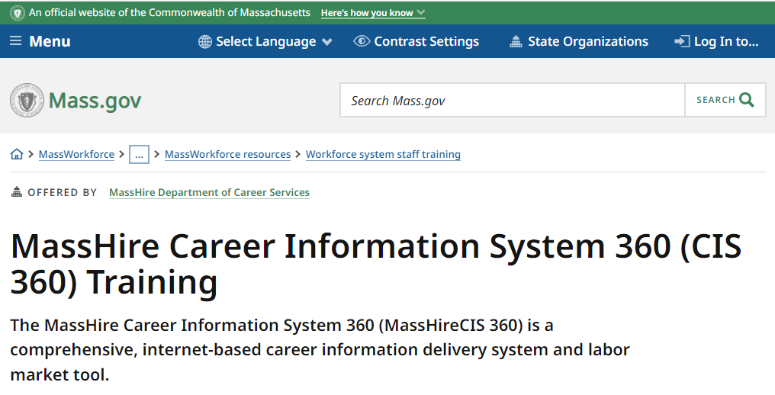
CIS Training

Slide 45
Contact Information
Email: MassHireCIS@State.MA.US
Telephone: 617-626-6808
URL: https://portal.masscis.IntoCareers.org

Slide 46

?
?
?
Questions and Answers
?
?
?
?
?
?
?
?

