Slide 1

MassHire Career Information Systems 360
Part 1: Account Creation +
Career Planning
  MassHire Programs & Services are funded in full by US Department of Labor (USDOL) Employment and Training Administration grants. (Additional details furnished upon request.)

Slide 2

University of Oregon : into CAREERS

Slide 3

MassHire Career Information System
MassHire Career Information Systems 360 is purchased with grants by the US Department of Labor (USDOL) Employment and Training Administration, it is primarily procured for the use of the Department of Career Services Career Centers, it’s partners and Massachusetts constituents. As such the trainings focus is for career center staff usage.

Slide 4
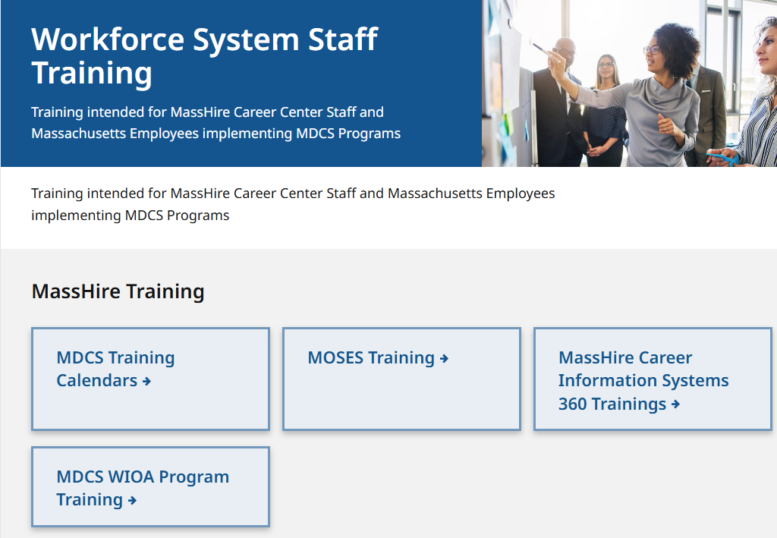
The MassHire CIS Training Calendar https://www.mass.gov/workforce-system-staff-training

Slide 5
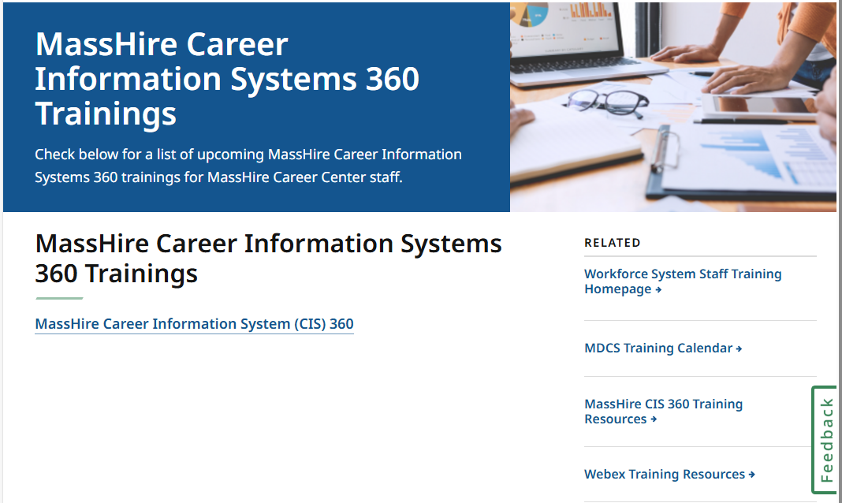
The MassHire CIS Training Calendar https://www.mass.gov/info-details/masshire-career-information-systems-360-trainings

Slide 6
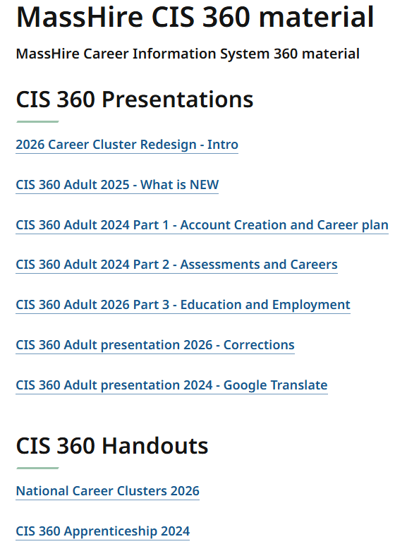
The MassHire CIS Training Calendar https://www.mass.gov/how-to/masshire-career-information-system-360-cis-360-training

Slide 7
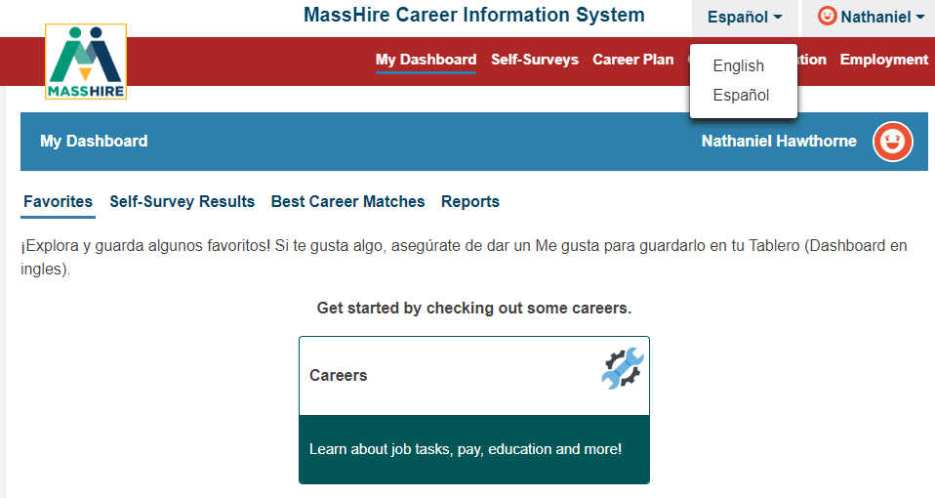
English / Español
Note:
Español version originally done by Texas translation affiliation using Mexican Spanish

Slide 8


Translation

Slide 9

The MassHire Career Information System Portal https://portal.ma.cis360.org/

Slide 10
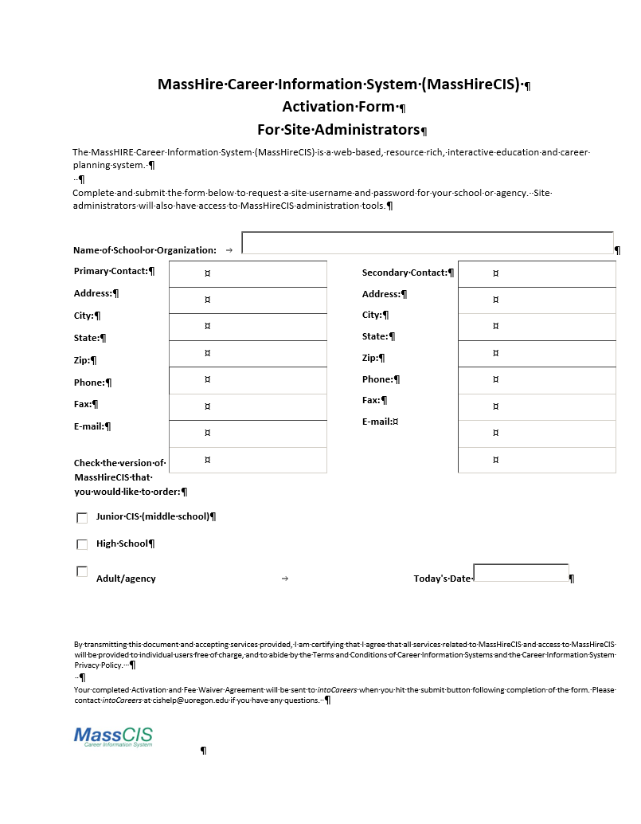
CIS 360 Activation Form
https://portal.ma.cis360.org/
Email to:
MassHireCIS@State.MA.US

Slide 11
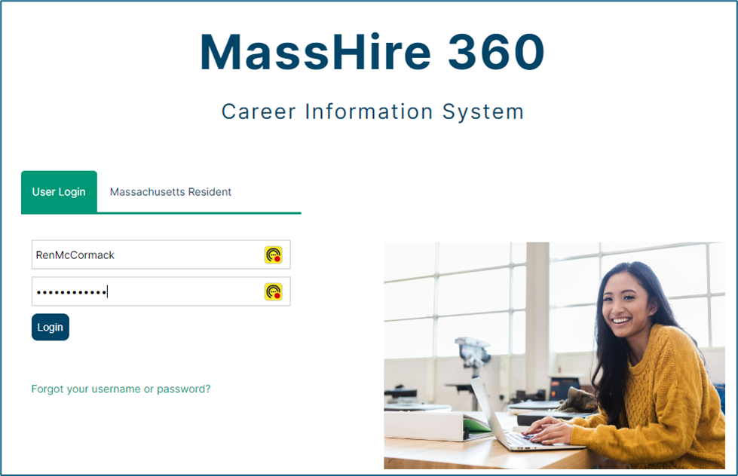
Log In with new account

Slide 12
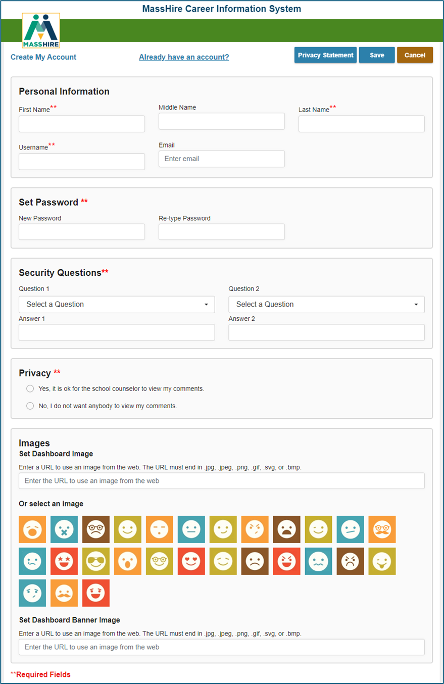
Create your Account Profile

Slide 13
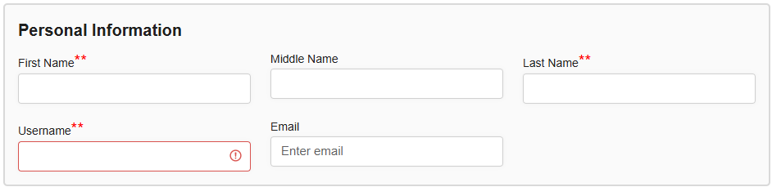
Personal Information
Email is critical !!! (Forgot my password.)

Slide 14
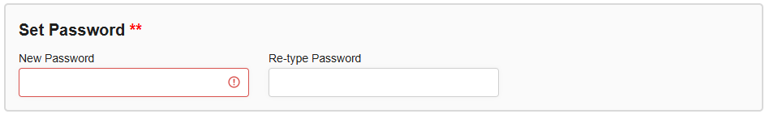
Password
Must be at least 8 characters long, including at least one CAPITAL letter , one LOWER case letter and at least 1 NUMBER.

Slide 15
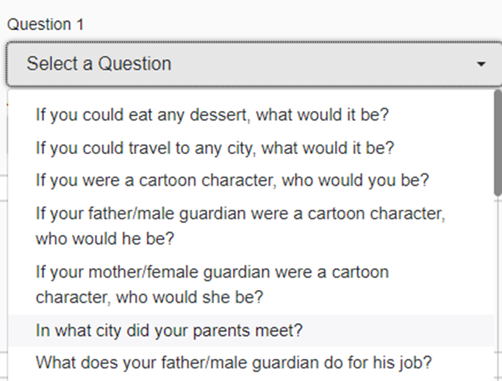

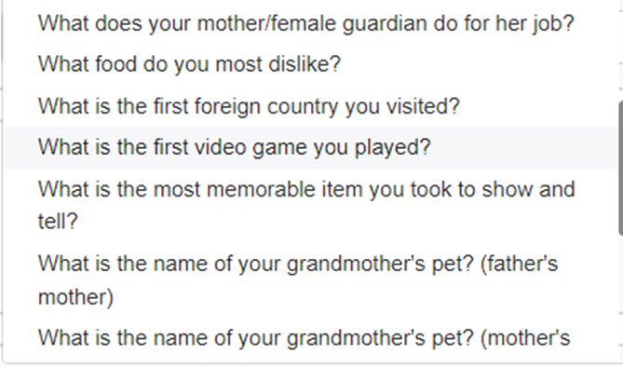
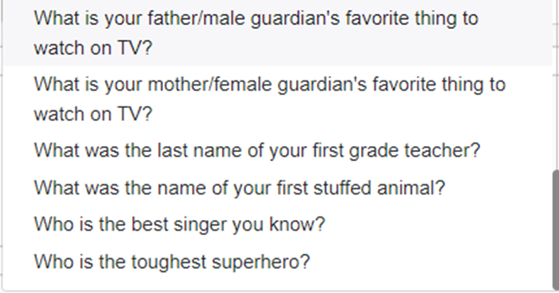
Secret Questions

Slide 16
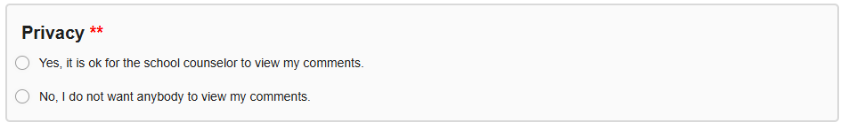
Privacy Question

Slide 17
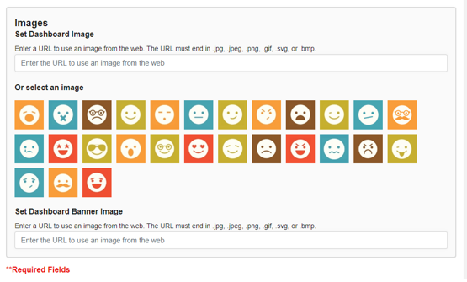
Emoji or Picture

Slide 18

Pictures

Slide 19
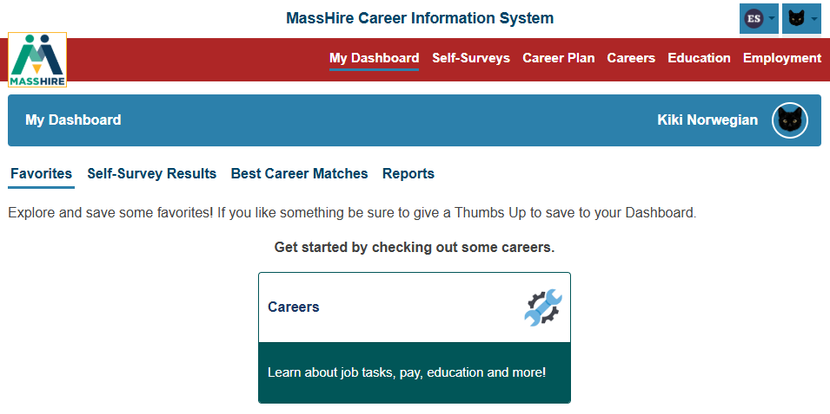
My Dashboard

Slide 20
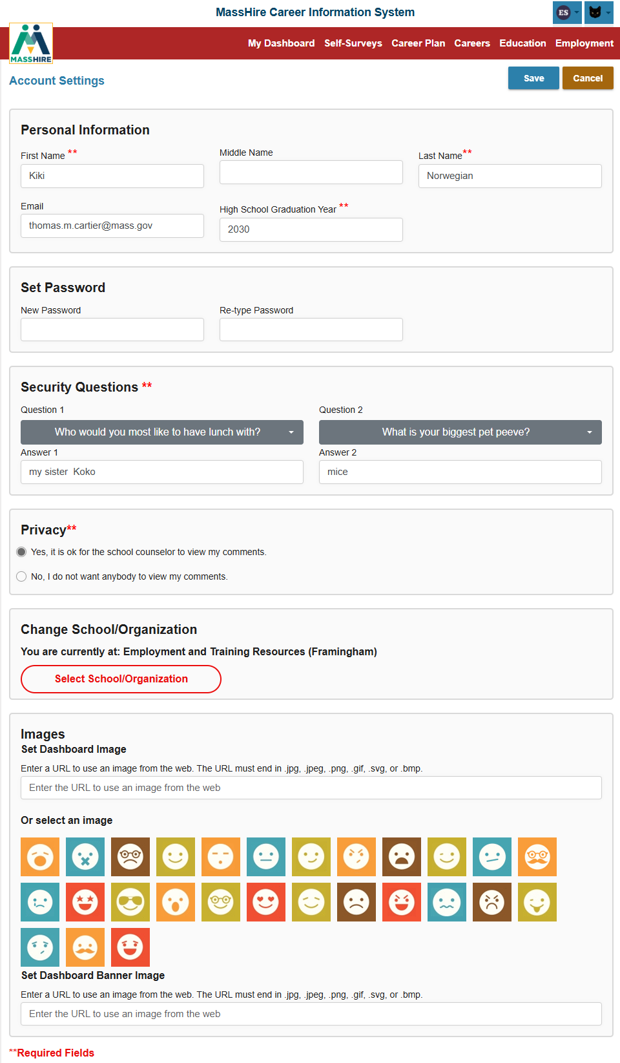
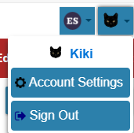
Account Settings
Your personal profile
Reiterates Security Questions
Privacy settings
Can Change affiliation / office association
And Emoji / Image / Banner

Slide 21
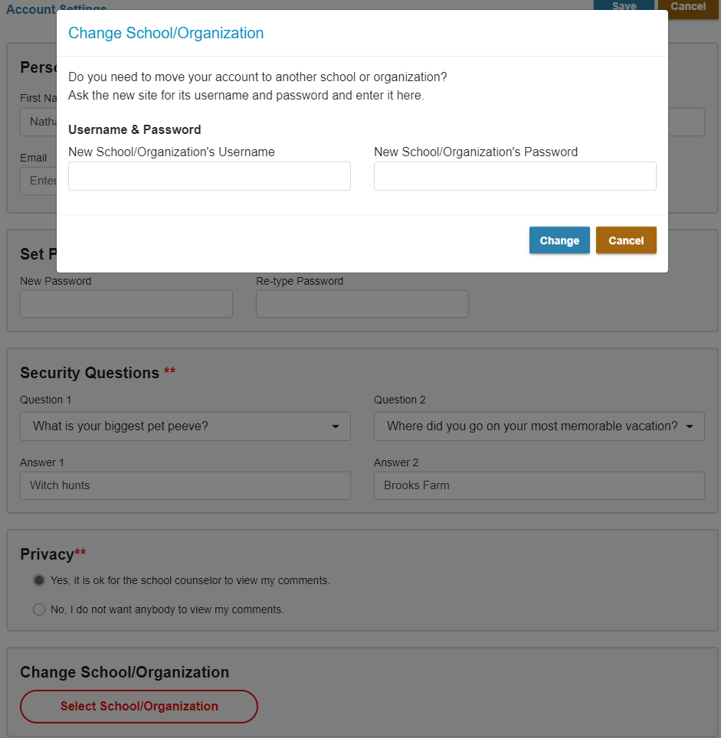
Changing Offices
To change the location where your account was created / assigned , you will need Username and Password of new office you wish to be associated with.

Slide 22

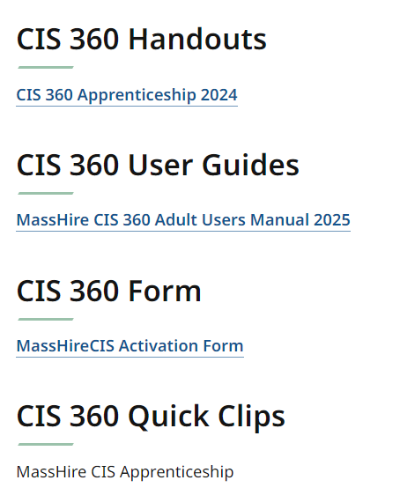
Activation Form locations

Slide 23
CIS 360 Activation Form
https://portal.ma.cis360.org/
Email to:
MassHireCIS@State.MA.US

Slide 24
Contact Information
Email: MassHireCIS@State.MA.US
Telephone: 617-626-6808
URL: https://portal.masscis.IntoCareers.org

Slide 25

?
?
?
Questions
?
?
?
?
?
?
?
?

Slide 26
Part 1: Career Plan in CIS 360

Slide 27
MY PLAN. MY CAREER. MY FUTURE.
Whether you are a first-time job seeker or experienced professional looking to make a change, CIS 360 has the tools for you.
Discover more about yourself and explore- careers and education that can help you reach your goals.
Prepare for your job search and use local employment wage and outlook data to seek the job that is right for you.

Slide 28
Components
CAREER PLAN
Career Plans are a combination of Custom Activities, Components, and Self-Surveys.
They are designed for audiences at different stages of their professional and career development, they may be theme specific and will track user progress.

Slide 29
Career Plan
Sections
  DISCOVER (Discover yourself)
  EXPLORE (Learn / explore career options)
  PREPARE (Become Job Search / Job Market ready)
  SEEK (Find your new job / career)

Slide 30
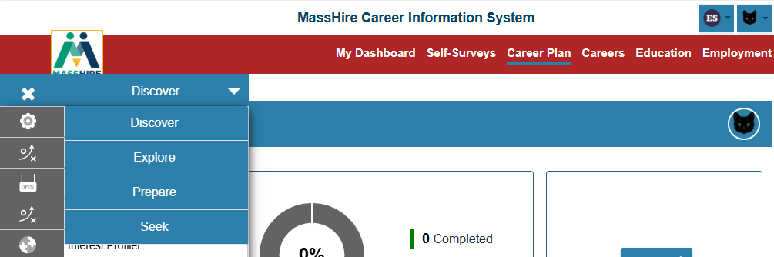
Career Plan

Slide 31
DISCOVER
One of the best ways to explore careers is to understand more about yourself.
Answer questions to discover your interests, values, likes and dislikes.
Use these tools to discover a career you will enjoy!

Slide 32
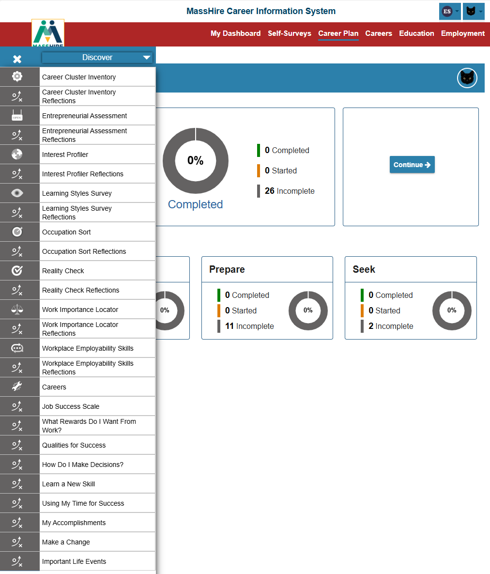
Discover
There are
26 Career Plan activities
to help you discover your new career options.

Slide 33
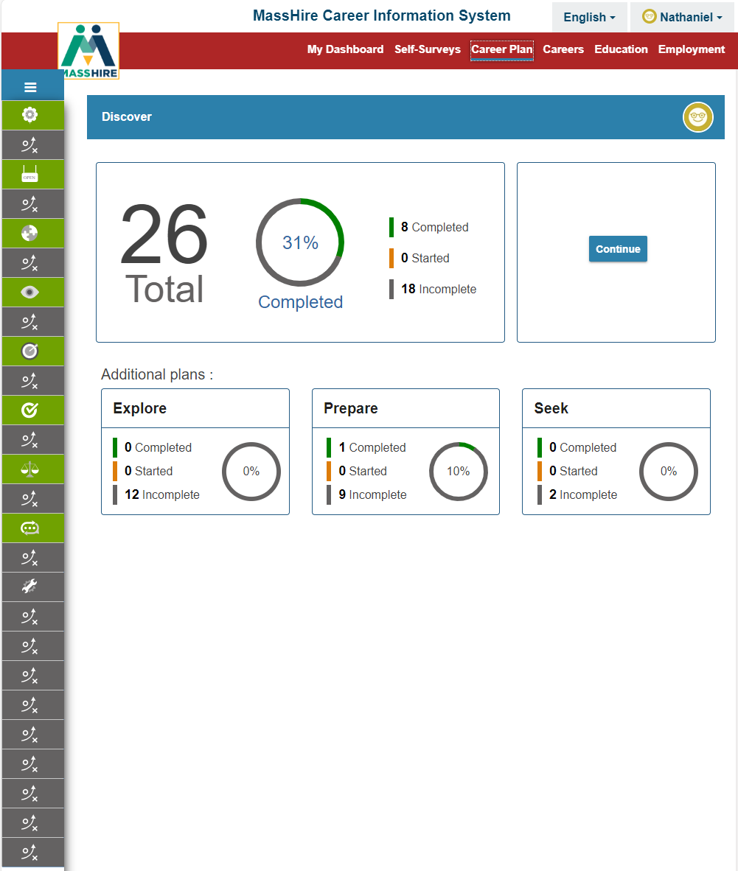
Discover

Slide 34
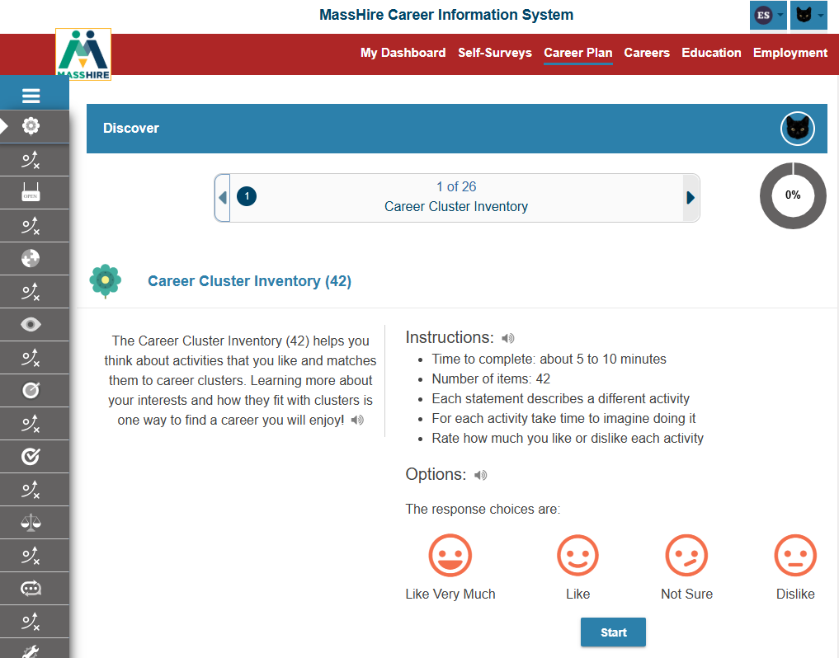
Discover
Activity #1
Career Cluster Inventory

Slide 35
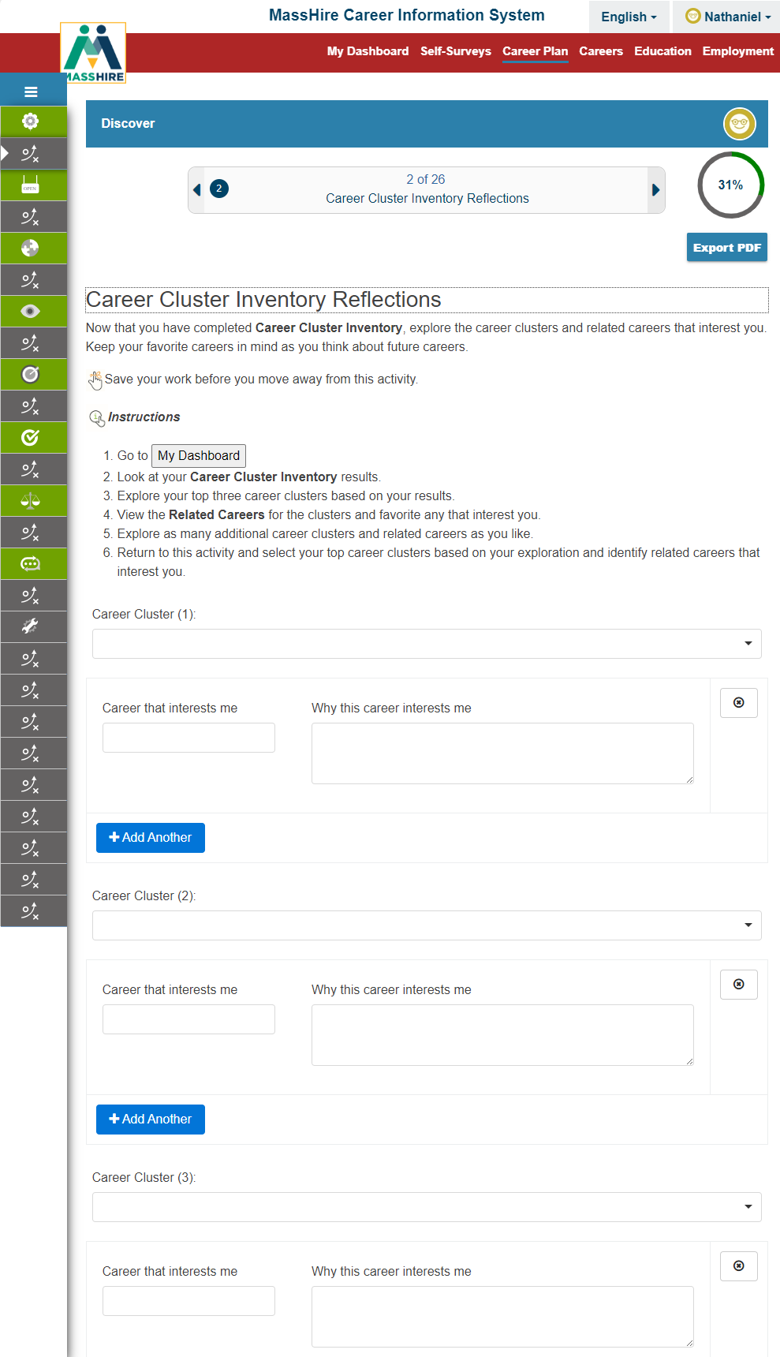
Discover
Activity #2
Career Cluster Inventory
Reflections

Slide 36
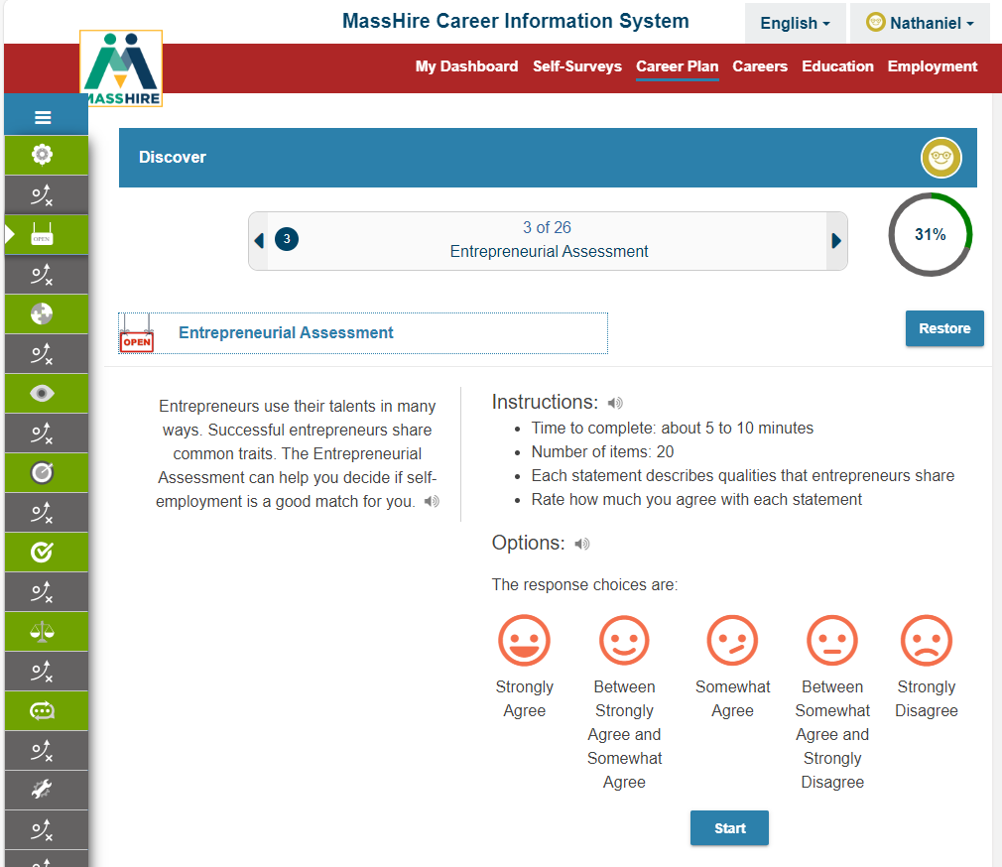
Discover
Activity #3
Entrepreneurial Assessment

Slide 37
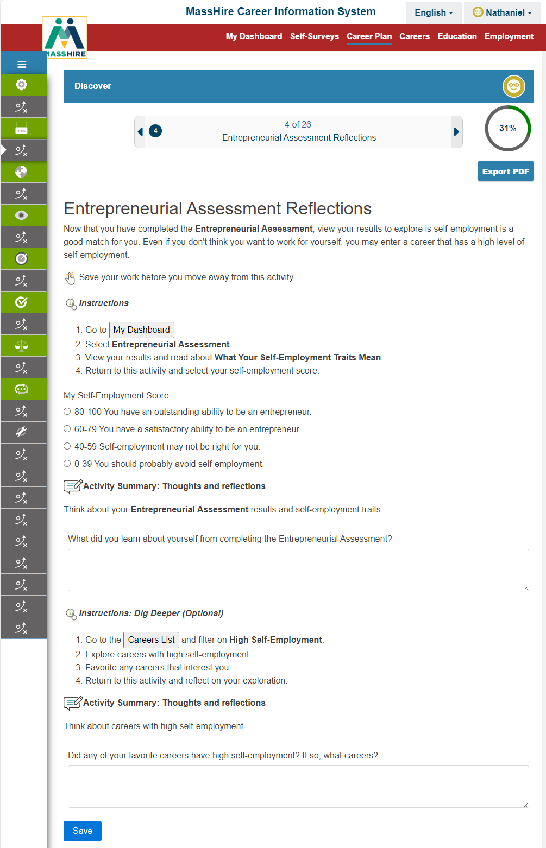
Discover
Activity #4
Entrepreneurial Assessment Reflections

Slide 38
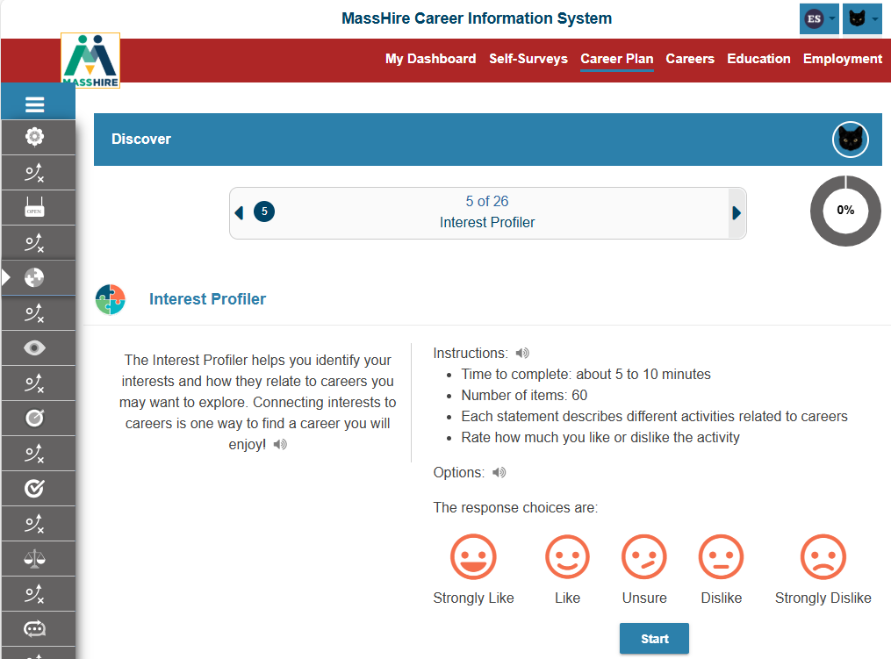
Discover
Activity #5
Interest Profiler

Slide 39
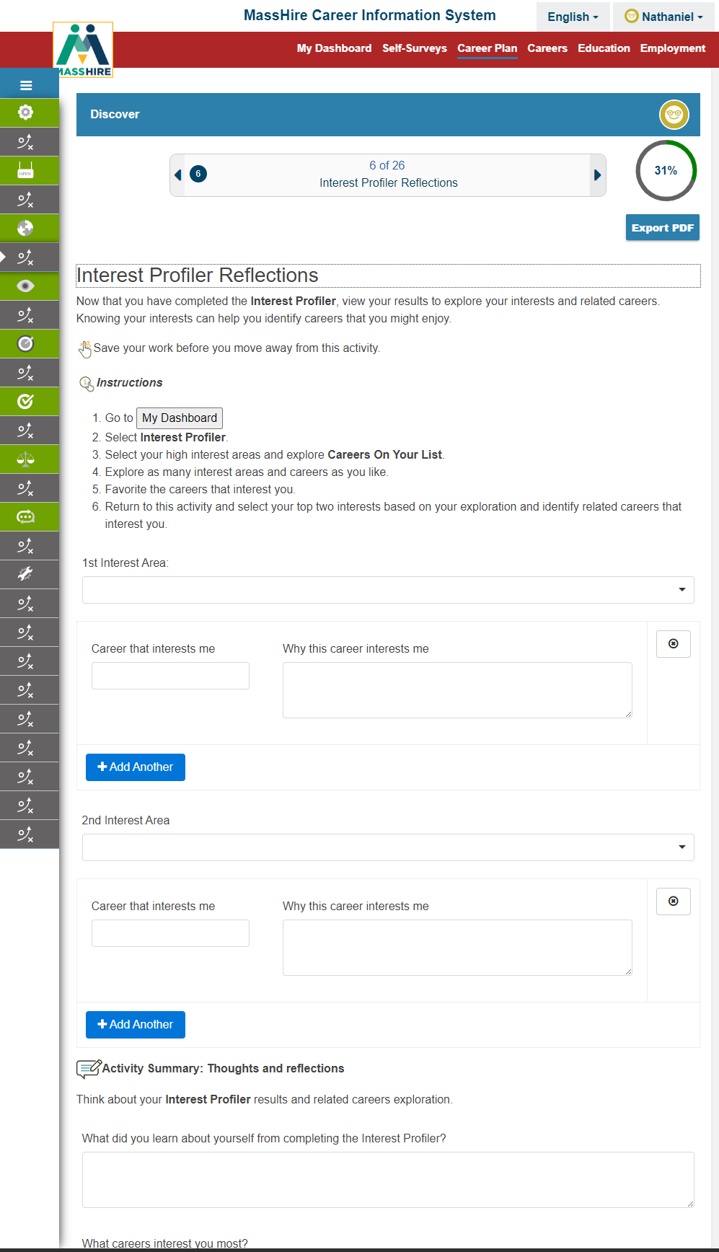
Discover
Activity #6
Interest Profiler
Reflections

Slide 40
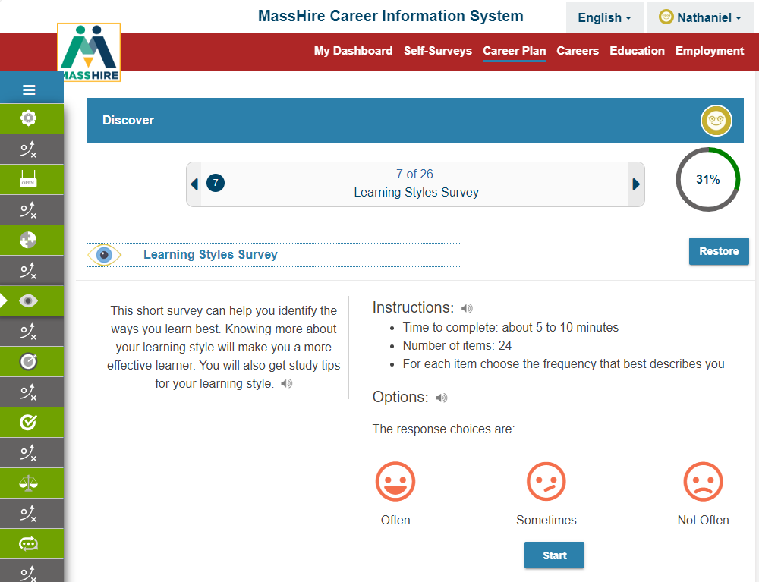
Discover
Activity #7
Learning Styles
Survey

Slide 41
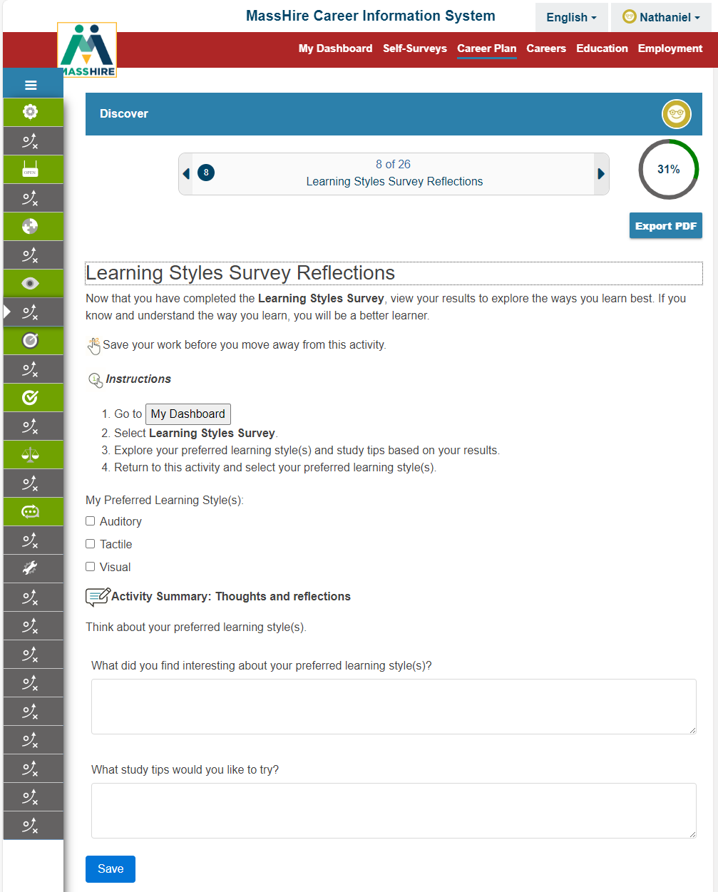
Discover
Activity #8
Learning Styles
Survey
Reflections

Slide 42
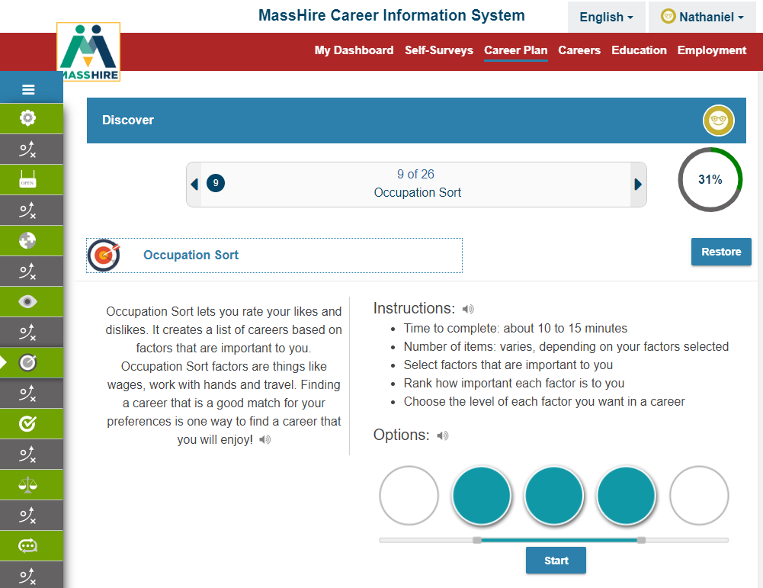
Discover
Activity #9
Occupation Sort

Slide 43
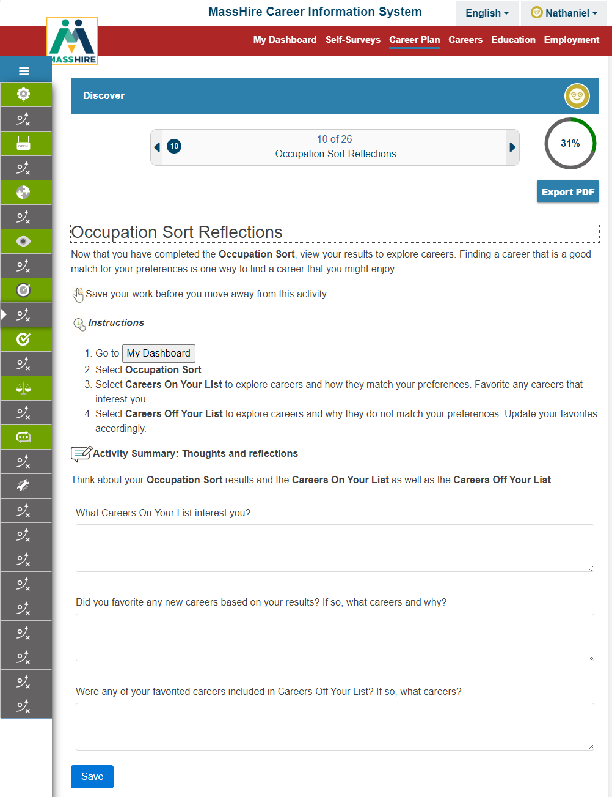
Discover
Activity #10
Occupation Sort
Reflections

Slide 44
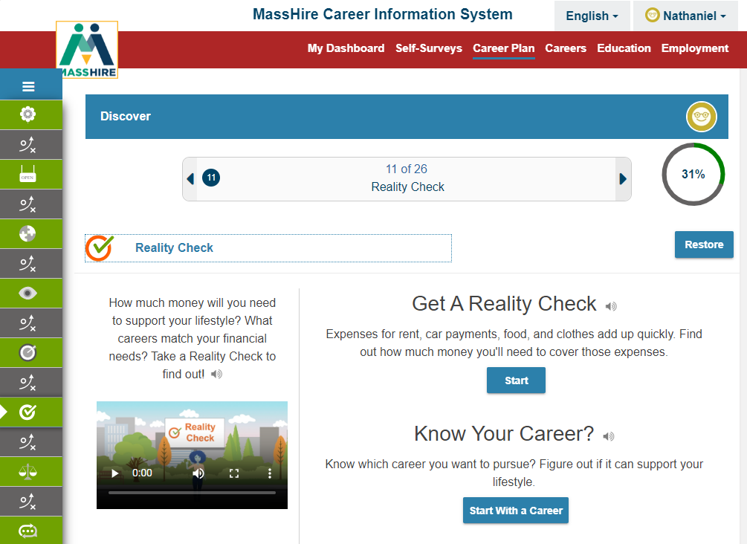
Discover
Activity #11
Reality Check

Slide 45
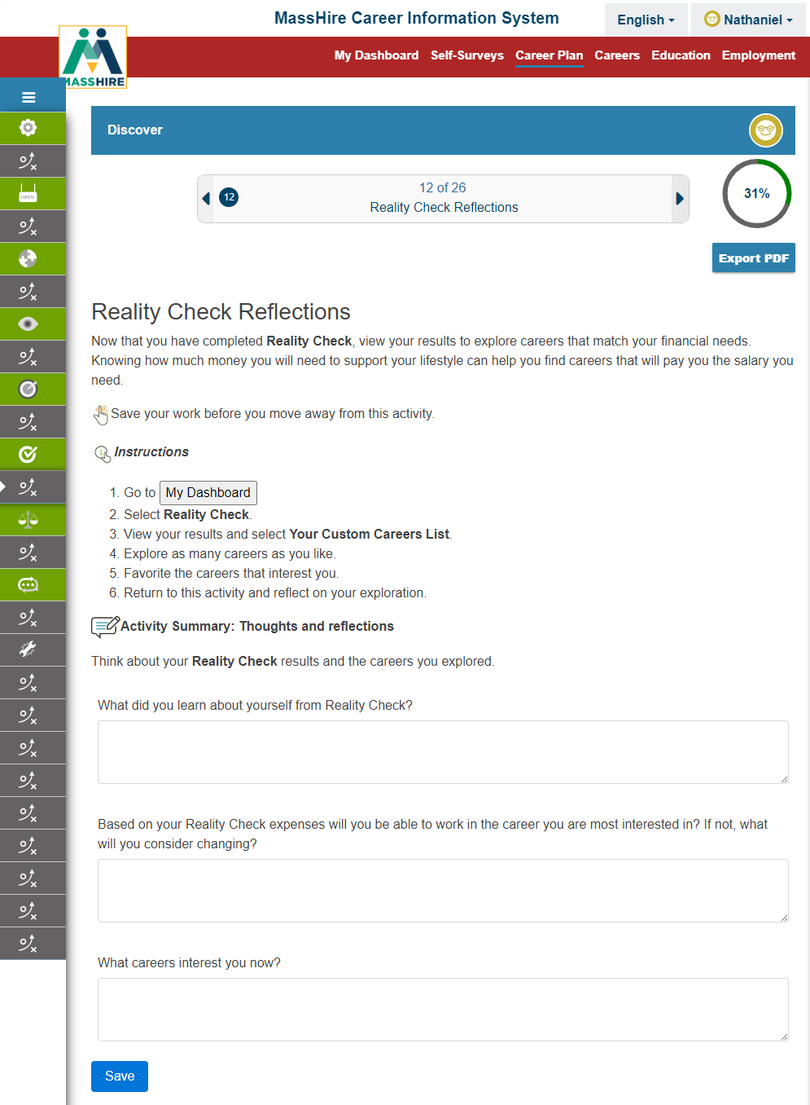
Discover
Activity #12
Reality Check
Reflections

Slide 46
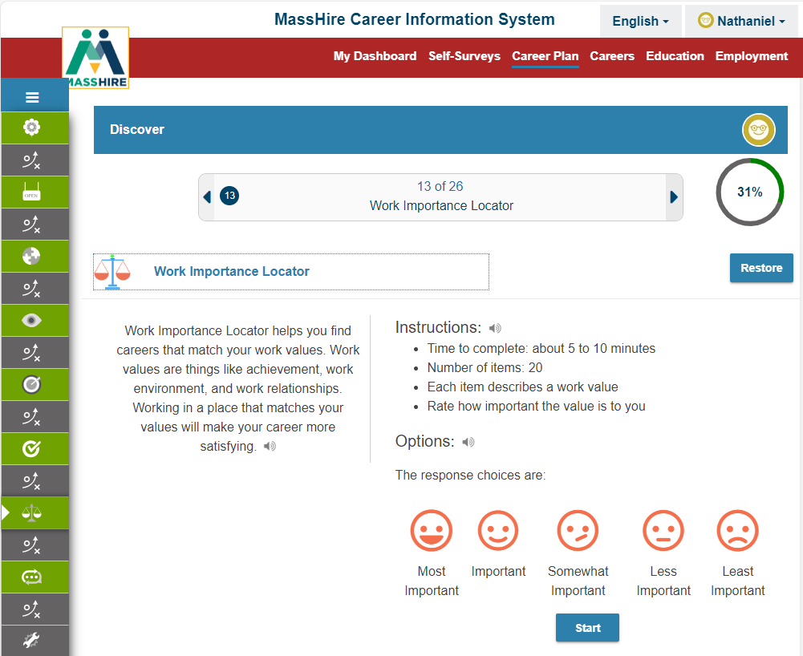
Discover
Activity #13
Work Importance Locator (WIL)

Slide 47
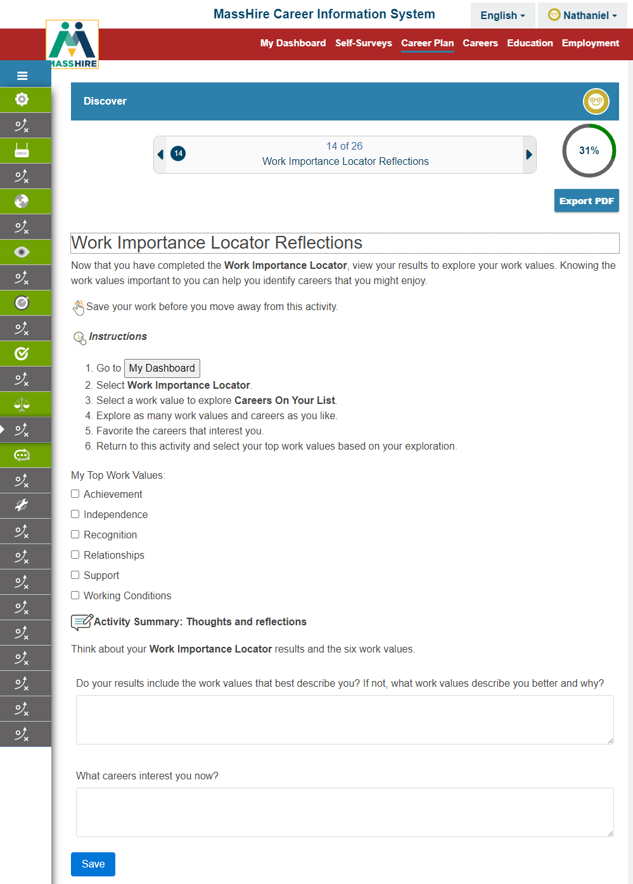
Discover
Activity #14
Work Importance Locator (WIL)
Reflections

Slide 48
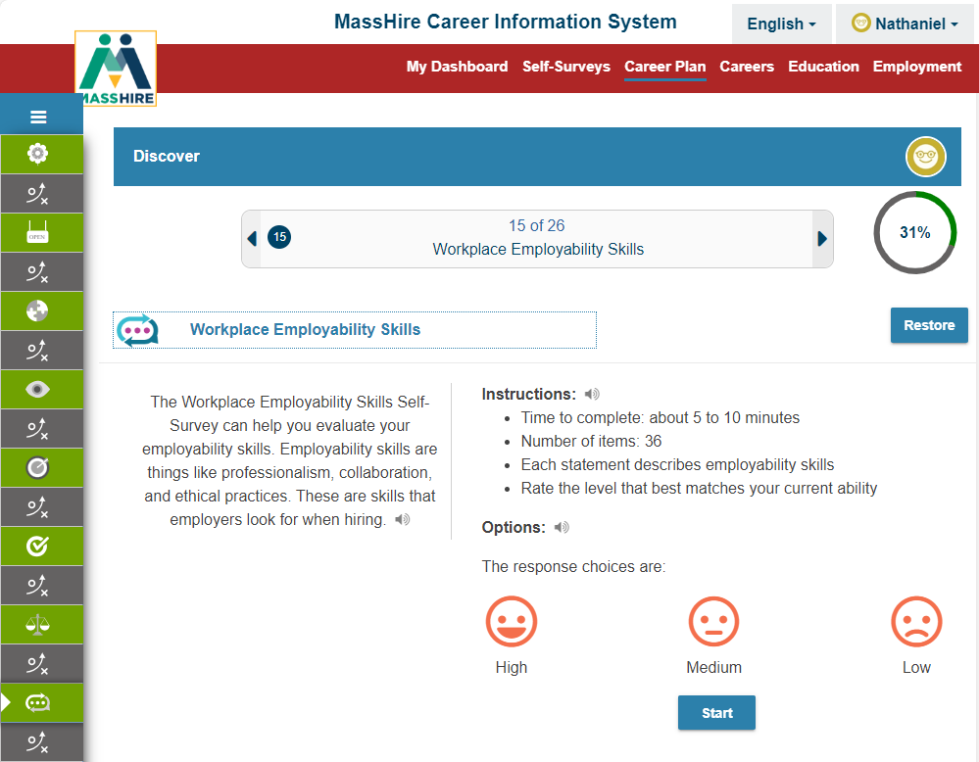
Discover
Activity #15
Workplace Employability Skills

Slide 49
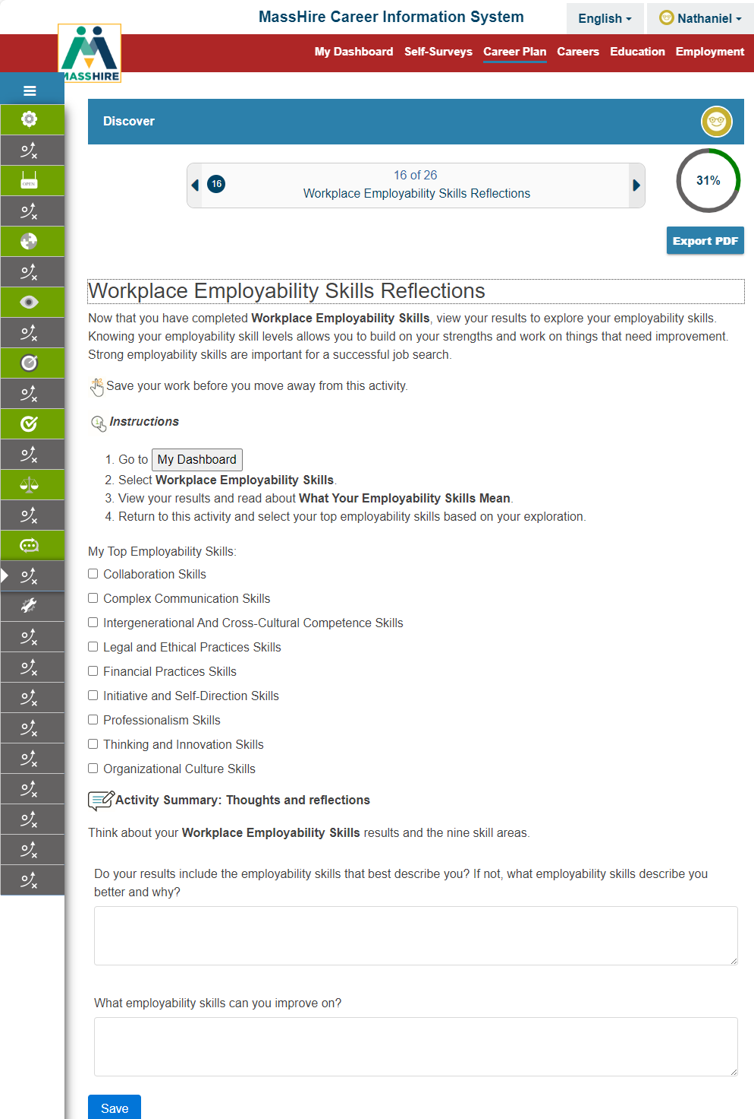
Discover
Activity #16
Workplace Employability Skills
Reflections

Slide 50
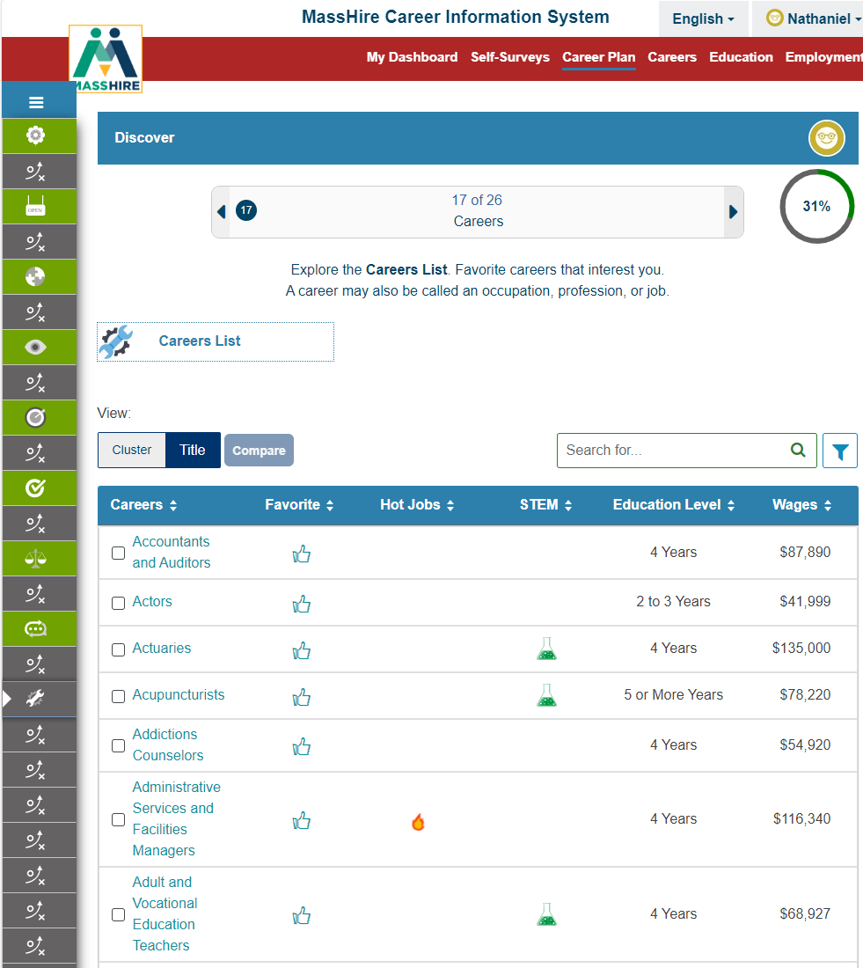
Discover
Activity #17
Careers

Slide 51
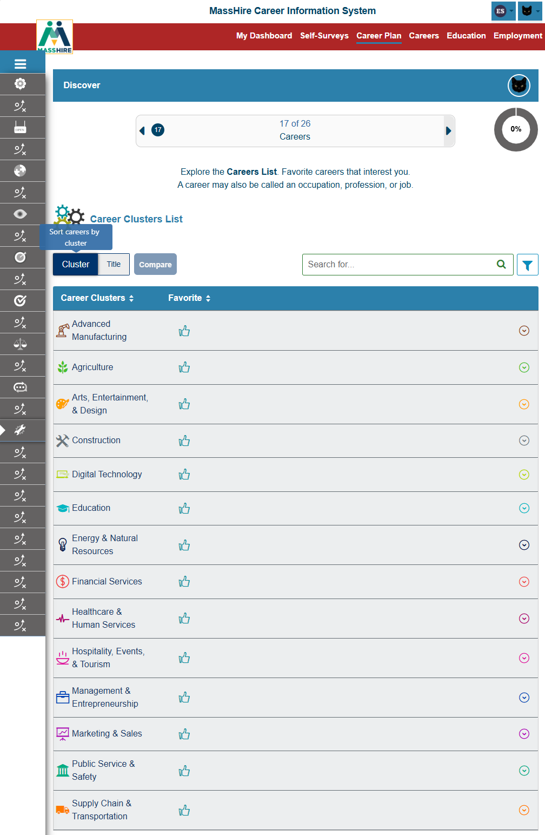
Discover
Activity #17
Careers
By Cluster

Slide 52
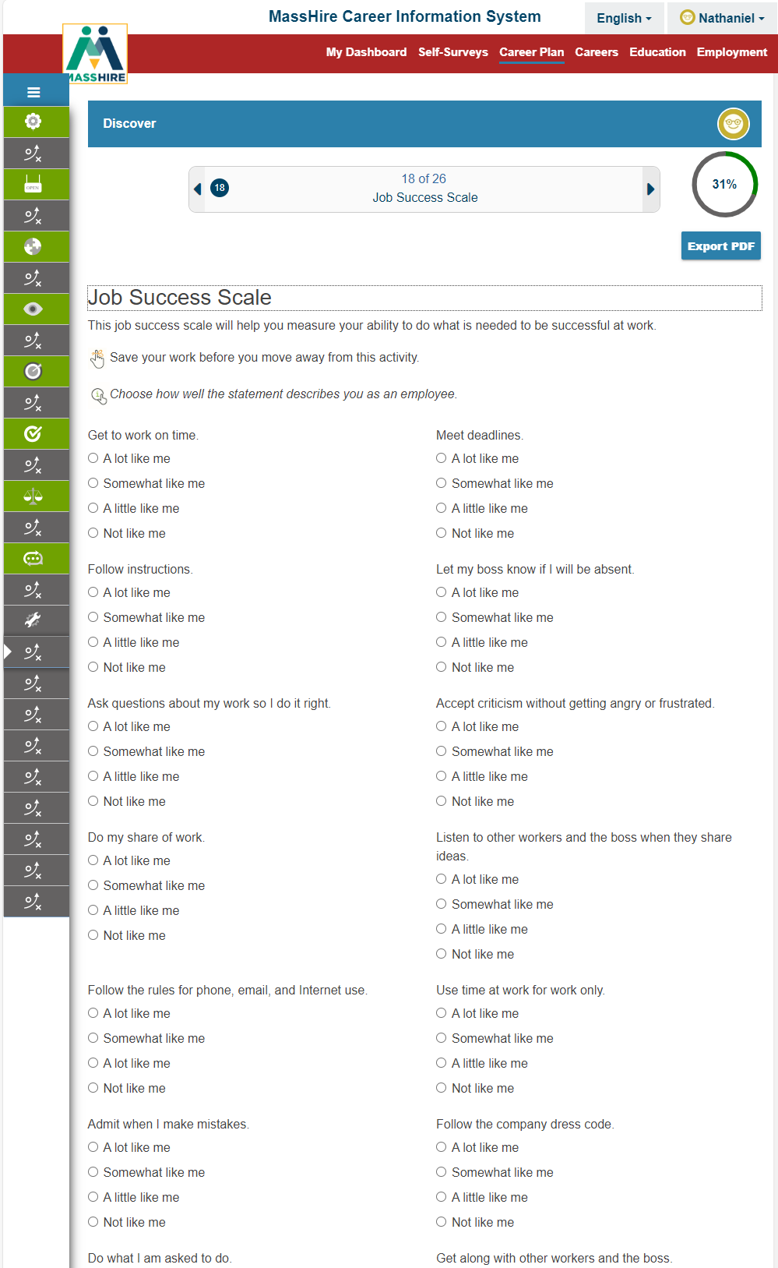
Discover
Activity #18
Job Success Scale

Slide 53
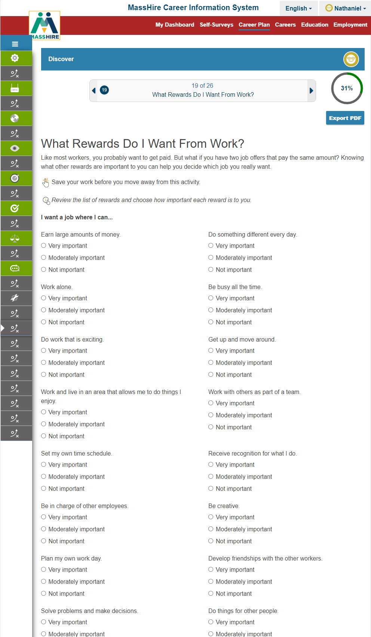
Discover
Activity #19
What Rewards Do I Want From Work?

Slide 54
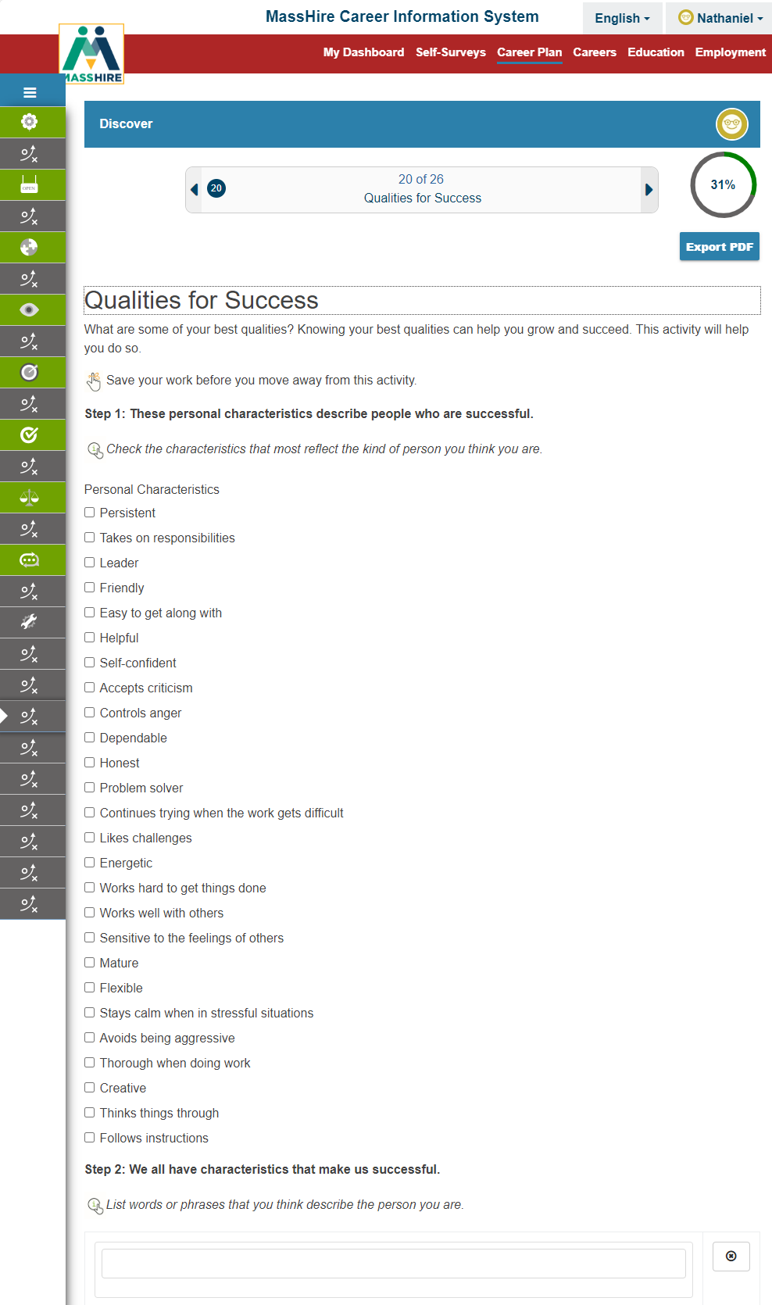
Discover
Activity #20
Qualities for Success

Slide 55
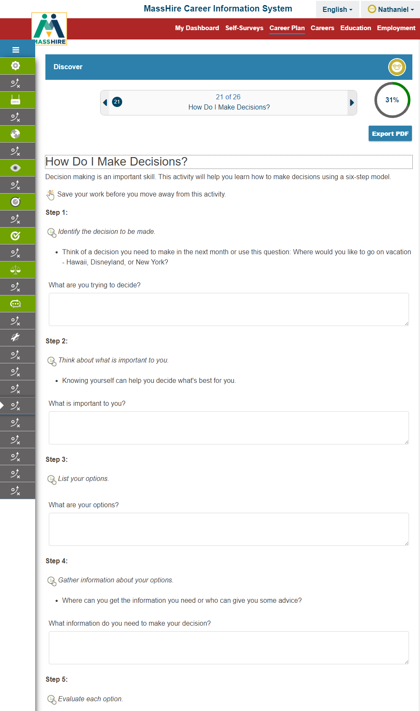
Discover
Activity #21
How Do I make Decisions?

Slide 56
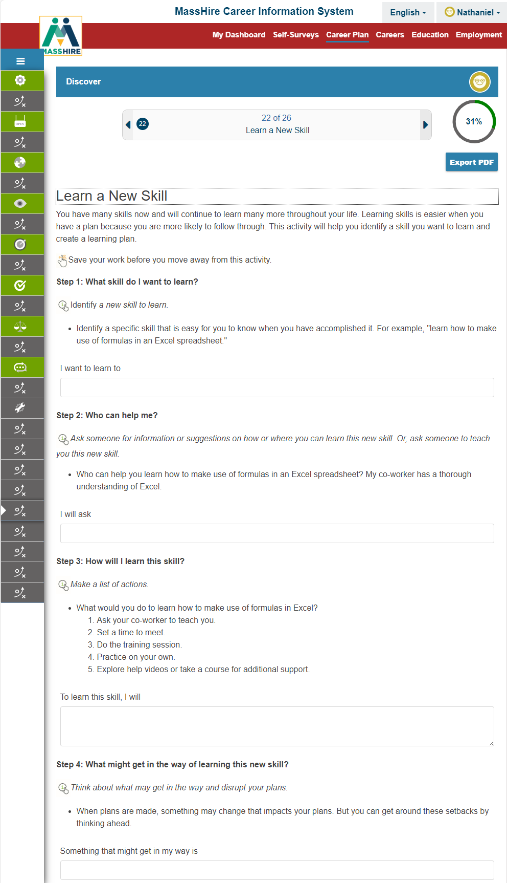
Discover
Activity #22
Learn a New Skill

Slide 57
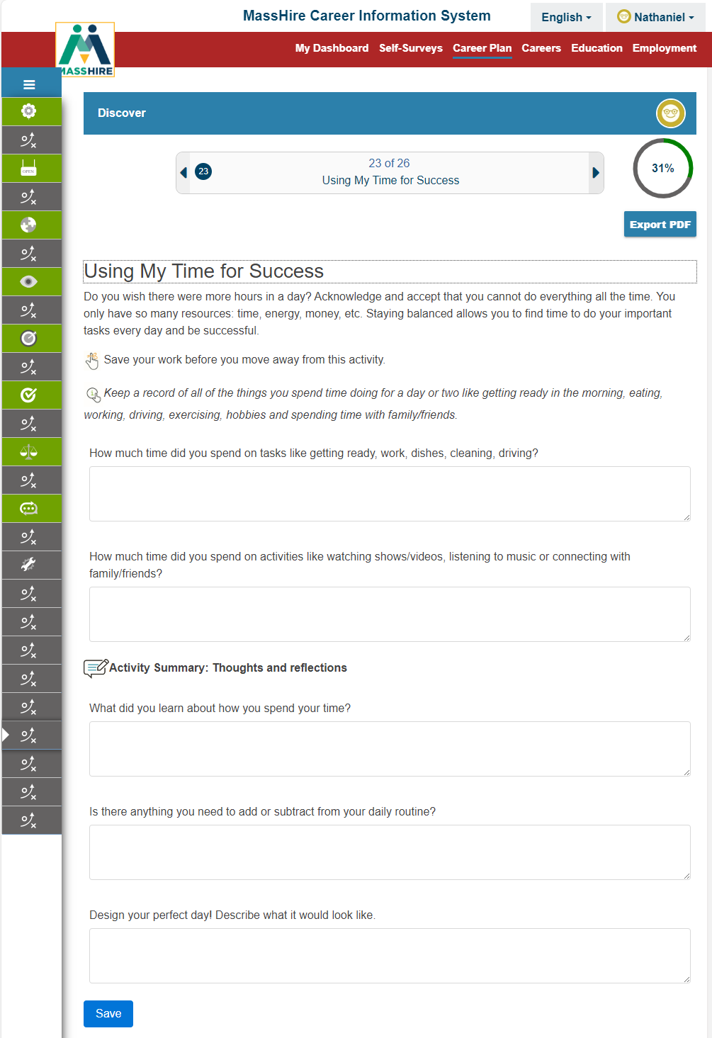
Discover
Activity #23
Using My Time for Success

Slide 58
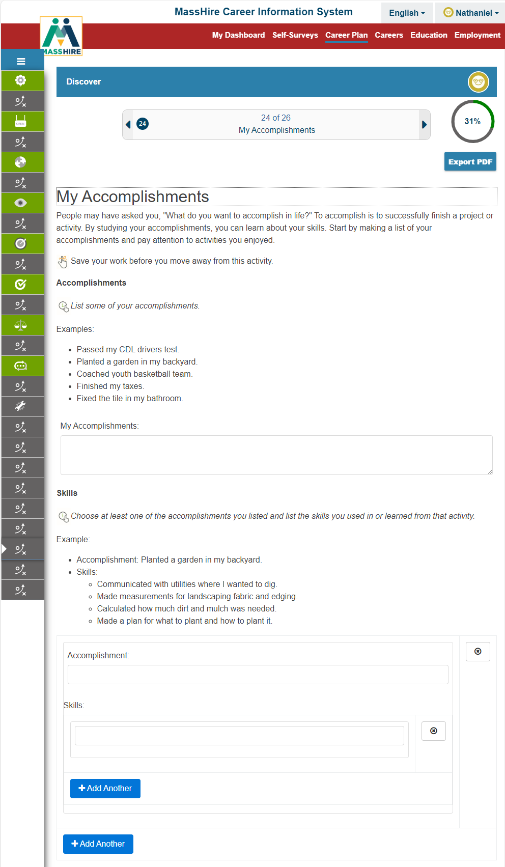
Discover
Activity #24
My Accomplishments

Slide 59
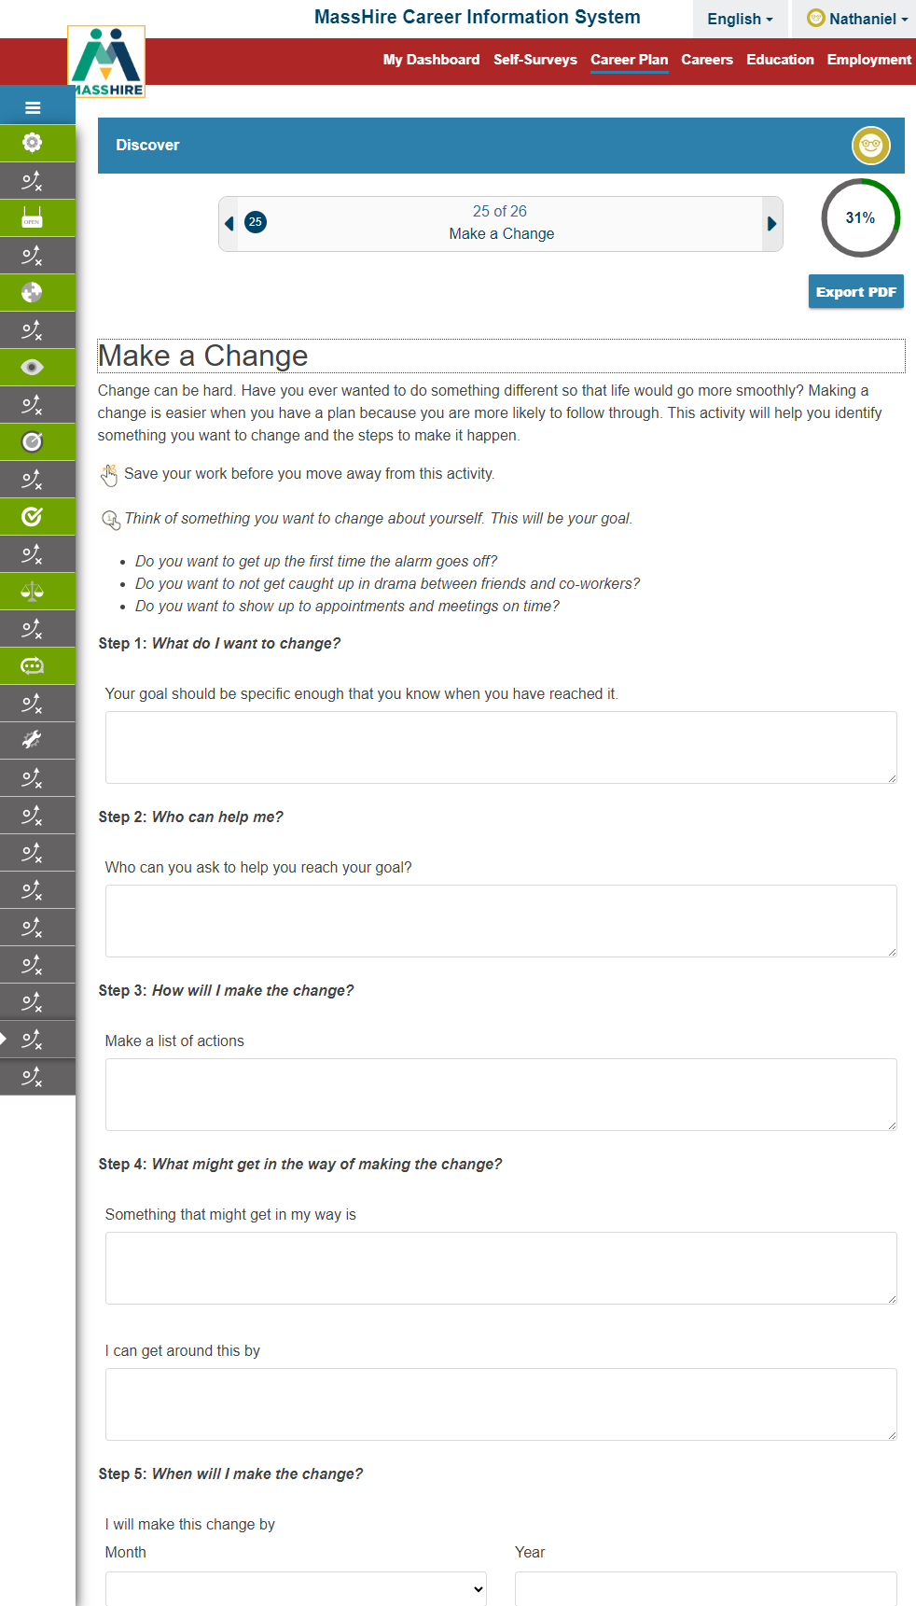
Discover
Activity #25
Make a Change

Slide 60
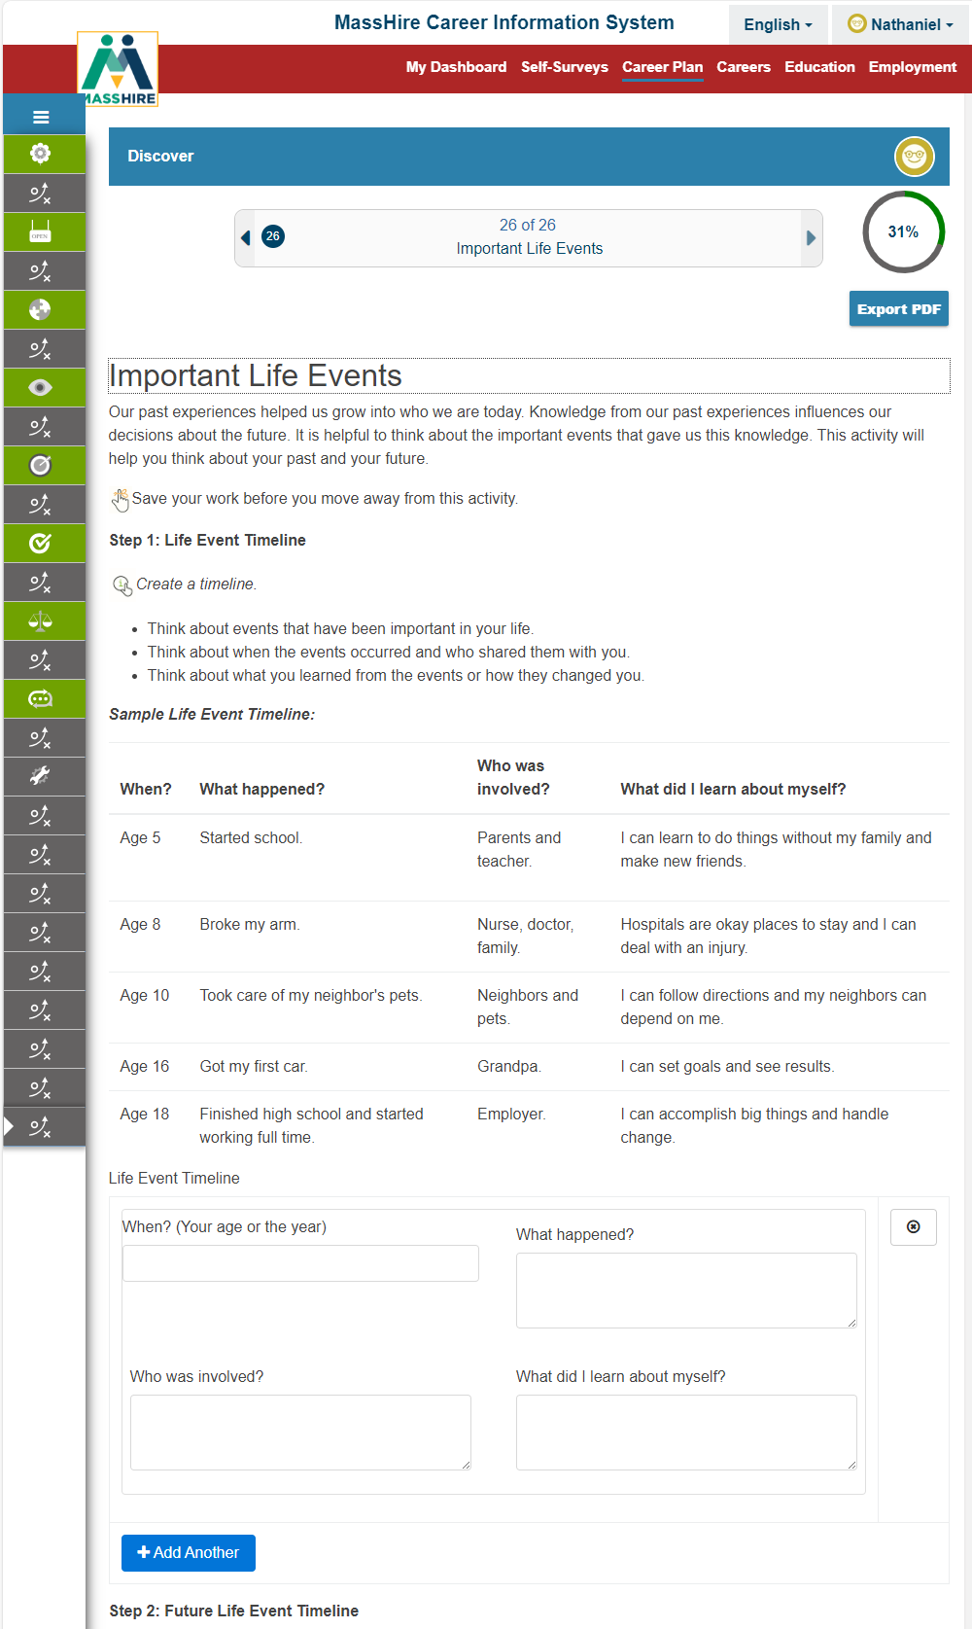
Discover
Activity #26
Important Life Events

Slide 61
EXPLORE
There is a lot to consider when thinking about your career and education.
Explore different careers. Learn what people do, how much they earn, and how to prepare for a career. Learn about training and school options.
Find scholarships and financial aid.
The more you know, the better career and education decisions you will make!

Slide 62
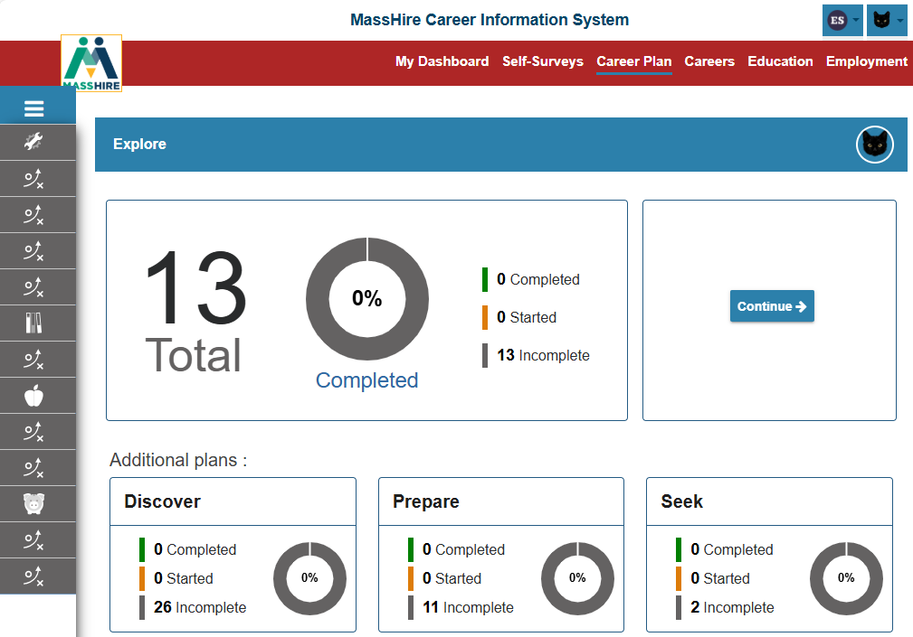
Career Plan: Explore

Slide 63

Explore
There are
13 Career Plan activities
to help you explore your new career options.

Slide 64

Explore
Activity #1
Careers

Slide 65

Explore
Activity #1
Careers
By Cluster

Slide 66

Explore
Activity #2
Compare Careers

Slide 67

Explore
Activity #3
Career Project

Slide 68

Explore
Activity #4
What are Working Conditions?

Slide 69

Explore
Activity # 5
Explore Apprenticeship

Slide 70

Explore
Activity #6
Programs of Study List
Study Clusters

Slide 71

Explore
Activity #7
School FAQs

Slide 72

Explore
Activity #8
Schools

Slide 73

Explore
Activity #9
Education Research

Slide 74

Explore
Activity #10
Financial Aid FAQs

Slide 75

Explore
Activity #11
Scholarships
By Cluster

Slide 76

Explore
Activity #11
Scholarships

Slide 77

Explore
Activity #12
FAFSA

Slide 78

Explore
Activity #13
Military Transition FAQs
(TAP)

Slide 79
PREPARE
Your resume and cover letter are key to a successful job search.
Create professional job search materials using the easy, step-by-step resume and cover letter builders.
Enhance your career knowledge through job shadowing, networking, and informational interviewing.

Slide 80

Career Plan: Prepare

Slide 81

Prepare
There are
11 Career Plan activities
to help you prepare to be job ready for your new career options and search.

Slide 82

Prepare
Activity #1
Careers
Cluster

Slide 83

Prepare
Activity #1
Careers
Title

Slide 84

Prepare
Activity #2
Job Shadow Guide

Slide 85

Prepare
Activity #3
Informational Interview Guide

Slide 86

Prepare
Activity #4
My Financial Plan

Slide 87

Prepare
Activity #5
Set Goals

Slide 88

Prepare
Activity #6
Facing Obstacles

Slide 89

Prepare
Activity #7
Job Search Action Plan

Slide 90

Prepare
Activity #8
My Network

Slide 91

Prepare
Activity # NEW
#9
Track Work-Based Learning

Slide 92

Prepare
Activity #10
Resume

Slide 93

Prepare
Activity #11
Cover Letter Tasks

Slide 94
Seek
Now that you have learned more about yourself and where you want to go, it is time to search for jobs that can get you there.
Explore updated and localized career and wage information, and search current job openings.
You are job ready!

Slide 95

Career Plan: Seek

Slide 96

Career Plan
There are
2 Career Plan activities
to help you search (seek) for your new career.

Slide 97

Seek
Activity #1
Careers
By Cluster

Slide 98

Seek
Activity #1
Careers
By Title

Slide 99

Seek
Activity #2
Find Jobs

Slide 100

Career Plan: Military

Slide 101

Career Plan: Military

Slide 102

Career Plan: Military

Slide 103
?
?
?
?
?
?
Questions
On the
Adult Career Plan
?
?
?
?
?

Slide 104
Career Plan: YOUTH
Youth
Youth Career Plans are a combination of Custom Activities, Components, and Self-Surveys.
They are designed for audiences at different stages of their academic life (by grade level) , be theme specific, and will track user progress.
Each grade level builds upon the previous grade level.

Slide 105

Career Plan: Youth
6th grade to
12th grade

Slide 106

Career Plans

Slide 107

Career Plan 6th

Slide 108

Career Plan 7th

Slide 109

Career Plan 8th

Slide 110

Career Plan 9th

Slide 111

Career Plan 10th

Slide 112

Career Plan 11th

Slide 113

Career Plan 12th

Slide 114

Career Plan
Work Based Learning

Slide 115
Contact Information
Email: MassHireCIS@State.MA.US
Telephone: 617-626-6808
URL: https://portal.masscis.IntoCareers.org

Slide 116
?
?
?
Questions
?
?
?
?
?
?
?
?

