Slide 1

MassHire Career Information Systems 360
Education + Employment
  MassHire Programs & Services are funded in full by US Department of Labor (USDOL) Employment and Training Administration grants. (Additional details furnished upon request.)

Slide 2

University of Oregon : into CAREERS

Slide 3

MassHire Career Information System
MassHire Career Information Systems 360 is purchased with grants by the US Department of Labor (USDOL) Employment and Training Administration, it is primarily procured for the use of the Department of Career Services Career Centers, it’s partners and Massachusetts constituents. As such the trainings focus is for career center staff usage.

Slide 4
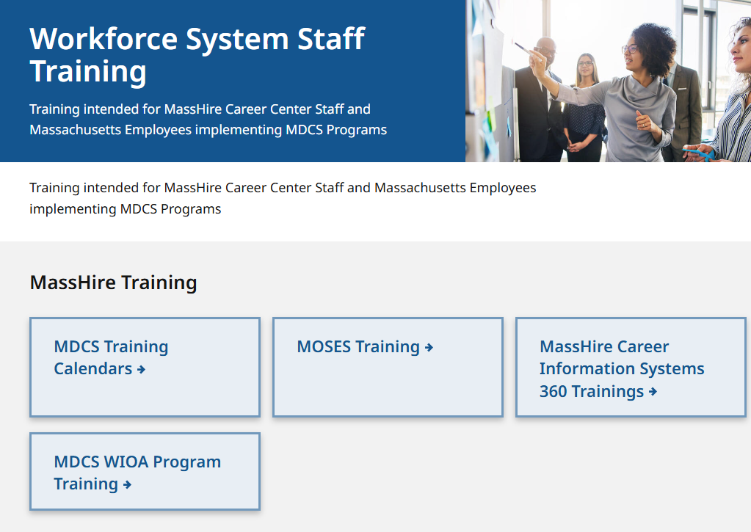
The MassHire CIS Training Calendar https://www.mass.gov/workforce-system-staff-training

Slide 5
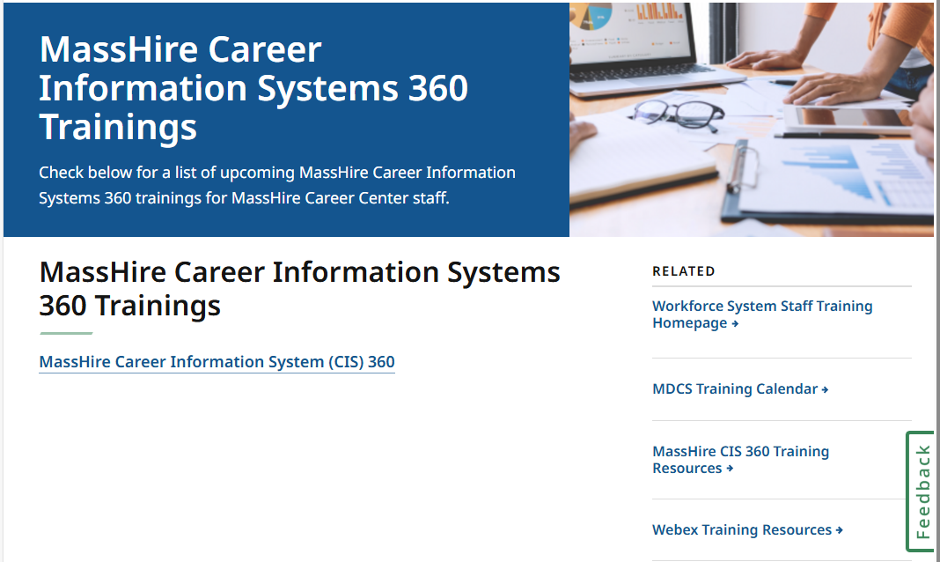
The MassHire CIS Training Calendar https://www.mass.gov/info-details/masshire-career-information-systems-360-trainings

Slide 6
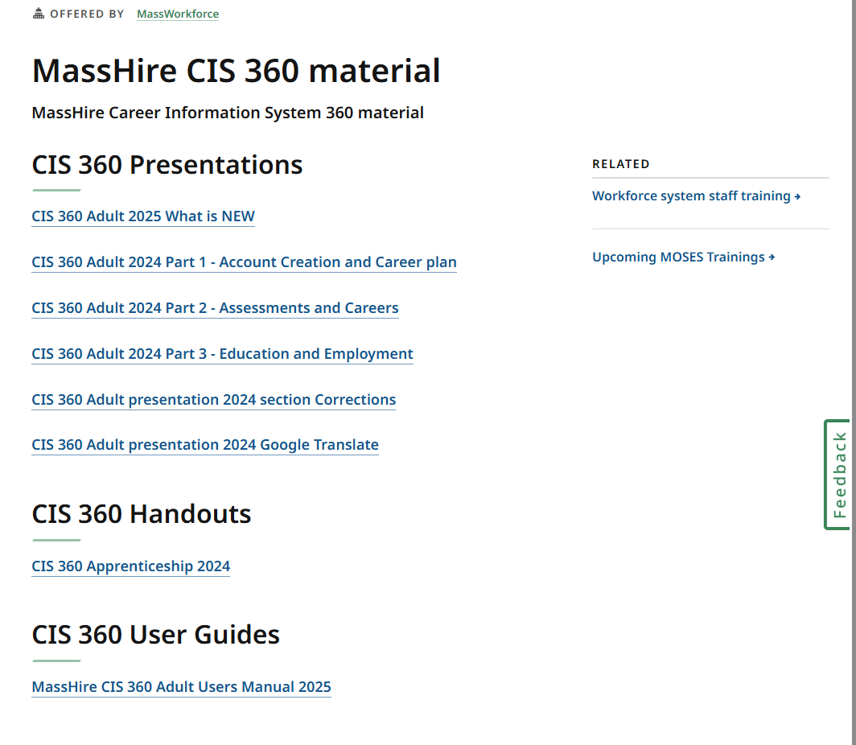
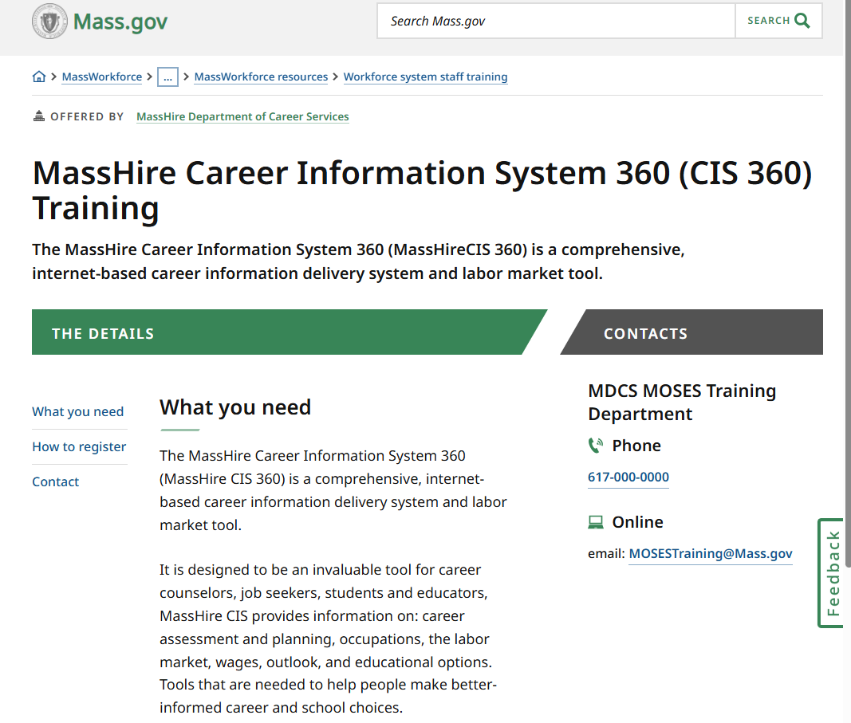
The MassHire CIS Training Calendar https://www.mass.gov/how-to/masshire-career-information-system-360-cis-360-training

Slide 7

The MassHire Career Information System Portal https://portal.ma.cis360.org/

Slide 8
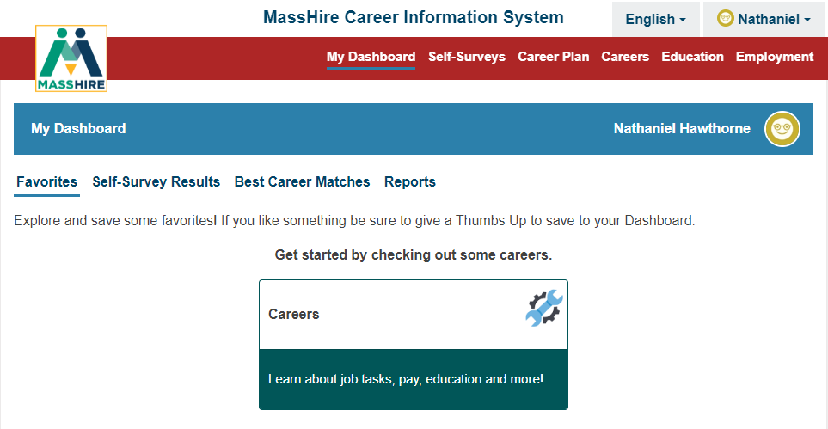
User Dashboard

Slide 9
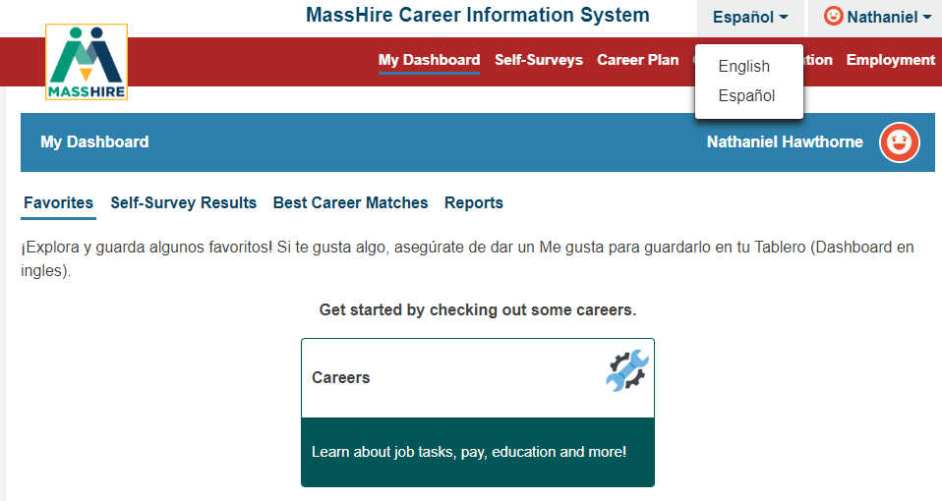
English / Español
Note:
Español version originally done by Texas translation affiliation using Mexican Spanish

Slide 10


Translation

Slide 11
Education

Slide 12
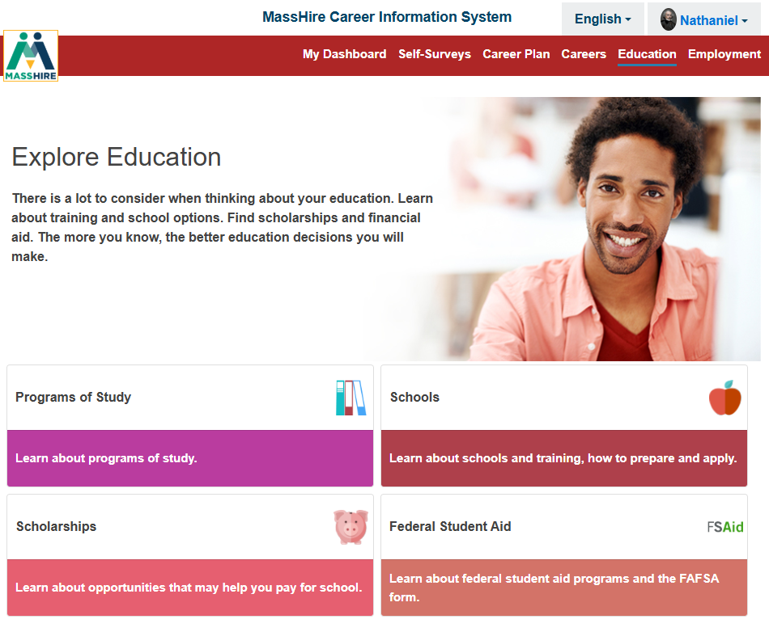
Education

Slide 13
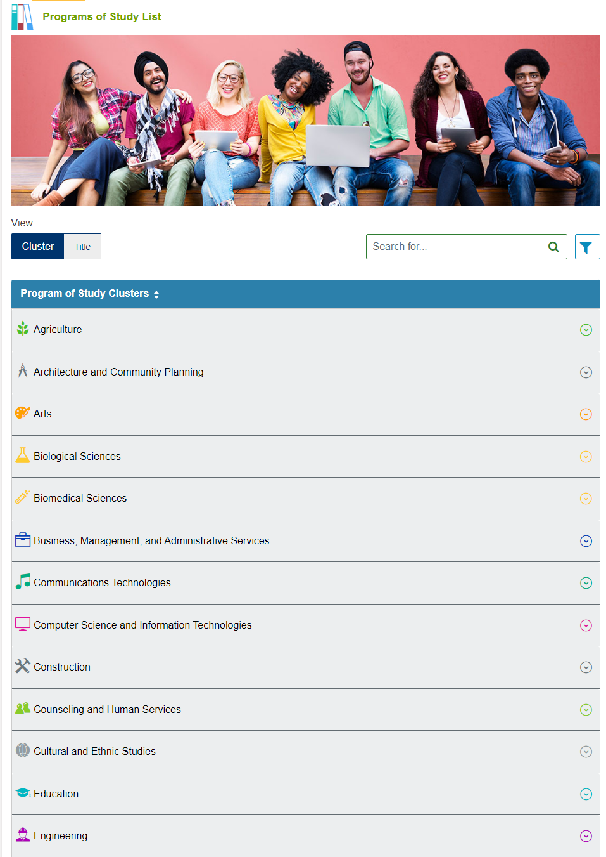

Education
Note:
Program of Study
Majors (by Study Cluster)

Slide 14
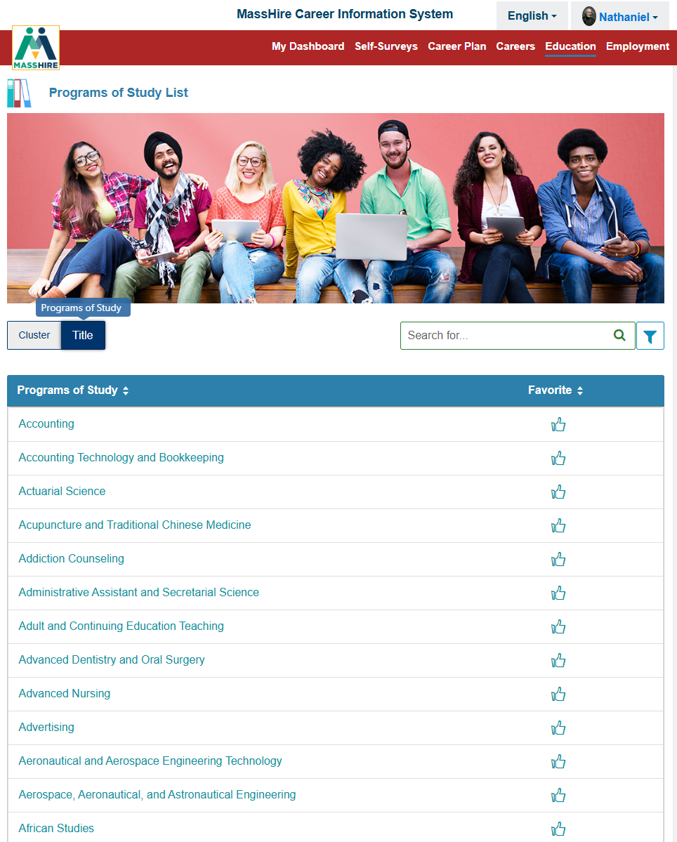
Education
Note:
Program of Study
Majors (by Title)

Slide 15
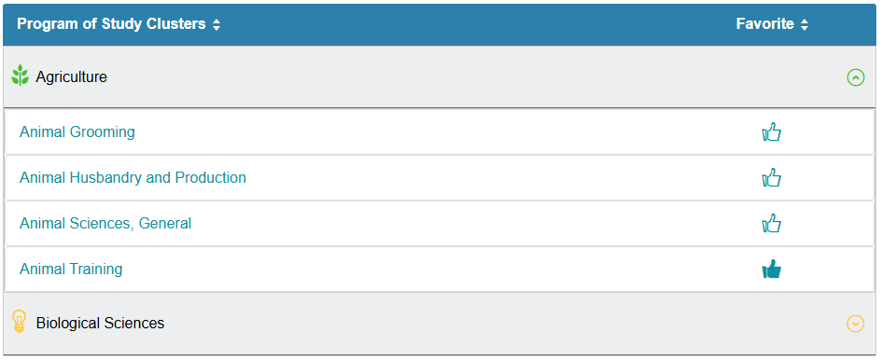
Education
Note:
Program of Study
Majors
Subject and Minors

Slide 16

Education
Note:
Program of Study
At A Glance

Slide 17
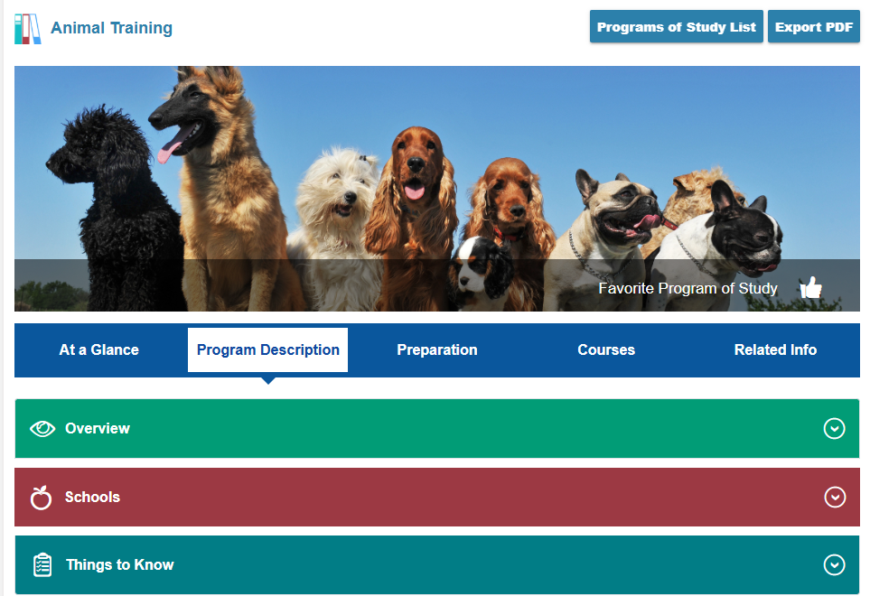
Education
Note:
Program of Study
Program Description

Slide 18
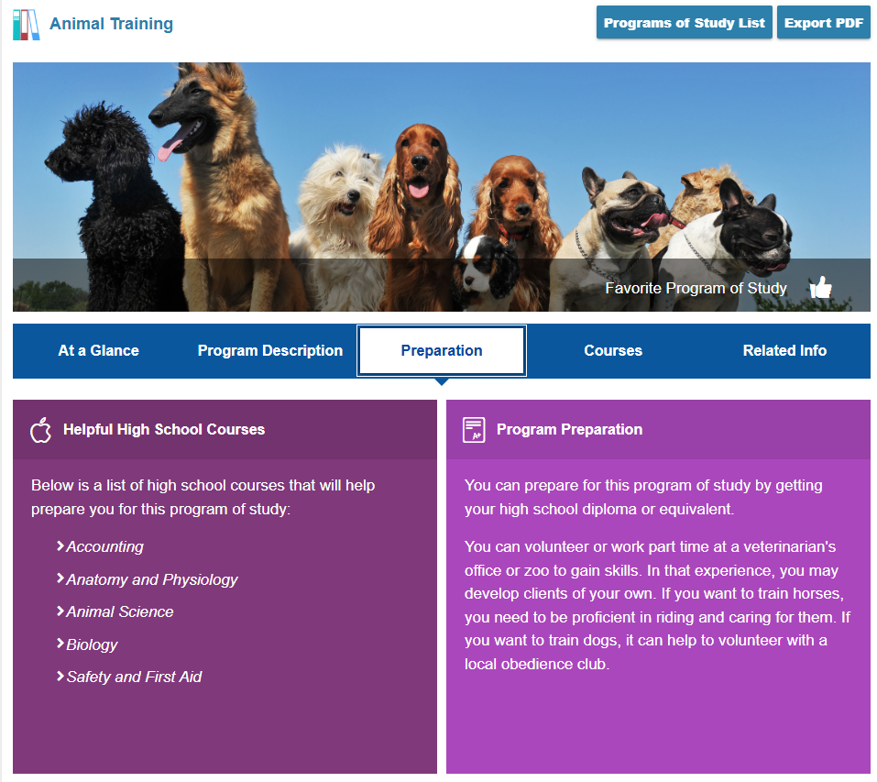
Education
Note:
Program of Study
Preparation

Slide 19
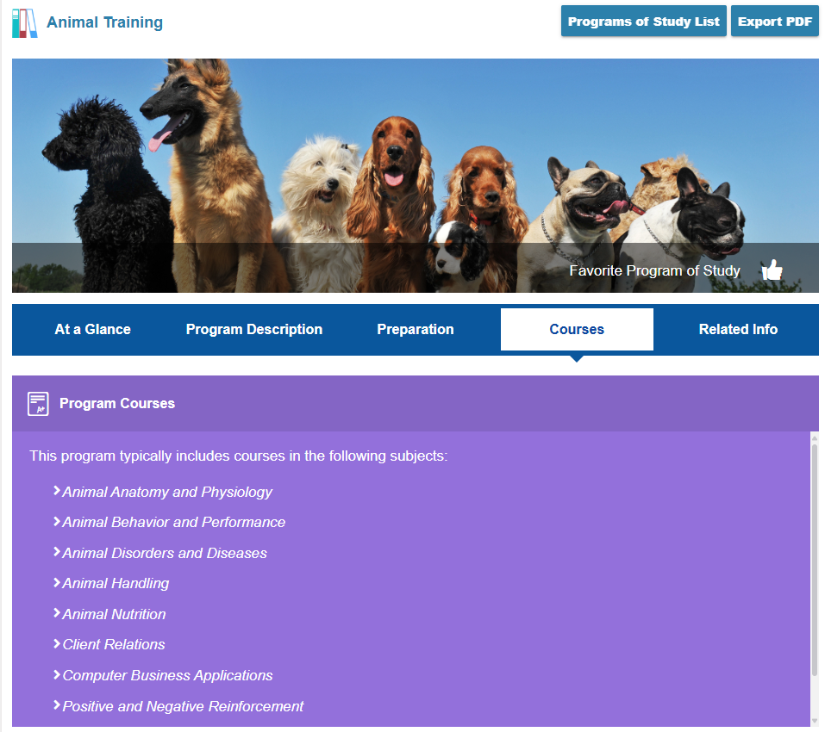
Education
Note:
Program of Study
Courses

Slide 20
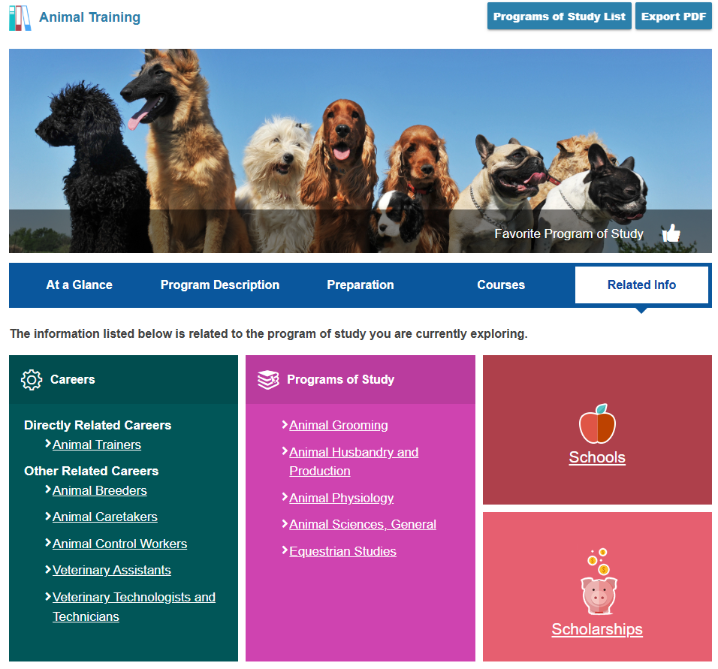
Education
Note:
Program of Study
Related Info

Slide 21
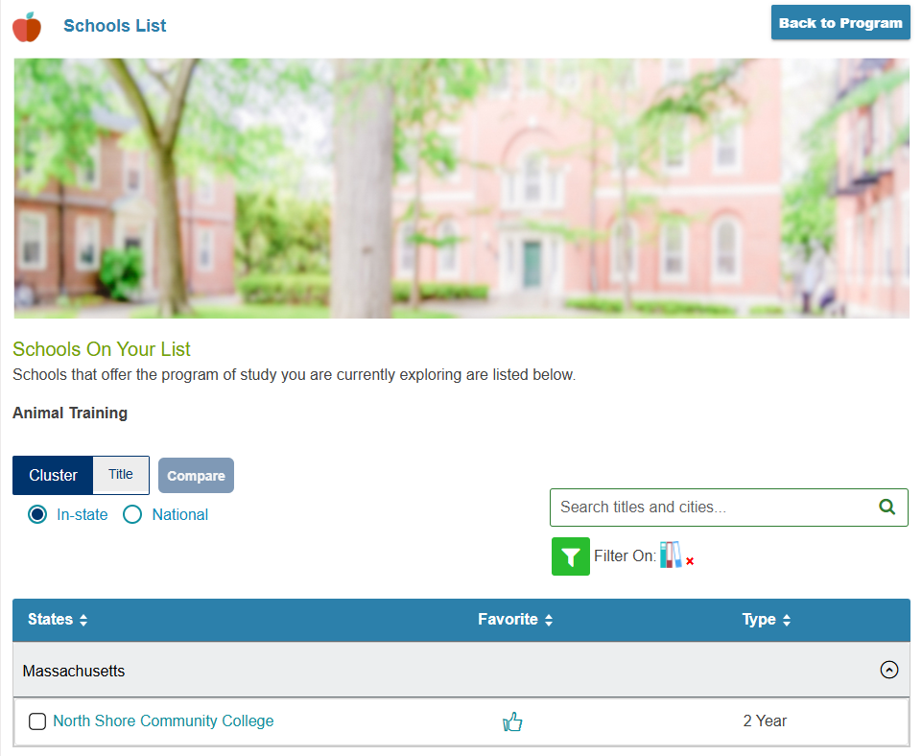

Education
Note:
Related Info
Schools
  Massachusetts is the default

Slide 22
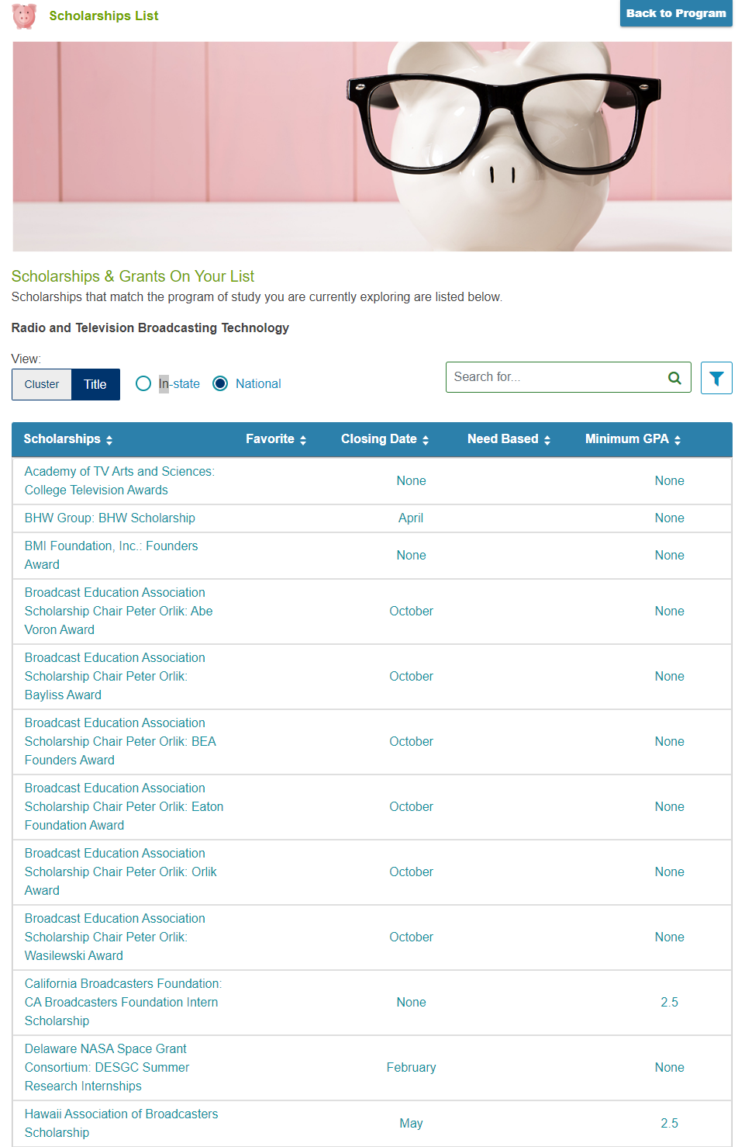

Education
Note:
Related Info
Scholarships & Grants listing

Slide 23
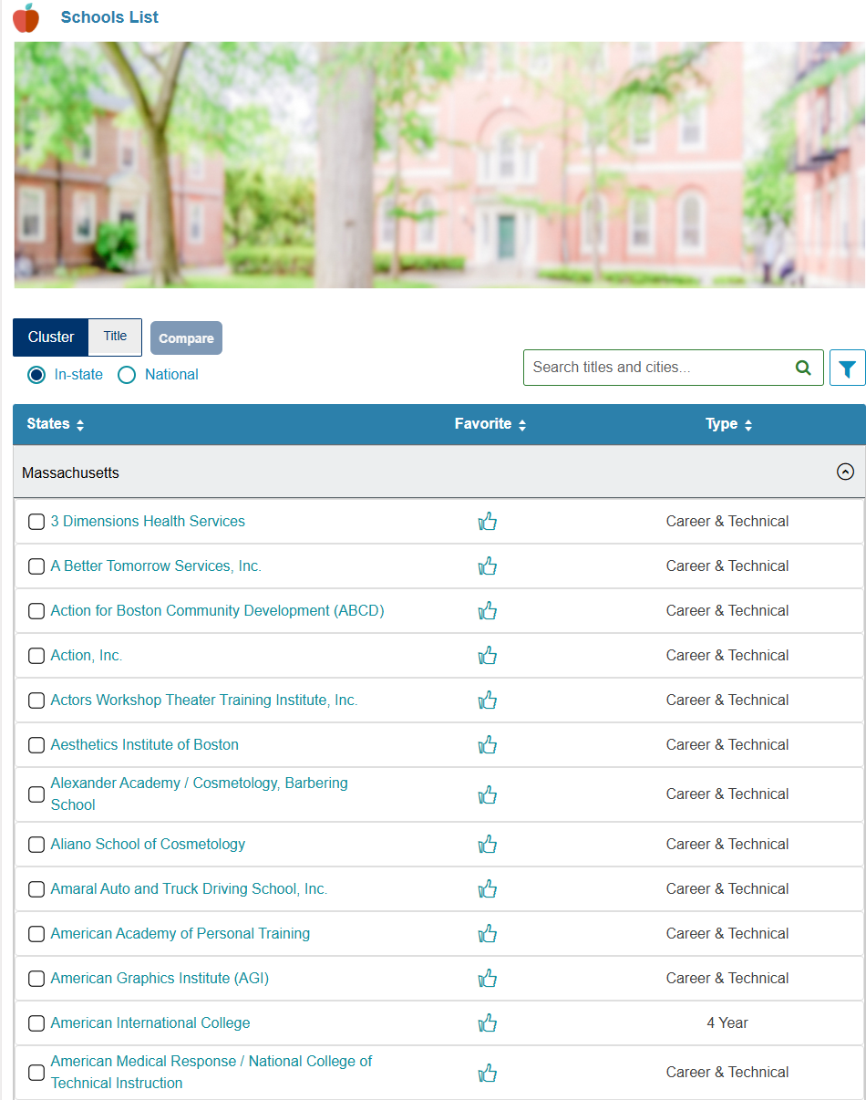
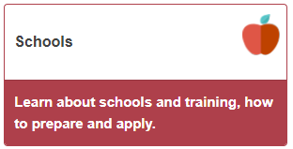
Education

Slide 24
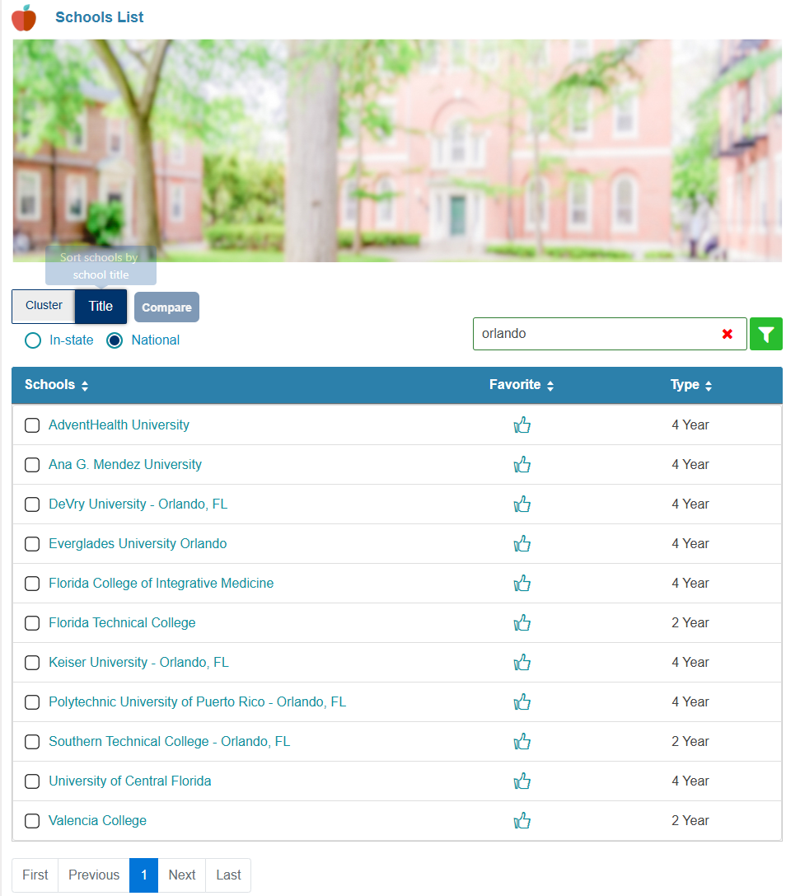
Education
Can now type a city title into the school search and be returned a list of schools in that city.

Slide 25
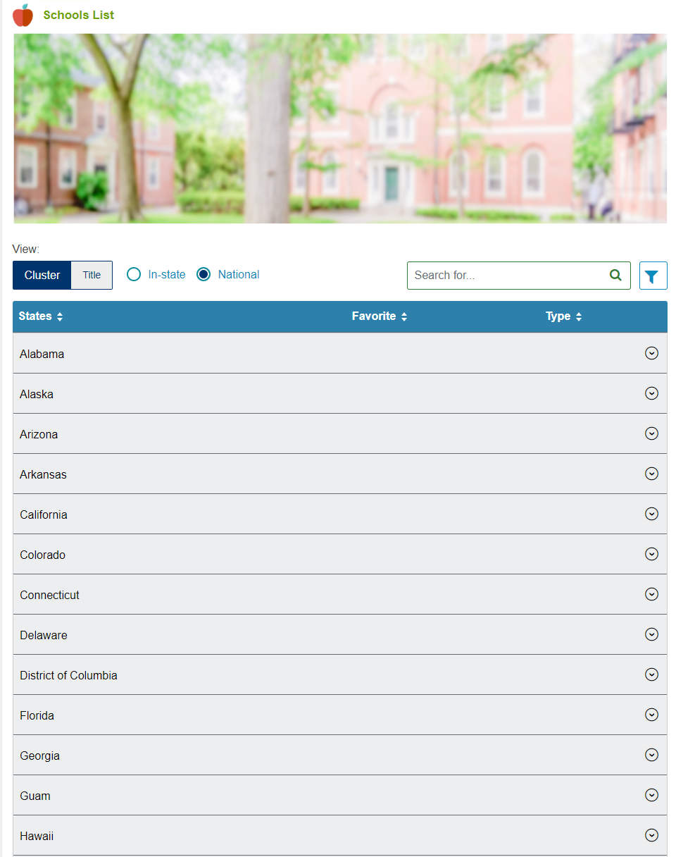

Education
Note:
Schools
States
(Petersons)

Slide 26
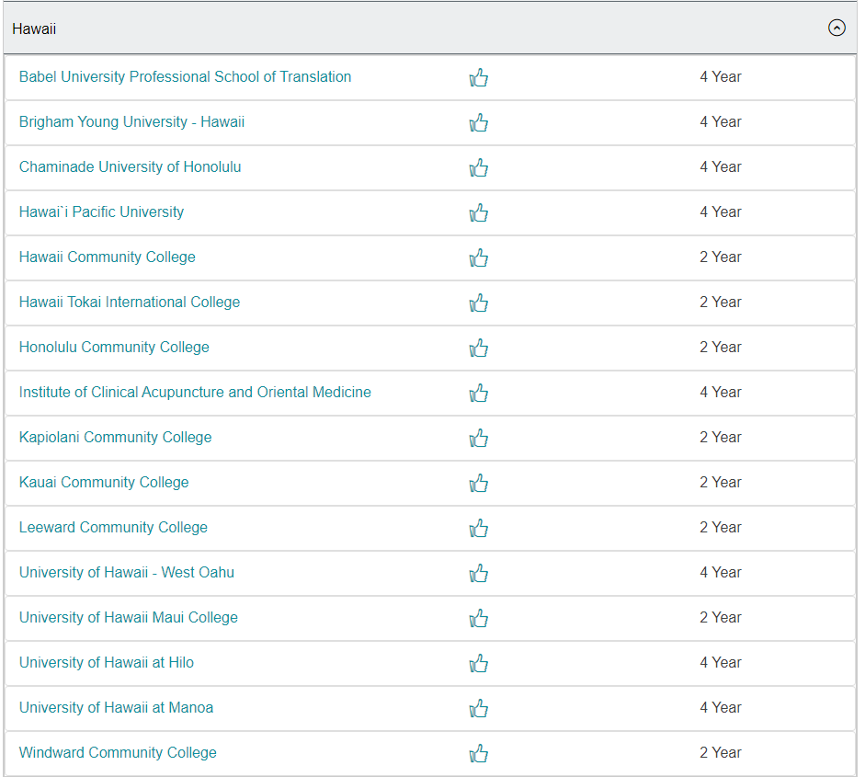
Education
Note:
Schools
A state:
Hawaii

Slide 27
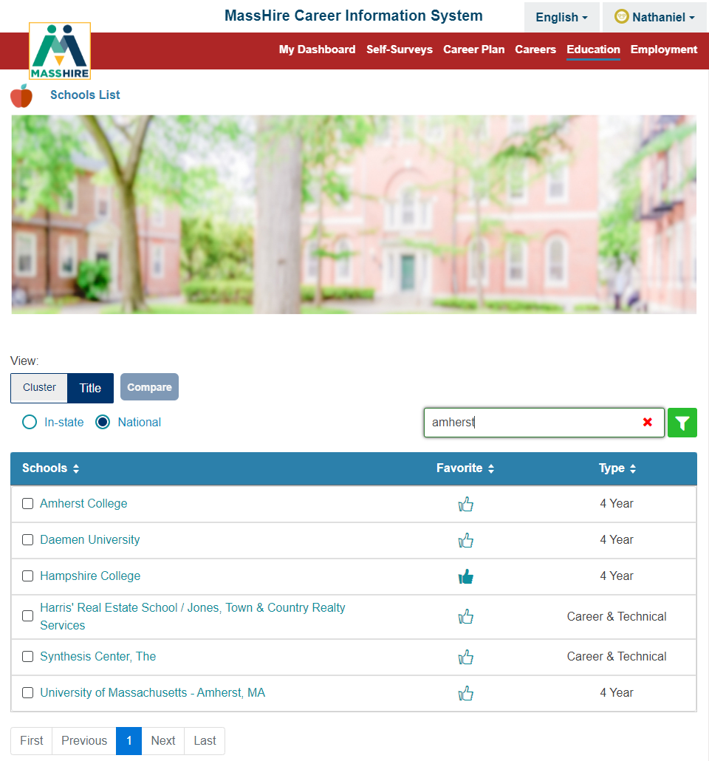

Education Update
Can now type a city title into the school search and be returned a list of schools in that city.

Slide 28
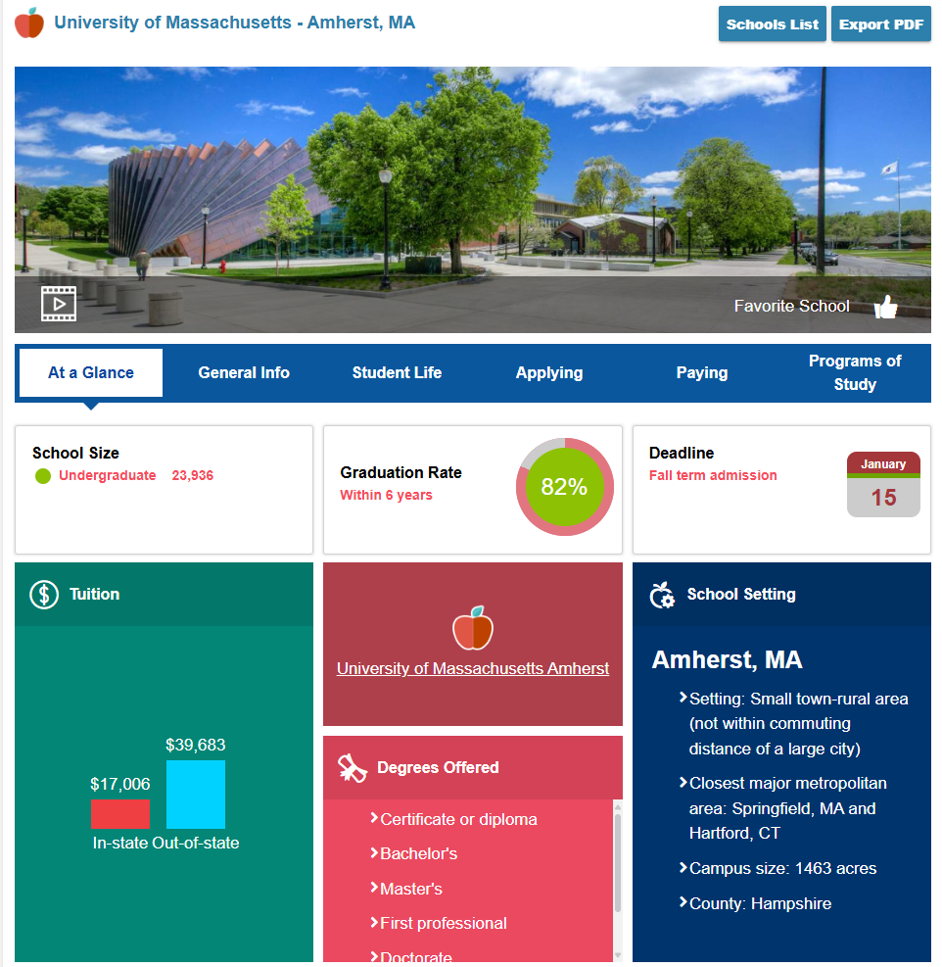
Education
Note:
Schools
A College / University / Training Provider
At A Glance

Slide 29
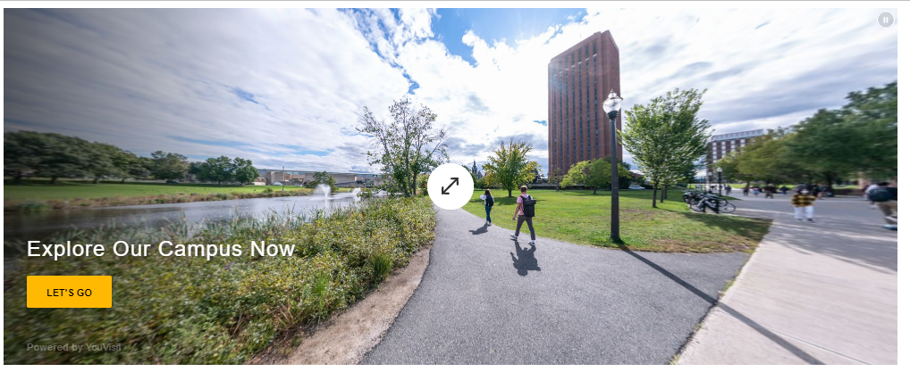
Education
Note:
Schools
A College / University / Training Provider
At A Glance
Video

Slide 30
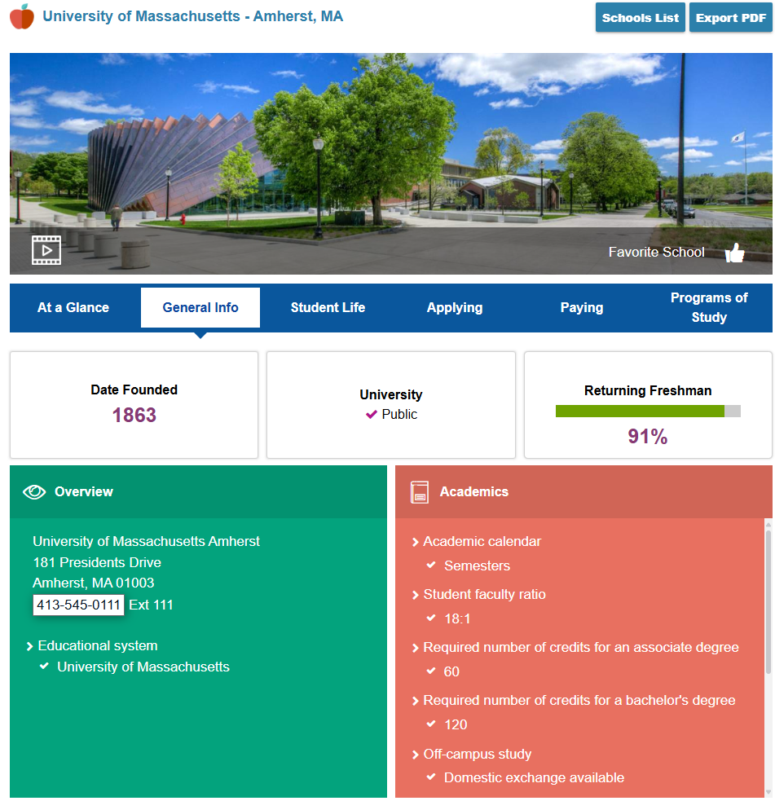
Education
Note:
Schools
A College / University / Training Provider
General Info

Slide 31
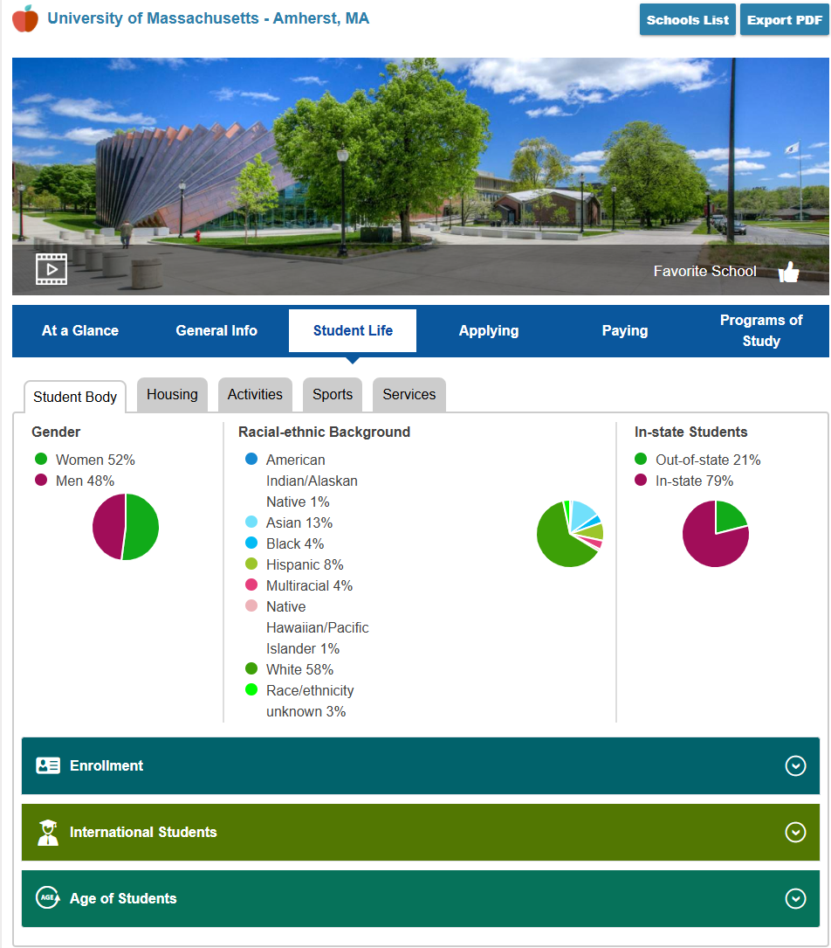
Education
Note:
Schools
A College / University / Training Provider
Student Life

Slide 32
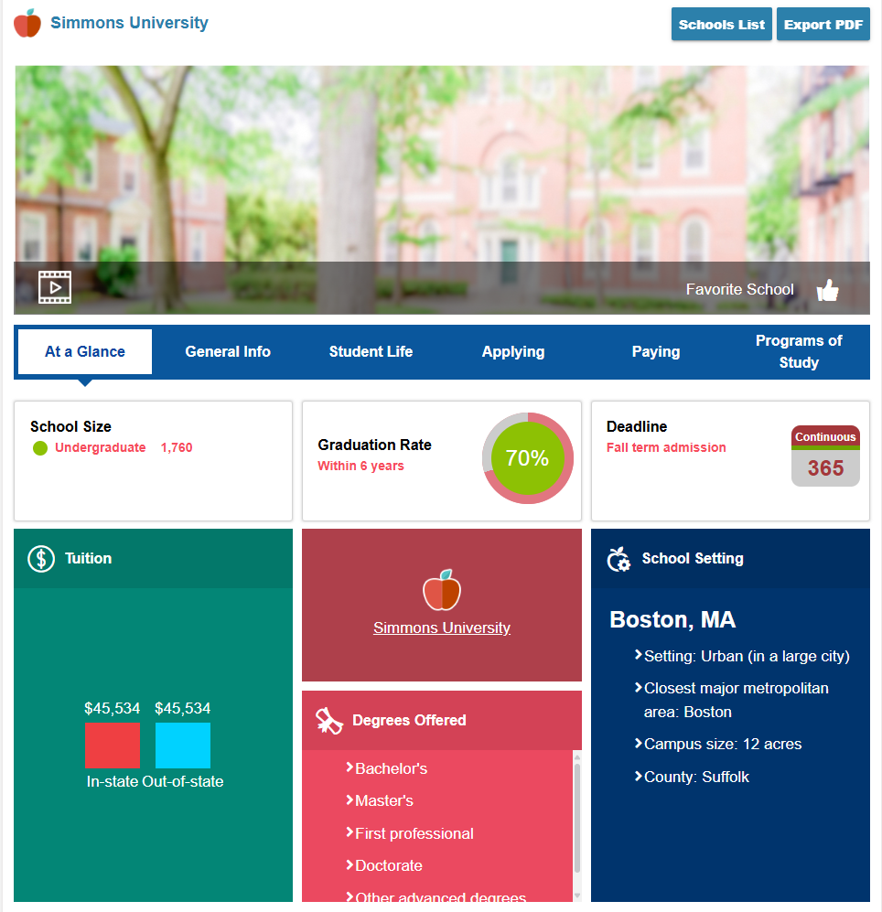
Education

Slide 33
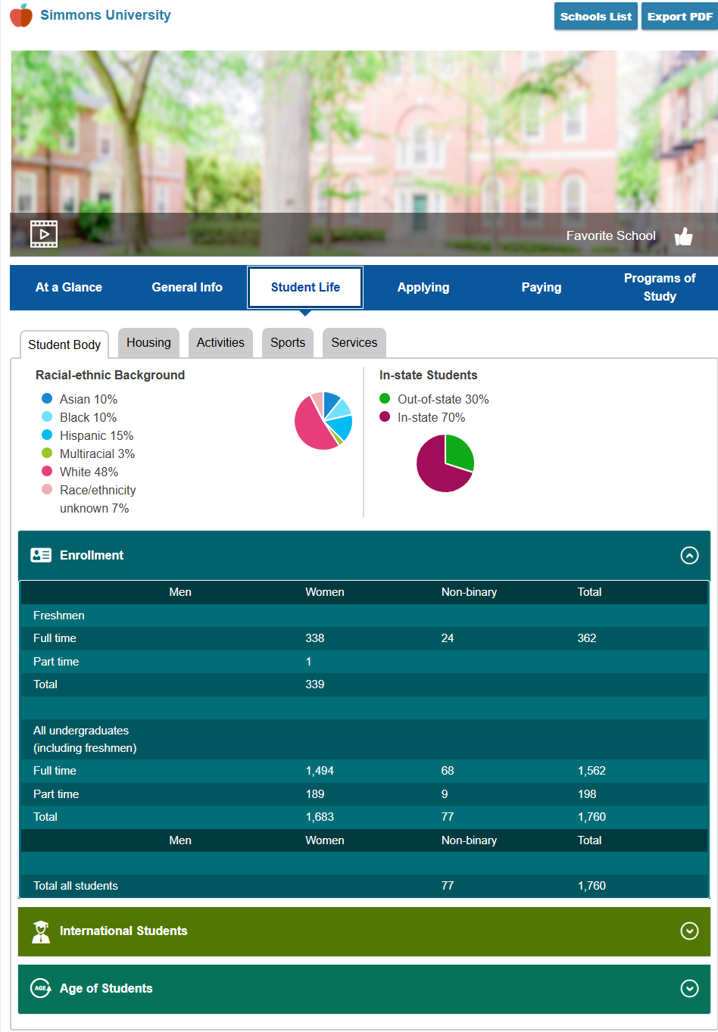
Education
In Education
Student Life
Student Body
Gender update

Slide 34
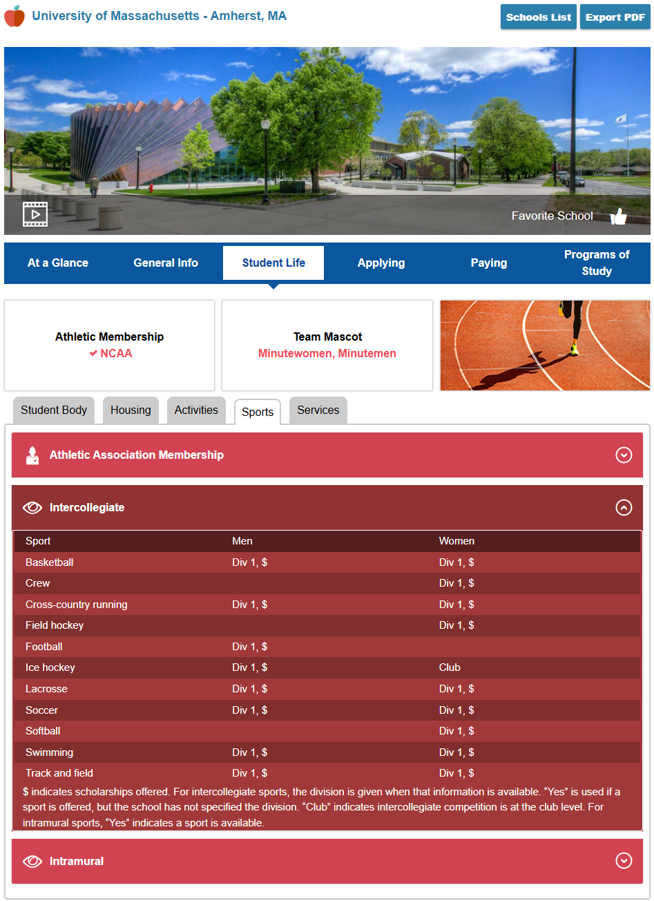
Education
Note:
Schools
A College / University / Training Provider
Student Life
Sports with Scholarships

Slide 35
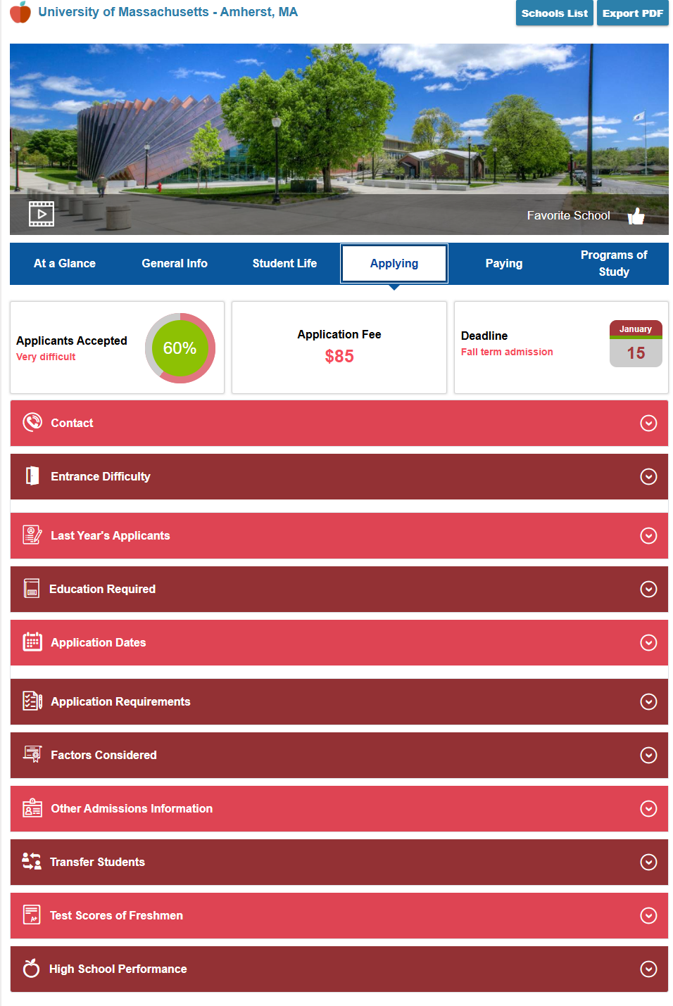
Education
Note:
Schools
A College / University / Training Provider
Applying

Slide 36
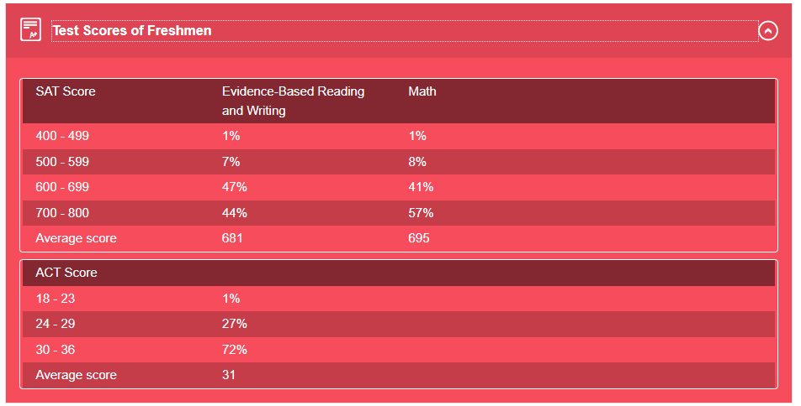
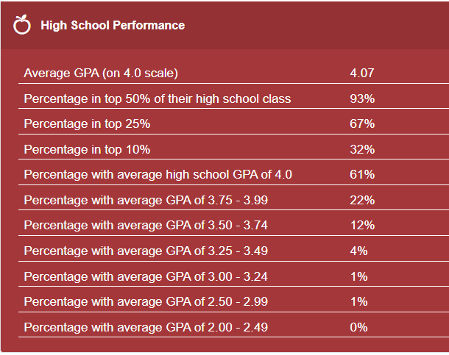
Education

Slide 37
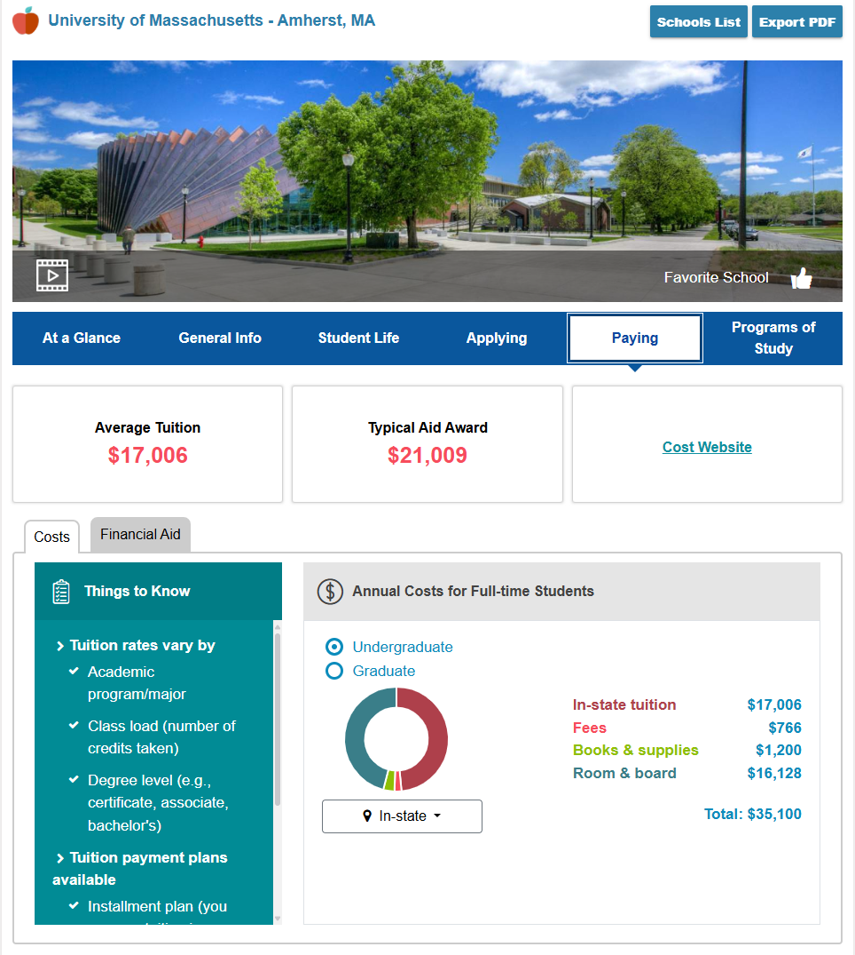
Education
Note:
Schools
A College / University / Training Provider
Paying (Costs tab)

Slide 38
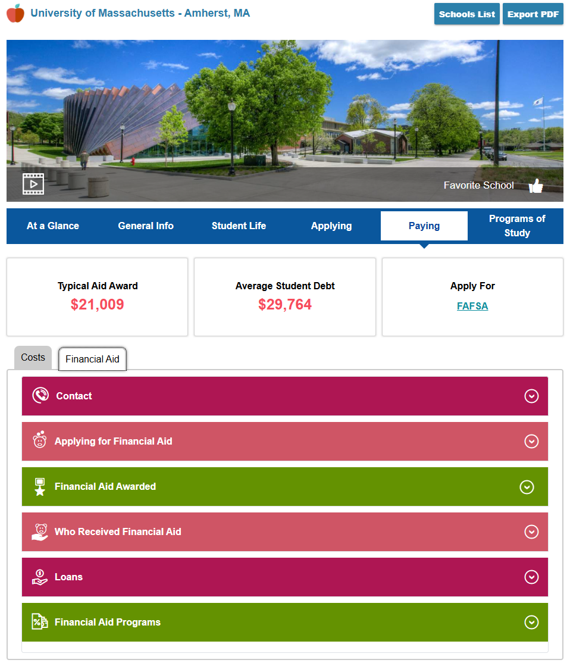
Education
Note:
Schools
A College / University / Training Provider
Paying
Financial Aid (sub tab)

Slide 39
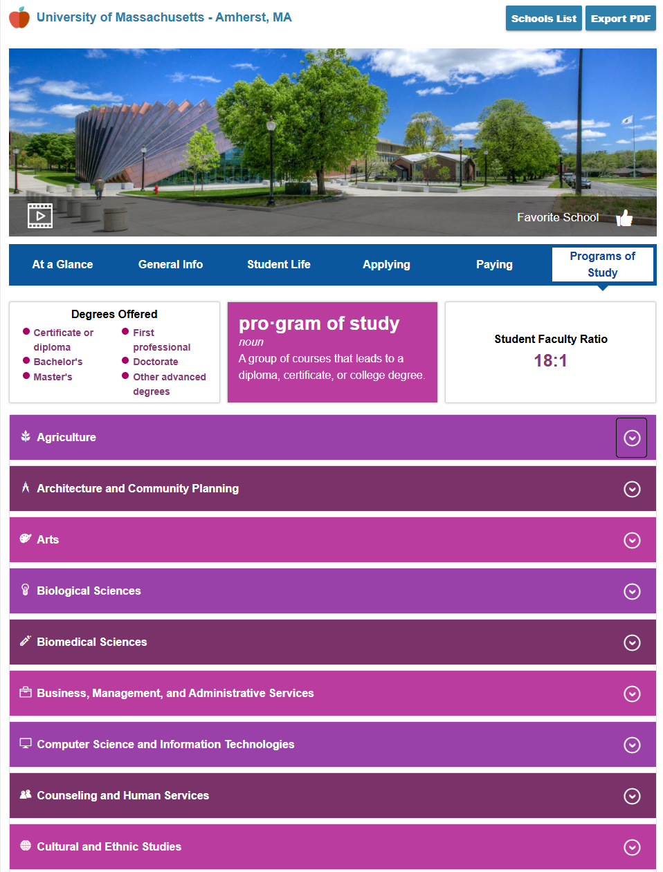
Education
Note:
Schools
A College / University / Training Provider
Programs of Study

Slide 40
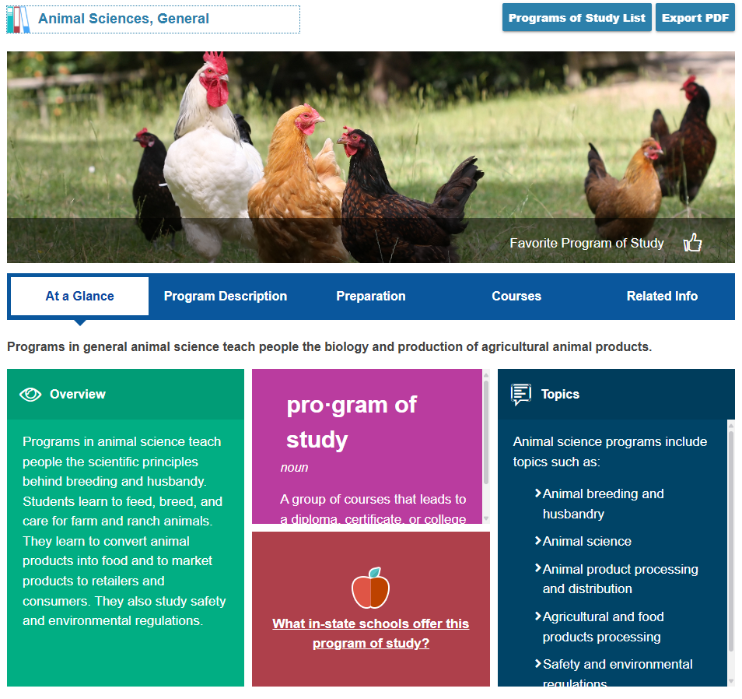
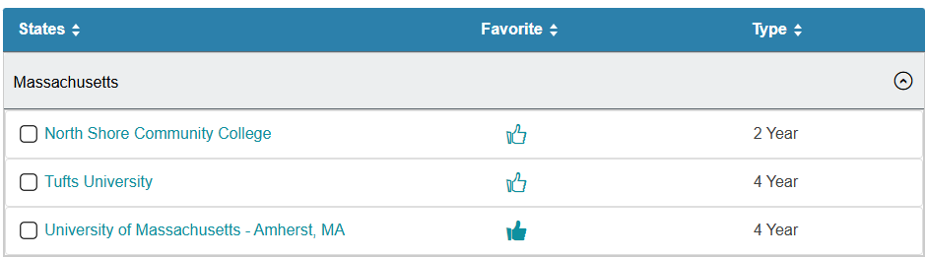
Education
A College / University / Training Provider
Programs of Study & Massachusetts schools

Slide 41
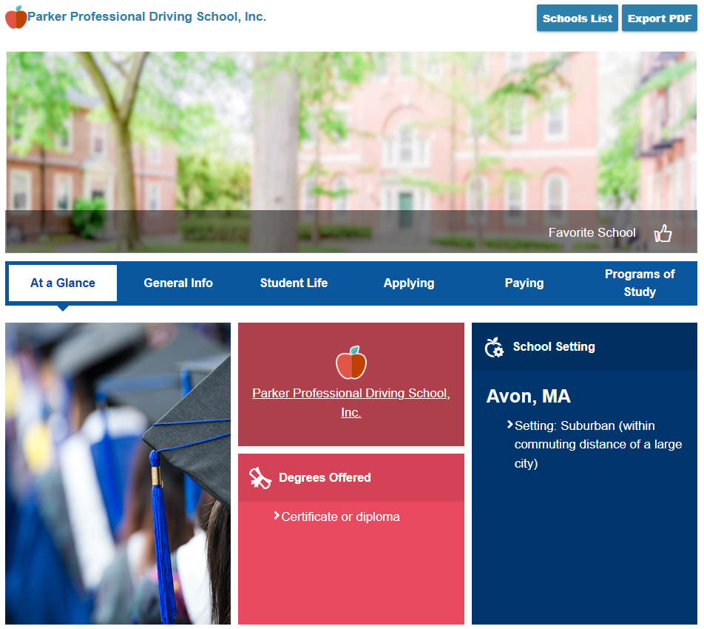
Certificate Provider

Slide 42
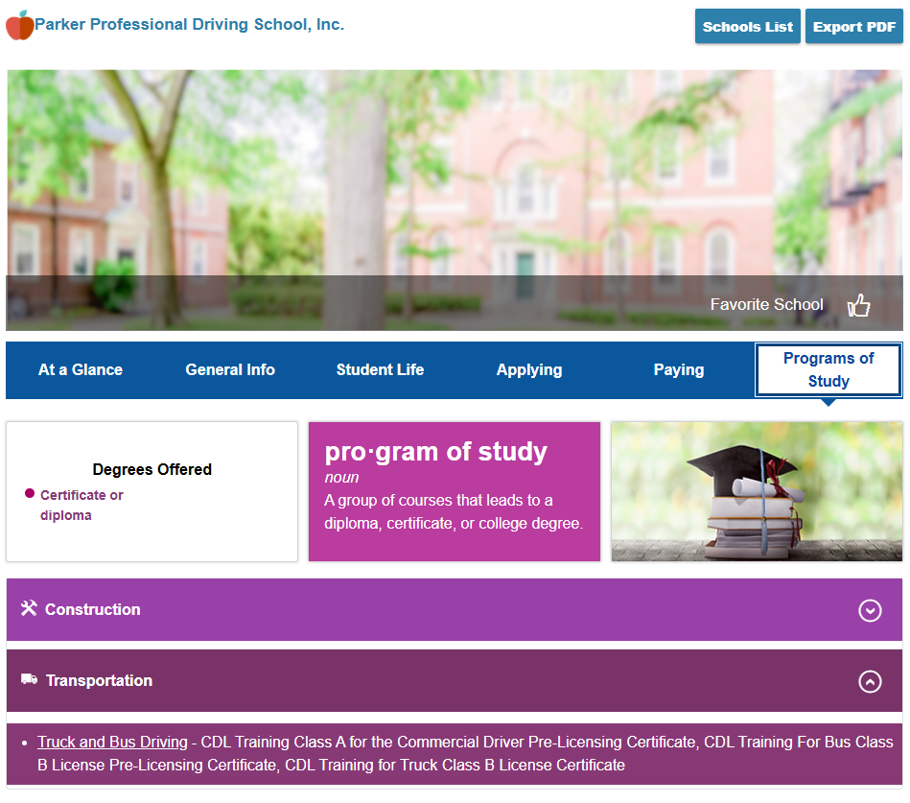
Certificate Provider

Slide 43

Certificate Provider

Slide 44
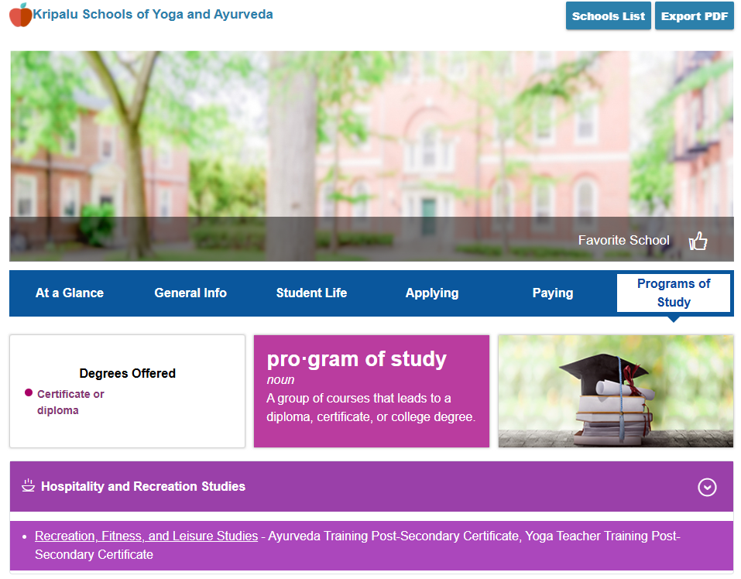
Certificate Provider

Slide 45
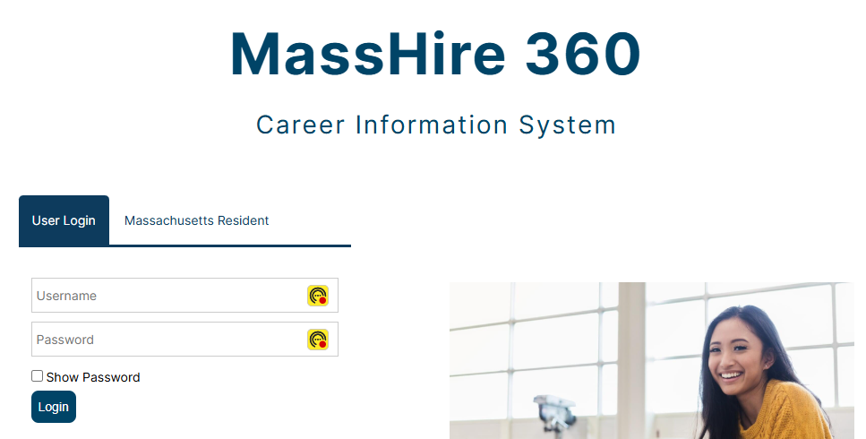


In CIS , not necessarily in MOSES , TrainingPro and / or Approved

Slide 46
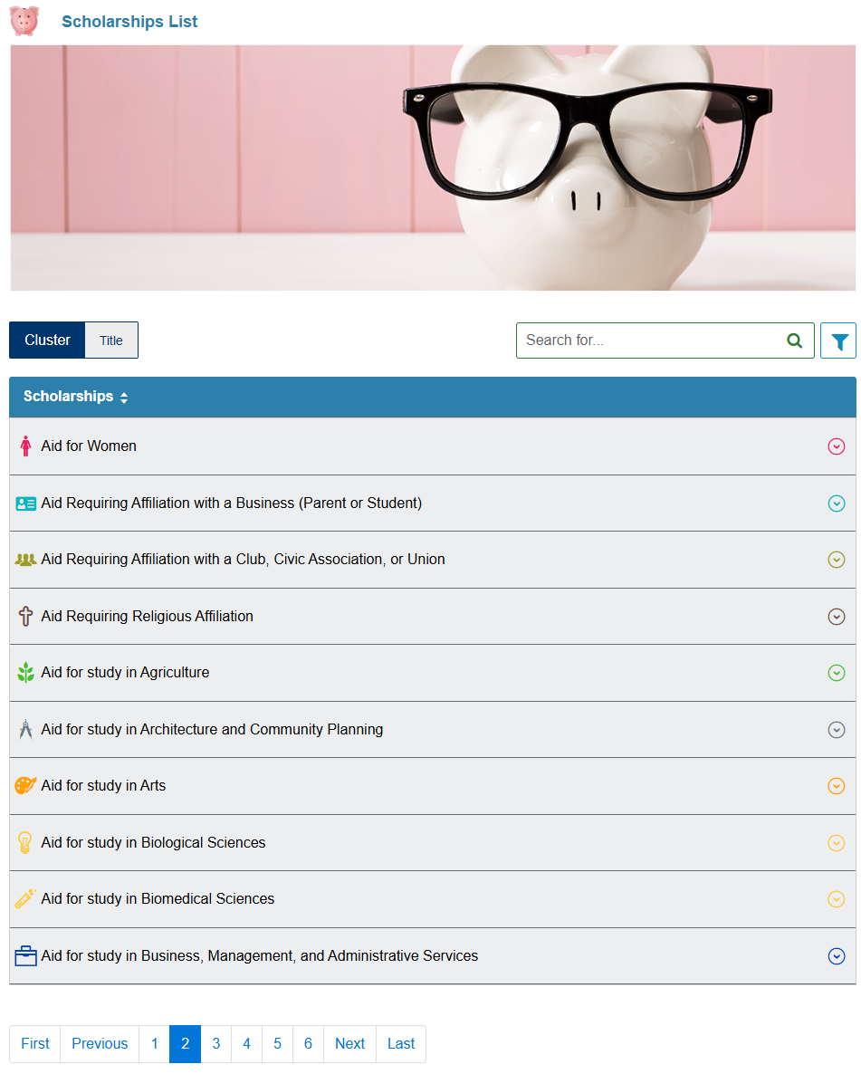
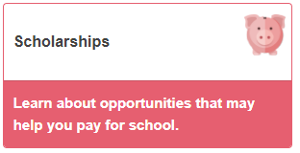
Education

Slide 47
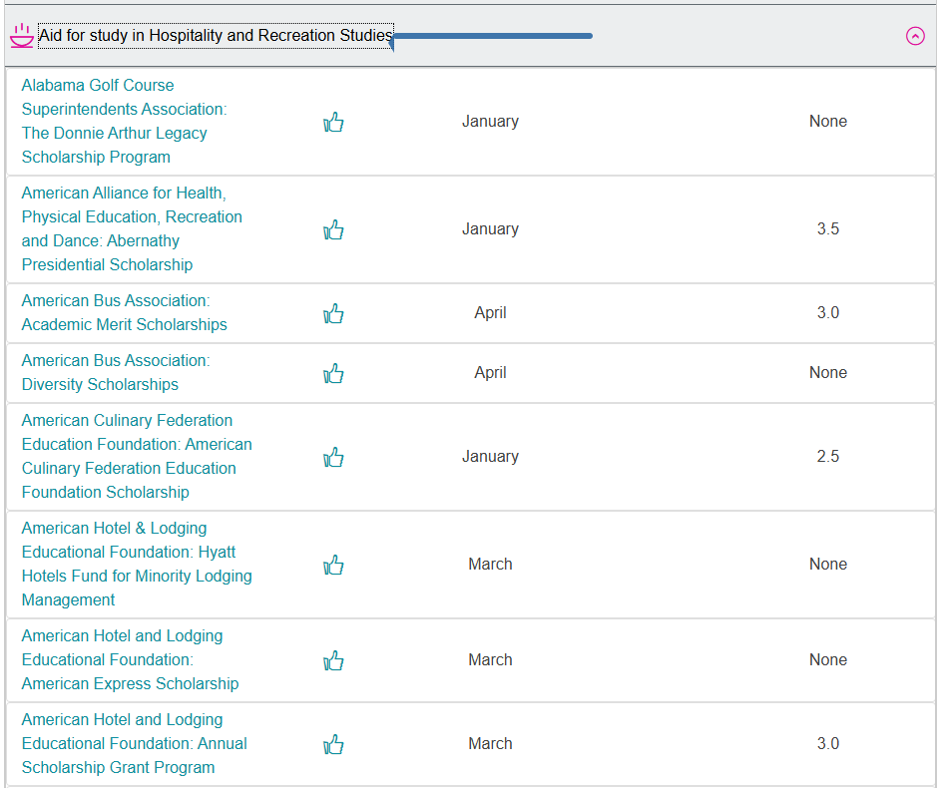
Education
Note:
Scholarships
By Category (Cluster)

Slide 48
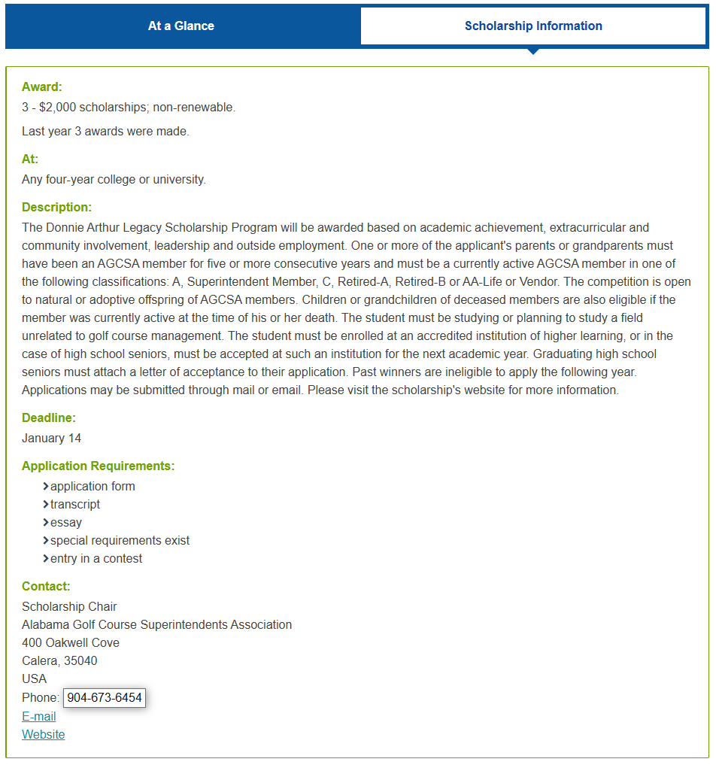
Education
Note:
Scholarships
Details
(Scholarship Information)

Slide 49
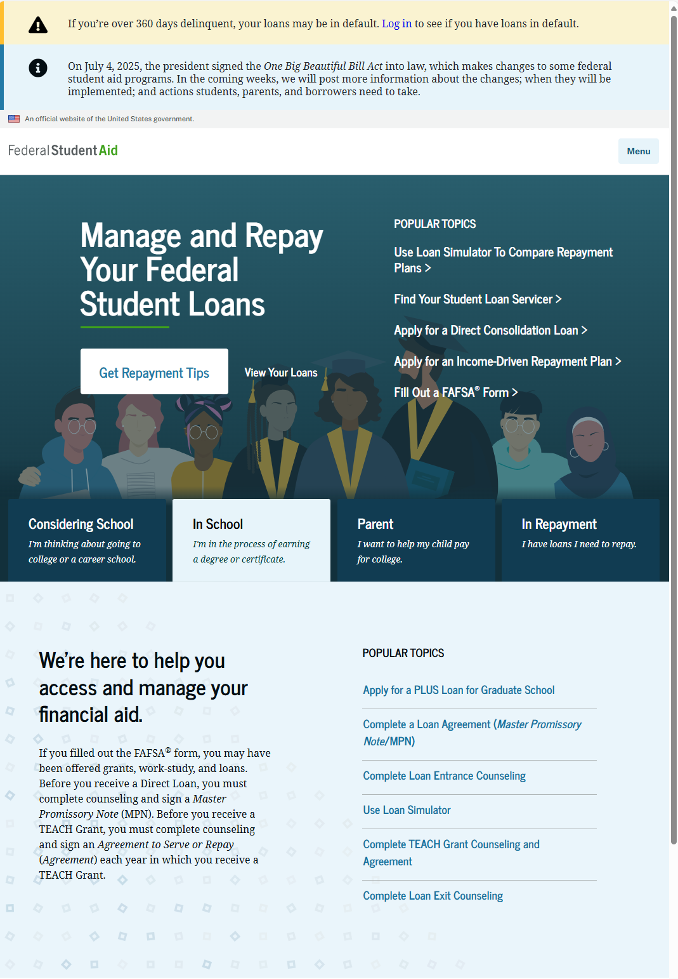
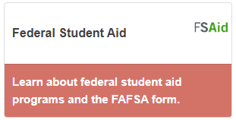
Education
https://studentaid.gov/

Slide 50

Education

Slide 51
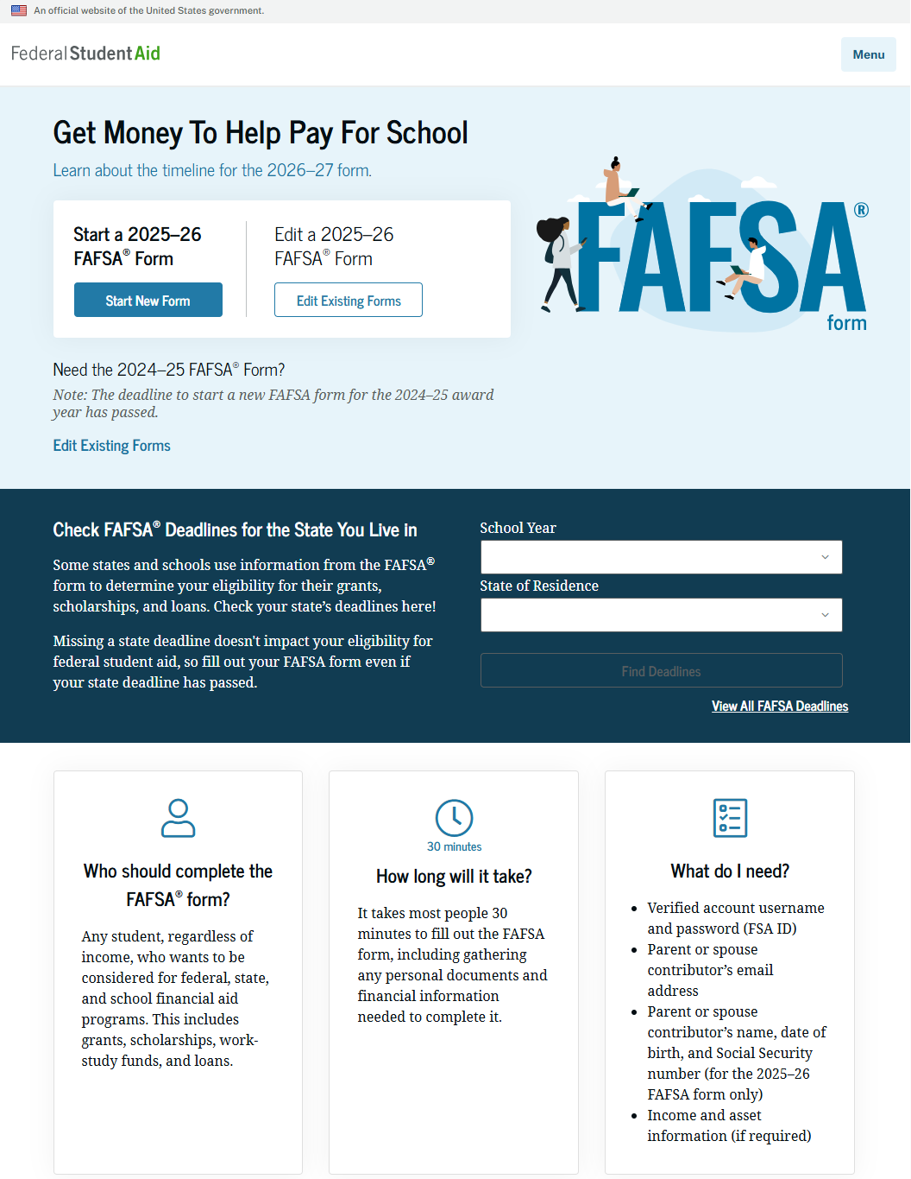
Education

Slide 52
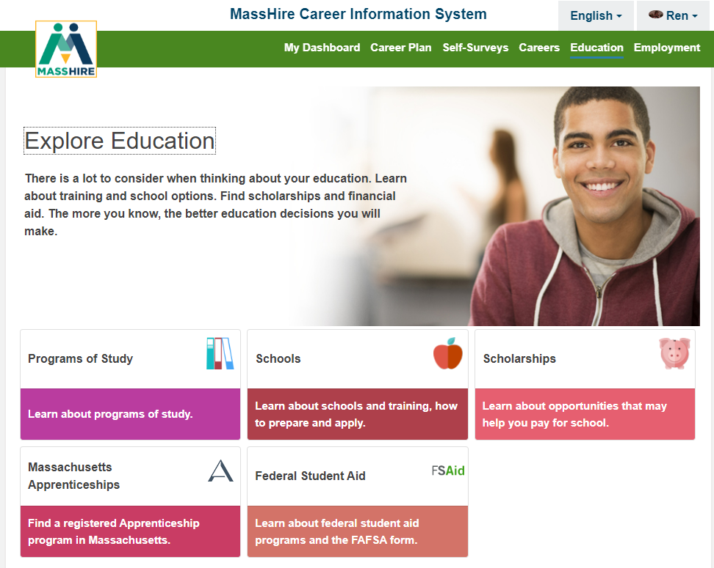

Education
High School / College edition

Slide 53
Contact Information
Email: MassHireCIS@State.MA.US
Telephone: 617-626-6808
URL: https://portal.masscis.IntoCareers.org

Slide 54

?
?
?
Questions
?
?
?
?
?
?
?
?

Slide 55
Employment in CIS 360

Slide 56
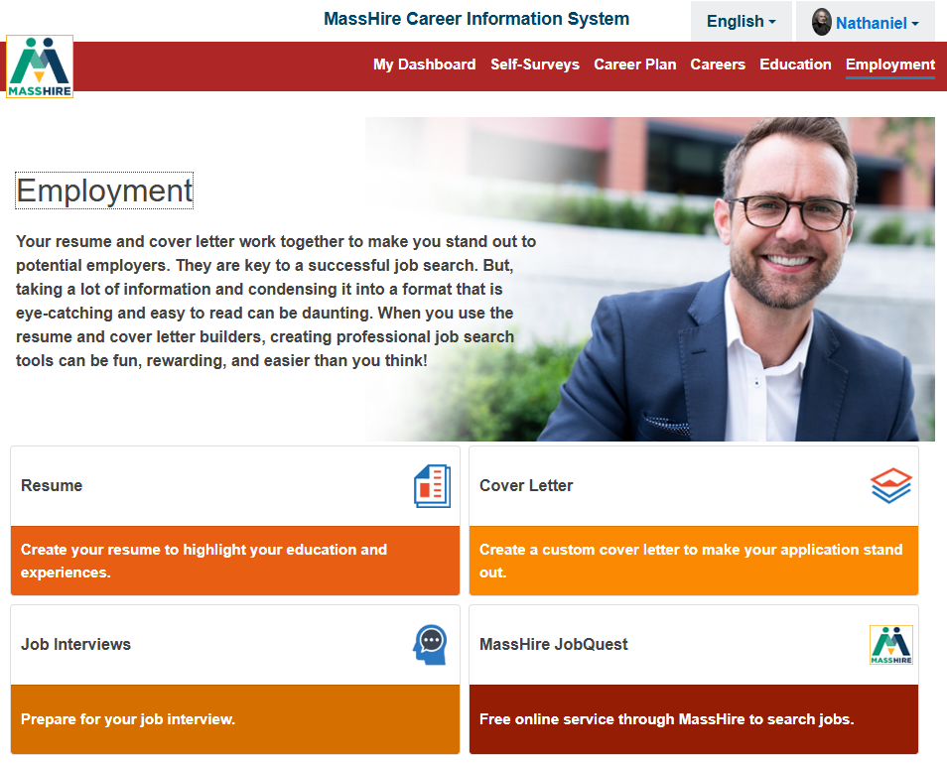
Employment

Slide 57


Employment

Slide 58


Employment

Slide 59


Employment

Slide 60


Employment

Slide 61

Employment

Slide 62


Employment

Slide 63


Employment

Slide 64


Employment

Slide 65


Employment

Slide 66

Employment

Slide 67

Employment
Note:
Career Plan
  SEEK
Careers
Find Jobs

Slide 68

Employment
CAREERS
Employment & Outlook
Career Plan
  SEEK
Careers
Find Jobs

Slide 69

National Labor Exchange

Slide 70

Employment
Note:
Career Plan
  SEEK
Careers
Find Jobs
NLx

Slide 71

Employment
Note:
Career Plan
  SEEK
Careers
Find Jobs
NLx

Slide 72

Employment
Note:
Career Plan
  SEEK
Careers
Find Jobs
NLx

Slide 73

Employment
Note:
Career Plan
  SEEK
Careers
Find Jobs
NLx

Slide 74


Employment

Slide 75


Employment

Slide 76



Employment

Slide 77


Employment

Slide 78


Employment

Slide 79


Employment

Slide 80

Employment
High School / College edition

Slide 81
Contact Information
Email: MassHireCIS@State.MA.US
Telephone: 617-626-6808
URL: https://portal.masscis.IntoCareers.org

Slide 82
?
?
?
Questions
?
?
?
?
?
?
?
?

