Slide 1

MassHire Career Information Systems 360
Massachusetts State Log In
  MassHire Programs & Services are funded in full by US Department of Labor (USDOL) Employment and Training Administration grants. (Additional details furnished upon request.)

Slide 2

University of Oregon : into CAREERS

Slide 3

MassHire Career Information System
MassHire Career Information Systems 360 is purchased with grants by the US Department of Labor (USDOL) Employment and Training Administration, it is primarily procured for the use of the Department of Career Services Career Centers, it’s partners and Massachusetts constituents. As such the trainings focus is for career center staff usage.

Slide 4
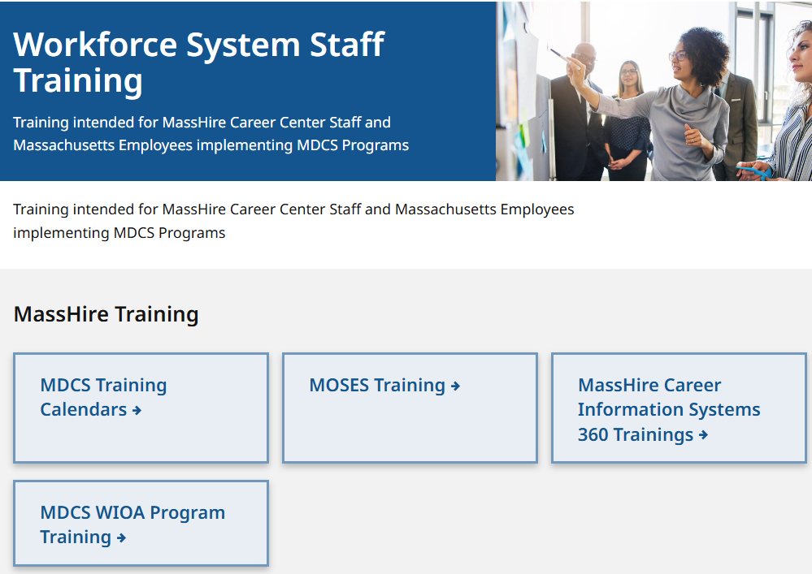
The MassHire CIS Training Calendar https://www.mass.gov/workforce-system-staff-training

Slide 5
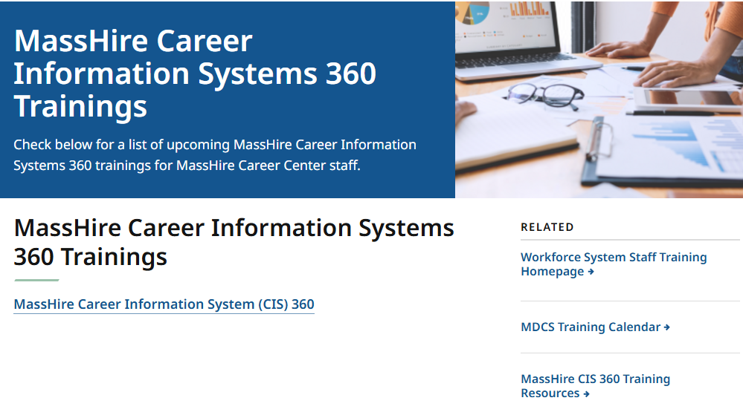
The MassHire CIS Training Calendar https://www.mass.gov/info-details/masshire-career-information-systems-360-trainings

Slide 6
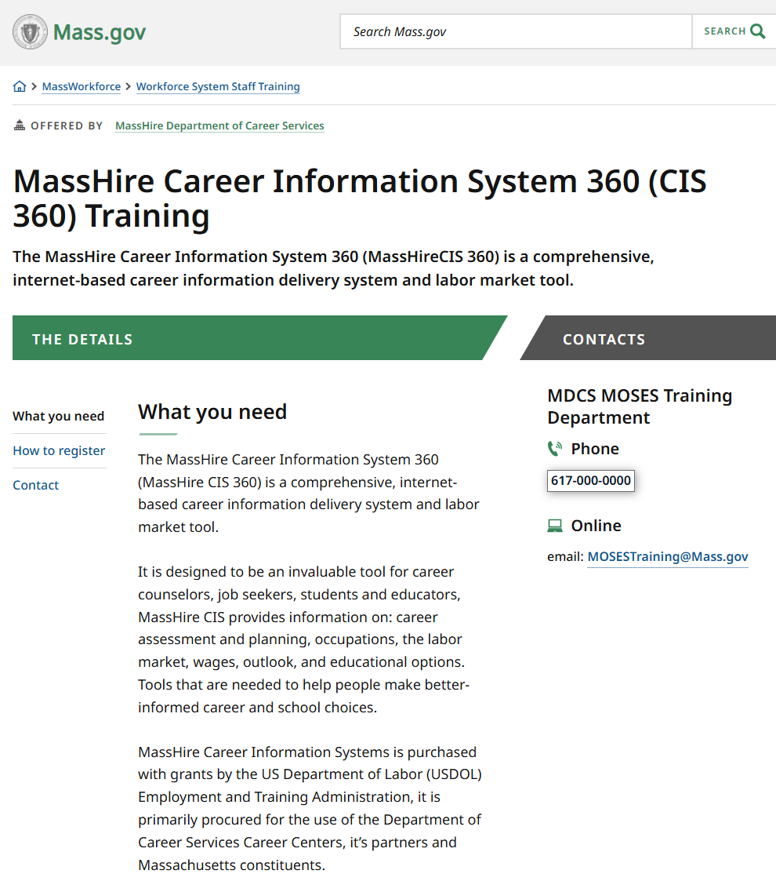
The MassHire CIS Training Calendar https://www.mass.gov/how-to/masshire-career-information-system-360-cis-360-training

Slide 7
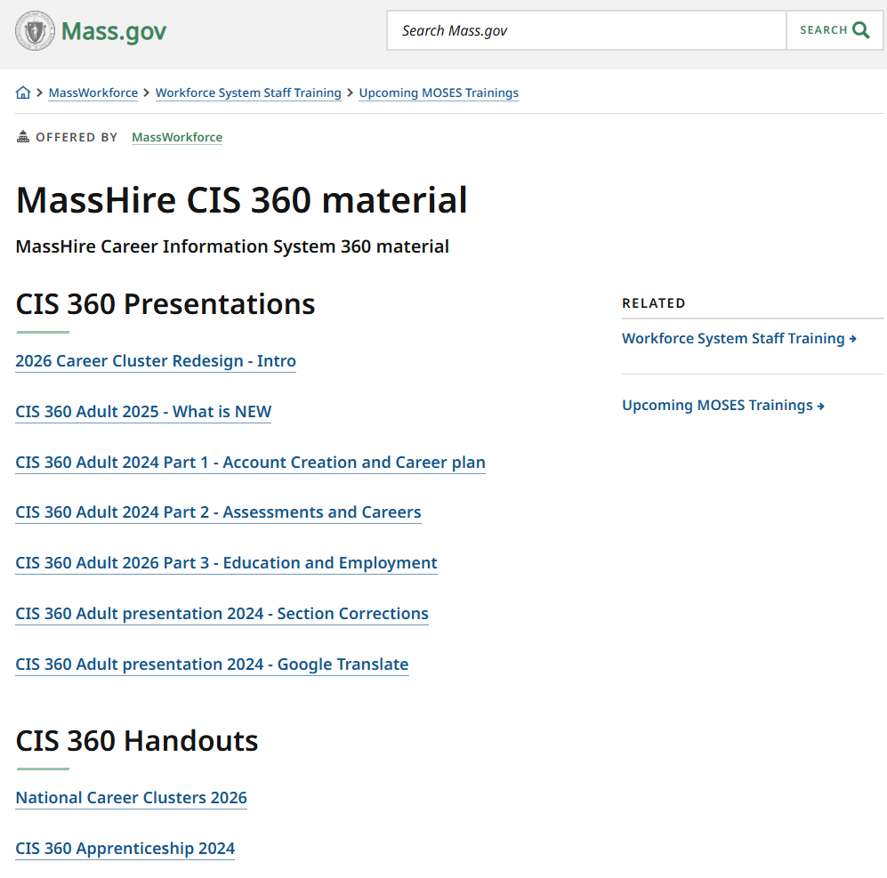
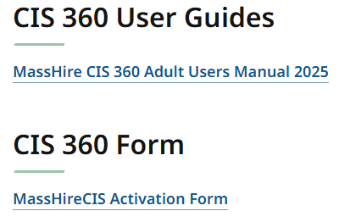
The MassHire CIS Resources https://www.mass.gov/info-details/masshire-cis-360-material

Slide 8
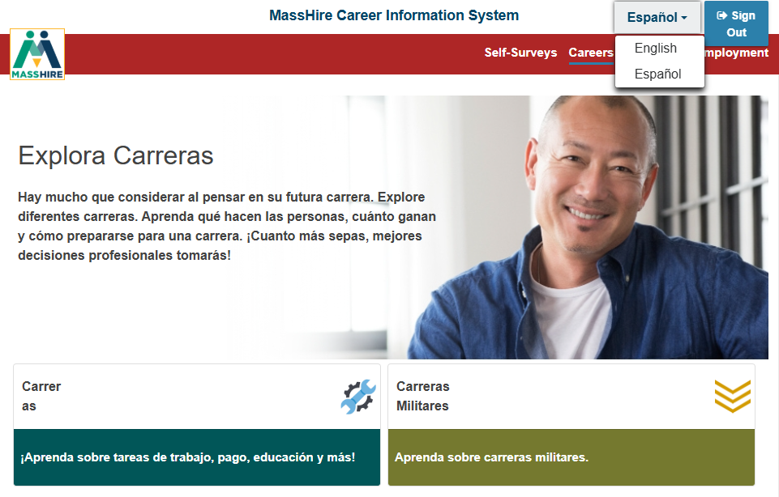
English / Español
Note:
Español version originally done by Texas translation affiliation using Mexican Spanish

Slide 9


Translation

Slide 10

The MassHire Career Information System Portal https://portal.ma.cis360.org/

Slide 11
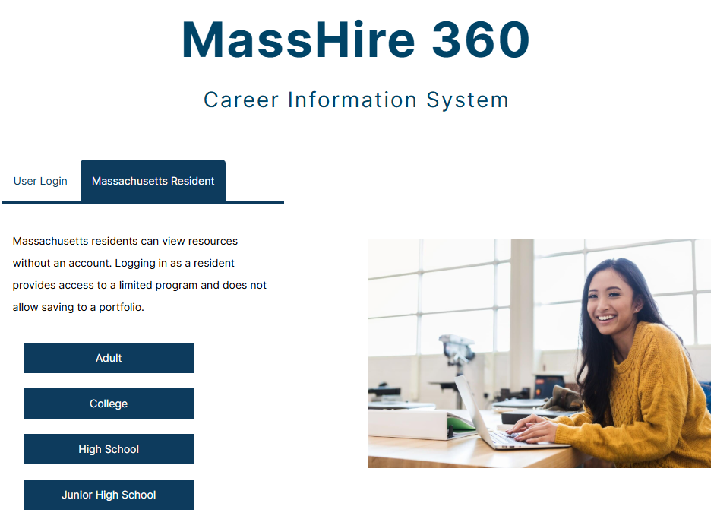
Massachusetts Residents Log In
Statewide license for all Massachusetts Cities and Towns.
Lists all 4 types of CIS 360 education levels.
Only Junior High School has significant differences.

Slide 12
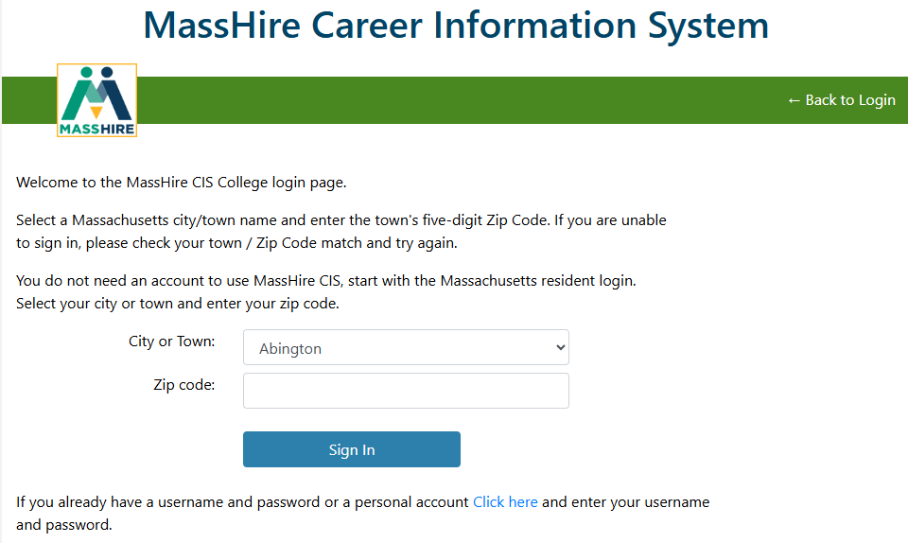
Massachusetts Residents Log In
Statewide license for all Massachusetts Cities and Towns.
Just Enter the correct Zip Code for the Selected City / Town.
The selected type of CIS 360 will come up. (Adult to Junior High School.)

Slide 13
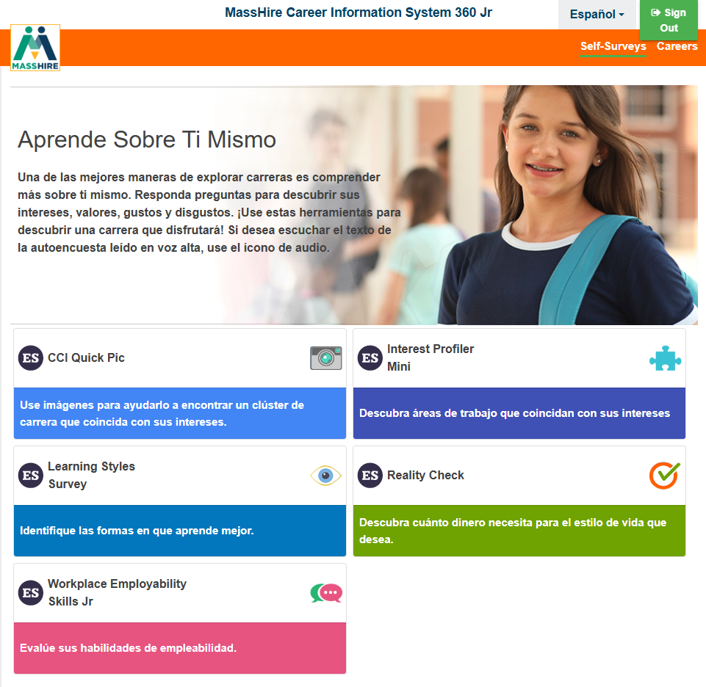
Massachusetts Residents Log In
NOTE:
State (City and Town) log in does come in:
English
Spanish (Espanol)
(Junior High School Version shown) .

Slide 14
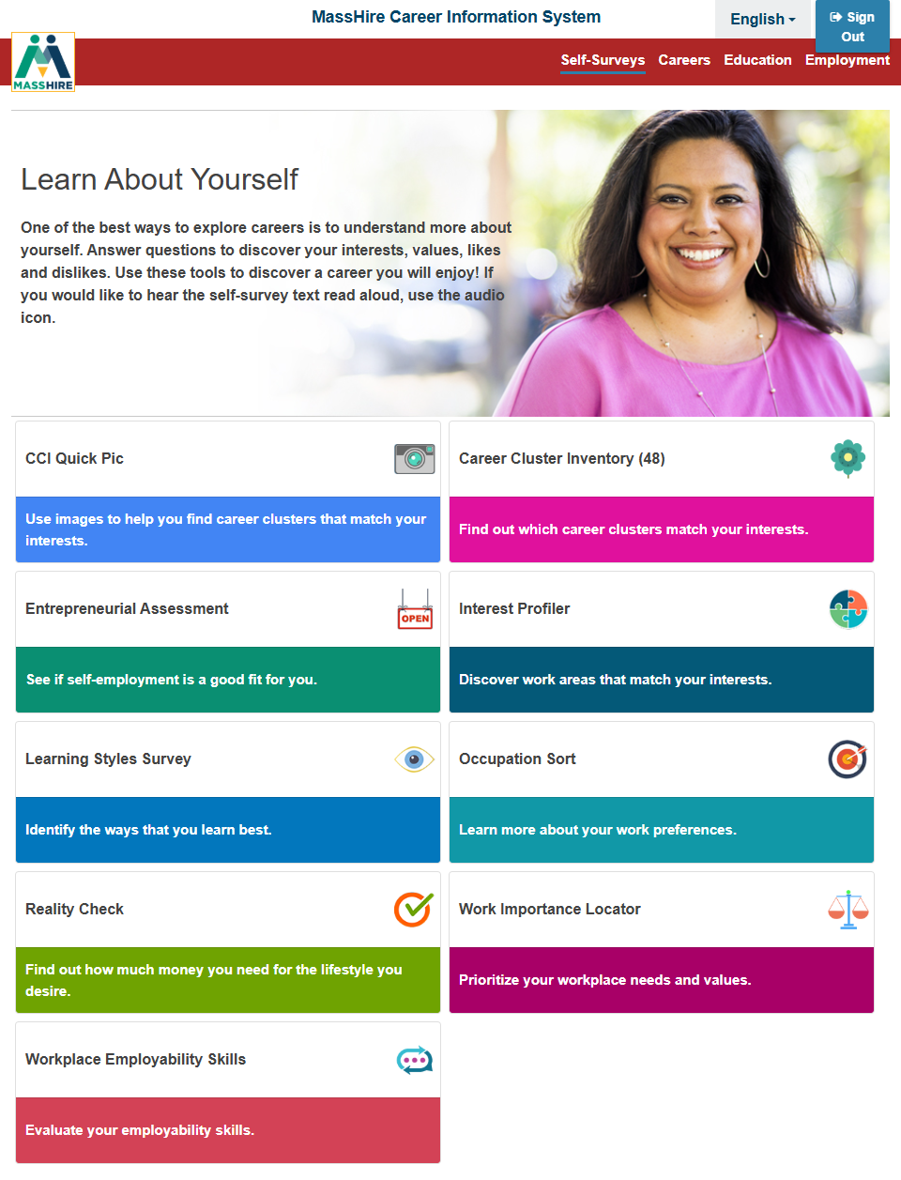
Massachusetts Residents Log In
NOTE:
State (City and Town) log in
does not have the ability to save to a portfolio.

Slide 15

Massachusetts Residents Log In
NO:
My Dashboard
or
Career Plan

Slide 16
Massachusetts Residents Log In
Self - Surveys

Slide 17
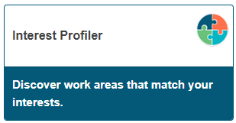
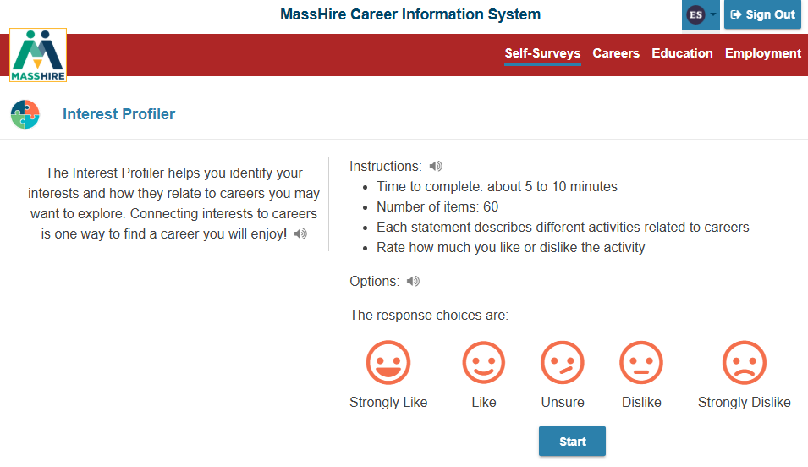
Interest Profiler
Note:
Sixty (60) questions about work activities.
You select / decide your interest on a sliding scale of Strongly Like to Strongly Dislike.

Slide 18
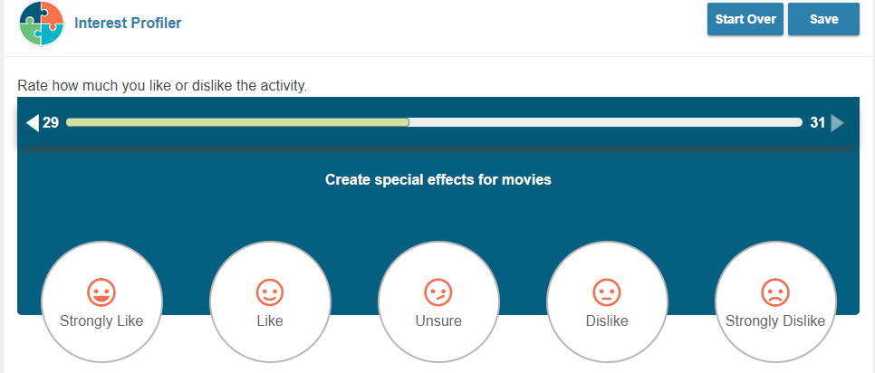
Interest Profiler: Sample Question
Note:
Sample work activity , you select your level of interest.
Bar above the activity keeps track of the questions answered and those still to be answered.

Slide 19
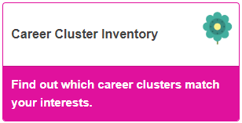
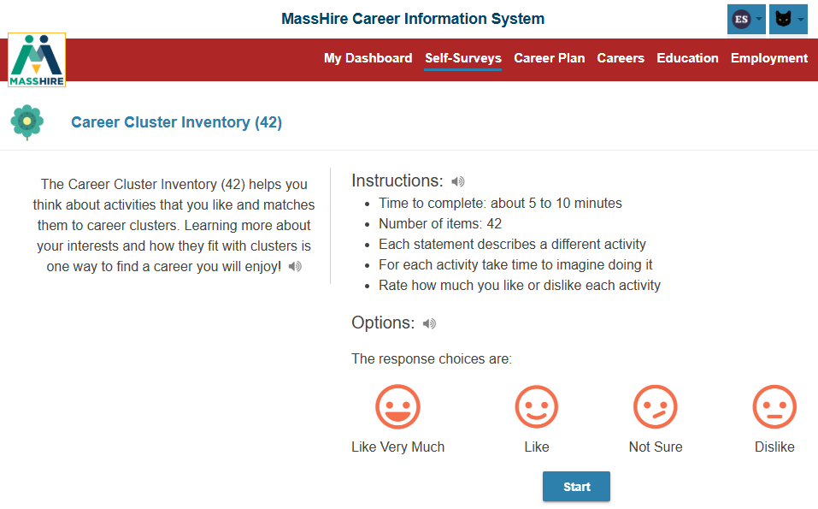
Career Cluster Inventory
Note:
Forty-two (42) questions about activities.
You select / decide your interest on a scale from Like Very Much to Dislike.

Slide 20
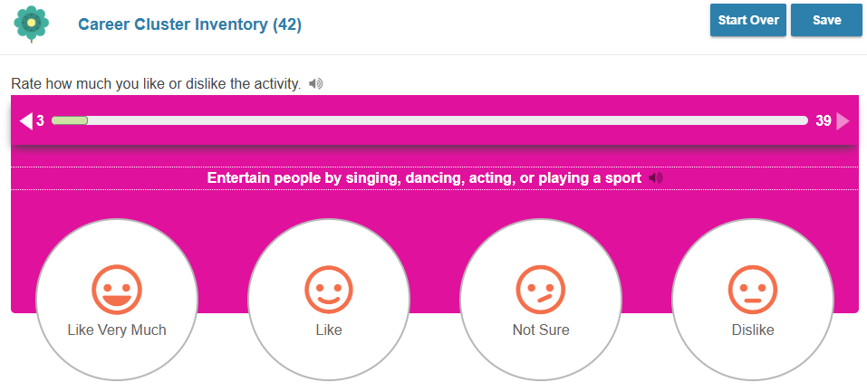
Career Cluster Inventory
Note:
Sample activity , you select your Likes and Dislikes.
The bar above the question keeps track of the questions answered and those still to be answered.

Slide 21
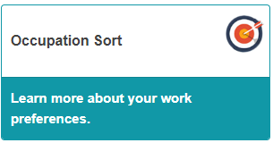
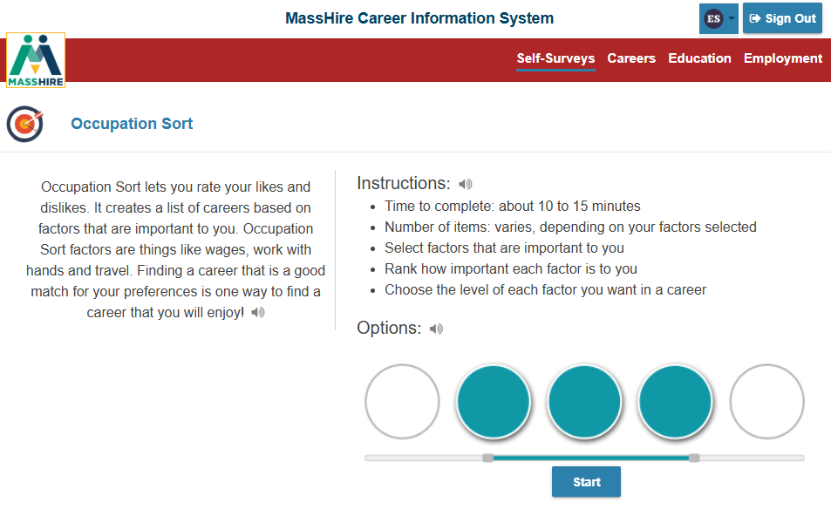
Occupation Sort
Note:
Twenty-Eight (28) career factors are provided.
You provide how important or not important it is in your work.
You are limited in your selection.

Slide 22
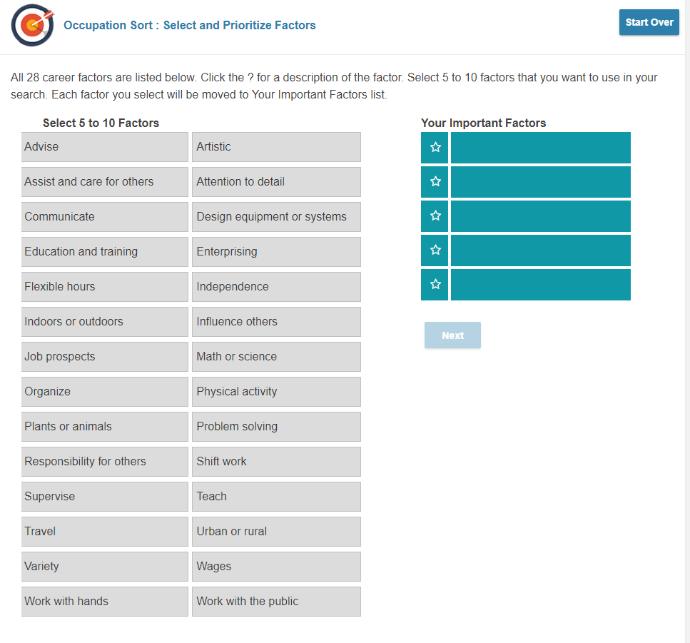
Occupation Sort
Select a minimum of five (5) to a maximum of ten (10) work factors that are important to you.
Select by clicking

Slide 23
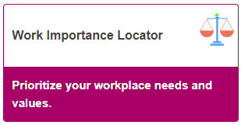
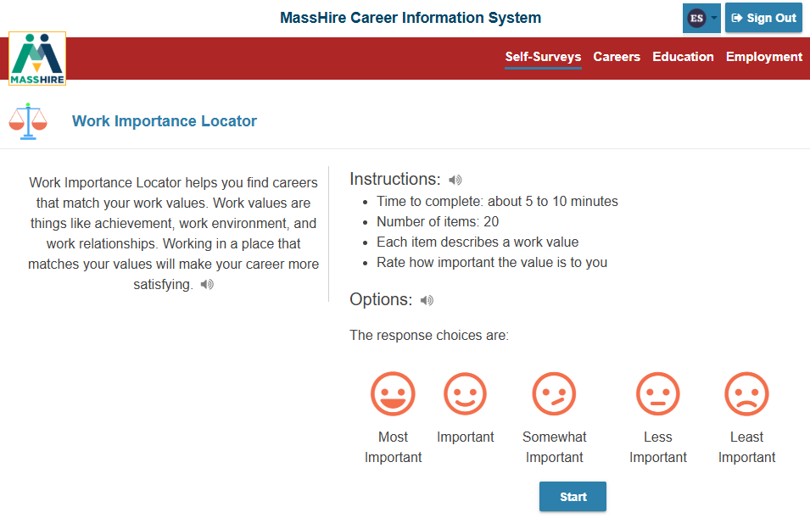
Work Importance Locator
Note:
Twenty (20) work values are provided.
You Rate how important each is to you.
Scale is:
Most Important
To
Least Important

Slide 24
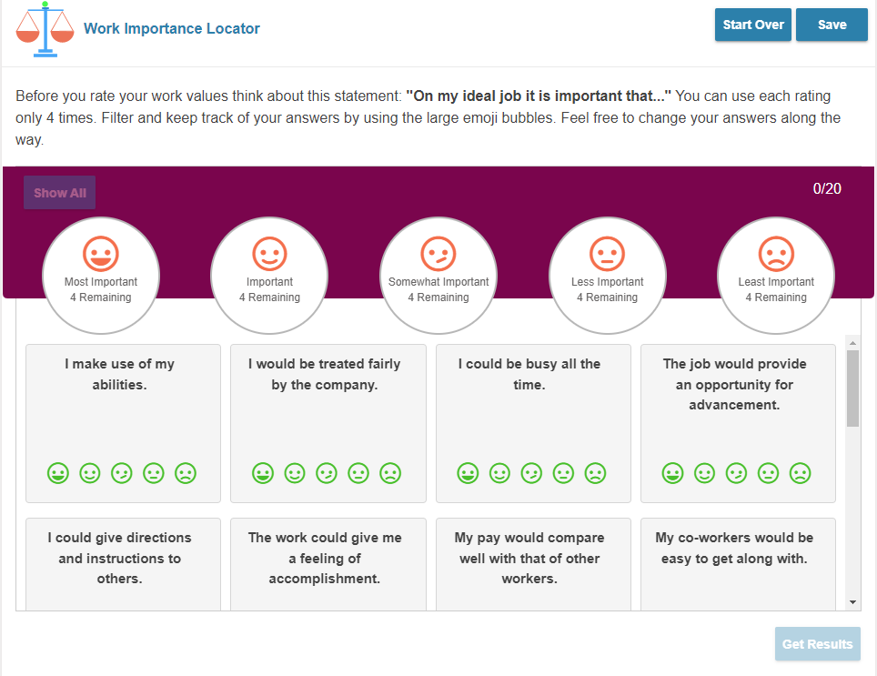
Work Importance Locator
Note:
You are only allowed to use the Ratings given four (4) times each.
So, only 4 Most Important values, only 4 Least Important values, etc…
You need to rate all the values.

Slide 25
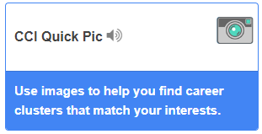
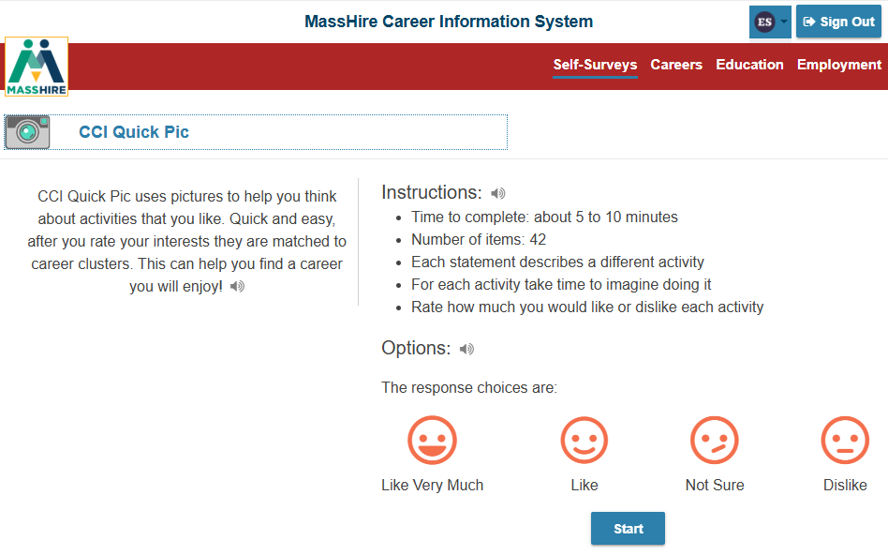
CCI Quick
Pic
Note:
View forty-two (42) photographs and rate how much you like or dislike that activity

Slide 26
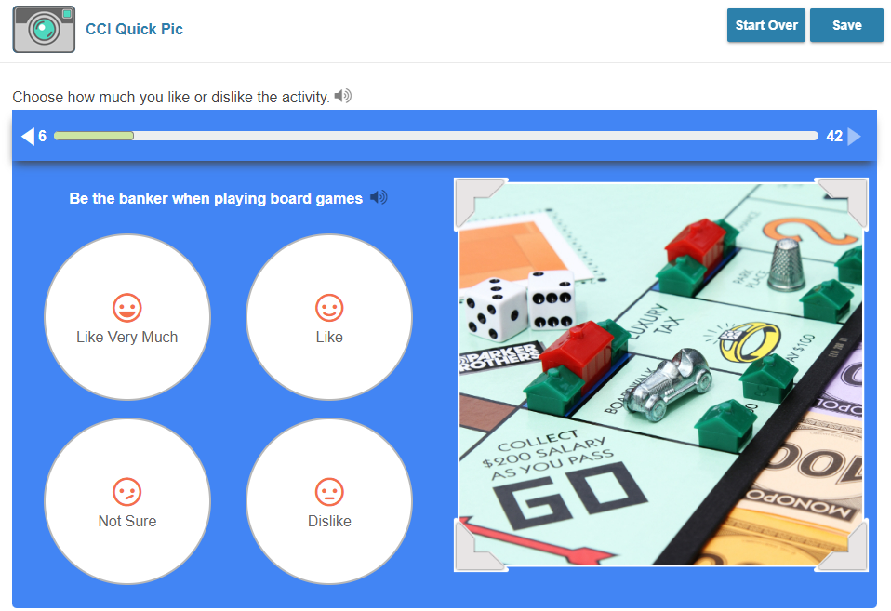
CCI Quick Pic
Note:
Rate how much you like or dislike that activity
From
Like Very Much
To
Dislike

Slide 27
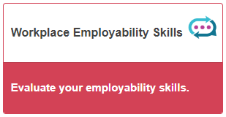
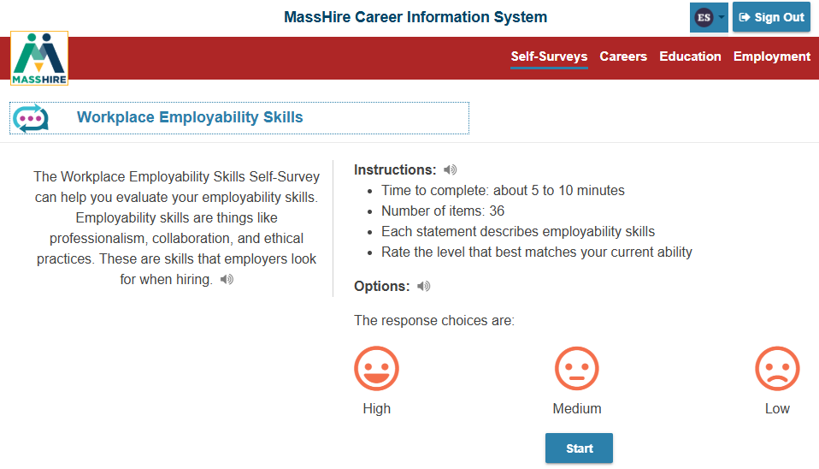
Workplace Employability Skills
Note:
Thirty-six (36) Employability factors to rate
Rating scale is from
High
To
Low

Slide 28
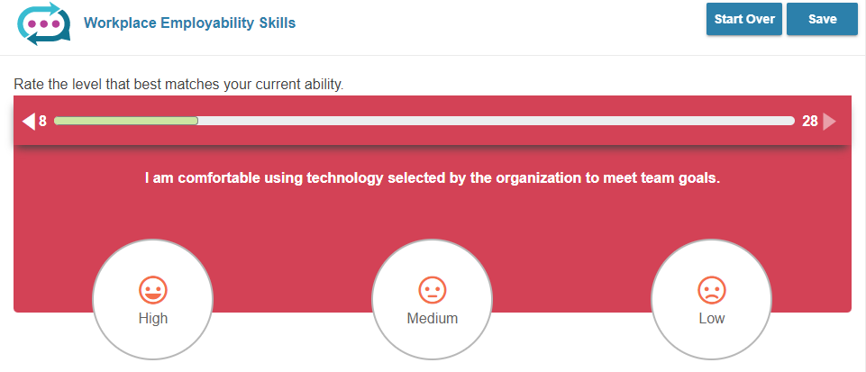
Workplace Employability Skills
Note:
Sample of a
Workplace Employability Skill,
you select your High and Low.
The bar above the question keeps track of the questions answered and those still to be answered.

Slide 29
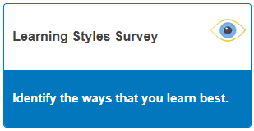
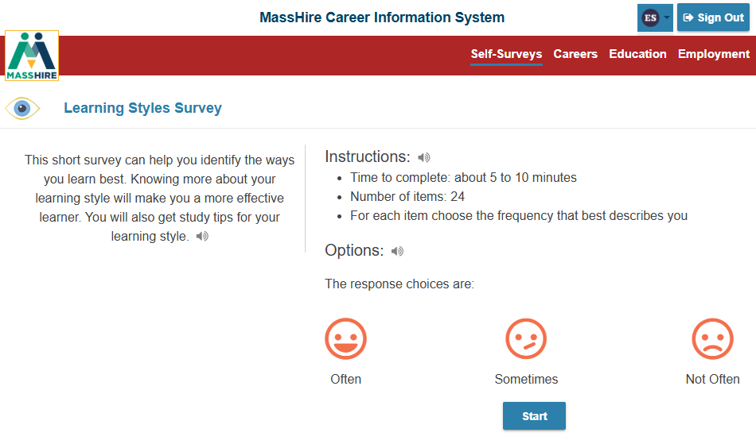
Learning Styles Survey
Note:
Twenty-four (24) Learning / Activities to rate
Rating scale is from
Often
To
Not Often

Slide 30
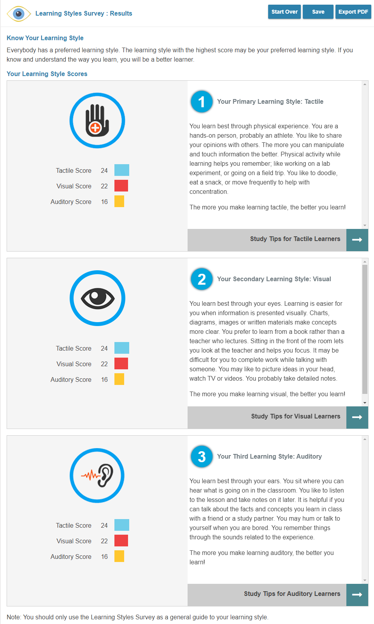
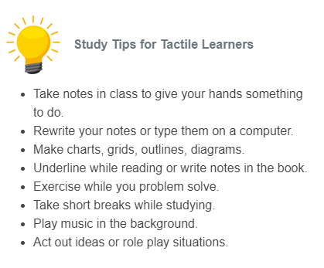
Learning Styles Survey
Note:
RESULTS
Lists your primary learning style
And the top three learning styles
Has Learning / Studying Tips

Slide 31
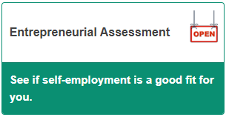
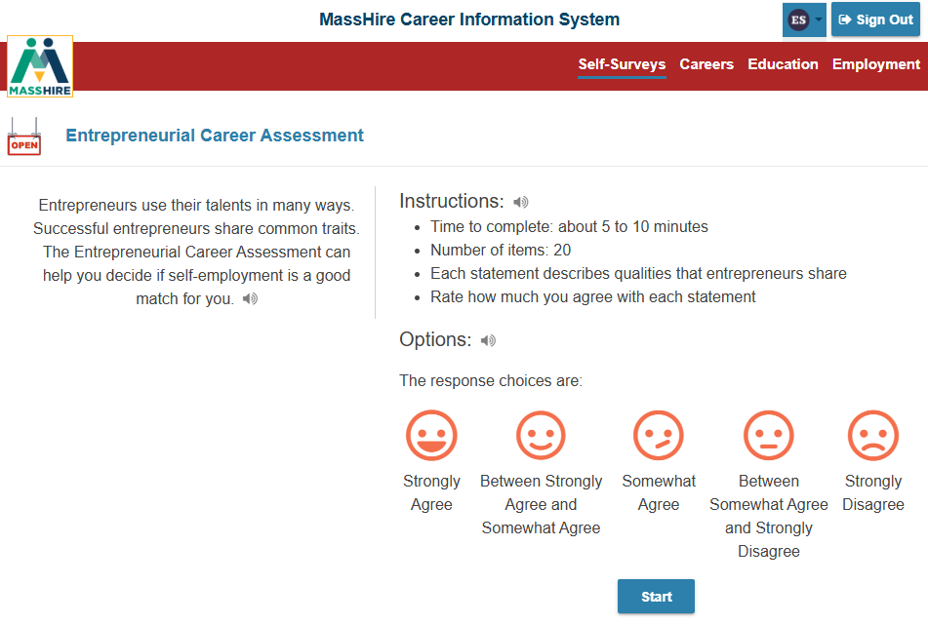
Entrepreneurial Assessment
Note:
Twenty (20) entrepreneurial questions to rate
Rating scale is from
Strongly Agree
To
Strongly Disagree

Slide 32
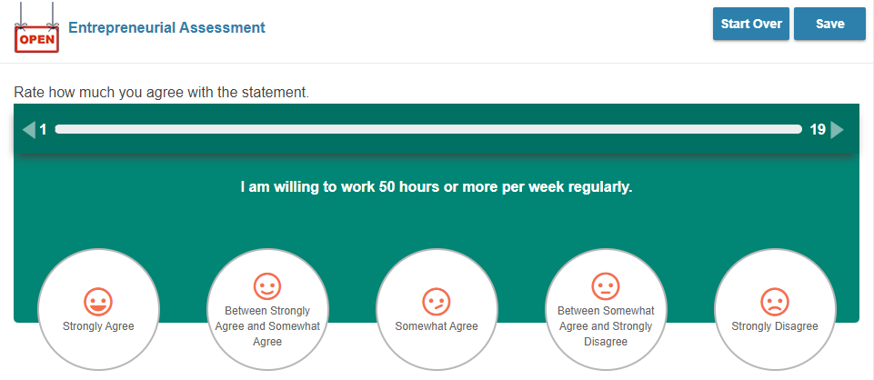
Entrepreneurial Assessment
Note:
Sample of a
Entrepreneurial question,
you select Strongly Agree to Strongly Disagree
as the response.
The bar above the question keeps track of the questions answered and those still to be answered.

Slide 33
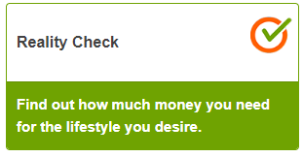
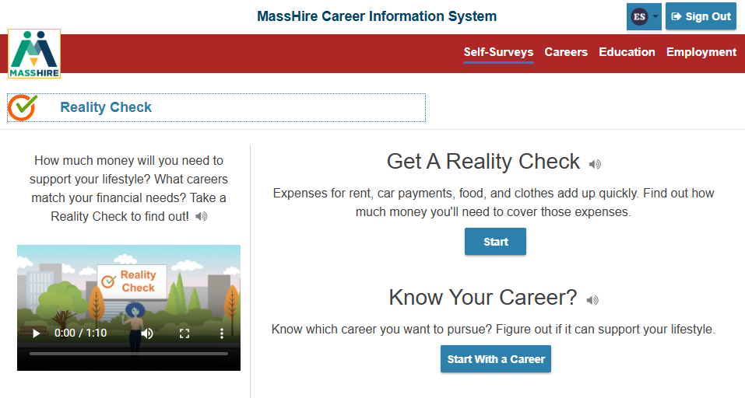
Reality Check
Note:
This assessment is a lifestyle assessment.
It has a minimum of twelve (12) living expenses.
You will select the various options under each expense.
From there the program will determine a needed budget and various career options that meet these expenses / budget.

Slide 34
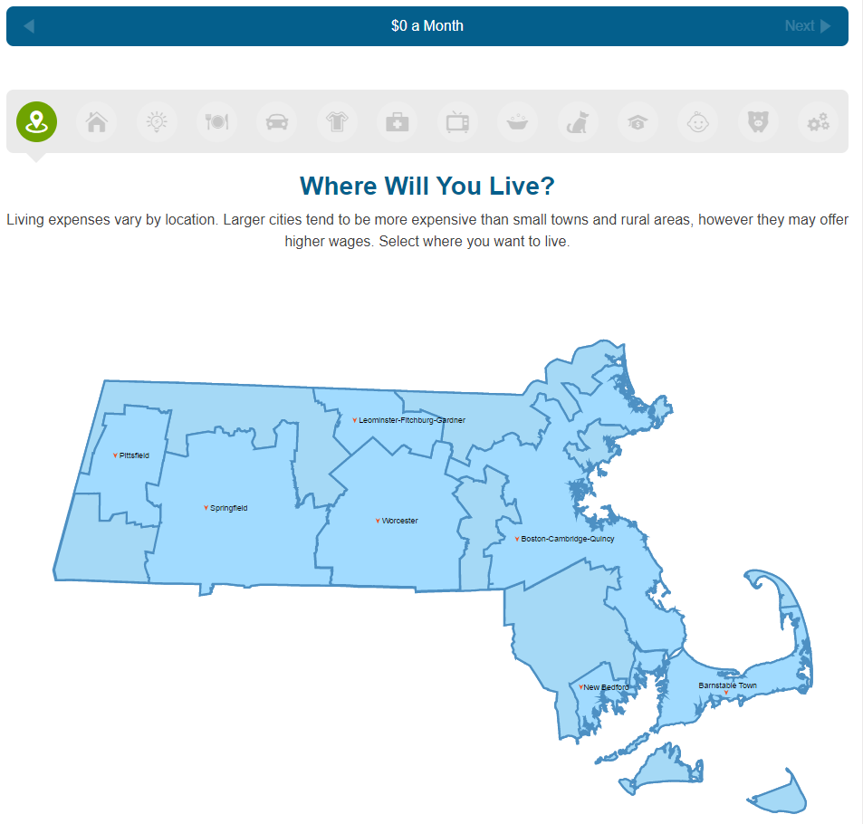
Reality Check
Note:
Expenses under the various categories comes from a variety of documented sources.
Mass Real Estate information,
National costs for transportation (autos + insurance + upkeep),
national utility costs, etc.
Child expense are optional

Slide 35
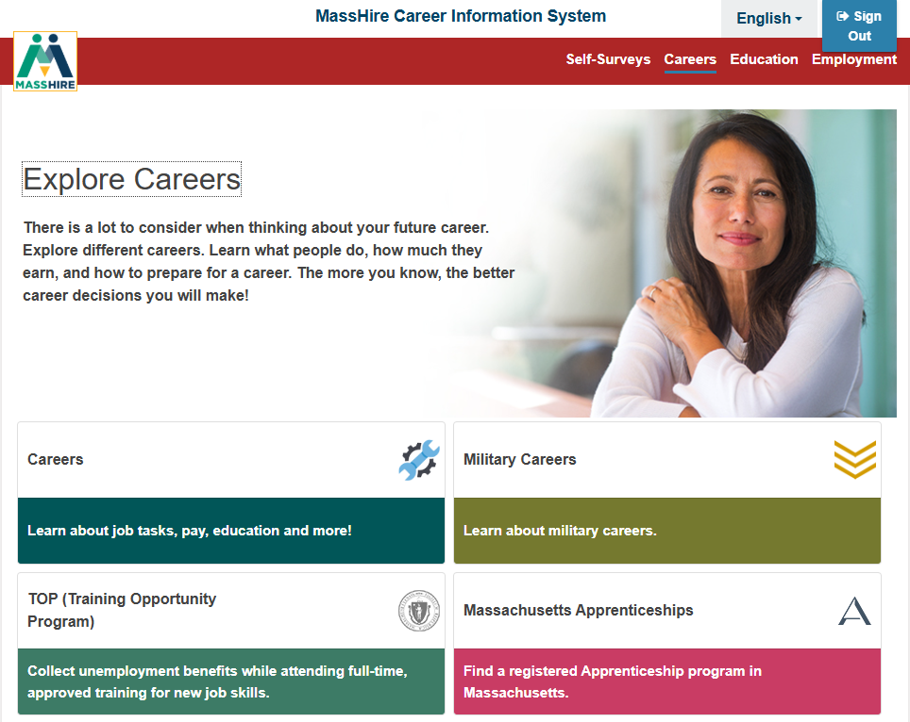
Massachusetts Residents Log In
NOTE:
Same contents as a
User Account

Slide 36
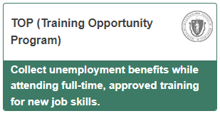
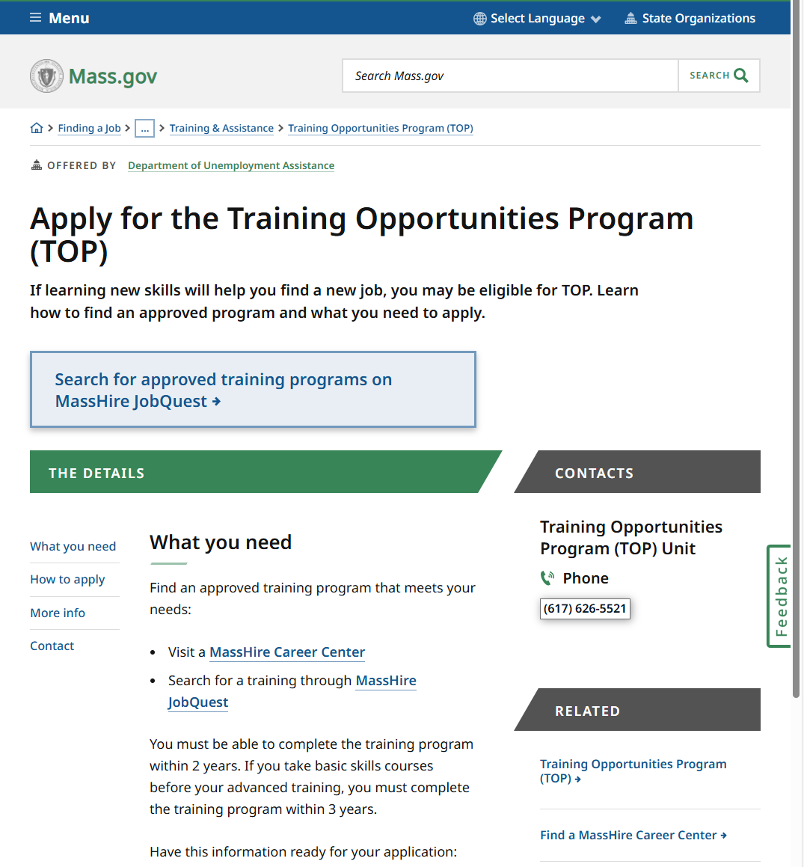
Careers
Department of Unemployment Assistance
Section 30
Training Opportunities Program

Slide 37
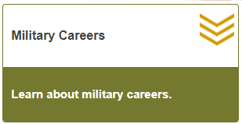
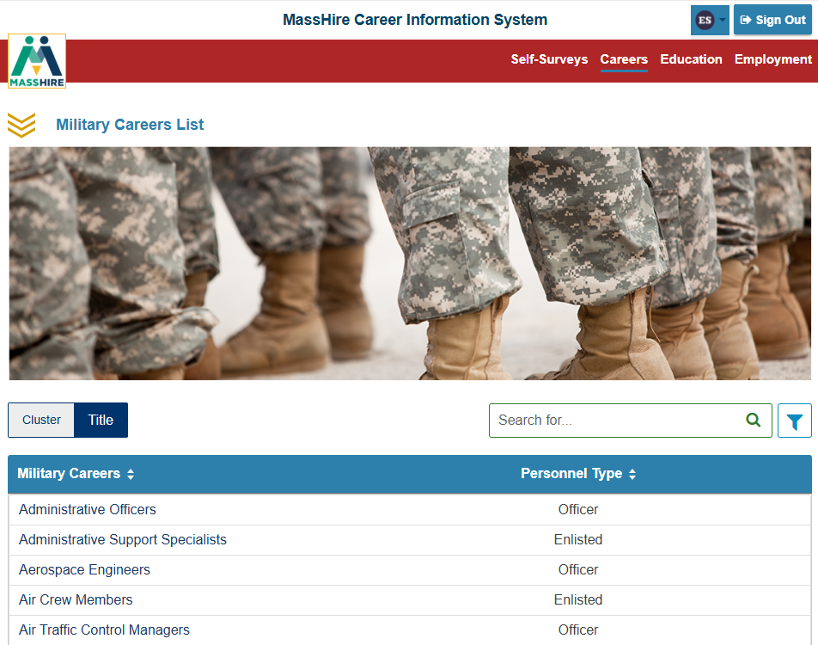
Careers
Military Careers Overview
Title: Including military careers by branch

Slide 38
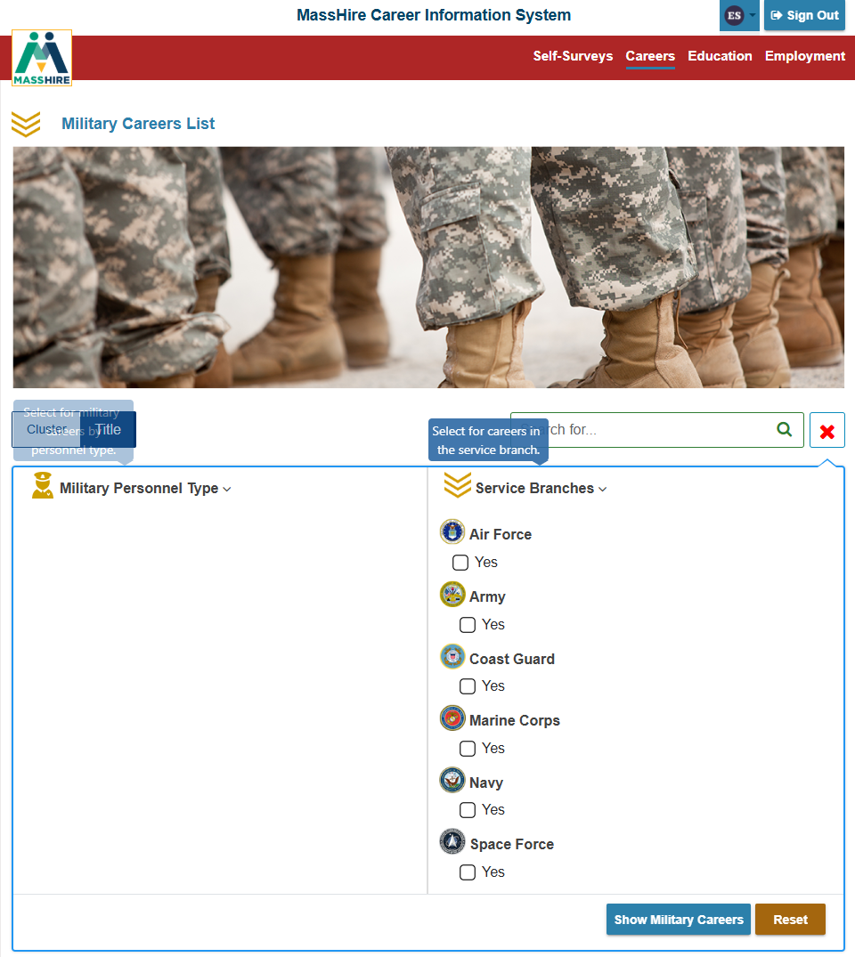
Careers
Military Overview
Title : Including military careers by branch and type

Slide 39
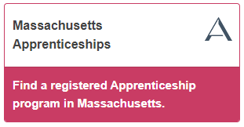
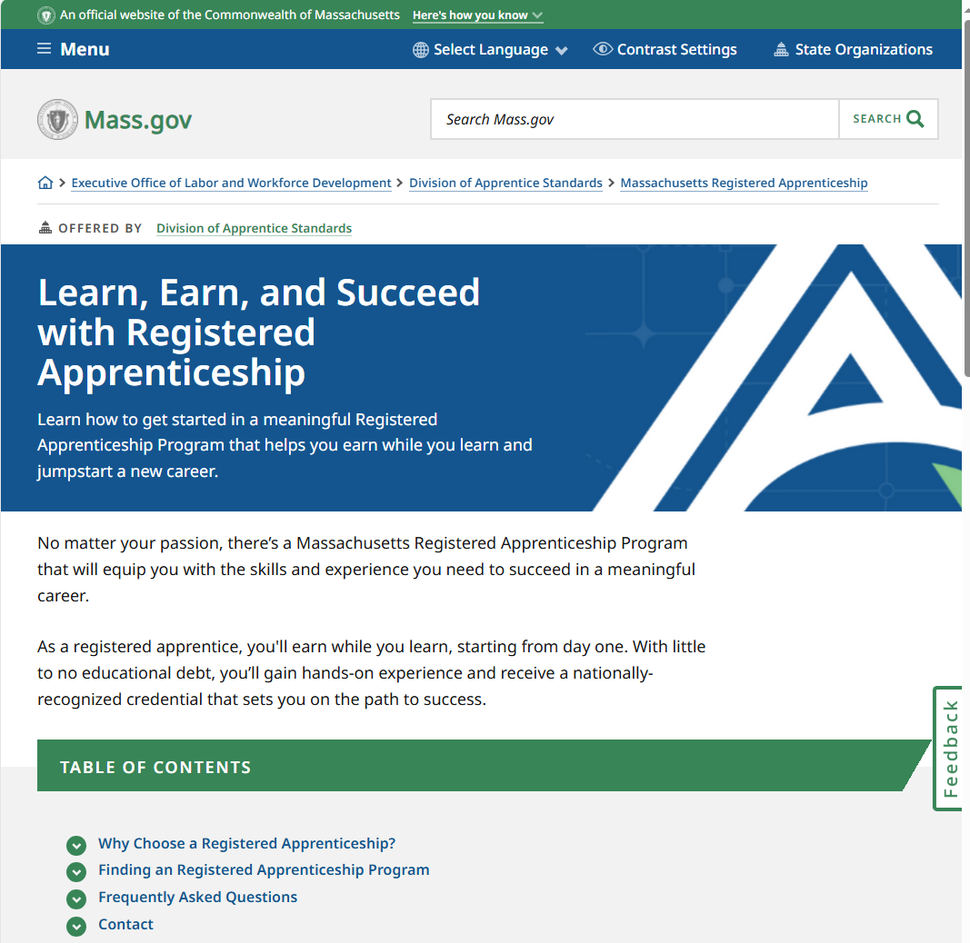
Careers

Slide 40
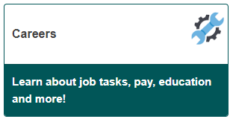
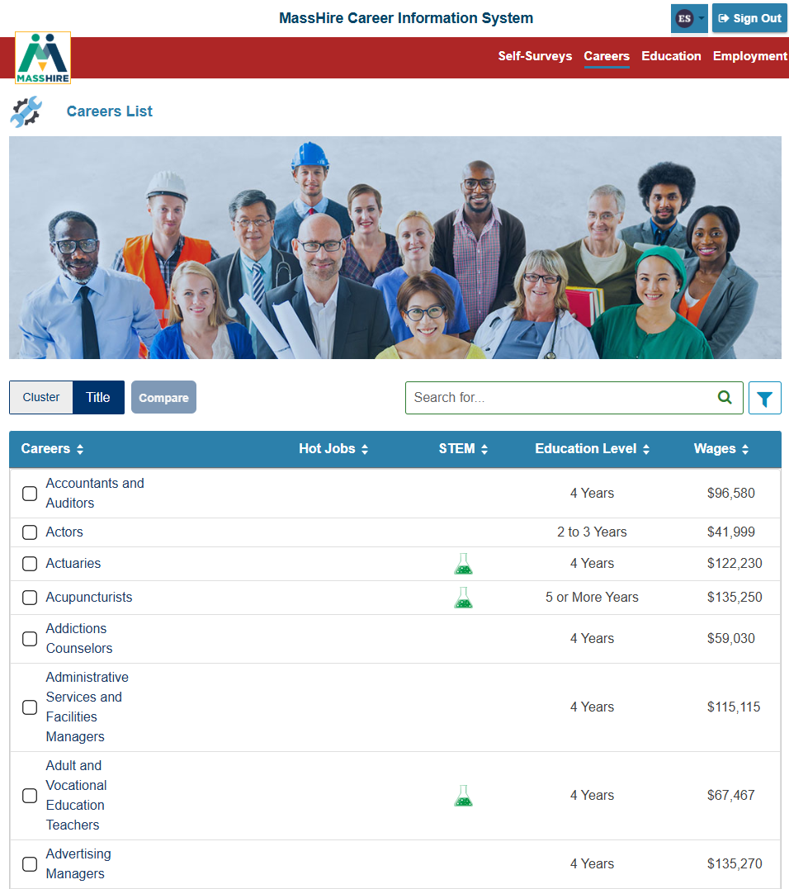
Careers
Careers by Title
Alphabetical

Slide 41
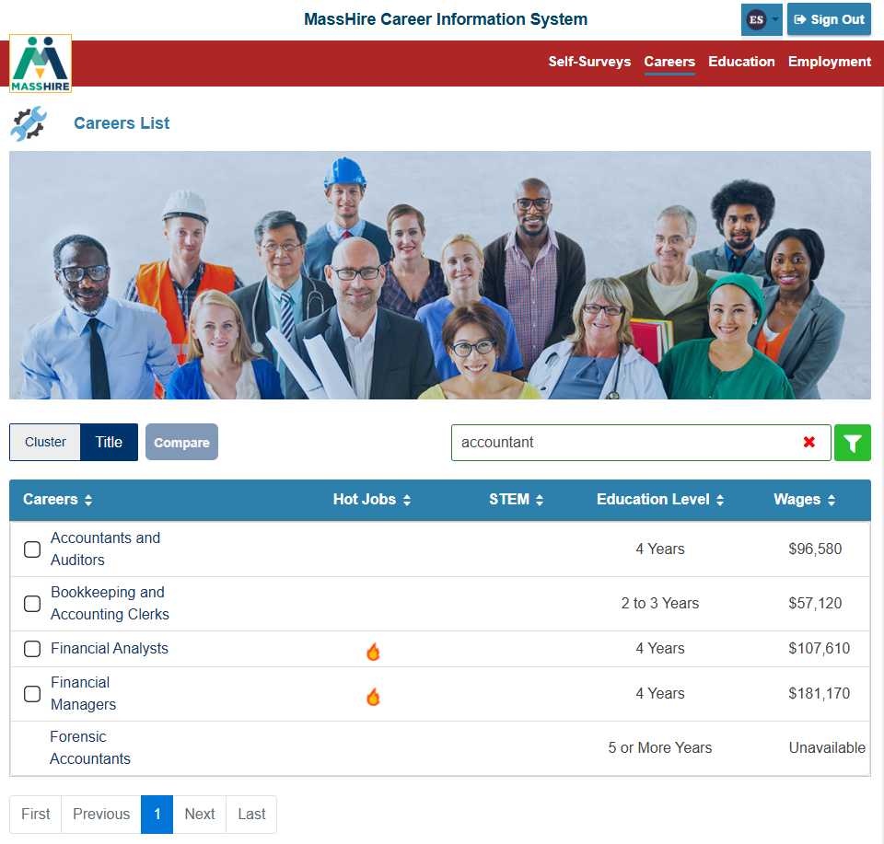
Careers
Careers by Title
Careers search has been updated to include the O*NET alternate titles
https://www.onetcenter.org/dictionary/28.2/excel/alternate_titles.html

Slide 42
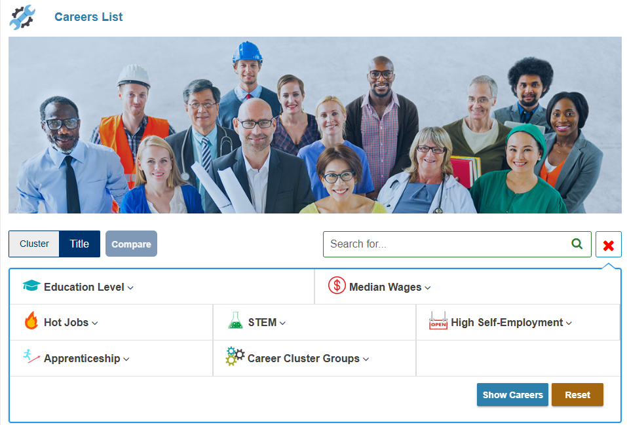
Careers
Careers by Title
Advanced Search feature
NOTE:
Self Surveys as an Advanced Search feature is not available.

Slide 43

Careers
At A Glance
  Wages
  Education & Training
  Employment Opportunities
  Job Tasks
  Work Settings
  Career Cluster category
Video

Slide 44

Careers
Job Description
  Overview
  Job Tasks
  Skills & Abilities
  Work Settings
  Physical Demands
Sub sections provide more details

Slide 45

Labor Market Information
Note:
Wages
  Annual, Monthly, Hourly
Massachusetts default by New England City Town Areas (NECTAs)
Select other states
Top five states

Slide 46

Labor Market information
Employment & Outlook
By sixteen (16) board areas , where sufficient data allows.
(In 2026 , this data will be reported by counties.)
Growth rate projections

Slide 47

Other States / Territories

Slide 48

Careers
Education & Training
  Preparation
  Helpful High School Courses
  Knowledge
  Related Programs of Study
  Licensing / Certification
  (Apprenticeship)

Slide 49

Careers
Related Careers
Associated careers that could have minimal training to enter that occupation.
Career Cluster(s)

Slide 50

Careers
Related Careers
Associated careers that could have minimal training to enter
Career Cluster
Military Careers

Slide 51

Careers
Compare 2 Careers

Slide 52

Careers
Compare 2 Careers

Slide 53

Careers
Compare 2 Careers
Wages for the United States

Slide 54

Careers
Compare 2 Careers
Employment Projections United States

Slide 55
Apprenticeships

Slide 56


Apprenticeships

Slide 57


Apprenticeships
250 Registered
Apprenticeship careers/occupations

Slide 58


Apprenticeships

Slide 59

Massachusetts Residents Log In

Slide 60


Education
Program of Study
Majors (by Study Cluster)

Slide 61

Education
Program of Study
Majors (by Title)

Slide 62

Education
Program of Study
At A Glance

Slide 63

Education
Program of Study
Related Info

Slide 64


Education
Alphabetically listed

Slide 65

Education
Search Feature:
Enter a city name into the school search
and
it will return a list of schools in that city.

Slide 66


Education
Complete list of Schools
States and Territories
(Petersons)

Slide 67

Education
Schools
A state:
Hawaii

Slide 68

Education
Schools
At a Glance

Slide 69

Education
Schools
General Info

Slide 70

Education
Schools
Paying (Costs tab)

Slide 71

Education
Schools
Programs of Study

Slide 72

Certificate Provider

Slide 73

Certificate Provider

Slide 74


Education

Slide 75


Education
https://studentaid.gov/

Slide 76

Massachusetts Residents Log In

Slide 77


Employment

Slide 78


Employment

Slide 79


Employment

Slide 80



Employment

Slide 81


Employment

Slide 82


Employment

Slide 83


Employment

Slide 84
Massachusetts Residents Log In
MassHire Career Information System
Standard Portfolio / User Edition

Slide 85


Massachusetts Residents Log In
Omitted from the State Log In
My Dashboard
Career Plan
Plus, the ability Save to a Portfolio

Slide 86

“Regular MassHire CIS 360”
Reports

Slide 87


“Regular MassHire CIS 360”

Slide 88

“Regular MassHire CIS 360”
Ability to save
Self-Survey Results

Slide 89
Massachusetts Residents Log In
Submit Site Activation form
For
Individual / Personal Account

Slide 90

Massachusetts Residents Log In
Email: MassHireCIS@State.MA.US
Telephone: 617-626-6808
URL:
https://portal.masscis.IntoCareers.org

Slide 91
State (City + Town) Log In

Slide 92
Contact Information
Email: MassHireCIS@State.MA.US
Telephone: 617-626-6808
URL: https://portal.masscis.IntoCareers.org

Slide 93

?
?
?
Questions
?
?
?
?
?
?
?
?

