Slide 1
Welcome to MassHire Career Information Systems &

Slide 2
How do I add Google Translator to my computer?
Open Google

Slide 3
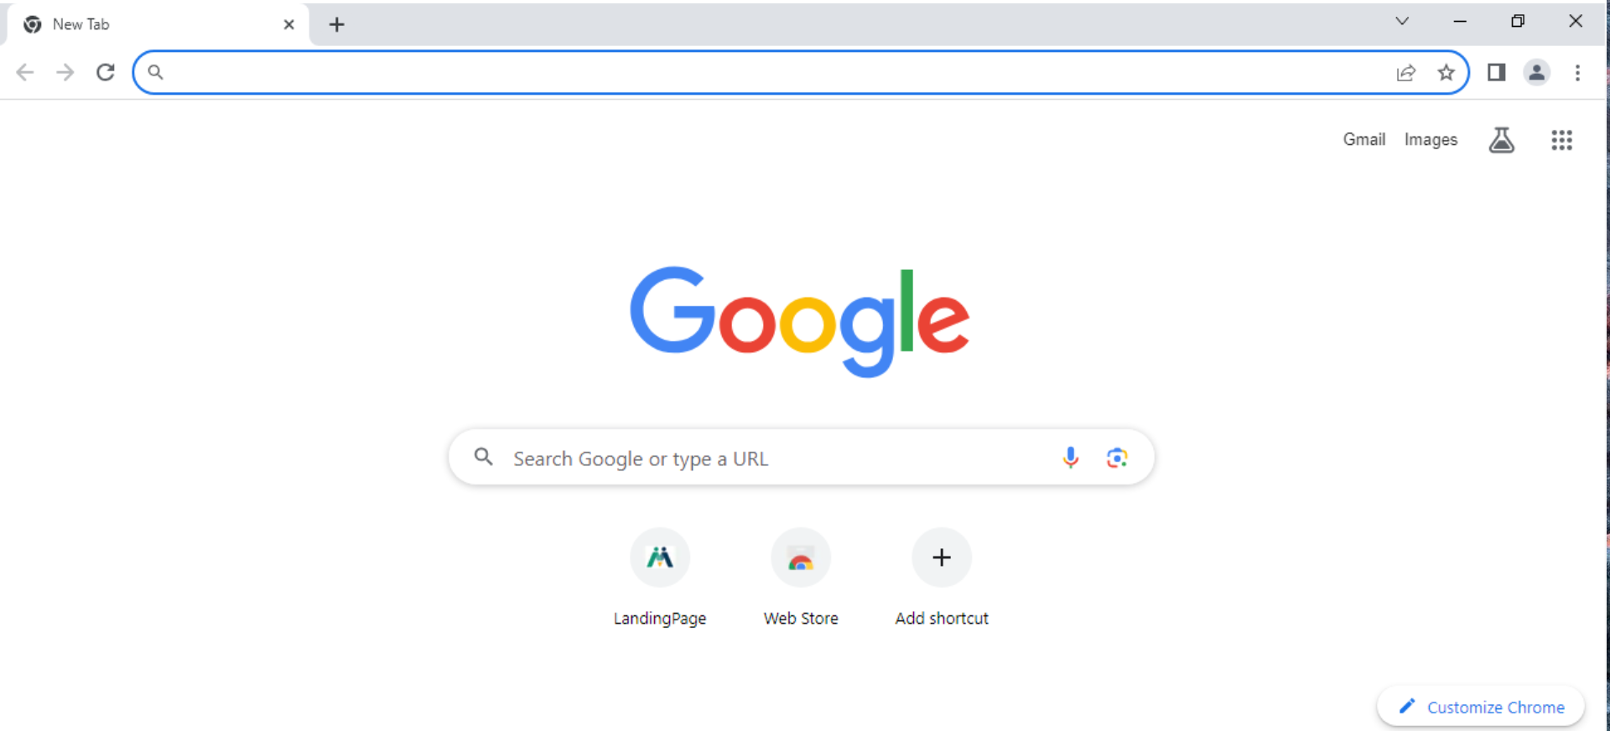
Open Google.

Slide 4
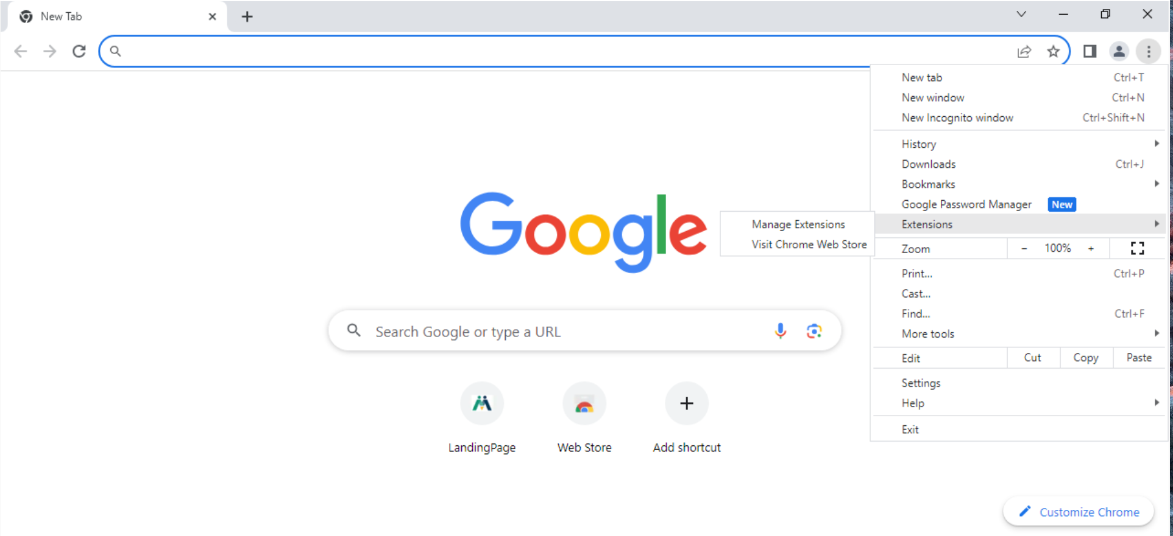
On Google go to Extensions then Visit Chrome Web Store.

Slide 5
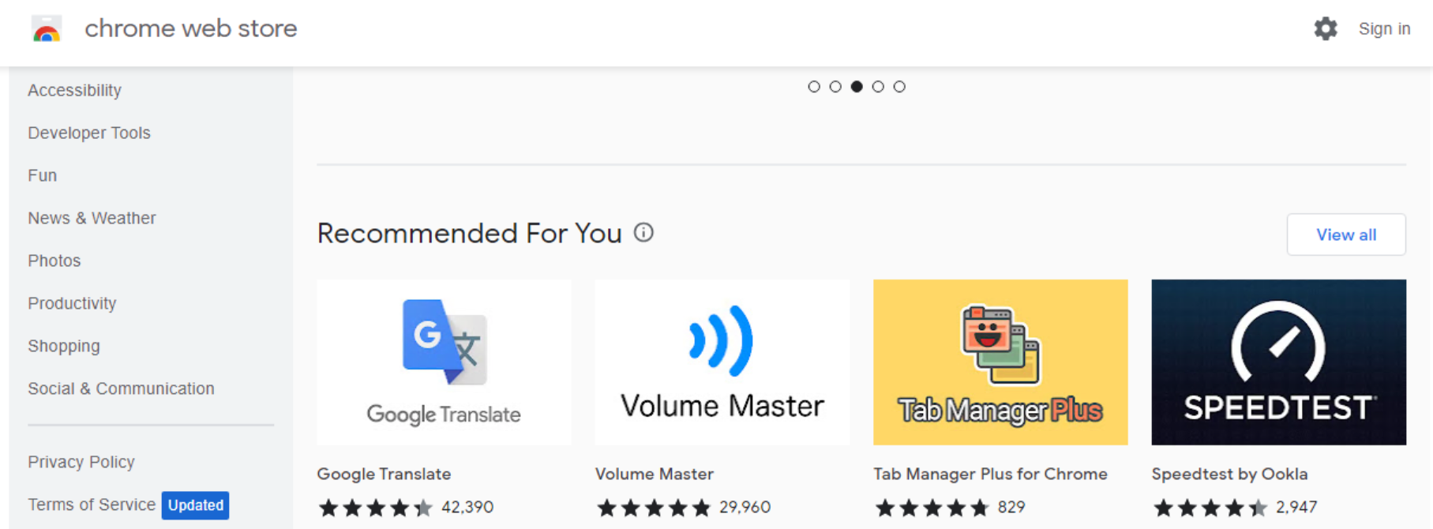
Chrome Web Store. Find Google Translate.

Slide 6
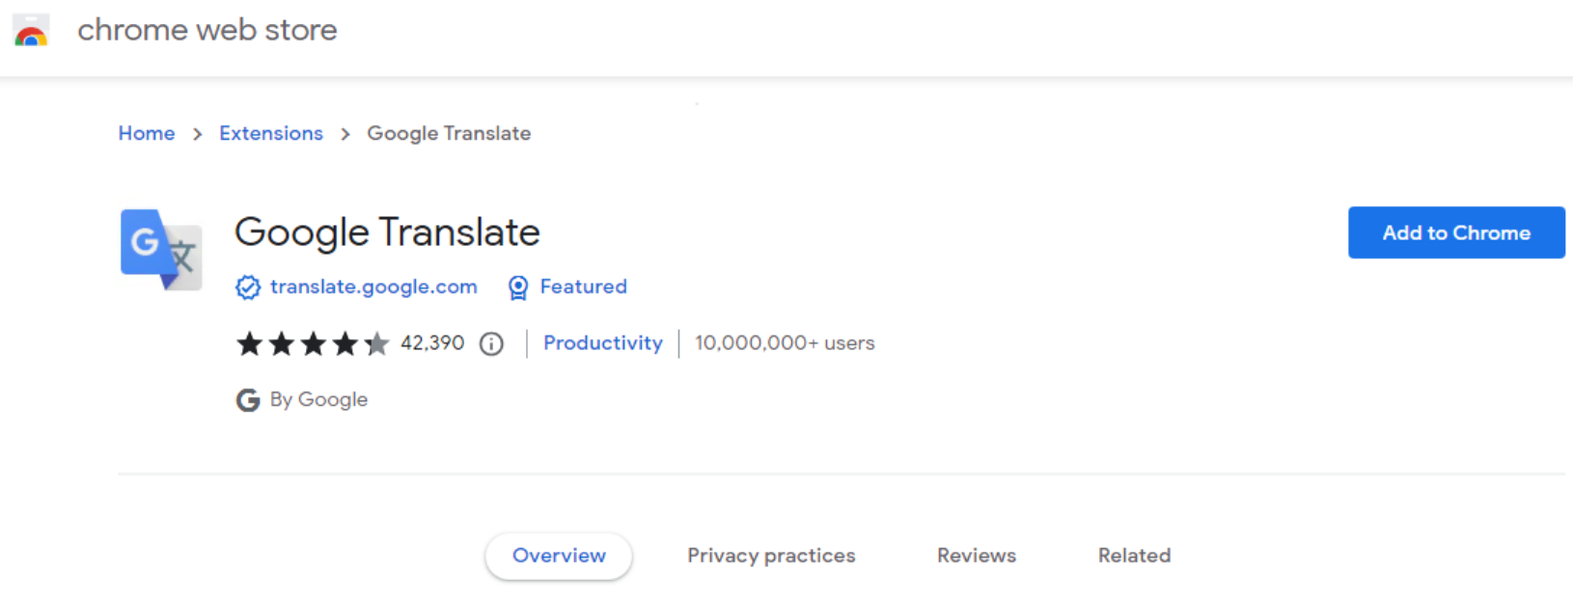
Click Add to Chrome.

Slide 7
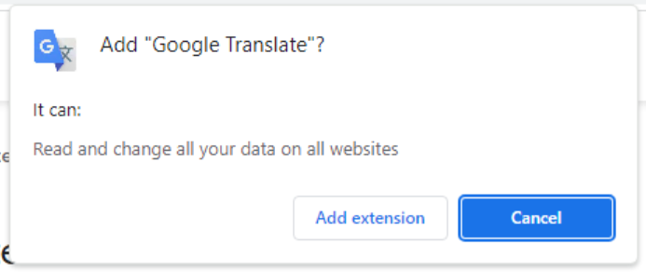
Google Translate has been Added.

Slide 8
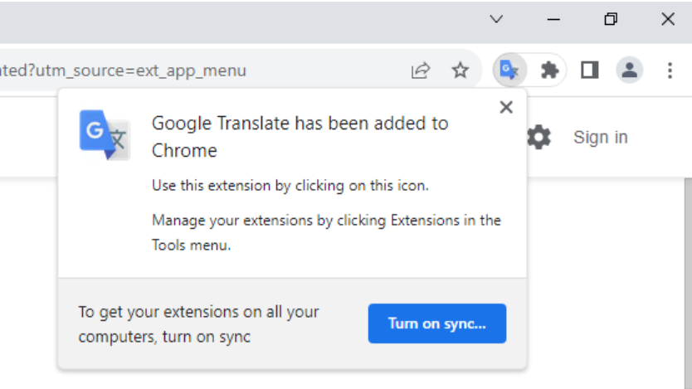
Google Translate has been Added.

Slide 9
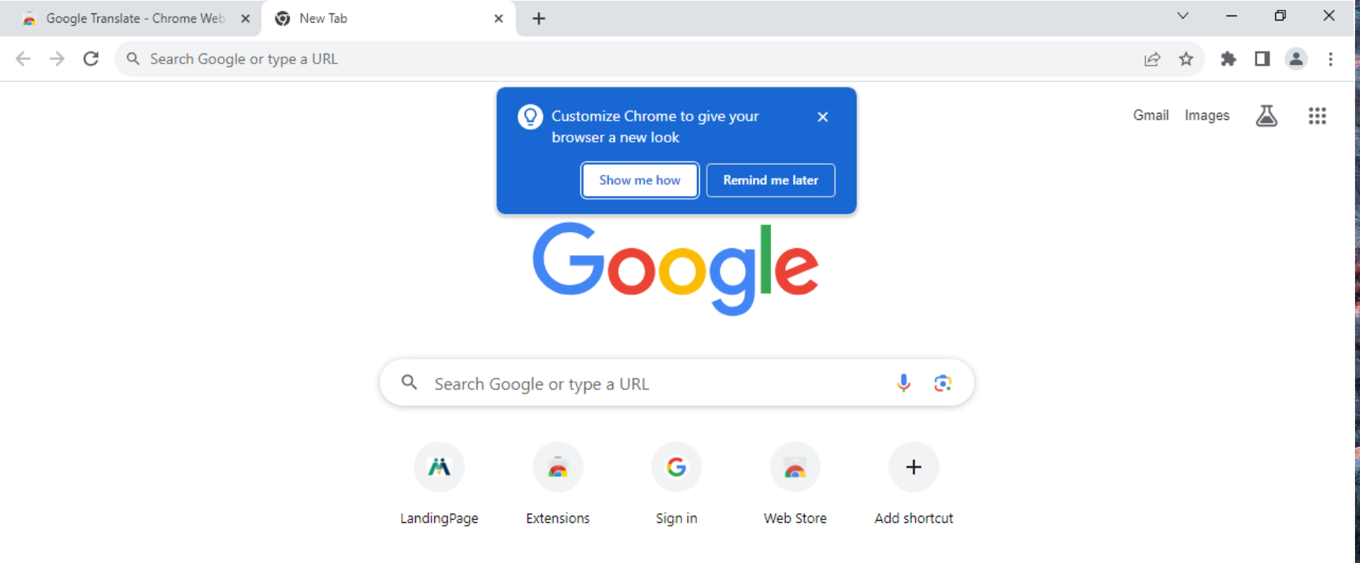
Customize Chrome Options.

Slide 10
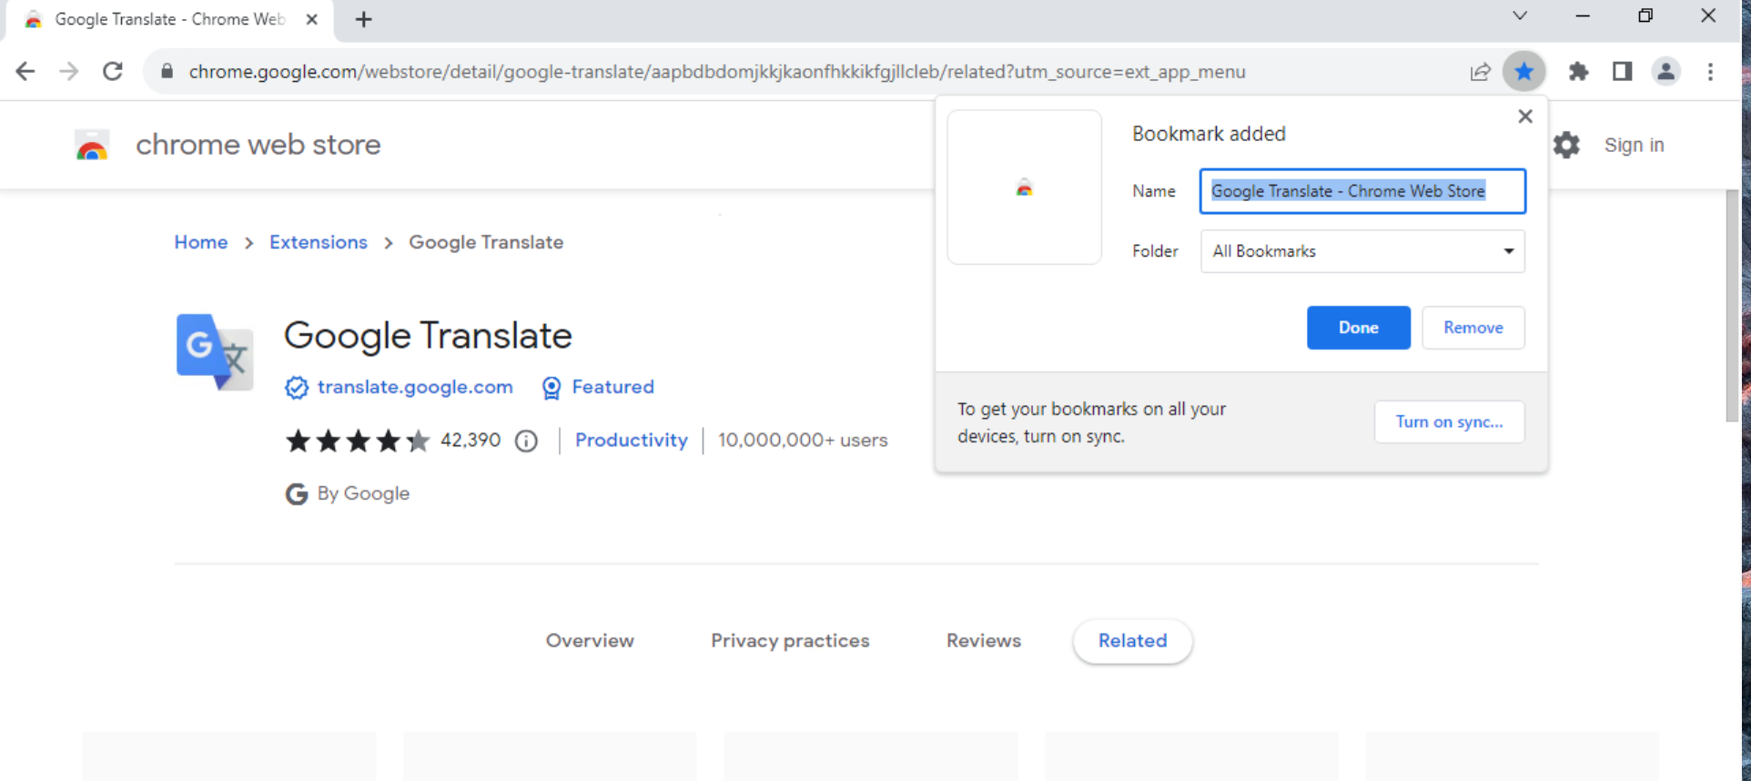
Google Translate is added to Google Chrome and Bookmarks

Slide 11
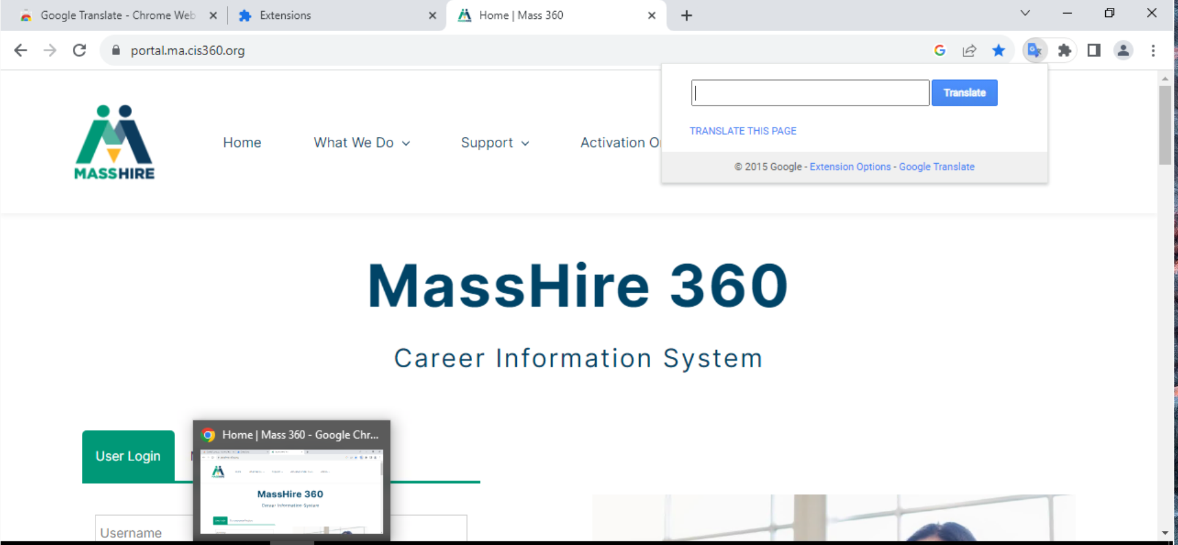
Click on Extensions Icon and Click Translate this page.

Slide 12
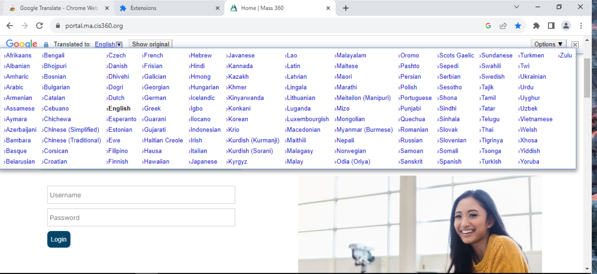
Select Language from Options

Slide 13
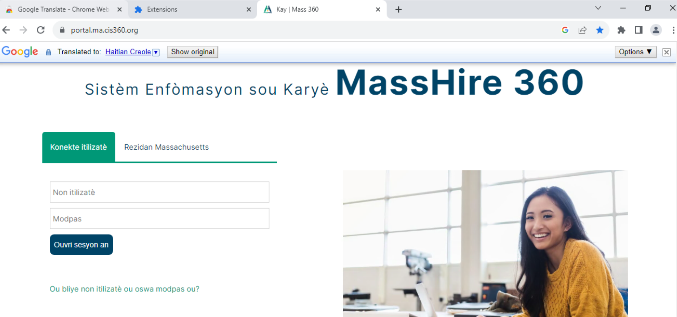
Haitian Creole

Slide 14
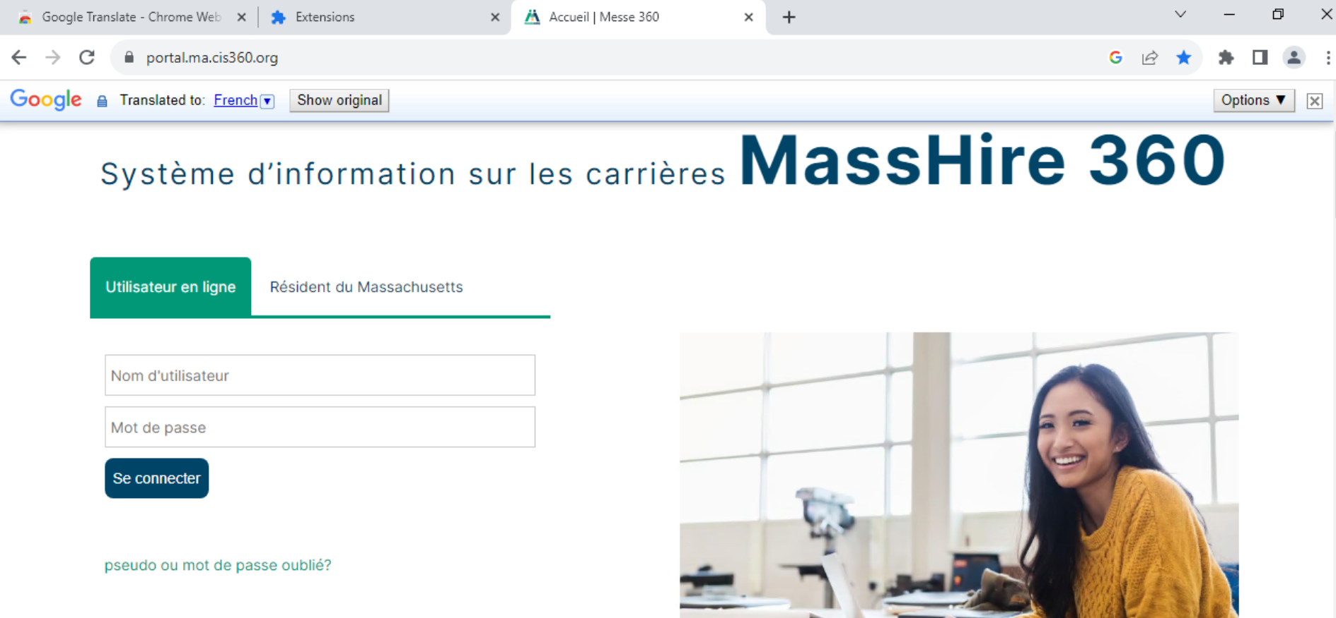
French

Slide 15
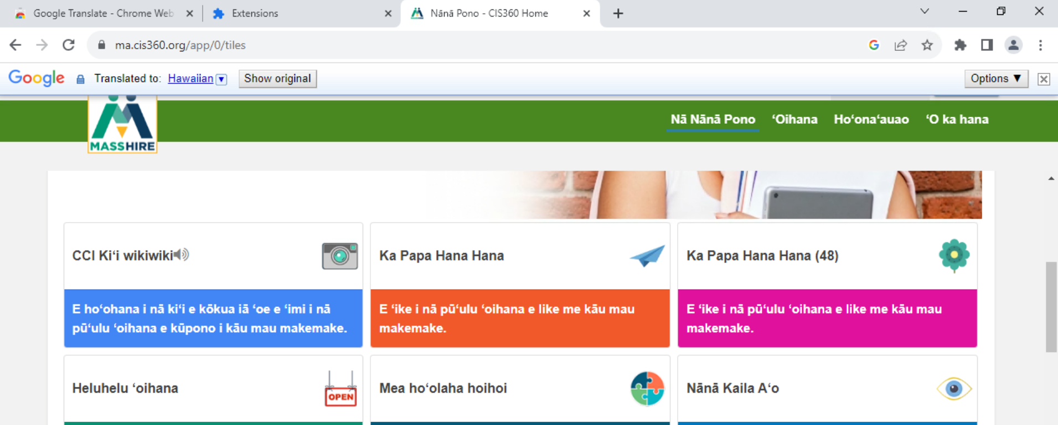
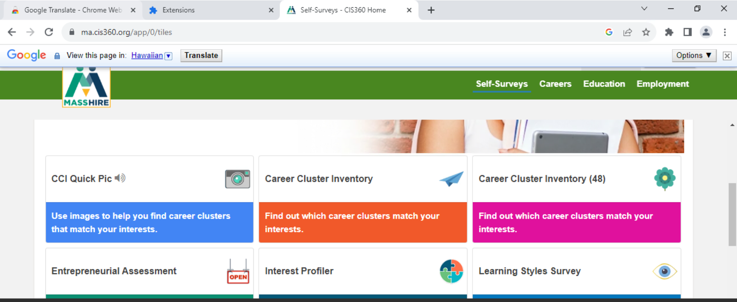
Show Original returns you to Original language.

Slide 16
DONE!!!!

Slide 17
To view in other languages, you can install the Google Translate extension on your Chrome browser.
In your browser, navigate to Google Translate extension on the Chrome web store.
Click Add to Chrome.
It will ask if you want to Add "Google Translate". ...
Google Translate will now be added to Chrome.

Slide 18
Translation

Slide 19
?
?
?
Questions and Answers
?
?
?
?
?
?
?
?

