Slide 1
Welcome to MassHire Career Information Systems

Slide 2
University of Oregon : into CAREERS

Slide 3
MassHire Career Information System
MassHire Career Information Systems is purchased with grants by the US Department of Labor (USDOL) Employment and Training Administration, it is primarily procured for the use of the Department of Career Services Career Centers, it’s partners and Massachusetts constituents. As such the trainings focus is for career center staff usage.

Slide 4
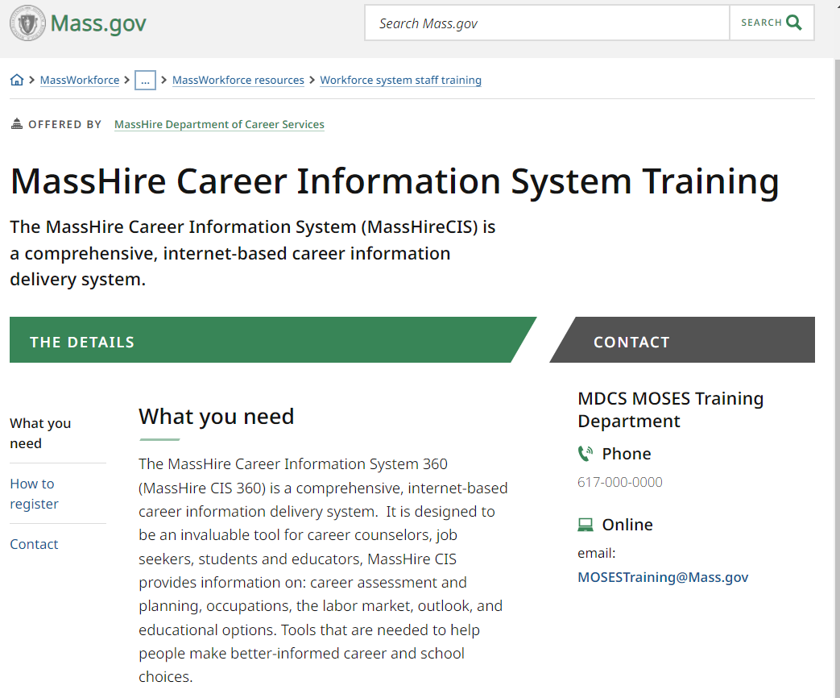
The MassHire CIS Training Calendar https://www.mass.gov/how-to/masshire-career-information-system-training

Slide 5
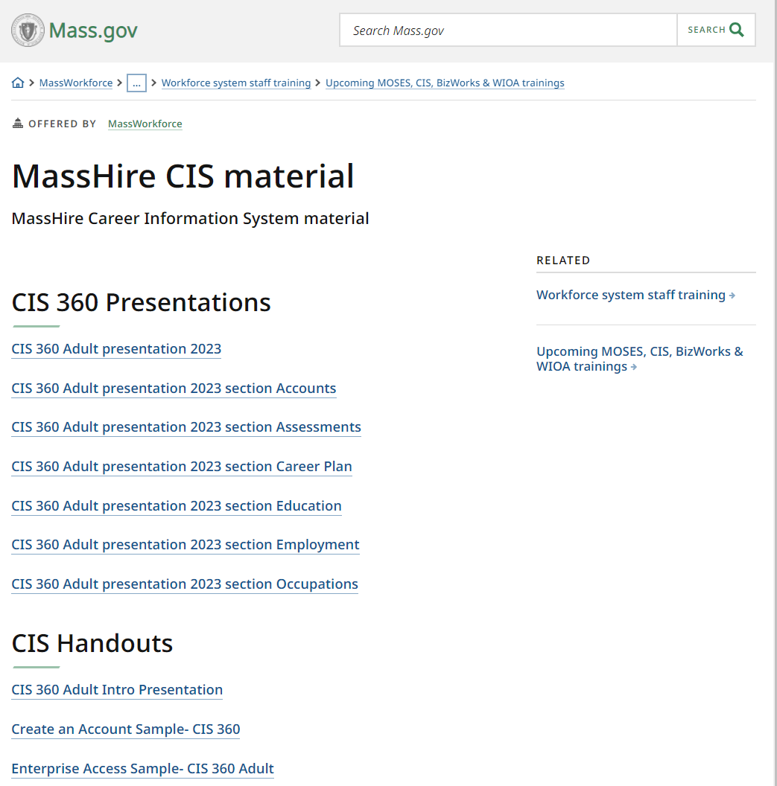
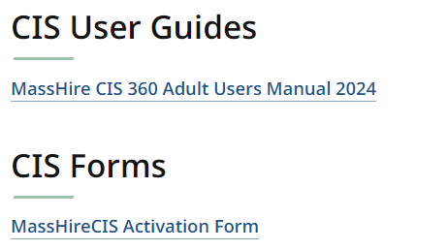
The MassHire CIS Resources https://www.mass.gov/service-details/masshire-cis-material

Slide 6
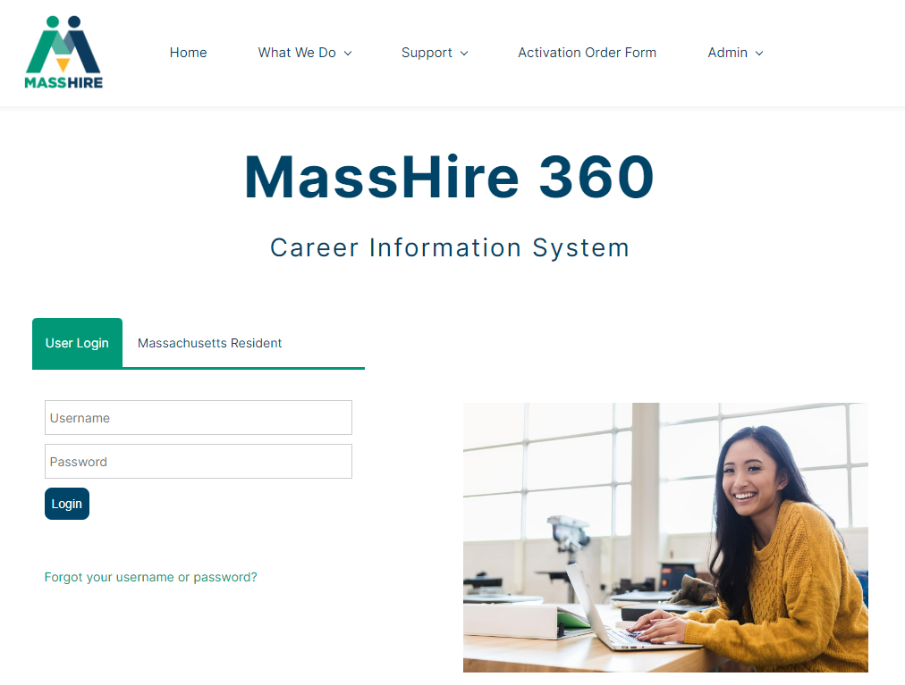
The MassHire Career Information System Portal https://portal.ma.cis360.org/

Slide 7
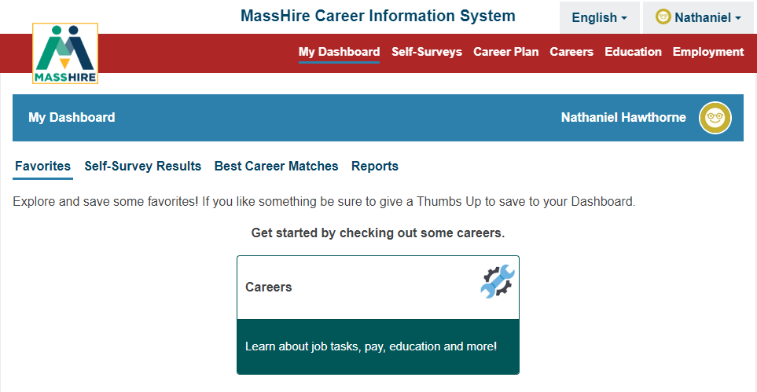
User Dashboard

Slide 8
Go To Enterprise or 360

Slide 9
English / Español
Note:
Español version originally done by Texas translation affiliation using Mexican Spanish

Slide 10
Self-Surveys / Assessments

Slide 11
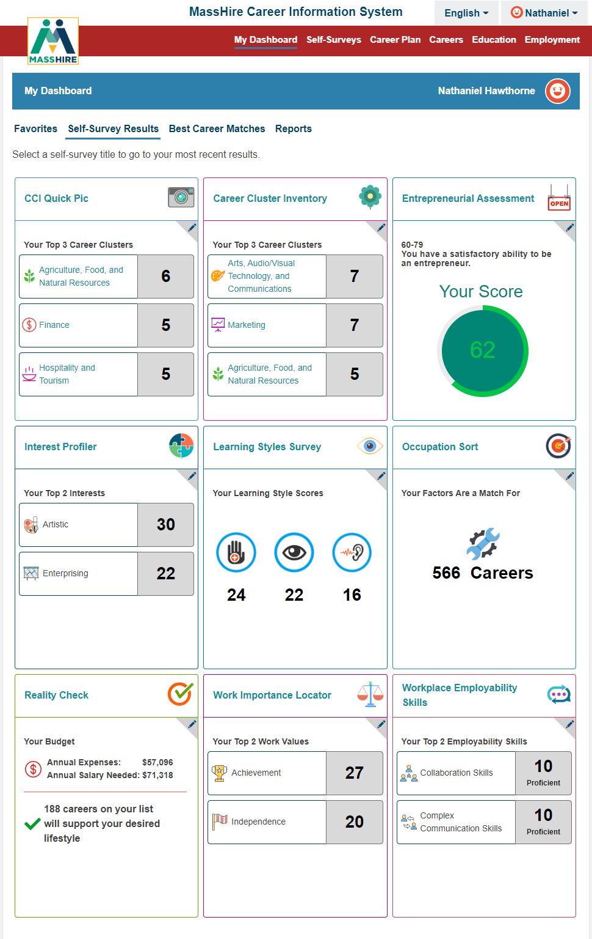
Self-Survey Results
Note:
Nine Surveys available to take in MassHire CIS 360.

Slide 12
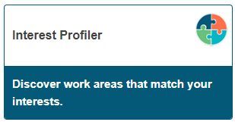
Interest Profiler
The O*NET Interest Profiler can help you find out what your interests are and how they relate to the world of work. You can find out what you like to do.
The O*NET Interest Profiler helps you decide what kinds of careers you might want to explore.
The Interest Profiler was introduced in 1999 as one of the U.S. Department of Labor’s (DOL) O*NET Career Exploration Tools. John Holland’s (1997) RIASEC theoretical model (Realistic-Investigative-Artistic-Social-Enterprising-Conventional) is the basis of the Interest Profiler scales.

Slide 13
Interest Profiler
Note:
Sixty (60) questions about work activities.
You select / decide your interest on a sliding scale of Strongly Like to Strongly Dislike.

Slide 14
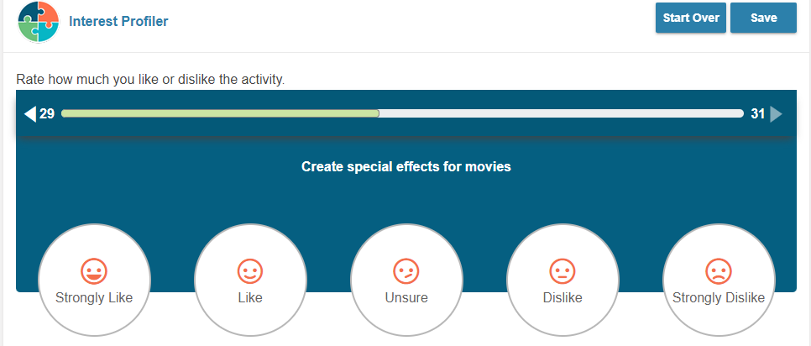
Interest Profiler: Sample Question
Note:
Sample work activity , you select your level of interest.
Bar above the activity keeps track of the questions answered and those still to be answered.

Slide 15
Interest Profiler : Results
Note:
John Holland’s RIASEC theoretical career model lists interest areas by highest score to lowest score.
Realistic
Investigative
Artistic
Social
Enterprising
Conventional

Slide 16
Careers from Results From Interest Profiler

Slide 17
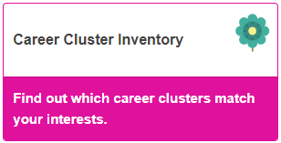
Career Cluster Inventory
This survey helps individuals to discover which of the 16 Career Clusters the majority of their career interests are in to help direct their vocation aspirations.
The Sixteen Career Clusters are: Agriculture, Food & Natural Resources; Architecture & Construction; Arts, Audio/Video Technology & Communications; Business, Management & Administration; Education & Training; Finance; Government & Public Administration; Health Science; Hospitality & Tourism; Human Services; Information Technology; Law, Public Safety, Corrections & Security; Manufacturing; Marketing, Sales & Service; Science, Technology, Engineering & Mathematics; and Transportation, Distribution & Logistics

Slide 18
Career Cluster Inventory
Note:
Forty-Eight (48) questions about activities.
You select / decide your interest on a scale from Like Very Much to Dislike.

Slide 19
Career Cluster Inventory
Note:
Sample activity , you select your Likes and Dislikes.
The bar above the question keeps track of the questions answered and those still to be answered.

Slide 20
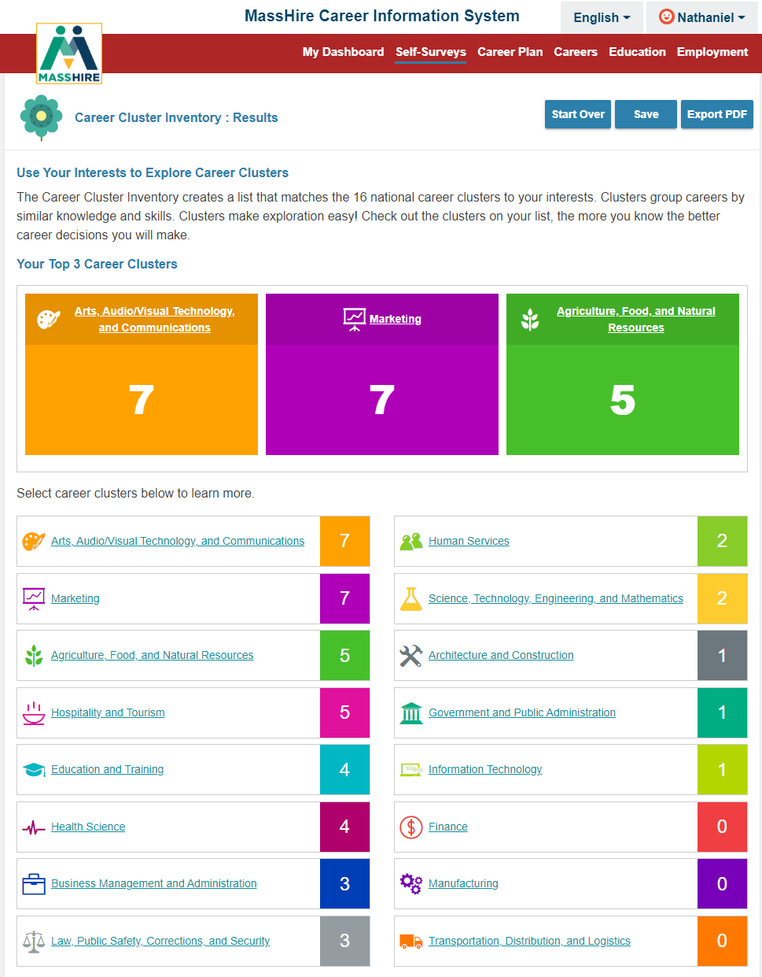
Career Cluster Inventory: Results
Lists results by highest score in the sixteen career clusters.

Slide 21
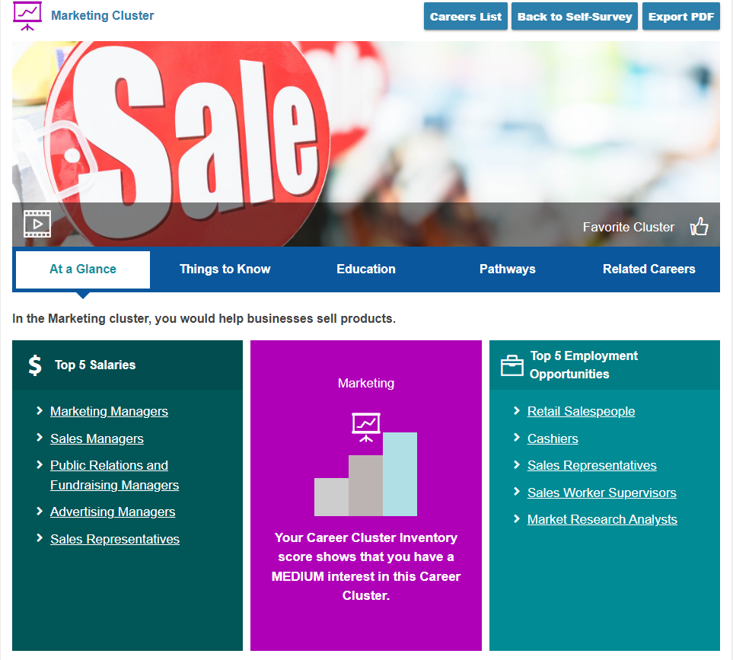
Career Cluster Inventory: Results more details
Can explore career options by selecting a specific career clusters.
In this example: Marketing
This is At a Glance overview

Slide 22
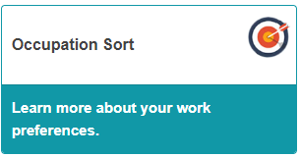
Occupation Sort
Occupation Sort Assessment is used to help clients clarify their skills, values, and occupational interests. (Oldie but goodie: Sometimes referred to as Card Sorts. )
Occupation sorts are believed to be as effective as standardized assessments in predicting career choice; but because they are subjective in nature and do not produce scores or have norms.
Occupation sorts have been a career counseling tool since the 1960s and have continued to be used to help individuals in the career decision-making process.

Slide 23
Occupation Sort
Note:
Twenty-Eight (28) career factors are provided.
You provide how important or not important it is in your work.
You are limited in your selection.

Slide 24
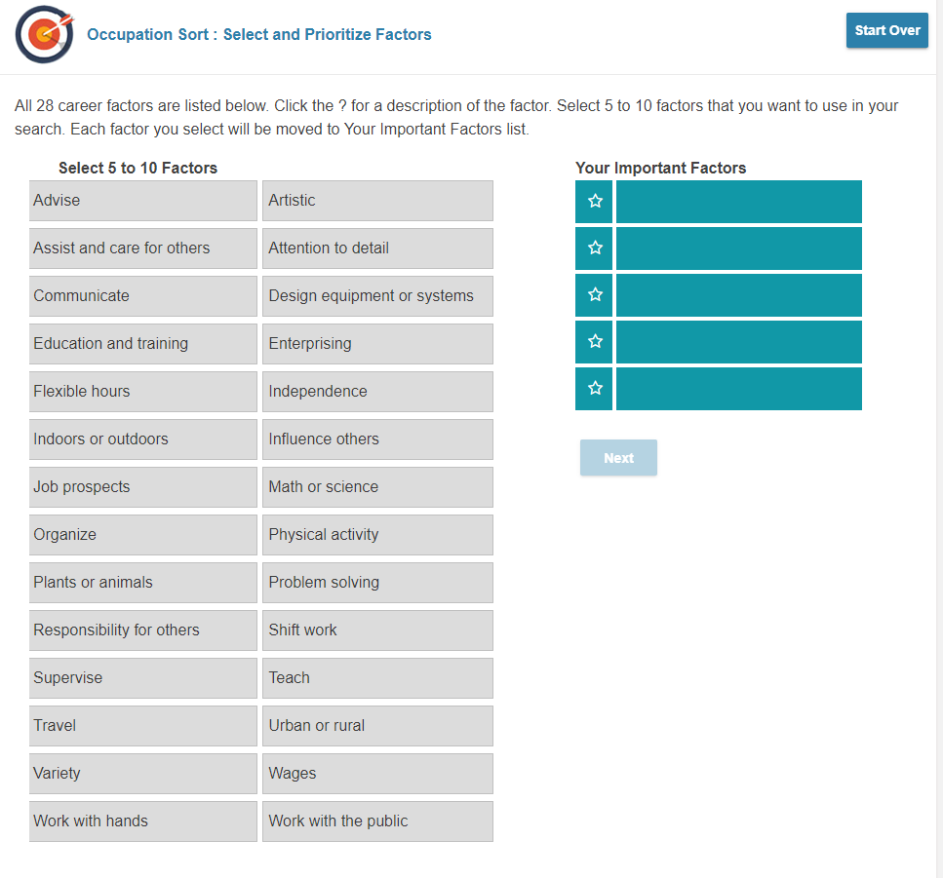
Occupation Sort
Select a minimum of five (5) to a maximum of ten (10) work factors that are important to you.
Select by clicking

Slide 25
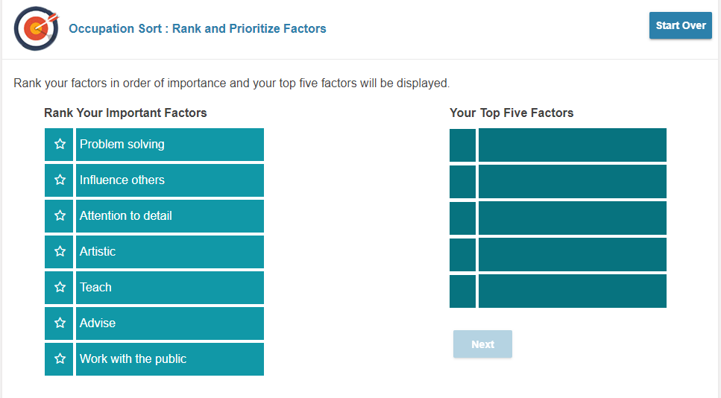
Occupation Sort
Now rank your TOP FIVE work factors.
Select by clicking

Slide 26
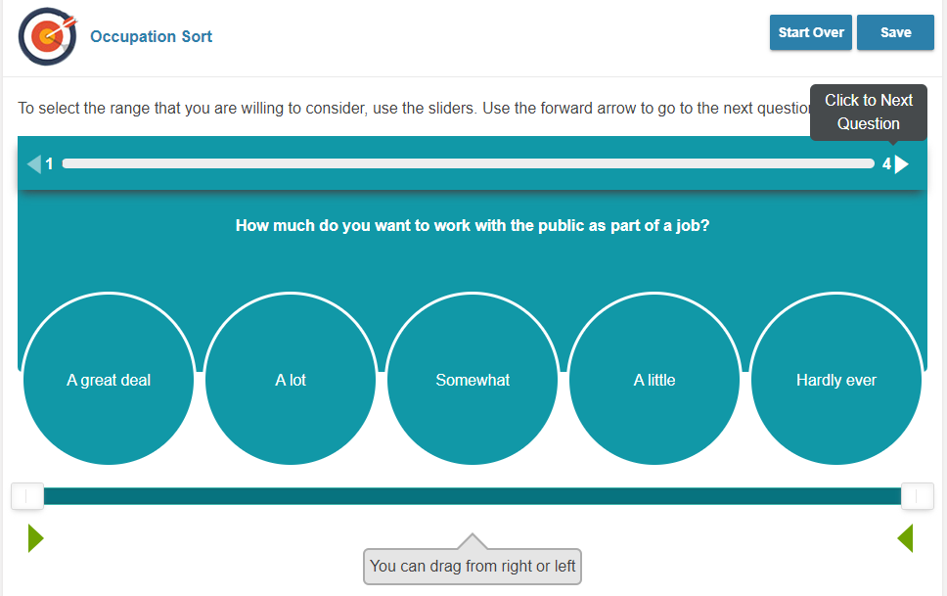
Occupation Sort
Now answer the questions based on the five factors you selected.
Note: The scale is from A Great Deal to Hardly Ever (try and be decisive)

Slide 27
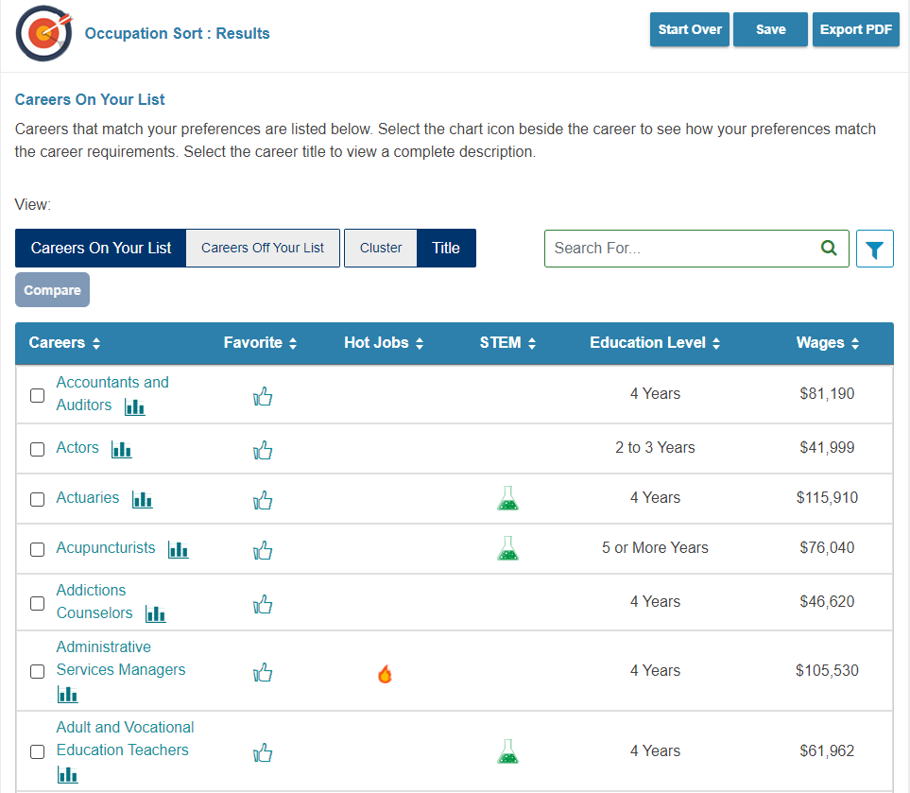
Occupation Sort
Results list Careers / occupations that you closely match

Slide 28
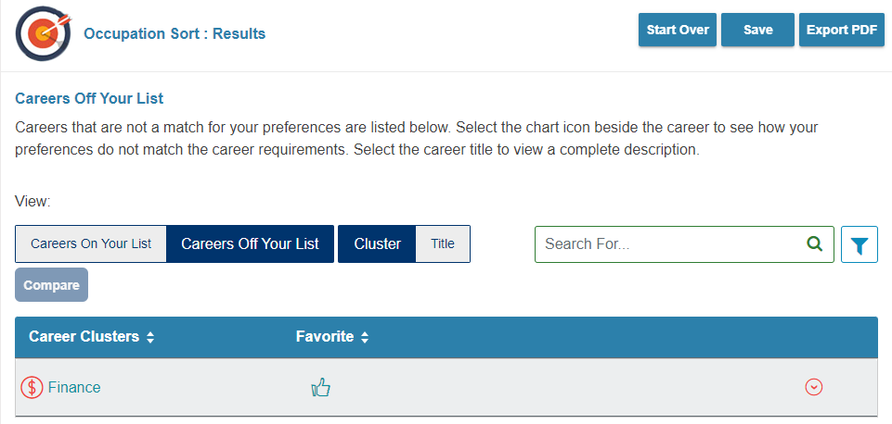
Not on list by Cluster
Note:
Not On List can be as important as On List
Can validate why not to chose a career

Slide 29
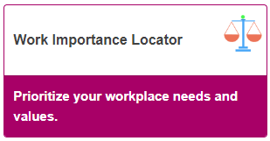
Work Importance Locator
The Work Importance Locator (WIL) is a self-assessment career exploration tool that allows clients to pinpoint what is important to them in a job. It helps people identify occupations that they may find satisfying based on the similarity between their work values (such as achievement, independence, and conditions of work) and the characteristics of the occupations.

Slide 30
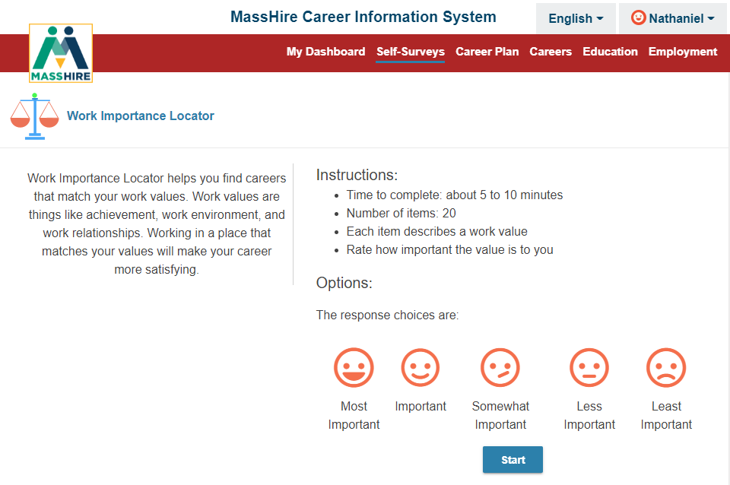
Work Importance Locator
Note:
Twenty (20) work values are provided.
You Rate how important each is to you.
Scale is:
Most Important
To
Least Important

Slide 31
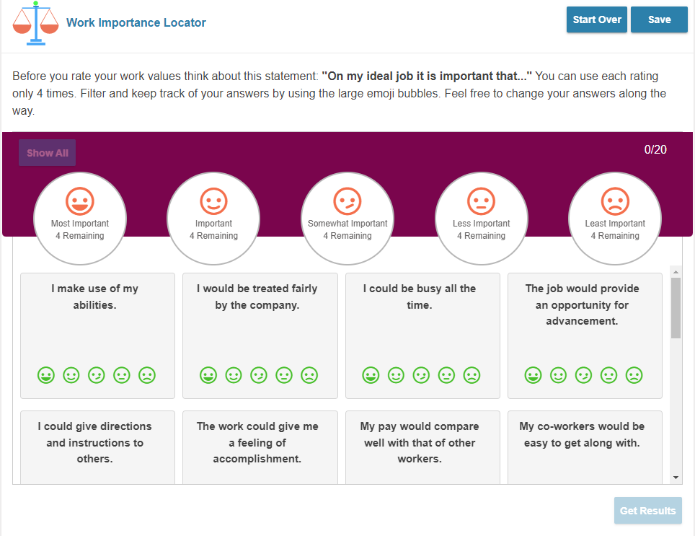
Work Importance Locator
Note:
You are only allowed to use the Ratings given four (4) times each.
So, only 4 Most Important values, only 4 Least Important values, etc…
You need to rate all the values.

Slide 32
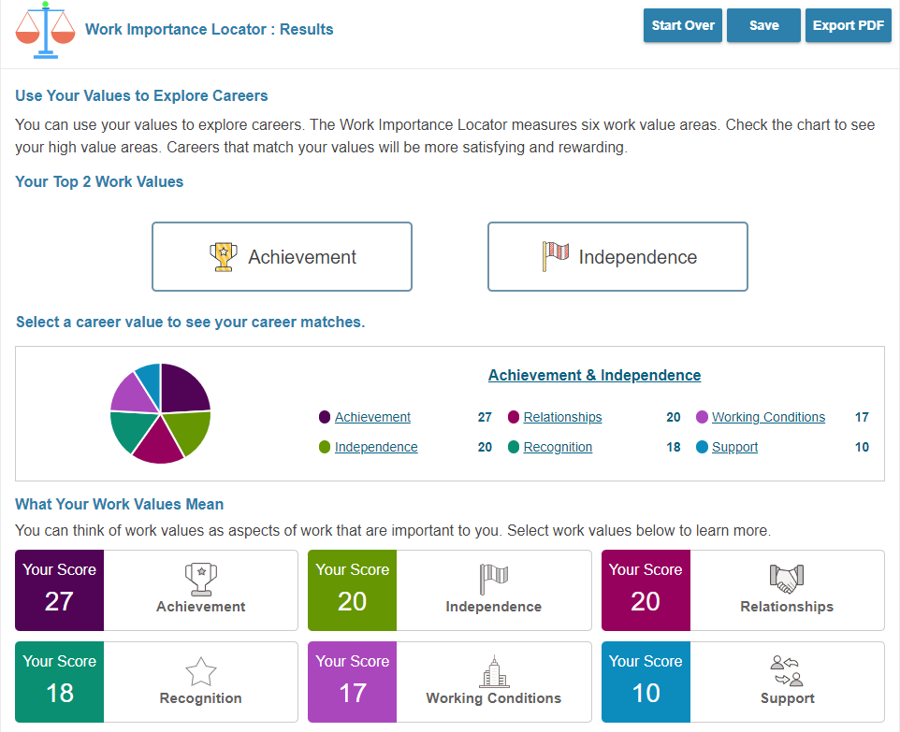
Work Importance Locator
Note:
RESULTS
Are broken out by work values groups that you rated highest in

Slide 33
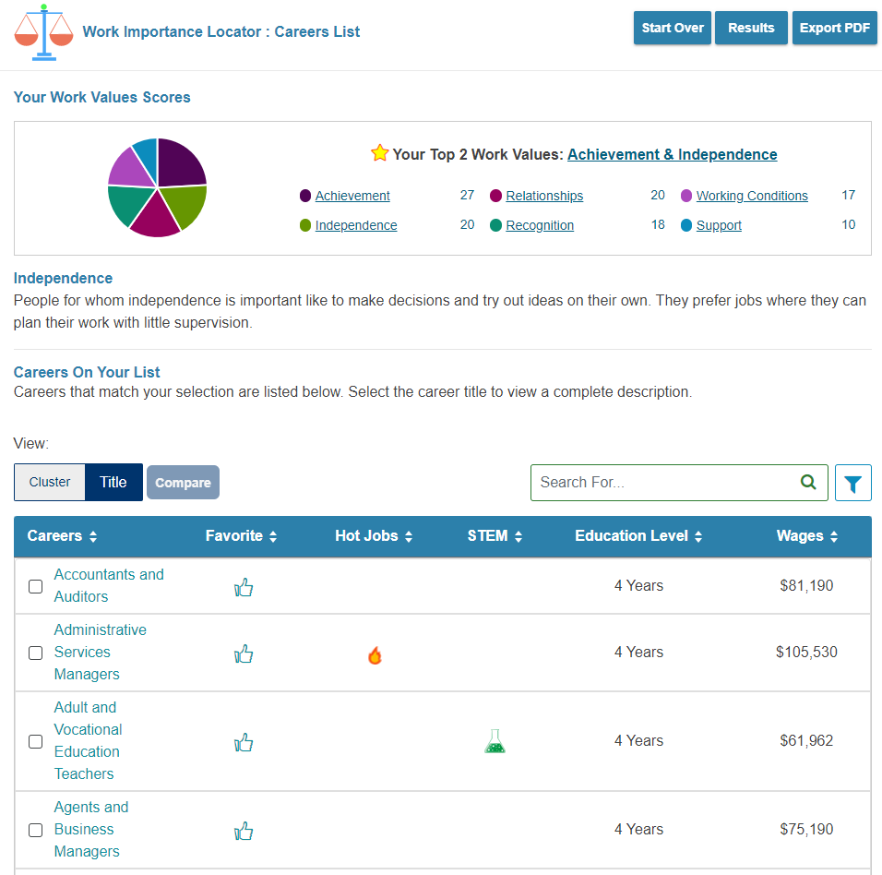
Work Importance Locator
Note:
RESULTS
Work Value Groups can then be broken out by Careers in that Group

Slide 34
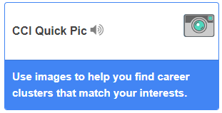
CCI Quick Pic
CCI Quick Pic uses pictures to help you think about activities you like. Quick and easy, after you rate your interests, they are matched to career clusters.
Can be helpful for people that are language skills deficient.

Slide 35
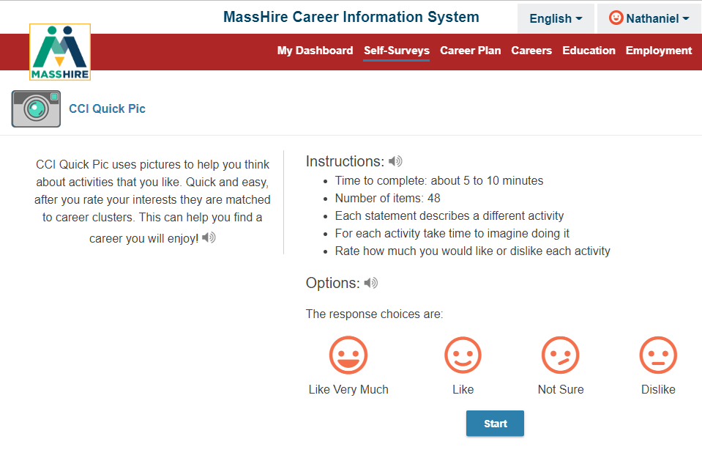
CCI Quick Pic
Note:
View forty-Eight (48) photographs and rate how much you like or dislike that activity

Slide 36
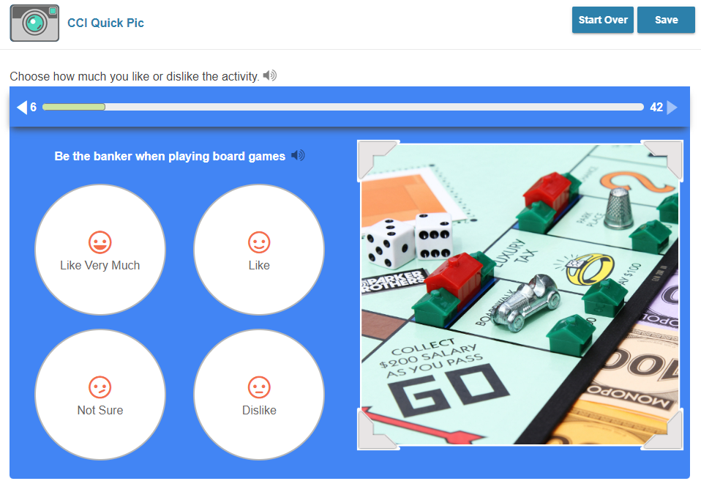
CCI Quick Pic
Note:
Rate how much you like or dislike that activity
From
Like Very Much
To
Dislike

Slide 37
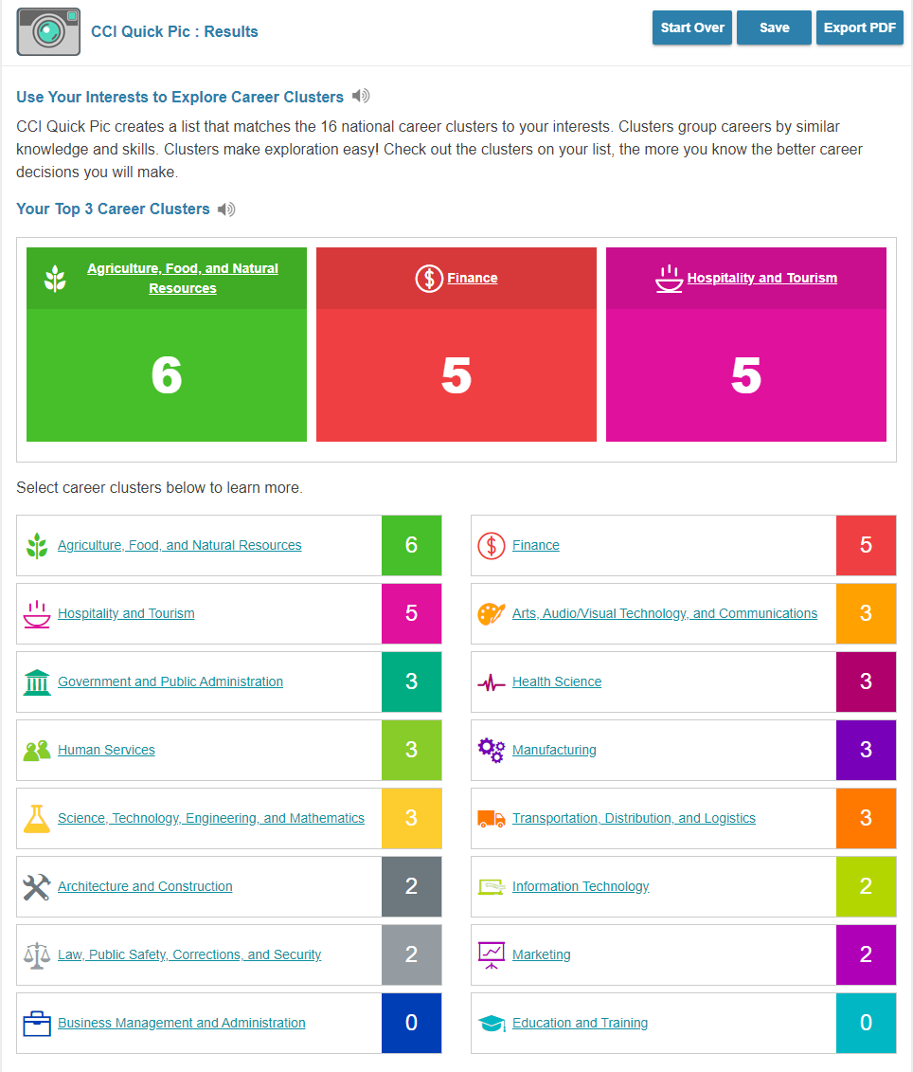
CCI Quick Pic Results
Note:
RESULTS
Broken out by the Sixteen (16) Career Clusters.
With highest scoring ones listed on top.
And all clusters listed on bottom with scores

Slide 38
CCI Quick Pic Results
Note:
RESULTS
Can be drilled down to specific career clusters
With associated careers / occupations listed
At a glance provides an overview of Cluster.

Slide 39
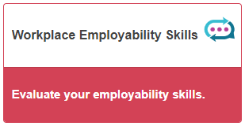
Workplace Employability Skills
This assessment measures nine skill areas. Check the chart to see your strengths, as well as skills that need improvement. Knowing more about your skill levels will allow you to build on your strengths and work on things that need improvement. Strong employability skills are important for a successful job search.

Slide 40
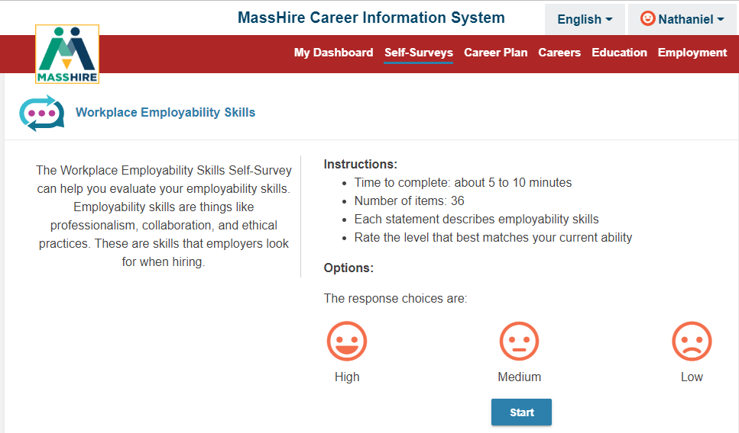
Workplace Employability Skills
Note:
Thirty-six (36) Employability factors to rate
Rating scale is from
High
To
Low

Slide 41
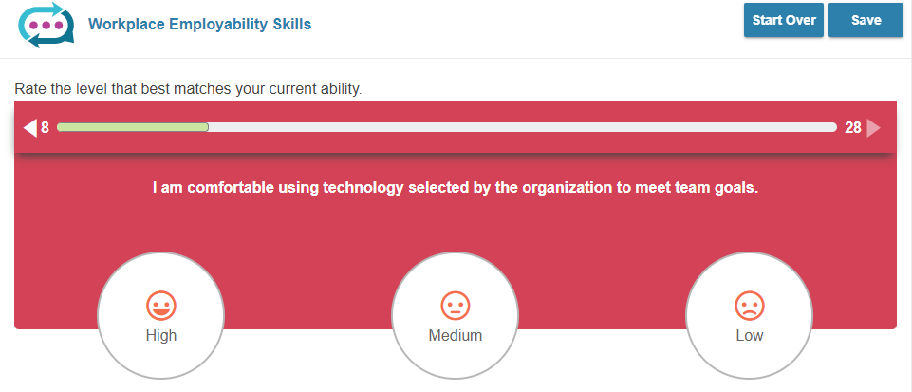
Workplace Employability Skills
Note:
Sample of a
Workplace Employability Skill,
you select your High and Low.
The bar above the question keeps track of the questions answered and those still to be answered.

Slide 42
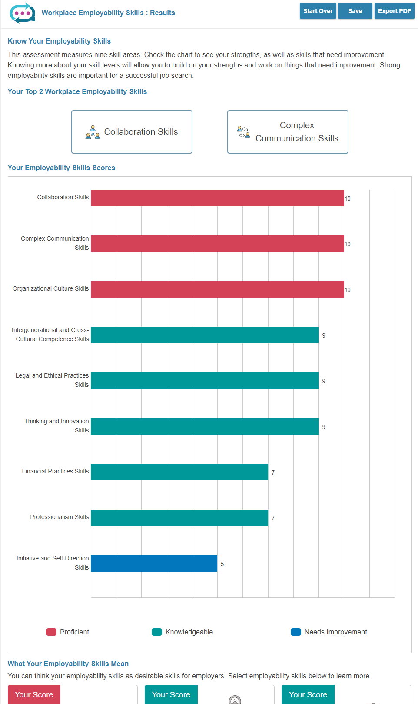
Workplace Employability Skills
Note:
RESULTS
Of the Nine Skills areas.
Your highest scoring skill area is on top

Slide 43
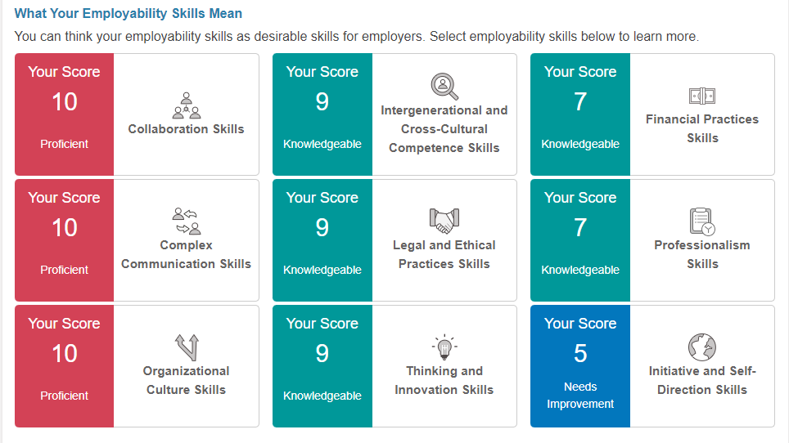
Workplace Employability Skills
Note:
RESULTS
(at bottom of previous page)
Of the Nine Skills areas.

Slide 44
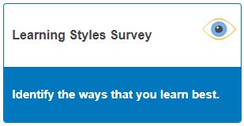
Learning Styles Survey
The Learning Style Survey is designed to assess your general approach to learning. It does not predict your behavior in every instance, but it is a clear indication of your overall style preferences.
And can provides a set of recommended learning strategies to help you study / train in a productive manner.

Slide 45
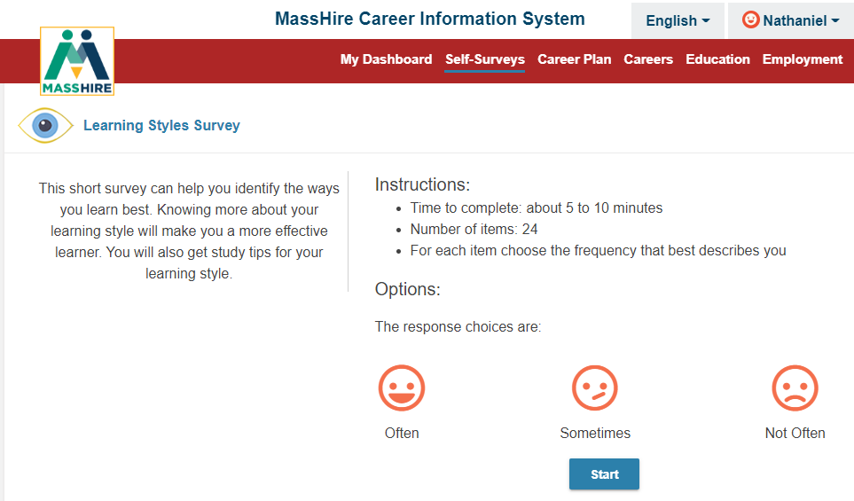
Learning Styles Survey
Note:
Twenty-four (24) Learning / Activities to rate
Rating scale is from
Often
To
Not Often

Slide 46
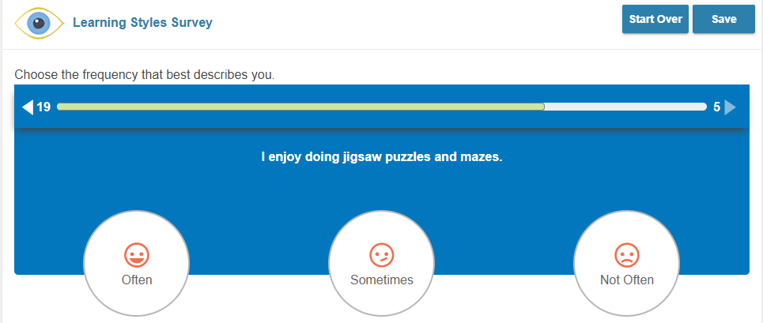
Learning Styles Survey
Note:
Sample of a
Learning style question,
you select your Often to Not Often response.
The bar above the question keeps track of the questions answered and those still to be answered.

Slide 47
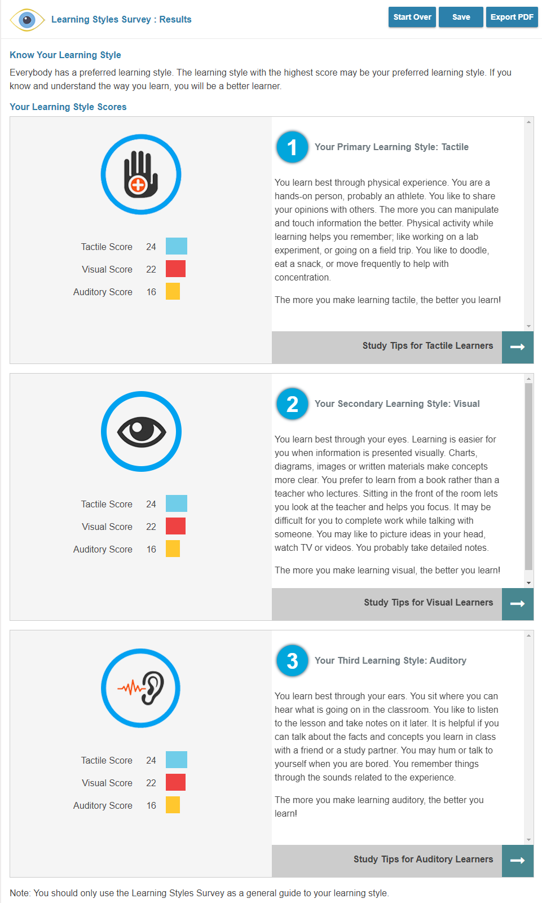
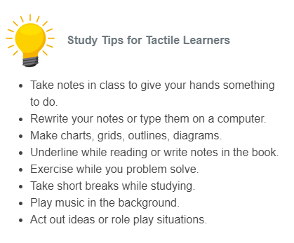
Learning Styles Survey
Note:
RESULTS
Lists your primary learning style
And the top three learning styles
Has Learning / Studying Tips

Slide 48
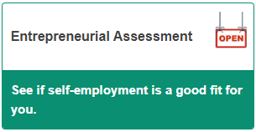
Entrepreneurial Assessment
The Entrepreneur Assessment identifies the necessary skills and entrepreneurial characteristics needed to start a new venture. The assessment analyses key dimensions of personality, motivations, skills, and experiences required to be successful as an entrepreneur / business starter.
Commonwealth Corporation had done this previously for partner agencies.

Slide 49
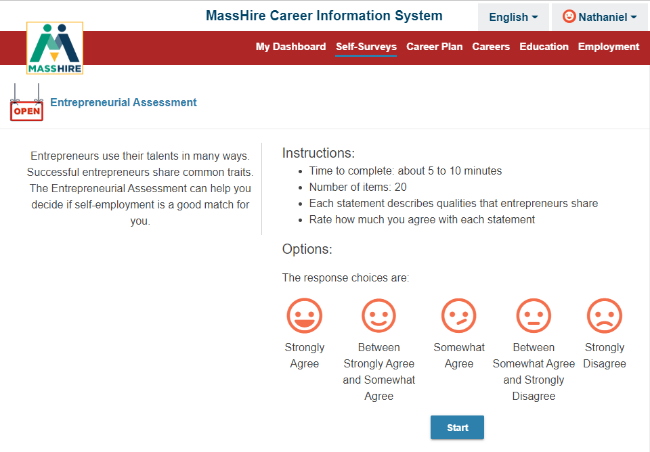
Entrepreneurial Assessment
Note:
Twenty (20) entrepreneurial questions to rate
Rating scale is from
Strongly Agree
To
Strongly Disagree

Slide 50
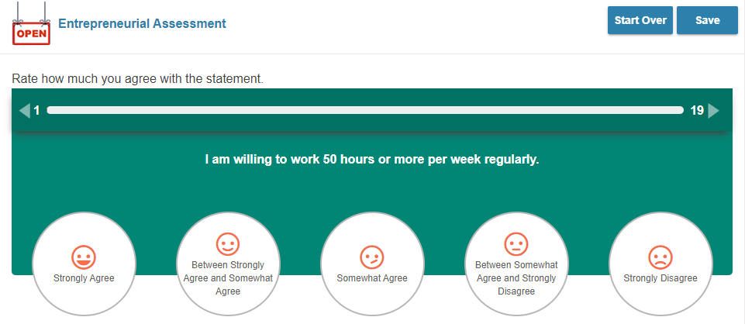
Entrepreneurial Assessment
Note:
Sample of a
Entrepreneurial question,
you select Strongly Agree to Strongly Disagree
as the response.
The bar above the question keeps track of the questions answered and those still to be answered.

Slide 51
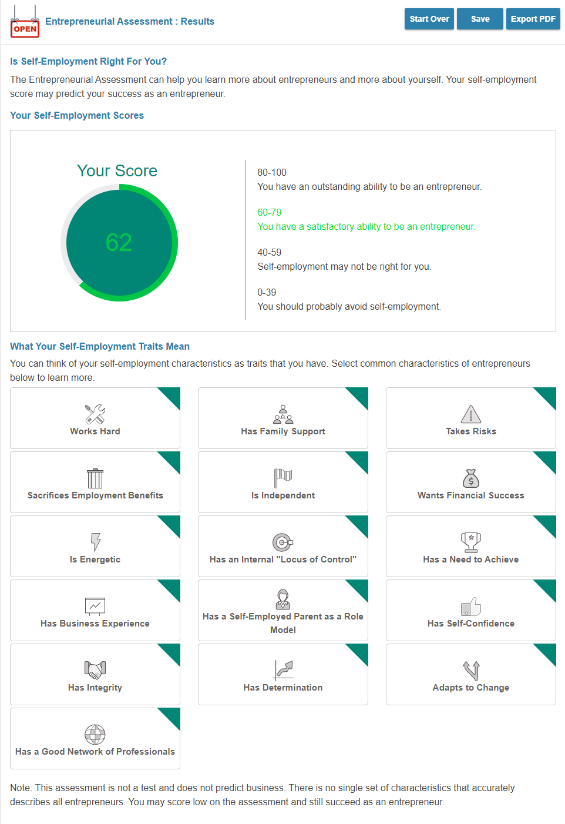
Entrepreneurial Assessment
Note:
RESULTS
Provides a Score
With a gauge
It is a predictive indicator of how successful you could be as an entrepreneur.

Slide 52
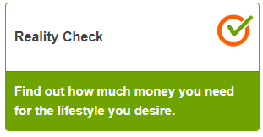
Reality Check
Reality Check from the is an engaging online tool designed to estimate the income necessary to support your desired lifestyle. You'll be asked questions about where you’d like to live in Massachusetts and how you spend your money (budget) . From there, you’ll be directed to jobs that meet your financial needs.
Reality Check will show you how much your living expenses will cost, and the amount of money you will need to earn to pay for them.

Slide 53
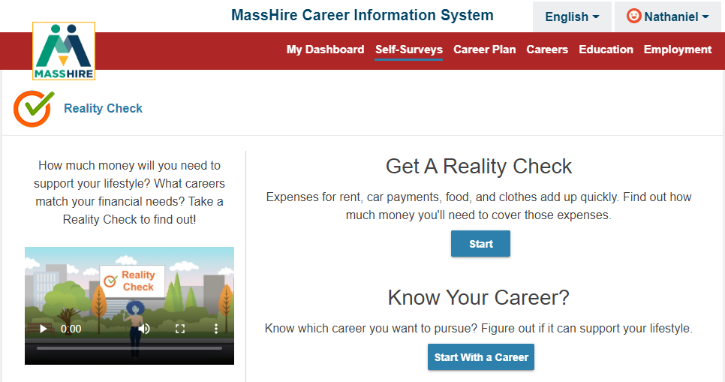
Reality Check
Note:
This assessment is a lifestyle assessment.
It has a minimum of twelve (12) living expenses.
You will select the various options under each expense.
From there the program will determine a needed budget and various career options that meet these expenses / budget.

Slide 54
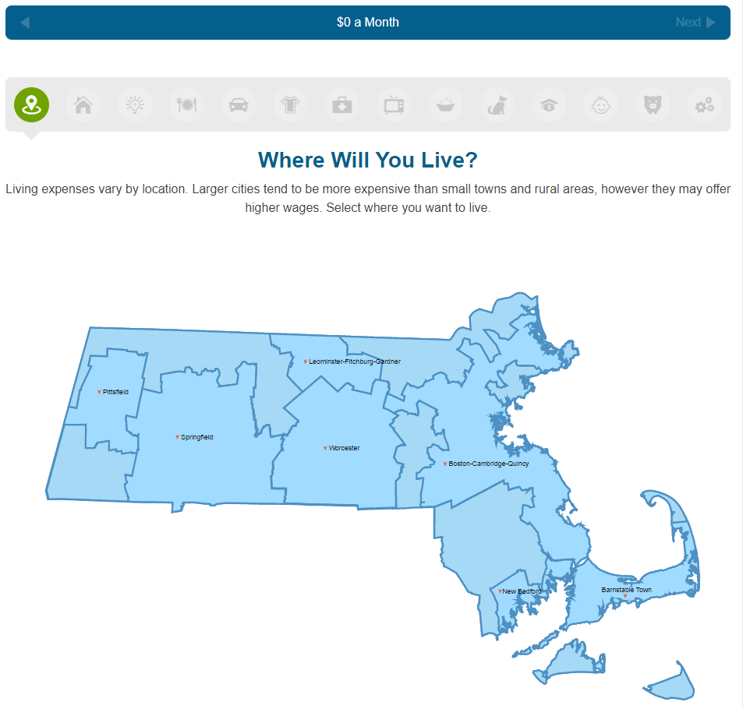
Reality Check
Note:
Expenses under the various categories comes from a variety of documented sources.
Mass Real Estate information,
National costs for transportation (autos + insurance + upkeep),
national utility costs, etc.
Child expense are optional

Slide 55
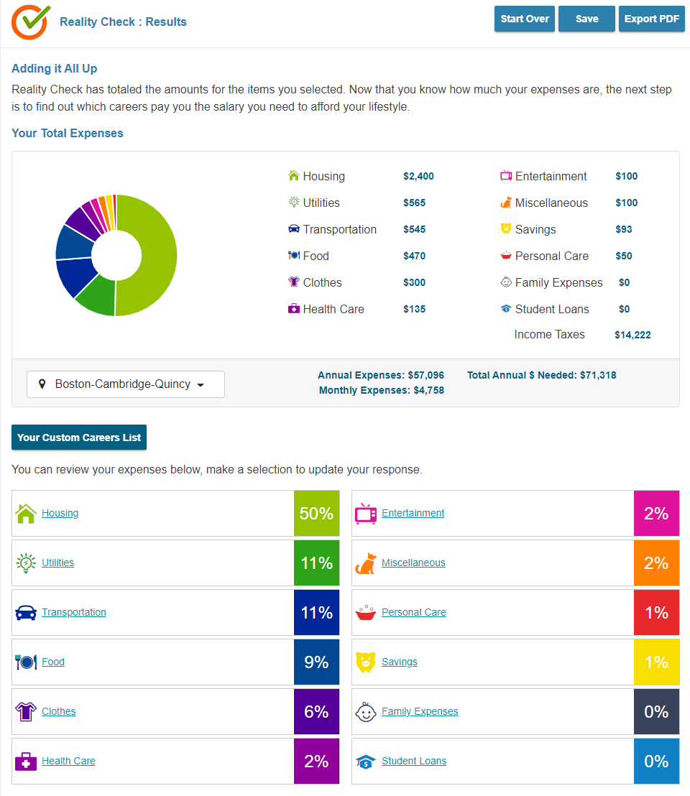
Reality Check
Note:
Annualized Expenses are calculated + Taxes
And Itemized

Slide 56
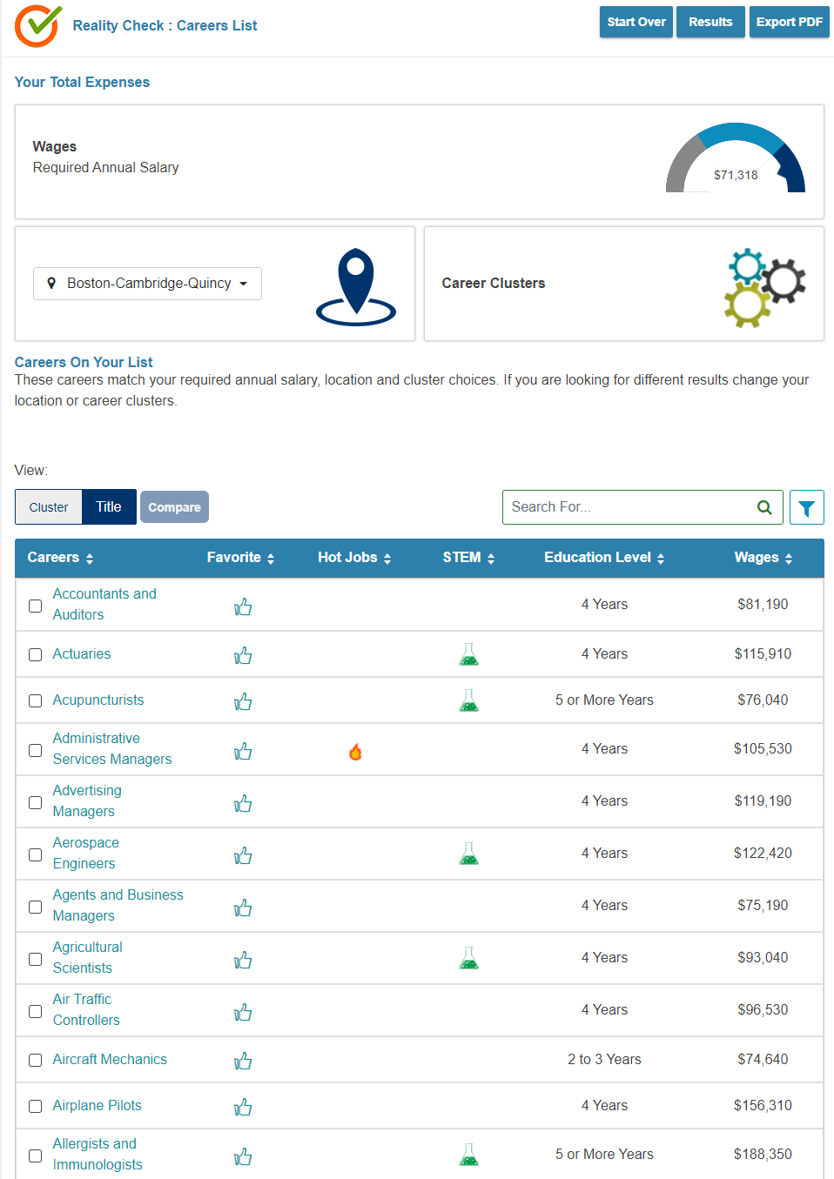
Reality Check
Note:
Career Option can be extrapolated from Expenses.
Will list Occupations in your demographics that meet your expense.
Can adjust with Career Cluster filter

Slide 57
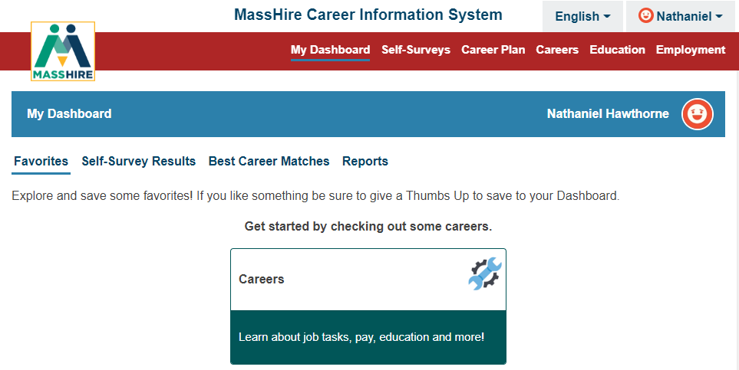
My dashboard

Slide 58
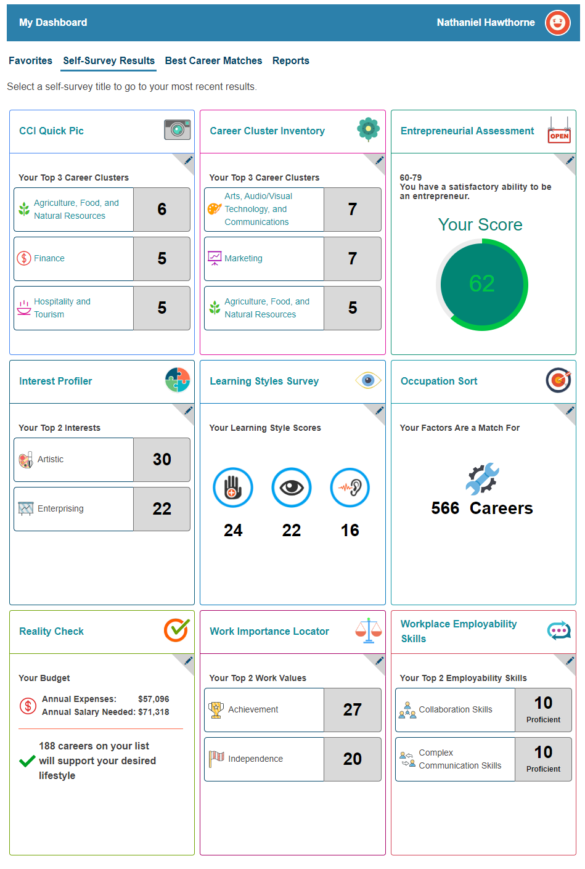
My dashboard
Note:
Self-Survey Results

Slide 59
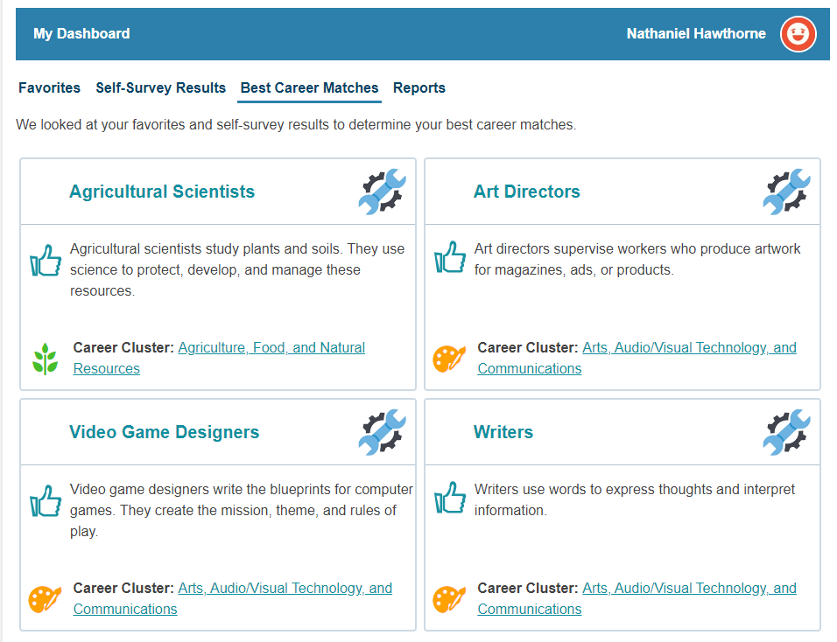
My dashboard
Note:
Careers selected as Favorites and Self-Survey Results

Slide 60
Translation

Slide 61
Contact Information
Email: MassHireCIS@State.MA.US
Telephone: 617-626-6808
URL: https://portal.masscis.IntoCareers.org

Slide 62
?
?
?
Questions and Answers
?
?
?
?
?
?
?
?

