Slide 1

Welcome to
MassHire
Career Information Systems

Slide 2
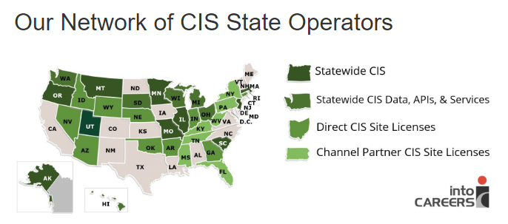
University of Oregon : into CAREERS

Slide 3

MassHire Career Information System
MassHire Career Information Systems is purchased with grants by the US Department of Labor (USDOL) Employment and Training Administration, it is primarily procured for the use of the Department of Career Services Career Centers, it’s partners and Massachusetts constituents. As such the trainings focus is for career center staff usage.

Slide 4
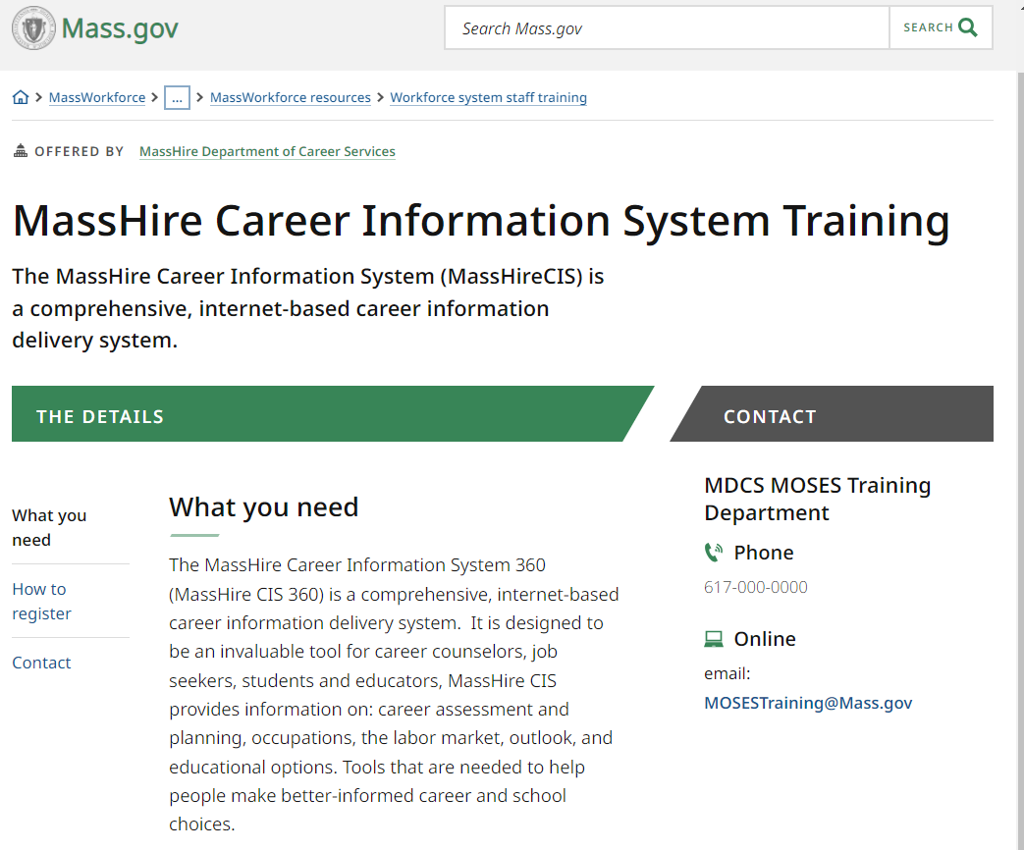
The MassHire CIS Training Calendar https://www.mass.gov/how-to/masshire-career-information-system-training

Slide 5
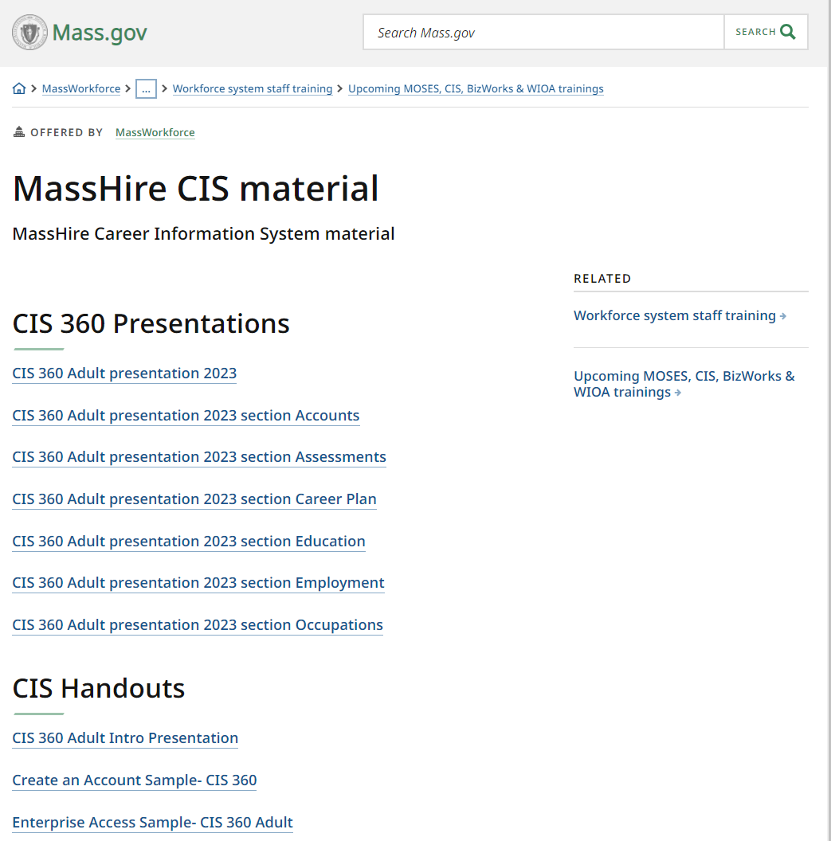
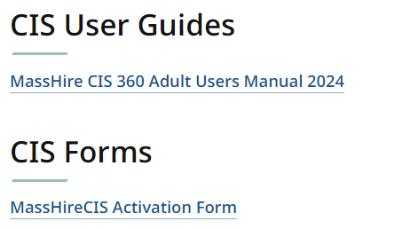
The MassHire CIS Resources https://www.mass.gov/service-details/masshire-cis-material

Slide 6
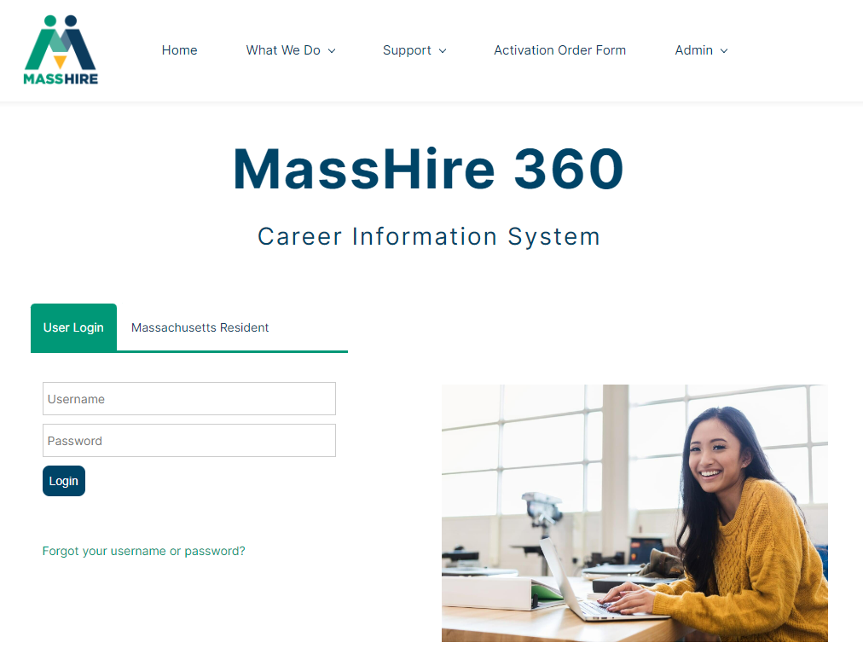
The MassHire Career Information System Portal https://portal.ma.cis360.org/

Slide 7
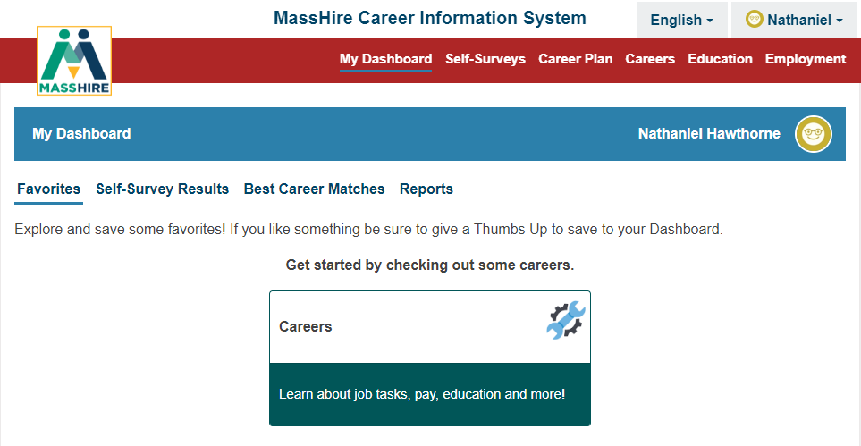
User Dashboard

Slide 8
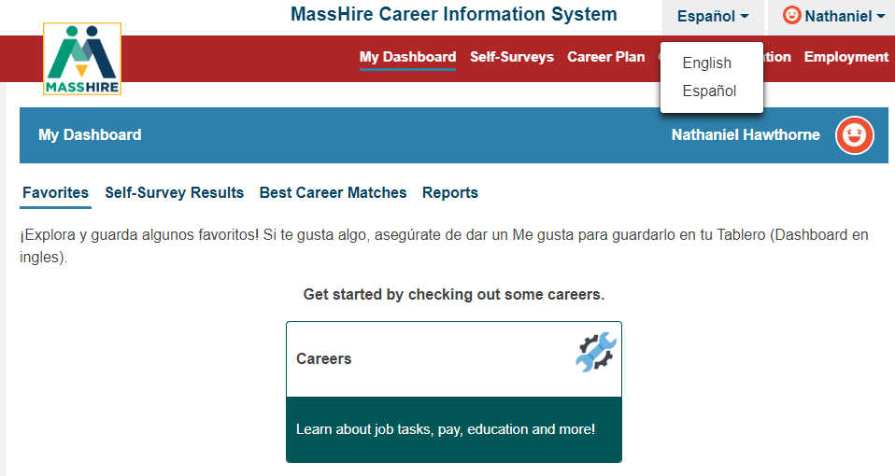
English / Español
Note:
Español version originally done by Texas translation affiliation using Mexican Spanish

Slide 9
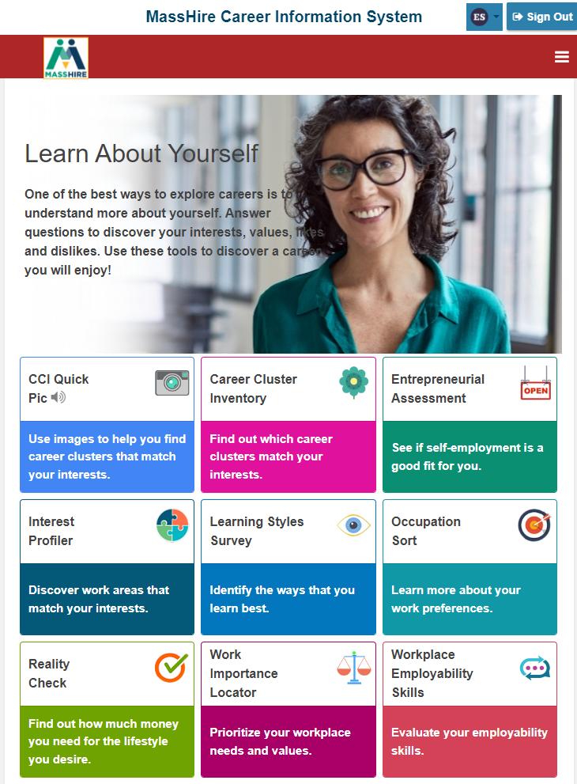
Corrections Site
No log in account / Personal account

Slide 10
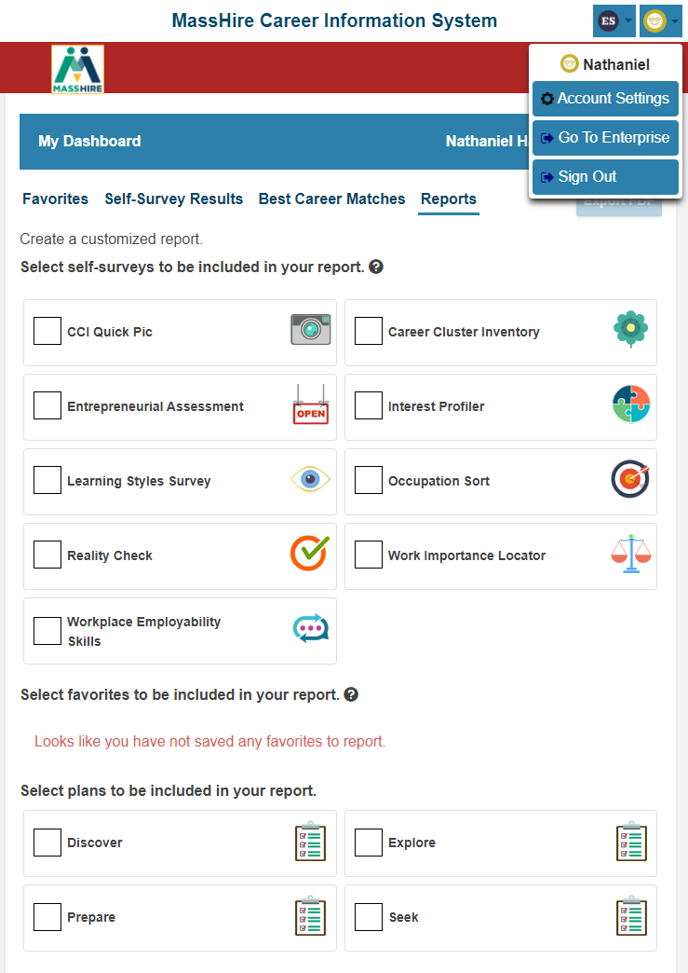
“Regular MassHire CIS 360”
Has Log in account / Personal account

Slide 11
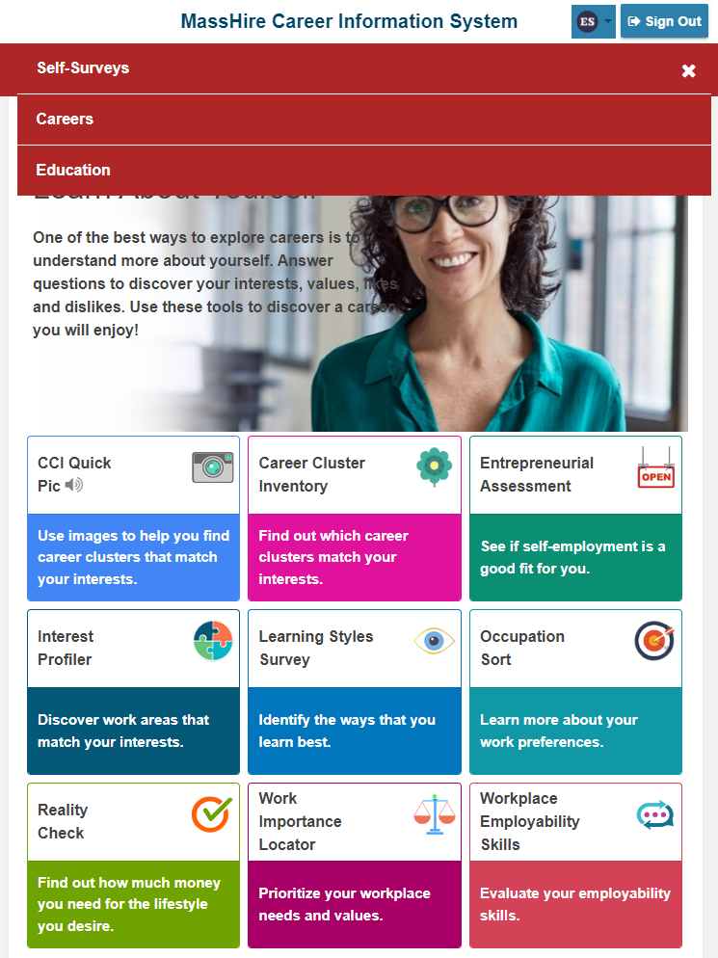
Corrections Site
Has only three options:
    Self Surveys
    Careers (Occupations)
    Education (Schools)

Slide 12
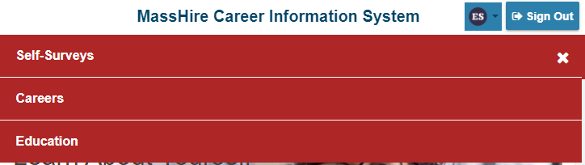
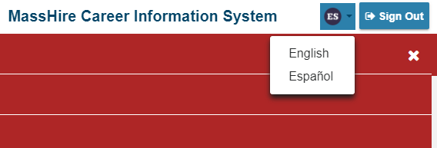
Corrections Site
English / Spanish Language options

Slide 13
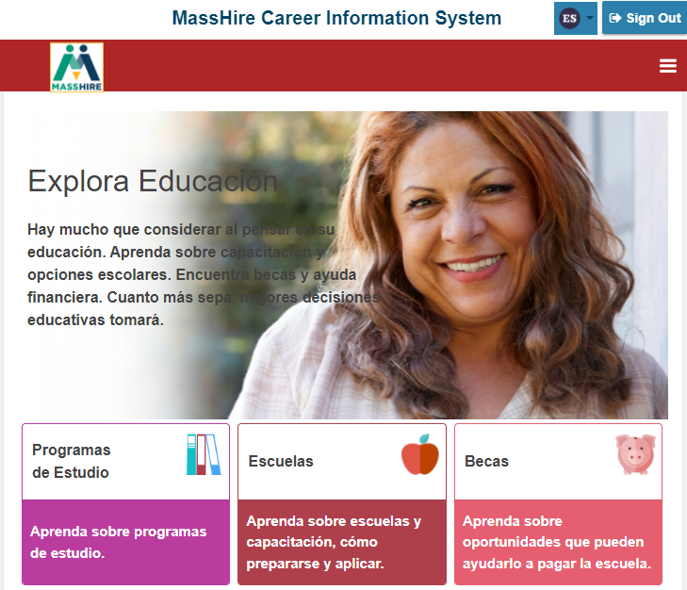
Corrections Site

Slide 14
Corrections Site
All nine surveys available
But you can not save them, except as a print out

Slide 15
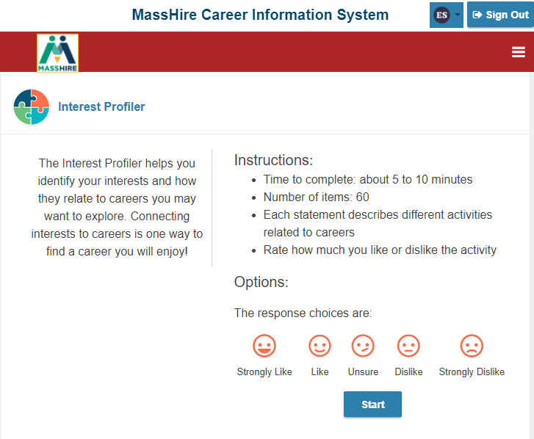
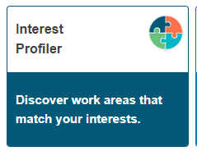
Corrections Site

Slide 16
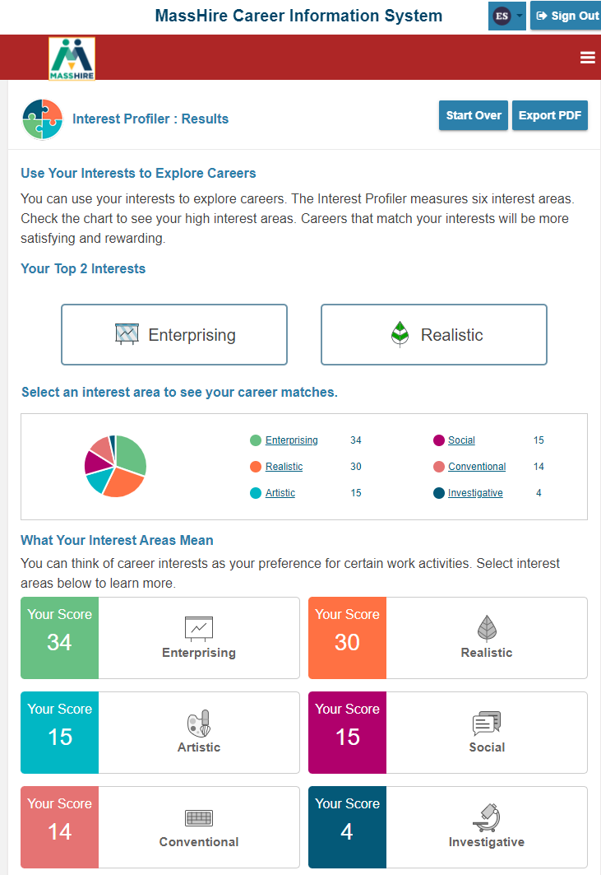
Corrections Site

Slide 17
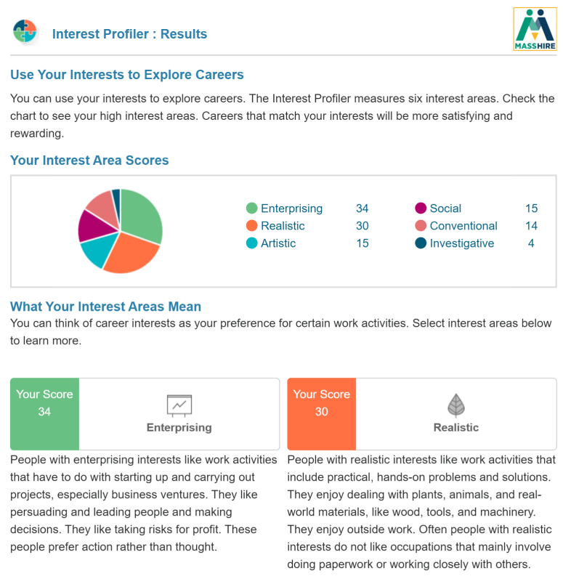
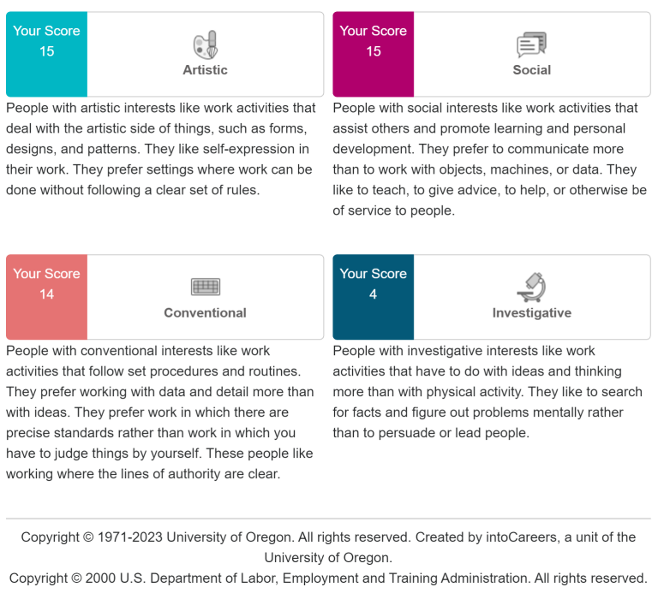

Corrections Site

Slide 18
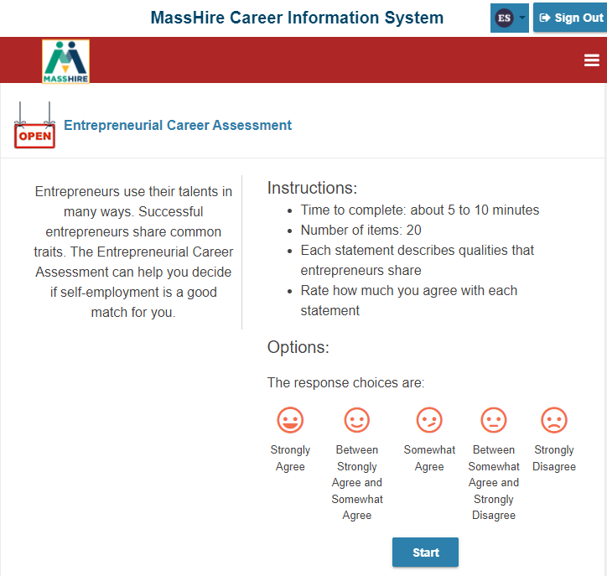

Corrections Site

Slide 19
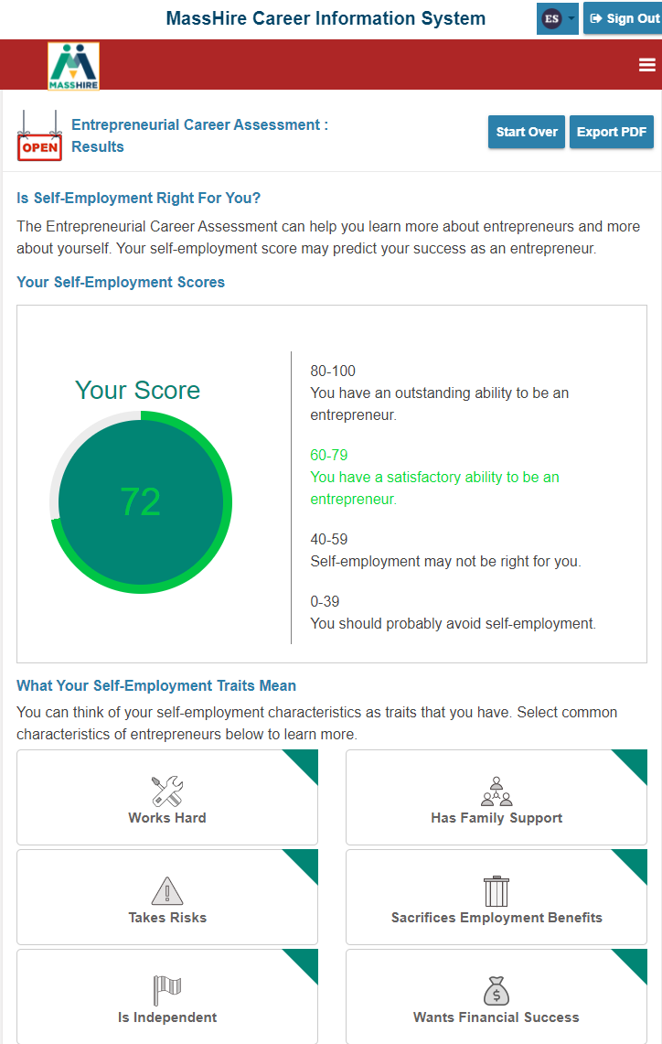
Corrections Site

Slide 20
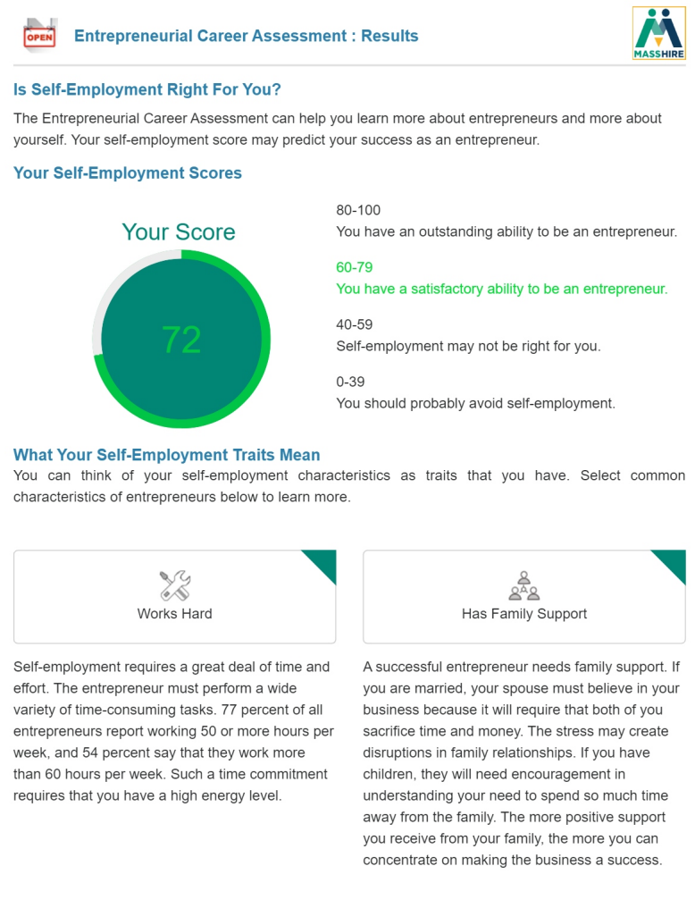
Corrections Site

Slide 21
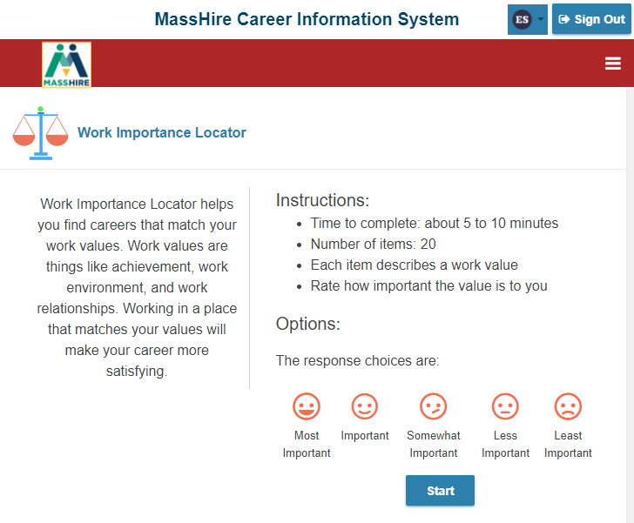
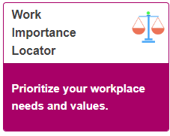
Corrections Site

Slide 22
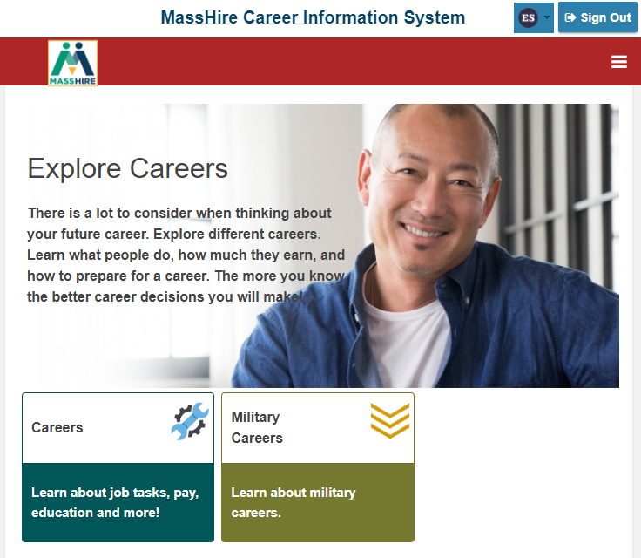
Corrections Site
Careers

Slide 23
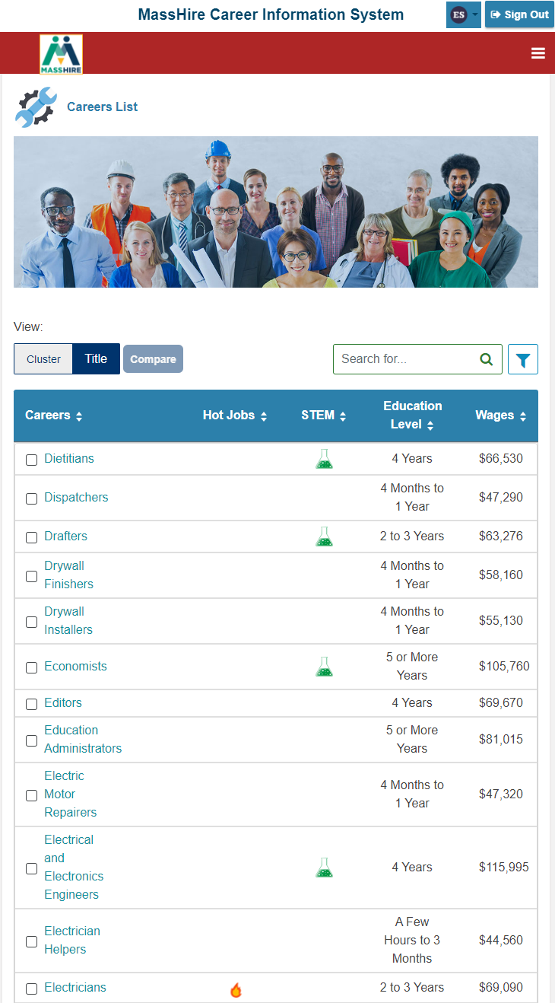

Corrections Site
List of all Careers

Slide 24
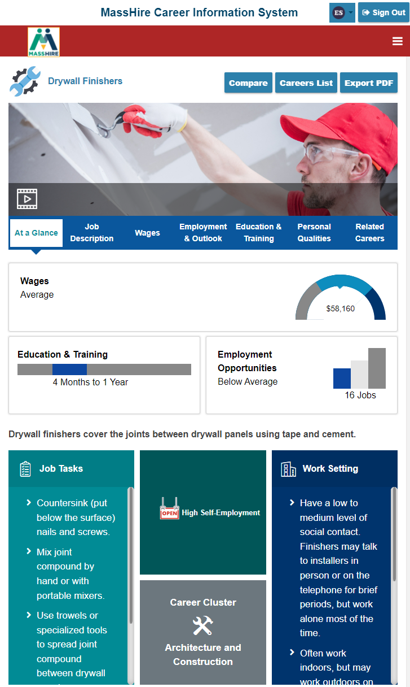
Corrections Site
Careers
At a Glance

Slide 25
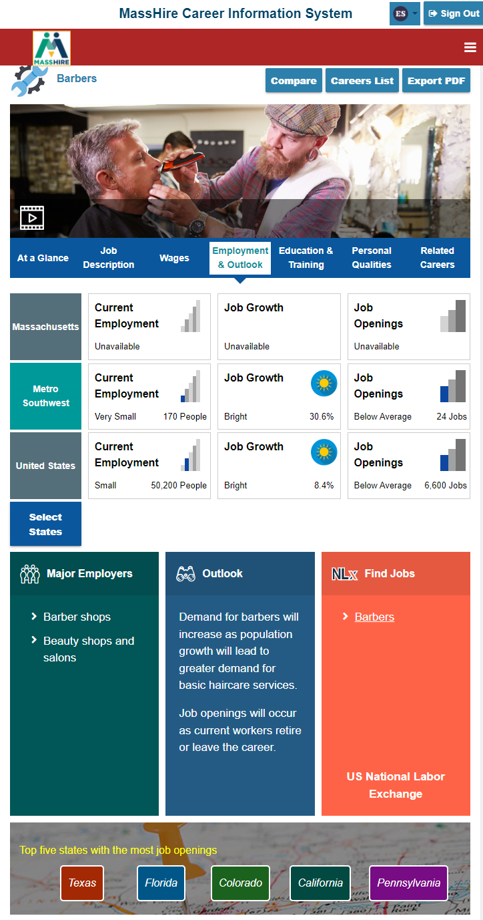
Corrections Site
Has Wages and Forecast / Outlook information

Slide 26
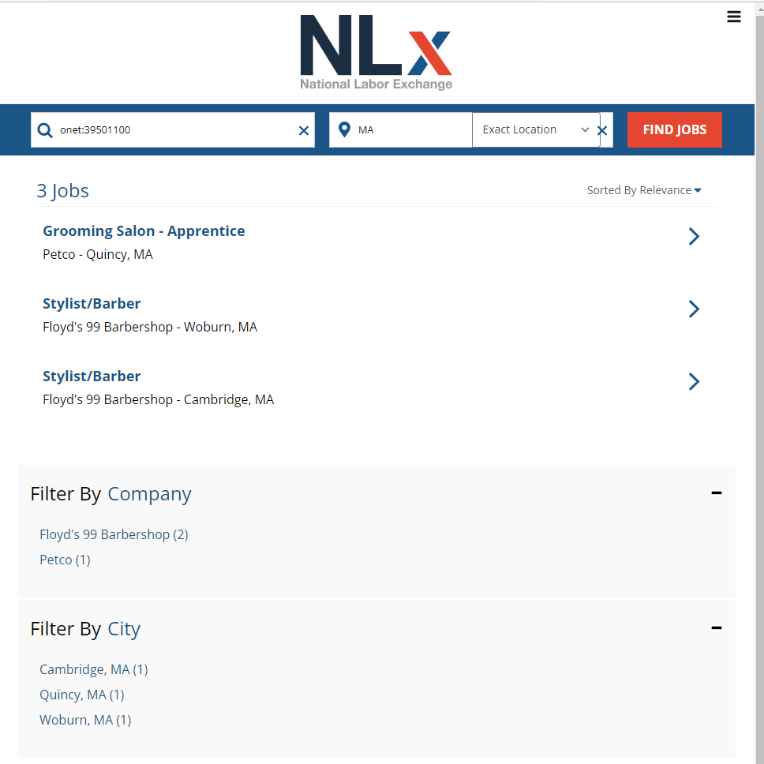
Corrections Site

Slide 27
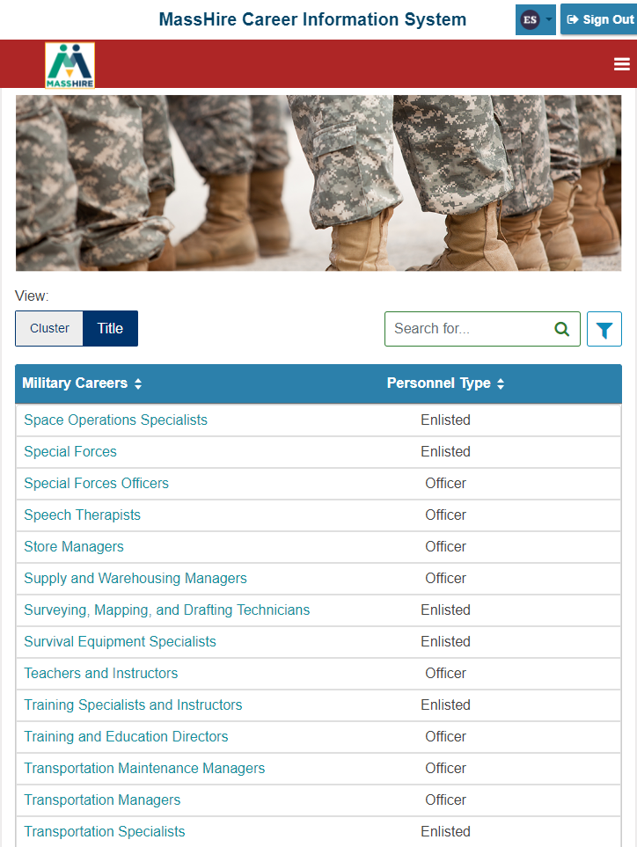

Corrections Site

Slide 28
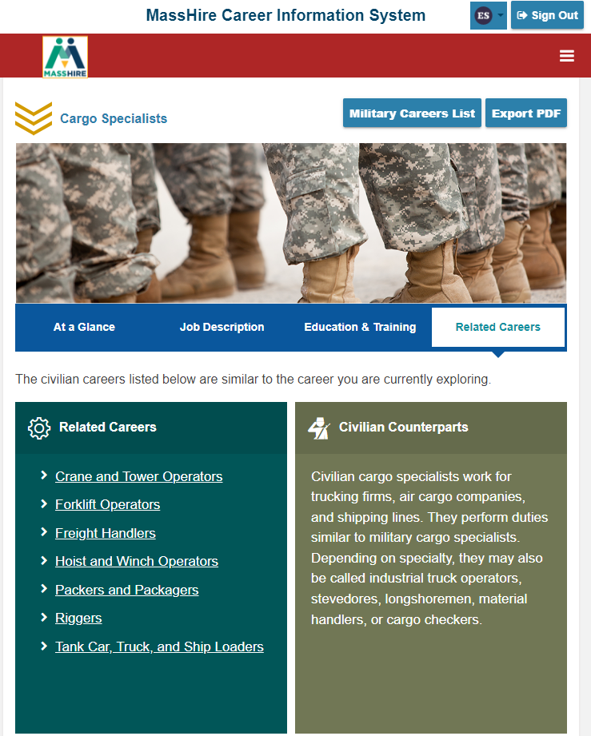
Corrections Site
Related Careers

Slide 29

Corrections Site

Slide 30
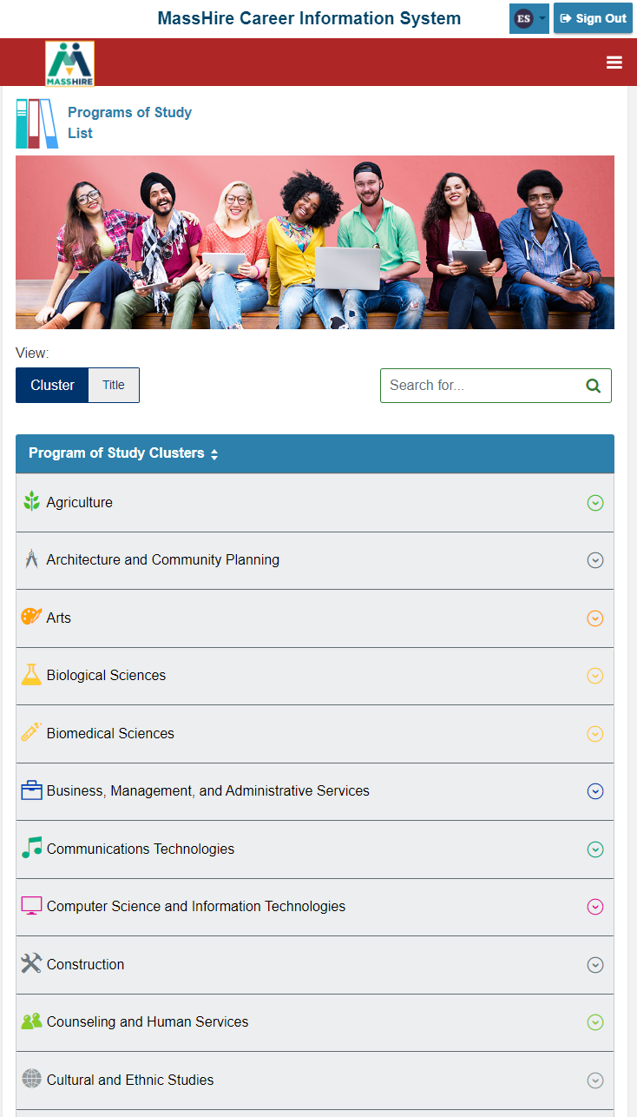

Corrections Site
Cluster information / programs

Slide 31
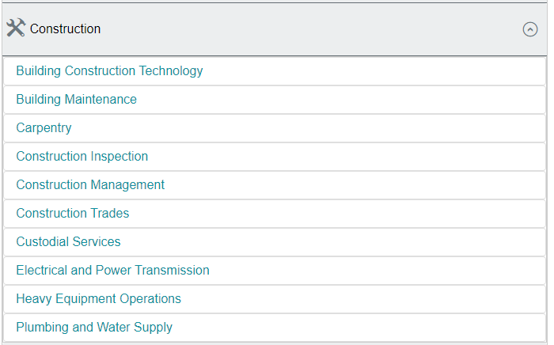
Corrections Site
Cluster details

Slide 32
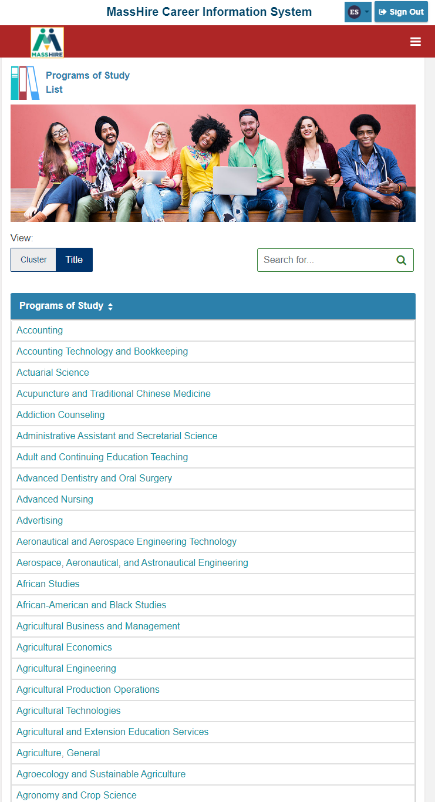
Corrections Site
By Title details

Slide 33
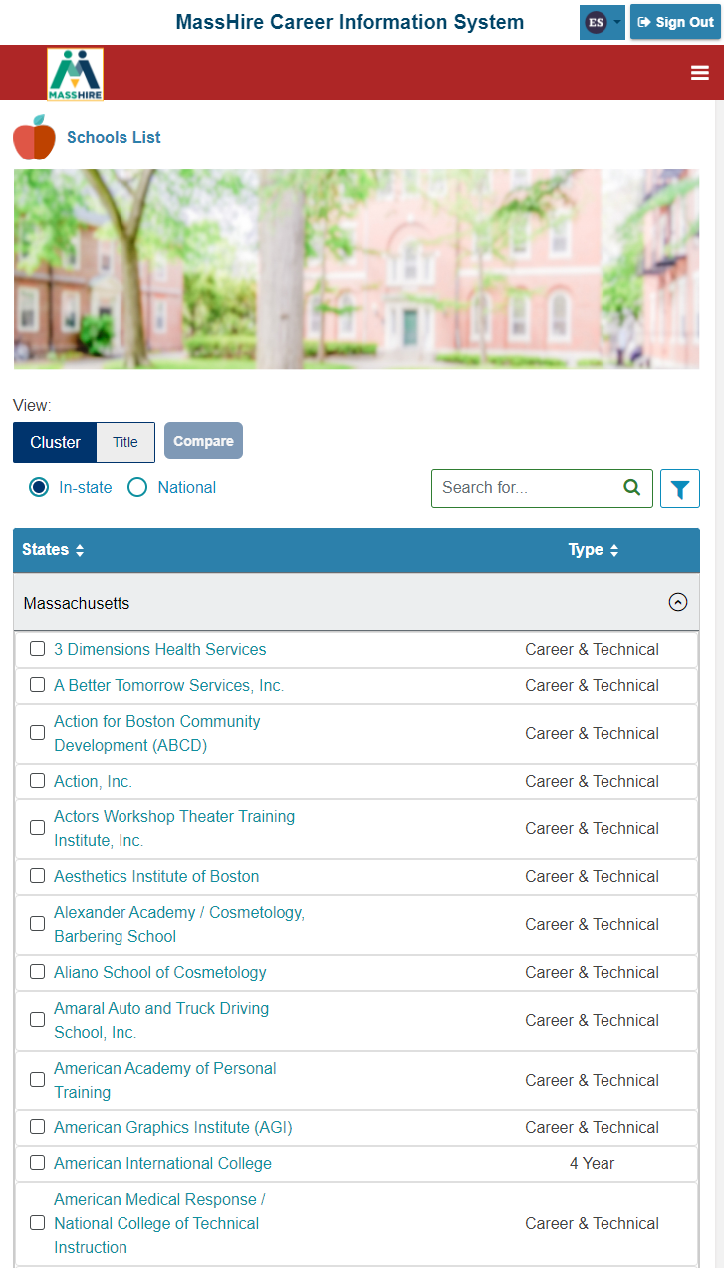
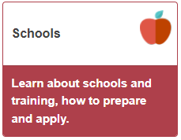
Corrections Site
Defaults to Massachusetts schools

Slide 34
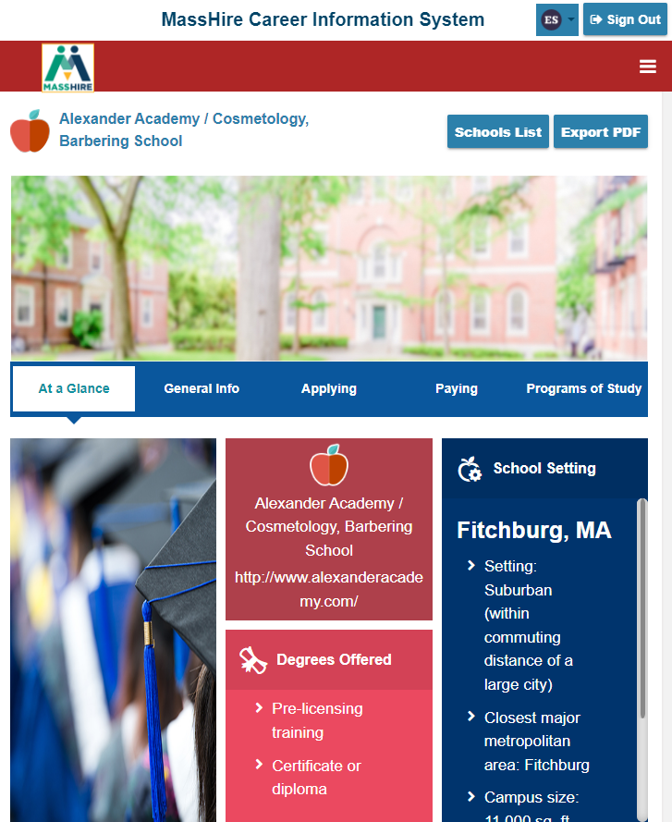
Corrections Site
Schools at a Glance

Slide 35
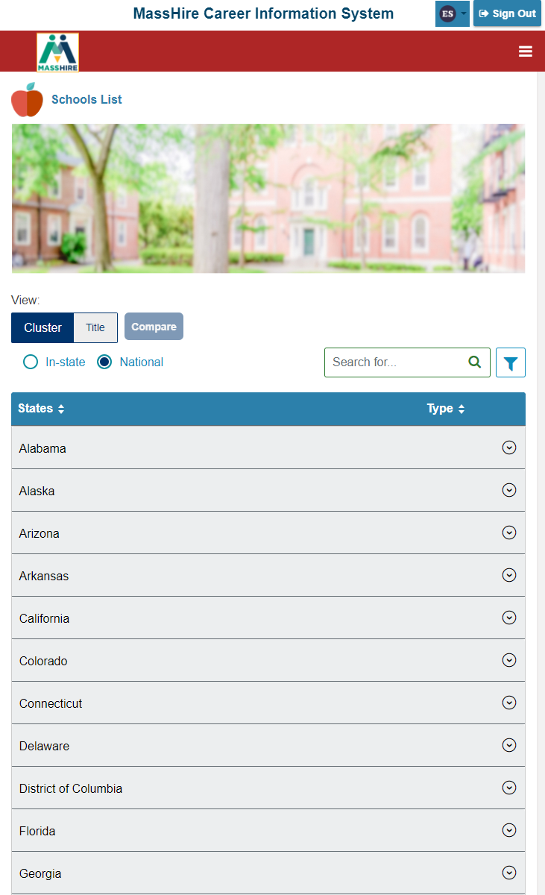
Corrections Site
National School Listings

Slide 36
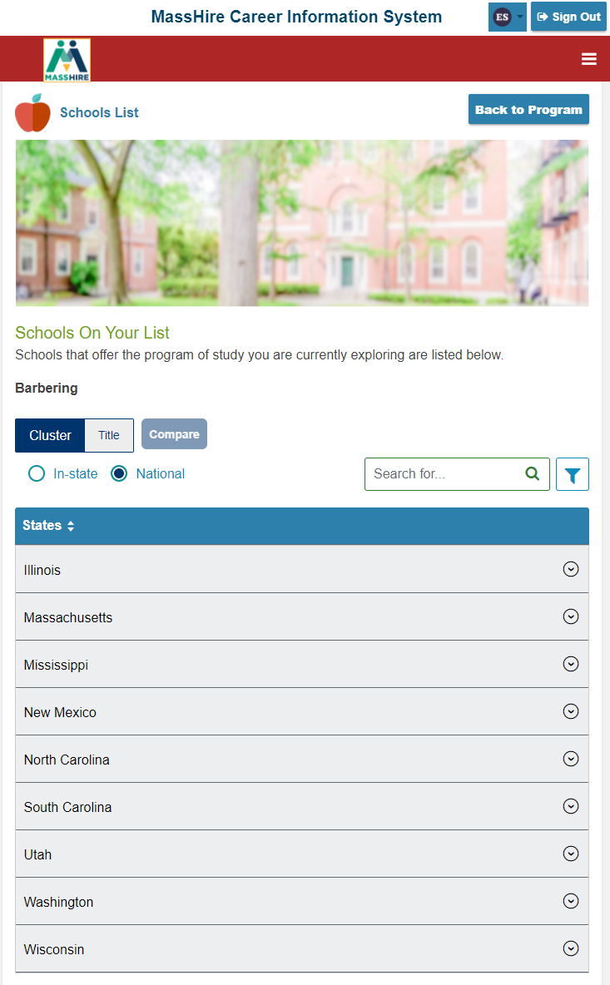
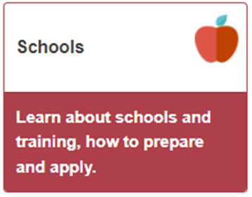
Corrections Site
National School Listings

Slide 37
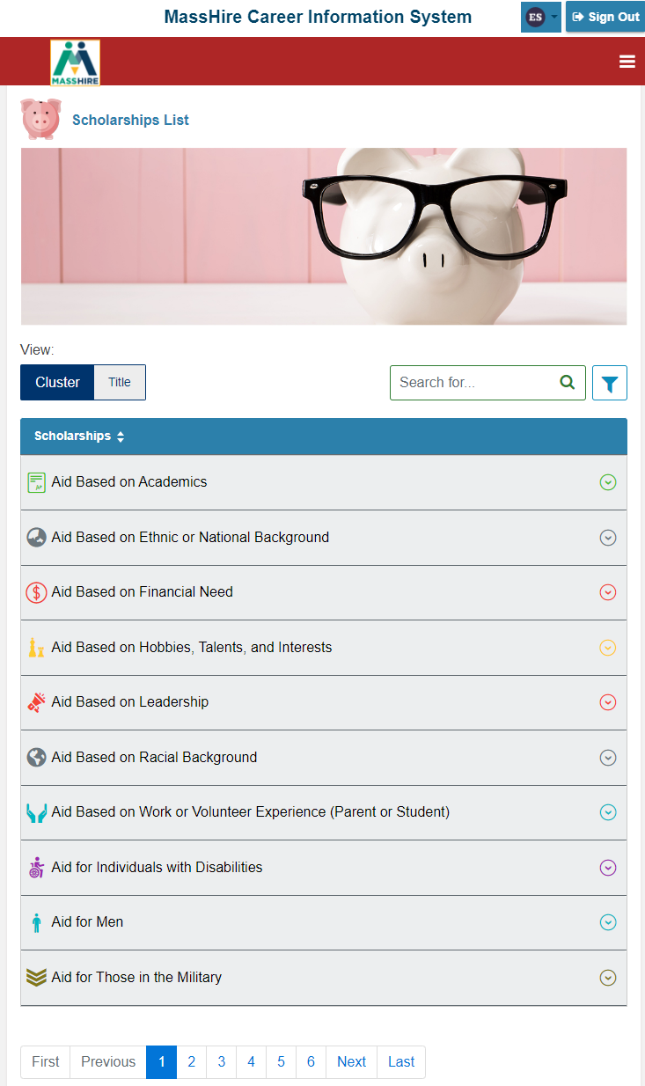

Corrections Site

Slide 38
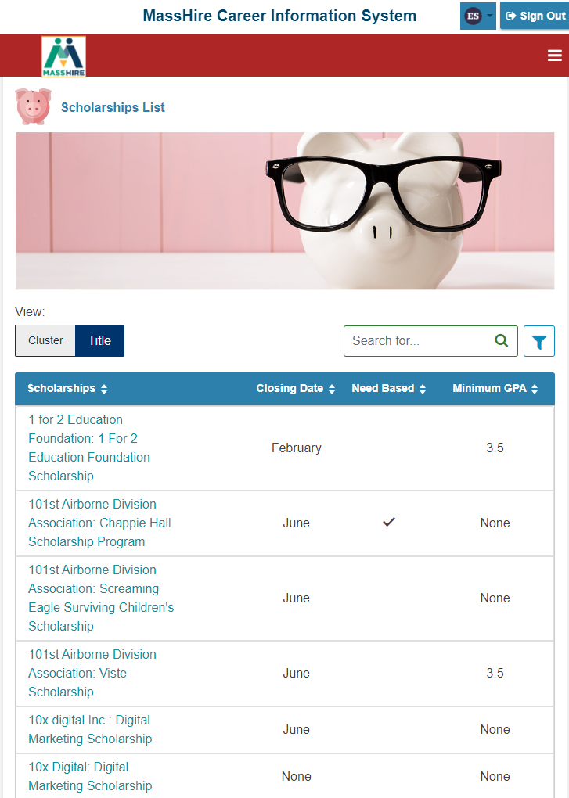
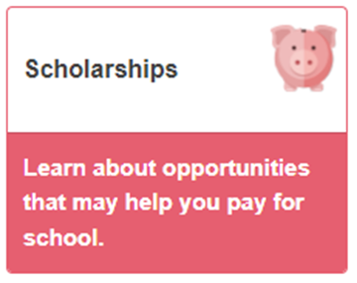
Corrections Site

Slide 39
Corrections Site
MassHire Career Information System
Standard Edition

Slide 40
“Regular MassHire CIS 360”

Slide 41
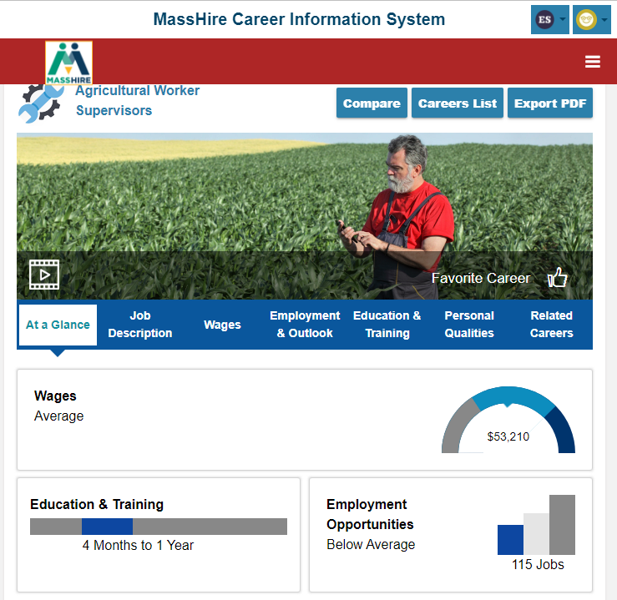

“Regular MassHire CIS 360”

Slide 42
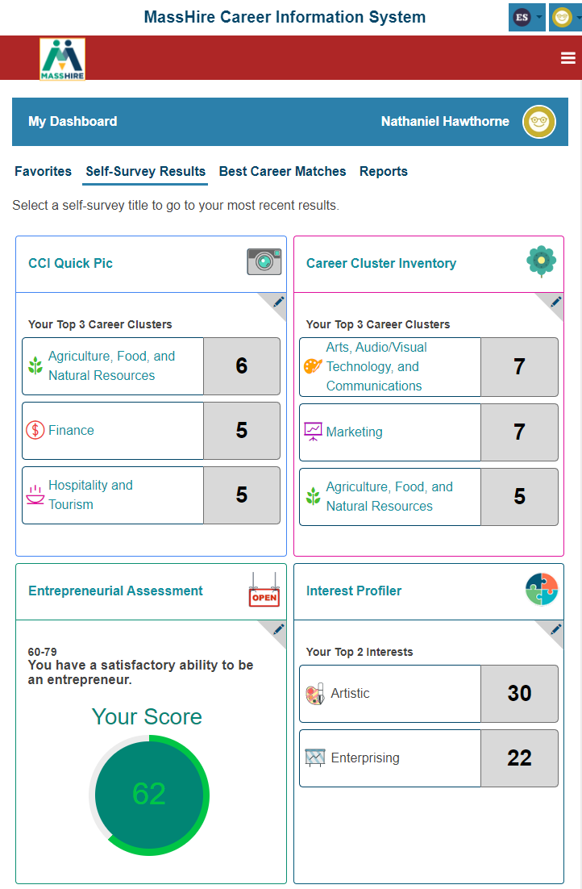
“Regular MassHire CIS 360”

Slide 43
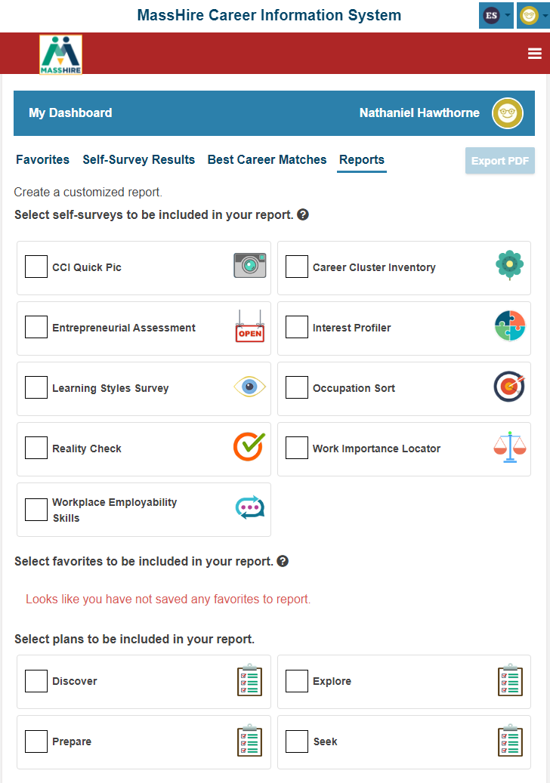
“Regular MassHire CIS 360”

Slide 44
Corrections Site
Corrections Edition
Next Steps

Slide 45
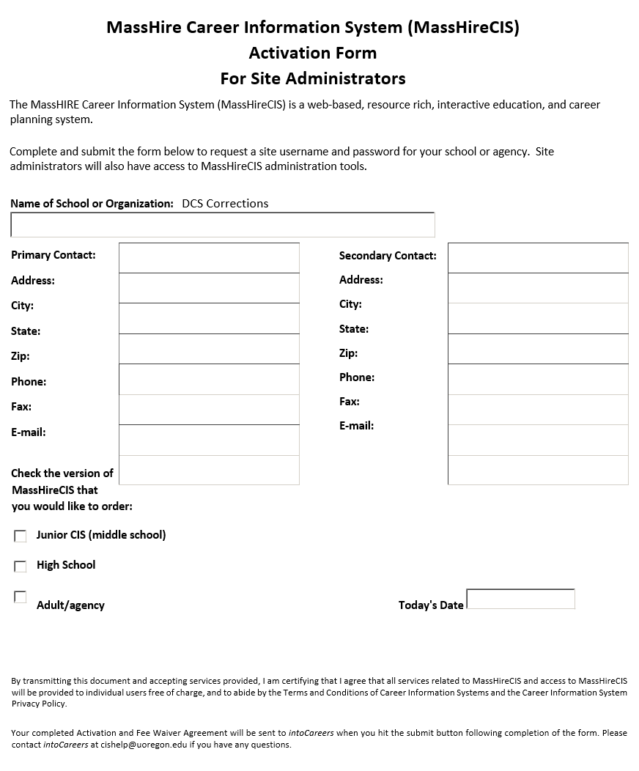
Corrections Site
Email: MassHireCIS@State.MA.US
Telephone: 617-626-6808
URL: https://portal.masscis.IntoCareers.org

Slide 46
Corrections Site
Submit Site Activation form
For
Your Correction Location / Program

Slide 47
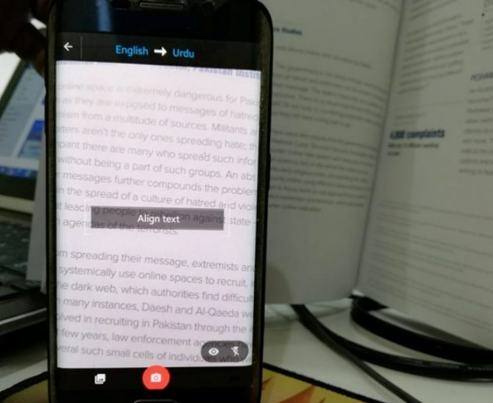

Translation

Slide 48
Contact Information
Email: MassHireCIS@State.MA.US
Telephone: 617-626-6808
URL: https://portal.masscis.IntoCareers.org

Slide 49

?
?
?
Questions and Answers
?
?
?
?
?
?
?
?

