Slide 1
Welcome to MassHire Career Information Systems

Slide 2
University of Oregon : into CAREERS

Slide 3
MassHire Career Information System
MassHire Career Information Systems is purchased with grants by the US Department of Labor (USDOL) Employment and Training Administration, it is primarily procured for the use of the Department of Career Services Career Centers, it’s partners and Massachusetts constituents. As such the trainings focus is for career center staff usage.

Slide 4
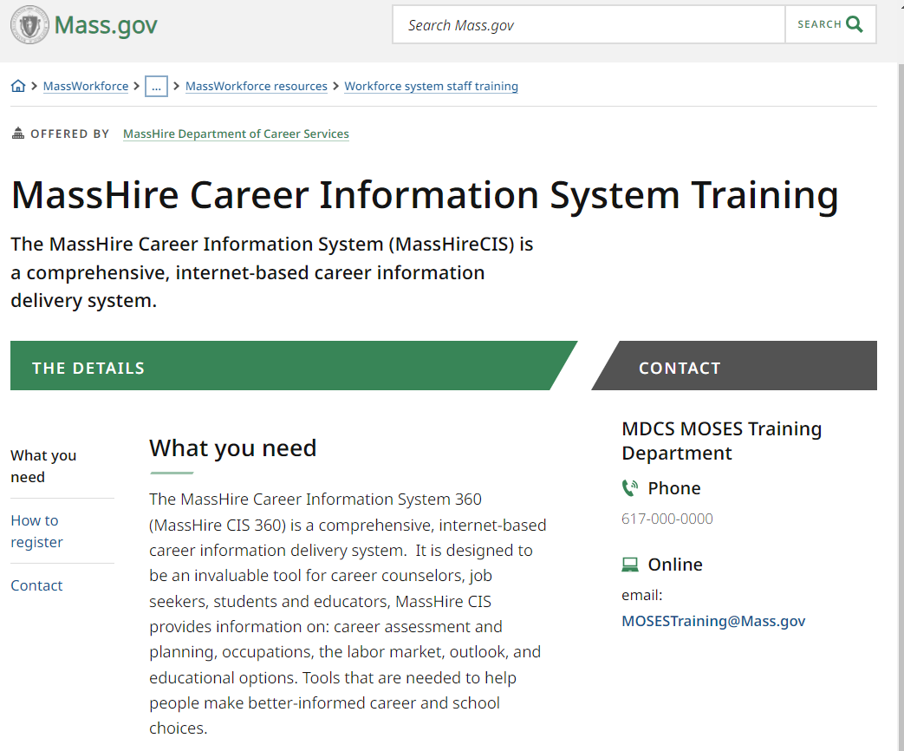
The MassHire CIS Training Calendar https://www.mass.gov/how-to/masshire-career-information-system-training

Slide 5
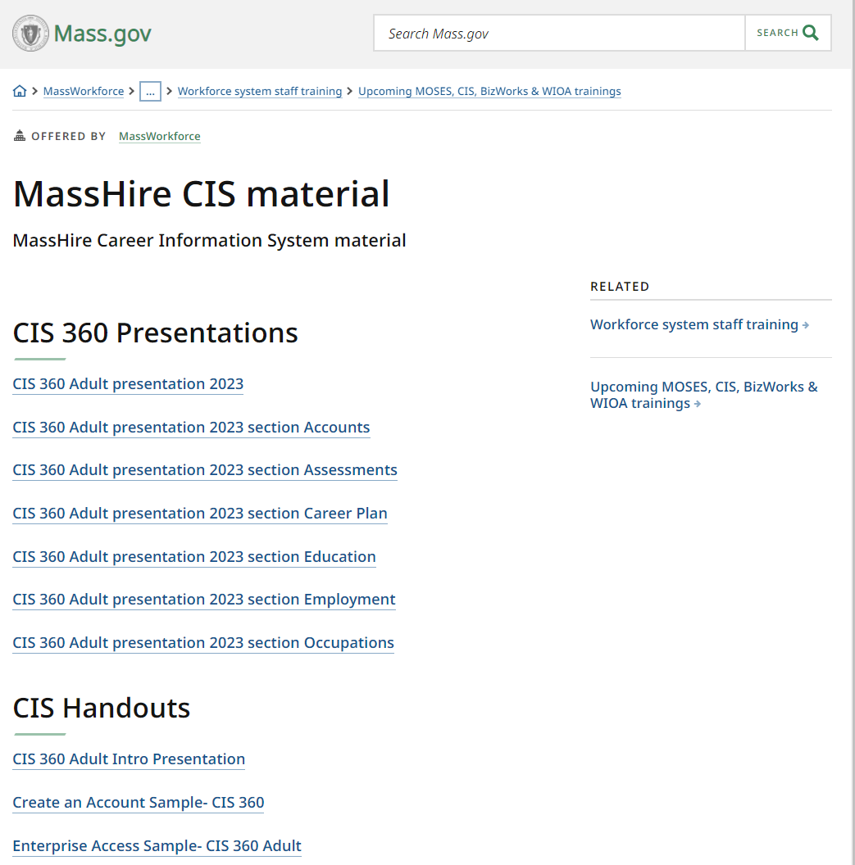
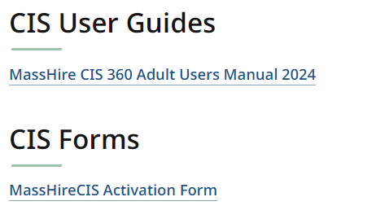
The MassHire CIS Resources https://www.mass.gov/service-details/masshire-cis-material

Slide 6
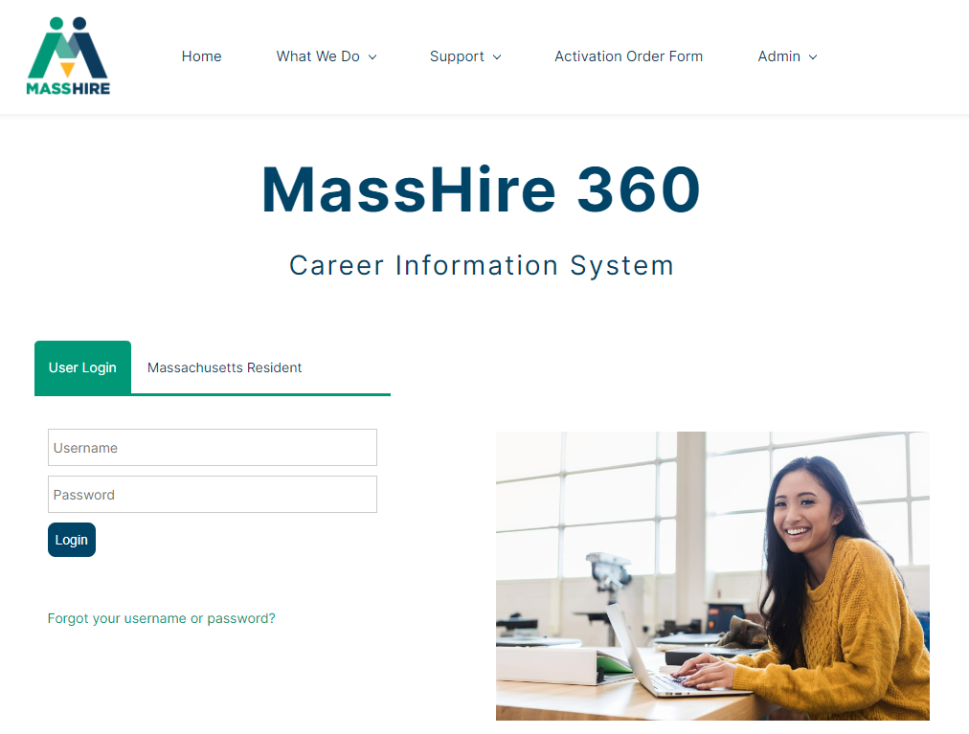
The MassHire Career Information System Portal https://portal.ma.cis360.org/

Slide 7
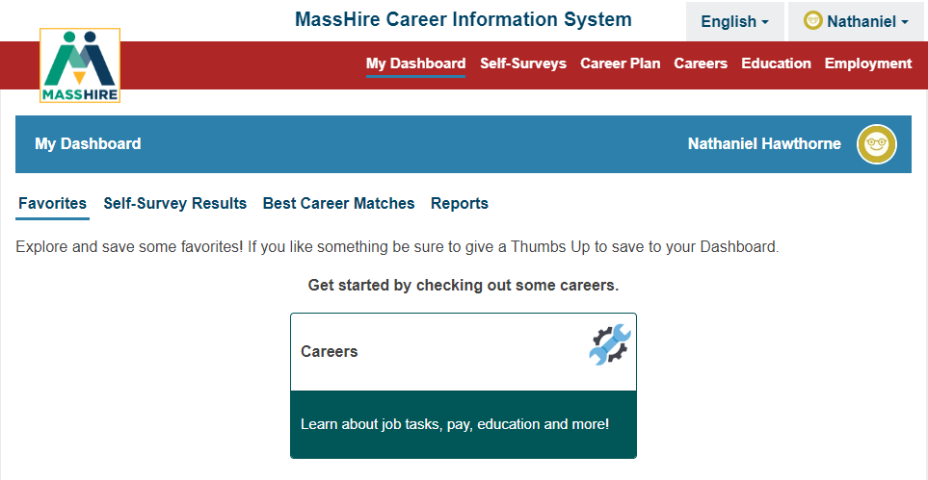
User Dashboard

Slide 8
English / Español
Note:
Español version originally done by Texas translation affiliation using Mexican Spanish

Slide 9
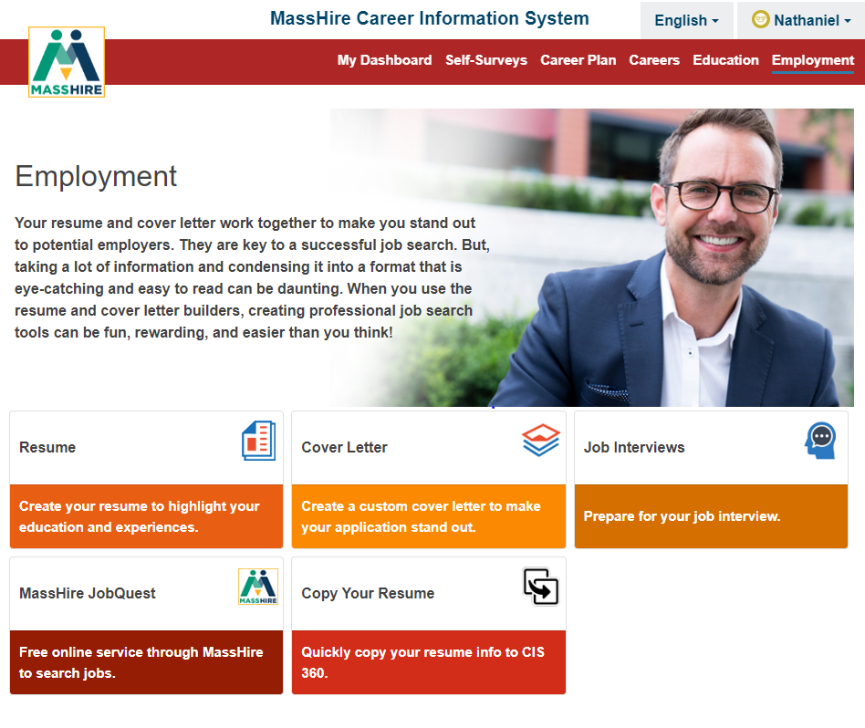
Employment

Slide 10
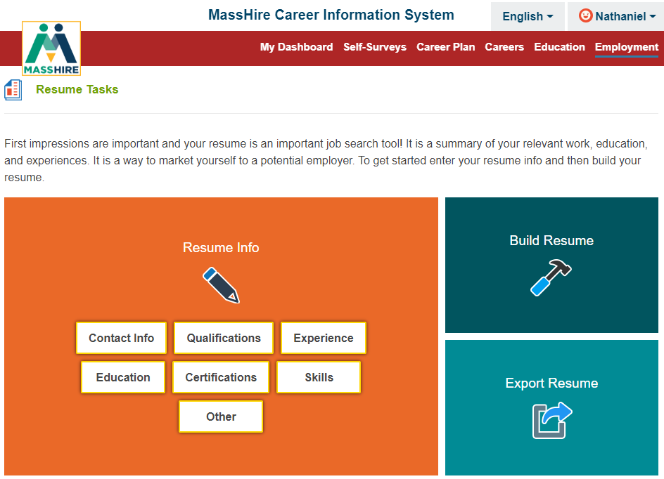
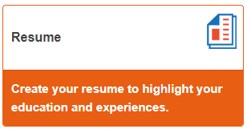
Employment

Slide 11
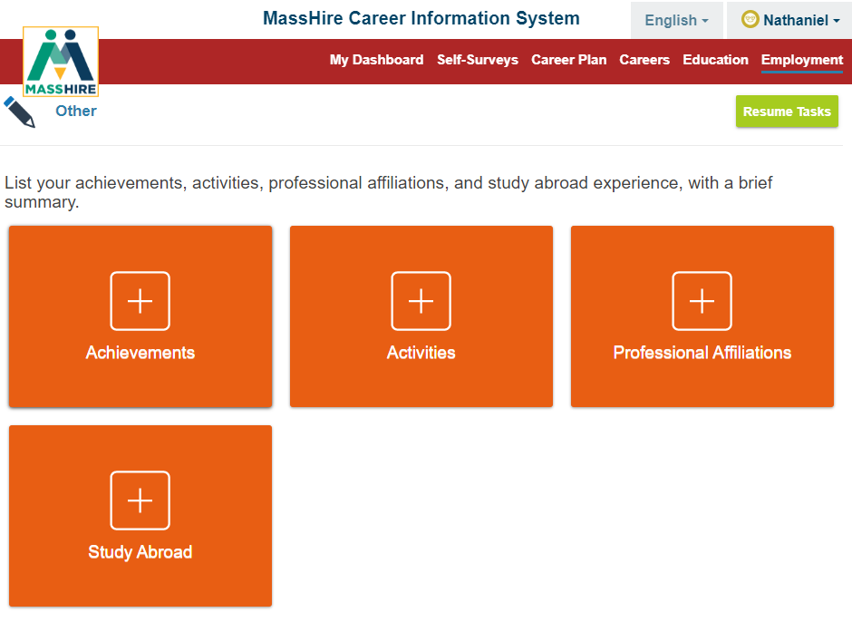
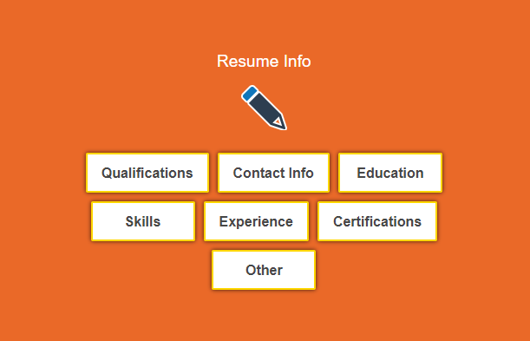
Employment

Slide 12
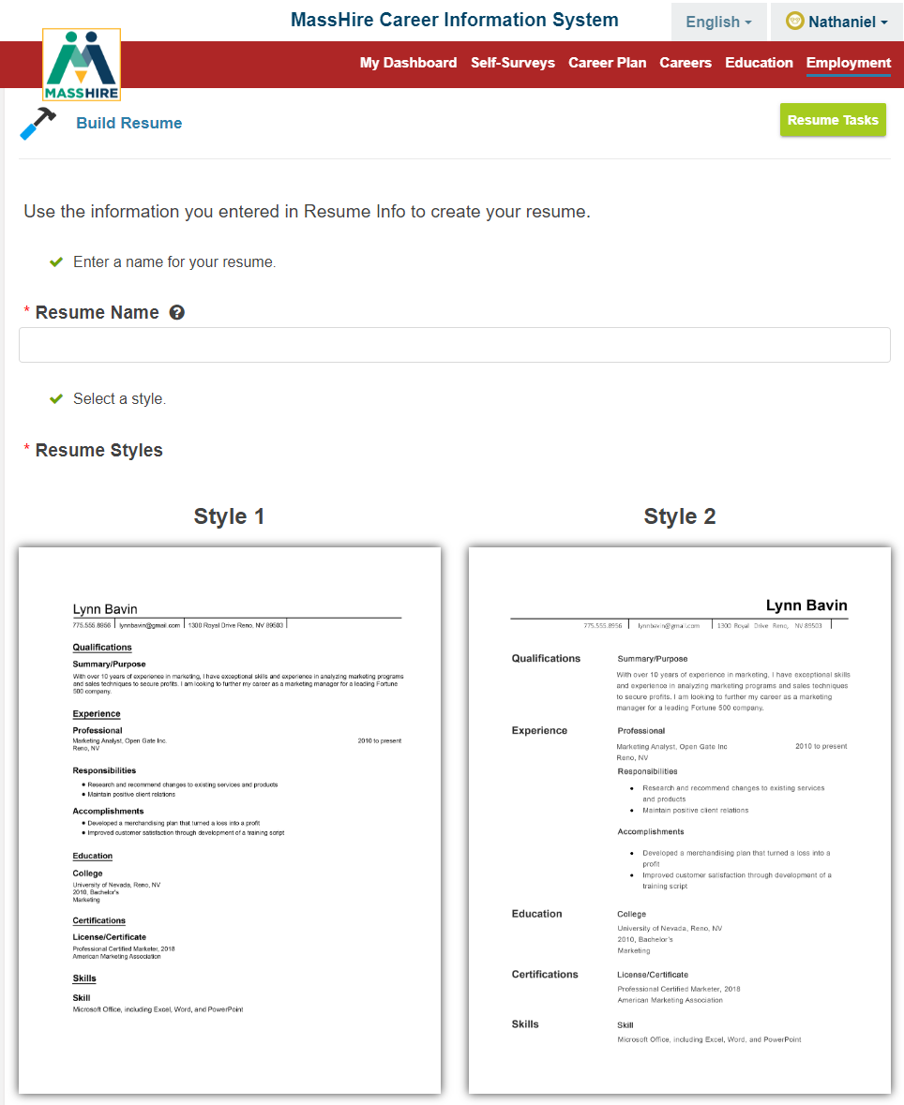
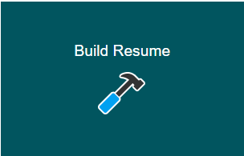
Employment

Slide 13
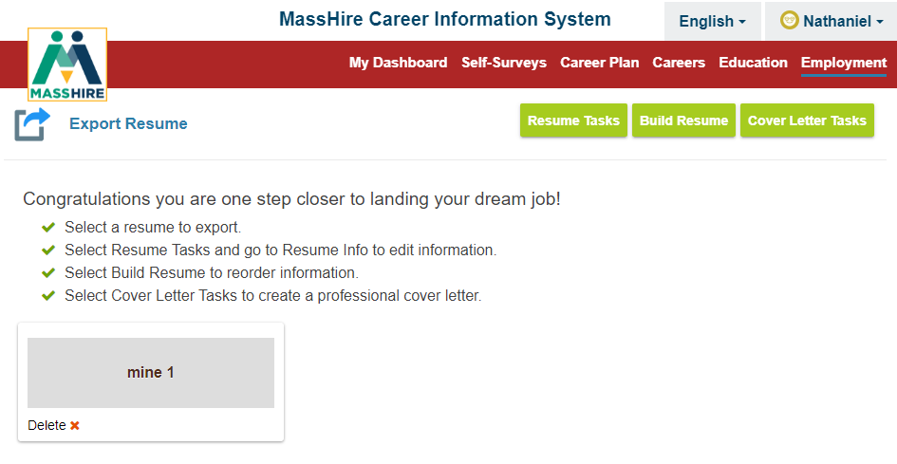
Employment

Slide 14
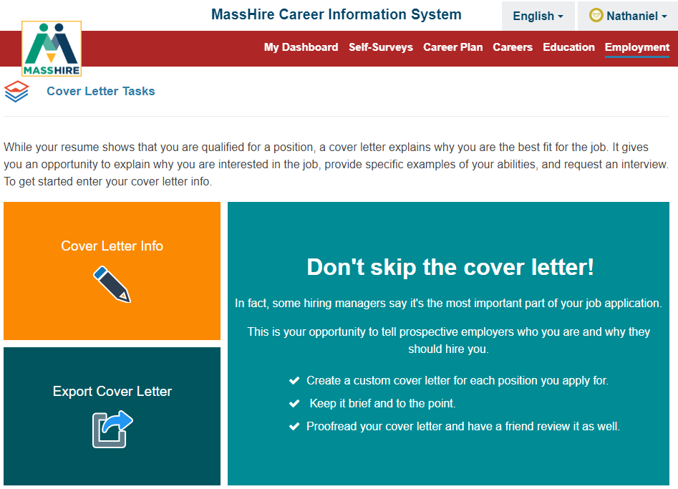
Employment

Slide 15
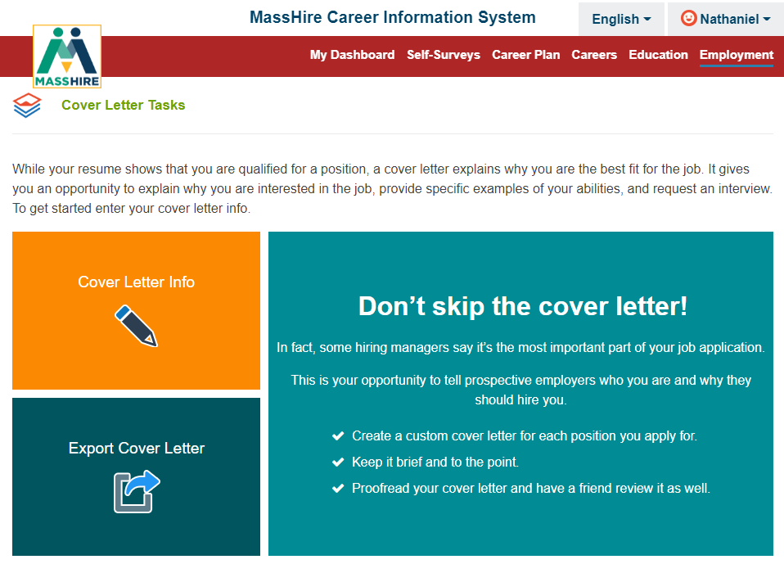
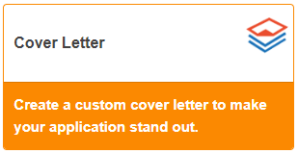
Employment

Slide 16
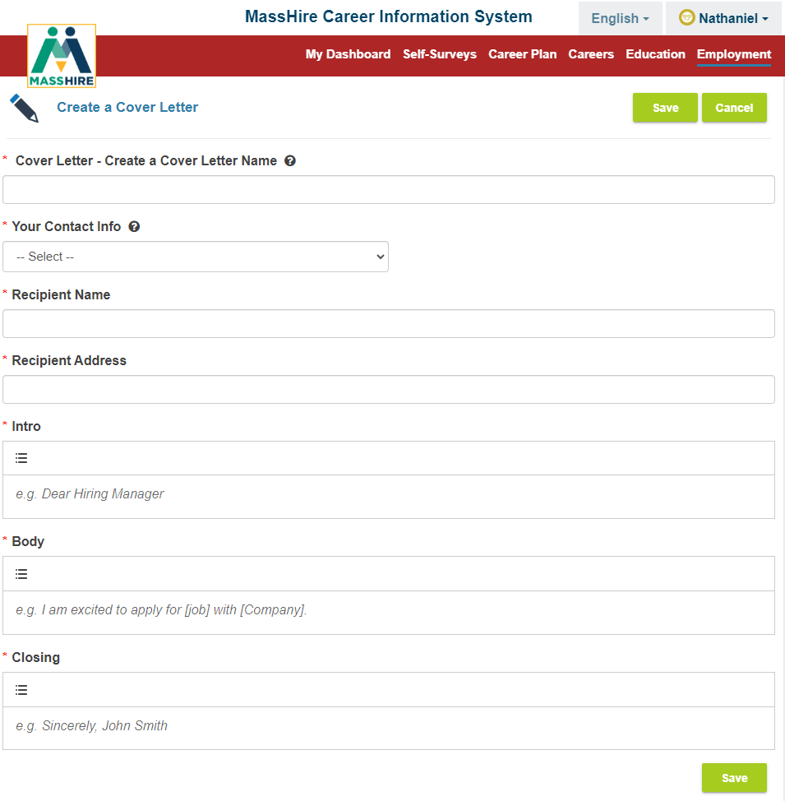
Employment

Slide 17
Employment

Slide 18
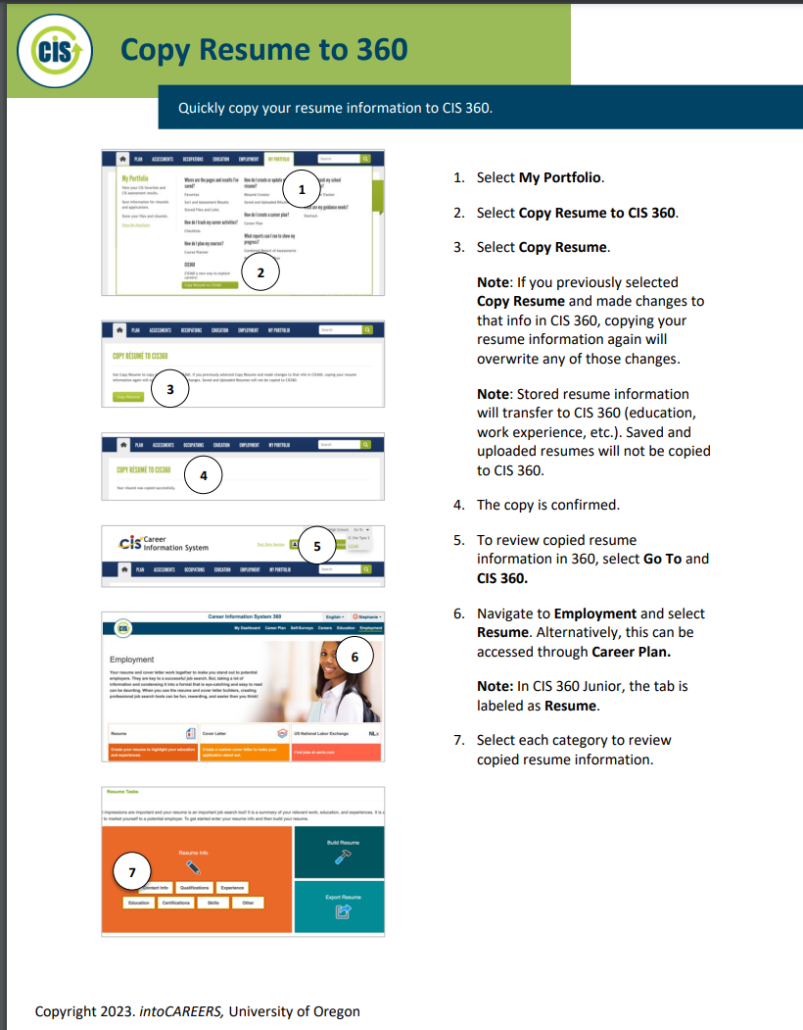
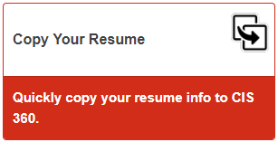
Employment

Slide 19
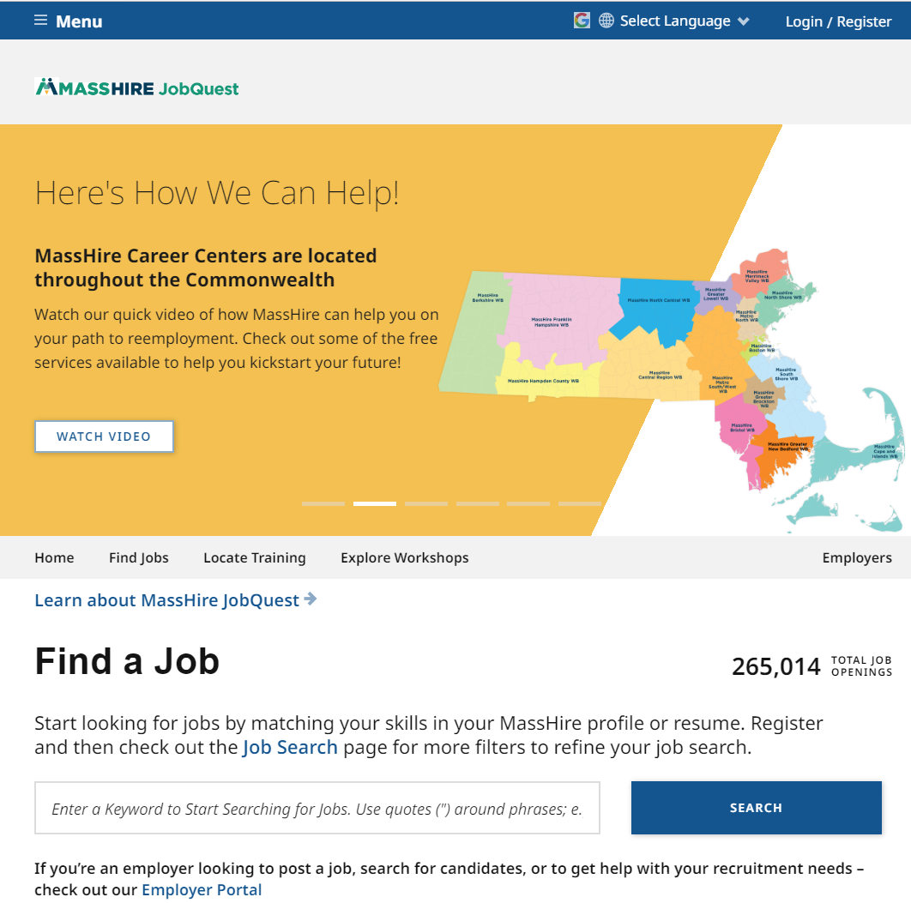
Employment

Slide 20
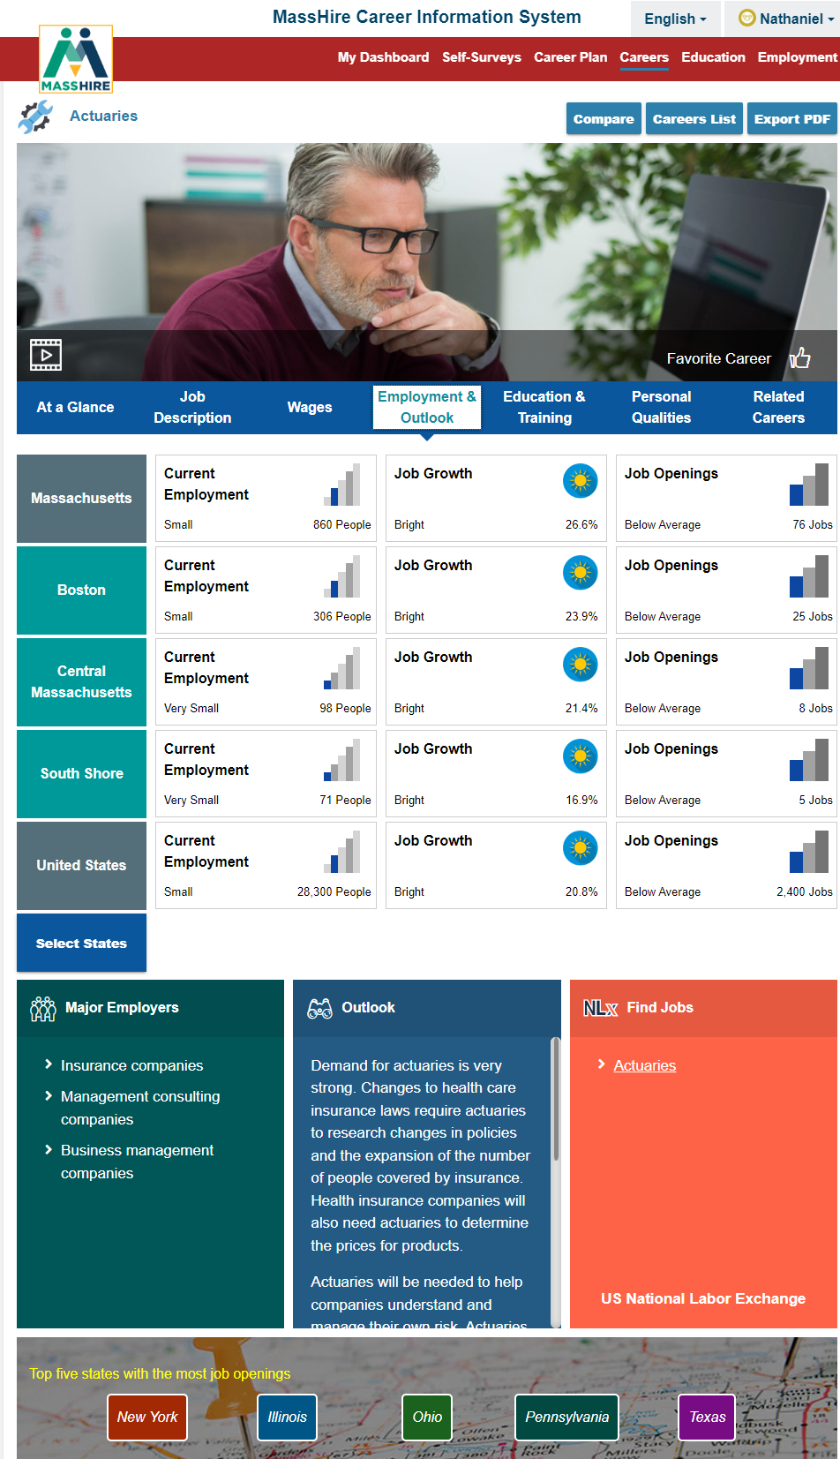
Employment
Note:
Career Plan
SEEK
Careers
Find Jobs

Slide 21
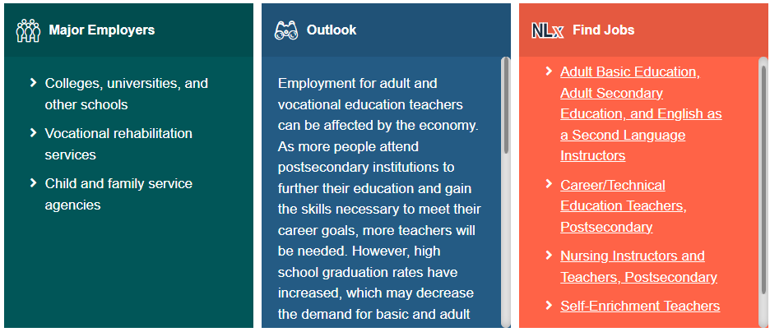
Employment
Note:
Career Plan
SEEK
Careers
Find Jobs

Slide 22
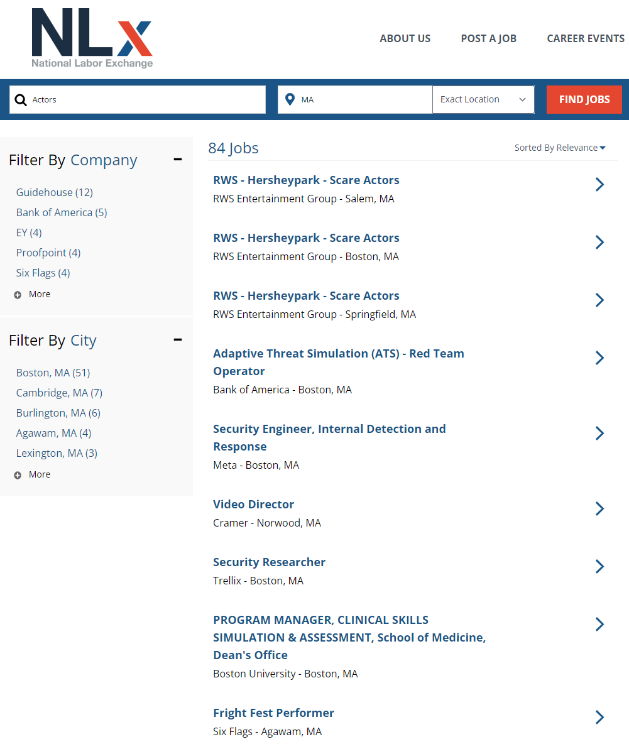
Employment
Note:
Career Plan
SEEK
Careers
Find Jobs
NLx

Slide 23
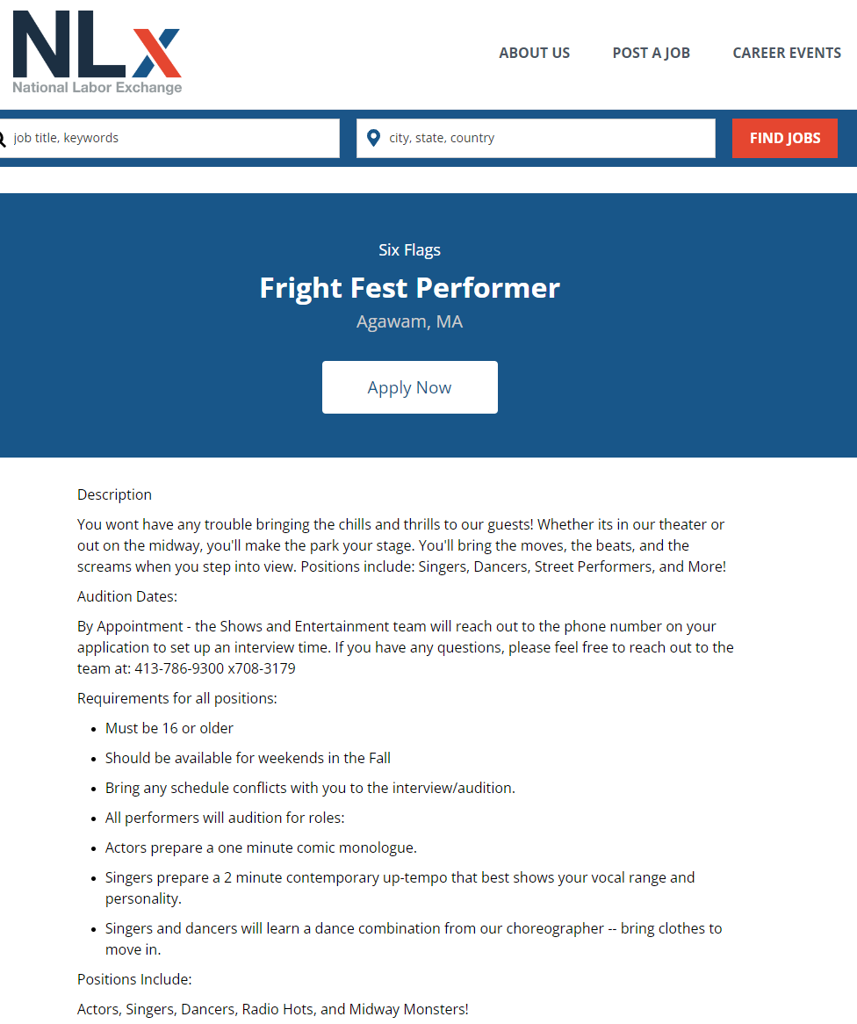
Employment
Note:
Career Plan
SEEK
Careers
Find Jobs
NLx

Slide 24
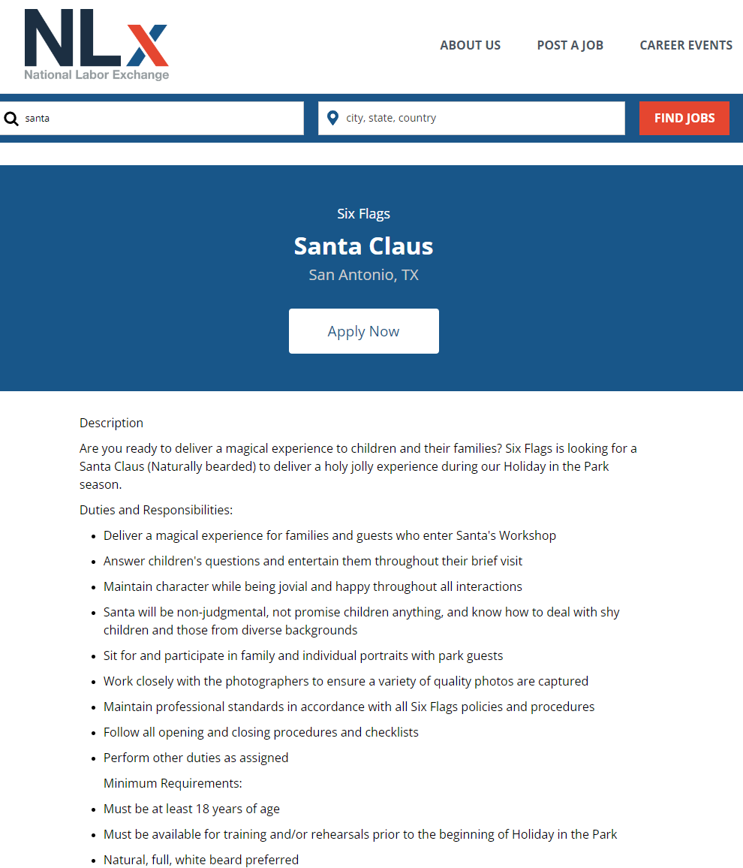
Employment
Note:
Career Plan
SEEK
Careers
Find Jobs
NLx

Slide 25
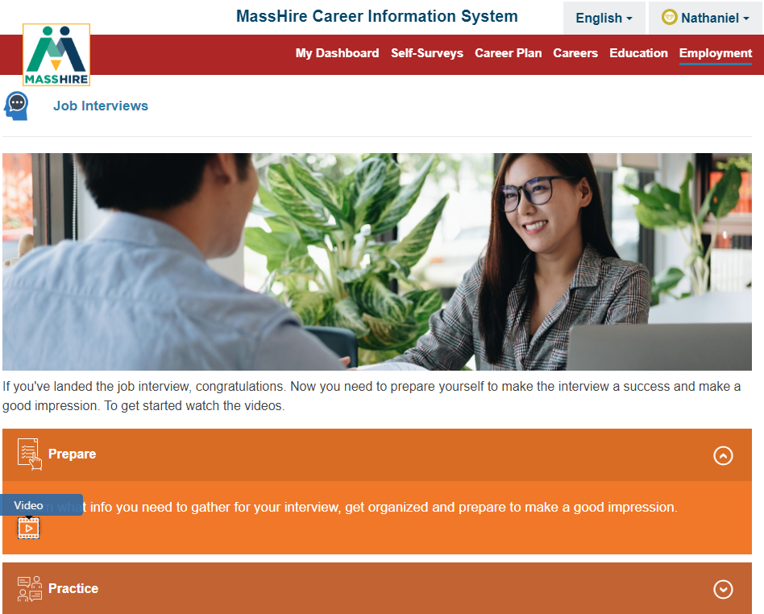
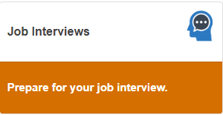
Employment

Slide 26
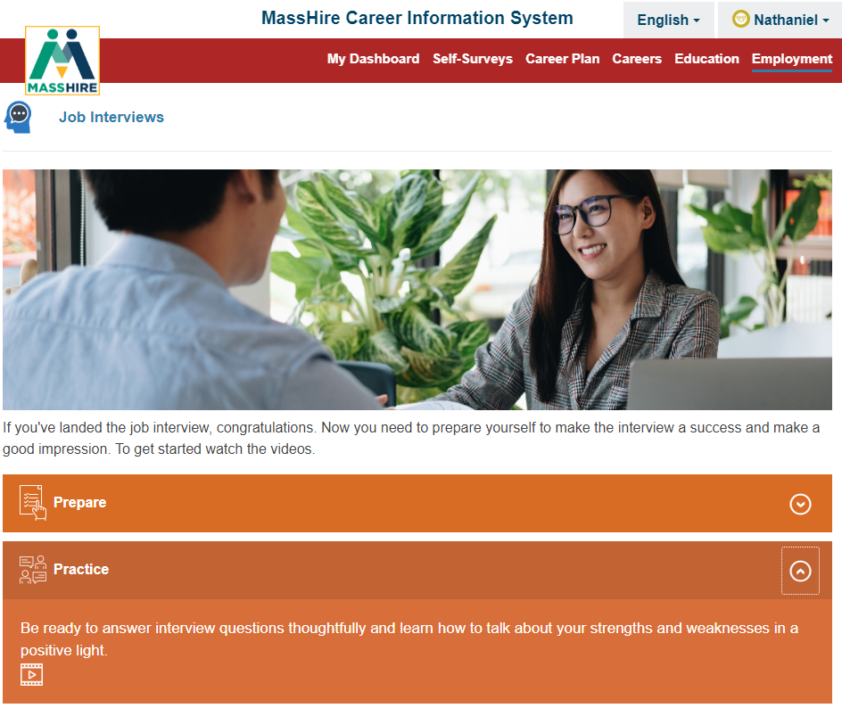
Employment

Slide 27
Employment

Slide 28
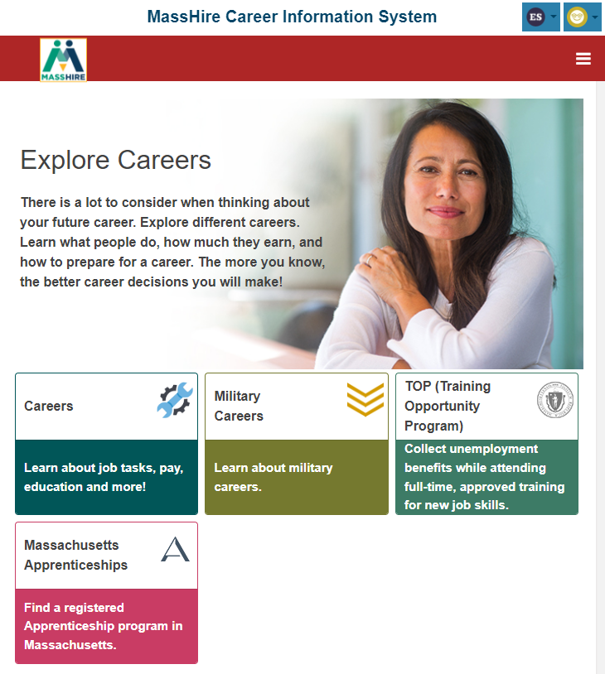
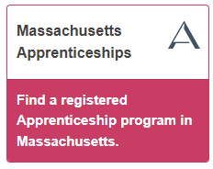
Careers

Slide 29
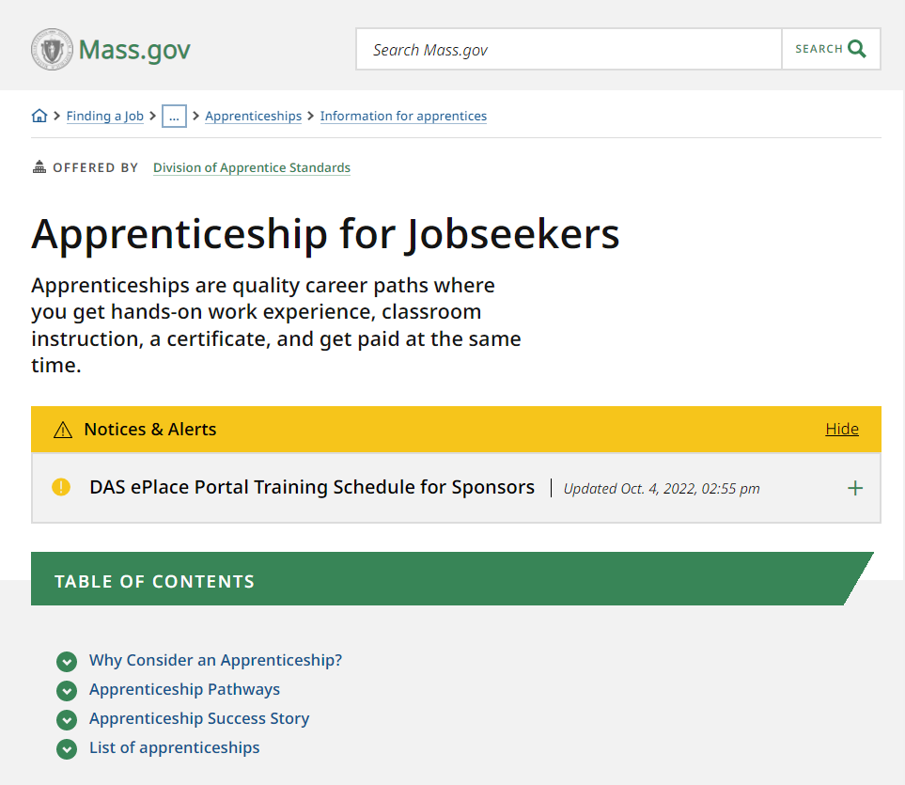
Careers

Slide 30
Translation

Slide 31
Contact Information
Email: MassHireCIS@State.MA.US
Telephone: 617-626-6808
URL: https://portal.masscis.IntoCareers.org

Slide 32
?
?
?
Questions and Answers
?
?
?
?
?
?
?
?

