Slide 1

MassHire Career Information Systems 360
The Corrections Site
  MassHire Programs & Services are funded in full by US Department of Labor (USDOL) Employment and Training Administration grants. (Additional details furnished upon request.)

Slide 2

University of Oregon : into CAREERS

Slide 3

MassHire Career Information System
MassHire Career Information Systems 360 is purchased with grants by the US Department of Labor (USDOL) Employment and Training Administration, it is primarily procured for the use of the Department of Career Services Career Centers, it’s partners and Massachusetts constituents. As such the trainings focus is for career center staff usage.

Slide 4
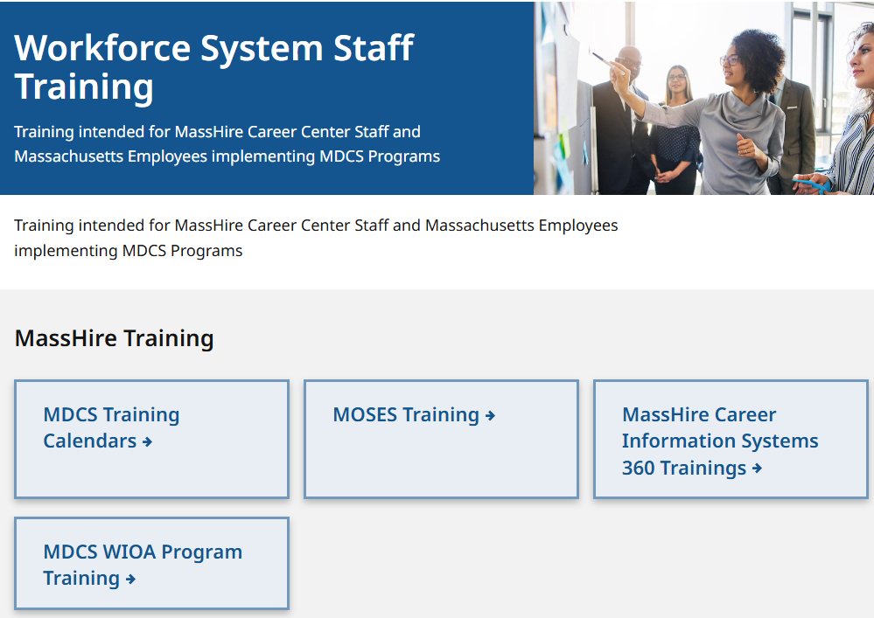
The MassHire CIS Training Calendar https://www.mass.gov/workforce-system-staff-training

Slide 5
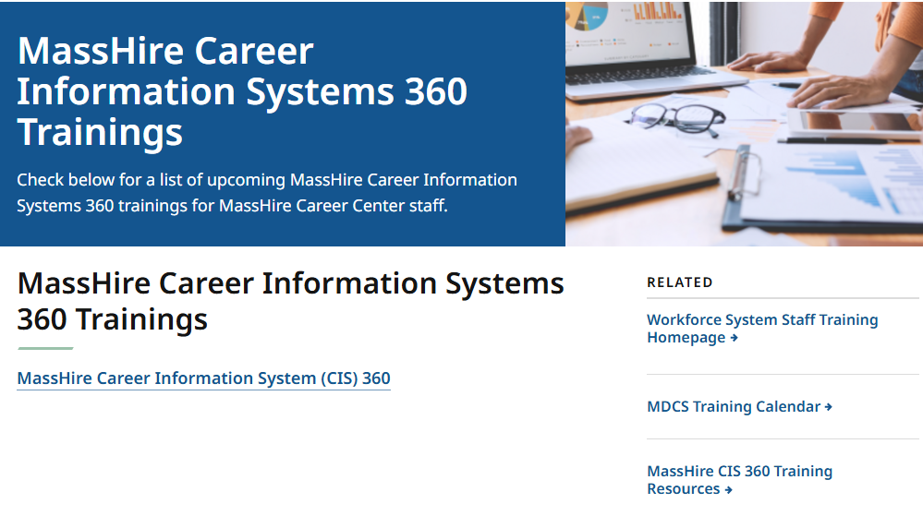
The MassHire CIS Training Calendar https://www.mass.gov/info-details/masshire-career-information-systems-360-trainings

Slide 6
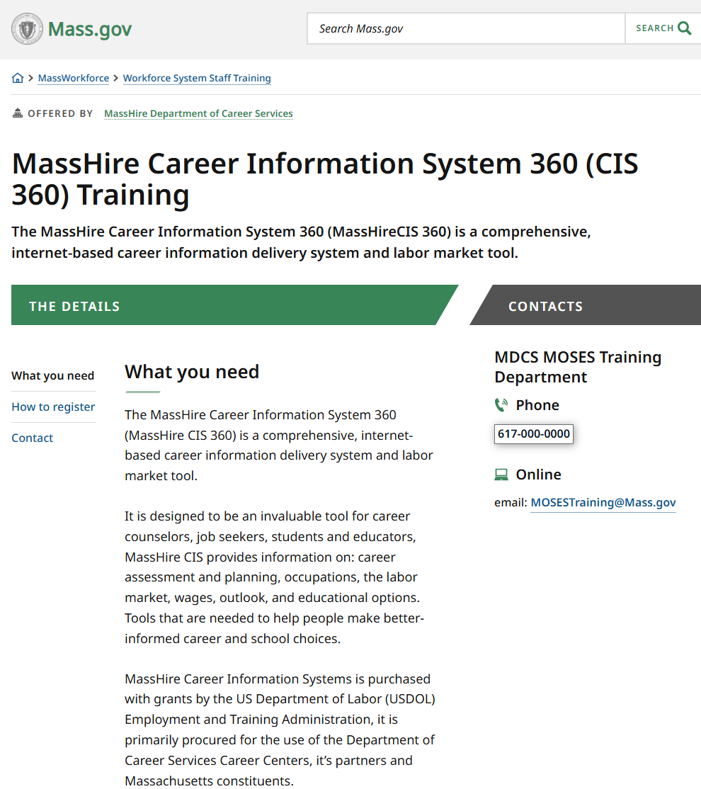
The MassHire CIS Training Calendar https://www.mass.gov/how-to/masshire-career-information-system-360-cis-360-training

Slide 7
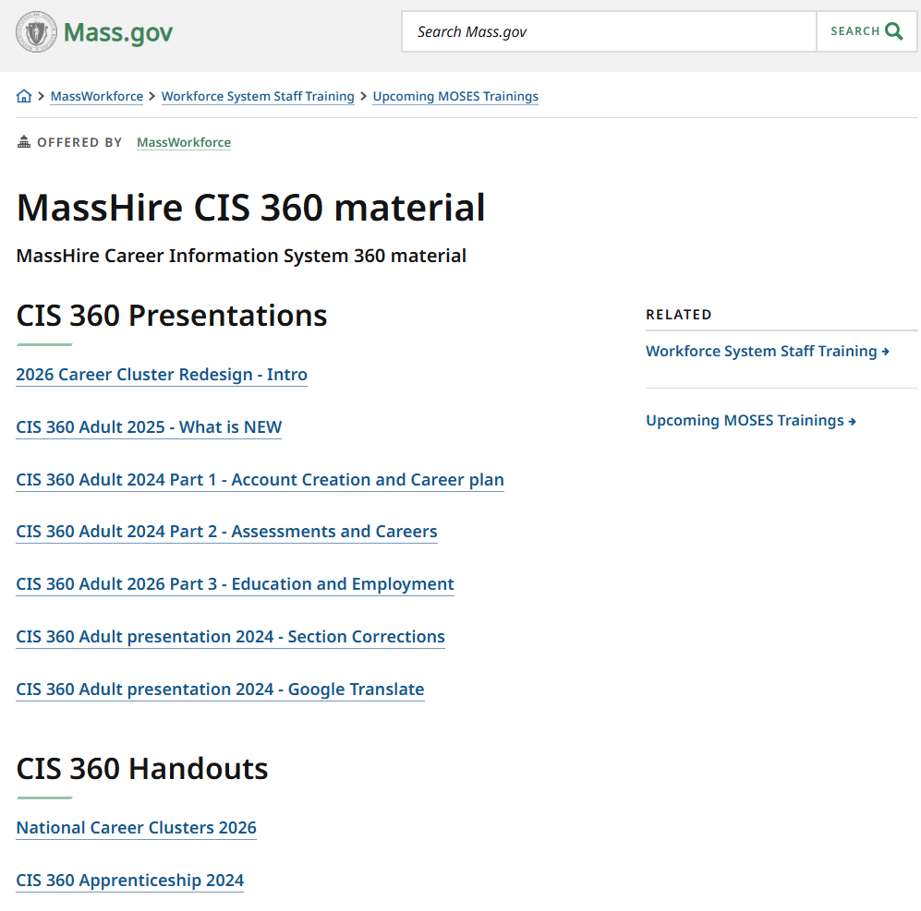
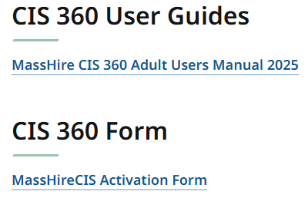
The MassHire CIS Resources https://www.mass.gov/info-details/masshire-cis-360-material

Slide 8
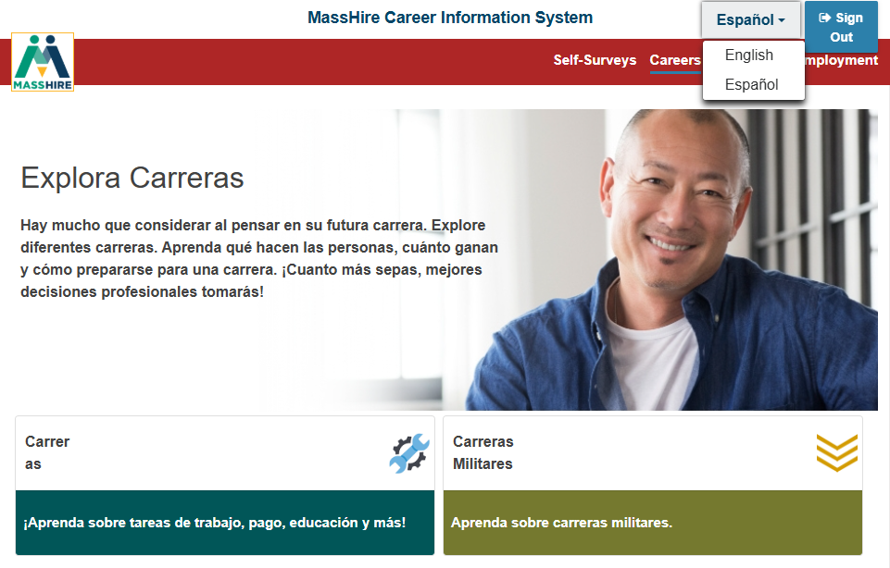
English / Español
Note:
Español version originally done by Texas translation affiliation using Mexican Spanish

Slide 9


Translation

Slide 10

The MassHire Career Information System Portal https://portal.ma.cis360.org/

Slide 11
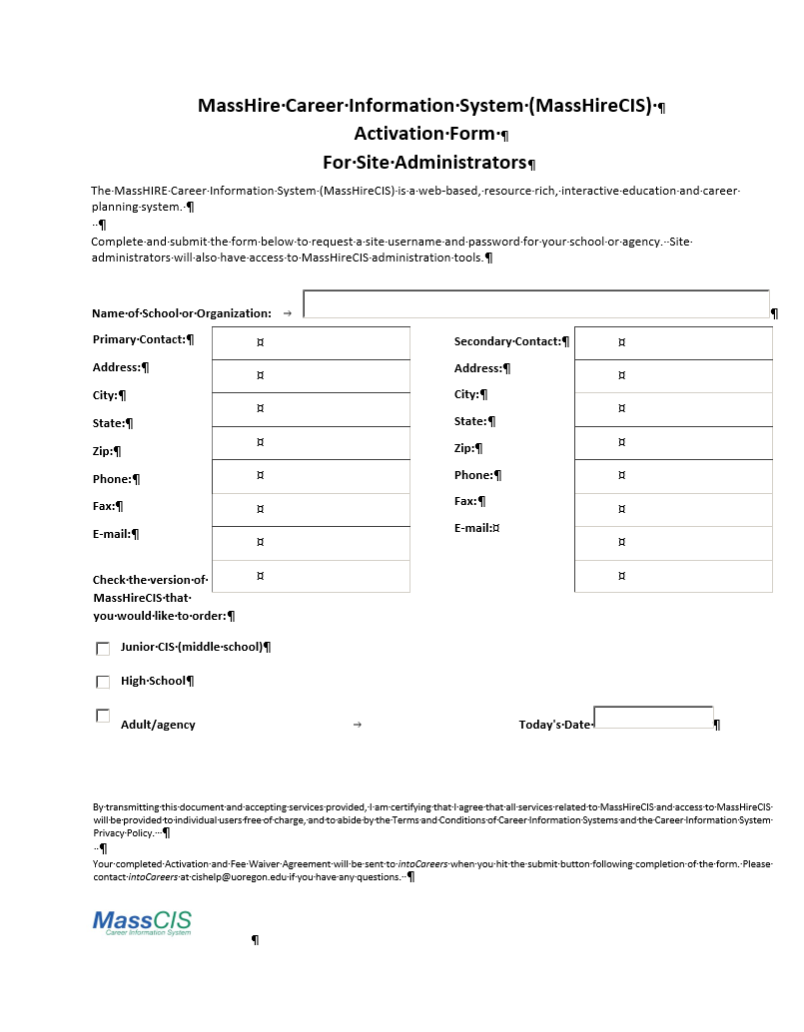
CIS 360 Activation Form
https://portal.ma.cis360.org/
Email to:
MassHireCIS@State.MA.US

Slide 12
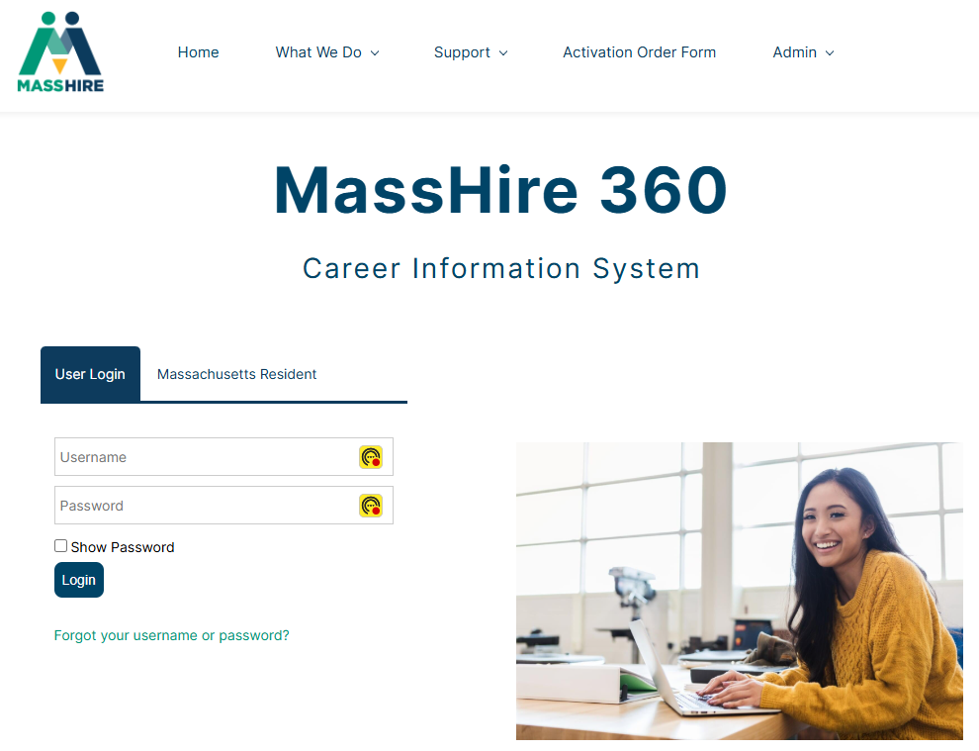
Log In with account

Slide 13
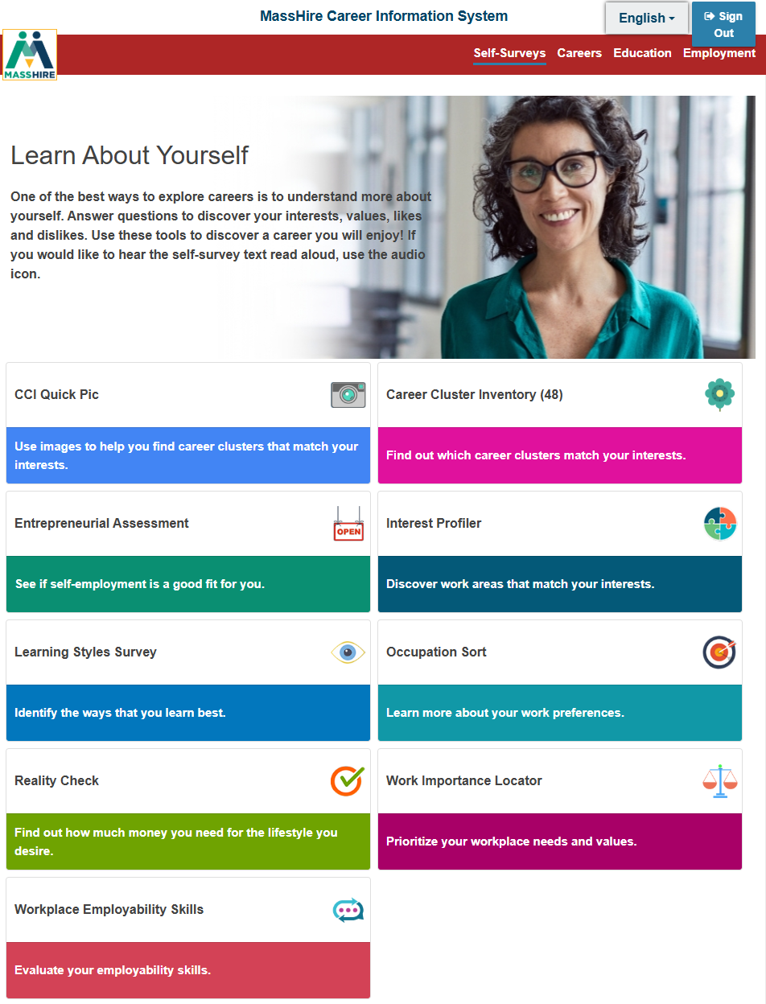
Corrections Site
No log in account /
No Personal account

Slide 14
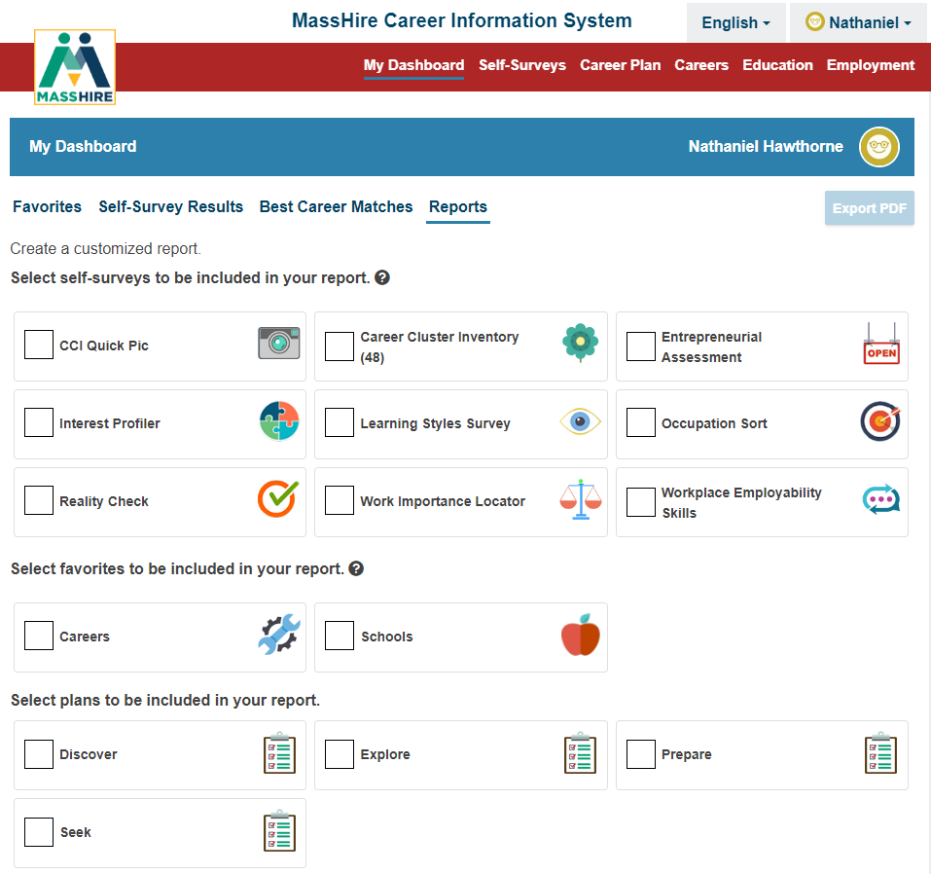
“Regular MassHire CIS 360”
Has Log in account /
Personal account

Slide 15
Corrections Site
Has only four options:
    Self Surveys
    Careers (Occupations)
    Education (Schools)
    Employment

Slide 16
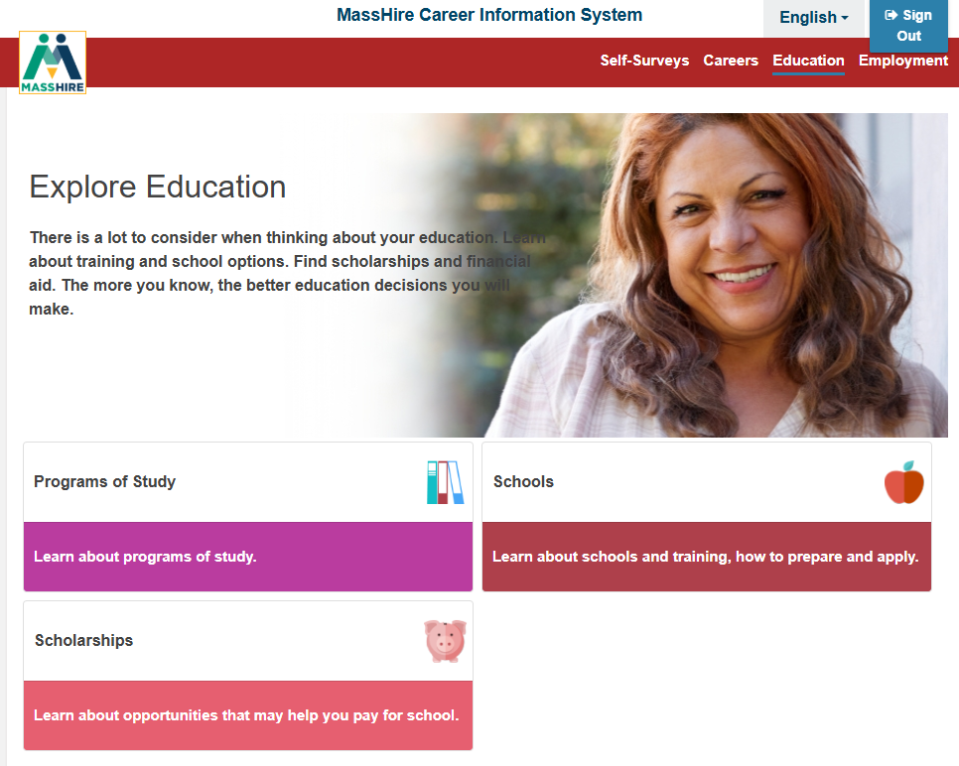
Corrections Site
Omitted:
Federal Student Aid

Slide 17
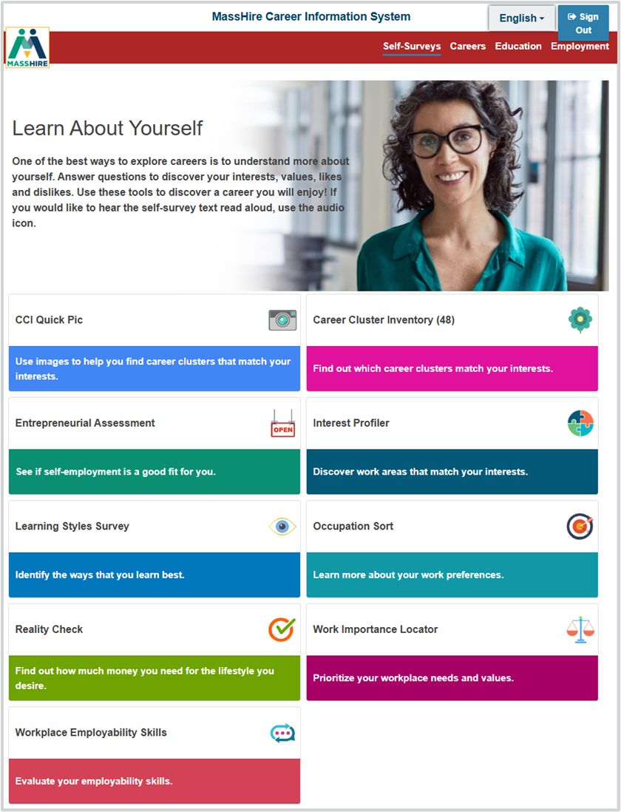
Corrections Site
All nine surveys available
You can not save them, except as a print out

Slide 18
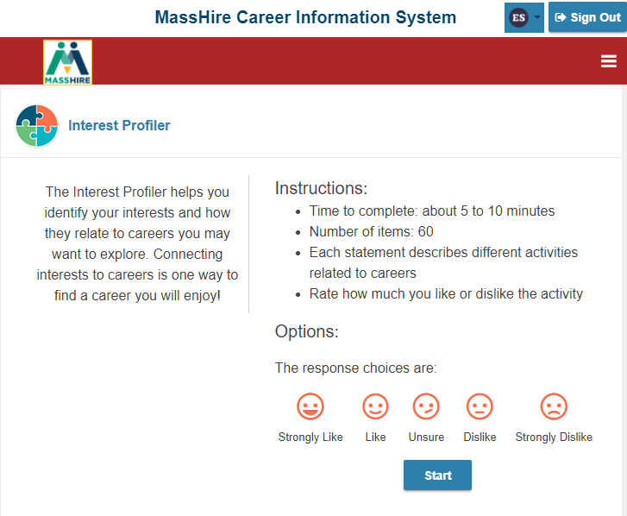
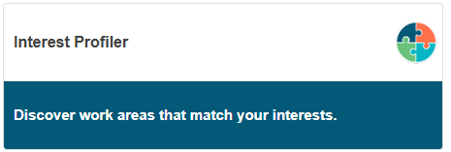
Corrections Site

Slide 19
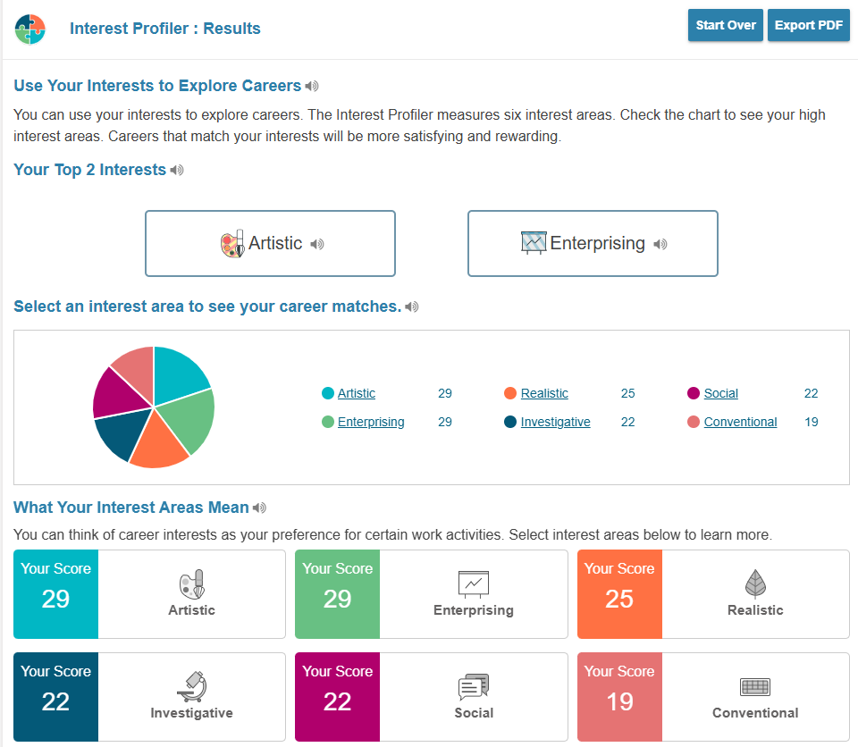
Corrections Site

Slide 20
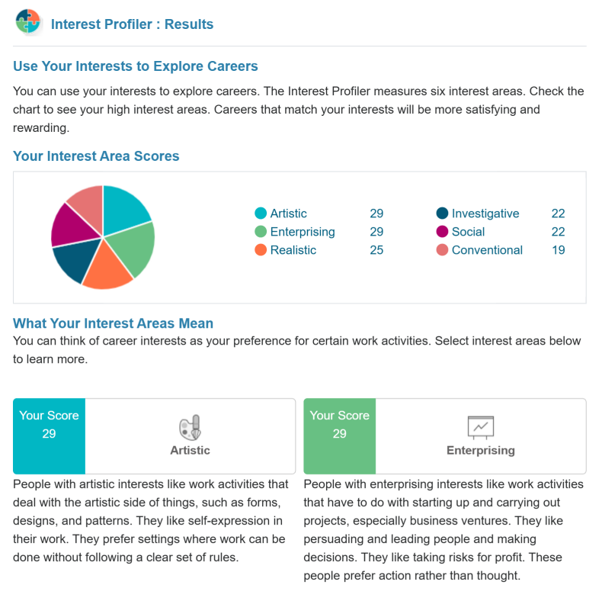
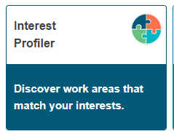
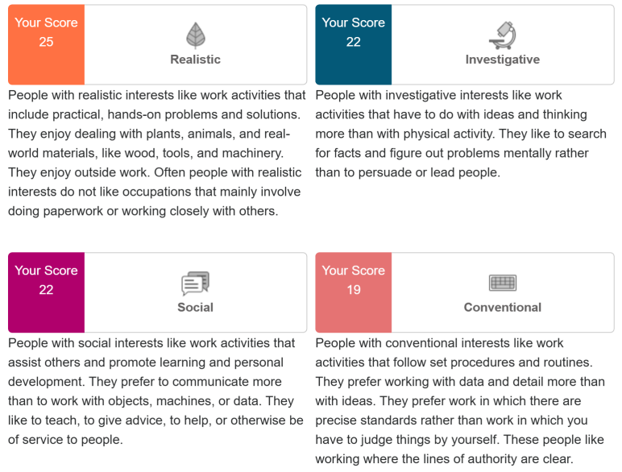

Corrections Site

Slide 21
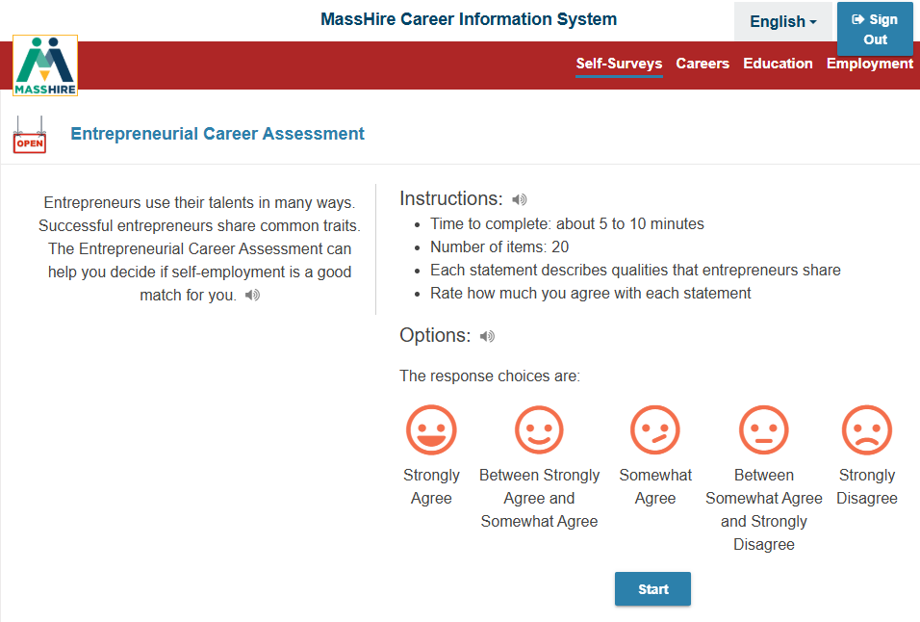
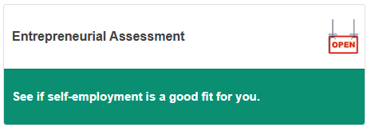
Corrections Site

Slide 22
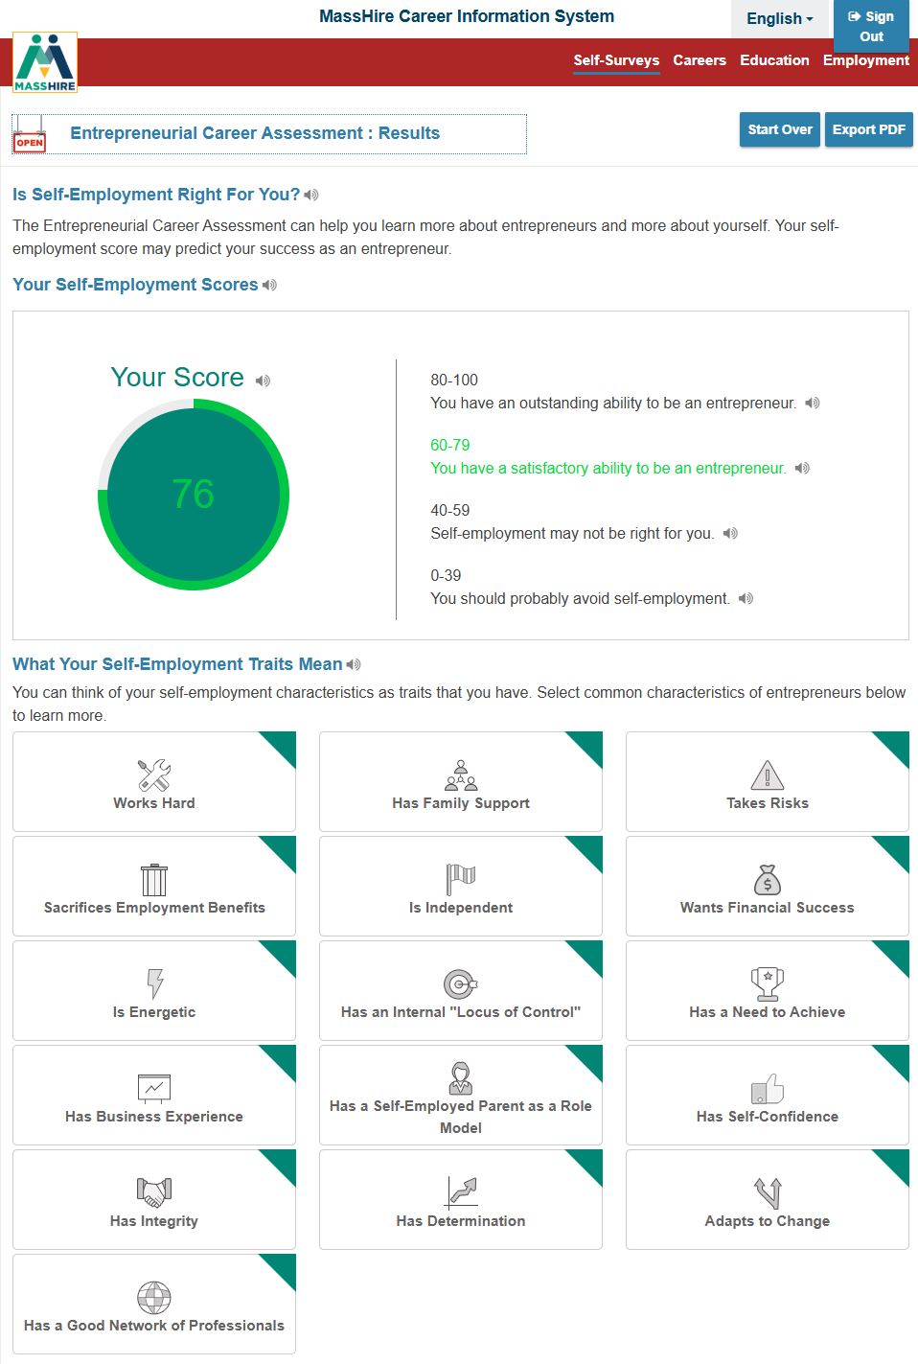
Corrections Site

Slide 23
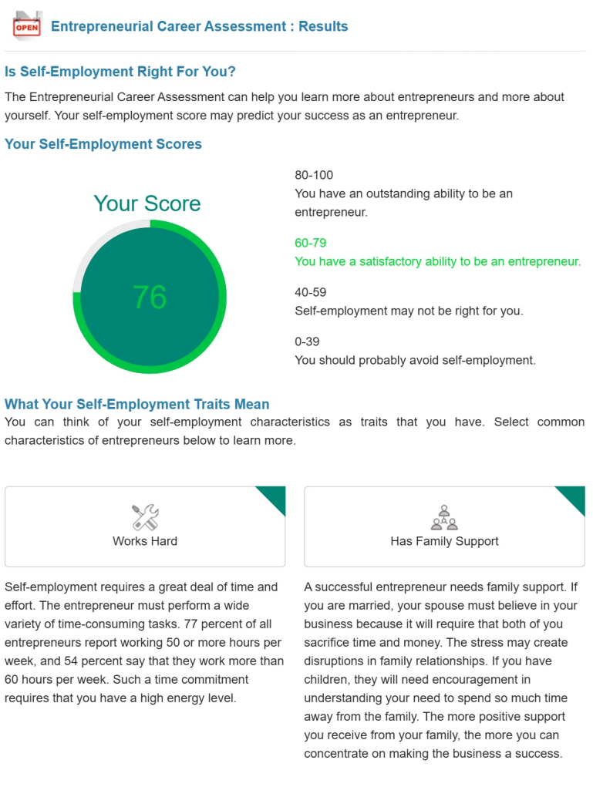
Corrections Site

Slide 24
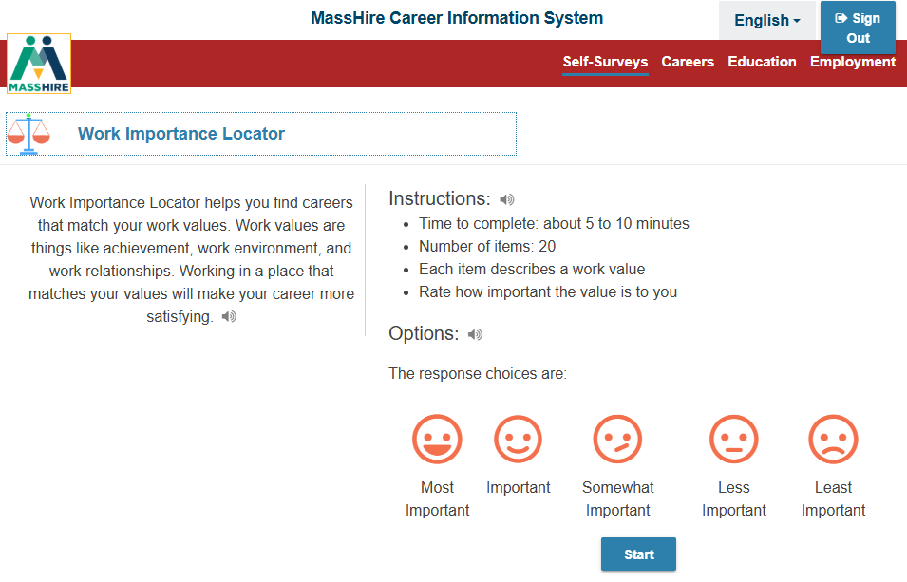
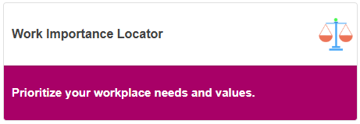
Corrections Site

Slide 25
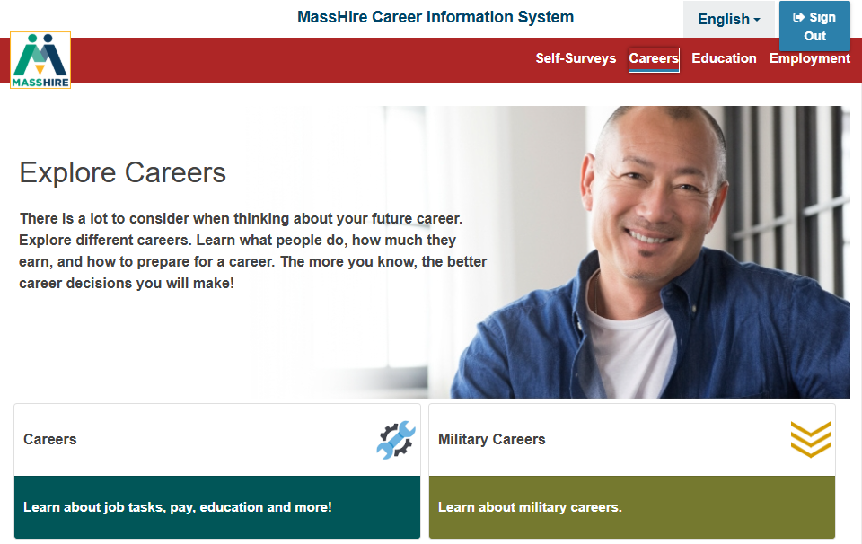
Corrections
Site
Careers
Omitted:
Massachusetts Apprenticeships
Training Opportunity Program

Slide 26
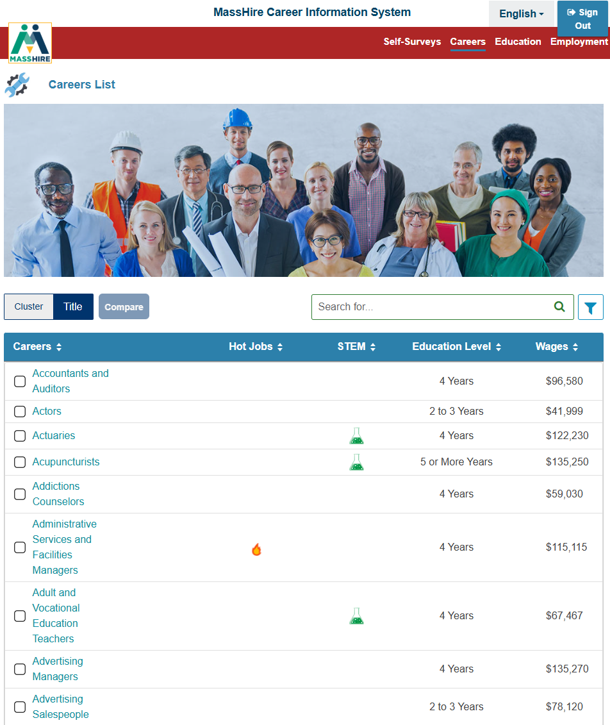
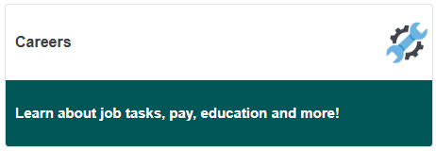
Corrections Site
List of all Careers

Slide 27
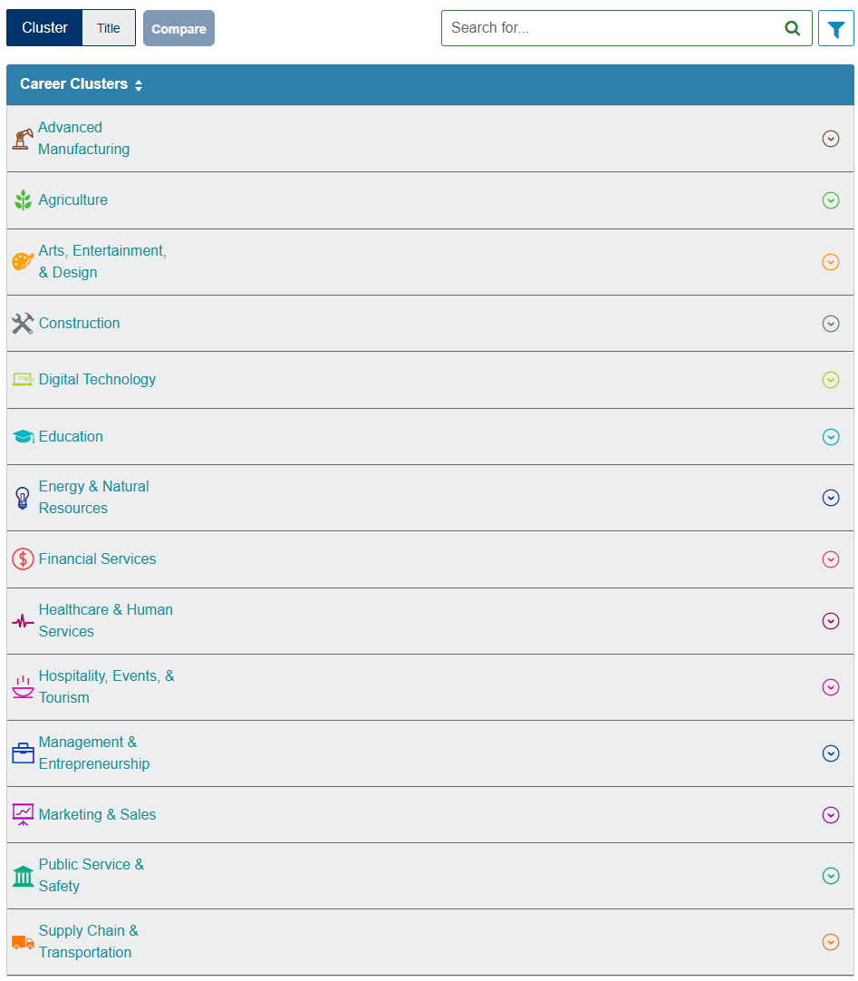
Corrections Site
List of the New Career Clusters

Slide 28
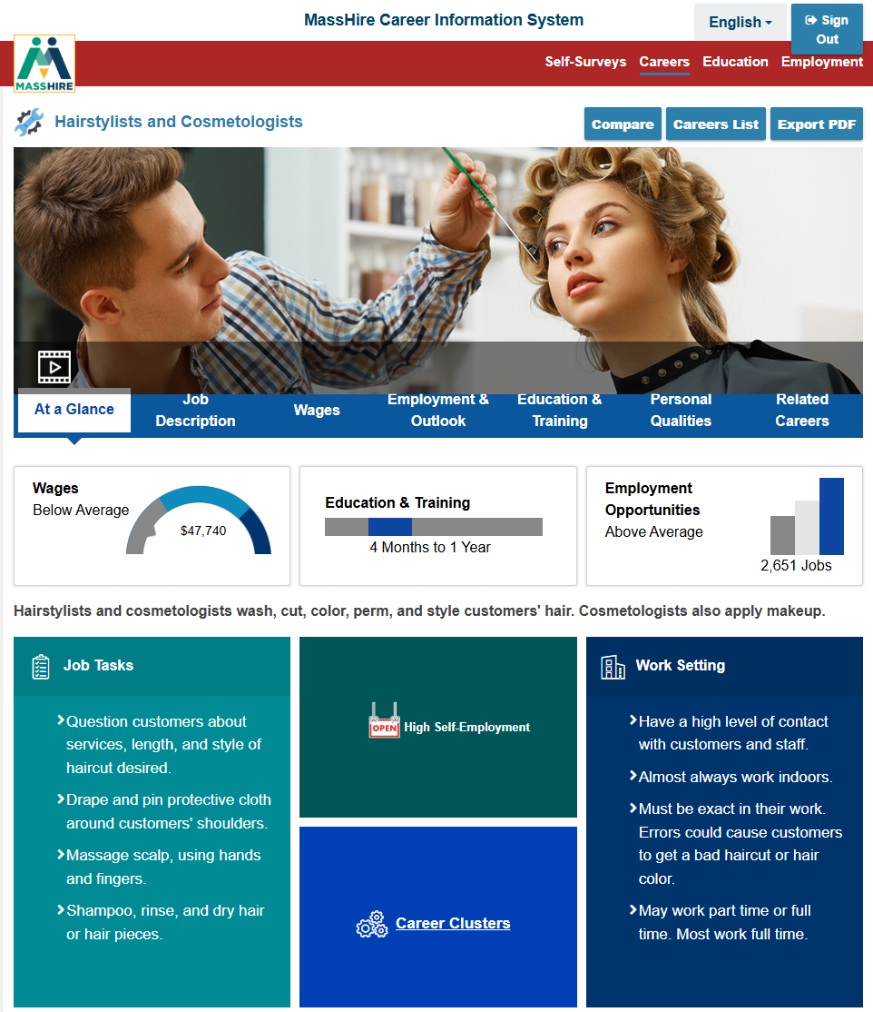
Corrections Site
Careers: At a Glance

Slide 29
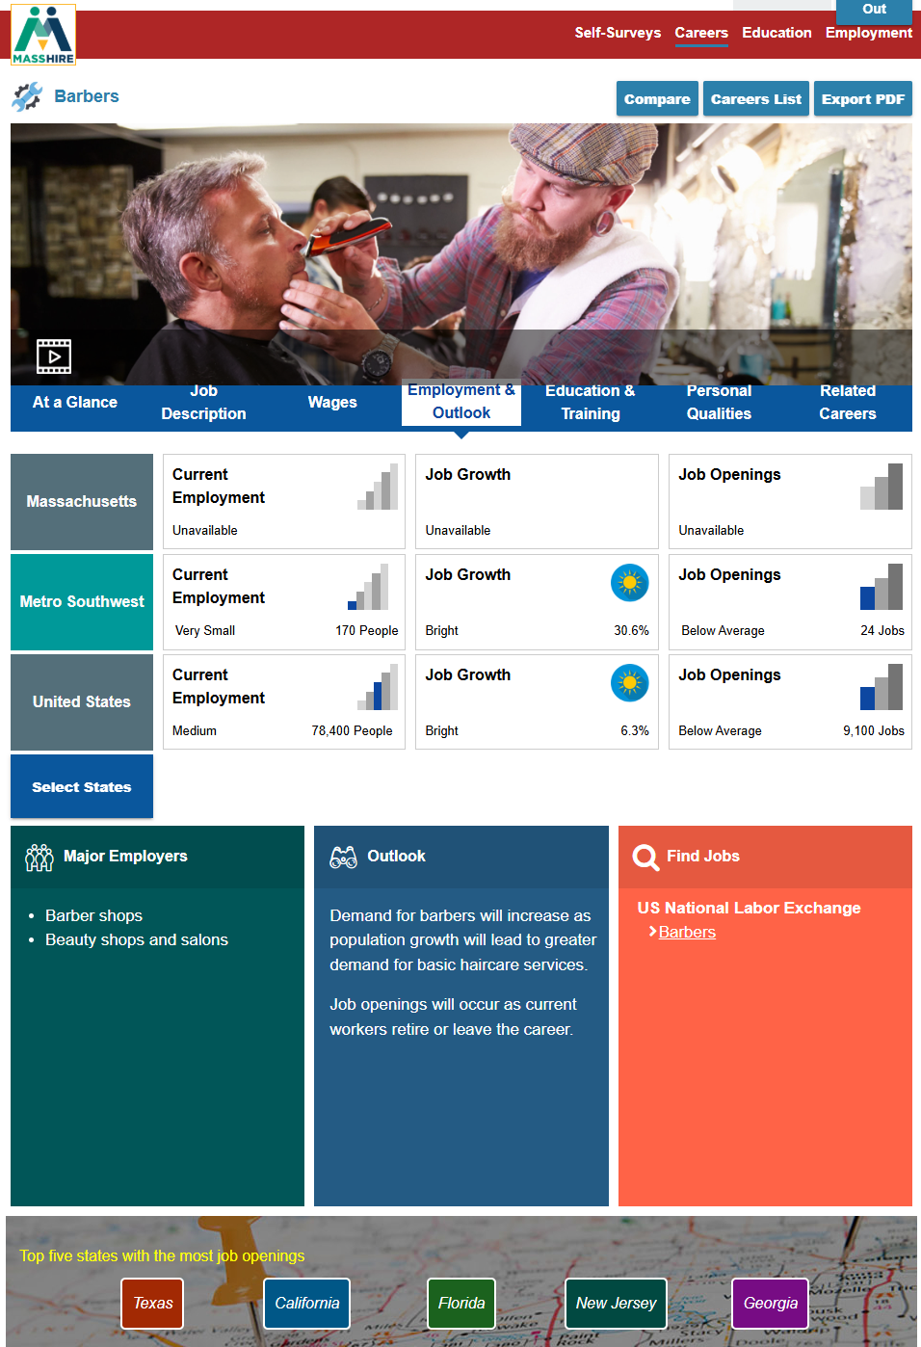
Corrections Site
Has Wages and Forecast / Outlook information

Slide 30
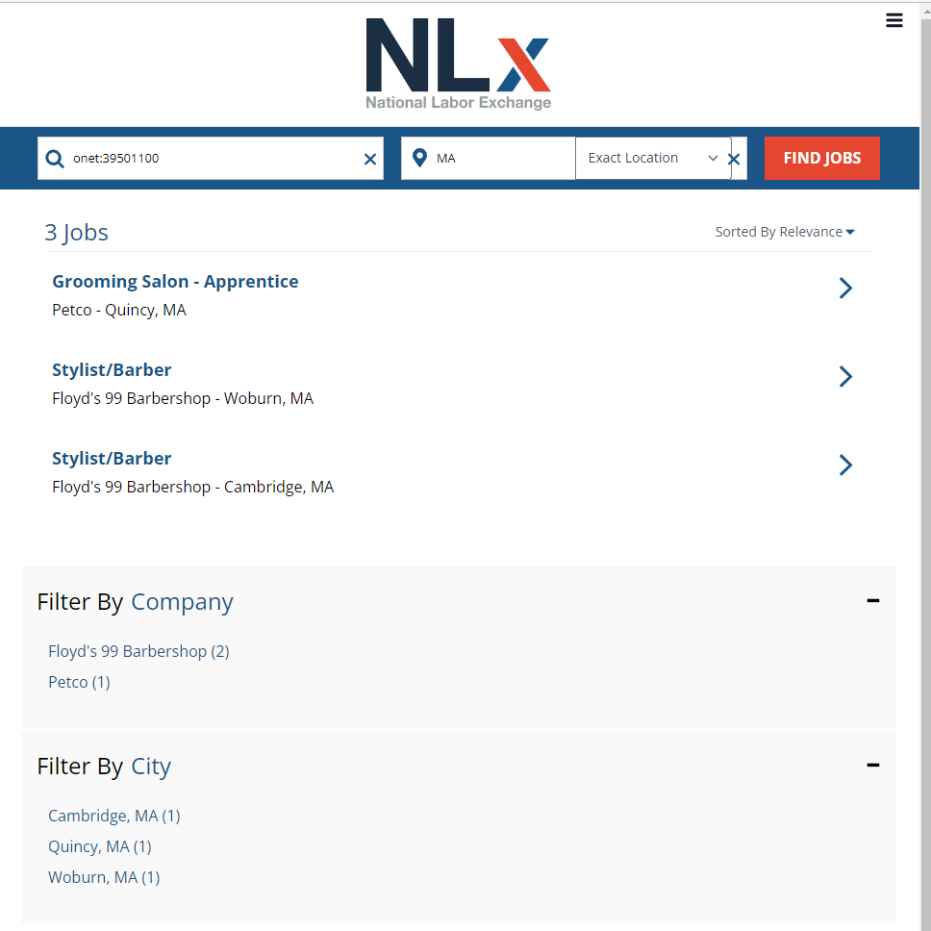
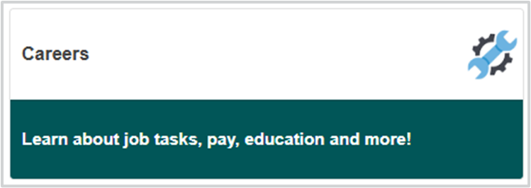
Corrections Site

Slide 31
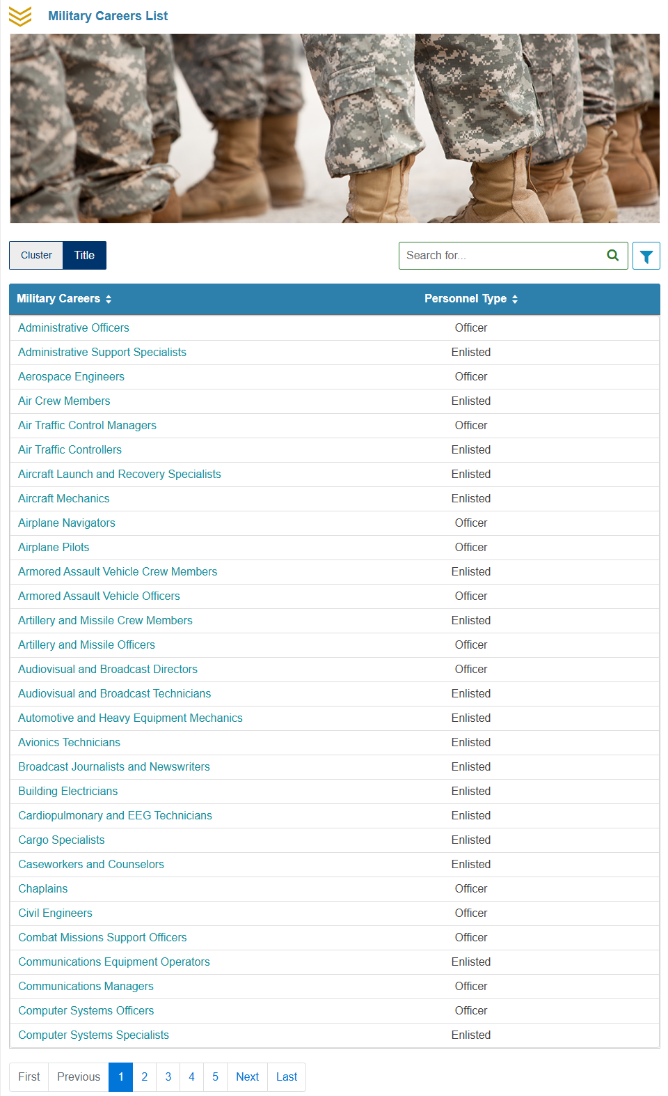

Corrections Site

Slide 32
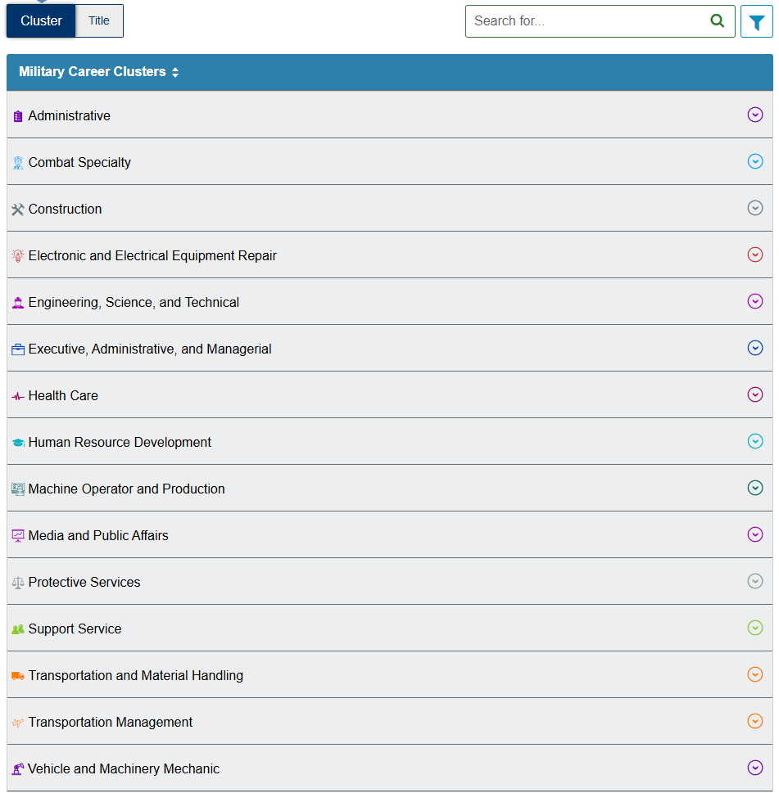
Corrections Site

Slide 33
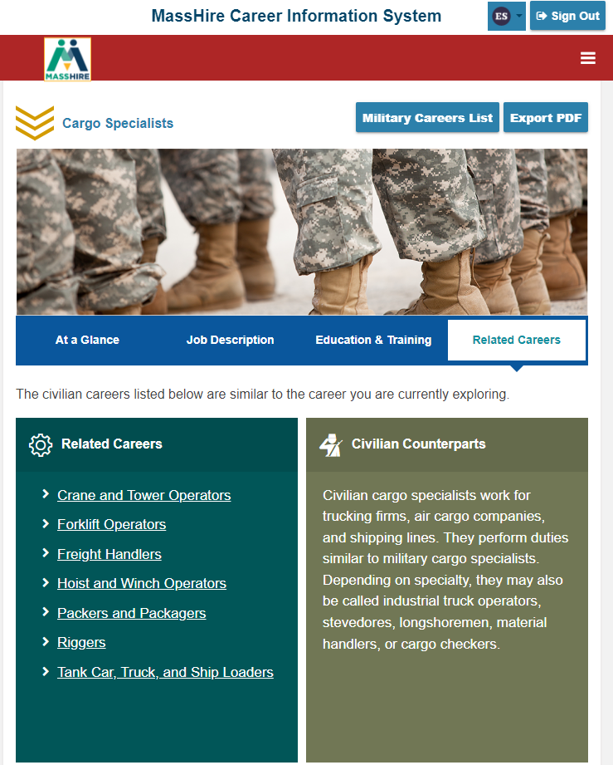
Corrections Site
Related Careers

Slide 34
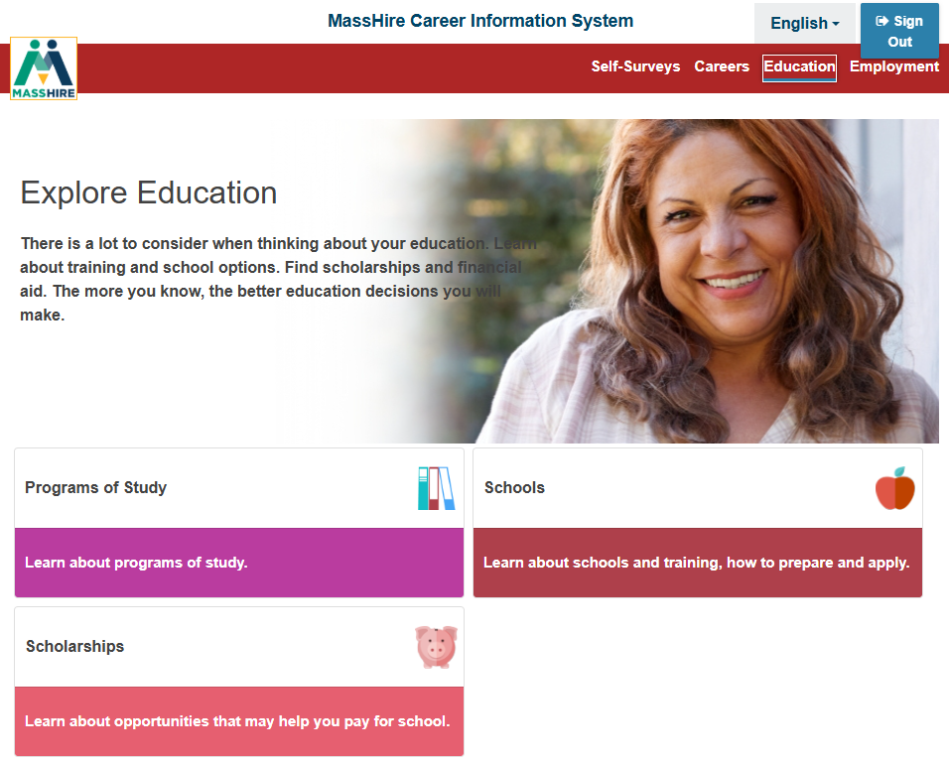
Corrections Site
Omitted:
Federal Student Aid

Slide 35
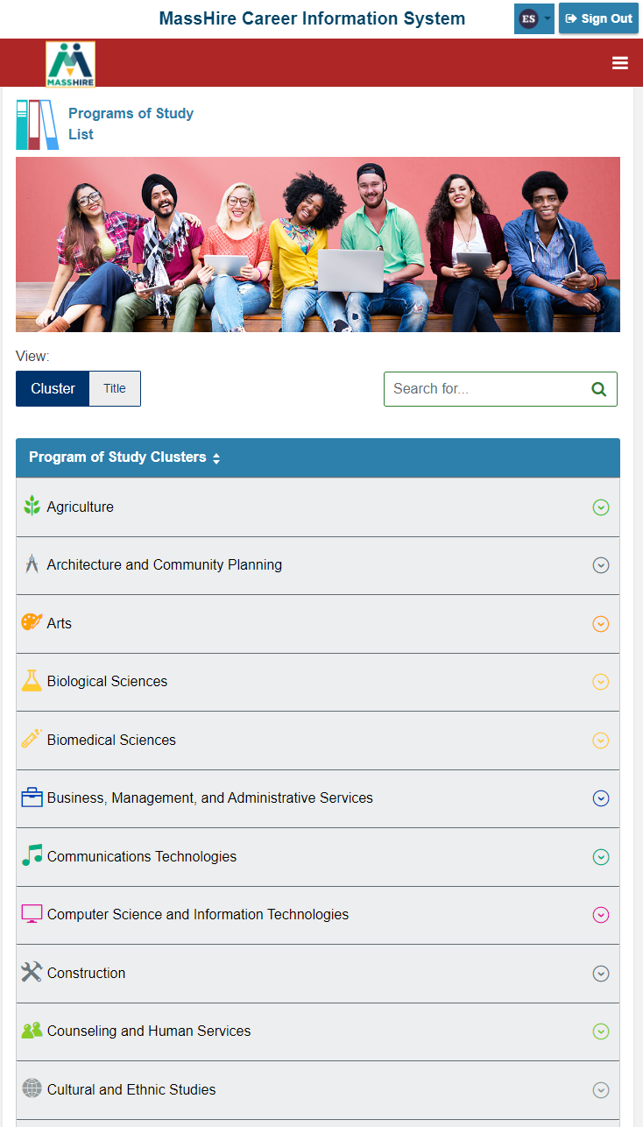

Corrections Site
Study Cluster information / programs

Slide 36
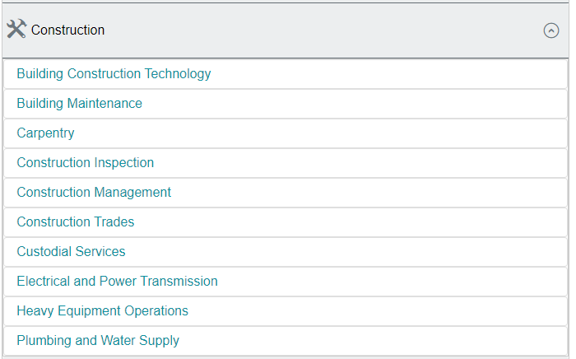
Corrections Site
Study Cluster details

Slide 37
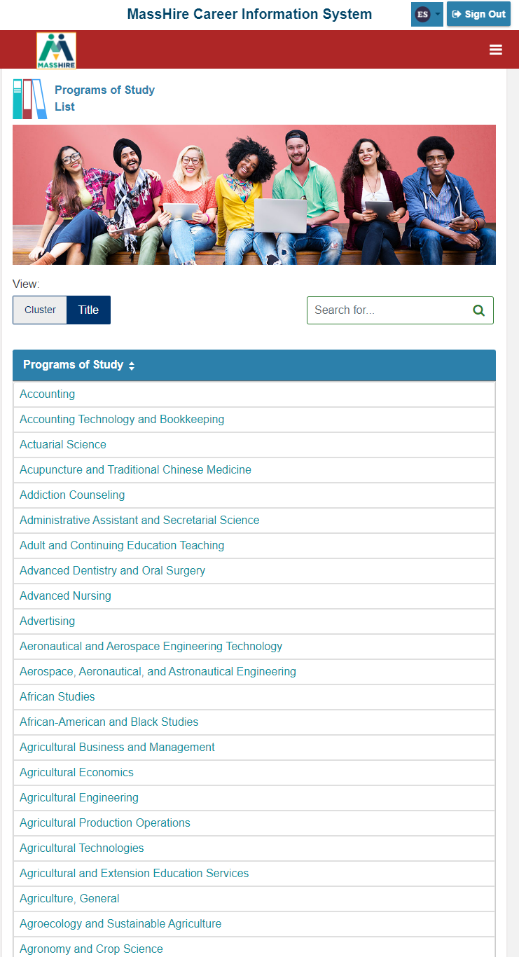
Corrections Site
By Title details

Slide 38
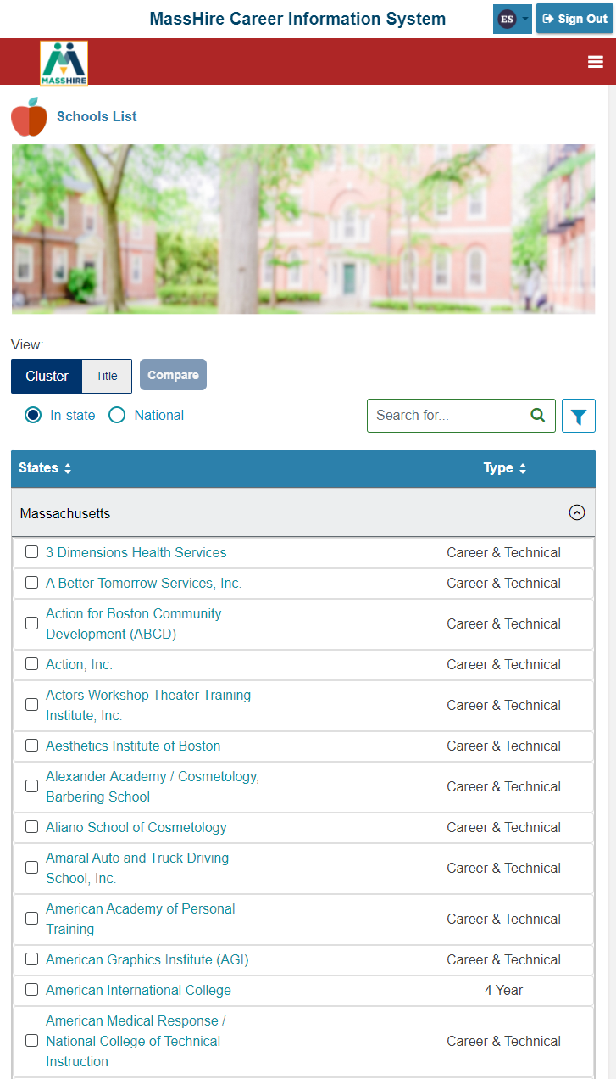
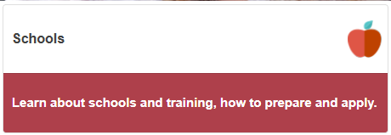
Corrections Site
Defaults to Massachusetts schools

Slide 39
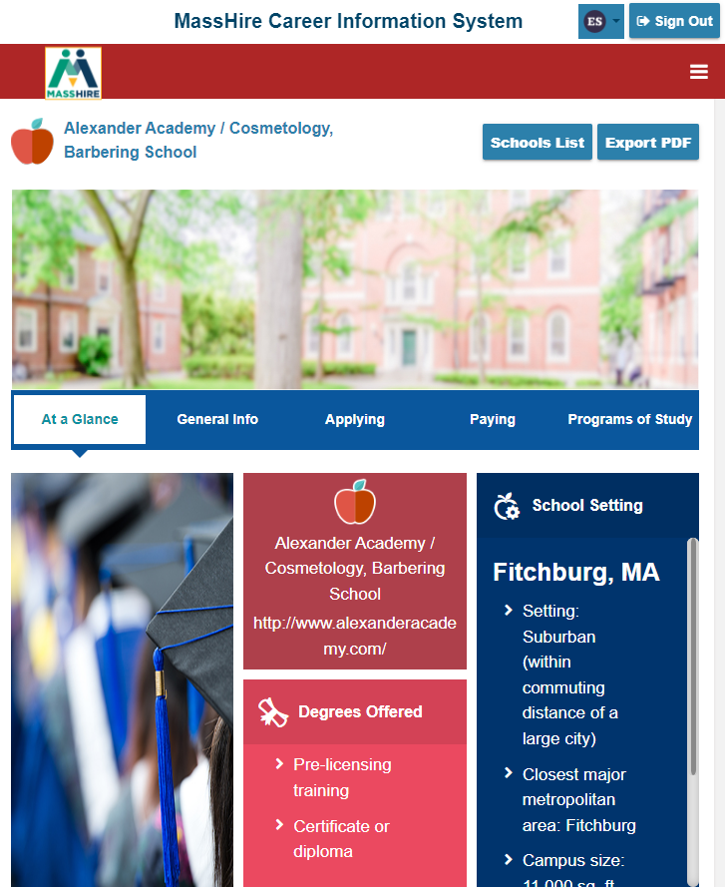
Corrections Site
Schools at a Glance

Slide 40
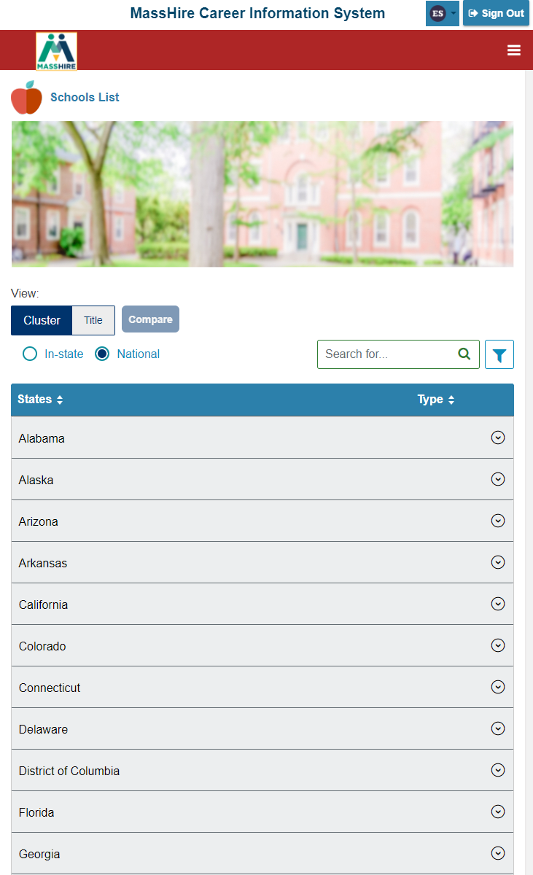
Corrections Site
National School Listings

Slide 41
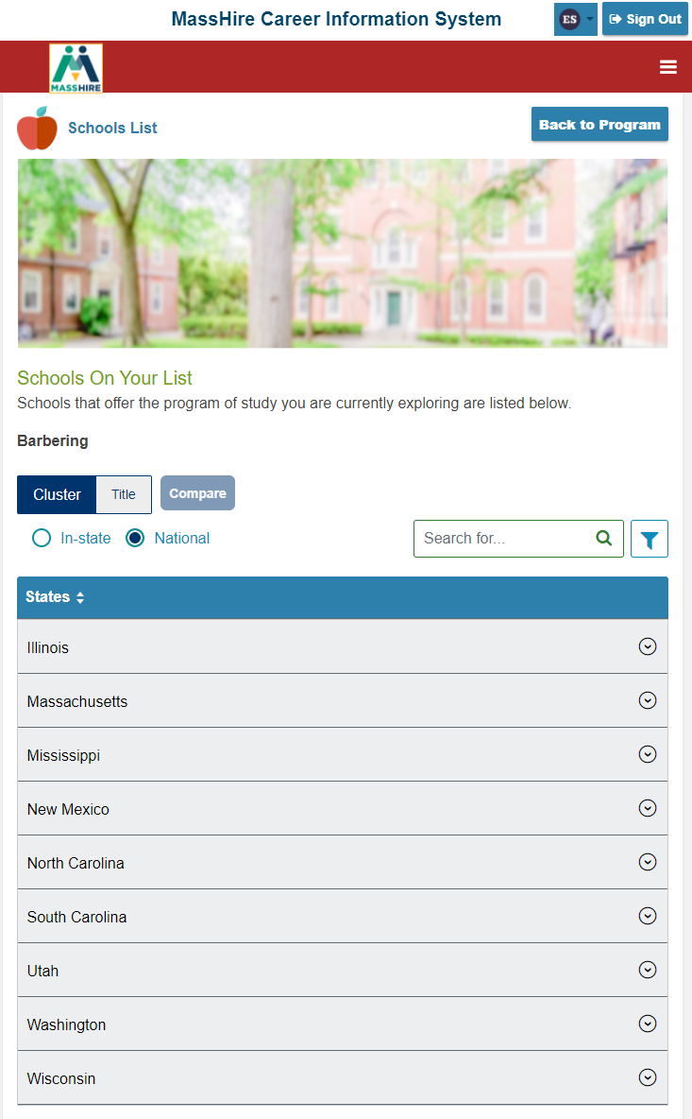
Corrections Site
National School Listings

Slide 42
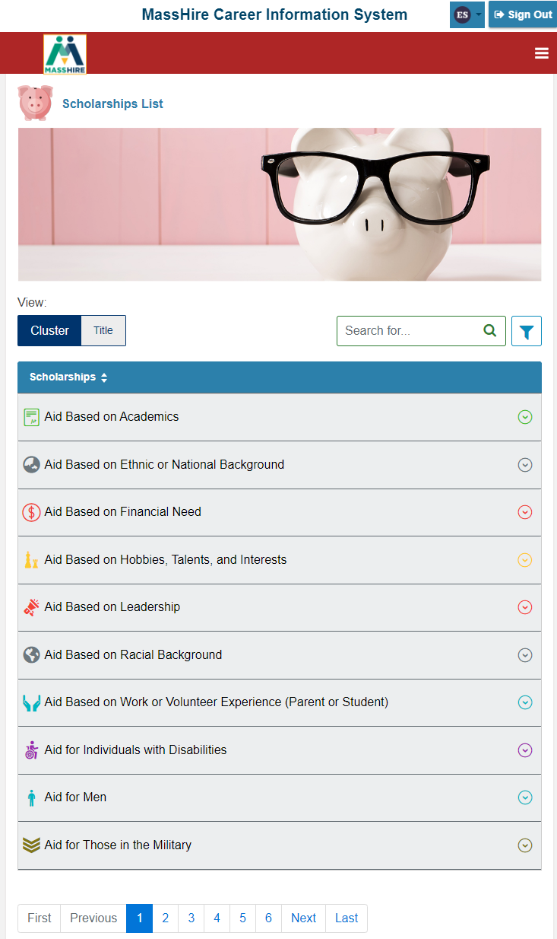
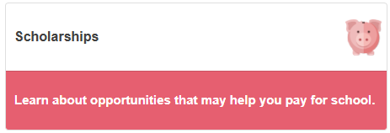
Corrections Site

Slide 43
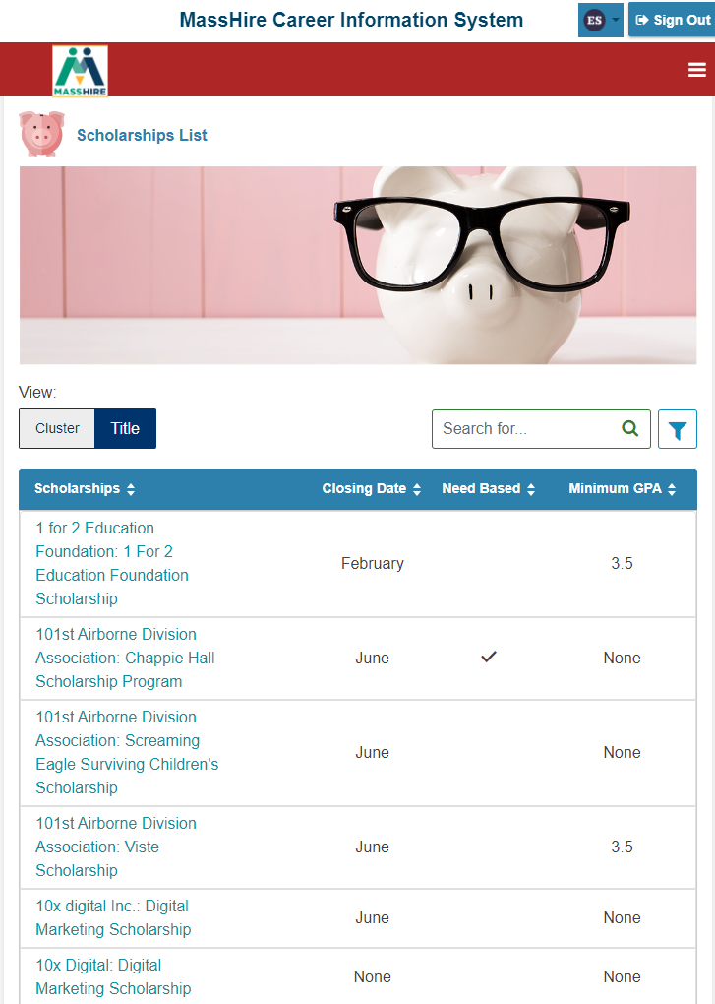
Corrections Site

Slide 44
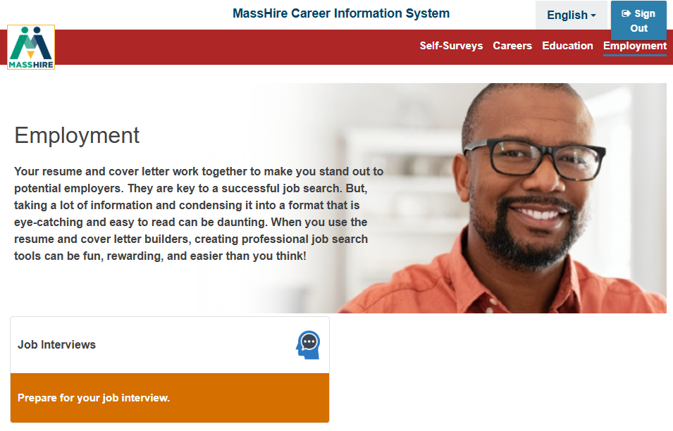
Corrections Site
EMPLOYMENT
Omitted:
Resume
Cover Letter
MassHire JobQuest

Slide 45
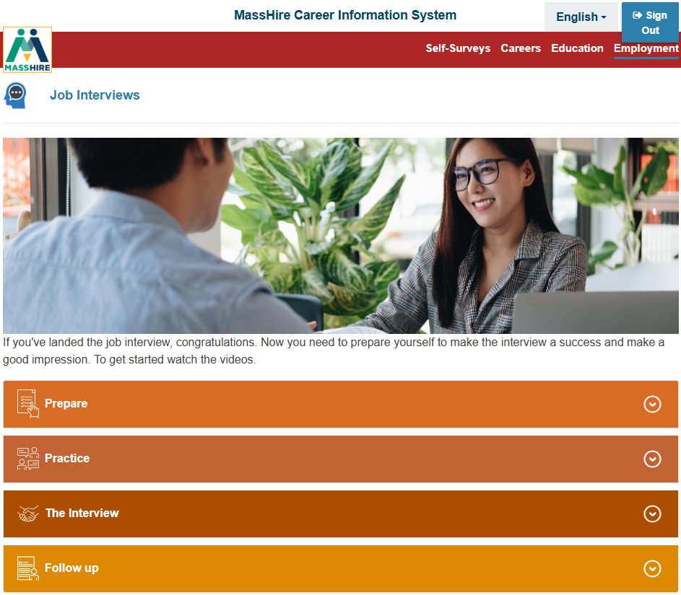
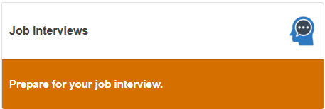
Corrections Site

Slide 46



Corrections Site

Slide 47



Corrections Site

Slide 48


Corrections Site

Slide 49


Corrections Site

Slide 50


Corrections Site

Slide 51

Massachusetts Residents Log In
Statewide license for all Massachusetts Cities and Towns.
Lists all 4 types of CIS 360 education levels.
Only Junior High School has significant differences.

Slide 52

Massachusetts Residents Log In
Statewide license for all Massachusetts Cities and Towns.
Just Enter the correct Zip Code for the Selected City / Town.
The selected type of CIS 360 will come up. (Adult to Junior High School.)

Slide 53

Massachusetts Residents Log In
NOTE:
State (City and Town) log in does come in:
English
Spanish (Espanol)
(Junior High School Version shown) .

Slide 54

Massachusetts Residents Log In
Difference between
State log In
versus
Corrections site:
None
NOTE:
State (City and Town) log in does not have the ability to save (like the Corrections site) to your portfolio.

Slide 55

Massachusetts Residents Log In
Difference between
State log In
versus
Corrections site:
Included are:
Training Opportunity Program
Massachusetts Apprenticeships
NOTE:
State (City and Town) log in does not have the ability to save (like the Corrections site) to your portfolio.

Slide 56

Massachusetts Residents Log In
Difference between
State log In
versus
Corrections site:
Included is:
Federal Student Aid
NOTE:
State (City and Town) log in does not have the ability to save (like the Corrections site) to your portfolio.

Slide 57

Massachusetts Residents Log In
NOTE:
State (City and Town) log in does not have the ability to save (like the Corrections site) to your portfolio.
Difference between
State log In
versus
Corrections site:
Included is:
MassHire JobQuest

Slide 58


Massachusetts Residents Log In
NOTE:
Omitted from the State Log In
My Dashboard
Career Plan
Plus, the ability Save to a Portfolio

Slide 59
Corrections Site
MassHire Career Information System
Standard Portfolio / User Edition

Slide 60

“Regular MassHire CIS 360”

Slide 61


“Regular MassHire CIS 360”

Slide 62

“Regular MassHire CIS 360”

Slide 63
“Regular MassHire CIS 360”

Slide 64
Corrections Site
Corrections Edition
Next Steps

Slide 65

Corrections Site
Email: MassHireCIS@State.MA.US
Telephone: 617-626-6808
URL:
https://portal.masscis.IntoCareers.org

Slide 66
Corrections Site
Submit Site Activation form
For
Your Correction Location / Program

Slide 67
Or…….. Use State (City + Town) Log In

Slide 68
Contact Information
Email: MassHireCIS@State.MA.US
Telephone: 617-626-6808
URL: https://portal.masscis.IntoCareers.org

Slide 69

?
?
?
Questions
?
?
?
?
?
?
?
?

