Slide 1
Climate Change Resilience Planning for Municipalities
Mia Mansfield, Executive Office of Energy and Environmental Affairs

Slide 2
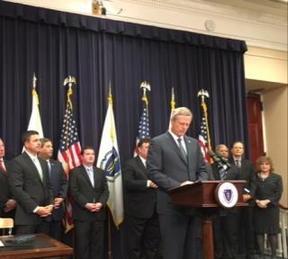
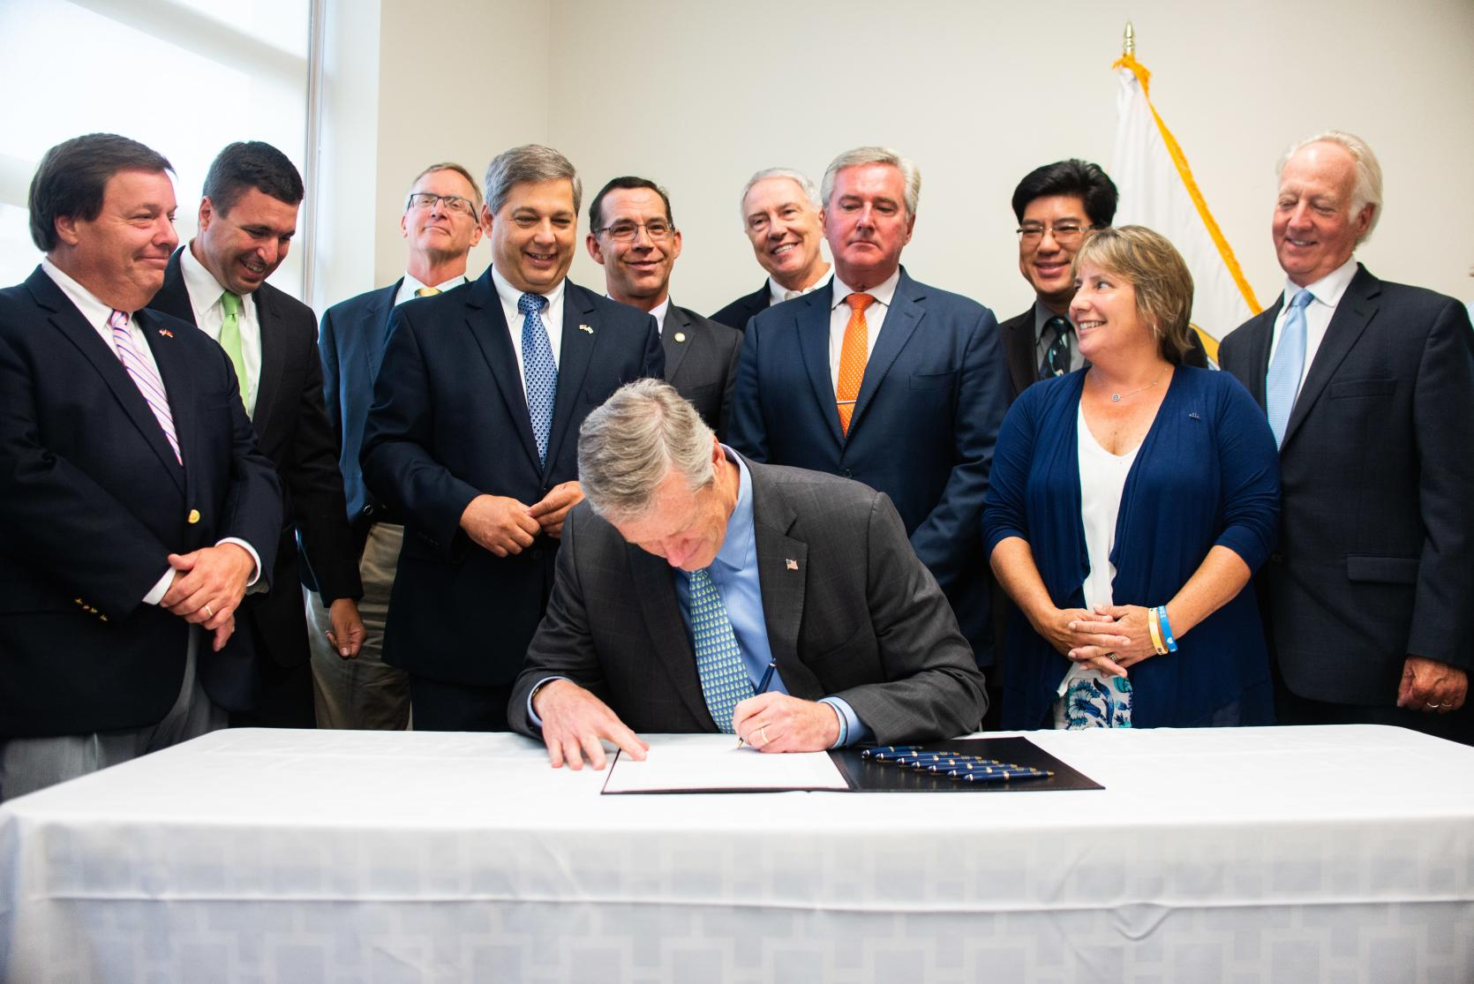
EXECUTIVE ORDER 569 2016
ENVIRONMENTAL BOND 2018
Reducing greenhouse gas emissions to combat climate change
Preparing for the impacts of climate change
State Adaptation Plan
Climate Coordinators
Agency Vulnerability Assessments
Municipal Support
$2.4 billion bond bill with focus on climate change resiliency
Over $500 million authorized for climate change adaptation
Codifies EO 569, including the MVP Program

Slide 3
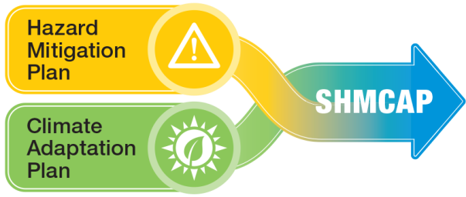
2018 Massachusetts State Hazard Mitigation and Climate Adaptation Plan (SHMCAP) September 2018
Notes:
First-of-its-Kind Integrated State Plan

Slide 4
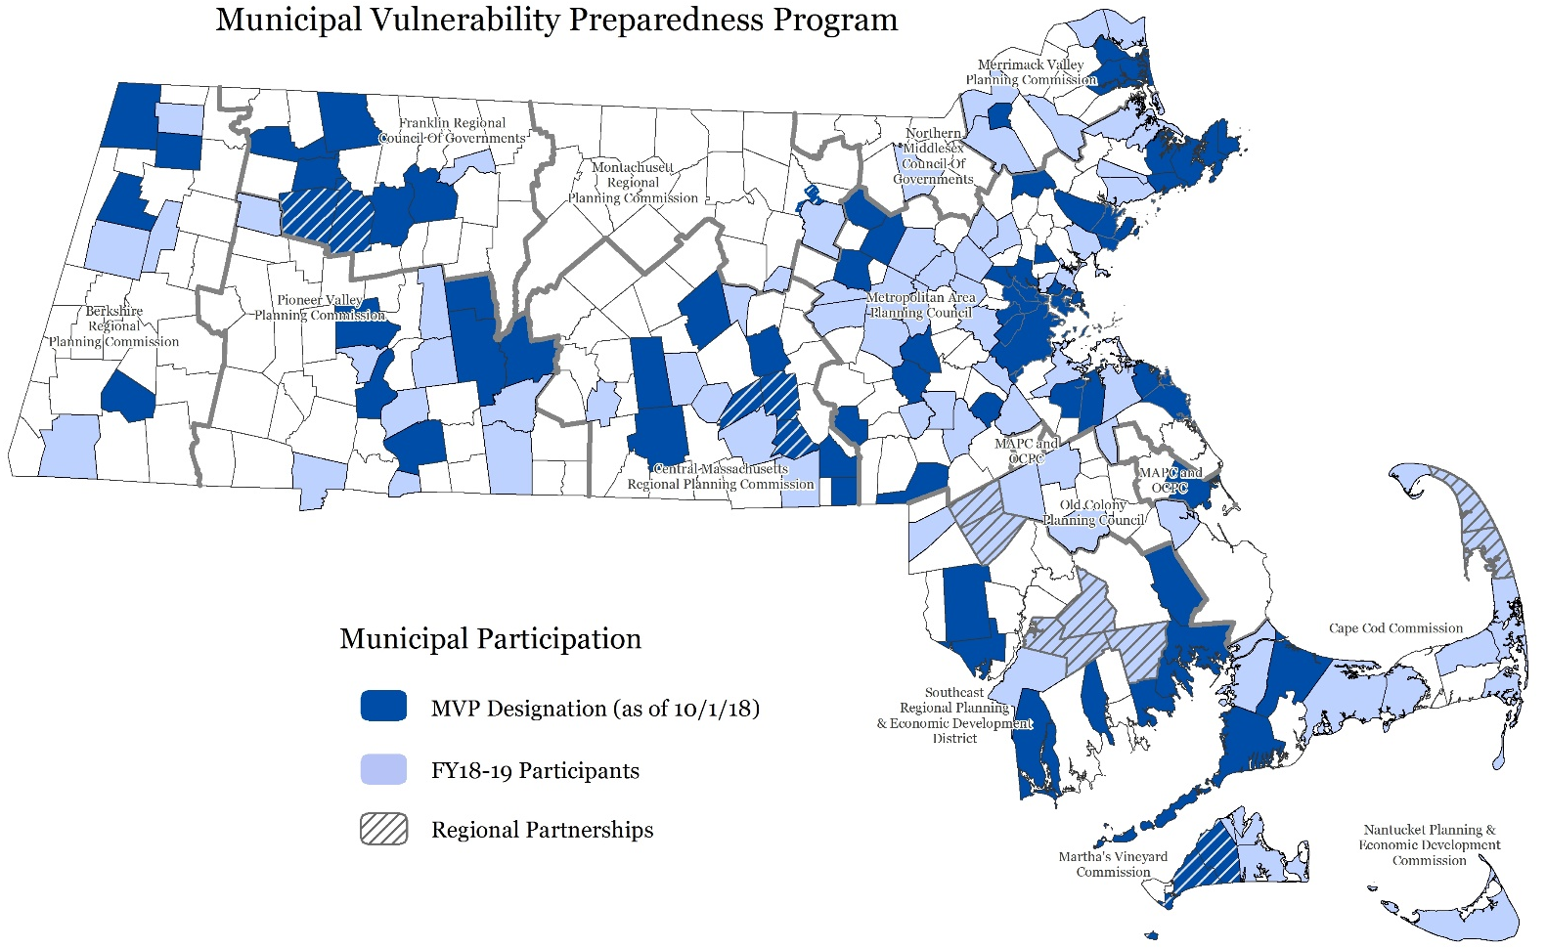
Municipal Vulnerability Preparedness (MVP) 44% of the Commonwealth/ 155 communities
Engage Community
Identify CC impacts and hazards
Complete vulnerability assessment
Develop and prioritize actions
Take Action
State and local partnership to build resiliency to climate change
Notes:
The new Municipal Vulnerability Preparedness (MVP) program will provide funding for cities and towns across the state plan for climate change impacts and build more resilient communities.
Through the MVP program, our administration will provide direct funding and support to cities and towns to complete vulnerability assessment.
These municipalities will develop action-oriented resiliency plans using an accessible, tested approach that can be used in any community, from our coastal communities and Gateway Cities, to the hill towns of Western Massachusetts.
The MVP program will provide state government with a window into the challenges communities face and help frame coordinated statewide efforts and align state programs with the critical challenges facing communities.
Communities who have completed these vulnerability assessments and action plans will receive designation as an MVP community which will help them compete for other state grant programs and funding opportunities.

Slide 5
MVP Principles
Community-led process that employs local knowledge and buy-in
Accessible
Utilizes partnerships and leverages existing efforts
Mainstreams climate change
Addresses social equity, vulnerabilities, and strengths
Certified MVP providers
Informs coordinated statewide efforts.
Springfield MVP Workshop
www.communityresiliencebuilding.com

Slide 6
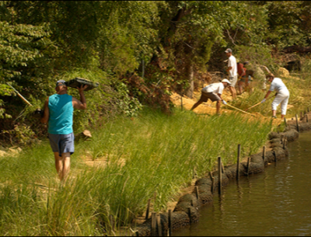
MVP Planning Grant
Open now, rolling applications through 5/3/19
$15,000- $100,000 per plan, completed by 6/30/2020
$1M available
MVP Action Grant
Open to MVP communities, applications close 4/19/19
$25,000- $2M per project, completed by 6/30/2020
37 projects underway
$10M available
https://www.mass.gov/municipal-vulnerability-preparedness-mvp-program

Slide 7
MVP PLANNING Grant
Lead a community-driven planning process to understand climate vulnerabilities and identify priority adaptation actions.
Utilize state-certified MVP providers, toolkit, and climate data to develop an MVP Plan through workshops and community outreach
Be designated as an MVP Community and eligible for Action Grant funding
Submit regular progress reports
Findings inform State Adaptation Plan
Notes:
UPDATING PLAN?
HOWSTATE IS USING DATA?

Slide 8
MVP ACTION Grant
Implement priority adaptation actions identified through the planning process
Utilize nature-based solutions and reach EJ communities
Clearly demonstrate how you’re incorporating climate change data to redesign and reconsider
Notes:
Proposals may include a range of climate change adaptation actions including advanced vulnerability assessments, education and outreach, changes to local policies, plans or management strategies, redesigns and retrofits, nature-based solutions designed to increase resiliency within the community, or ecological restoration and habitat management. Projects should be proactive, and applicants should clearly demonstrate how the projects have been redesigned, re-evaluated, or reconsidered to better respond to changing climate conditions and to incorporate new climate change data. Projects must include full consideration and incorporation of climate change projections and data that align with the anticipated lifespan of the project and the risk tolerance of the asset. Projects that seek to simply repair to previous conditions will not receive funding. All projects are encouraged to consider the use of nature-based strategies to address climate change impacts, and projects that do so will receive higher scores on their applications.
Please note that many other grant programs exist across state government to support climate change adaptation and resiliency types of projects and we encourage applicants to apply to these opportunities as well (see Appendix D). Proposals must address one (or more) priority implementation action(s) within the municipality’s MVP plan/report and use best available techniques and climate projections. Any additions, deletions or other changes to the scope must be approved by EEA prior to commencement of such activities. All applicants are required to provide opportunities for community engagement in project tasks and communicate lessons learned through a brief project summary submitted to EEA.

Slide 9
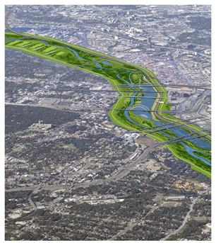
MVP Action Grants: Project Types
Detailed Vulnerability and Risk Assessment
Community Outreach and Education
Local Bylaws, Ordinances, Plans, and Other Management Measures
Redesigns and Retrofits
Nature-Based Flood Protection, Drought Prevention, Water Quality, and Water Infiltration Techniques
Nature-Based, Infrastructure and Technology Solutions to Reduce Vulnerability to Extreme Heat and Poor Air Quality
Notes:
Climate Resilience Policy Audit/Amendments, LID & Design Guidelines (Town of Brookline)
Sawmill Brook Central Pond Restoration Design (Town of Manchester)
Feasibility Study for an Essex Bay Living Shoreline (Town of Essex)
Tree Planting Plan to Mitigate Heat Islands and Reduce Runoff (Town of Natick)
Water/Sewer Infrastructure Green Emergency Power Study (Town of Holden)

Slide 10
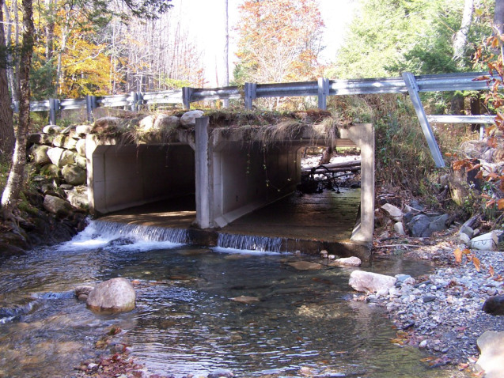
MVP Action Grants: Project Types
Nature-Based Solutions to Reduce Vulnerability to other Climate Change Impacts
Ecological Restoration and Habitat Management to Increase Resiliency
NEW IN 2019
Energy Resilience
Chemical Safety
Land Acquisition for resilience
Expanded eligibility of project location
Notes:
OTHER: other impacts of climate change such as extreme weather, damaging wind and power outages, increased incidence of pests and vector-borne illnesses and other public health issues, and increases in forest pests
Ecological restoration: repair or improve degraded natural resources within a municipality to enhance resilience and adapt to climate change, such as right-sizing culverts, dam removal, controlled burns, soil stabilization
Energy resilience: incorporate clean energy and be paired with resilience enabling technologies such as energy storage, energy management systems, blackstart and islanding technology, and microgrids
Chemical safety: engage the business and manufacturing community on identifying vulnerabilities to chemical releases due to severe weather events, reducing use of toxic or hazardous chemicals, improving operations and maintenance procedures to prevent chemical releases and accidents, improving emergency and contingency planning, and/or identifying existing contaminated sites that pose chemical dispersion risks during flood events are eligible.
Land acquisition: if the parcel has been identified through a climate vulnerability assessment as an appropriate location for a specific eligible adaptation activity to occur

Slide 11
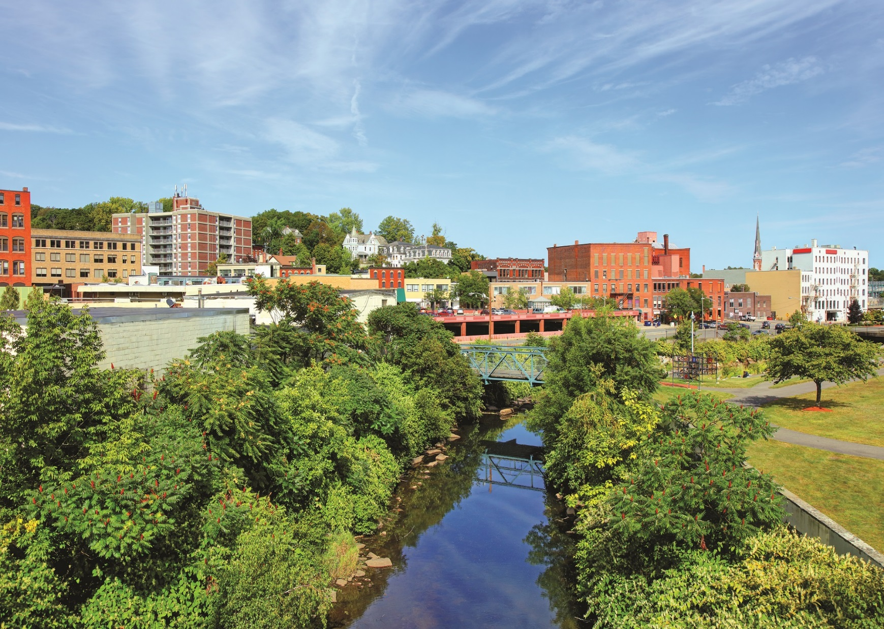
Why nature-based solutions?
Notes:
Nature-Based Solutions use natural systems, mimic natural processes, or work in tandem with traditional approaches to address natural hazards like flooding, erosion, drought, and heat islands

Slide 12
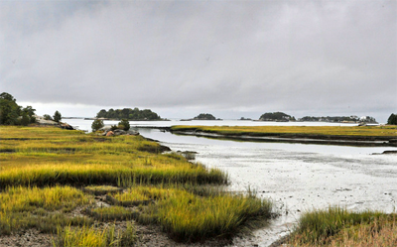
Next Steps
Strong local partnerships through an expanded MVP network
Growing EEA capacity
MA Coast Flood Risk Model
resilientMA Climate Change Clearinghouse
Notes:
Geospatial tool to track vulnerabilities and strategies

Slide 13
Climate Resilient Communities Initiative (S.10)
Climate-resilient infrastructure is a sound investment for Massachusetts
Estimated $1 billion over 10 years for the Global Warming Solutions Trust Fund
Estimated $75 million in fiscal year 2020 and $137 million on an annualized basis
The Commonwealth’s deeds excise rate, paid at time of sale, is proposed to increase from $2 per $500 of value to $3.
This represents an all-in rate increase of 0.228%. The excise is paid by the seller upon the transfer of property.
At the median single family home sale price of $399,900, the increase is approximately $912. At the median condo sale price of $370,000, the increase is approximately $864.
The Massachusetts total deeds excise rate will continue to rank in the middle-of-pack among the six New England states.
Housing price data source: Massachusetts Association of Realtors, “Single-Family Market Overview” and “Condominium Market Overview” for November 2018 on a year-to-date basis.

Slide 14
Next Steps
Government leads by example
Resilient MA Action Team (RMAT)
Statewide vulnerability assessments and adaptation strategies
Resilient capital planning
Notes:
Geospatial tool to track vulnerabilities and strategies

Slide 15
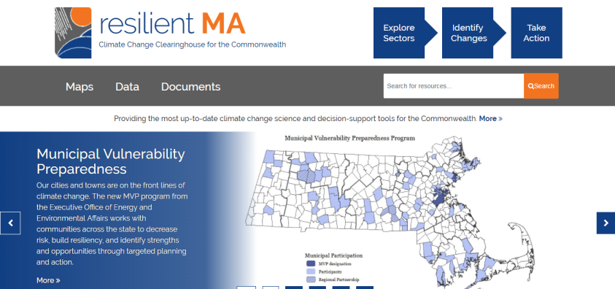
www.resilientma.org

Slide 16
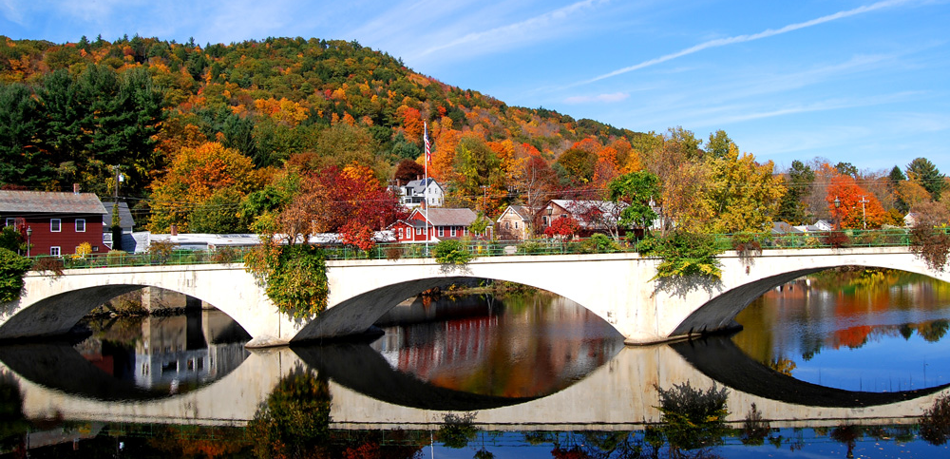
Mia.Mansfield@mass.gov
https://www.mass.gov/municipal-vulnerability-preparedness-program
https://www.mass.gov/municipal-vulnerability-preparedness-program

