Slide 1
Collaborative Workspace Program Guidance Webinar
Community One Stop for Growth

Slide 2
Webinar Road Map
What is the Community One Stop for Growth?
Where does this program fit in the One Stop?
Important program parameters.
How to be competitive.
Examples of successful applications.
Completing the application.
Key dates and information.

Slide 3
What is the Community One Stop for Growth?
The Community One Stop for Growth is the main driver of economic development in the Commonwealth.
The One Stop is a single application portal and collaborative review process designed to streamline the experience for the applicant and better coordinate economic development programs and staff on engagement and grant making.

Slide 4
What is the Community One Stop for Growth?
Executive Office of Economic Development | MassDevelopment Finance Agency | Executive Office of Housing and Livable Communities
MassWorks Infrastructure Program Rural Development Fund Urban Agenda Grant Program Massachusetts Downtown Initiative | Underutilized Properties Program Site Readiness Program Collaborative Workspace Program Brownfields Redevelopment Fund Real Estate Services Technical Assistance | HousingWorks Infrastructure Program Housing Choice Grant Program Community Planning Grants Program

Slide 5
MassDevelopment - Overview
MassDevelopment Finance Agency
MassDevelopment is the state’s development finance agency and land bank, working with businesses, nonprofits, banks, and municipalities to stimulate economic growth across the Commonwealth.
What We Offer
Finance
Bond Financing
Grants
Loans & Guarantees
Tax Credits
PACE Financing
The Commonwealth’s Land Bank
As a land bank, we help smaller and under-resourced communities address vacant properties; help address larger or more complex properties or projects across the state; and administer and distribute funding.
Real Estate
Development Projects
Technical Assistance
Site Readiness Program

Slide 6
Collaborative Workspace - Program Overview
Purpose of the Program
Accelerate the pace of new business formation, job creation, and entrepreneurial activity in communities by supporting infrastructure that fuels community-based innovation.
Spaces may include: innovation centers, maker spaces, artist spaces, fabrication labs, collaborative kitchens, and co-working spaces.
Awards are in two categories: Seed Grants for planning and design, and Fit-Out for building improvements and equipment purchases.
Who’s Eligible?
Municipalities, non-profit organizations, for-profit businesses
Building owners hosting a collaborative workspace or an operator of a collaborative workspace registered with the Massachusetts Secretary of State.
Statewide Program Manager Richard Griffin, Jr. - Vice President, Community Investment Email: rgriffin@massdevelopment.com

Slide 7
Where Do Collaborative Workspaces Fit in the One Stop?
Preparing for Growth |  |  | Catalyzing Specific Projects
Community Activation & Placemaking | Planning & Zoning | Site Preparation | Building | Infrastructure
Technical Assistance for Downtowns Downtown Design Consultant Services Downtown Mobility/Parking Consultant Services Downtown Wayfinding/Branding Consultant Services Economics of Downtown Consultant Services Pedestrian Orientation/Placemaking Consultant Services Small Business Support/E-commerce Consultant Services Forming a Downtown Management District Equitable Workforce and Business Development Programming Entrepreneurship and Small Business Development Workforce Development and Training Initiatives Community Organizing and Leadership Development | Community Plan Master Plan Neighborhood Plan Downtown Plan Urban Renewal Plan Housing Production Plan Regional Plan Corridor Plan Zoning Revision Zoning Revision to Comply with Section 3A of MGL c.40A Comprehensive Zoning Review & Revision Planning for Housing Housing Feasibility Plan Housing Site Master Plan Housing Infrastructure Plan Housing Site Design Plan District Redevelopment Technical Assistance Planning for Growth in a Commercial/Industrial District | Brownfield Site Clean Up Brownfields Site Assessment Brownfields Remediation Site Improvements to Unlock Development Site Readiness Pre-Construction Site Readiness Construction Municipal Surplus Property Disposition Municipal Surplus Property Disposition Study | Underutilized Property Rehabilitation Underutilized Property Pre-Construction Underutilized Property Construction Creating Collaborative Workspace Collaborative Workspace Feasibility Study Collaborative Workspace Fit-Out or Equipment Community Lead Housing Production Support Housing Production Support Housing Rehabilitation Support Housing Preservation | Public Infrastructure to Support Housing Growth (Residential Only) Pre-construction - Design / Engineering Documents Only Construction Public Infrastructure to Support Mixed-Use and Commercial/Industrial Growth Pre-construction - Design / Engineering Documents Only Construction Small Town Road Improvements to Enhance Public Safety (STRAP) Construction of Road Improvements to Enhance Public Safety

Slide 8
Project Parameters
Project Budget | Up to $15,000 for Seed grants and up to $100,000 for Fit-Out grants. Applicants may not apply for both types in the same round.
Project Timeline Requirements | Seed and Fit-Out activities should be completed within 6 months of execution of Grant Agreement.
Eligible Use of Funds | Seed grants: feasibility & market studies, business plans, and design drawings. Fit-Out grants: building improvements and equipment purchases. Funds cannot be used for operating costs or working capital.
Funding Restrictions | Grants require a 1:1 match (cash, in-kind rent or quantifiable equipment donation) Fit-Out grants require signed leases for existing or proposed spaces. Budget should include scopes of work, contractor estimates, and equipment quotes that encompasses uses of grant funds as well as use of matching funds.

Slide 9
How to Be Competitive
What is the key information that program reviewers take into consideration?
Connection and engagement to the community of users who they believe will use the space. The program does not use a “build it and they will come” approach to funding.
Can the proposed work be completed within reasonable timelines?
Is the applicant likely to have secured their match by the time of award?
What important questions should I be asking?
How does the collaborative workspace accelerate the pace of new business formation, job creation, and entrepreneurial activity?
How will a specific community of users be served and what programs will be offered to support them?
Does the project team have the ability to oversee completion of the proposed work, as well as operate the space going forward?
What attachments should applicants be prepared to include in their applications?
Executed lease or proof of ownership for project location.
Evidence of matching funds – bank statements, grant award letters, documentation of in-kind rent, work or equipment.
Scopes of work, consultant or contractor quotes, equipment estimates.

Slide 10
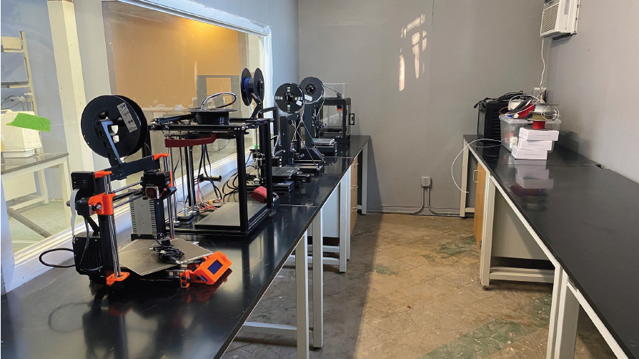
Successful Application Example #1
Applicant: | The Brickyard Collaborative, Lynn (Fit-Out Grant)
Project description: What made the project successful? | An established makerspace, the Brickyard is a fully-equipped shared space focused on STEAM, technology, math, engineering and art. As it has grown in size and users, it needed to redesign its layout to maximize floorspace and improve traffic flow. This application was successful because it was able to quantify the impacts and benefits of the redesign to its existing customers. The project budget was clear as was the proposed scope of work.

Slide 11
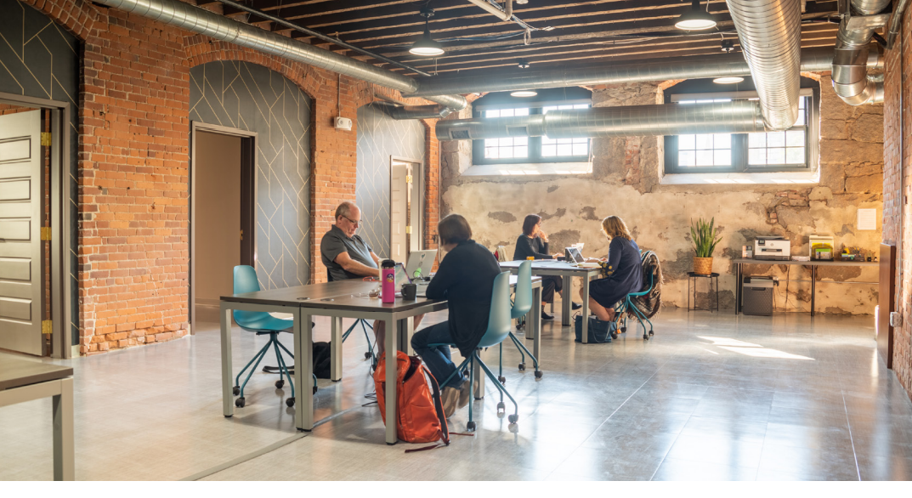
Successful Application Example #2
Applicant: | Groundwork Fall River, Fall River (Fit-Out Grant)
Project description: What made the project successful? | Groundwork in Fall River is a 5,000 sq.ft. co-working site that sought to add conference rooms, soundproof phone booths and additional seating at their newest location. The management team at Groundwork had prior experience operating a successful co- working site in New Bedford. They provided data validating that their proposed physical space and programming met market demands. This, along with an in-depth business plan, helped their application be successful during the review phase.

Slide 12
Successful Application Example #3
Applicant: | Berkshire Innovation Center, Pittsfield (Seed Grant)
Project description: What made the project successful? | The BIC is a multi-faceted facility offering members the ability to access its research and innovation space to explore new technologies. After operating for two years, it wanted to explore the potential to redesign its current space as well as expand. The BIC wanted to engage a consultant to develop a feasibility study/business plan to study the idea. This request received a favorable review as it was able to highlight gaps in the western Mass market for similar services offered in Pittsfield. The BIC had already met with a consultant to discuss their needs and submitted a thorough and reasonable scope of work. It also submitted proof of matching funds.

Slide 13
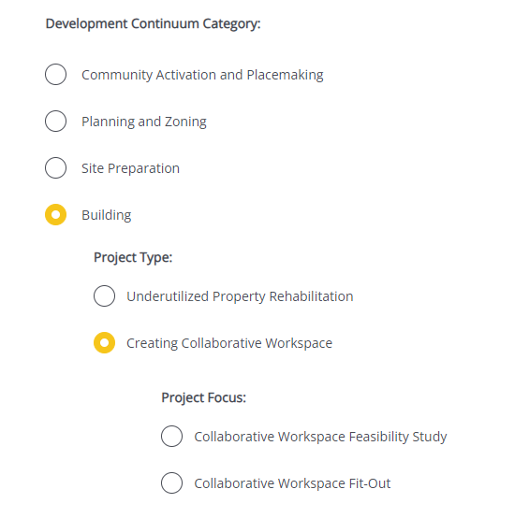
Completing the Full Application
Key Question: In Section 2 of the Full Application, applicants are asked to indicate the Project Category. To be reviewed by the Collaborative Workspace program, applicants should make the following selections in question 2.4:
Visit www.mass.gov/onestop to view: One Stop Webinar 2: Application Guidance
Development Continuum: | Building
Project Type: | Creating Collaborative Workspace
Project Focus: | Select the most appropriate project type for your application

Slide 14
FY25 Round - Timeline
Jan.
Full Application and Expression of Interest Open (January) – The Full Application is the official form for submitting all funding requests. Applicants may now begin to work on applications in the IGX system, however applications will only be accepted during the submission period.
One Stop Guidance Phase (January – May) – A series of webinars will be hosted be both the One Stop Team and staff from each program within the One Stop. In addition, office hours will be hosted to answer applicant questions. Visit www.mass.gov/onestop for the full schedule of webinars and office hours.
Full Application Submission Period (May-June) – Applicants may submit their Full Application(s) beginning May 6, 2024. All applications must be submitted by the Full Application deadline of 11:59 p.m. on Wednesday, June 5.
Review and Evaluation (July – August) – All complete and eligible Full Applications submitted by the deadline will be reviewed and evaluated by the corresponding program managers at each state agency. The One Stop team will also conduct joint application reviews across agencies. Based on the program’s criteria, each program will prepare its list of applications recommended for funding, to be further reviewed and approved by agency and Secretariat leadership.
Notification of Grant Decisions (September) – Once final recommendation have been approved, applicants will be notified of grant decisions in writing, and announcement events will be scheduled.
Sept.

Slide 15
Opportunities for Guidance and Information
Visit www.mass.gov/onestop for more information on:
Expression of Interest
Complete an Expression of Interest to see if your project(s) is eligible for funding through the One Stop and get tips for preparing your application.
One Stop and Program Webinars
Recordings of all One Stop webinars are now available on the One Stop website.
Office Hours
One Stop General Guidance Office Hours – One Stop staff will hold office hours to discuss general One Stop process and technology questions.
Program Office Hours – Staff from each program will hold an office hour to answer applicant questions related to the program.
CoWork Program Office Hour: March 5, 12:00 pm (noon)

Slide 16
Thank you!

