Slide 1
Customer Centered Design Workshop Outline
Panel presentations 1:20-1:50
Hands-on exercise 1:50-2:15
Q&A (if time permits)

Slide 2
Customer Centered Design Workshop Outline
Panel presentations

Slide 3
Customer Centered Design Workshop INTERAGENCY COLLABORATIONS: BERKSHIRE COUNTY
By Ken Demers, BerkshireWorks
December 6, 2016

Slide 4
ECONOMY DRIVEN BY INNOVATION AND MANUFACTURING
Paper Industry
Electrical Innovation
Engineering - Hoosac Tunnel
Notes:
Paper Industry – At one time, Berkshire mills produced much of the paper used in the United States. The first Berkshire paper mill was founded by Zenas Crane in Dalton, MA in 1801. The company’s dedication to constant improvement against counterfeiting is a major reason why their paper has been used to print American dollar bills since 1879.
Local inventors developed the first commercially successful wood pulp paper from native Berkshire poplar in 1867 leading to the first newsprint paper produced in America. Onyx Specialty Papers, among others, carry on the tradition of papermaking in the Berkshires.
Electricity – On March 6,1886 in Great Barrington William Stanley demonstrated the first practical system for providing electric illumination with the use of alternating current, and transformers to adjust the voltage levels of the distribution system, which is virtually identical to the system used today. The Great Barrington AC plant continued to operate until that summer when a technician dropped a screwdriver into the Siemens generator and destroyed it (can’t make this stuff up!).
Hoosac Tunnel - A 4.75-mile active railroad tunnel in Western Massachusetts that passes through the Hoosac Range in North Adams. At completion the tunnel was the world's second-longest and was the longest tunnel in North America until 1916 and remains the longest active transportation tunnel east of the Rocky Mountains. In 1872, East Tunnel and the Central Shaft tunnel aligned within 9⁄16 inch, a tremendous engineering achievement at that time. The tunnel is described as the 'fountain-head of modern tunnel technology.' The American Society of Civil Engineers made the tunnel a Historic Civil Engineering Landmark in 1975.

Slide 5
PAPER INDUSTRY

Slide 6
ELECTRICAL INNOVATION

Slide 7
ENGINEERING - HOOSAC TUNNEL

Slide 8
HOSPITALITY AND SERVICE BASED ECONOMY
While manufacturing remains an important component of the economy, the region has moved toward a more Hospitality and Service based economy. Innovation continues but the County has had to become more self-reliant as its geographic location keeps it separate from the larger urban centers. This self-reliance has manifested itself in the strength of our communities.

Slide 9
LARGE BUSINESSES ARE NOT NEARLY AS PREVALENT TODAY
Less than 2% of the region’s businesses have more than 500 employees, and just over 4% of businesses have more than 100 employees. The remaining 95% have fewer than 100 employees. Business owners are busy running their businesses, and it is imperative that the education, social service and workforce development community listen to their workforce needs and respond in an efficient and effective manner. To do that we coordinate, collaborate, and work toward this common agenda.

Slide 10
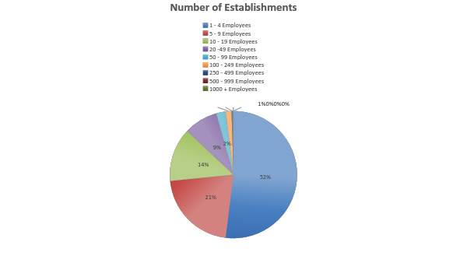
BERKSHIRE BUSINESSES
Source: 2014 County Business Patterns

Slide 11
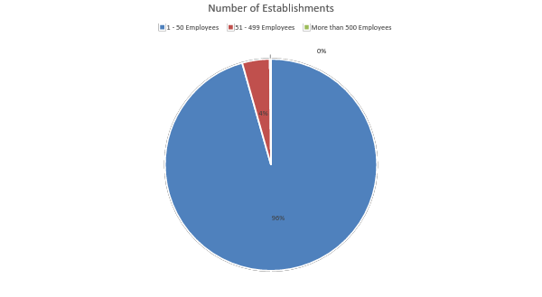
BERKSHIRE BUSINESSES

Slide 12
CHALLENGES THAT DRIVE THE COLLABORATIVE NATURE OF THE REGION’S BUSINESS, MUNICIPAL, AGENCY AND NON-PROFIT COMMUNITIES
Need to maximize resources
Limited transportation options
High housing costs
Job Seeker skill gaps for region’s advanced manufacturing base
Lower wages
Re-engagement of the local workforce

Slide 13
HOW DO WE ADDRESS THESE CHALLENGES ON A REGIONAL LEVEL?
Selected collaborative initiatives tackling the region’s challenges:
Berkshire Bridges – A Working Cities Pittsfield Initiative
Berkshire Compact for Education
The Asset Based Community Development (ABCD) Learning Community
Community Connector Partnership (Benefits Hub)
Employ North Berkshire
Notes:
Working Cities - addressing poverty through community resident engagement, leading to resident inclusion, engagement and access to the regions cultural, education, support networks and workforce opportunities.
Berkshire Compact for Education – a group of regional civic, education and business leaders who seek to ensure the wellbeing of each individual and the strength of our economy and community by raising educational access aspirations and attainment.
The Asset Based Community Development (ABCD) Learning Community with the goal of identifying individuals’ gifts (or strengths) and passions and to connect them to assets in the community so that all Berkshire County residents are self-sufficient, proud of, active and engaged in our community.
Community Connector Partnership (Benefits Hub) connecting service agencies through a common referral portal that promotes the “no wrong door” access to community resources.

Slide 14
COMMUNICATION
While these or similar initiatives and collaborations exist in all our communities, in the Berkshires we have been able to keep the lines of communication open between the initiatives and programs themselves. There are consistent stakeholders represented at each of these initiatives that contribute to a more cohesive message; they are not moving forward in a silo.

Slide 15
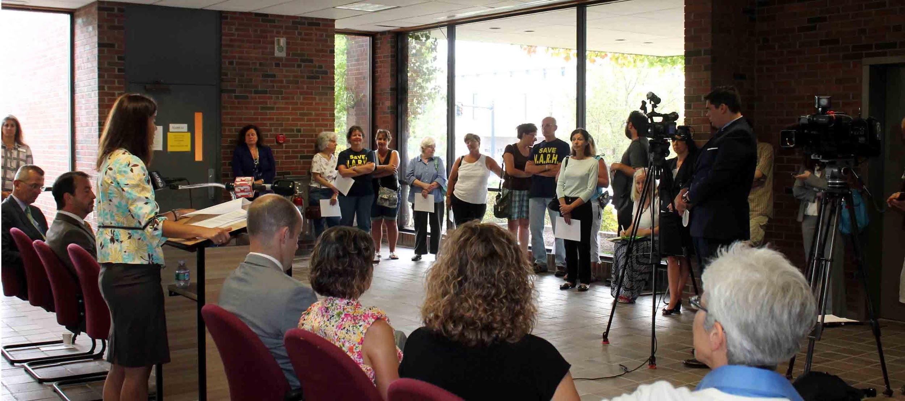
WHO INFORMS THESE INITIATIVES SO THAT THEY ADDRESS THE ISSUES EFFECTIVELY?
You need to talk to your customers.
Opening of Worker Assistance Center in North Adams following the abrupt closing of North Adams Regional Hospital

Slide 16
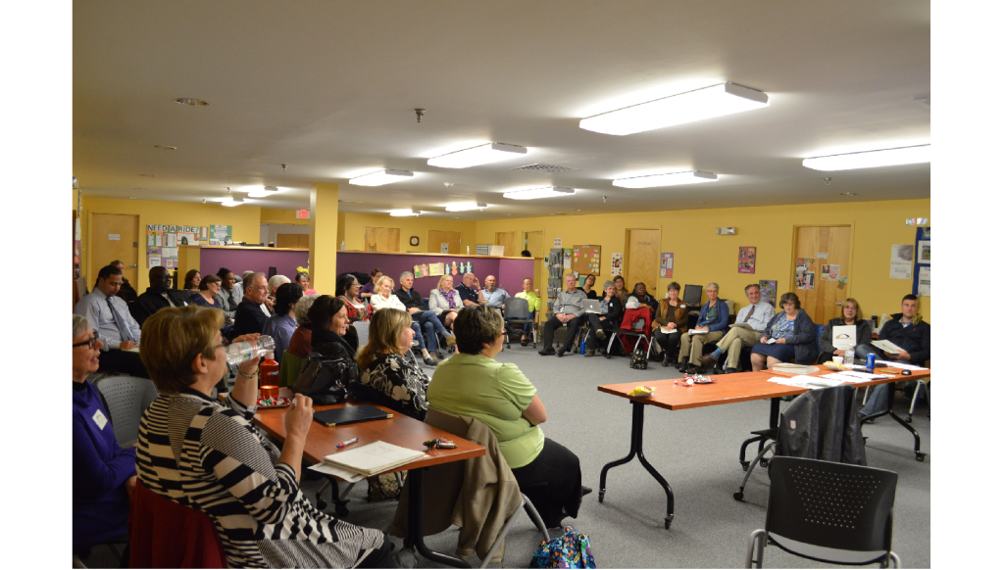
CUSTOMER #1 COMMUNITY RESIDENTS
Who would know more about what they need than those who actually need assistance?
Berkshire Bridges Community Meeting

Slide 17
EXAMPLE: WORKING CITIES INITIATIVE
Community conversations where 269 participants in 11 locations across Pittsfield between Jan 27 and March 8, 2016 identified what they saw as their primary needs.
- What the “experts” thought – jobs, transportation, child care.
- What the community identified – resource access, better communication, inclusion, perception and
information.
As a result, the initial design and focus of the proposal for the Working Cities grant was re-aligned with the stated needs of the community. United Way, Habitat for Humanity and many other stakeholders, ensure that the initiative’s activities are aligned and supported by current and ongoing community based programs.

Slide 18
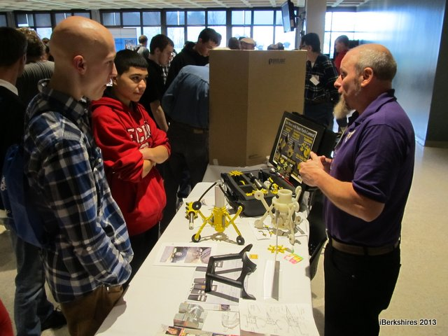
CUSTOMER #2 BUSINESSES
Who would know more about what skill sets job applicants need than the business who has job openings?
Students from all over the county see their potential futures in STEM fields at Berkshire Community College STEM Career Fair.
General Dynamics engineers help Reid students take flight.

Slide 19
EXAMPLE: BERKSHIRE COMMUNITY COLLEGE
BCC recently met with businesses and workforce development stakeholders to assist and inform BCC in the design and development of appropriate training, education, and certificate programs that will prepare job seekers for local employment. This ensures that stackable credentials and education and career pathways meet the needs of the business community.

Slide 20
EXAMPLE: CANYON RANCH AND KRIPALU
Efforts to find transportation options for employees at Canyon Ranch and Kripalu resulted in both businesses collaborating on using business vehicles to pick up employees at a central location that is served by public transit to get employees to each other’s business. This collaboration resulted after experimentation with other options and ideas.

Slide 21
WHAT DOES IT TAKE TO DO ALL OF THIS?
Collective Impact Model
Need for a champion, someone who will fill that facilitator role
Respect for the skills and talent that each person brings to the table
Put turf issues aside
Awareness of what everyone else is doing
Engage agencies that would not otherwise be involved in service delivery (Regional Planning Commission, etc.) - they need to hear from stakeholders about the impact of plans they are envisioning
Collective understanding of the challenges facing the community
Look to engage all stakeholders, regardless of perceived impact on the issues
Build collaboration into the core values of each stakeholder

Slide 22
WHAT DOES IT TAKE TO DO ALL OF THIS
Encourage relationships that build trust between all partners, businesses and customers to ensure sustainability
Share as much information as possible, don’t operate in a vacuum
Eliminate the notion of competition, the focus should be on the customer
Part of our nature is to take care of each other, embrace your regional identity
Check your ego at the door
Leverage services, do your best to limit duplication, use each other
Listen to your customers, and commit to making the changes necessary to meet their needs
Coordination of service delivery from partner agencies
Communication between all parties involved, both among themselves as a sector but also with each other.

Slide 23
TAKEAWAYS
1. USE AVAILABLE RESOURCES
Benefits Hub is a Community Action Program available state wide….can assist in referral and tracking of common customers.
2. COMMUNICATE
To build a true collaborative environment it takes a lot of personal effort and time. You have to be committed to listening to your customers and committed to making the changes necessary that lead to improved outcomes. We have not perfected the model yet, but all of us together are committed to working toward a point where social initiatives are interconnected and working seamlessly toward a common goal.
3. MEET REGULARLY
Meet regularly, not only within your sector, but on a community wide basis.
Example - Regional Housing Authority meets with regional and local landlords monthly to discuss housing availability, quality, identity trends, upcoming units, etc. At the same time they are also a part of Working Cities, Secure Jobs, etc. making the connection between employment and housing retention/stability.
Example - Regional State Agency Directors (DDS, MRC, DTA, DCF) meet quarterly to address common issues and coordinate services…leading from the top. At the same time they also engage Career Center, Working Cities and other regional initiatives to ensure a true continuum of services and work toward an alignment with these initiatives.

Slide 24
Next Presenter

Slide 25
Customer Centered Design
DOL Challenge

Slide 26
CHALLENGE: How to collaborate effectively to make things easier/better for our shared customers?

Slide 27
The Greater Lowell Workforce Development Team Members
One click to reveal….
Shannon Norton-Calles, Lead, Career Center of Lowell
Stacey Thompson, Co-Lead, Career Center of Lowell
Cathy Byrnes, Wagner Peyser
Jessica Cohen, Community Teamwork Inc.
Nancy Gagnon, Career Center of Lowell
Maureen Krieff, Massachusetts Rehabilitation Commission
Louise Lynch, Department of Transitional Assistance
Shaun McCarthy, Greater Lowell Workforce Development Board
Robert McIntosh, Career Center of Lowell
Elizabeth McKiernan, Abisi Adult Education Center
Janet O’Brien, Career Center of Lowell
Timothy O’Connor, Career Center of Lowell
Erin Quinn, Department of Transitional Assistance
Amy Veillette, Career Center of Lowell

Slide 28
We acknowledged and became versed in the steps of the program created by Ideo.org: Introduction, Inspiration, Ideation, Prototyping, and Implementation
Intro: Learn about the process
Inspiration: We delved into those of ourselves and our customers
Ideation: We became adept “brainstormers”
Prototyping: Created a new orientation and lobby area
Implementation: We implemented and tested our new orientation and triage system
http://www.designkit.org/methods
https://novoed.com/design-kit-2017-1

Slide 29
Inspiration in Interviews
In order to truly see what direction we needed to move in and where the changes needed to be made, we had to consult with people who knew what we do AND those who experienced the services we provide...
CUSTOMERS
Customers were given $25 Market Basket Gift Cards to participate
Remarked that they felt worse after the orientation
Felt lost in the Career Center

Slide 30
Expert Interview Commentary
Internal Expert Q & A
Question
What tools do you think could assist in providing better customer service here at the Career Center (of Lowell) and in general?
Response/Answer
“A friendly face, cheerful, and accommodating staff…I try to remember a customer’s name so they feel welcomed. A good idea is giving customer a name tag so they feel important and welcomed.”
External Expert Q &A
Question
What do you feel is integral in providing quality/effective customer service?
Response/Answer
“Forgetting about those performance measures. Don’t worry about regs. Build it and step back. Then assess. Find out where “are the trouble buckets”. Then we can look at things like can I change?”

Slide 31
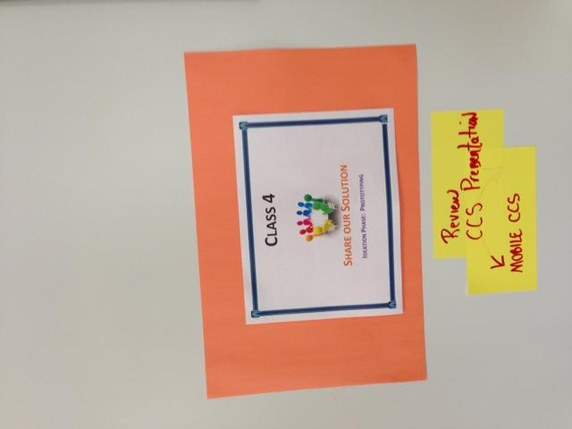
Ideation: HOW MIGHT WE….
Take all our ideas, the customer and expert data and make the changes necessary to really put our shared customers FIRST

Slide 32
Putting Plans In Motion
Storyboard Style

Slide 33
Storyboard
Shared Customer Referred Over..
Welcome and Let’s Get you started
The Shared Customer is referred to the Career Center of Lowell, greeted and ushered to the Orientation. During the Orientation, questions are posed and answers given. Afterward a membership is granted and the journey to your next step begins…but how we get you there could use some tweaking!!
Ask Questions & Gain Membership
I’m a member, now what?

Slide 34
Prototyping
After looking thoroughly through our HMW (How Might We) section, we realized that we could combine our post-it thoughts and in our initial assessments and delve into not the deep end, but the steps of the shallow end.
Our HMW Question: How Might We change our space and orientation to make it more welcoming while providing a plan of action/referral system for the customer to better their experience at the Career Center of Lowell?

Slide 35
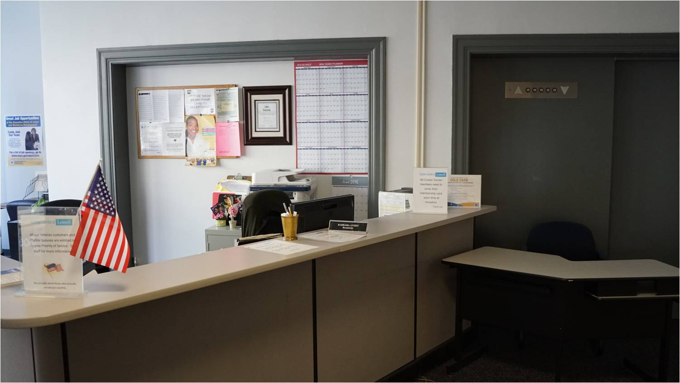
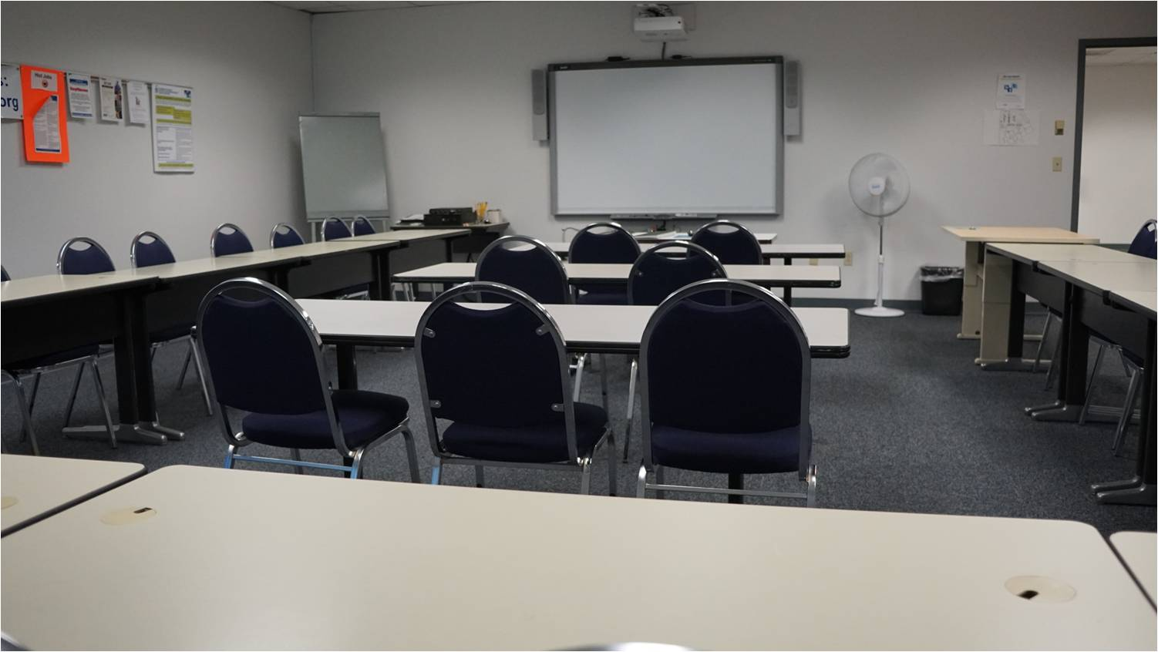
Prototyping-Welcome to the Career Center? Sometimes something as simple as a change of appearance can make a difference!
The Career Center Lobby
The CC Workshop Room
Pictures taken and a definite sprucing up is in order.
The first room for Customer Workshop

Slide 36
Career Center Seminar
Next up????

Slide 37
Re-vamping the CCS
Updating the PowerPoint to freshen up the presentation
Combine slides for customer ease
Evaluate the presenter styles-rotate different presenters in and out
Adapting presentation to the more stylish Prezi platform; will survey which comes across and addresses the material better.

Slide 38
IMPLEMENTATION

Slide 39
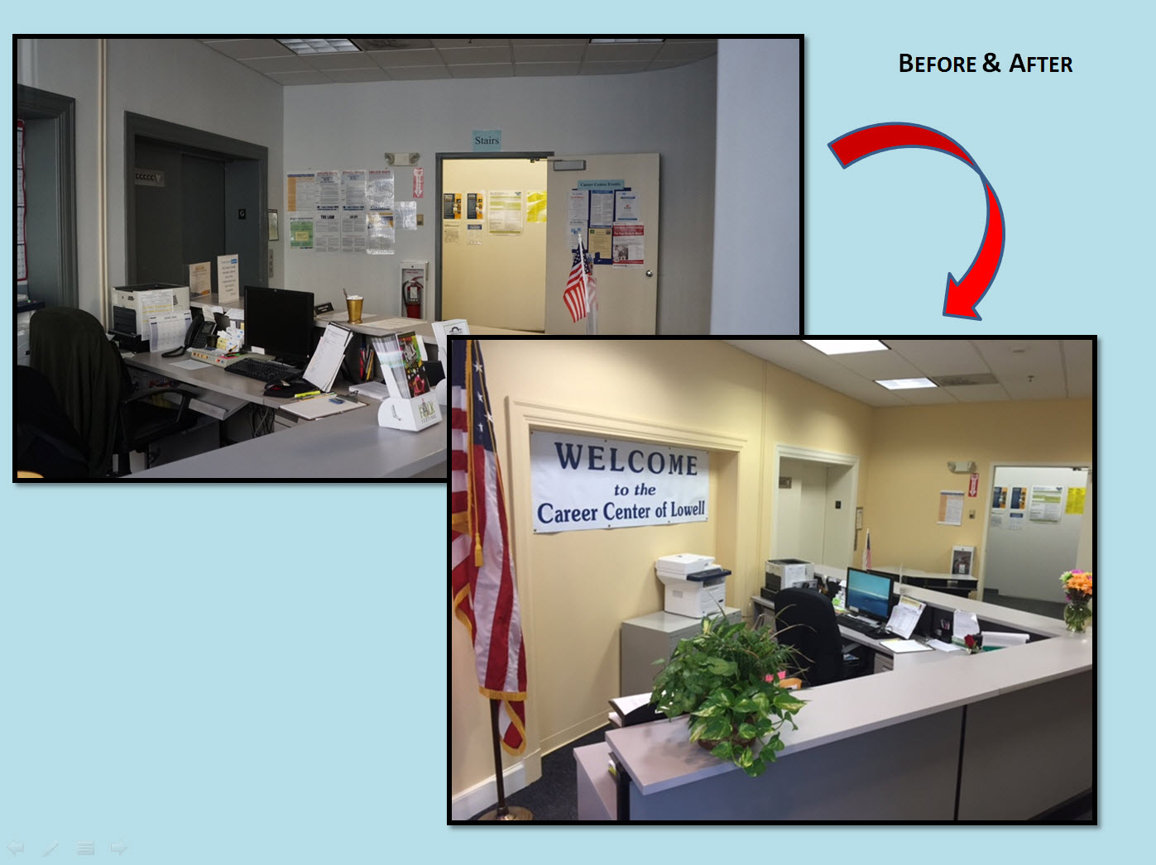
A Warmer ‘Reception’
The prototype lead to the physical alteration of our space to create a less sterile, more inviting lobby area. There have been many positive comments about the color and less cluttered signage.

Slide 40
Still Iterating…
Now that customers could feel a little more upbeat and welcomed visually, we had to address the next portion of their experience: The Non-UI Career Center Seminar. (CCS)
Our team had numerous discussions on the necessity for this to change and areas in which the change could take place, including style of presentation, length of time, etc.
However in the end we decided to start with the meat: the content of the CCS.

Slide 41
Non-UI Career Center Seminar
Before Prototype
Post-Prototype
Long
Covered Areas That Did Not Apply to Attendees
Too much information
No Ability to Meet with Career Advisor/Limited Next Step Assistance for All
More concise
Slides/Presentation Geared to Population
Essential Information
Concentrating on Next Step Guidance

Slide 42
What did we learn from testing the prototype?
It remains fluid…and not everything you try is going to ‘land’ BUT you have to keep trying!
Also, you have to be really careful in this process to not get so caught up in the procedures/steps of change, even though for a great reason, that you forget the reason for the change—THE CUSTOMER!

Slide 43
Iterations….
Explore the possibility of a Mobile Career Center Seminar
More physical changes to the center to ensure a warm experience
Strengthen systems to assist non-computer savvy members
Continue to tweak the triage approach
Create ongoing improvement teams

Slide 44
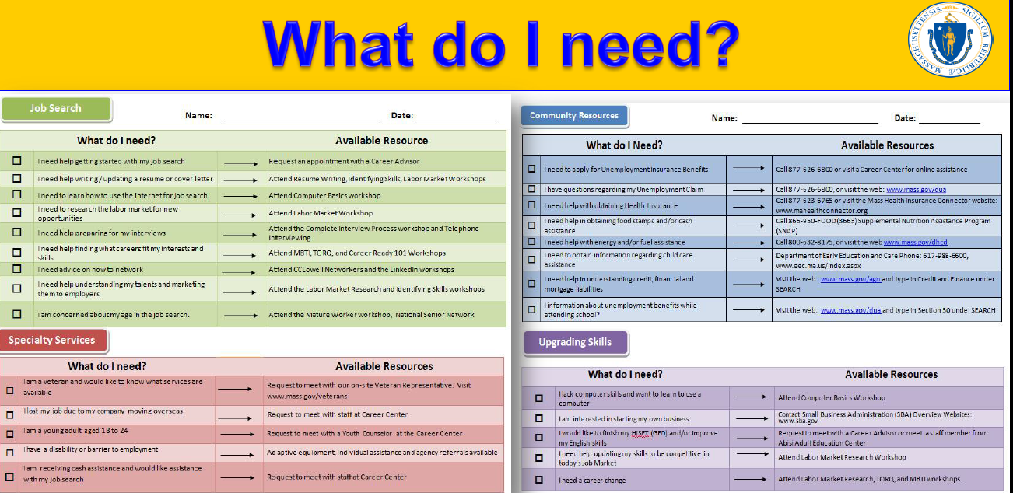
Prototype to Implementation
The newly-designed Non-UI Career Center Seminar is presented to its first set of customers. In addition to a new seminar, we selected a new presenter to deliver the material.
We added a very helpful self-assessment tool for the customers as well the “What Do I Need” form. This form assists clients with identifying areas for discussion and bring this form to their initial triage appointment.

Slide 45
Changes for the BETTER ??
How are things going?
THEN….
NOW….
How seminars were received prior to the Customer Centered Design Challenge…
UI-Career Center Seminar has an 80% customer return
Non-UI Career Center Seminar had a 39% customer return
After structural, facilitator and creative adaptations; customer response…
Customers are enjoying having a clear next step
79% of customers have opted to return to meet with the Career Center staff

Slide 46
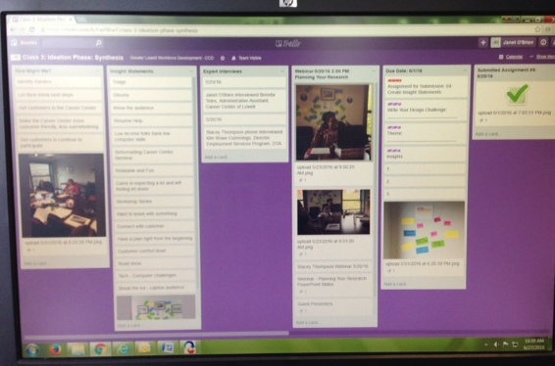
With a lot of readings, videos to view, assignments to complete and deadlines approaching…you need to stay organized!
Suggestions
For our team TRELLO was a great tool to organize our overall process. We also utilized doodle.com to create polls to organize and schedule interviews with customers and experts.
Take the free course
Ideo/Acumen course info:
http://www.designkit.org/methods
https://novoed.com/design-kit-2017-1

Slide 47
Prototype, Ideate, & Repeat
Customer Centered Design has enlightened our view and we can see implementations in two immediate areas where we’d like to test its impact:
How we deliver services to businesses
How we serve out of school youth
The customer first approach has also allowed for us to re-visit a concern--getting a “job-ready” resume to customers with limited computer skills.

Slide 48
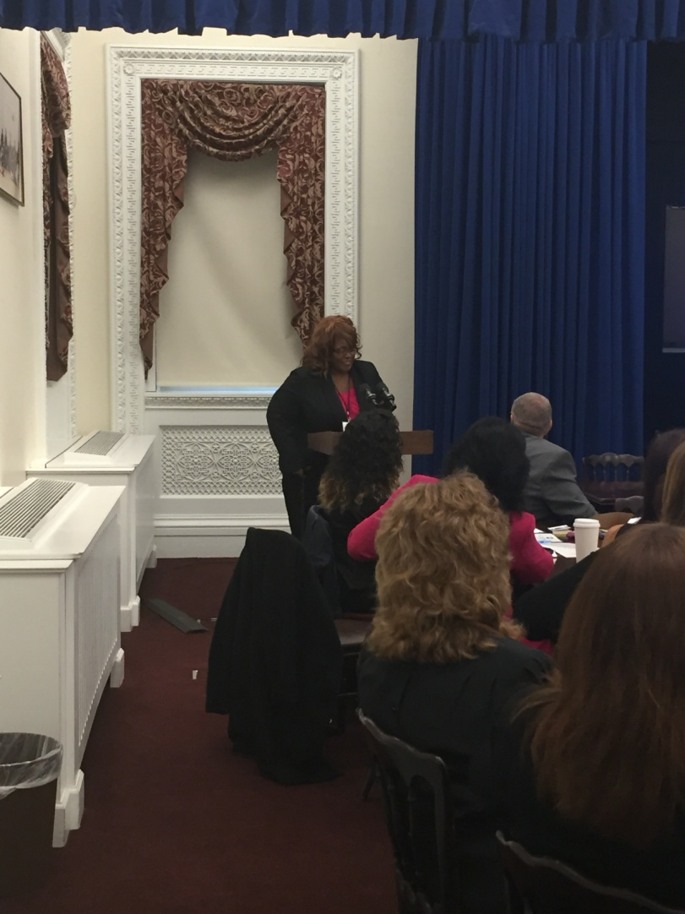
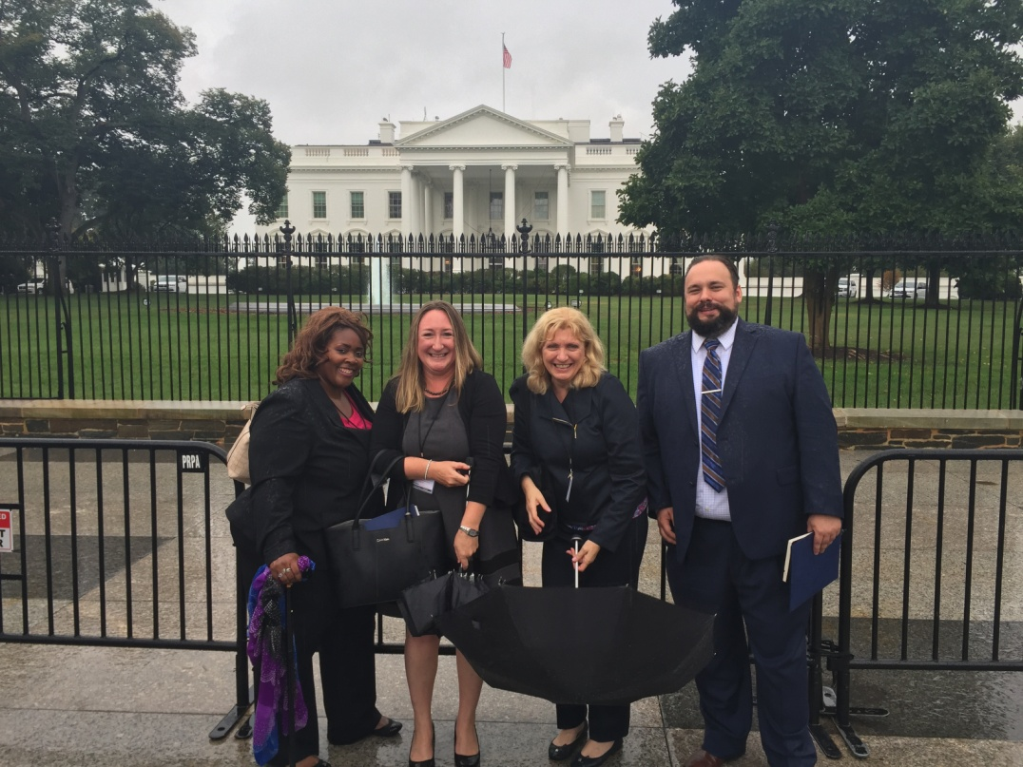
The White House Celebration
Above: Group photo in front of the White House; Stacey Thompson (CCL), Shannon Norton Calles (CCL), Cathy Byrnes (DCS), Shaun McCarthy (GLWDB)
Left: Stacey presenting our project at the White House

Slide 49
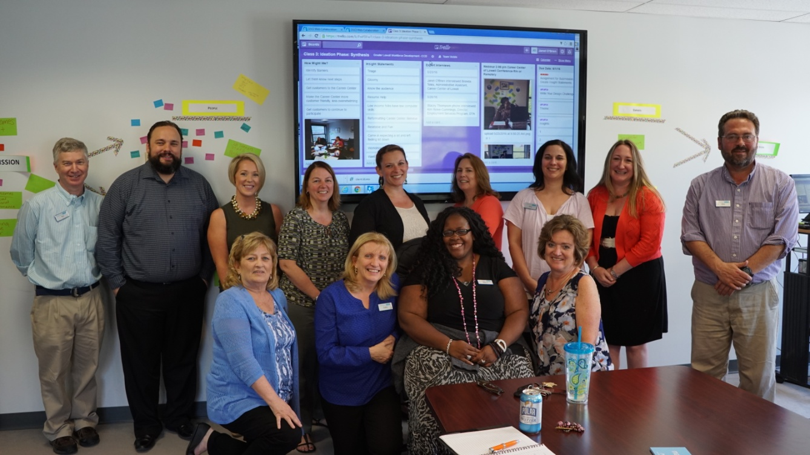
The Greater Lowell Workforce Development Board Team
Many thanks to our WIOA Partners including:
Title 1,Wagner-Peyser, Voc Ed, Adult Ed & Community Partners:
CTI and DTA

Slide 50
Next Presenter

Slide 51
Evaluating a Person Centered Design
Choice
Control
Self-Direction
KERRI ZANCHI, ASSOCIATE EXECUTIVE DIRECTOR
CENTER FOR LIVING & WORKING, INC.
KZANCHI@CENTERLW.ORG

Slide 52
Objectives
Differentiate between a System Centered Design and a Person Centered Design
Understand the Values and Guiding Principles of a Person Centered Design
Maximizing Partnerships and Resources for Successful Outcomes
Defining Quality in a Person Centered Design
Tools and Techniques for Evaluating Quality

Slide 53
System Centered Design vs. Person Centered Design
SYSTEM CENTERED DESIGN
PERSON CENTERED DESIGN
Focus is on collective outcomes and services often delivered around regulations
Services are limited to existing programs and systems
Plans and goals are limited to scope of a program
Strengths-based
Focus is on individual outcomes and the delivery of integrated services
Services are more reflective of innovative programming to meet individualized preferences and capacities
Plans are unique, individualized and value the significance of personal relationships and community life

Slide 54
Guiding Principles and Values of a Person Centered Design
Control
Choice
Self-Direction

Slide 55
Person Centered Values are Promoted Through:
Discovery
Self-guided assessments/Exploration tools
Honoring Individual Preferences
Empower consumer to identify what’s important ‘to’ them while exploring with consumer what’s important ‘for’ them
Embracing the Dignity of Risk
Promote autonomy by recognizing that opportunities for growth carry the potential for failure
Maximizing Partnerships and Community Resources
Setting Goals and Objectives
Personally designed and measurable goals
Determining and assigning roles and responsibilities

Slide 56
Goals

Slide 57
Quality in a Person-Centered Design

Slide 58
Quality in a Person-Centered Design
Access
Physical
Use of formal and informal evaluations
Develop mechanisms for ongoing feedback
Communication/Linguistic
Assistive technology – http://www.massmatch.org/
Web – http://www.w3.org/WAI/eval/selectingtools.html
Printed documents – Office Accessibility Checker

Slide 59
Quality in a Person-Centered Design
Services
Use of Self-Guided Assessments vs. Administered Assessments
Use of Person Centered Planning Tools – http://sdaus.com/resources
Collaborate with Community Resources to Create Streamlined Access/No Wrong Door
Embrace Dignity of Risk
Innovative, Flexible and Responsive to Change

Slide 60
Quality in a Person-Centered Design
Organizational Culture
The values of person centeredness are modeled through organizational policies and practices
Staff are empowered through training and engagement in organizational vision
Consumers are matched to staff at point of entry
Staff are recognized as facilitators -- ‘power with consumers’
Support plans are accountable – who is doing what and in what time frame
Shared vision exists across all levels of organization and with stakeholders

Slide 61
Evaluating Quality
Tools and Techniques
Utilize a Quality Management System
Continuous, relevant and integrated throughout the organizational structure
Outcomes are everyone’s responsibility
Obtain staff and stakeholder input into defining key outcomes
Define clear and specific data elements and set benchmarks to analyze outcomes for success and improvement

Slide 62
Evaluating Quality
Tools and Techniques
In addition to tracking key data elements, use tools that assess both quantitative and qualitative measures
Satisfaction surveys to assess access, services, staffing, outcomes
Self-evaluation tools at key intervals of service
Evaluate initial contacts who don’t pursue services
Obtain input from partnerships, collaborations, and local community resources
Staff evaluations
Create reports or dashboards to promote access and communication around outcomes data
Engage staff and stakeholder in quality improvement plans
QI Committee
Focus Groups

Slide 63
Next Presenter

Slide 64
A SCSEP SUCCESS STORY
Bonny DiTomasso
Home and Community Based Programs Supervisor
bditomasso@esbci.org

Slide 65
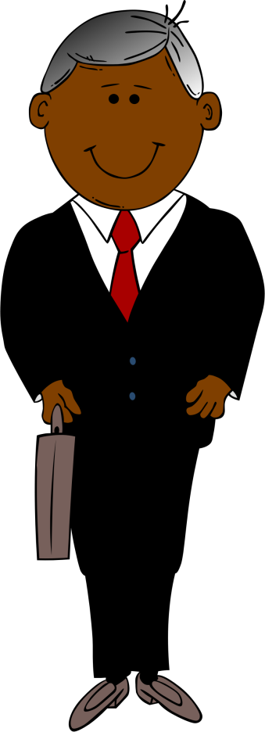
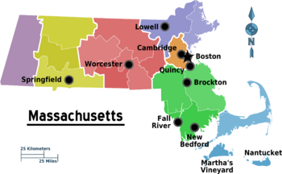
David’s Barriers

Slide 66
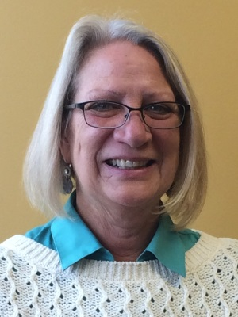
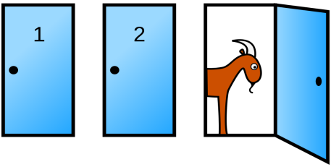
Putting Policy into Practice
Berkshire Aging and Disability Consortium (ADRC) utilizing the No Wrong Door approach with Person Centered Counseling to meet the consumer’s needs
SCSEP Job Developer, Linda Kay, met one on one with David to identify what was important TO David
David entered the SCSEP program as a custodian at a local church but shared that his goal was to learn to cook

Slide 67
RESOURCE TOOLKIT
WORKFORCE
DEVELOPMENT

Slide 68
RESOURCE TOOLKIT
COMPUTER
TRAINING

Slide 69
RESOURCE TOOLKIT
PERSONAL
APPEARANCE
& HYGIENE

Slide 70
RESOURCE TOOLKIT
SPECIALIZED
CAREER
TRAINING

Slide 71
RESORCE TOOLKIT
TRANSPORTATION

Slide 72
RESOURCE TOOL KIT
HOUSING

Slide 73
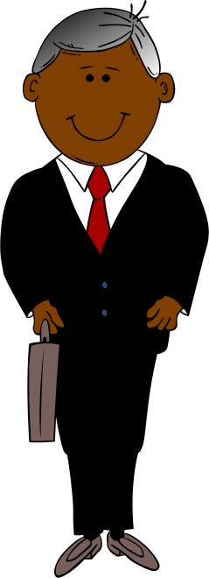

Slide 74
Bonny Ditomasso
Home and Community
Based Programs
Supervisor
BDitomasso@ESBCI.org
(413) 499-0524 x 750

Slide 75
Customer Centered Design Workshop Outline
II. Hands-on exercise – 25 minutes

Slide 76
Please work at your table for 20 minutes; then report out
Meet Your Customer
Ms. Diaz is 59 years old with legal immigration status. She recently moved to Leominster from her native town of Arequipa, Peru where she worked as a nurse at the regional hospital in the cardiac care unit.
Ms. Diaz lives with her daughter who has a family of five. Because her daughter’s apartment only has 2 bedrooms, Ms. Diaz sleeps on the sofa. Her current address is 100 Main Street, Leominster, MA. She does not have a car and relies on her son-in-law for transportation. However, he is about to begin full-time employment, and her daughter also works full-time.
Ms. Diaz’s English proficiency is limited; she can understand English better than she can speak it. She is unable to read or write in English.
Ms. Diaz doesn’t have a bank account yet. Her income is $0.
She receives only informal support from family and friends.
Ms. Diaz has a self-declared disability: Type-1 diabetes.
Ms. Diaz is very enthusiastic and hopes to be able to work in healthcare soon

Slide 77
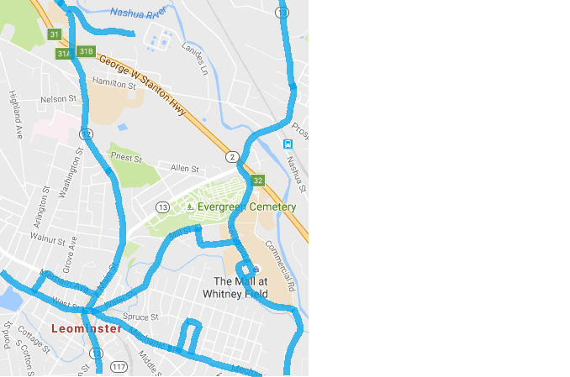
Resources
Labor Market Info and Other Resources
Largest Employers:
Health Alliance Hospital, 500 – 999 employees
Georgia-Pacific Corp (paper product manufacturing), 250 – 499 employees
Hannaford Supermarket, 250 – 499 employees
Alpha Gary Corp (plastics manufacturing), 100 – 249 employees
Atlas Copco Inc. (industrial equipment manufacturing), 100 – 249 employees
Local community health center is looking for volunteer patient navigators
Community college offers ESL courses and CNA certification programs
Training programs available to bridge gap between HCA and CNA
Spanish-American Center offers bilingual services, referrals, and ESL classes
Senior Center runs Diabetes Management Support group in Spanish
Legend
Home (100 Main St)
Career Center
Community College
Senior Center
Community Health Center
Spanish-American Center
Food Pantry
Housing Authority
Public Library
City Hall
Bus Route

