Slide 1
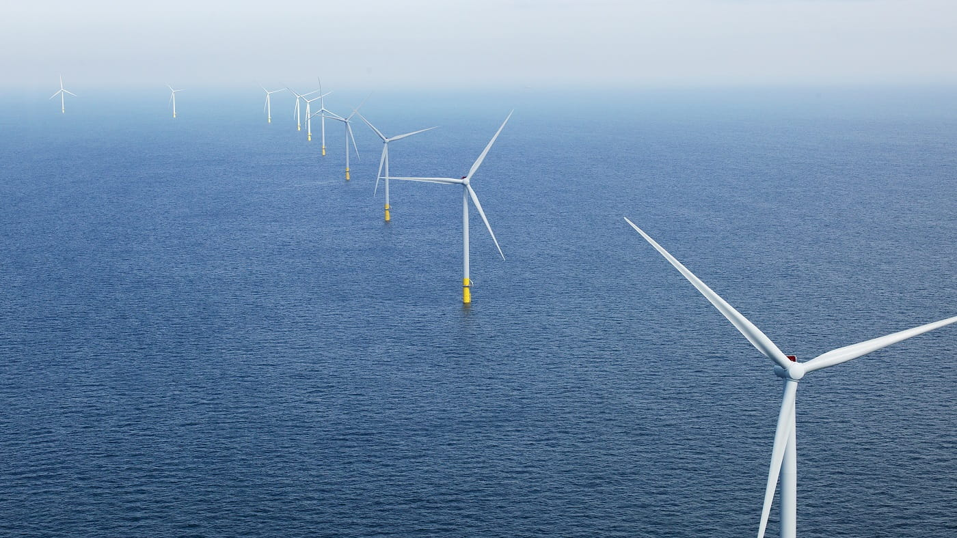
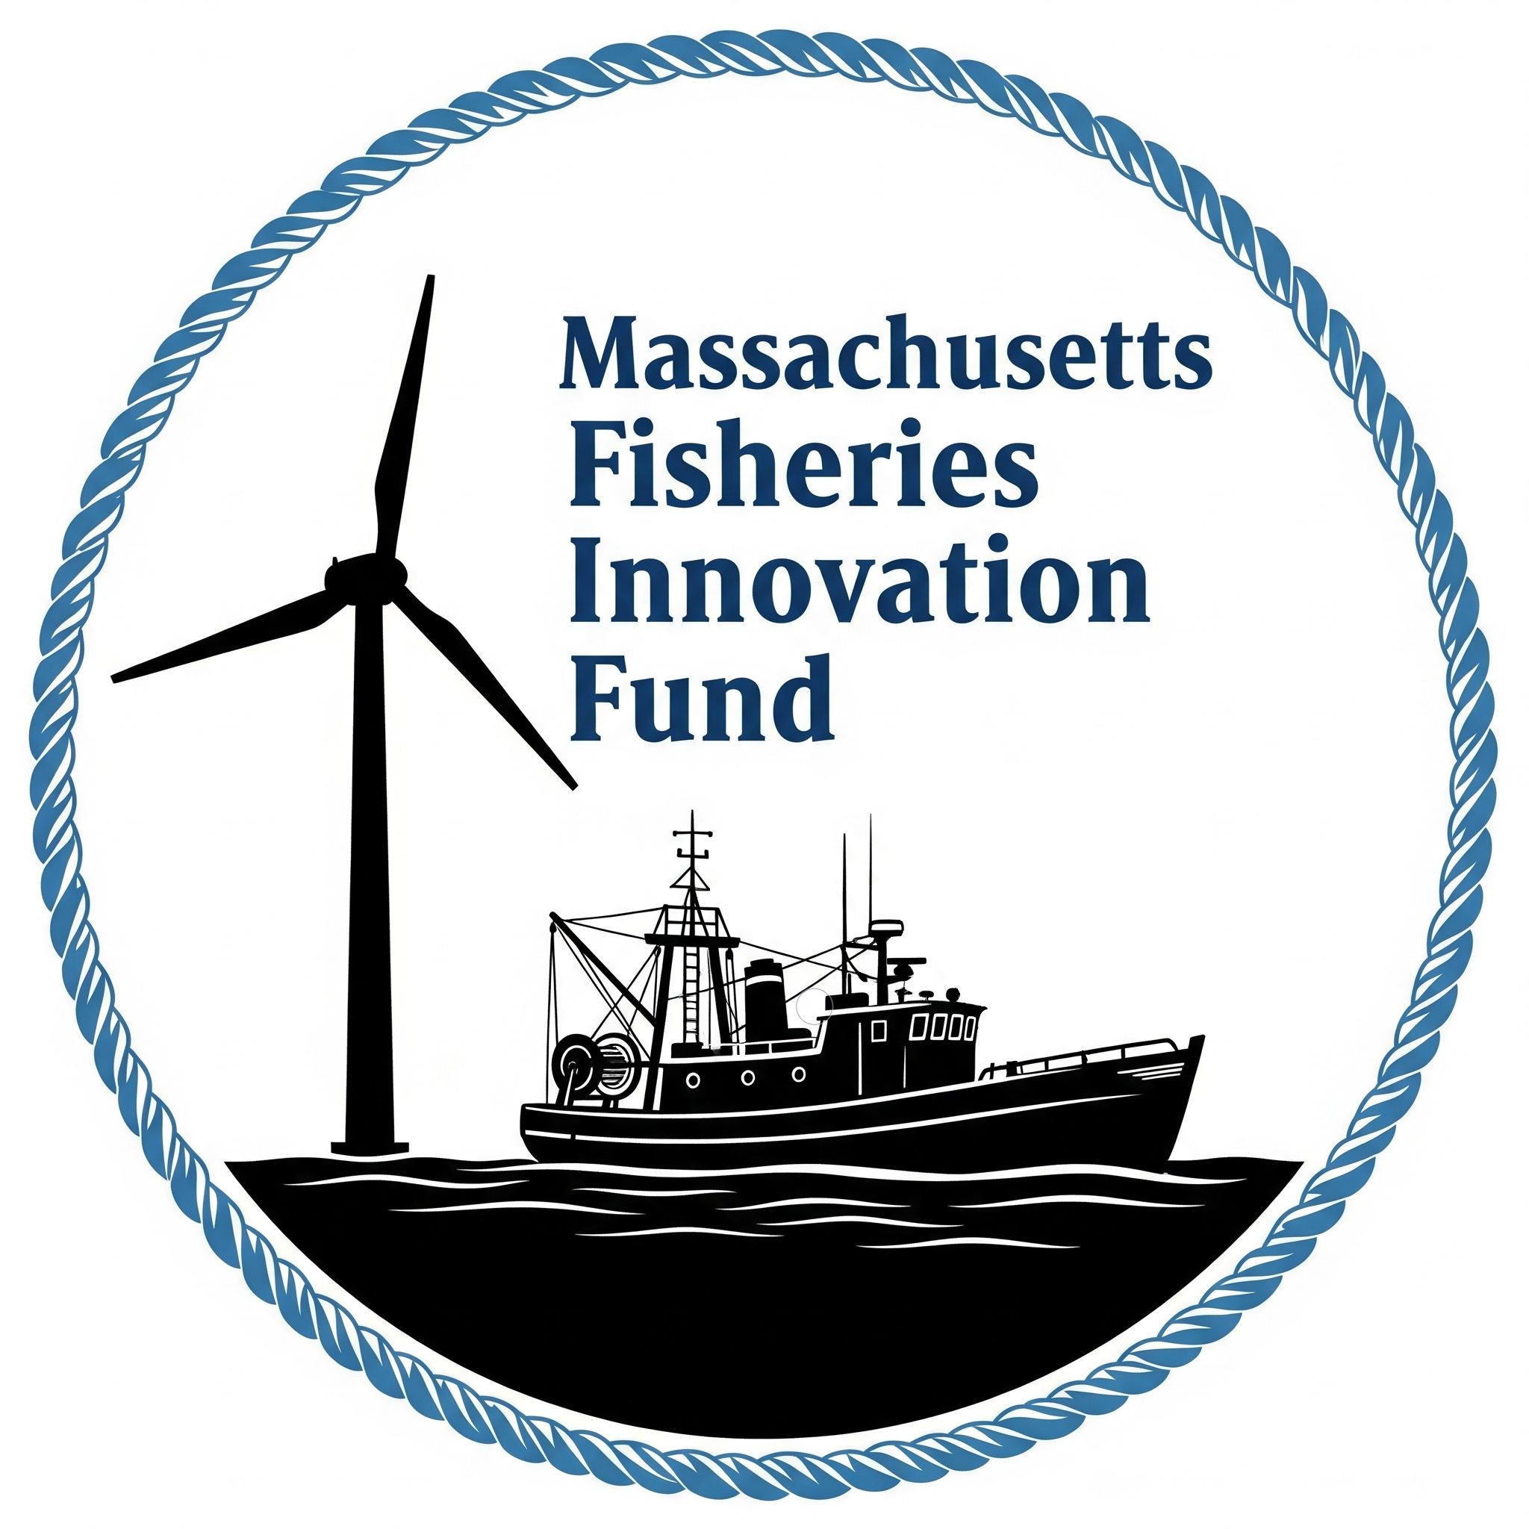
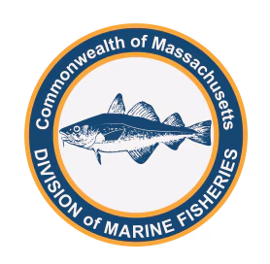
Massachusetts Fisheries Innovation Fund
Funding Award Announcement
Brad Schondelmeier
Offshore Wind and Fishery Specialist
Massachusetts Division of Marine Fisheries

Slide 2
Massachusetts Fisheries Innovation Fund Background
$1.75m mitigation fund created in 2020 by Vineyard Wind to:
“support programs and projects that ensure safe and profitable fishing continues as Vineyard Wind and future offshore wind projects are developed in Northern Atlantic waters”¹
“Conduct studies on the impacts of offshore wind development on fishery resources and the recreational and commercial fishing industries” ¹
“Provide grants for technology and innovation upgrades for fishery participants (and vessels) actively fishing within a wind energy area” ¹
Where “the criteria used to guide the disbursement of funds from The [Fund] will be developed in consultation with the [Advisory] Panel” ²
DMF drafts RFP CZM/DMF staff review RFP May 2025 meeting of Advisory Panel
FIF Advisory Panel refines RFP → prioritize projects that benefit and collaborate with fishing industry, and de-emphasize research and monitoring (funds available elsewhere)
FIF Solicitation 1 Priorities: Fishing Innovation Community Safety
¹ VW-EEA Agreement ²VW-EEA Declaration of Trust

Slide 3
Massachusetts Fisheries Innovation Fund Update
Progress Update
Request for Proposals published July 7th, closed August 29th
  Grants applied to, reviewed and managed digitally
  Ethics statements, NDAs and COI forms
  Initial and Final Review Panels (two rounds)
  Approved by EEA/Gov’s Office
Received 20 Proposals
seeking $3.37m
Proposals reviewed over 2 rounds by nine content experts from diverse backgrounds (including all eligible/willing members of FIF Advisory Panel)
Recommendation for funding presented to Trustee and accepted
Six projects and nearly $1.2m awarded
Notes:
… and without further ado, those project are //

Slide 4
Massachusetts Fisheries Innovation Fund Awards
Priority | Awardee | Project Title | Funding
Fishing Innovation | FV Martha Elizabeth | Fishermen Led Gear Innovation in Southern New England | $ 174,908
Fishing Innovation | Commercial Fisheries Research Foundation | Advancing Mechanical Jigging to Strengthen Squid Fishery Resilience Amid Offshore Wind Development | $ 261,443
Fishing Innovation | UMass Dartmouth - SMAST | Novel fish potting with lights for black seabass and scup: Developing innovative fishing gear for safe and efficient operation in offshore wind farm areas | $ 265,984
Community | Eating with the Ecosystem | Reelsilience: Strengthening Markets for Massachusetts Seafood through Video and Public Engagement | $ 156,533
Community | New Bedford Port Authority | New Bedford Seafood Study, Marketing and Promotional Campaign | $ 250,000
Safety | Commercial Fisheries Research Foundation | Evaluating the Hazard of Trawling Over Cable Protection Mattresses | $ 60,768
Solicitation 1 awards up to $1,169,635 to six projects

Slide 5
Fisheries Innovation Fund Awarded Project Details 1
Fishermen Led Gear Innovation in Southern New England
Project Lead: FV Martha Elizabeth/Wes Brighton/Menemsha MA
Project Partners: Coonamessett Farm Foundation, Falmouth MA
  Develop, test and monitor lighted traps for finfish, scallops and possibly squid
  Goal is to produce viable gear solutions that can sustain and supplement fishing opportunities in or alongside offshore wind farms
Fishing Innovation
Advancing Mechanical Jigging to Strengthen Squid Fishery Resilience Amid
Offshore Wind Development
Project Lead: Commercial Fisheries Research Foundation/David Bethoney/Saunderstown, RI
Project Partners: FVs Princess Scarlett & Lightning Bay, The Town Dock, Atlantic Shellfish, Inc., Coonamessett Farm Foundation (Falmouth MA), Fishing Machine LLC – Japan
  Leverage existing knowledge to streamline deployment and operations of jig machines to maximize catches
  Develop SOP for deploying jig gear - inshore, within/near offshore wind farms and offshore
  Create outreach materials and share results with relevant communities and regulatory bodies
Fishing Innovation

Slide 6
Fisheries Innovation Fund Awarded Project Details 2
Novel fish potting with lights for black seabass and scup: Developing innovative fishing gear for safe and efficient operation in offshore wind farm areas
Project Lead: UMassD-SMAST/Pingguo He/New Bedford, MA
Project Partners: Reidars Manufacturing (New Bedford), local commercial fisherman
  Develop and evaluate fish pots with different LED light colors
  Commercial fisherman will deploy best-performing pot/light configuration in OSW array
  Measure catch performance and describe economic feasibility of broader industry adoption
Fishing Innovation
Reelsilience: Strengthening Markets for Massachusetts Seafood through Video and Public Engagement
Project Lead: Eating with the Ecosystem/Kate Masury/South Coast, MA
Project Partners: Tackle 2 The People, collaborating chefs and commercial fishermen
  Promote MA-harvested seafood (Scup, sea bass, pollock, monkfish, Jonah crab, skate, whiting) through public engagement, produced video episodes (with fishermen and chefs) and social media
  Host four public events in MA, pairing episode screenings with tastings and panel discussions
  Reduce consumer intimidation, grow seafood demand and build public support for fishing industry
Community

Slide 7
Fisheries Innovation Fund Awarded Project Details 3
New Bedford Seafood Study, Marketing and Promotional Campaign
Project Lead: New Bedford Port Authority/John Regan/New Bedford, MA
Project Partners: New Bedford Ocean Cluster/Jen Downing, seafood marketing entity
  Marketing and promotional campaign for New Bedford fisheries and seafood products
  Strengthen market visibility, consumer awareness and New Bedford brand identity
  Support local fishermen, enhance New Bedford’s competitiveness and generate measurable economic benefits throughout the region
Community
Evaluating the Hazard of Trawling Over Cable Protection Mattresses
Project Lead: Commercial Fisheries Research Foundation/David Bethoney/Saunderstown, RI
Project Partners: Commercial fisherman, Superior Trawl
  Assess how different trawl gears and configurations, when towed at different speeds and directions, interact with cable protection mattresses
  Document and describe any gear damage, snagging incidents and movement of cable mattresses
  Collect feedback from fishermen on handling, safety and performance
Safety

Slide 8
Massachusetts Fisheries Innovation Fund Summary
Funding Summary
Next Steps
Scope of Work and Contracting with awardees
Meet with FIF Advisory Panel
  Discuss awards
  Refine application and review process
  Update scope of RFP for Solicitation 2 (2027)
  Consolidate OSW mitigation funds and
  consider future spending plan
Progress updates from awardees in Mid-2026
Final results (for 1-year projects) in Mid-2027
Funding Statistics
New Bedford/Cape & Islands applicants and collaborators to receive $742,000
Commercial fishing industry to receive $375,000 (32%)
Commercial fishing vessel contracts account for $160,000 (14%)
Massachusetts commercial fishing industry to receive $236,000 (20%)
Thank You
All applicants and industry partners
EEA Grant Management Staff
FIF grant reviewers
DMF staff

Slide 9
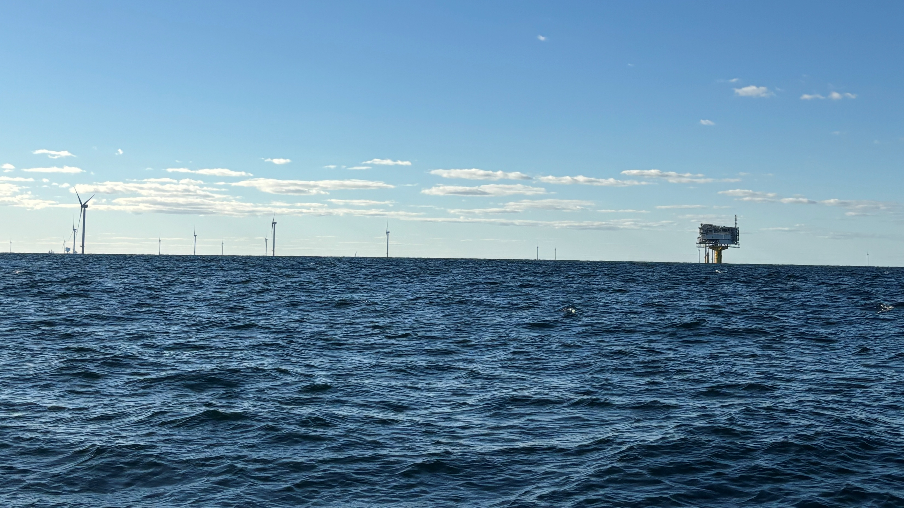
Questions?

Slide 10
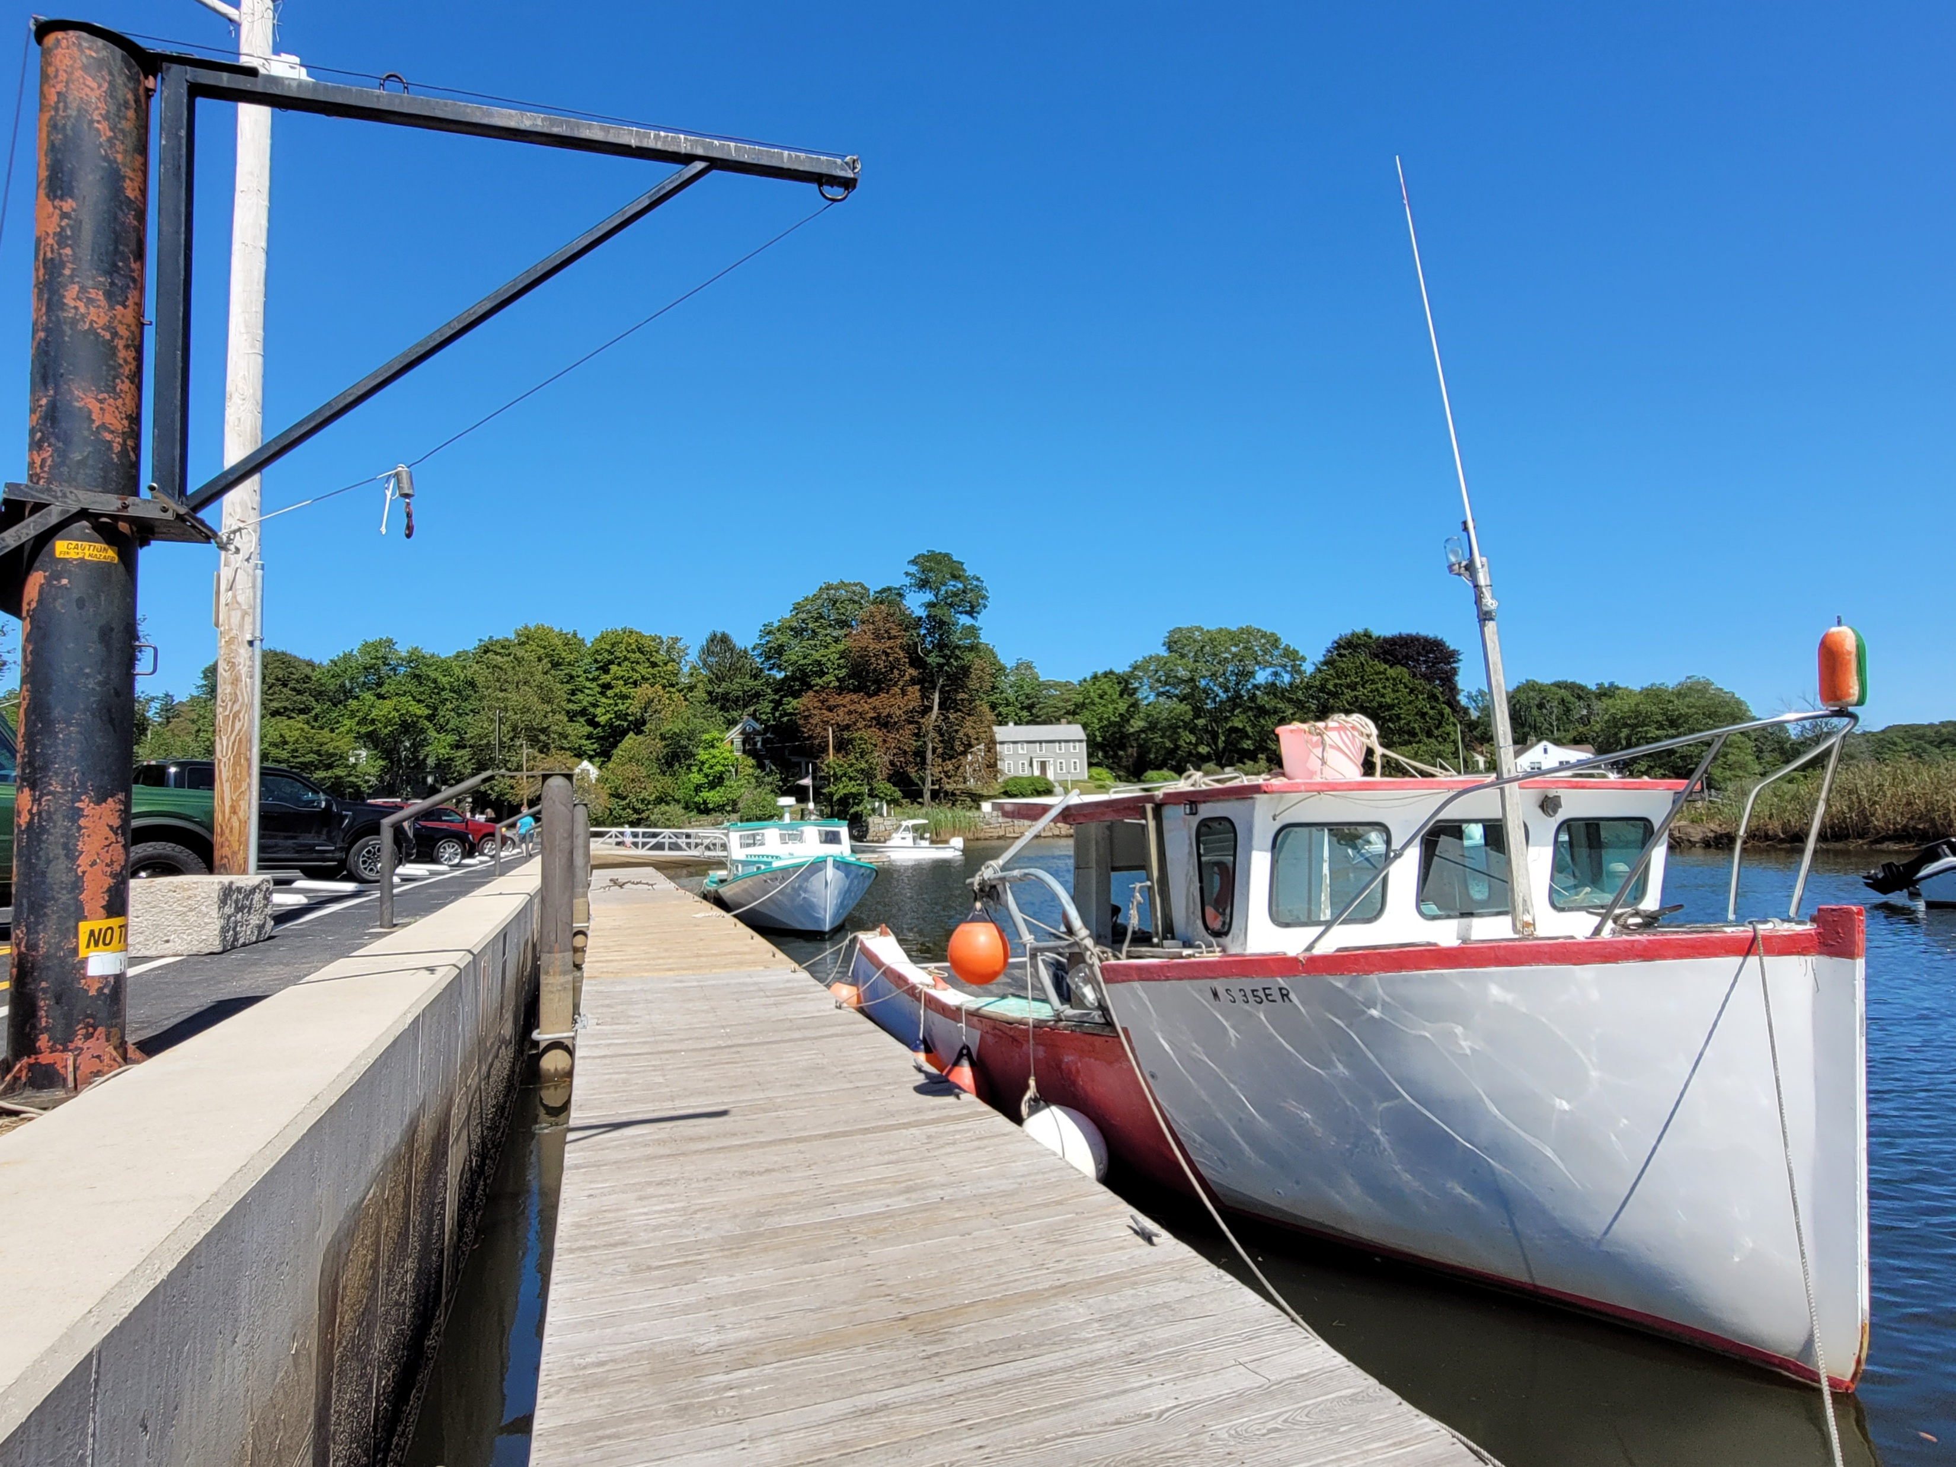
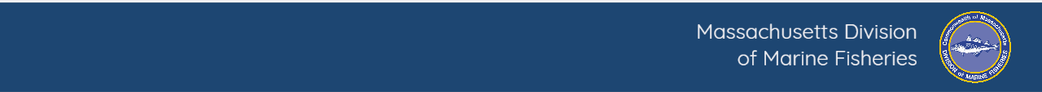
Port Profile Update
Harvester survey emailed out on November 7th, closed on December 10th
  ^{Two reminders sent}
  ^{~560 responses}
Harbormaster survey emailed out during the week of November 3rd
  ^{Follow-ups ongoing}
Updated fisheries statistics analysis is underway
December 12, 2025

Slide 11
Port Profile Timeline
Draft Timeline
June 2025
  Meet with CFC Focus Group
  Begin fisheries statistics work
Summer 2025
  Begin work with Urban Harbors Institute
  Finalize survey*
Fall/Early Winter 2025/2026
  Distribute Harbormaster and Fisher Surveys
  Survey outreach*
Winter 2026 – Analyze results and write report
Spring 2026
  Release full report
  Report outreach*
December 12, 2025

Slide 12
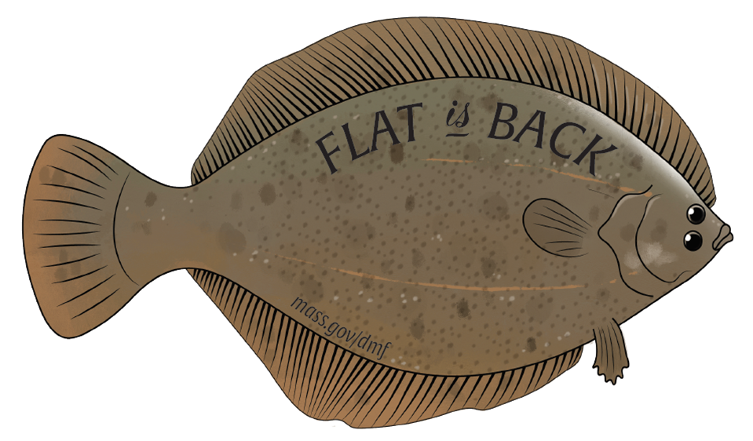
Flounder Processing Focus Group Update
Focus group met on December 9, 2025
The group discussed three main topics for future work:
Processing and infrastructure
  Identify barriers and needs
Marketing
  Media and social media
  Consumers and chefs
SNAP in seafood retailers
Next Meeting
Late January
December 12, 2025
Notes:
Present at December 9th meeting were Al Cottone, Roger Berkowitz, Frank Mirarchi, Sefatia Romeo Theken, Dan McKiernan, Jared Silva, Wendy Mainardi, and myself.

