Slide 1
COMMISSION ON METHAMPHETAMINE USE
Established by Section 131 of Chapter 24 of the Acts of 2021
April 29, 2022

Slide 2
Table of Contents
Commission Overview
Background
Key Definitions
Stimulant Use – National Trends
Stimulant Use in the Commonwealth
Commission’s Overall Findings and Recommendations
Commission’s Findings by Charge
Appendices
Appendix A – Legislative Mandate
Appendix B – List of Commission Members
Appendix C – Summary of Meetings and Input Provided to the Commission
Appendix D – Resources Reviewed by the Commission
Appendix E – First Responder Resources
2

Slide 3
Commission Overview
The Commission on Methamphetamine Use was established in July 2021 with Governor Baker’s signing into law Section 131 of Chapter 24 of the Acts of 2022 (FY22 Budget). The Commission was chaired by the Secretary of Health and Human Services and was comprised of a diverse panel of policymakers, public health professionals, clinicians, and first responders appointed by the Governor, the Secretary of Health and Human Services, and medical, law enforcement, and first responder agencies (see full list in Appendix B).
The Commission met five times from December 2021 through April 2022 and was charged with developing recommendations regarding methamphetamine and other stimulant use in the Commonwealth.
All meetings were subject to the open meeting law and minutes were taken and approved for each meeting. Appendix C outlines the meetings and input provided, including the individuals who presented as well as their materials. All materials considered by the Commission as well as minutes of the Commission’s meetings are posted on a publicly-available webpage: https://www.mass.gov/info-details/commission-on-methamphetamine-use-meeting-materials
An email address was created for members of the public to submit comments and questions for the Commission: commission-on-methamphetamine-use@mass.gov
3

Slide 4
Commission Overview (cont.)
The Commission was required to submit its findings and recommendations to the Clerks of the Senate and House of Representatives, the Joint Committee on Mental Health, Substance Use and Recovery, the Joint Committee on Public Health, the Joint Committee on Public Safety and Homeland Security and the Senate and House Committees on Ways and Means not later than March 31, 2022.
At the Commission’s February 8, 2022 meeting, members determined that the breadth of their charges and the remaining topics to be covered necessitated additional time to allow for a more in-depth discussion of its findings and report. The Secretary submitted a letter to the Clerks of the Senate and House of Representatives on March 1, 2022 indicating that the Commission’s report would be filed no later than April 30, 2022.
4

Slide 5
Background – Key Definitions
Amphetamines: a class of central nervous system stimulants. Can be legally prescribed and used to treat attention-deficit hyperactivity disorder (ADHD) under the name Adderall and Ritalin. They can be highly addictive if used incorrectly/recreationally.
Methamphetamines: a potent amphetamine, which can be legally-prescribed for certain medical conditions, eg, to treat obesity and ADHD. Regular methamphetamine is a pill or powder, while crystal methamphetamine resembles glass fragments or shiny blue-white “rocks” of various sizes.
All Stimulants: term encompassing all amphetamines, methamphetamine, and crack/cocaine.
Acute Treatment Services (ATS): ATS programs provide inpatient medical management of withdrawal (often referred to as detoxification) to persons with addictive disorders who are dependent on medications, illicit drugs, or alcohol and are at risk of experiencing physical withdrawal.
Enhanced Acute Treatment Services (E-ATS): ATS programming for individuals with co-occurring addiction and mental health disorders that both require a 24-hour level of care. E-ATS patients require both medical management of withdrawal by an inpatient, 24-hour, medically-monitored evaluation, care, and treatment facility, as well as 24-hour care and treatment for their mental health needs, including thorough psychopharmacologic evaluation and treatment for stabilization.
Clinical Stabilization Services (CSS): CSS programs provide short-term stabilization services following ATS to persons with addictive disorders who are no longer at risk for withdrawal.
Transitional Support Services (TSS): TSS programs provide intermediate residential support services for people who need a safe and structured environment to support their recovery process after medical management of withdrawal. These programs are designed to transition individuals from acute treatment services to residential rehabilitation.
Note: definitions adapted from the following sources:
1. DEA Fact Sheets: https://www.dea.gov/sites/default/files/2020-06/Amphetamines-2020_0.pdf; https://www.dea.gov/sites/default/files/2020-06/Methamphetamine-2020_0.pdf; https://www.dea.gov/sites/default/files/2020-06/Stimulants-2020.pdf
2. BSAS website: https://www.mass.gov/service-details/substance-addiction-services-descriptions
3. Massachusetts Behavioral Health Partnership: https://www.masspartnership.com/pdf/MNC-E-ATS.pdf
5

Slide 6
Background – Key Definitions (cont.)
Contingency Management: an evidenced-based, outpatient treatment approach that utilizes positive incentives to promote cessation or reduction of substance use and engagement in treatment. In most cases, participants receive cash, vouchers, or other rewards in response to urine toxicology screens that are negative for non-prescribed substances and other positive behavior changes consistent with participants’ recovery goals, eg, showing up to appointments, compliance with medication regimen, etc. Bonuses increase with each positive outcome, such that with the accumulation of negative toxicology screens over time, patients can earn greater and greater rewards for each subsequent negative screen that is completed.¹
In 2019, the Harm Reduction Commission utilized the following definitions in its report:²
Harm Reduction: A spectrum of evidence-based and evidence-informed strategies including safer use, managed use, and abstinence to meet people who use drugs (PWUD) “where they’re at,” preserve their dignity, and address conditions of use along with the use itself. There is no universal definition or formula for implementation. As harm reduction approaches and interventions should reflect specific individual and community needs, program and policy design must reflect the diversity of settings and input from all relevant stakeholders.
Supervised Consumption Site: Supervised Consumption Sites (SCS), alternatively known as Overdose Prevention Sites, are a tool of harm reduction that primarily aim to reduce the acute risks of disease transmission through unhygienic injection and prevent drug-related overdose deaths. Most SCSs focus on injection drug use, however, some allow or include space for other types of consumption. Some SCSs connect individuals with addiction treatment and other health and social services. SCSs provide drug users with sterile consumption equipment and emergency care in the event of overdose. SCSs are spaces where people who use drugs (PWUD) can ingest pre-obtained substances in the presence of trained staff who provide clinical monitoring. SCSs may be free-standing, mobile, or attached to or part of another facility. SCSs tend to be located in settings that are experiencing problems of public use and primarily support sub-populations of users with limited opportunities for hygienic consumption. SCSs may offer additional services such as sterile injecting equipment to take home, counseling services before, during and after drug consumption, primary medical care, testing for HIV and Hepatitis C, and referral to appropriate services.
Notes
1. START presentation: https://www.mass.gov/doc/start-stimulant-treatment-and-recovery-team-presentation-2822-0/download
Contingency management: what it is and why psychiatrists should want to use it: https://www.ncbi.nlm.nih.gov/pmc/articles/PMC3083448/
2. Definition of Supervised Consumption Site slightly adapted for the context of this report. https://www.mass.gov/doc/harm-reduction-commission-report-3-1-2019/download
6

Slide 7
Background – Stimulant Use – National Trends
Although much attention has been focused on the ongoing opioid crisis, stimulant-related overdose deaths from methamphetamines and cocaine have increased dramatically over the past decade.
About 1 in 5 (13,942; 19.8%) of the 70,237 drug overdose deaths that occurred in the United States in 2019 involved cocaine, a 34.4% increase from 2016.
Drug overdose deaths involving synthetic opioids and methamphetamine have shifted geographically. From 2018 to 2019, the largest increase in death rates involving synthetic opioids occurred in the West (67.9%) while the largest increase in death rates involving psychostimulants occurred in the Northeast (43.8%).¹
From 2016 to 2017, death rates involving cocaine and psychostimulants increased across age groups, racial/ethnic groups, county urbanization levels, and multiple states.
Opioids were also involved in 72.7% of cocaine-involved deaths, primarily synthetic opioids like fentanyl.
Synthetic opioids appear to be the primary driver of cocaine-involved death rate increases, and recent data point to increasing synthetic opioid involvement in psychostimulant-involved deaths.
¹ CDC: (https://www.cdc.gov/drugoverdose/deaths/)
7

Slide 8
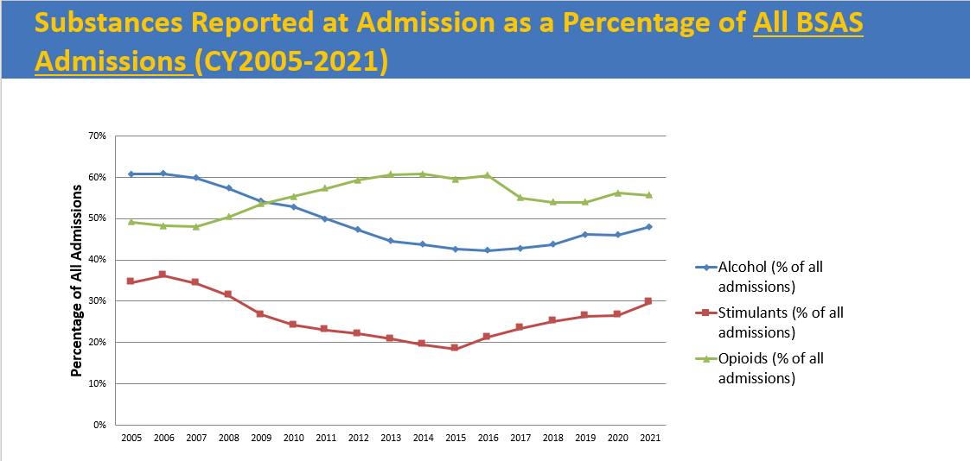
Background – Stimulant Use in the Commonwealth
In Massachusetts, the number of deaths involving stimulants has increased significantly since 2010, and this increase has been closely linked to increases in opioid-related overdose deaths.
Massachusetts has seen an increase in use of stimulants such as cocaine and methamphetamine, in addition to overdoses and deaths involving these substances.
In 2020 there were 1,124 deaths from stimulants and 103 attributed to methamphetamine.
Rates of methamphetamine use are higher in Suffolk County and the eastern portions of the state, consumed largely among the white non-Hispanic population.
Based on DPH BSAS data, consumption of crack cocaine is seen statewide and has a higher prevalence among African-American and Latinx populations.
Cross-contamination of stimulants with fentanyl is of great concern.
Source: Case Mix data is administered by CHIA and includes discharge records from approximately 70 acute hospitals in Massachusetts
Source: Treatment statistics prepared by the Office of Statistics and Evaluation, BSAS, DPH
8

Slide 9
Commission’s Overall Findings and Recommendations
Overall Findings
The Commonwealth lacks an overall culture of harm reduction, in which individuals who use stimulants have access to an array of harm reduction resources and free or low-cost treatment options available throughout the state.
While much attention has been placed on opioid use in recent years due to its lethality and risk of both fatal and non-fatal overdose, stimulant use overall, including methamphetamine use, is increasing in Massachusetts.
Individuals who use stimulants are at great risk for potential exposure to fentanyl due to a contaminated drug supply locally and nationally.
Among BSAS treatment populations, cocaine and crack use is disproportionately reported among African-American and Latinx populations. The increase in methamphetamine use is occurring primarily in the eastern part of the state and among white, non-Hispanic individuals.
Recreational use of methamphetamines within LGBTQIA+ communities, particularly gay, bisexual, and same-gender loving men is of longstanding and growing concern.
9

Slide 10
Commission’s Overall Findings and Recommendations (cont.)
Recommendations
Harm Reduction
The Commonwealth should adopt a culture of harm reduction that prioritizes the health, safety, and dignity of individuals who use substances.
There should be a range of harm reduction services available throughout the state, in which individuals who use stimulants have access to free or low-cost inpatient and outpatient treatment options for non-dual diagnosis patients who use stimulants.
The Commonwealth should promote the Massachusetts Health Promotion Clearinghouse, a free health promotion clearinghouse expected to launch in May 2022, where residents, health and social service providers, and non-medical entities, such as bars in the Commonwealth can purchase harm reduction materials and drug checking equipment.
DPH should establish a dashboard to provide timely, localized data that focuses on all substances not just opioids, maintaining near real-time situational awareness about local use patterns and overdose trends.
Awareness
The Commonwealth should develop public education, anti-stigma, and awareness campaigns around methamphetamine and stimulant use, including those that highlight the prevalence of counterfeit, pressed pills simulating common medications.
Further study is needed of the prevalence of methamphetamine and stimulant use among individuals who are experiencing homelessness and sex workers.
Anti-stigma campaigns, education and outreach is needed to support transgender and gender-diverse communities in the Commonwealth, including health care and harm reduction providers serving the LGBTQIA+ community.
10

Slide 11
Commission’s Overall Findings and Recommendations (cont.)
Recommendations (cont.)
Treatment
There is a need for intentional, culturally-tailored training, education prevention programming, and treatment specific to populations with an increased likelihood of stimulant use disorder, including populations defined by demographic, geographic, occupational, or socioeconomic factors. This includes individuals who are experiencing homelessness, who are LGBTQIA+, who work in the construction/trade industry, and African-American and Latinx communities. Programming should ensure cultural and linguistic competency.
The Commonwealth should increase access to behavioral interventions for treatment for stimulant use disorder, including evidence-based, effective approaches such as tailored cognitive behavioral therapy (CBT), Contingency Management, exercise, residential rehabilitation-based therapies, and matrix model interventions.
Contingency Management should be implemented broadly to ensure that access to treatment for stimulant use disorder, as well as harm reduction approaches, is an expectation not an exception.
The Commonwealth should advocate to raise federal caps on incentives for Contingency Management and explore the extent to which federal funding for Contingency Management programming could be supplemented by other revenue sources.
Additional research is needed in the development of evidence-based, patient-focused pharmacological approaches to treatment for stimulant use disorder.
11

Slide 12
Commission’s Overall Findings and Recommendations (cont.)
Recommendations (cont.)
State Laws
State opioid use disorder statutes should be reviewed and amended as appropriate to more explicitly include stimulant use disorder.
State drug paraphernalia laws should be reviewed to ensure that individuals and organizations including but not limited to first responders, emergency departments, hospitals and other healthcare providers, entities conducting comprehensive drug checking, non-medical entities, such as bars and churches that are acting as “Good Samaritans,” are not liable for their efforts, including the distribution of harm reduction supplies.
The Commonwealth should explore the feasibility of establishing and resourcing centers where first responders could divert certain patients from emergency departments where individuals under the influence of stimulants could “cool down” and access care and recovery services 24/7.
Insurance
Insurance coverage should cover all clinically necessary mental health and substance use treatment, including ATS and CSS regardless of substance used, eliminating barriers for insurance coverage of treatment for people who use stimulants.
Insurance coverage should be expanded to harm reduction specialists, including but not limited to Recovery Coaches, as they are critical to emergency department and in-patient care teams and contribute to increased patient engagement and outcomes for people who use stimulants.
12

Slide 13
Commission’s Overall Findings and Recommendations (cont.)
Recommendations (cont.)
First Responders and Emergency Departments
Hospitals and community-based health care providers should have sufficient resources in order to stock and distribute harm reduction supplies.
Training for first responders and other community-based emergency providers should be expanded with the goal of promoting co-response models, where a behavioral health/mental health clinician accompanies first responders for mental health related calls.
First responders, emergency departments, and the Commonwealth should develop guidance and best practices for interacting with individuals under the influence of stimulants to help providers discern between mental health and stimulant use incidents.
Hospitals, community-based health care providers, and first responders are encouraged to contribute drug samples to community drug checking services engaged in harm reduction and drug supply monitoring.
13

Slide 14
Commission’s Findings by Charge
14

Slide 15
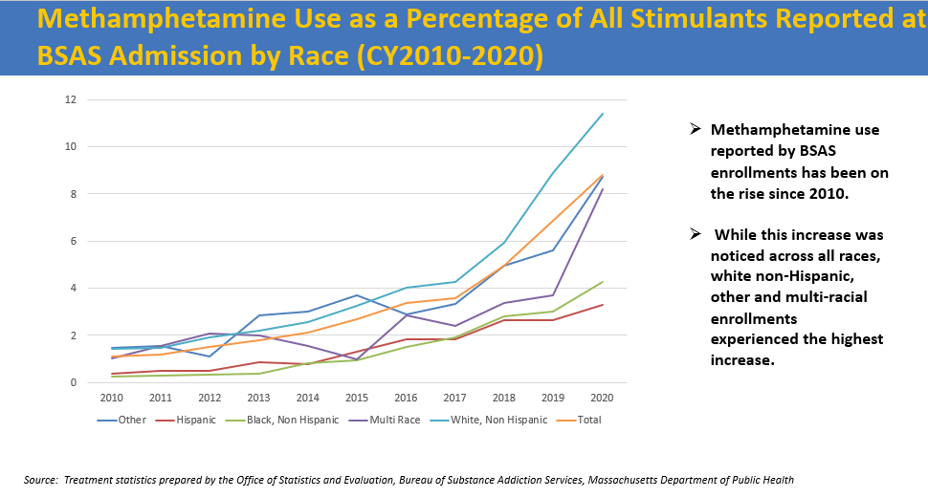
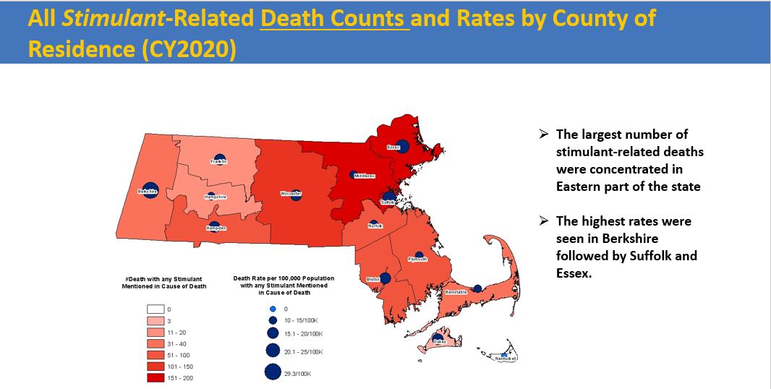
Commission’s Findings – Charge 1
Charge:
Create aggregate demographic and geographic profiles of individuals who use methamphetamines and other stimulants, including identifying populations most vulnerable to use.
Findings
Methamphetamine use is occurring at higher rates in Suffolk County and the eastern portions of the state, largely among the white non-Hispanic population. (BSAS presentation)
Crack/cocaine use is seen more broadly across the state, particularly among African-American and Latinx populations.
Recreational use of methamphetamines among men who have sex with men (MSM) is ten times higher than the general population (Dr. Keuroghlian presentation)
The construction/trades industry was the industry most at risk, with 28.8% of cocaine involved overdose deaths of those surveyed coming from construction trades, followed by 18.9% by those not in the workforce, e.g. unemployed, students, homemakers (Dr. Green’s presentation).
Further study is needed on reaching individuals who are experiencing homelessness and sex workers.
Source: Treatment statistics prepared by the Office of Statistics and Evaluation, BSAS, DPH
Source: Mortality data is maintained by the Registry of Vital Records and Statistics, and includes annual death record files for deaths occurring in Massachusetts.
15

Slide 16
Commission’s Findings – Charge 2
Charge:
Examine the current availability of, and barriers to providing, harm reduction services and treatment to individuals with a stimulant use disorder, including, but not limited to, in outpatient treatment, rehabilitation and continuum of care settings.
Findings
The Commonwealth lacks an overall culture of harm reduction, in which individuals who use stimulants have access to an array of harm reduction resources and free or low-cost treatment options throughout the state.
Access to care is positively fundamental in any aspect of harm reduction and recovery, yet there is a lack of access and insurance coverage for both inpatient and outpatient treatment programs for non-dual diagnosis patients who use stimulants. (Dr. Keuroghlian’s presentation, Dr. Baldwin’s presentation, Dr. Wilens' presentation)
Evidence-based treatment programs such as Contingency Management (CM) are not widely available across the state. Testimony provided during the lived experience panel highlighted a lack of access to treatment programs offering CM for patients outside of the Greater Boston area.
The current federal cap on incentives that can be paid to individuals participating in CM programs is limited to $75 per person per year, despite evidence that higher amounts are more efficacious. (SAMHSA Treatment for Stimulant Use Disorders, 2021 and other publications)¹
In March 2022, the U.S. Department of Health and Human Services Office of the Inspector General (OIG) issued a favorable advisory opinion regarding CM, which helps to clarify that CM incentives in excess of $75 may not violate federal laws.²
¹ Lussier, Jennifer Plebani, et al. "A meta‐analysis of voucher‐based reinforcement therapy for substance use disorders." Addiction 101.2 (2006): 192-203. https://onlinelibrary.wiley.com/doi/10.1111/j.1360-0443.2006.01311.x
² Office of the Inspector General Advisory Opinion (March 2022) www.tinyurl.com/yckjnkvn
16

Slide 17
Commission’s Findings – Charge 2 (cont.)
Findings
California recently became the first state to receive federal approval to cover Contingency Management. Since January 1, 2022, the state has funded a program with state and federal Medicaid dollars that would offer individuals a maximum of $599 for Contingency Management over 6 months.^{1,2}
Current state paraphernalia laws hamper the use and distribution of harm reduction supplies.
There is a lack of access and availability to quiet, therapeutic spaces where symptoms of stimulant withdrawal can be managed.
¹ https://www.dhcs.ca.gov/formsandpubs/publications/oc/Documents/2021/21-08-CalAIM-12-29-21.pdf
² 2 https://filtermag.org/california-contingency-management-stimulants/
17

Slide 18
Commission’s Findings – Charge 3
Charge:
Examine existing efforts undertaken by healthcare providers and the existing body of research around best practices for treating individuals with a stimulant use disorders, including, but not limited to, evidence for medication treatment for stimulant use disorder, the need for treatment of co-occurring disorders and how to create safe and therapeutic environments in inpatient and outpatient healthcare settings.
Findings
While some medications are available off label, there are currently no FDA approved medications for treating stimulant use disorder. (NIH: Combination therapy for methamphetamine use disorder)
Further study is needed on protocols for treating individuals with a stimulant use disorder at all levels of care, such as ATS, E-ATS, CSS, TSS, and outpatient walk-in clinics like the START program. An innovative protocol being piloted by Bay Cove Human Services is delivering promising results. (See Spotlight on Bay Cove Pilot Protocol on following slide and Dr. Wilens’ presentation)
Lessons learned from numerous programs, such as the need for restorative healing and compassionate care for those withdrawing from stimulant use, continue to be developed and disseminated, offering valuable insight on creating safer and more therapeutic environments for patients under the influence of stimulants.
18

Slide 19
Charge 3: Spotlight on Bay Cove Pilot Protocol
Bay Cove Pilot Protocol for Acute Treatment Services (ATS) Management of Methamphetamine
Since 2021, Bay Cove Human Services has been piloting an innovative protocol for management of patients with stimulant use disorder, which uses psychological and pharmacotherapy best practices and the latest data for methamphetamine management.
The protocol, developed in collaboration with Bay Cove Human Services, the Mass General Hospital Addiction Team, Department of Public Health, and Andrew House, ensures that patients are medically and psychiatrically safe, assisting with acute withdrawal management, including behavioral changes, urges/cravings, and helps engage in longer-term care (eg, abstinence, avoidance of drug for brain health).
While more work is necessary to enhance the protocol and improve patient retention, the protocol has been delivering promising results, which could be replicated in additional settings.
Bay Cove Pilot Protocol Summary
Upon admittance, patient undergoes a complete comprehensive medical evaluation with additional emphasis on vital signs, heart rate/rhythm disturbances, pulmonary status, oral/dental care, skin excoriations, or topical infections. Vitamin C (1000 mg po BID for 48 hours) is administered to assist with mitigating absorption and enhancing excretion of methamphetamine. Patients are encouraged to consume fluids, snacks, and meals. If patients are resting and/or unable to attend, meals are held for later administration. Stimulation is reduced (noise, lights, etc.) as much as possible and patients are placed in quiet areas of unit and/or in rooms away from activity. Noise canceling devices are available if requested. Patients are encouraged to sleep, with continued vital sign and other safety checks. Patient may be excused from group and other community-type groupings if sleeping. For the duration of the ATS admission, the patients are administered: For agitation, low dose diphenhydramine (Benadryl) 25 mg po QID-hold for disinhibition. For panic or anxiety, chlordiazepoxide (Librium) 25 mg po TID in lieu of standing PRN Librium order-hold for disinhibition. For moderate-to-severe agitation or paranoia or psychosis, quetiapine (Seroquel) 25-50 mg po TID PRN-hold for worsening of symptoms (if no result from Librium, may administer Seroquel) For insomnia, mirtazapine 15-30 mg qHS PRN ONLY if no other qHS sleep medications are being administered.
Source: Dr. Wilens' presentation
19

Slide 20
Commission’s Findings – Charge 4
Charge:
Examine existing efforts undertaken by service providers and the existing body of research around best practices for harm reduction efforts in working with individuals using stimulants, including, but not limited to, contingency management.
Findings
With the increased contamination of fentanyl in the drug supply, increased distribution and the means of distribution of harm reduction supplies such as fentanyl testing and provision of naloxone is needed. Safer consumption supplies and services for individuals who consume substances through non-injection means, such as smoking, remain a critical harm reduction tool reducing infections.
Harm reduction supplies may be distributed by syringe service providers (SSP), often packaged as safer consumption kits, which can be more easily distributed than individual supplies and can be customized based on participants’ feedback. In addition to fentanyl test strips and naloxone, these kits may include alcohol wipes, rubber pipe covers, protective mouthpieces, lip balm, antibiotic gel for sores, antiseptic towelettes, screens, bubblers, lighters, pocket literature, lubricant, and condoms.
Safer consumption supplies can also be distributed via dedicated harm reduction vending machines, which have been in use since the late 1980s in Europe and are currently being piloted in California, Nevada, and Ohio, with plans to expand pilot programs in other states, such as New York City. These machines offer anonymous 24/7 access to sterile equipment and supplies.
Contingency Management is an evidence-based, promising approach for treating individuals with a history of stimulant use. Due to a lack of access to Contingency Management programs across the state and a lack of reimbursement for non-traditional treatment supports such as recovery coaches, many individuals outside of the Greater Boston area are left with limited treatment options. (Dr. Baldwin’s presentation)
Testimony delivered during the lived experience panel highlighted both the utility of Contingency Management and the need for increased access to Contingency Management programs, as well as other treatment options such as Positive Affective Intervention, across the state.
20

Slide 21
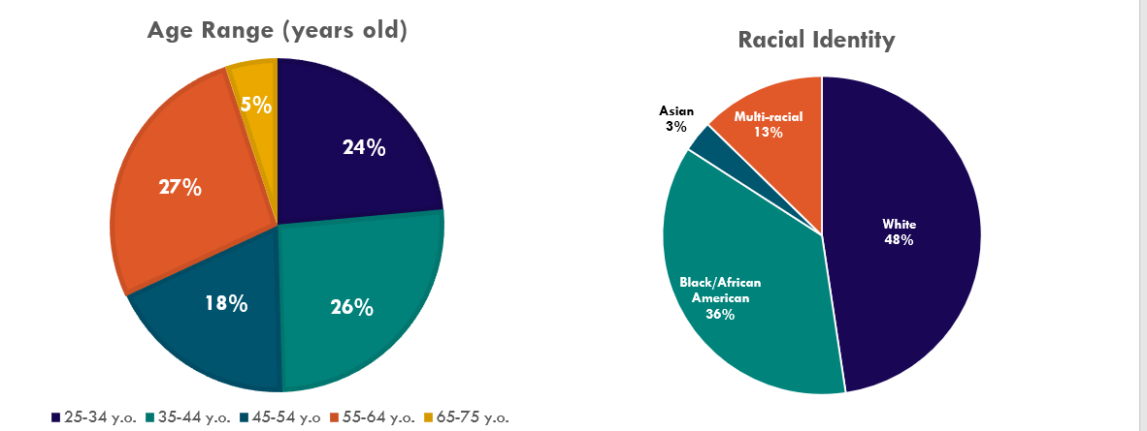
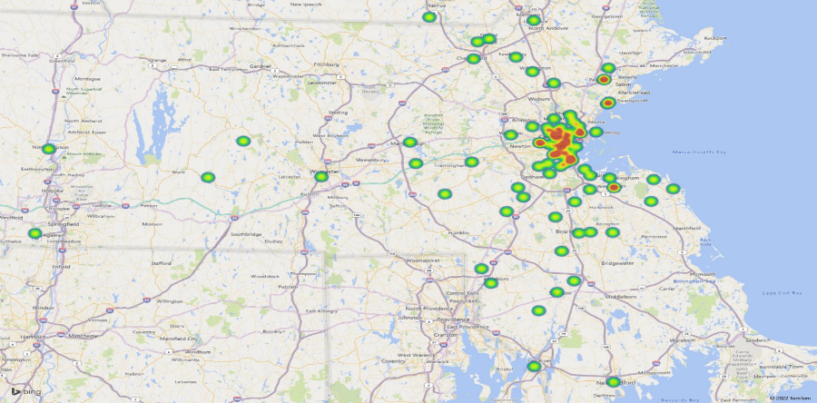
Charge 4: Spotlight on START Clinic
Stimulant Treatment and Recovery Team (START)
In 2019, Boston Medical Center launched the Stimulant Treatment and Recovery Team (START), a two-year pilot program offering street-level addiction treatment for stimulant use disorder in an outpatient clinical setting.
START utilizes contingency management approach through a recovery rewards program that encourages engagement and exercise.
The majority of START patients (82%) identified stimulants as the primary substance.
Over half of patients (55%) identify as a person of color, with 35% identifying as part of the LGBTQIA+ community.
The START clinic currently serves 64 individuals with an annual budget of $495,000, which includes administrative and management support.
START Patient Demographics (2022)
Geographic Distribution of START Clinic Utilization (2022)
Source: Dr. Baldwin's presentation
21

Slide 22
Commission’s Findings – Charge 5
Charge:
Examine the intersections among stimulant use and sexual health, particularly among the LGBTQIA+ community.
Findings
Testimony from the Commission’s lived experience panel provided insight on recreational use of methamphetamines among men who have sex with men (MSM), commonly known as “party and play” or “chemsex.”
Methamphetamine use among MSM is ten times higher than the general population, with an annual prevalence of 12-30%. (Dr. Keuroghlian presentation)
Due to the heightening of sexual stimulation, decrease in inhibitions, and relative low cost, recreational use of methamphetamines among gay, bisexual, and same-gender loving men remains an urgent concern.
The resulting decrease in inhibitions from methamphetamine use can lead to unprotected sexual encounters with multiple partners, leading to transmission of sexually transmitted infections (STI), such as syphilis, gonorrhea, chlamydia, HIV, and hepatitis.
Among people who use stimulants via injection, there is increased risk of transmitting infectious diseases, such as HIV and hepatitis C (HCV).
22

Slide 23
Commission’s Findings – Charge 6
Charge:
Examine the intersections between stimulant use and homelessness.
Findings
Key findings from a 2019 study funded by the CDC and DPH that examined trends in cocaine-opioid involved overdose deaths in Massachusetts using CDC surveillance data from the State Unintentional Drug Overdose Reporting System (SUDORS) revealed that compared to non-cocaine involved opioid overdoses, cocaine-opioid overdose decedents were more likely to have experienced homelessness. (Dr. Green’s presentation)
Preliminary data from a sample of patients receiving treatment for methamphetamine use at Bay Cove Human Services revealed that 91% of individuals (n=23) were homeless and 100% were unemployed. (Dr. Wilens’ presentation)
Use of stimulants after an individual becomes homeless may be attributed to coping as well as a need to remain vigilant during the night.
Additional studies are needed to record the full scope of stimulant use among this population.
Additional resources are needed to address housing insecurity among individuals who use stimulants and are experiencing homelessness.
23

Slide 24
Commission’s Findings – Charge 7
Charge:
Examine existing efforts undertaken by emergency medical service providers and law enforcement officials and the existing body of research on best practices for interacting with individuals with a stimulant use disorder, including, but not limited to, how to de-escalate situations and provide safety and security guidance to health care facilities and local police officers.
Findings
While EMS and law enforcement have developed standards of care and best practices for interacting with individuals with opioid use disorder, similar standards for care for individuals under the influence of stimulants are less developed.
As a result, emergency medical services (EMS) providers and law enforcement officials may feel unequipped to properly treat patients under the influence of stimulants and have expressed difficulty discerning between mental health and stimulant use calls.
Additionally, first responders may view emergency departments as the sole option for taking patients who are under the influence of stimulants, in contrast to individuals who use opioids.
Guidance outlining best practices for interacting with individuals under the influence of stimulants has not been developed nor promoted by national and regional coordinating bodies for EMS and law enforcement. Such guidance could be included in a package of trainings for first responders as well as emergency departments, which might include de-escalation trainings.
As voiced by members of the Commission, the development of guidance and resources for EMS, law enforcement, and emergency departments about stimulants and the management of individuals with stimulant use disorder is needed and would have the dual goal of providing better treatment in the moment and referrals and links to harm reduction services available in the community.
Grants such as those awarded by the City of Cambridge for 2021-2022 have the goal of creating regional trainings for frontline providers to bridge their knowledge gap and increase knowledge of best practices for working with people who use stimulants and increase their capacity and confidence in working with this population.
24

Slide 25
Commission’s Findings – Charge 8
Charge:
Examine the source, quantity, potency and pathways to local areas of illicit methamphetamine and other stimulants, related substances and products.
Findings
Based on the Drug Enforcement Agency’s (DEA) National Drug Threat Assessment for 2020, there has been a recent increase in methamphetamine seizures across the region, indicating that what has traditionally been a niche subculture drug, is now moving into mainstream drug use. The reasons for this are many but, among them is the availability of inexpensive, high-quality methamphetamine coming through traditional drug trafficking routes from the southwest border.¹
Results from the Massachusetts Drug Supply Data Stream (MADDS) community sampling in Boston, Berkshire County, Lowell, Lynn, New Bedford, and Quincy indicated a strong presence of fentanyl in many powder and pill form drugs. In addition, MADDS samples from 2021 indicated that the current drug supply contains a more toxic analog of fentanyl. (Dr. Green’s presentation)
The MADDS sampling presented also revealed multiple samples expected to be heroin or fentanyl were mixed methamphetamine.
¹ https://www.dea.gov/sites/default/files/2021-02/DIR-008-21%202020%20National%20Drug%20Threat%20Assessment_WEB.pdf
25

Slide 26
Appendices
26

Slide 27
Appendix A – Legislative Mandate
Chapter 24, Section 131 of the Acts of 2021 (FY22 Budget)
(a) There shall be a commission to study and make recommendations regarding methamphetamine and other stimulant use in the commonwealth.
The commission shall consist of: the secretary of health and human services or a designee, who shall serve as chair; the commissioner of public health or a designee; the chairs of the joint committee on mental health, substance use and recovery or their designees; a representative from The Massachusetts Medical Society; a representative from the Massachusetts Health and Hospital Association, Inc.; a representative from the Massachusetts Chiefs of Police Association Incorporated; a representative from the Fire Chiefs' Association of Massachusetts, Inc.; a representative from the Massachusetts Ambulance Association, Incorporated; a representative from Boston Emergency Medical Services; a representative from the New England High Intensity Drug Trafficking Area; a representative from the Association for Behavioral Healthcare, Inc.; and 7 members to be appointed by the chair, 1 of whom shall be a person with or in recovery from a stimulant use disorder, 1 of whom shall be a medical provider specializing in addiction with experience treating individuals with stimulant use disorder, 1 of whom shall be a behavioral health provider specializing in addiction with experience treating individuals with stimulant use disorder, 1 of whom shall have experience providing harm reduction services, 1 of whom shall be a clinician or researcher with expertise related to methamphetamine and other stimulant use in communities of color, 1 of whom shall be a clinician or researcher with expertise related to methamphetamine and other stimulant use by individuals experiencing homelessness and 1 of whom shall be a clinician or researcher with expertise related to methamphetamine and other stimulant use in the lesbian, gay, bisexual, transgender, queer and questioning community. In making appointments, the secretary shall, to the maximum extent feasible, ensure that the commission represents a broad distribution of diverse perspectives and geographic regions.
(b) The commission shall: (i) create aggregate demographic and geographic profiles of individuals who use methamphetamines and other stimulants, including identifying populations most vulnerable to use; (ii) examine the current availability of, and barriers to providing, harm reduction services and treatment to individuals with a stimulant use disorder, including, but not limited to, in outpatient treatment, rehabilitation and continuum of care settings; (iii) examine existing efforts undertaken by healthcare providers and the existing body of research around best practices for treating individuals with a stimulant use disorders, including, but not limited to, evidence for medication treatment for stimulant use disorder, the need for treatment of co-occurring disorders and how to create safe and therapeutic environments in inpatient and outpatient healthcare settings; (iv) examine existing efforts undertaken by service providers and the existing body of research around best practices for harm reduction efforts in working with individuals using stimulants, including, but not limited to, contingency management; (v) examine the intersections among stimulant use and sexual health, particularly among the lesbian, gay, bisexual, transgender, queer and questioning community; (vi) examine the intersections between stimulant use and homelessness; (vii) examine existing efforts undertaken by emergency medical service providers and law enforcement officials and the existing body of research on best practices for interacting with individuals with a stimulant use disorder, including, but not limited to, how to de-escalate situations and provide safety and security guidance to health care facilities and local police officers; (viii) examine the source, quantity, potency and pathways to local areas of illicit methamphetamine and other stimulants, related substances and products; and (ix) examine other matters deemed appropriate by the commission.
(c) The commission shall submit its findings and recommendations to the clerks of the senate and the house of representatives, the joint committee on mental health, substance use and recovery, the joint committee on public health, the joint committee on public safety and homeland security and the senate and house committees on ways and means not later than March 31, 2022. The secretary of health and human services shall make the report publicly available on the website of the executive office of health and human services.
27

Slide 28
Appendix B – List of Commission Members
Name / Affiliation | Commission Seat
Marylou Sudders (chair) Secretary, Executive Office of Health and Human Services | Secretary, Executive Office of Health and Human Services, Massachusetts
Brian K. Andrews President, County Ambulance, Inc. & Director, Massachusetts Ambulance Association Board | President, County Ambulance, Inc. & Director, Massachusetts Ambulance Association Board
Julie Burns President & CEO, RIZE Massachusetts | Clinician or researcher with expertise related to methamphetamine and other stimulant use in the LGBTQIA+ community
Deirdre Calvert Director, Bureau of Substance Addiction Services (BSAS), DPH | Designee of Department of Public Health Commissioner
Amanda Consigli Public Health Analyst, New England High Intensity Drug Trafficking Area | New England High Intensity Drug Trafficking Area (NEHIDTA)
Prentice Crowell Recovery Coach, Arbor Hospital & Harm Reduction Volunteer at Safe and Sound Recovery Center | Person with or in recovery from a stimulant use disorder
Julian Cyr Massachusetts Senator | Co-chair of the Joint Committee on Mental Health, Substance Use and Recovery
28

Slide 29
Appendix B – List of Commission Members (cont.)
Name / Affiliation | Commission Seat
Jon Davine Fire Chief, Northampton Fire Rescue | Fire Chiefs’ Association of Massachusetts
Thomas W. Fowler Chief, Salisbury Police Department | Massachusetts Chiefs of Police Association
Kristen Godin, LMHC Vice President for Substance Use Services, Community Healthlink | Behavioral health provider specializing in addiction with experience treating individuals with stimulant use disorder
Traci Green, PhD Professor and Director of the Opioid Policy Research Collaborative, Brandeis University | Clinician or researcher with expertise related to methamphetamine and other stimulant use in communities of color
Jim Hooley Chief of the Department, Boston Emergency Medical Services | Boston Emergency Medical Services
Abby Kim Director of Public Policy and Strategic Initiatives, Association for Behavioral Healthcare | Association for Behavioral Healthcare (ABH)
29

Slide 30
Appendix B – List of Commission Members (cont.)
Name / Affiliation | Commission Seat
Gene Lambert, MD, MBA, FACP Associate Medical Director, Director of Clinical Operations, Addiction Consult Team, Substance Use Disorders Initiative, Mass General Hospital | Massachusetts Medical Society
Adrian Madaro Massachusetts Representative | Co-chair of the Joint Committee on Mental Health, Substance Use and Recovery
Albie Park Co-founder, Harm Reduction Hedgehogs of 413 (HRH413) | Person with experience providing harm reduction services
Maria Quinn, NP Psychiatric Nurse Practitioner & Director of Recovery Support, Holyoke Hospital | Clinician or researcher with expertise related to methamphetamine and other stimulant use by individuals experiencing homelessness
Claudia P. Rodriguez, MD Director of Outpatient Addiction Recovery Program, Brigham and Women’s Faulkner | Medical provider specializing in addiction with experience treating individuals with stimulant use disorder
Leigh Simons Youmans, MPH Senior Director, Healthcare Policy, Massachusetts Health & Hospital Association | Massachusetts Health and Hospital Association (MHA)
30

Slide 31
Appendix C – Summary of Meetings and Input Provided to the Commission
Presenters | Topics Discussed | Resources and Supporting Documents
December 8, 2021
Secretary Sudders (chair) Secretary, Executive Office of Health and Human Services | Discussion of the Commission’s charges, proposed meeting schedule | Commission presentation
Deirdre Calvert Director, Bureau of Substance Addiction Services (BSAS) | Overview of methamphetamine and stimulant use trends in Massachusetts | DPH/BSAS Overview of Methamphetamine and Stimulant Use in Massachusetts
Traci Green, PhD Brandeis University | Summary of recent research on stimulant use, consumer experiences, and illicit drug supply in Massachusetts | Navigating the New Stimulant Landscape Presentation by Traci Green, PhD
January 11, 2022
Prentice Crowell Stephen Murray James Duffy Mitchell Barys | Lived experience panel discussion with individuals with firsthand experience with stimulant use | Commission presentation
31

Slide 32
Appendix C – Summary of Meetings and Input Provided to the Commission (cont.)
Presenters | Topics Discussed | Resources and Supporting Documents
February 8, 2022
Secretary Sudders (chair) Secretary, Executive Office of Health and Human Services | Discussion of the Commission’s charges, revised meeting schedule | Commission presentation
Alex Keuroghlian, MD, MPH Associate Professor of Psychiatry, Harvard Medical School, and Director of the National LGBTQIA+ Health Education Center at The Fenway Institute and Mass General Hospital Psychiatry Gender Identity Program | Overview of methamphetamine and stimulant use within the LGBTQIA+ community | Stimulant Use Within the LGBTQIA+ Community
Marielle Baldwin, MD Medical Director at Boston Medical Center’s Stimulant Treatment and Recovery Team (START) | Overview of the START clinic and contingency management approach | START – Stimulant Treatment and Recovery Team
Timothy E. Wilens, MD Psychiatric Consultant-Bay Cove Human Services Co-Director, Center for Addiction Medicine Chief, Division of Child and Adolescent Psychiatry, Mass General Hospital Professor of Psychiatry, Harvard Medical School | Pilot protocol for Acute Treatment Services (ATS) management of methamphetamine | Pilot Protocol for ATS Management of Methamphetamine
32

Slide 33
Appendix C – Summary of Meetings and Input Provided to the Commission (cont.)
Presenters | Topics Discussed | Resources and Supporting Documents
March 8, 2022
Secretary Sudders (chair) Secretary, Executive Office of Health and Human Services | Discussion of the Commission’s charge, findings, and preliminary working draft of the Commission’s report | Commission charge
Jon Davine Fire Chief, Northampton Fire Rescue | First responder resources | Mass. State Police Clandestine Laboratory Enforcement Team (CLET) one-pot flier
Deirdre Calvert Director, BSAS | Existing practices and interventions for stimulant use disorder | Overview of existing practices and interventions for stimulant use disorder
April 12, 2022
Secretary Sudders (chair) Secretary, Executive Office of Health and Human Services | Discussion of the Commission’s findings and working draft of the Commission’s report | Commission charge
33

Slide 34
Appendix D – Resources Reviewed by the Commission
December 8, 2021
Commission on Methamphetamine Use Meeting Presentation
DPH/BSAS Overview of Methamphetamine and Stimulant Use in Massachusetts
Navigating the New Stimulant Landscape Presentation by Traci Green, PhD
January 11, 2022
Commission on Methamphetamine Use Meeting Presentation
February 8, 2022
Commission on Methamphetamine Use Meeting Presentation
Stimulant Use Within the LGBTQIA+ Community Presentation
START – Stimulant Treatment and Recovery Team Presentation
Pilot Protocol for ATS Management of Methamphetamine Presentation
34

Slide 35
Appendix D – Resources Reviewed by the Commission (cont.)
March 8, 2022
Commission on Methamphetamine Use Charge
One-Pot Methamphetamine Lab Flier
Overview of Existing Practices and Interventions for Stimulant Use Disorder
Trends in U.S. methamphetamine use and associated deaths (2021)
Combination therapy for methamphetamine use disorder (2021)
State and Community Efforts to Address Stimulant Use (May 2021)
Bureau of Justice Assistance COSSAP Law Enforcement and First Responder Diversion
April 12, 2022
Methamphetamine Assessment and Analysis Report authored by the Institute for Community Health in Nov. 2021 (one-pager)
Institute for Community Health – Methamphetamine Assessment and Analysis Report (full report)
35

Slide 36
Appendix E – First Responder Resources
36

Slide 37
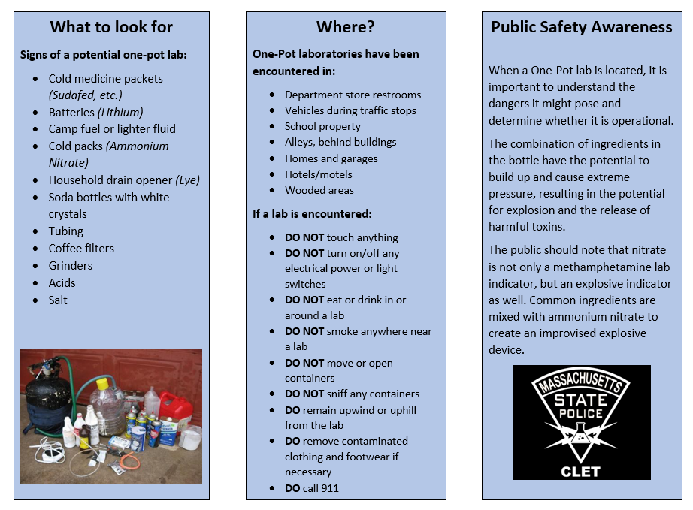
Appendix E – First Responder Resources (cont.)
37

Slide 38
Appendix E – First Responder Resources (cont.)
38

Slide 39
Appendix E – First Responder Resources (cont.)
39

