Slide 1
Trauma Systems Committee Proposal
Trauma Systems Committee March 17, 2021
Reginald Alouidor MD, FACS
Assistant Professor of Surgery, UMMS-Baystate Health
Division of Trauma/Critical Care and Acute Care Surgery

Slide 2
Trauma Systems Committee Proposal
Modification MA DPH OEMS Trauma Field Trauma Criteria
Anatomic Criteria:
Add Known Solid Organ Injury
Outpatient Management
NOM Solid Organ Injury

Slide 3
2) Does the patient have
Physiologic Criteria:
Glasgow Coma Scale <14
Respiratory rate < 10 or > 29 or respiratory rate out of range for age?
Systolic Blood Pressure < 90 mmHg or < 70-90 (age appropriate) in pediatrics
Anatomic Criteria:
Flail Chest?
Open or depressed skull fractures?
Penetrating trauma to head, neck, torso, or extremities proximal to elbow and knee?
Crushed, degloved or mangled extremity
Pelvic fractures (excluding simple fractures)
Paralysis
2 or more proximal long bone fractures, or any open proximal long bone fracture?
Amputations proximal to wrist or ankle
2) Does the patient have
Physiologic Criteria:
Glasgow Coma Scale <14
Respiratory rate < 10 or > 29 or respiratory rate out of range for age?
Systolic Blood Pressure < 90 mmHg or < 70-90 (age appropriate) in pediatrics
Anatomic Criteria:
Flail Chest?
Open or depressed skull fractures?
Penetrating trauma to head, neck, torso, or extremities proximal to elbow and knee?
Crushed, degloved or mangled extremity
Pelvic fractures (excluding simple fractures)
Paralysis
2 or more proximal long bone fractures, or any open proximal long bone fracture?
Amputations proximal to wrist or ankle
Known Solid Organ Injury

Slide 4
Background: Solid Organ Injuries
NOM accepted SOC for many types of patients with blunt and even penetrating Solid Organ Injuries
Patients do well accepted SOC
Risks and complications
Delayed rupture/ Delayed bleeding
Emergency hospital admission and interventions
Resuscitation
Angiography embolization
Emergency operative management

Slide 5
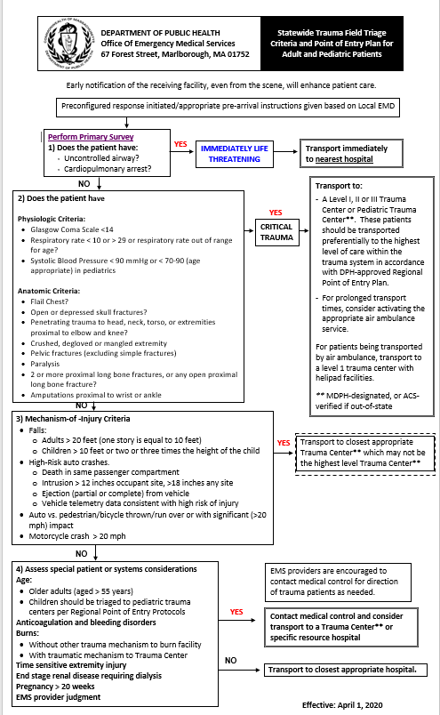
Current OEMS POE
Protocol
Trauma Field Triage Criteria
1.Primary Survey
2.
Physiologic criteria
Anatomic criteria
3.Mechanism of Injury Criteria
4.Special patient/system considerations

Slide 6
Current OEMS POE
Protocol
Trauma Field Triage Criteria
1.Primary Survey
2.
Physiologic criteria
Anatomic criteria
3.Mechanism of Injury Criteria
4.Special patient/system considerations

Slide 7
Current OEMS POE
Protocol
Trauma Field Triage Criteria
1.Primary Survey
2.
Physiologic criteria
Anatomic criteria
3.Mechanism of Injury Criteria
4.Special patient/system considerations

Slide 8
Current OEMS POE
Protocol
Trauma Field Triage Criteria
1.Primary Survey
2.
Physiologic criteria
Anatomic criteria
3.Mechanism of Injury Criteria
4.Special patient/system considerations

Slide 9
Current OEMS POE
Protocol
Trauma Field Triage Criteria
1.Primary Survey
2.
Physiologic criteria
Anatomic criteria
3.Mechanism of Injury Criteria
4.Special patient/system considerations

Slide 10
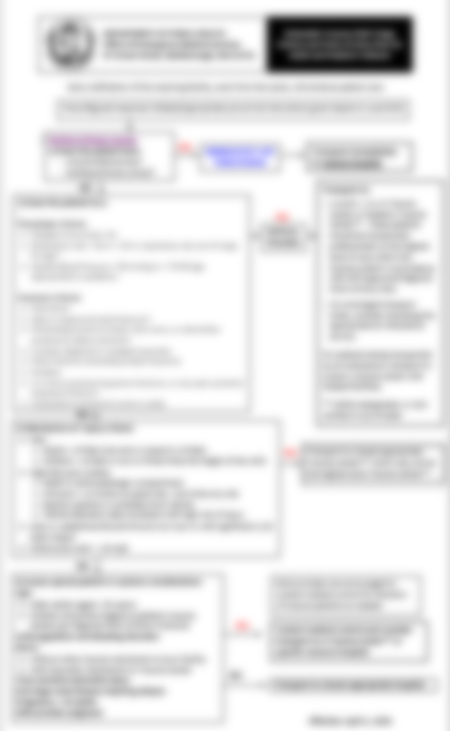
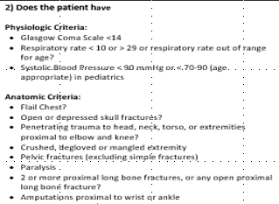
Current OEMS POE
Protocol
Trauma Field Triage Criteria
1.Primary Survey
2.
Physiologic criteria
Anatomic criteria
3.Mechanism of Injury Criteria
4.Special patient/system considerations

Slide 11
2) Does the patient have
Physiologic Criteria:
Glasgow Coma Scale <14
Respiratory rate < 10 or > 29 or respiratory rate out of range for age?
Systolic Blood Pressure < 90 mmHg or < 70-90 (age appropriate) in pediatrics
Anatomic Criteria:
Flail Chest?
Open or depressed skull fractures?
Penetrating trauma to head, neck, torso, or extremities proximal to elbow and knee?
Crushed, degloved or mangled extremity
Pelvic fractures (excluding simple fractures)
Paralysis
2 or more proximal long bone fractures, or any open proximal long bone fracture?
Amputations proximal to wrist or ankle
2) Does the patient have
Physiologic Criteria:
Glasgow Coma Scale <14
Respiratory rate < 10 or > 29 or respiratory rate out of range for age?
Systolic Blood Pressure < 90 mmHg or < 70-90 (age appropriate) in pediatrics
Anatomic Criteria:
Flail Chest?
Open or depressed skull fractures?
Penetrating trauma to head, neck, torso, or extremities proximal to elbow and knee?
Crushed, degloved or mangled extremity
Pelvic fractures (excluding simple fractures)
Paralysis
2 or more proximal long bone fractures, or any open proximal long bone fracture?
Amputations proximal to wrist or ankle
Known Solid Organ Injury

Slide 12
What this allows: Right Patient → Right Place
24 hr. availability
Blood Products
Operative Room
Surgery
Anesthesia
Interventional Radiology
Trauma Center:

Slide 13
What this allows: Right Patient → Right Place

Slide 14
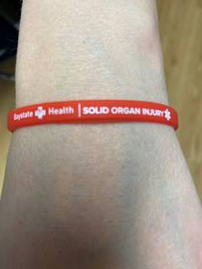
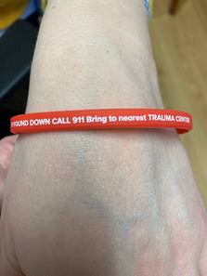
How to identify solid organ injury NOM?

Slide 15
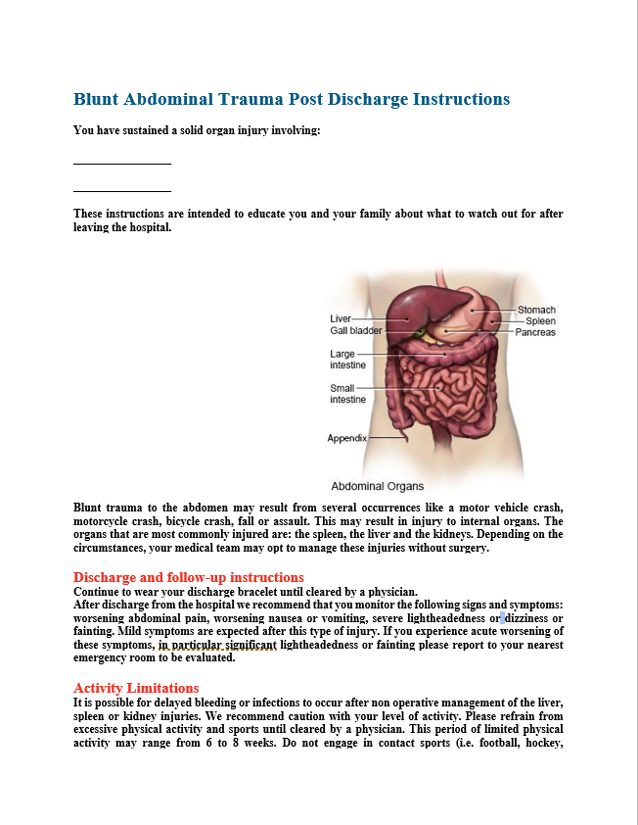
How to identify solid organ injury NOM?

Slide 16
Disclosure
EMS Medical Services Committee - April 9th 2021
Attorneys at Massachusetts, DPH

Slide 17
Trauma Systems Committee Proposal
Modification MA DPH OEMS Trauma Field Trauma Criteria
Anatomic Criteria:
Add Known Solid Organ Injury
NOM Solid Organ Injury Bracelet

Slide 18
Questions:

