Slide 1
FY26 RAFT Policies
Community-Based Organization (CBO) Training
October 30 and November 5, 2025

Slide 2
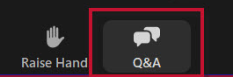
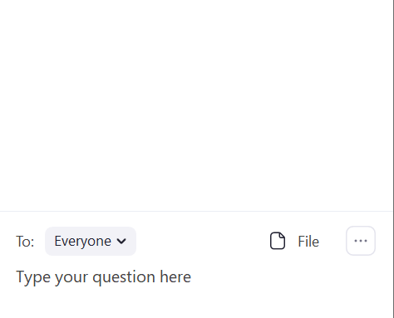
Engagement Best Practices
Asking Questions
We will be monitoring the Q&A for questions
1
Click “Q&A” to submit a question
2
Enter your question into the “Q&A” box

Slide 3
This Call Is Being Recorded

Slide 4
Meet Your EOHLC Facilitators
Ricky Hartman
Senior Program Coordinator, Eviction Diversion
Amy Mullen
Director of Prevention and Diversion
Molly Butman
Senior Database Management Specialist
Jackie Buttaro
RAFT and HCEC Technical Assistance Supervisor
Melissa Donalds
RAFT and HCEC Program Coordinator
Alisse Russell
RAFT and HCEC Program Coordinator

Slide 5
Training Objective
Purpose
Discuss the FY26 RAFT Program
Goal
Provide community partners with guidance and continued support related to RAFT

Slide 6
Our Journey Today
1 Hour
Welcome, Goals, & Objectives
5 mins
Fiscal Year 2026 RAFT Policies
RAFT Policy Overview
Housing Help Hub Overview
50 mins
Questions
Support & Resources
5 mins

Slide 7
FY26 RAFT

Slide 8
FY26 RAFT - Context
FY26:
$7,000 benefit cap
Homeowner assistance
No stipends for prospective rent
Goal: Prioritize assistance for households most in need and maintain housing stability for our most vulnerable residents

Slide 9
Housing Help Hub and the RAAs
Applications for RAFT must come through the statewide application portal, known as the Housing Help Hub
Applications are automatically routed to 11 Regional Administering Agencies (RAAs) based on geography and processing capacity at each organization

Slide 10
RAFT Policy Overview

Slide 11
Policy Overview
Housing Eligibility
Income Verification
Benefit Cap
Required Documentation
Eligible Uses of Funds

Slide 12
Eligibility

Slide 13
RAFT Eligibility
Households must meet certain eligibility criteria to be eligible for RAFT
1
2
3
Risk of homelessness/housing instability in MA
Currently renting or moving to a new rental
For homeowners, must be owner occupants of the property in question
Income at or below 50% of Area Median Income (AMI); 60% AMI for households experiencing DV

Slide 14
Renter Housing Crises
Notice to Quit
Domestic Violence
Eviction
Fire/Flood/Natural Disaster
Doubled Up and Must Leave/Overcrowding
Utility Shutoff
Health and Safety
Other Crisis that Will Result in Imminent Housing Loss

Slide 15
Homeowner Housing Crises
Three or More Months Behind on Mortgage
Behind on Property Taxes
Behind on Other Homeownership Payments
Right to Cure Notice
Foreclosure
Utility Shutoff

Slide 16
Benefit Cap

Slide 17
RAFT Benefit Cap
The maximum benefit limit for RAFT is $7,000 per household
in any rolling 12-month period
Eligible households can receive RAFT in a combination of benefit types and more than once in a given year, as long as the total assistance does not exceed $7,000 within any rolling 12-month period
Households with income-based rental subsidies cannot receive payment for more than six months of rent arrears in a rolling 12-month period
Example: A household previously received $3,000 in RAFT on 3/1/2025. The household applies for RAFT again on 1/1/2026. Now the maximum the household can receive is $4,000.

Slide 18
Eligible Uses of Funds

Slide 19
Eligible Uses of RAFT Funds
RAFT may be used for
Rent arrears
Start-up costs (first and last month’s rent, security deposit)
Moving costs
Utility arrears (minimum required to get service restored or protected)
Furniture (up to $1,000)
Appliances (if required to make the unit habitable; up to $1,500)
Mortgage arrears, for homeowners
Property taxes, homeowner’s insurance, or other costs, for homeowners

Slide 20
Letter of Intent
The application portal includes a “Letter of Intent” (LOI) process for start-up costs and moving expenses
An applicant can be found pre-eligible before they locate a unit and will be given a LOI confirming pre-eligibility to provide landlords when searching for a unit
Tenants will have 90 days to locate a unit
When the tenant locates a unit, they must log back into the portal and convert their LOI into a RAFT application
At that time, the landlord will need to complete the landlord application
In most cases, tenant eligibility does not have to be re-assessed

Slide 21
Households with Income-based Rental Subsidies
Reminders regarding RAFT applicants with income-based rental subsidies (e.g. Section 8, MRVP, public housing, etc.):
Households with income-based rental subsidies cannot receive payment for more than six months of rent arrears in a rolling 12-month period
Households residing in subsidized housing must demonstrate good cause for nonpayment
  Hardship or increase in expenses would be considered good cause
  Good cause is required for assistance with arrears only, not other benefit types
  If the household is unable to provide verification of good cause for the full period of their rental arrears, the household must submit verification demonstrating the RAFT benefit will resolve the current housing crisis (i.e., a plan for the remaining balance that RAFT cannot cover)

Slide 22
Income Verification

Slide 23
Income Verification
Categorical income eligibility through MassHealth and/or DTA verification
Categorical income eligibility through subsidized housing income verification
Income verification using pay stubs, benefit letters, or other documentation
Self-attestation of zero income and cash income

Slide 24
Required Documentation

Slide 25
Required Tenant/Homeowner Documentation
1
Application field responses
Identification for head of household
Verification of current housing (e.g. lease, tenancy agreement or tenancy at will form)
Verification of eligible housing crisis (documentation will depend on housing crisis)
Verification of income, or verification of presumed income eligibility
2
3
4
5

Slide 26
Required Landlord Documentation
1
Application field responses
W-9 for property owner or authorized agent
Proof of identity for property owner or authorized agent
Authorization of agent, if applicable
Proof of ownership for unit
2
3
4
5

Slide 27
Housing Crisis List (Renters)
Housing Crisis | Verification (Examples)
Notice to Quit | Notice to quit that meets criteria in the next slide
Eviction | Summary process summons and complaint (court summons), Agreement for Judgment, execution letter
Doubled up and must leave/ Overcrowding | Letter from primary tenant/landlord that verifies that family is asked to leave within 30 days Documentation to demonstrate unit is too small for household (e.g. letter from landlord)
Health and safety | Documentation to demonstrate a serious health and safety risk that prevents continued residency (e.g. failed inspection report, letter from a healthcare professional)
Domestic violence | Documentation to support allegation connected to inability to stay safely Self-statement from applicant if other documents not available
Fire/Flood/Natural disaster | Report of fire, flood, or natural disaster
Utility shutoff | Current shutoff notice or verification that service has already been disconnected For deliverable fuel, invoice from utility company for one delivery of fuel
Other crisis that will result in imminent housing loss | Documentation to demonstrate that family will imminently be homeless within 30 days

Slide 28
Notices to Quit
To Be Considered an Allowable Notice to Quit Under FY26 RAFT, the Notice Must Meet at Least the Following Criteria:
Written statement from the landlord to the tenant (usually with the title “Notice to Quit” or “Notice Terminating Tenancy”) that states that the tenancy is being terminated
Includes the date of the notice
Includes the date that the tenancy will be terminated (actual dates meet this requirement, as do phrases like “within 30 days” or “14 day notice to quit”)
Includes the name of the leaseholder
Includes the rental address
Includes the amount due, or, if for something other than nonpayment, includes the reason for the termination
Dated within 90 days of the RAFT application

Slide 29
Housing Crisis List (Homeowners)
Housing Crisis | Verification (Examples)
Three or more months behind on mortgage | Mortgage statement showing three months’ missed payments. The three payments do not have to be delinquent; in other words, it is acceptable for two payments to be past due and the third payment to be listed as a current charge, as long as the homeowner has already received the bill for it
Right to cure notice | 90 day right to cure notice dated within the last 60 days
Foreclosure | Notice of intent to foreclose dated within the last 60 days, or foreclosure notice of sale dated within the last 60 days
Behind on property taxes | Documentation showing there is currently a lien on the property from the city or town
Behind on other homeownership payments | Documentation showing that other payments are putting the homeowner applicant at risk of foreclosure, such as notice of an impending lien for unpaid taxes or other payments, bill or notice for payment from a reverse mortgage company (for those with reverse mortgages), or other documentation that the RAA recognizes as putting the household at imminent risk of foreclosure

Slide 30
Housing Help Hub Overview

Slide 31
Overview of the Housing Help Hub
Visit https://applyhousinghelp.mass.gov/ to apply on behalf of a tenant/homeowner through the Housing Help Hub
Applications where payment is made to a landlord require a tenant application and a corresponding landlord application
Applications where no payment is made to a landlord do not require a corresponding vendor application
Tenants/Homeowners or their advocates must register before creating a Tenant/Homeowner Application
Landlords may register before creating a Landlord Application or apply as a "guest landlord"

Slide 32
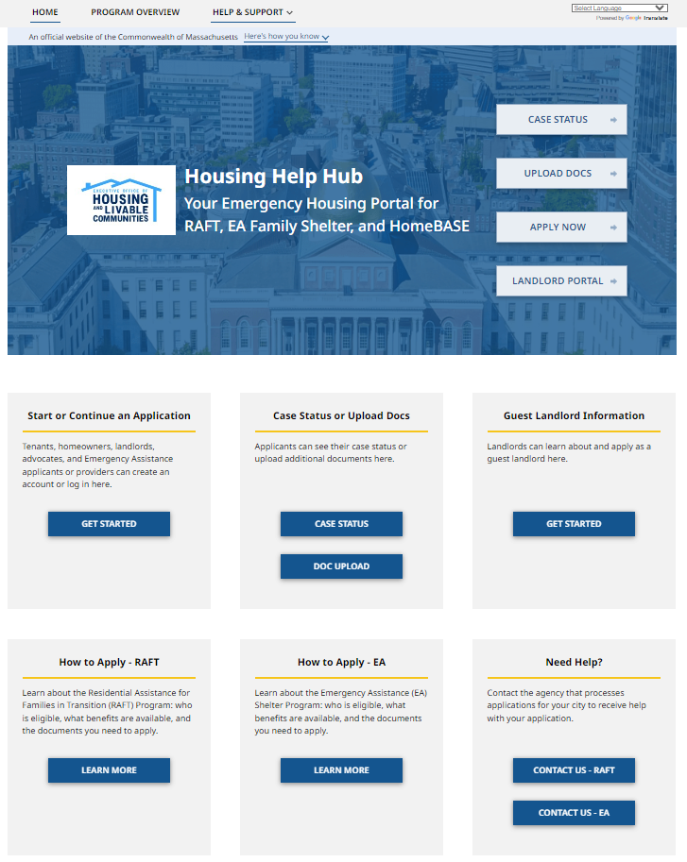
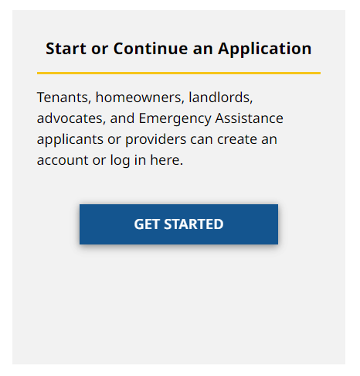
Registering an Account in the Housing Help Hub
Navigate to https://applyhousinghelp.mass.gov/
and click Get Started

Slide 33
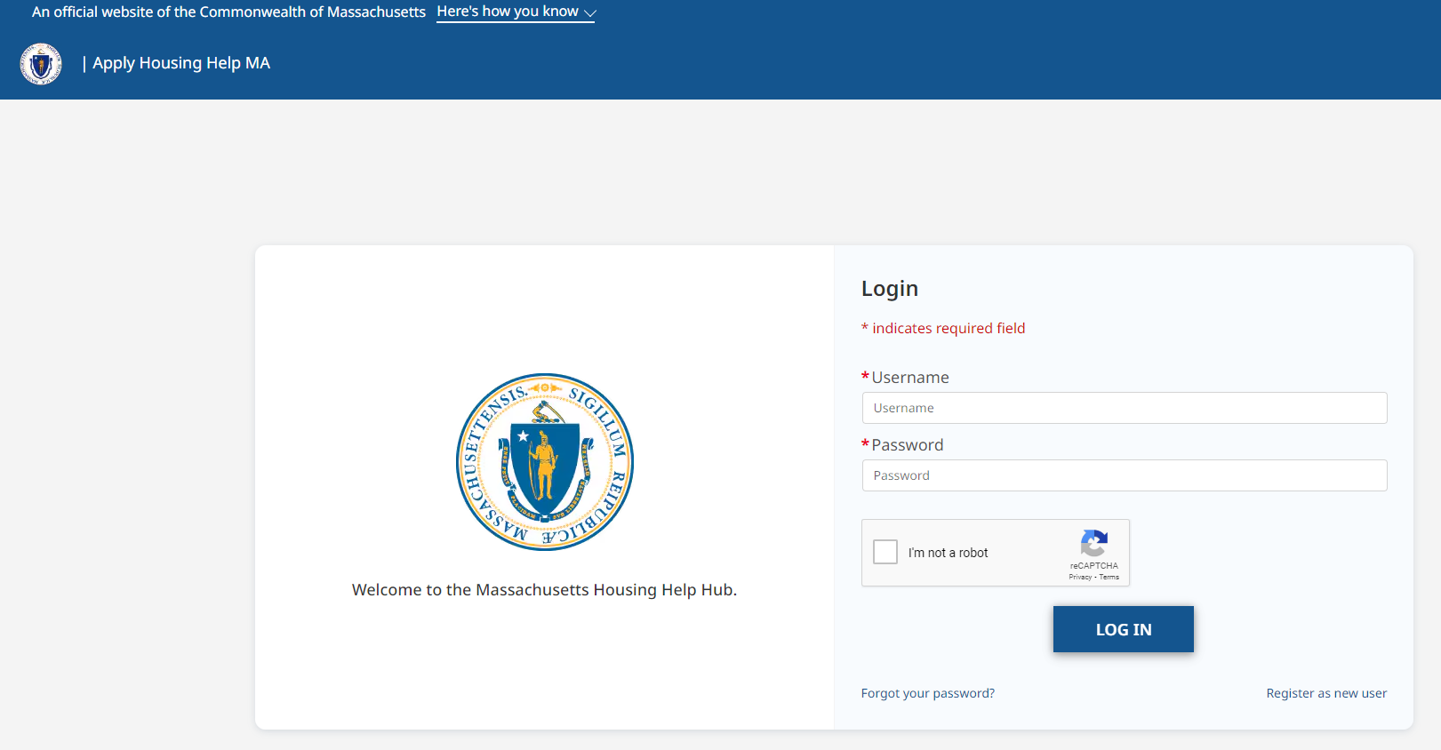
Registering an Account

Slide 34
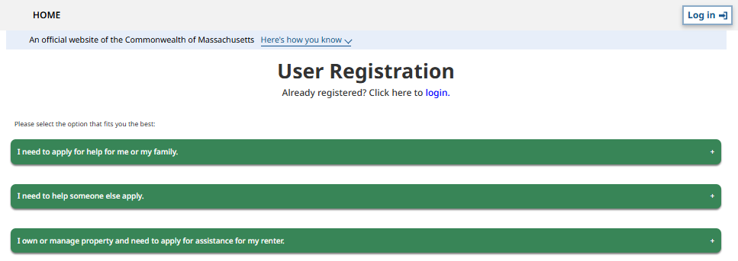
Registering a Tenant/Homeowner Advocate Account
Register as an advocate by first selecting I need to help someone else apply

Slide 35
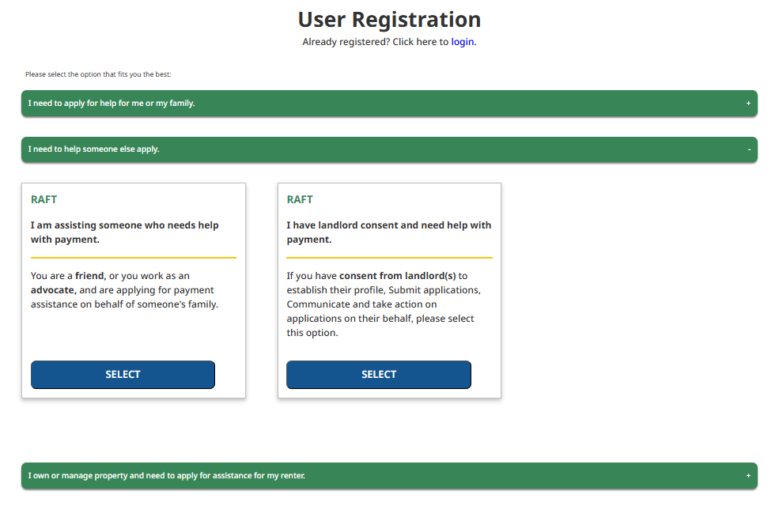
Registering a Tenant/Homeowner Advocate Account (part 2)
Next, select I am assisting someone who needs help with payment

Slide 36
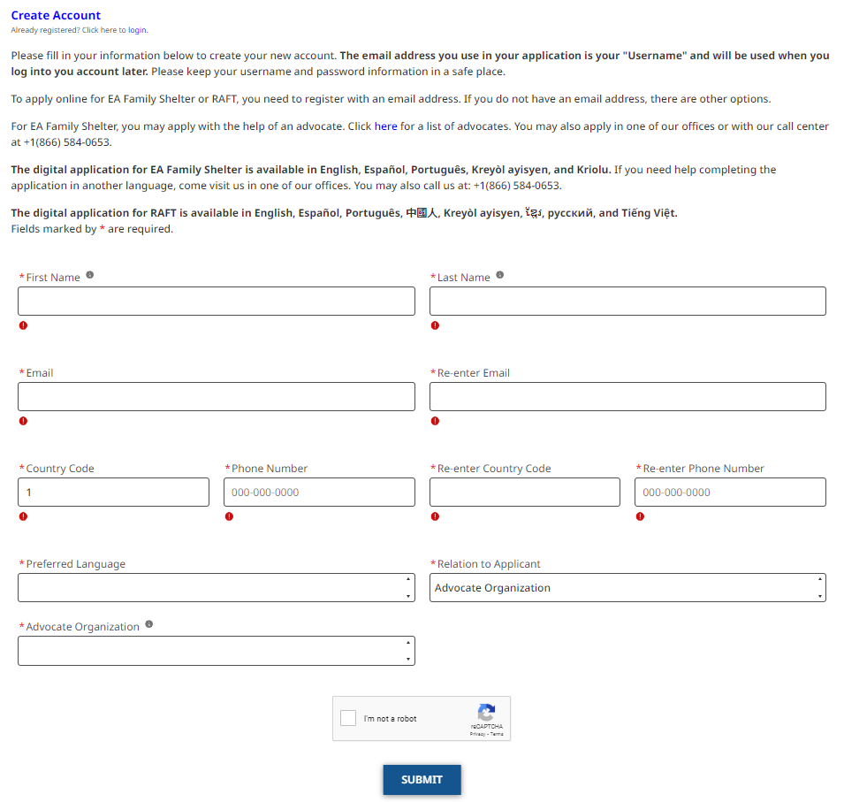
Registering a Tenant/Homeowner Advocate Account (part 3)
Finally, fill in the required info to create a new advocate account

Slide 37
Registering a Tenant/Homeowner Account
Tenants/Homeowners applying on their own will register by selecting I need to apply for help for me or my family and then filling in the required info to create a new account

Slide 38
How to Apply (Landlord Payment)
Fill out the application details and upload all required documents
  Save and resume functionality is enabled
  Applicants have 21 days to complete and submit the application
If advocate or tenant initiates the application
  Landlord will receive an email notification with a Tenant Application Code
  Landlord must log into landlord account and start an application
  When prompted under Tenant and Rent Details, landlord must select “Yes” when asked about email confirmation and then enter Tenant Application Code
  Landlord must upload required landlord documentation, sign, and submit
If landlord initiates the application
  Landlord must select “No” when asked about email confirmation and will not enter a Tenant Application Code
  When landlord completes application, tenant will receive an email notification with a Landlord Application Code, which must be entered in the tenant/tenant advocate application

Slide 39
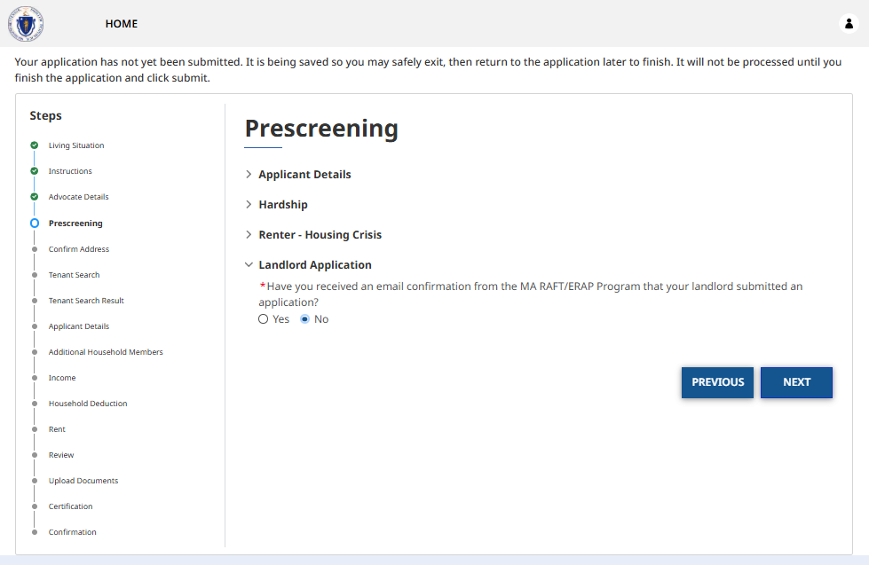
How to Apply (Landlord Payment) continued

Slide 40
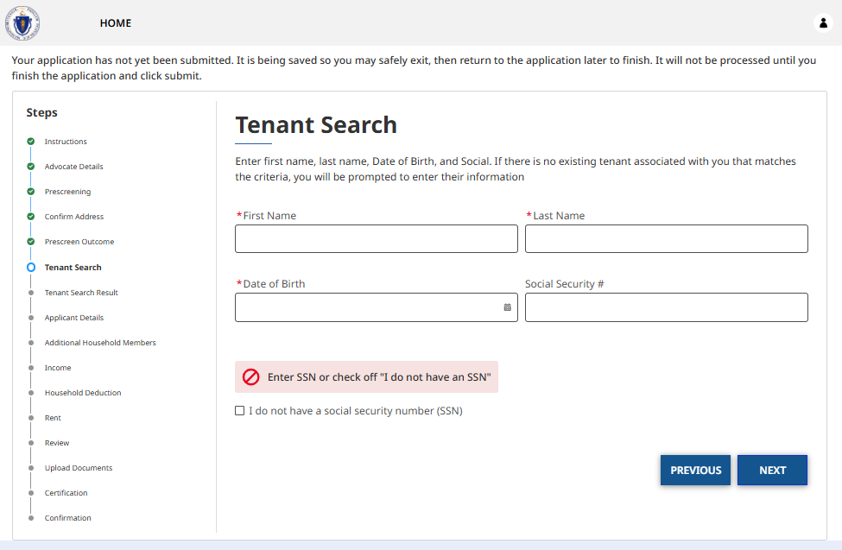
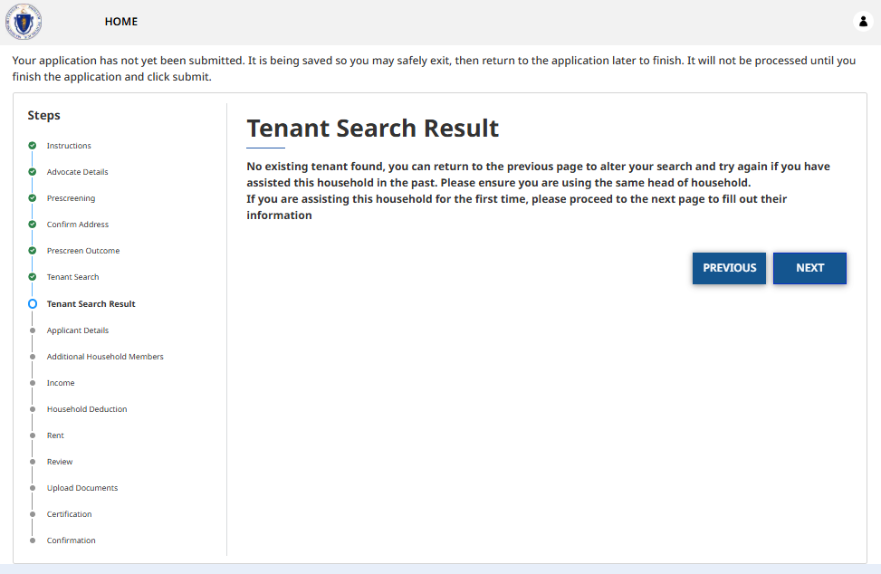
How to Apply (Landlord Payment): Tenant Search
On Tenant Search, if you entered information about a tenant that you have not completed an application for before, or you entered incorrect information about a tenant that you have completed an application for before, you will be taken to Tenant Search Result

Slide 41
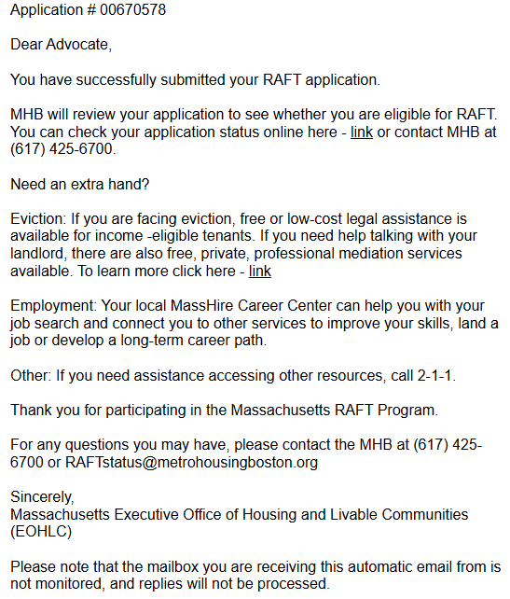
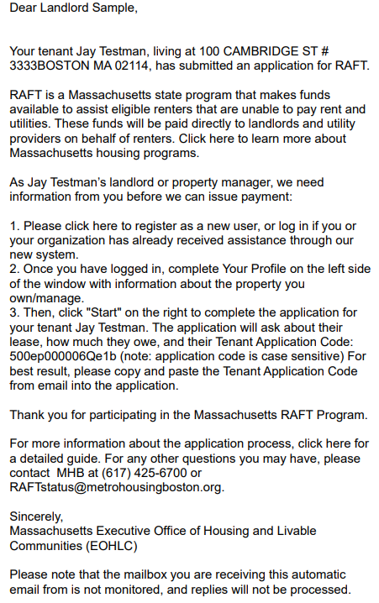
How to Apply (Landlord Payment): Notification Emails

Slide 42
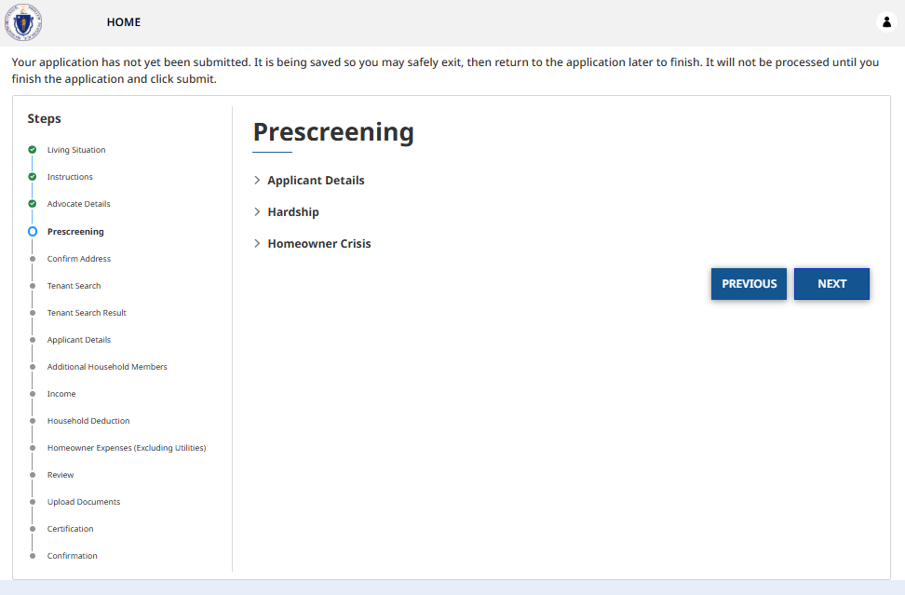
How to Apply (No Landlord Payment)​
Fill out the application details and upload all required documents
  Save and resume functionality is enabled
  Applicants have 21 days to complete and submit the application

Slide 43
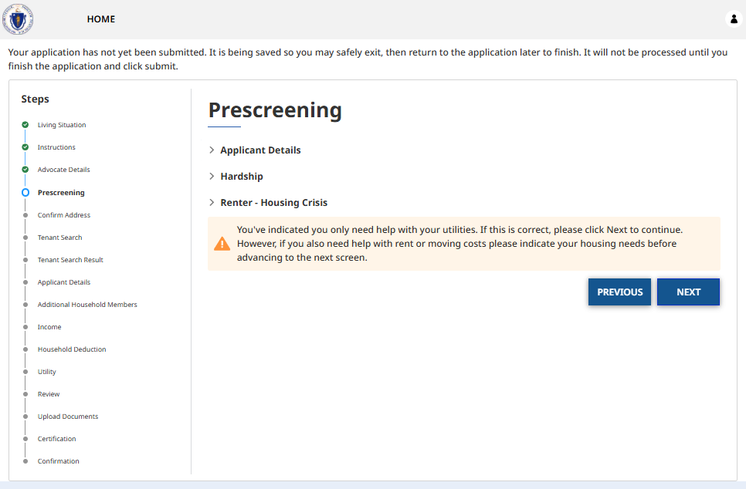
How to Apply (No Landlord Payment): Utilities Only

Slide 44
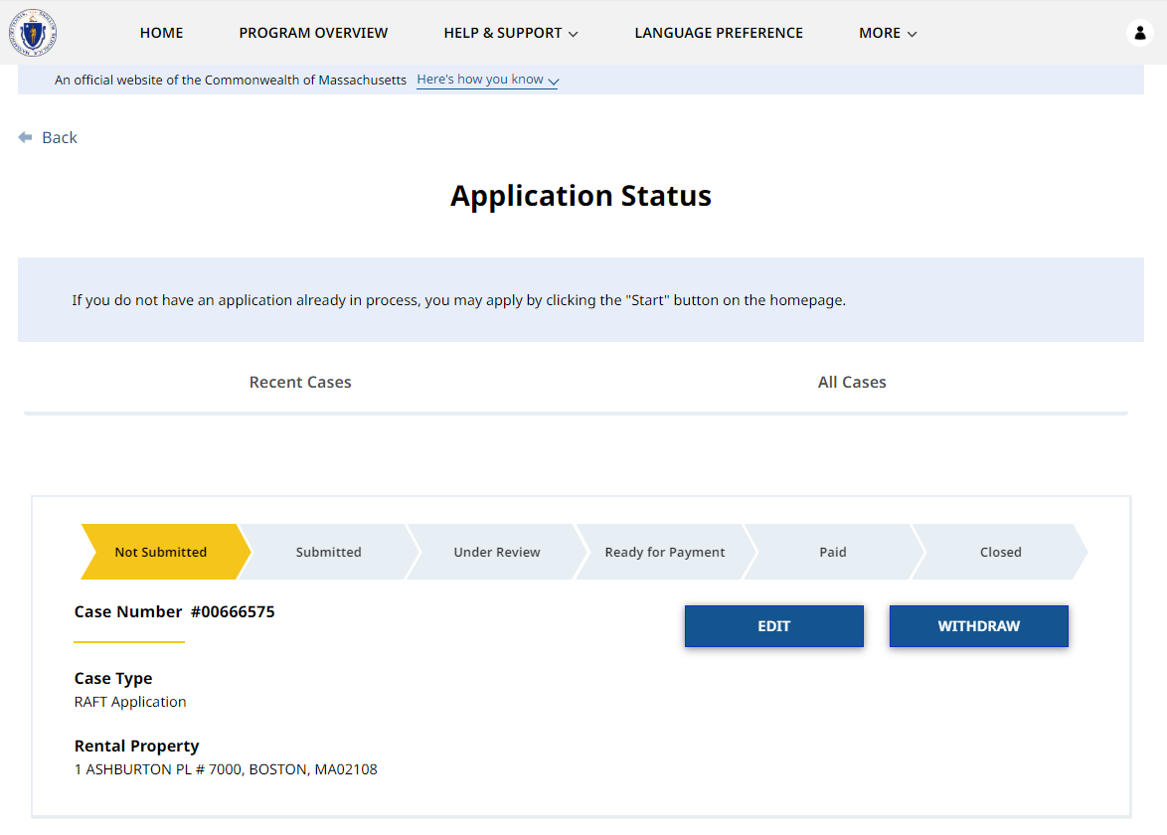
How to Check Application Status for Submitted Applications
Log into advocate account to view recent or all submitted cases
Status bar shows where each application currently is in the process
Unsubmitted applications can be edited before submission
Submitted applications cannot be edited, but additional documents may be uploaded

Slide 45
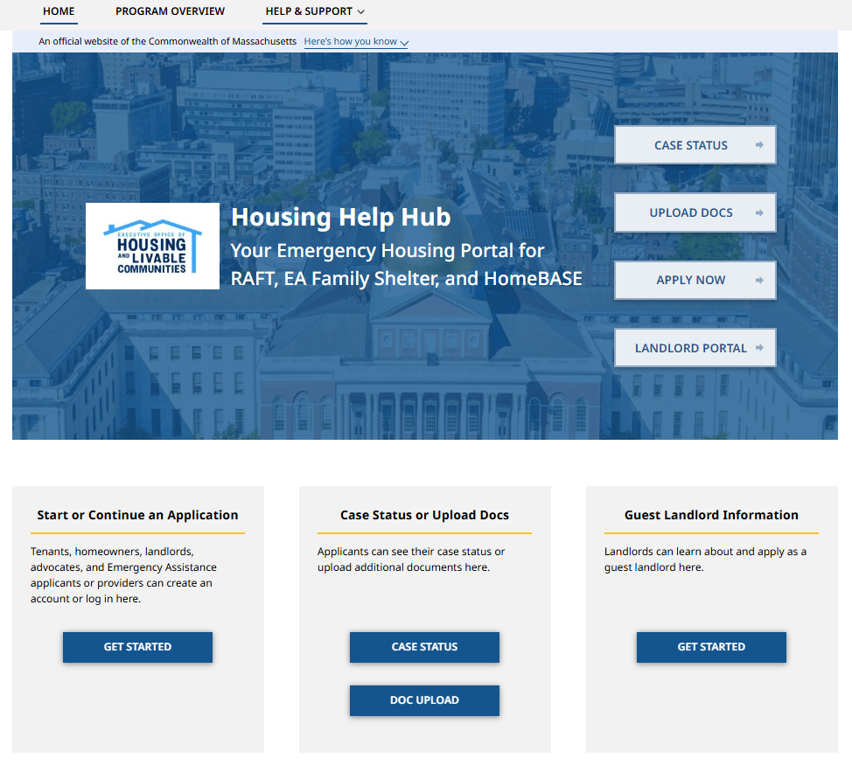
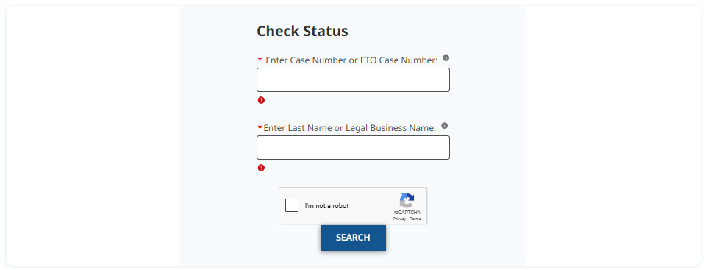
How to Check Application Status for Submitted Applications continued
Case Search page is a faster way of checking application status!

Slide 46
Case Status Definitions in the Tenant/Homeowner/Advocate Portal
Status | Definition
Not Submitted | The application has been started, but not submitted. Unsubmitted applications will be deleted after 21 days.
Submitted | The application has been submitted and, if applicable, is awaiting a match with a landlord application.
Under Review | The application has been matched with a landlord application (if applicable). An RAA is determining eligibility and reviewing documentation.
Ready for Payment | The application was approved and has been submitted for payment. Checks and direct deposits will be issued during the RAA's next check run. Status not applicable to LOI applications.
Paid | Payment has been issued to the landlord and/or vendors. Status not applicable to LOI applications.
Closed / Denied / Withdrawn Approved / Expired | The application was either closed (timed out), denied due to ineligibility, or withdrawn. "Approved" and “Expired” are only for LOI applications.

Slide 47
Questions

Slide 48
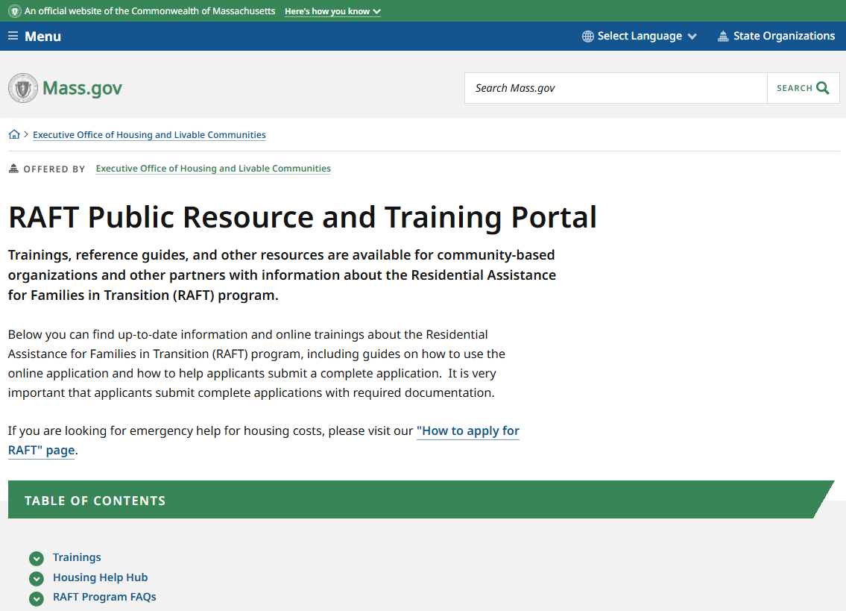
Resources
1
RAFT Public Resource and Training Portal
Trainings, reference guides, and other resources are available for community-based organizations and other partners with information about the Residential Assistance for Families in Transition (RAFT) program
2
  RAFT Eligibility Checker
  Optional form that asks a few questions about your
  client to see if they might be eligible for RAFT
3
  Housing Help Hub User Guides
  Tenant Portal Reference Guide
  Landlord Portal Reference Guide
4
  Regional Administering Agencies (RAAs)
  For case-specific questions, please reach out to the RAA processing your application

