Slide 1
Lahey Hospital and Medical Center
Determination of Need
Susan Moffatt-Bruce, MD
January 20th, 2026
Public Meeting

Slide 2
Agenda
Welcome and Introductions
Proposed Projects
Project Timeline
Community Health Initiative
Questions and Discussion

Slide 3
Expanding Services at Lahey Hospital & Medical Center
Proposed Project Need
  LHMC has experienced a growing need for inpatient, cardiac and advanced imaging services in recent years.
  To improve access to care, LHMC is proposing the following projects:
    Main Campus
      Add 36-40 new inpatient beds
      Expand cardiac catheterization capacity
    Peabody
      Add one new CT (total 2)

Slide 4
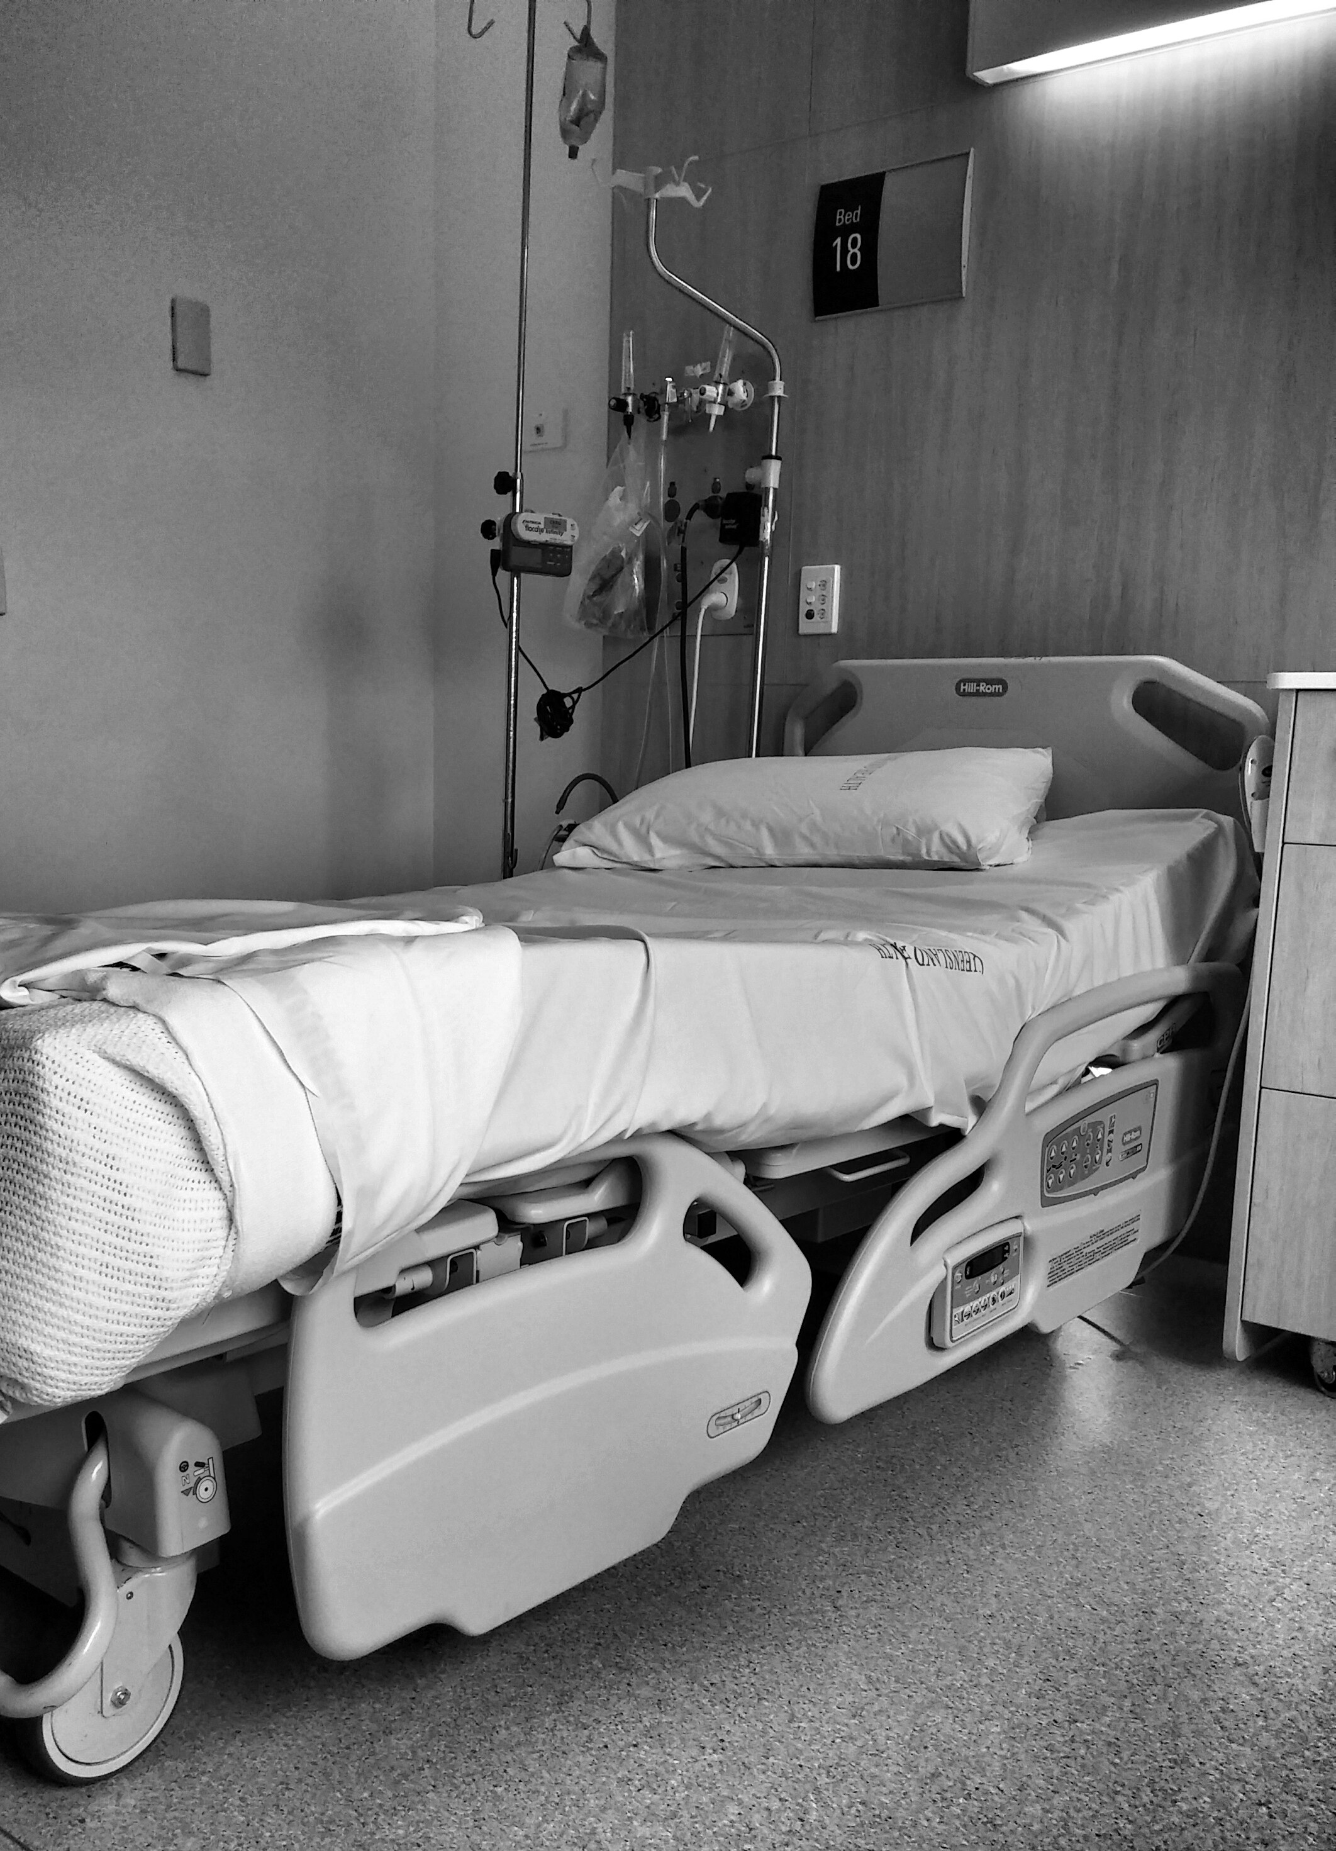
Expanding Services at Lahey Hospital & Medical Center
Inpatient Beds at the Main Campus
For more than two years, the number of patients admitted to LHMC has exceeded its licensed bed count, contributing to boarding in the emergency department.
This is the result of sicker patients who require a longer admission.
Adding beds will ensure patients can move from the emergency department sooner to when the decision to admit is ordered.

Slide 5
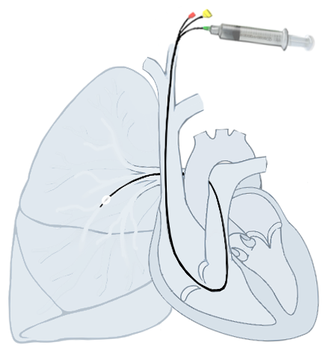
Cardiac Catheterization at the Main Campus
Expanding Services at Lahey Hospital & Medical Center
Cases at the Hospital’s cardiac catheterization lab have increased 25% since 2022.
During the same period, wait times have grown from two weeks to six weeks.
Additional capacity will reduce patient wait times ensuring patients can access timely treatment.

Slide 6
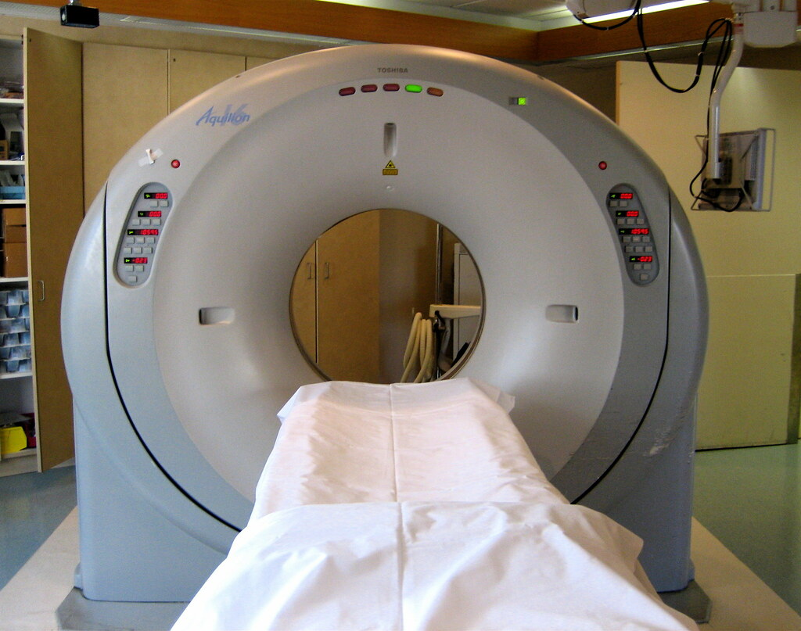
Computed Tomography (CT) at Peabody Campus
Expanding Services at Lahey Hospital & Medical Center
Lahey Medical Center – Peabody currently only has one CT machine to serve its inpatients, outpatients, and emergency patients, including patients experiencing stroke symptoms.
This leads to frequent disruptions for scheduled outpatients and contributes to long wait times for outpatients.
Adding a second CT machine will improve access and reduce delays for all patients.

Slide 7

Project Timelines
Expanding Services at Lahey Hospital & Medical Center
File Notice of Material Change with Health Policy Commission
      Early calendar year (CY) 2026
  File Determination of Need with Massachusetts Department of Public Health
      Early CY 2026
Review and approval
      Summer 2026
  Construction begins
      TBD
  Opening
      TBD

Slide 8
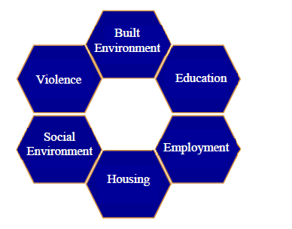
Expanding Services at Lahey Hospital & Medical Center (continued)
Community Health Initiative
DPH requires hospitals to distribute funding equal to 5% of the approved project’s cost through local initiatives.
This will result in approximately $2-$4 million being invested in Lahey Hospital & Medical Center’s Community Benefits Service Area (CBSA)
Over 5-7 years, this money will be distributed at the advice and guidance of the hospital’s CBAC adhering to the MA DPH Determination of Need Health Priorities.

Slide 9
Questions & Discussion

