Slide 1
Community Planning Grant Program Guidance Webinar
Community One Stop for Growth

Slide 2
Road Map
What is the Community One Stop for Growth?
Community Planning Grant Program (CP) Overview
Where does CP Fit in the One Stop?
Important CP Parameters
How to Be Competitive
Examples of Successful Applications
Completing the Full Application
Key Dates and Opportunities to Get Guidance

Slide 3
What is the Community One Stop for Growth?
The Community One Stop for Growth is the main driver of economic development in the Commonwealth.
The One Stop is a single application portal and collaborative review process designed to streamline the experience for the applicant and better coordinate economic development programs and staff on engagement and grant making.
Executive Office of Economic Development | MassDevelopment Finance Agency | Executive Office of Housing and Livable Communities
MassWorks Infrastructure Program Rural Development Fund Urban Agenda Grant Program Massachusetts Downtown Initiative | Underutilized Properties Program Site Readiness Program Collaborative Workspaces Program Brownfields Redevelopment Fund Real Estate Services Technical Assistance | HousingWorks Infrastructure Program Housing Choice Grant Program Community Planning Grant Program

Slide 4
Community Planning Grant Program Overview
Program Staff | McKenzie Bell, Senior Community Grants Coordinator (McKenzie.Bell@mass.gov)
What is the Purpose of the Program? | Fund a variety of activities related to community planning such as a community plan, zoning revision, or planning for housing to: support direct community engagement efforts to involve community members in the planning process, and/or produce planning and zoning document(s) and/or related materials in draft, phased, or final product form
Who is Eligible? | Municipalities Regional Planning Agencies Municipal entities (Redevelopment Authorities, Economic Development Industrial Corporations, bodies created by legislative act to serve a municipality)

Slide 5
Where Does CP Fit in the One Stop?
Preparing for Growth |  |  | Catalyzing Specific Projects
Community Activation & Placemaking | Planning & Zoning | Site Preparation | Building | Infrastructure
Technical Assistance for Downtowns Downtown Design Consultant Services Downtown Mobility/Parking Consultant Services Downtown Wayfinding/Branding Consultant Services Economics of Downtown Consultant Services Pedestrian Orientation/Placemaking Consultant Services Small Business Support/E-commerce Consultant Services Forming a Downtown Management District Equitable Workforce and Business Development Programming Entrepreneurship and Small Business Development Workforce Development and Training Initiatives Community Organizing and Leadership Development | Community Plan Master Plan Neighborhood Plan Downtown Plan Urban Renewal Plan Housing Production Plan Regional Plan Corridor Plan Zoning Revision Zoning Revision to Comply with Section 3A of MGL c.40A Comprehensive Zoning Review & Revision Planning for Housing Housing Feasibility Plan Housing Site Master Plan Housing Infrastructure Plan Housing Site Design Plan District Redevelopment Technical Assistance Planning for Growth in a Commercial/Industrial District | Brownfield Site Clean Up Brownfields Site Assessment Brownfields Remediation Site Improvements to Unlock Development Site Readiness Pre-Construction Site Readiness Construction Municipal Surplus Property Disposition Municipal Surplus Property Disposition Study | Underutilized Property Rehabilitation Underutilized Property Pre-Construction Underutilized Property Construction Creating Collaborative Workspace Collaborative Workspace Feasibility Study Collaborative Workspace Fit-Out or Equipment Community Lead Housing Production Support Housing Production Support Housing Rehabilitation Support Housing Preservation | Public Infrastructure to Support Housing Growth (Residential Only) Pre-construction - Design / Engineering Documents Only Construction Public Infrastructure to Support Mixed-Use and Commercial/Industrial Growth Pre-construction - Design / Engineering Documents Only Construction Small Town Road Improvements to Enhance Public Safety (STRAP) Construction of Road Improvements to Enhance Public Safety

Slide 6
Important Project Parameters
Project Budget | Awards for single entities limited up to $150K Awards over this amount are considered only for joint or regional applications on a case-by-case basis at EOHLC’s discretion No local cash match requirements, but applications with 10% local match get bonus points
Project Timeline Requirements | 2-year grant cycle Awards made in fall 2024 Projects must be completed by June 30, 2026
Eligible Use of Funds | Activities related to community planning may include, but are not limited to: Master Plan, Neighborhood Plan, Downtown Plan, Urban Renewal Plan, Housing Production Plan, Regional Plan, Corridor Plan Zoning revision to comply with Section 3A of MGL c.40A, comprehensive zoning review and revision Planning for housing such as Housing Feasibility Plan, Infrastructure Plan, Housing Site Master Plan, Housing Site Design Plan
Ineligible Activities | Cannot fund staff time or training Applicants with locally adopted growth limitations or housing or infrastructure moratoria are ineligible

Slide 7
How To Be Competitive
Key information to consider
Is the project best achieved as a full project within one grant cycle or as a phased approach?
Guidelines include scoring rubric: How can you maximize all possible points?
Note: Awards will take score, regional diversity, previous support from EOHLC, first time grant recipients, and alignment with priorities of the Secretary into account.
Full application questions to pay attention to
2.6. Project Need: Show, not just tell, the need specific to your community
2.14. Community Description and Engagement Plan: Robust community engagement plans with clear path to implementation
2.16. Progress to Date: Include descriptions of recently implemented local ordinances or bylaws that directly impact this project
2.20. Project Impacts: Provide best estimates for housing outcomes (if possible)
Expected attachments
2.11. Consultant/Contractor Cost Estimate
2.12. Project Location Map

Slide 8
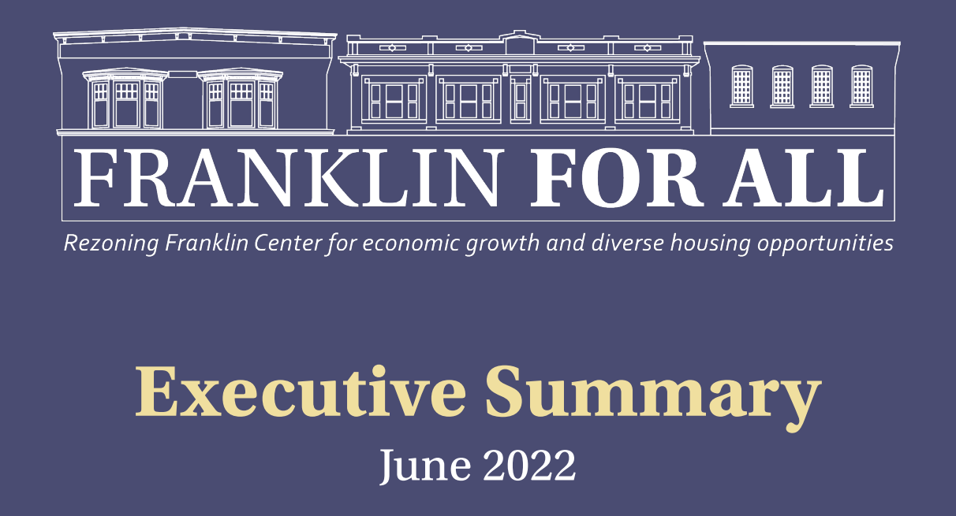
Successful Application Example #1
Applicant: | Franklin (FY22)
Project Description: | Zoning Review/Updates The Town will complete a zoning audit with a substantial public engagement process, and develop zoning bylaw amendments to modernize and update their zoning bylaw. The Proposed Project will assure Franklin’s Zoning Bylaw reflects current best zoning practices and planning concepts and increase economic activity & the number of affordable housing units in the project area.
What Made the Project Successful: | Documented evidence of progress to date Detailed scope of work Clear leadership with proven track record to execute project Project feasible within grant timeline and ready to start soon upon award Feasible and defensible cost
Learn more about the “Franklin for All” plan

Slide 9
Successful Application Example #2
Applicant: | Leverett (FY23)
Project Description: | The Town of Leverett will implement the second of two phases in developing a Comprehensive Plan for Leverett. For the second phase, a steering group and expert consultant will guide community engagement through visioning sessions and focus groups and synthesize outputs to present options to residents for consideration.
What Made the Project Successful: | Project need clearly described and evidence of locally defined and documented needs Commitment to date shown via phased approach Well-articulated objectives that showcase clear implementation path forward
Learn more about Leverett’s ongoing efforts

Slide 10
Successful Application Example #3
Applicant: | Southeastern Regional Planning & Economic Development District - SRPEDD (FY24)
Project Description: | Zoning Revision to Comply with Section 3A SRPEDD will support efforts in its region for compliance with Section 3A of the Zoning Act among seven eligible rural communities in the region.
What Made the Project Successful: | Clearly addressed local and regional needs as a joint/collaborative project Demonstrated commitment to date through continuity of similar past projects Ready and timely implementation Robust community engagement and implementation plan Clear expected outcomes to help communities comply with M.G.L. 40A section 3A
Learn more about SRPEDD’s MBTA Communities compliance assistance efforts

Slide 11
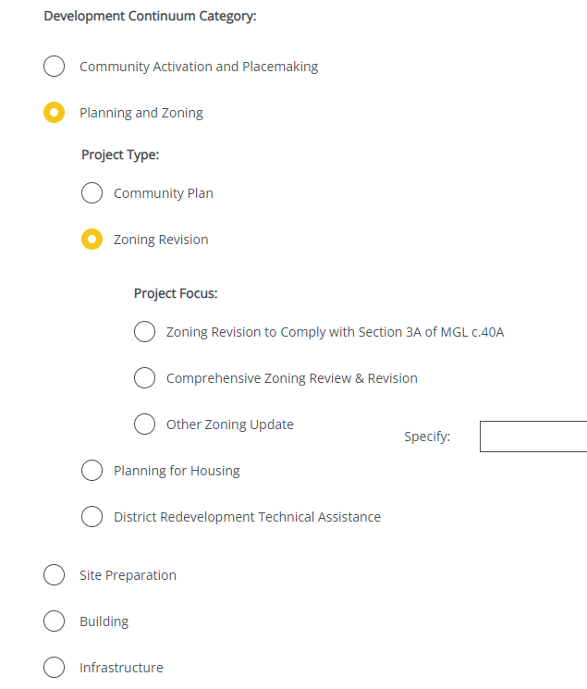
Completing the Full Application
Key Question: In Section 2 of the Full Application, applicants are asked to indicate the Project Category. To be reviewed by CP, applicants should make the following selections in question 2.4:
For more information on completing the Full Application, visit www.mass.gov/onestop to view One Stop Webinar 2: Application Guidance
Development Continuum: | Planning and Zoning
Project Type: | {Insert Project Type}
Project Focus: | Select the most appropriate Project Focus option for your application

Slide 12
FY25 Round Timeline
JAN
Jan.
Full Application and Expression of Interest Open (January) – The Full Application is the official form for submitting all funding requests. Applicants may now begin to work on applications in the IGX system, however applications will only be accepted during the submission period.
One Stop Guidance Phase (January – May) – A series of webinars will be hosted be both the One Stop Team and staff from each program within the One Stop. In addition, office hours will be hosted to answer applicant questions. Visit www.mass.gov/onestop for the full schedule of webinars and office hours.
Full Application Submission Period (May-June) – Applicants may submit their Full Application(s) beginning May 6, 2024. All applications must be submitted by the Full Application deadline of 11:59 p.m. on Wednesday, June 5.
Review and Evaluation (July – August) – All complete and eligible Full Applications submitted by the deadline will be reviewed and evaluated by the corresponding program managers at each state agency. The One Stop team will also conduct joint application reviews across agencies. Based on the program’s criteria, each program will prepare its list of applications recommended for funding, to be further reviewed and approved by agency and Secretariat leadership.
Notification of Grant Decisions (September) – Once final recommendation have been approved, applicants will be notified of grant decisions in writing, and announcement events will be scheduled.
Sept.

Slide 13
Opportunities for Guidance
Visit www.mass.gov/onestop for more information on:
Expression of Interest
Complete an Expression of Interest form to see if your project(s) is eligible for funding through the One Stop and get tips for preparing your application
One Stop and Program Webinars
Recordings of all One Stop webinars are now available on the One Stop website
Office Hours
One Stop General Guidance Office Hours – One Stop staff will hold office hours to discuss general One Stop process and technology questions
Program Office Hours – Staff from each program will hold an office hour to answer applicant questions related to the program
CP’s office hours will be held on Monday, March 11 from 12:30PM – 2:30PM

