Slide 1
FY20 Contract Forms Webinar

Slide 2
Overview
Foundational Information
Terminology
Contract Types
Chapter 257
Forms
Service Summary Form
ICMS Reports for ALTR & Shared Living
Standard Contract Form (Cost Reimbursement)
Attachments 1, 3, & 6
Day, Work, & Support Roster
Residential Absence Policy Worksheet

Slide 3
Terminology
Contract: Refers only to the Standard Contract Form and associated attachments. This is a formal legal document establishing contractual relationship between State and Provider.
Service Engagement: Refers to the annual process of determining rates and allotting units. Documents are for planning purposes and do not represent binding contractual agreement.
Chapter 257: Refers to Chapter 257 of the Acts of 2008 which requires the Executive Office of Health and Human Services to establish rates of payment for human service programs.

Slide 4
Form Types
Contract Documents
Standard Contract Form
Standard Contract Form Attachments
Attachment 1: Program Cover Page
Attachment 3: Fiscal Year Program Budget
Attachment 6: Capital Budget
Service Engagement Documents
Service Summary Form

Slide 5
Contract Types
There are only two primary types of contracts
Rate Agreement
Contract is an agreement for provision of service and rates of payment
Encumbrance level may be modified without formal contract amendment
Maximum Obligation
Contract is agreement to purchase specific amount of service
Must be accompanied by line item budget detailing reimbursable costs

Slide 6
Rate Agreement: Master Agreements
Master Agreement contracts are issued when provider qualifies for an open enrollment procurement
Multi-year rate agreements which remain in effect throughout the entire procurement lifetime
Places provider on qualified list making them eligible for referrals from DDS Area Offices
Specific rates and units managed through service engagement process

Slide 7
Master Agreements - Programs
The following service classes are managed through master agreement contracts:
Adult Long Term Residential Services (ALTR-14)
Shared Living / Placement Services (PS-15)
Employment and Day Programs (EmpDay20)
Supplemental Day Services (SuppDay20)
Support Services (SSQUAL-10)
In Home Supports (IHS-16)
Agency with Choice (AWC-19)
Once the Master Agreement contract is signed all activity will be managed through Service Engagement Document

Slide 8
Rates – Chapter 257
All programs contracted under a Master Agreement will be reimbursed with rates established by EOHHS
Rate Regulations may be found on EHS website:
https://www.mass.gov/lists/provider-payment-rates-purchase-of-service
DDS maintains chart of all Chapter 257 rates used by the Department which is available at DDS website
https://www.mass.gov/lists/dds-pos-contracts-information
Specific rates will be negotiated between Area/Region and Provider

Slide 9
Service Summary Form
FY20 Service Summary Form is same as FY19 version
DDS has published new SSF with updated Master Agreement references and Ready Pay eligibility
Service engagement document used for all rate agreements:
Adult Long Term Residential Services
Shared Living
Employment and Day Programs
Supplemental Day Services
In Home Supports
Support Services
As Needed Support Services

Slide 10
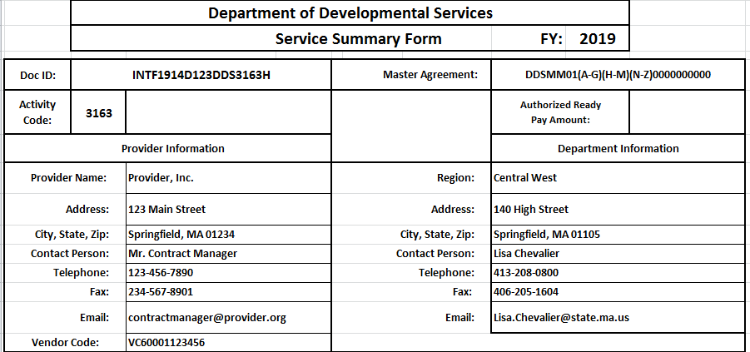
Service Summary Form
20 character unique identifier. This ID will be used to search for contract in EIM. ID will be provided to you by Regional Contract Office
Must match Doc ID from Master Agreement Contract. If unknown check reference tab on SSF.
If unsure reference matrix. Activity code is also listed in Doc ID (Last 4 numbers)
Regional Contract Office will enter Ready Pay Amount

Slide 11
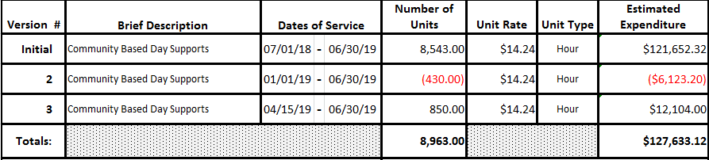
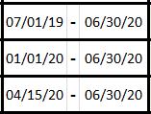
Service Summary Form
The body of the Service Summary Form keeps a running tab of agreed upon units and rates
Amendments to SSF should show the change value, not the new total
For downward changes, enter negative units
Start Date should be effective date of form
Enter agreed upon rate
Frequency units will be billed in:
Month, Day, Hour,
Enter Service Name
Enter agreed upon units
For each amendment enter changes on next available line. Do not delete or replace information from previous versions.

Slide 12
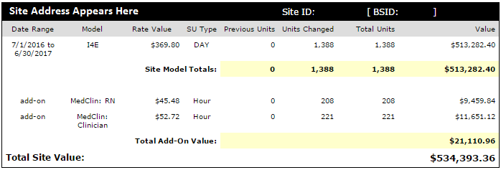
SSF Attachments For ALTR & Shared Living
The site / individual detail report will show all the rate information for each site / individual
Be sure to check all of the highlighted information to make sure it matches what was negotiated with Area Director
Amendments will show both the previous units and the amount changing due to the amendment

Slide 13
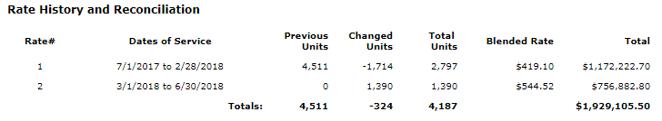
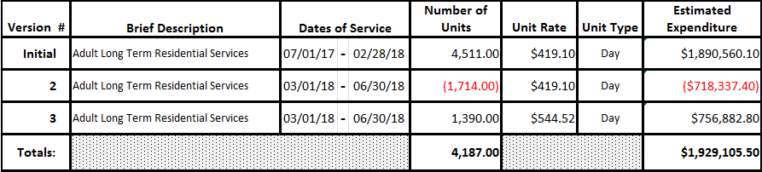
SSF Attachments For ALTR & Shared Living
Rates and units entered on SSF should match information on ICMS Rate Computation Report
Need to show removal of units at old rate and addition of units at new rate

Slide 14
Cost Reimbursement Contract
Contract that reimburses provider based on an accounting of actual costs incurred
Contract is based on a line item budget that details program costs
Contracts have a maximum obligation that cannot be exceeded without formal amendment
Service Class Examples:
Financial Assistance / Stipends
Furnishings and Equipment
Agency with Choice
See Matrix for full list of activity codes

Slide 15
Cost Reimbursement Forms
Forms to Complete
Standard Contract Form
Attachment 1: Program Cover Page
Attachment 3: Fiscal Year Program Budget
Attachment 6: Capital Budget (if applicable)
For contracts that only purchase capital items, Attachment 3 is not needed (ex: 3191 contracts)

Slide 16
Standard Contract Form
Required contract document for all Commonwealth Departments
Must be submitted for both new and amended contracts
Requires original signature
Includes:
Identifying contract information
Whether contract is new or amended
Terms and conditions
Compensation
Start date and end date
Certifications

Slide 17
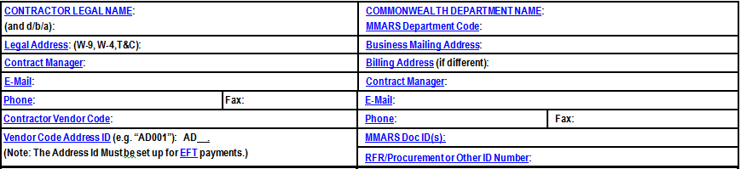
Standard Contract Form: Header
Must match W9 on file with Comptroller
Only list 20 digit ID. Obtain from regional contract office. ID stays the same over life of contract
List RFR ID number of procurement associated with contract. Obtain from region if unsure. Example: “AWC-19”

Slide 18
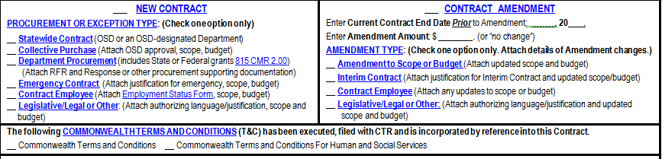
Standard Contract Form: New/Amend
Fill out ONLY ONE section. For amendments, “New Contract” section must be blank
Always select Department Procurement unless specifically directed otherwise
Select Amendment to Scope or Budget unless directed otherwise
Enter Contract End Date from most recent version of contract
Check Commonwealth Terms and Conditions for Human and Social Services
Enter value of amendment (change value, not new total)

Slide 19
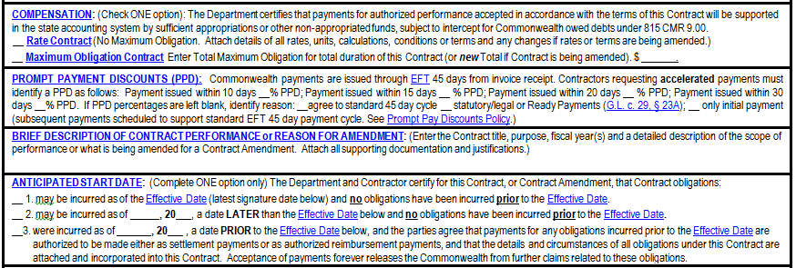
Standard Contract Form: Compensation Type & Start Date
All Cost Reimbursement contracts are Maximum Obligation
Enter contract total. Must match multiyear total from Attachment 1
Enter Brief Description
Check statutory/legal
Start Dates – Situation for each option:
Amend to add money during the fiscal year.
Renew/extend contract to the next fiscal year. Check box and write start date (usually 7/1).
Special situations only—Region will direct you if this option is needed.
Make sure to change the check from 2 to 1 and remove start date the first time you amend the contract in the next year

Slide 20
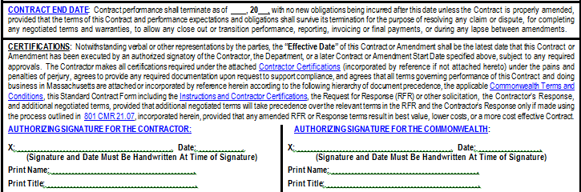
Standard Contract Form: End Date & Signature
End date generally June 30 of current fiscal year. Multiyear contract will have end date in future year.
Sign and Date in BLUE INK
Signature date must be prior to Effective Date if checked option 2 above. If signatory changed, also submit updated Authorized Signatory Form

Slide 21
Attachment 1: Program Cover Page
Provides general contractor and program information
Creates historical starting point for all future amendments
Includes:
Document ID #
UFR Program #
RFR Information
Anticipated contract duration
Fiscal terms
Pricing options
Current maximum obligation
Funding

Slide 22
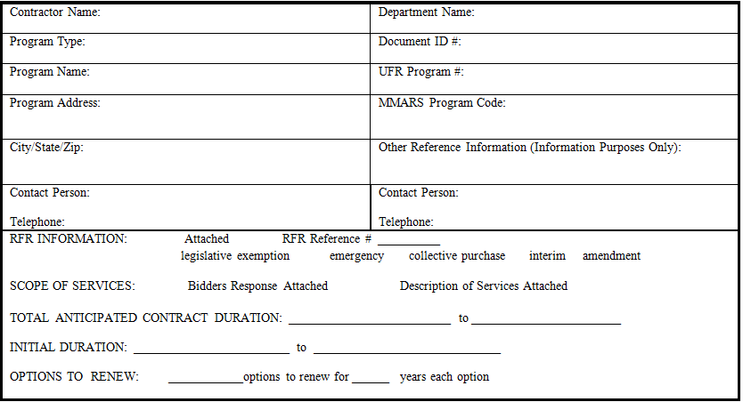
Attachment 1: Program Cover Page
Use the anticipated UFR number
Use activity code
Leave blank
Use the original date range
Must match RFR ID from SCF
Use original start date to current end date

Slide 23
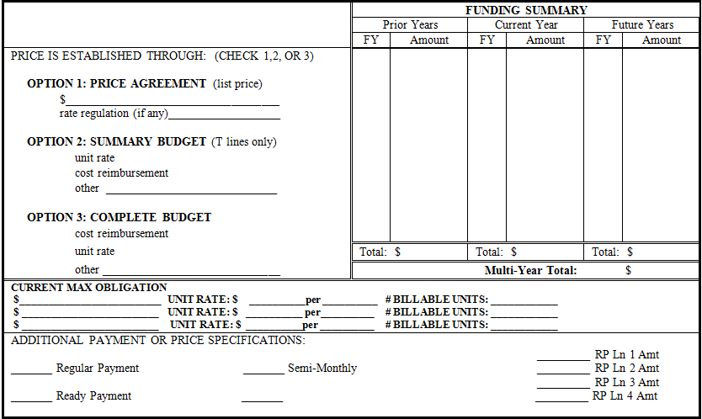
Attachment 1: Program Cover Page Fiscal Terms
One row for each version during year
Include future years if extending to next fiscal year
Include one row with contract total for each previous year
Check Cost reimbursement under option 3
Leave blank
Multi-year total must match maximum obligation on SCF

Slide 24
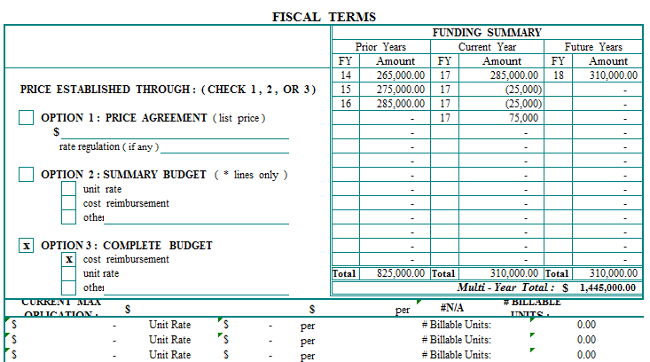
Attachment 1: Program Cover Page
Sample completed Fiscal Terms:
Contract active since FY14. There were 4 versions during FY17. Contract is being extended into FY18

Slide 25
Attachment 3: Fiscal Year Program Budget
Reflects total annual program costs associated with the fiscal year operation of the program
Required where payment is based on submission of program budget
Includes:
Line item detail of all program costs
Current, Amended, and New Subtotals
Budget Total

Slide 26
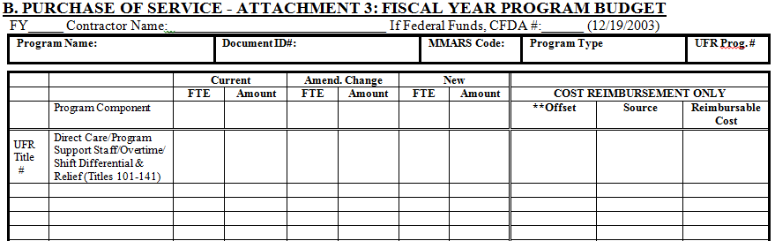
Attachment 3: Fiscal Year Program Budget
Fill in UFR Title # and UFR Position Title. Only use titles defined in UFR Preparation Manual
Enter sum of Current and Amend. Change columns
New FY Contracts: Fill in initial FTE and Amount
Amendments: Enter Total FTE and Amount from previous version
For Amendments Only: Enter change value of amendment (not new total)
Enter offsets as negatives. Subtract Offsets from Total to establish Reimbursable Cost

Slide 27
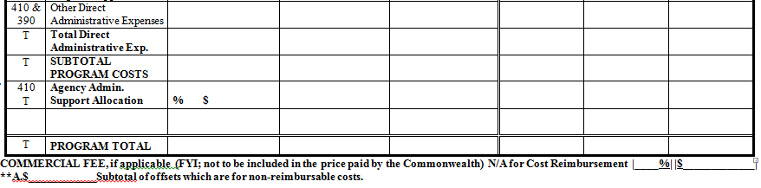
Attachment 3: Fiscal Year Program Budget
Continue to fill in lines as shown on previous slide
Program total must match FY total from Attachment 1 Funding Summary

Slide 28
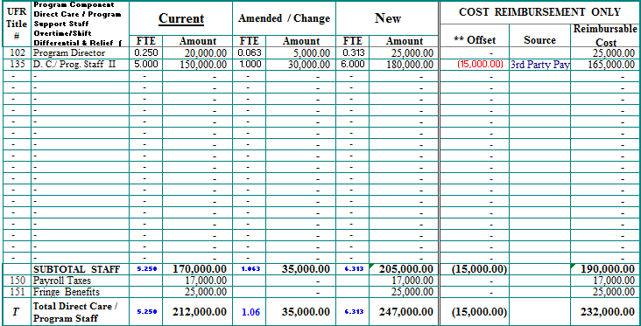
Attachment 3: Fiscal Year Program Budget
Example: Part 1 (Staff Expenses)

Slide 29
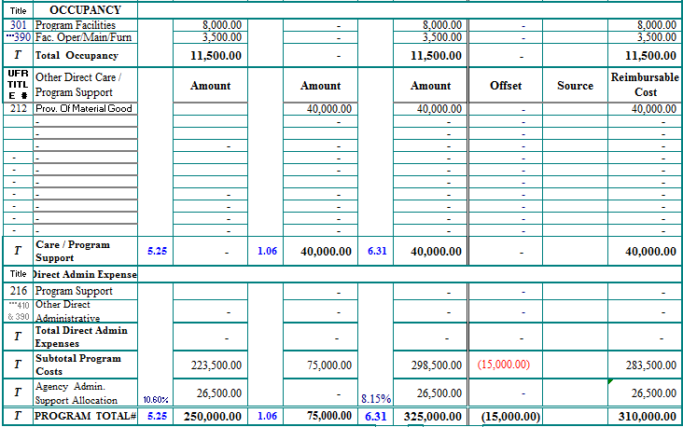
Attachment 3: Fiscal Year Program Budget
Example: Part 2 (Below the Line Expenses and Total)
Budget Total

Slide 30
Attachment 6: Capital Budget
Documents capital expenditures required to support the delivery of contracted human and social services
Items may only be included after approval from Regional Contract office
Includes:
List of capital items
Need for item
Quantity
Estimated Costs

Slide 31
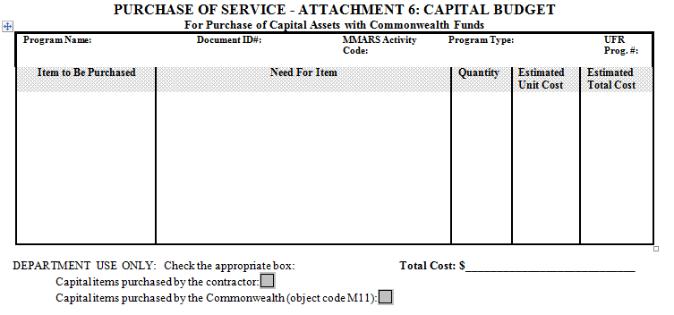
Attachment 6: Capital Budget
List each capital purchase in it’s own row
Select Items purchased by contractor

Slide 32
Day, Work & Support Roster
No change to Roster format for FY20
Used for all unit rate Day, Employment, and Support service programs
Community Based Day Supports
Supported Employment
Individual Home Supports
Support Services
One roster per rate
Multi-rate engagements must use separate rosters for each rate

Slide 33
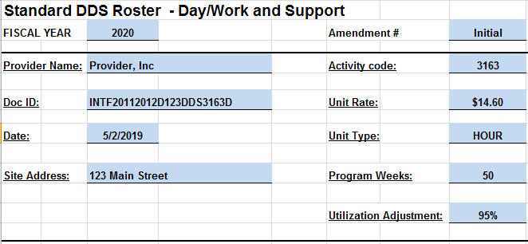
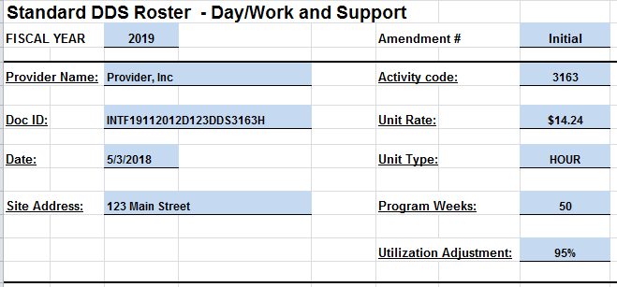
Day, Work & Support – Header
Utilization adjustment will reduce units based on anticipated program utilization. Negotiate with Area based on program history and anticipated utilization. Day and Employment contracts will start FY20 with a maximum of 95%
Enter total weeks program is in operation.
Day and Employment programs will start FY20 with a maximum of 50 weeks.

Slide 34
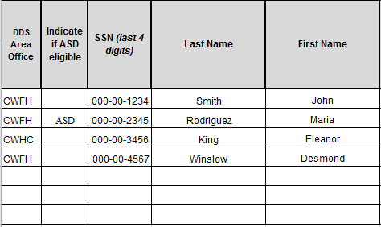
Day, Work & Support – Individual Info
Select Area of tie from dropdown
Enter “ASD” if individual ONLY has ASD eligibility, otherwise leave blank

Slide 35
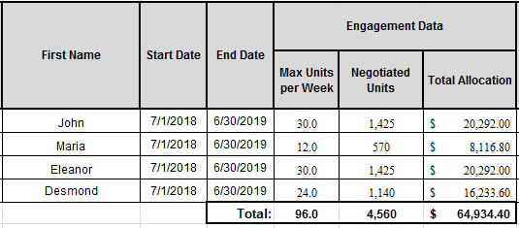
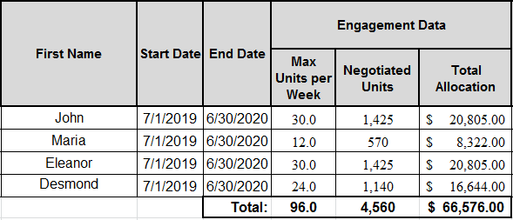
Day, Work & Support – Units and Allocations
Enter total weekly authorization for service
Negotiated Units = (Units per Week) * (Program Weeks) * (Utilization Adjustment)
Note: Area Director may authorize you to override Negotiated Units calculation and manually enter agreed upon units

Slide 36
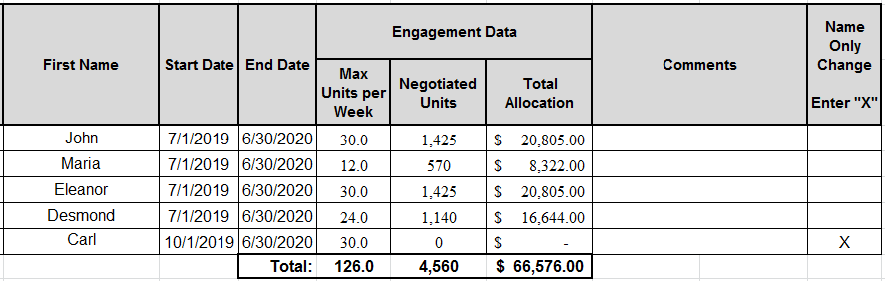
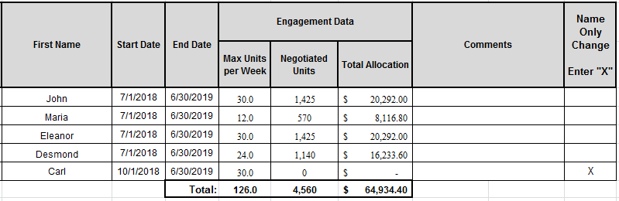
Day, Work & Support – Name Only Changes
You may add individuals to the roster without adding negotiated units by entering “X” in the “Name Only Change” column
Service Authorization will still be captured, but will not add units to the engagement

Slide 37
Day, Work & Support – Unit Change Amendment
Consider following situation:
Two individuals have been added “name only” during year
Area conducts utilization review
Result of both factors is that Area wants to amend 1200 units into engagement

Slide 38
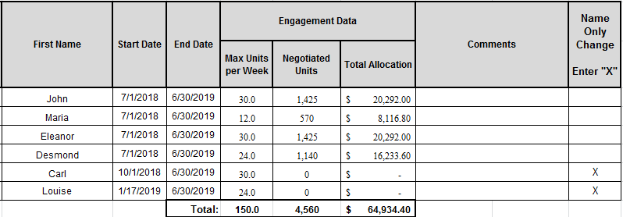
Day, Work & Support – Unit Change Amendment
Name Only checks should remain – roster will still show zero units and allocation for added individuals

Slide 39
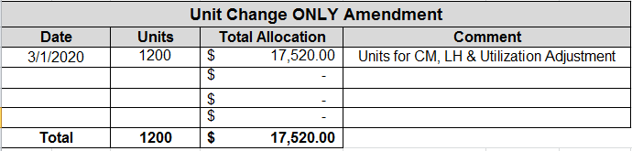
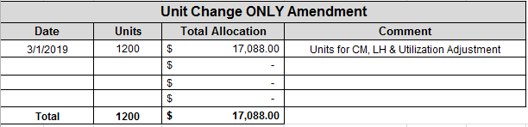
Day, Work & Support – Unit Change Amendment
Enter total units to be added to engagement in “Unit Change ONLY Amendment” box
This box allows for addition of units to roster without having to apportion changes by individual

Slide 40


Day, Work & Support – Unit Change Amendment
Changes made in the body of the roster and unit change box are summarized at the bottom of the roster

Slide 41
Residential Absence Policy Worksheet
Absence Policy Worksheet is tool used to demonstrate eligibility for absence unit billing in a residential program
Documents Needed:
Start of FY ICMS Report (Site/Individual Detail Report)
Current ICMS Report (if different from start of FY)
Record of all billing submitted to date

Slide 42
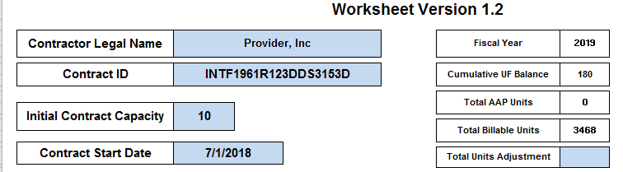
Absence Policy Worksheet – Header
Total Contract Capacity at start of FY (will not change over course of year)
Total Billable Units should match billable units on ICMS Report. Due to rounding there may be some discrepancy. Use Adjustment box to add or remove units as necessary to equal ICMS report.
Total remaining absence days. Will update as billing is entered
Absence units billed to-date

Slide 43
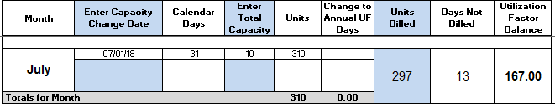
Absence Policy Worksheet – Monthly Data
Maximum possible attendance for month
Worksheet calculates number of absences
Enter actual attendance for month. Include any billed absence units
Shows remaining balance of absences. Current month’s absences are removed from balance

Slide 44

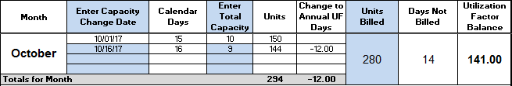
Absence Policy Worksheet – Capacity Change
Refer to ICMS site detail report for changes.
Only include capacity changes that have been amended into ICMS through model change OR changes that have been negotiated and will be amended in
Change date matches ICMS Report
Enter new TOTAL capacity
Unit information will update based on capacity change

Slide 45
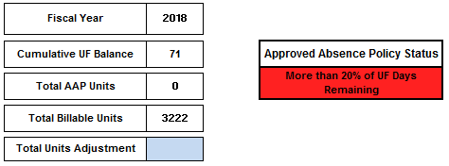
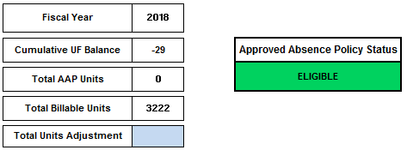
Absence Policy Worksheet - Eligibility
Red Light
There are still pre-paid absences available. Not eligible to request absence units yet
Green Light
All pre-paid absences have been exhausted. Eligible to request billable absence units

Slide 46
Additional Resources
DDS POS Website
https://www.mass.gov/lists/dds-pos-contracts-information
Activity Code Matrix
Lists all DDS service codes and which forms are required for each
DDS Purchase of Service Manual
DDS Contracting Policies
Bidding and Procurement Processes
Service Code Definitions
UFR Guidance & Preparation Manual
https://www.mass.gov/service-details/information-and-resources-on-the-uniform-financial-reports

