Slide 1
COVID-19 Vaccination Resource Guide Options, Accommodations, and Tools for DDS Individuals, Families, and Providers
April 2021

Slide 2
COVID-19 Vaccination Resources
Background and Eligibility
All people (age 16+) are now eligible to get vaccinated for COVID-19 in Massachusetts
It is important for individuals with Intellectual and Developmental Disabilities to get vaccinated
There may be options available that help improve access and provide accommodations and support for individuals with I/DD
The two-dose Pfizer and Moderna vaccines and single-dose Johnson & Johnson vaccine are all currently available in Massachusetts, but supply is limited
The COVID-19 vaccine is free
The COVID-19 vaccine is safe

Slide 3
COVID-19 Vaccination Resources
People Under 18
Currently, individuals age 16-17 are only able to get the Pfizer vaccine
Consent is required from the guardian, but the parent or guardian does not need to go to the appointment to give consent
Use the consent forms here (multiple translations)
If you are booking an appointment for a 16-17 year old, be sure to choose a location with a supply of Pfizer vaccine (for example, some locations may only have a supply of Moderna)
Learn more here: https://www.mass.gov/info-details/covid-19-vaccinations-for-people-under-age-18
Clinical trials are currently underway for children under 16 and vaccines may be available later this year

Slide 4
COVID-19 Vaccination Resources
Local Vaccination Options
Contact your Primary Care Physician (PCP) or healthcare provider about booking a vaccination appointment
Use the vaxfinder.mass.gov website to search for available appointments nearby at a local pharmacy, grocery store, Community Health Center, or site organized by a regional collaborative or Local Board of Health
This site will show you the locations nearby with available appointments
You will be taken to another website, like a pharmacy website, to book the appointment
Use this map of vaccination sites to find all the locations in your community that are currently offering COVID-19 vaccinations
Call 2-1-1 to book an appointment over the phone

Slide 5
COVID-19 Vaccination Resources
Accommodations at MassVax Sites
There are seven MassVax sites across the state available to get vaccinated in Boston, Danvers, Dartmouth, Foxboro, Natick, Roxbury, and Springfield
Register for an appointment now here: vaccinesignup.mass.gov
Accommodations available at all MassVax sites include:
Companions allowed for special assistance
Standard wheelchairs available
Clear face masks available for staff
Service dogs allowed with relief area identified
Clear routes from public transportation, paratransit, and rideshare drop-off locations
Accommodations available at some MassVax sites include:
Designated low-sensory area
Sensory kit available (headphones, ear protection, stress ball)
Large wheelchairs and large seats in waiting areas

Slide 6
COVID-19 Vaccination Resources
MassVax Community Appointment Vouchers
To support individuals who need help booking a vaccination appointment or need supports and accommodations during their visit to a MassVax site, organizations can request appointments slots to distribute to the individuals and families they serve
Request a batch of appointment voucher codes for priority booking through the Appointment Voucher Code Request Google Form
Indicate accommodations (low sensory rooms, live ASL interpreter, wheelchair, language translator) that may be needed
Organizations may request a block of time and certain number of appointments, then do outreach to families and arrange for on-site supports and accommodations at that time
Families may get vaccinated together

Slide 7
COVID-19 Vaccination Resources
Homebound Vaccination Program
In-Home vaccinations are now available for individuals who would have considerable difficulty leaving home for a vaccination, including behavioral and mobility challenges
To arrange an in-home vaccination, call the Homebound Vaccination Central Intake Line at (833) 983-0485
Representatives are available Monday through Friday from 9:00 AM to 5:00 PM in both English and Spanish, with access to translators for over 100 languages
All eligible family members may be vaccinated during an in-home visit
Visit this site to learn more

Slide 8
COVID-19 Vaccination Resources
Tip for Booking Appointments on the CVS Website
Visit the CVS website to find an appointment at a retail pharmacy near you: https://www.cvs.com/immunizations/covid-19-vaccine
Massachusetts may show no available appointments, but that’s not actually true
Click on a different state that shows available appointments (like Florida, California, or Texas)
Click “Schedule an Appointment Now” then enter a zip code near your home or work to find available appointments in Massachusetts

Slide 9
COVID-19 Vaccination Resources
MassVax Site Contact Information
Location | City | Vaccine | Phone | Call Center Hours of Operation
Gillette Stadium | Foxboro | Moderna | 888-623-3830 | 7 days per week, 8 a.m. to 8 p.m.
Hynes Convention Center | Boston | Pfizer
Reggie Lewis Center | Roxbury | Pfizer
Eastfield Mall | Springfield | Pfizer | 888-702-9042 | Monday-Saturday, 8 a.m. to 11 p.m. Sunday, 8 a.m. to 9 p.m.
DoubleTree Hotel | Danvers | Pfizer
Former Circuit City | Dartmouth | Pfizer
Natick Mall | Natick | Moderna | 888-990-6066 | Monday-Friday, 7 a.m. to 7 p.m. Saturday-Sunday, 9 a.m. to 2 p.m.
Tip: If you have gotten your first dose of the Moderna or Pfizer vaccine, but don’t have a second dose appointment, call a MassVax site directly to book your second dose appointment.

Slide 10
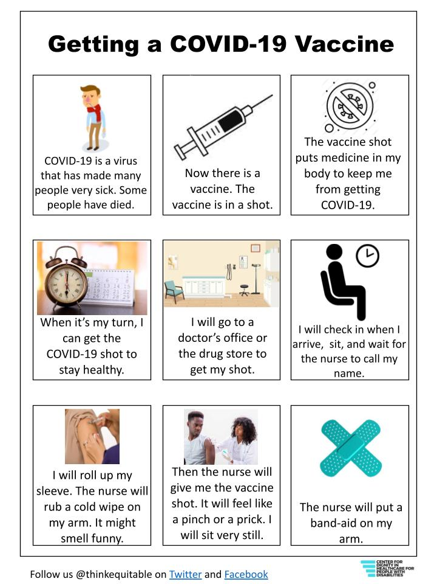
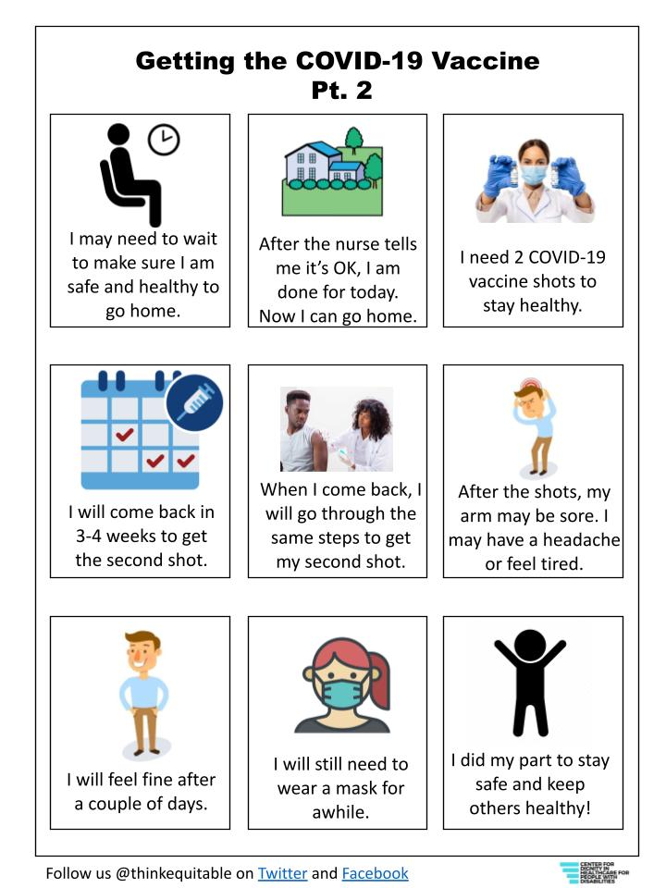
COVID-19 Vaccination Resources
Social Story

Slide 11
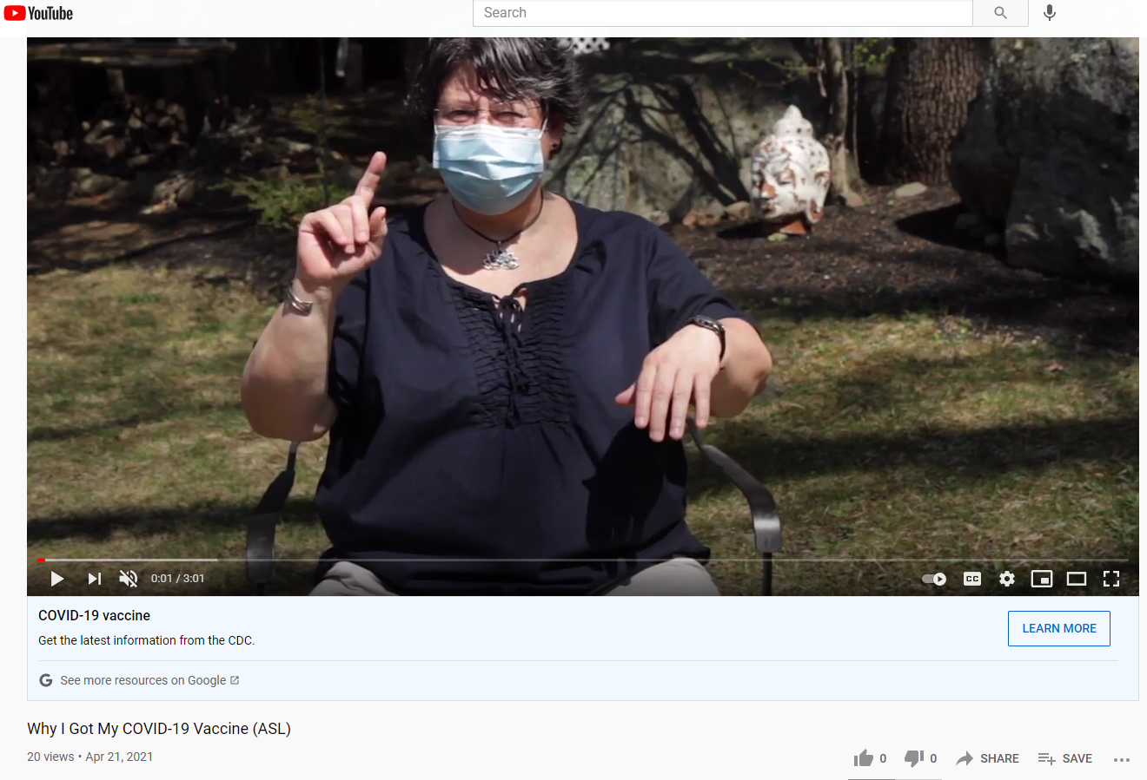
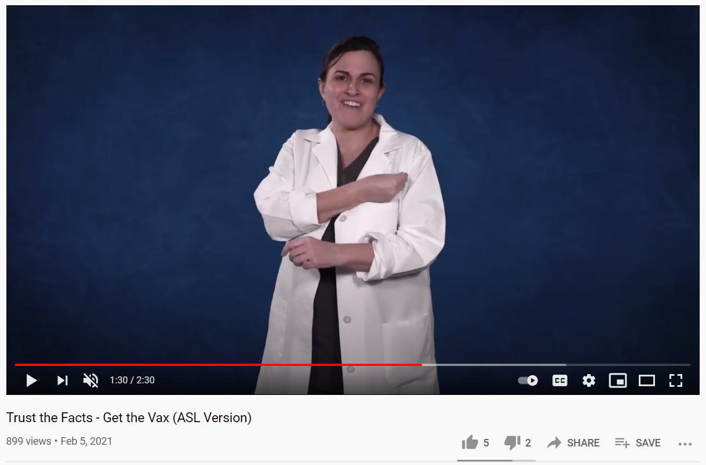
COVID-19 Vaccination Resources
ASL Resources
The videos below feature ASL versions of the Why I Got My Vaccine and Trust the Facts campaigns from the Massachusetts Department of Public Health
Link: Why I Got My COVID-19 Vaccine (ASL) - YouTube
Link: Trust the Facts - Get the Vax (ASL Version) - YouTube

