Slide 1
COVID-19 Vaccination Uptake Among Pregnant and Postpartum People in Massachusetts, December 1, 2020 – March 31, 2022 Key Takeaways for Healthcare Providers
Massachusetts Department of Public Health
Center for Birth Defects Research and Prevention

Slide 2
Healthcare Providers are Trusted Messengers
The following data are tailored for providers, giving background and context on vaccination uptake among pregnant people in MA.
Healthcare providers play a critical role in counseling and recommending their patients to get vaccinated against COVID-19.

Slide 3
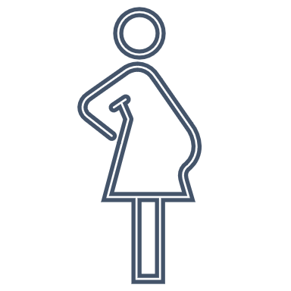
Background
COVID-19 vaccination is recommended for people who are pregnant, recently pregnant, or might become pregnant in the future.
Despite these recommendations, studies suggest that COVID-19 vaccine uptake is lower among pregnant people compared with non-pregnant people.
Sources:
https://www.cdc.gov/coronavirus/2019ncov/vaccines/recommendations/pregnancy.html
https://www.ncbi.nlm.nih.gov/pmc/articles/PMC9145279/3.
https://www.sciencedirect.com/science/article/pii/S2211335522000201

Slide 4
Methods
We estimated vaccination uptake (receipt of >1 doses of COVID-19 vaccine) among pregnant and postpartum people in MA.
To identify pregnant people, we relied upon MA vital records (birth certificates & fetal death certificates). Thus, we were limited to identifying those with completed deliveries (during December 1, 2020 – March 31, 2022).
We linked* data from MA vital records and MA Immunization Information System (MIIS) COVID-19 vaccination to identify pregnant people with and without receipt of one or more doses of COVID-19 vaccine as of May 23, 2022.
*We used probabilistic and deterministic linkages; this process and the inability to ascertain vaccinations that were not in MIIS may lead to an undercount of vaccinations among pregnant people.

Slide 5
12/15/2020: Phase 1 of vaccine roll out
9/29/2021: CDC issues HAN urging COVID-19 vax for pregnant people
2/1/2021: Phase 2 of vaccine roll out
4/19/2021: Phase 3 of vaccine roll out
7/30/2021: ACOG recommends pregnant people get vaccinated
8/13/2021: Boosters and third doses available‡
8/11/2021: CDC recommends all pregnant people get vaccinated
2/18/2021: Pregnancy now a priority condition for vaccination eligibility
COVID-19 Vaccine Timeline of Events in MA
Phase 1
December 15, 2020: Clinical and non-clinical health care workers doing direct and COVID-facing care
December 28, 2020: Long term care facilities, rest homes and assisted living facilities
January 11, 2021: First responders
January 18, 2021: Congregate care settings
January 21, 2021: Home-based health care workers, health care workers doing non-COVID-facing care
Phase 2
February 1, 2021: People 75+
February 18, 2021: People 65+, People with 2 or more certain medical conditions (including pregnancy), People who live or work in low income and affordable senior housing
March 11, 2021: K-12 educators, K-12 school staff, and childcare workers
March 22, 2021: People 60+, Workers in certain categories
April 5, 2021: People 55+, People with 1 or more certain medical conditions (including pregnancy)
Phase 3
April 19, 2021: People aged 16 and older can get vaccinated
May 12, 2021: People aged 12 and older can get vaccinated
‡ Pregnant people eligible for boosters.

Slide 6
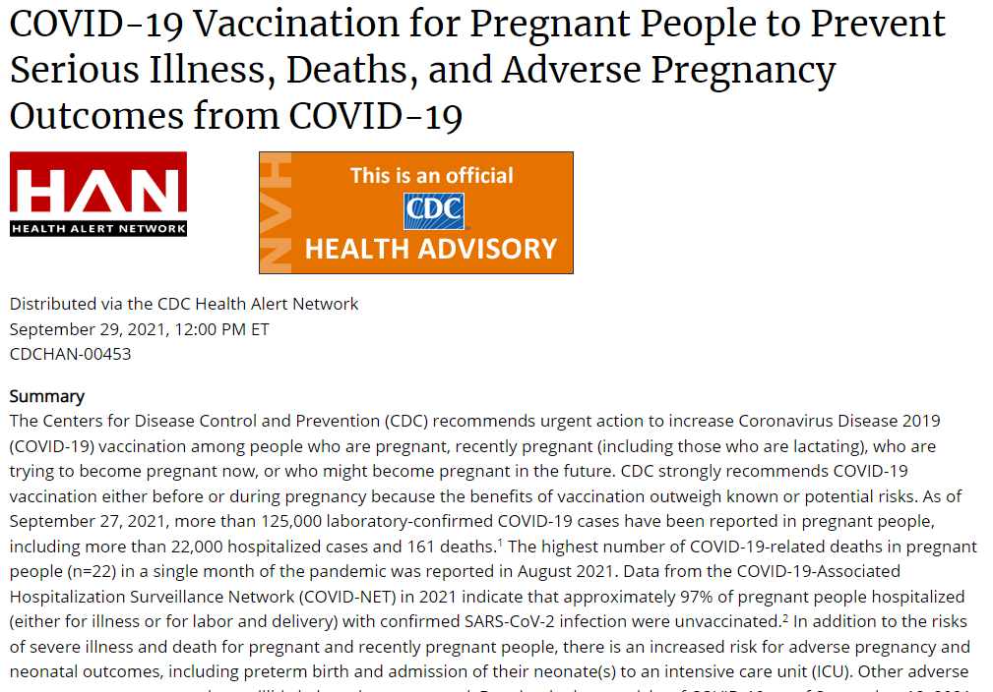
To read the full Health Alert, visit: https://emergency.cdc.gov/han/2021/han00453.asp
Notes:
Need alt text

Slide 7
Contextualizing the Data
In this analysis, we present racialized data, or data that are grouped into socially constructed race/ethnicity categories that are often used to perpetuate and support systems of privilege and oppression.
Differences in vaccination uptake by race/ethnicity reflect structural and institutional racism which drive barriers to healthcare access, medical mistrust, and marginalization in communities of color.
For more granular information on each race/ethnicity grouping presented, see Appendix A for further disaggregated data.
https://www.mass.gov/doc/racial-equity-data-road-map-pdf/download

Slide 8
Results

Slide 9
1. Among people who delivered between May 1, 2021– March 30, 2022 (n=66,450)*, 37% received >1 doses of COVID-19 vaccine before or during pregnancy.
Month of Delivery | May 2021 | Jun 2021 | Jul 2021 | Aug 2021 | Sep 2021 | Oct 2021 | Nov 2021 | Dec 2021 | Jan 2022 | Feb 2022 | Mar 2022 | Weighted Avg.
Proportion Vaccinated (Receipt of >1 Doses) Before or During Pregnancy | 22.0% | 26.2% | 28.8% | 30.7% | 34.5% | 40.6% | 41.9% | 43.9% | 47.4% | 49.8% | 50.6% | 37.3%
Data Source: Massachusetts Immunization Information System, Bureau of Infectious Diseases and Laboratory Sciences (current through May 23, 2022) & Registry of Vital Records and Statistics (current through March 31, 2022)
Analyses conducted by Massachusetts Department of Public Health COVID-19 Pregnancy Surveillance Team
*Data are restricted to May 1, 2020 - March 31, 2022 because vaccinations were not widely available in MA until April 16, 2021.

Slide 10
2. However, among people who delivered between May 1, 2021 – January 2022*(n=55,339), an additional 17% went on to get vaccinated after delivery.
Month of Delivery | May 2021 | Jun 2021 | Jul 2021 | Aug 2021 | Sep 2021 | Oct 2021 | Nov 2021 | Dec 2021 | Jan 2022 | Weighted Avg.
Proportion Vaccinated (Receipt of >1 Doses) After Delivery | 31.1% | 25.7% | 22.9% | 20.4% | 16.1% | 12.0% | 8.4% | 6.4% | 3.4% | 16.7%
Data Source: Massachusetts Immunization Information System, Bureau of Infectious Diseases and Laboratory Sciences (current through May 23, 2022) & Registry of Vital Records and Statistics (current through March 30, 2022)
Analyses conducted by Massachusetts Department of Public Health COVID-19 Pregnancy Surveillance Team
*Data are restricted to this time period for this point estimate to ensure that everyone had the opportunity (at least a 2-month window) to get vaccinated after delivery.

Slide 11
3. COVID-19 vaccination uptake before or during pregnancy has increased over time but plateaued after completed deliveries as of October 2021.
Vaccine Timing by Month of Delivery
N=5,073
N=5,063
N=4,981
N=5,927
N=5,898
N=6,345
N=6,410
N=6,523
N=6,542
N=6,453
N=6,125
N=5,835
N=5,681
N=5,470
N=5,193
N=5,938
Vax: receipt of >1 dose(s) of COVID-19 vaccine.
Notes:
Need alt text

Slide 12
4. Vaccination uptake before or during pregnancy was lowest among pregnant people who identified as non-Hispanic (NH) American Indian/Alaska Native (AI/AN) (n=459), Hispanic (n=19,457), NH Black (n=9,832), or NH Other/Unknown (n=2,025).
Vaccination Before or During Pregnancy by Race/Ethnicity*
Month of Delivery
Data Source: Massachusetts Immunization Information System, Bureau of Infectious Diseases and Laboratory Sciences (current through May 23, 2022) & Registry of Vital Records and Statistics (current through March 31, 2022)
Analyses conducted by Massachusetts Department of Public Health COVID-19 Pregnancy Surveillance Team
*For race/ethnicity, Hispanic was top-coded over all race/ethnicity groups followed by American Indian/Alaska Native, Black, Asian/Native Hawaiian/Pacific Islander, White, then Other/Unknown
**NHOPI: Native Hawaiian or Other Pacific Islander
Notes:
Need alt text

Slide 13
5. Vaccination uptake before or during pregnancy was lowest among those who preferred to speak a language other than English.
Vaccination Status by Preferred Spoken Language*
Cape Verdean Creole
N=212
Haitian
Creole
N=428
Portuguese
N=1,508
Spanish
N=3,845
English
N=57,206
Other
N=756
Vax: receipt of >1 dose(s) of COVID-19 vaccine.
*Data are restricted to May 1, 2020 - March 31, 2022 because vaccinations were not widely available in MA until April 16, 2021.
Notes:
Need alt text

Slide 14
6. Vaccination uptake before or during pregnancy was lowest among those <24 years of age.
Vaccination Status by Age*
<20
N=1,231
20-24
N=6,180
25-29
N=13,864
30-34
N=25,654
35-39
N=15,826
40+
N=3,560
Vax: receipt of > 1 dose(s) of COVID-19 vaccine.
*Data are restricted to May 1, 2020 - March 31, 2022 because vaccinations were not widely available in MA until April 16, 2021.
Notes:
Need alt text

Slide 15
7. Vaccination uptake before or during pregnancy was lower among those with public insurance compared with private insurance.
Vaccination Status by Insurance Type at Delivery*
Private Insurance
N=39,714
Public Insurance
N=22,813
Vax: receipt of >1 dose(s) of COVID-19 vaccine.
*Data are restricted to May 1, 2020 - March 31, 2022 because vaccinations were not widely available in MA until April 16, 2021.
Notes:
Need alt text

Slide 16
Next steps you can take as a provider
Recommend the vaccine to your patients, especially those who are pregnant, recently pregnant, or who might become pregnant in the future.
In MA, vaccination uptake before or during pregnancy is lower among those who identify as non-Hispanic (NH) American Indian/Alaska Native, Hispanic, or NH Black, and those who prefer to speak a language other than English.
For multilingual COVID-19 Materials, visit: https://www.mass.gov/resource/multilingual-covid-19-materials (includes “Pregnancy and the COVID-19 vaccine” FAQ flyer in 12 languages) or https://www.pnqinma.org/patient-hub
Learn how to provide more culturally and linguistically appropriate maternal health care here: https://thinkculturalhealth.hhs.gov/education/maternal-health-care
Stay up-to-date on the growing body of literature documenting the disproportionate impact of COVID-19 on pregnant people and the safety and efficacy of COVID-19 vaccination during pregnancy.
LitCovid is a curated hub for tracking literature about COVID-19 (website: LitCovid: Pregnancy)

Slide 17
Resources & Supports
You can go to VaxFinder.mass.gov to search for a vaccine appointment in Massachusetts at locations including mobile pop-up clinics, health care, pharmacies, grocery stores, and local Boards of Health and VaxAbilities.com to find disability-friendly vaccination events across Massachusetts.
For more information on how Massachusetts is embedding equity into their COVID-19 vaccine roll-out, visit the Vaccine Equity Initiative.
Download the Perinatal Neonatal Quality Improvement Network (PNQIN)’s Best Practices for COVID-19 Vaccination Document.
See PNQIN’s Communication Skills Training tailored for providers counseling pregnant and postpartum patients regarding COVID-19 vaccination.
More MDPH Resources
Immunization Division Main Number
For questions about immunization recommendations, disease reporting, etc.
Phone: 617-983-6800 (24/7 MDPH Epi line)
Fax: 617-983-6840
Website: https://www.mass.gov/topics/immunization
MIIS Help Desk
Phone: 617-983-4335
Fax: 857-323-8321
Email questions to: miishelpdesk@mass.gov
Website: https://www.mass.gov/massachusetts-immunization-information-system-miis
MDPH Vaccine Unit
Phone: 617-983-6828
Email questions to: dph-vaccine-management@mass.gov
Website: https://www.mass.gov/service-details/vaccine-management
COVID-19 Email Box
Email questions to: COVID-19-Vaccine-Plan-MA@mass.gov

Slide 18
Acknowledgments
Tommy Aluko
Kathryn Ahnger-Pier
Claudia Catalano
Anne Marie Darling
Megan Hatch
Monina Klevens
Susan Manning
Eirini Nestoridi
Michelle Reid
Katie Stetler
Mahsa Yazdy

Slide 19
Appendix A.1. Among those self-identified as Hispanic/Latinx, vaccination uptake* was lowest among those who also identify as Hispanic/Latina/Other, Guatemalan, or Brazilian.
Hispanic/Latinx | N | % Vaccinated
Hispanic/Latinx Overall | 13826 | 36.0%
Colombian | 438 | 45.9%
White | 697 | 45.6%
Mexican American | 584 | 42.3%
American | 1633 | 41.8%
Dominican | 3110 | 38.0%
Honduran | 445 | 37.1%
Hispanic/Latina/White | 8714 | 36.9%
Hispanic/Latina/Black | 2348 | 36.2%
Other South American** | 671 | 35.8%
Puerto Rican | 4352 | 35.2%
Salvadoran | 1131 | 33.7%
Hispanic/Latina/Other | 2232 | 31.6%
Guatemalan | 1196 | 31.4%
Brazilian | 1361 | 30.8%
*Vaccination uptake: receipt of >1 doses of COVID-19 vaccine before, during or after pregnancy among deliveries occurring between May 1, 2021 and March 31, 2022.
**Other South American includes those identifying with the following ethnicities/cultures: Argentinian, Bolivian, Ecuadorian, Peruvian, Uruguayan, and Venezuelan

Slide 20
Appendix A.2. Among those who self-identified as American Indian or Alaska Native, vaccination uptake* was lowest among those who also identify as Cape Verdean, or members of the Nipmuc Tribe or Cherokee Tribe.
American Indian or Alaska Native | N | % Vaccinated
American Indian or Alaska Native Overall | 354 | 36.4%
Choctaw Tribe | 8 | 62.5%
Chippewa Tribe | 11 | 54.5%
Mi’kmaq Tribe | 28 | 50.0%
European | 86 | 44.2%
American | 173 | 41.6%
White | 190 | 41.1%
Portuguese | 31 | 38.7%
Other Tribe** | 185 | 36.8%
Black | 75 | 33.3%
African American | 76 | 31.6%
Blackfoot Tribe | 58 | 31.0%
Cape Verdean | 26 | 30.8%
Nipmuc Tribe | 14 | 28.6%
Cherokee Tribe | 162 | 21.6%
*Vaccination uptake: receipt of >1 doses of COVID-19 vaccine before, during or after pregnancy among deliveries occurring between May 1, 2021 and March 31, 2022.
*Other Tribe includes those identifying with the following tribes: Chickasaw, Comanche, Creek, Lakota, Lumbee, Massasoit, Pequot, Potawatomi, and Wampanoag

Slide 21
Appendix A.3. Among those self-identified as Asian/Native Hawaiian/Pacific Islander, vaccination uptake* was lowest among those who also identify as Filipino, Laotian, or Black.
Asian or Native Hawaiian or Other Pacific Islander | N | % Vaccinated
Asian/Native Hawaiian or Other Pacific Islander Overall | 5865 | 65.1%
Japanese | 157 | 72.0%
Asian Indian | 1763 | 68.4%
Cambodian | 430 | 67.4%
Chinese | 1507 | 66.7%
Middle Eastern | 74 | 66.2%
Vietnamese | 527 | 64.7%
Korean | 312 | 64.1%
American | 486 | 61.3%
European | 166 | 57.2%
White | 418 | 54.8%
Other Ethnicity** | 63 | 52.4%
Filipino | 257 | 51.4%
Laotian | 60 | 46.7%
Black | 62 | 45.2%
*Vaccination uptake: receipt of >1 doses of COVID-19 vaccine before, during or after pregnancy among deliveries occurring between May 1, 2021 and March 31, 2022.
**Other Ethnicity includes those identifying with the following ethnicities/cultures: Afghani, Bangladeshi, Burmese, French Canadian, Greek, Hmong, Italian, Kazakh, Kyrgyz, Māori, Nepalese, Pakistani, Polish, Sri Lankan, Taiwanese, Thai, Trinidadian, Ukrainian, and West Indian

Slide 22
Appendix A.4. Among those self-identified as Black, vaccination uptake was lowest among those who also identify as Portuguese, Brazilian, or American Indian/Alaska Native.
Black | N | % Vaccinated
Black Overall | 7547 | 43.6%
African | 1360 | 55.8%
European | 184 | 47.3%
African American | 3283 | 44.7%
Caribbean | 474 | 42.4%
American | 560 | 41.4%
White | 567 | 41.3%
Haitian | 1458 | 40.7%
Hispanic/Latina/Black | 240 | 38.3%
Puerto Rican | 246 | 37.4%
Dominican | 96 | 35.4%
Portuguese | 128 | 34.4%
Brazilian | 110 | 33.6%
American Indian or Alaska Native | 84 | 33.3%
*Other Ethnicity includes those identifying with the following ethnicities/cultures: Bajan, Bermudian, French Canadian, Irish, Jamaican, Native American and West Indian

Slide 23
Appendix A.5. Among those self-identified as White, vaccination uptake* was lowest among those who also identify as African American, American Indian/Alaska Native, or Puerto Rican.
White | N | % Vaccinated
White Overall | 39495 | 56.4%
European | 8640 | 63.2%
Other Ethnicity** | 1004 | 62.2%
Middle Eastern | 907 | 58.7%
American | 28808 | 57.9%
Refused Ethnicity | 251 | 57.4%
African | 255 | 56.1%
Asian | 197 | 53.8%
Russian | 575 | 50.4%
Portuguese | 1692 | 47.6%
African American | 415 | 44.1%
American Indian or Alaska Native | 173 | 41.6%
Puerto Rican | 284 | 40.1%
*Vaccination uptake: receipt of >1 doses of COVID-19 vaccine before, during or after pregnancy among deliveries occurring between May 1, 2021 and March 31, 2022.
*Other Ethnicity includes those identifying with the following ethnicities/cultures: Albanian, Armenian, Australian, Canadian, French Canadian, Greek, Irish, Italian, Jewish, Polish and Turkish

Slide 24
Appendix A.6. Among those who self-identified as belonging to another or unknown race/ethnicity, vaccination uptake* was lowest among those who also identify as Black, Cape Verdean, or Hispanic/Latina/Other.
Other/Unknown Race/Ethnicity | N | % Vaccinated
Other/Unknown Race/Ethnicity Overall | 1840 | 50.7%
European | 344 | 66.6%
American | 372 | 61.8%
White | 1056 | 61.4%
Middle Eastern | 122 | 58.2%
Asian | 57 | 50.9%
Portuguese | 124 | 48.4%
African | 60 | 46.7%
African American | 57 | 38.6%
Hispanic Latina White | 67 | 37.3%
Black | 73 | 35.6%
Cape Verdean | 91 | 29.7%
Hispanic/Latina/Other | 47 | 25.5%
*Vaccination uptake: receipt of >1 doses of COVID-19 vaccine before, during or after pregnancy among deliveries occurring between May 1, 2021 and March 31, 2022.

