Slide 1

Community Policing and
Behavioral Health Advisory Council
June 15, 2026
DHHS Deputy Commissioner, Michele Farry Sgt. David Burns, Palmer Police TA LEAD-CIT

Slide 2





Department of Health and Human Services (DHHS)
City of Northampton, Massachusetts
The public health mission is to prevent disease and injury, promote healthy behaviors and lifestyles, and protect people from health hazards. This “Prevent, Promote, Protect” model serves as the core function of public health, which aims to improve the health and well-being of individuals and communities through various actions, including research, policy, and direct community services.

Slide 3

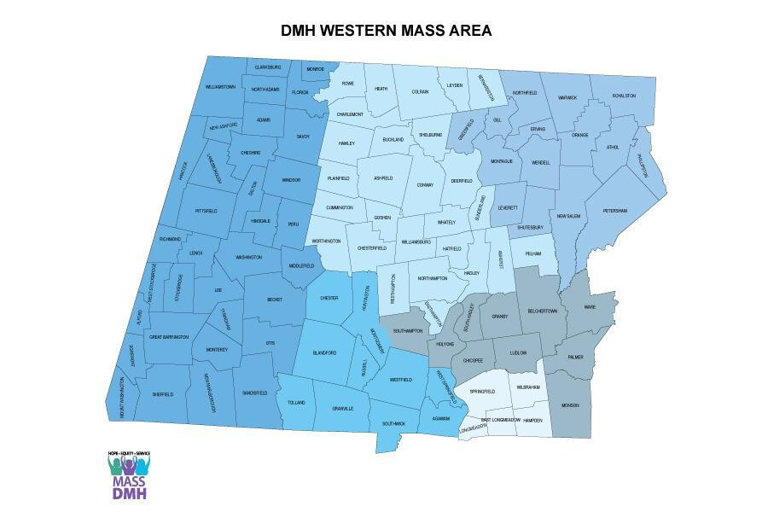
The View from Western Massachusetts
800,000+ regional population
multiple counties
limited transportation
workforce shortages
treatment access gaps
“Innovation often emerges when waiting isn’t an option.”

Slide 4
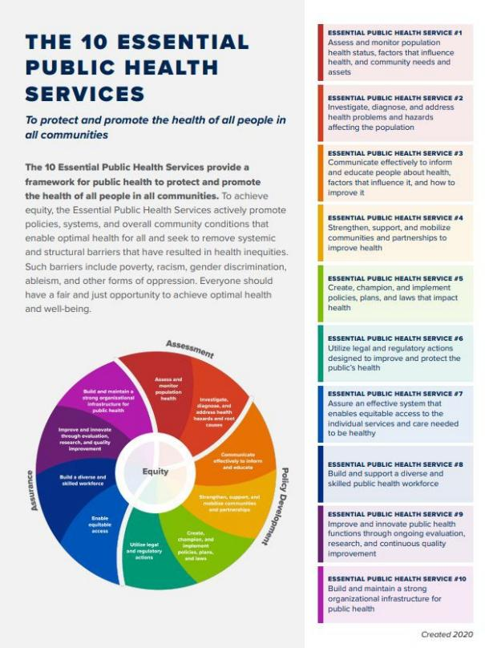
Local Public Health Essential Skills Frameworks
The 10 Essential Public Health Services in Practice
You can optionally include a small footer or appendix callout noting that the document explicitly operationalizes:
Program Origins & Purpose
Meeting People Where They Are: Harm Reduction as Public Health Practice
Workforce & Capacity Building
Cross-Training as Infrastructure
Trust Before Treatment: Relationship-First Engagement
Shared Language Across Disciplines
Assess & Monitor Population Health
Substance Use Disorder as a Chronic, Recurring Condition
Addressing Secondary Trauma in First Responders
Investigate & Address Root Causes
Data, Evaluation, and Ethics
Data Ethics as a Foundation, Not an Afterthought
Systems Alignment & Cross-Sector Design
Public Health and Public Safety as Co-Designers, Not Opposites
Communicate Effectively
Mobilize Partnerships
HIPAA-Compliant Multi Sector Data Sharing
Create & Implement Policy
From Arrest Cycles to Care Pathways
Utilize Legal & Regulatory Actions
Evaluation for Learning, Not Surveillance
Navigating Community Fear, Trauma, and System Fatigue
Enable Equitable Access
Community & Regional Scale
Regional Collaboration Through Shared Services
Build a Skilled Workforce
Governance, Policy, and Ethics
Clear Role Boundaries to Protect Trust and Prevent Harm
Improve Through Evaluation & Research
Maintain Strong Organizational Infrastructure
Liability, Policy, and Regulatory Design as Enablers of Care
Respecting Local Autonomy While Scaling Infrastructure
Political Neutrality as a Public Health Strategy
A Menu of Responses, Not a Single Model

Slide 5
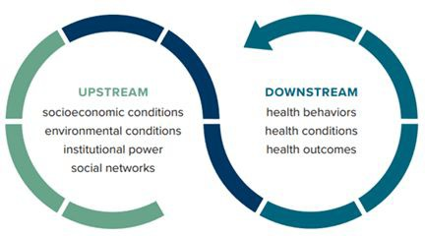
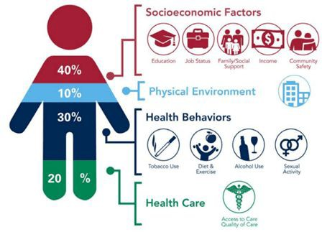
How DHHS Approaches LHD Public Health Regional Leadership Prevention, Protection and Promotion Responses
Regional partnerships and data collaborations, ongoing data surveillance and incorporating of real time emergencies (programmatic data) and systems of care together identify ongoing and emergent unmet social and behavioral health needs
Public health integrates prevention, harm reduction, strategy for short and long term responses, advocacy, research and developing of best practices that create impact and data equity
Equity and trust must be operationalized - not assumed

Slide 6

DHHS LHD
Building Regional Capacity
Public Health Led Data Infrastructure
Identify pathways to Data Sharing Agreements, Capacity Building, Business Associate Agreements, Contracts, Role Based Access, Research and Data to Action, HIPAA-compliance, public health-aligned systems
Designed for care coordination, not just compliance
Integrates service delivery and learning
Data gaps treated as equity signals
Developed iteratively with public safety, public health, and community partners
Grant Funding requires delivering od requirements, products and a tied scope of work - more funding does not always equal successes - Think Strategic!
Innovation and Modernization is Strategic

Slide 7

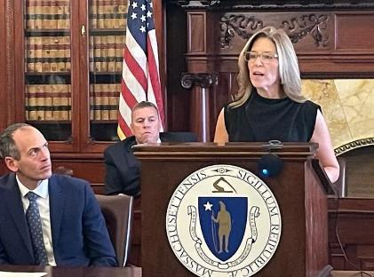

Commissioner O’Leary Providing Testimony at The Massachusetts State House for Public Health Excellence & Regional Shared Services and The Massachusetts Municipal Lawyers Association (MMLA)
Massachusetts Municipal Lawyers Association
Annual Meeting and Conference
October 23-24, 2025
Providing Public Health and other Municipal Services through Cross-Jurisdictional Sharing: Case Study of the Hampshire Public Health Shared Services Collaborative Delivering public health and other municipal services through cross-jurisdictional sharing is becoming an increasingly effective strategy for local governments seeking to enhance service quality and eﬃciency by pooling resources, expertise, and administrative functions. This panel will discuss the collaborative framework and strategies to coordinate and deliver public health and public safety services using the Hampshire Public Health Shared Services Collaborative (HPHSSC), in which the City of Northampton serves as the host municipality for 14 participating communities in western Massachusetts as a case study example.
DHHS Commissioner, Merridith O’Leary
Testiﬁes at the Massachusetts State House
Department of Health and Human Services (DHHS) Commissioner Merridith O’Leary was among four public health professionals invited to testify at a legislative brieﬁng at the Massachusetts statehouse on September 29. The brieﬁng underscored the vital importance of sustained funding for local and regional public health across the Commonwealth.
Commissioner O’Leary highlighted the work of the Hampshire Public Health Shared Services Collaborative (HPHSSC), overseen by Northampton DHHS, showcasing how collaboration among communities strengthens local capacity, consistency, and equity in public health services. The event, hosted by Senator Jo Comerford (D-Northampton) and Representative Hannah Kane (R-Shrewsbury), also featured Massachusetts Department of Public Health (DPH) Commissioner Robbie Goldstein and Director of the Oﬃce of Local and Regional Health Dr. Sam Wong, discussing how recent legislation has modernized and uniﬁed the state’s public health system.
Commissioner O’Leary emphasized that advocating for public health funding is more critical now than ever, as communities continue to face evolving health challenges, workforce demands, and the need to protect and promote the wellbeing of all residents. That advocacy continues at Public Health Excellence (PHE) Day at the State House on Thursday, October 23, where DHHS staff will join statewide partners to celebrate the passage of SAPHE 2.0 and ﬁve years of the PHE program, which has transformed public health in Western Massachusetts and beyond.

Slide 8

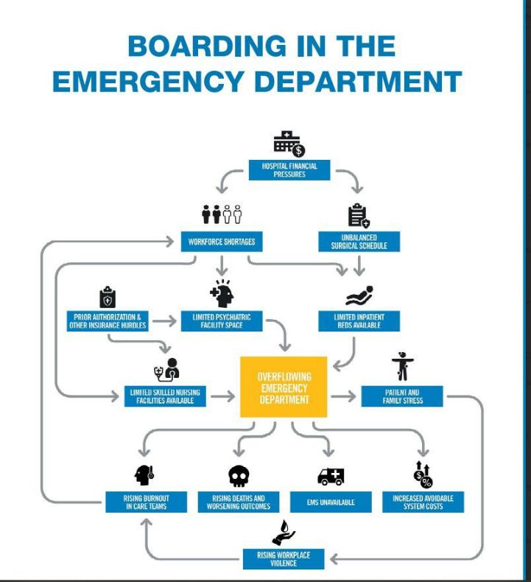

The Massachusetts Health Policy Commission (HPC): From Fragmented Systems to Coordinated Policy, Uniform Data, Legislation Action
Primary Care, Pharmacy Access, Behavioral Health, Substance Use and Social Needs
- increasingly common route is through emergency systems
Local public health is required to act before data systems are fully aligned

Slide 9


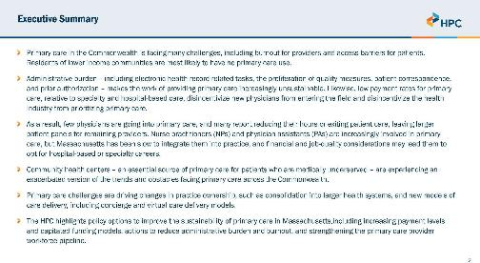
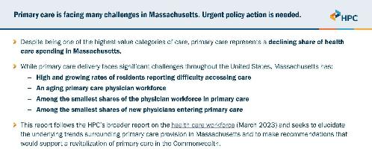
Massachusetts Health Policy Commission (HPC): How The DHHS Regional Local Health Department Role Included Increasing Awareness Through Communications, Advocacy and Opportunity To Voice Needs
State and Regional information - scaling impacts with community awareness
DHHS responds by reﬁning dispatch + data integration to include state and local context
Timely expanded prevention and harm reduction resources that reduce risks and harm
Bigger picture and advocacy role using Local Health Department expertise to design evaluation, inform regulation, policy and funding alignment
Public health innovations must include efforts for modernizing of a growing and evolving population and community based roles with added skills to enhance workforce development and effectiveness.
Local health departments sustain by offering mentorships, learning experiences, internships, volunteering and mixed disciplinary local learning and create pathways for opportunities to sustainability and systems professional expanded non-traditional work and lived experience moving ahead.

Slide 10


Essential Measures:A Local Public Health Toolkit for Addressing the Opioid Epidemic
Developed by the Massachusetts Health Oﬃcers Association and Education Development Center with support from the Local Public Health Institute of Massachusetts:This Opioid Toolkit is funded by a State Opioid Response grant from the Substance Abuse and Mental Health Services Administration (SAMHSA) to the Massachusetts Department of Public Health, Bureau of Substance Addiction Services.
Section IV: Putting It All Together
Northampton’s Drug Addiction and Recovery Team
Introduction: The Drug Addiction and Recovery Team (DART) is a program created to reduce overdose deaths and risks related to any substance of use by supporting people, communities, and organizations that are affected as well as those who experience loss and grief due to substance use. DART strives to meet people where they are, using a harm reduction framework. The program offers free community-based services to people referred by partnering agencies, other community organizations, and loved ones, as well as to self-referrals. Programs focus on limiting the risks and harms associated with unsafe drug use—by creating opportunities to reduce isolation, by building connections rather than promoting abstinence, and by recognizing that many individuals who use drugs may not be ready to stop. Its work is grounded in the understanding that substance use disorder is a condition that includes recurrence of use, and that “relapse” is an expected part of the recovery spectrum.
“We are one of the only programs that truly does not have an expectation that our participants enter detox or treatment,” says Michele Farry, DHHS Deputy Commissioner for the City of Northampton’s Department of Health and Human Services. “Our only goal is to try to build trust. We have facilitated entry into treatment for many people—but only if that’s what they wanted.”

Slide 11
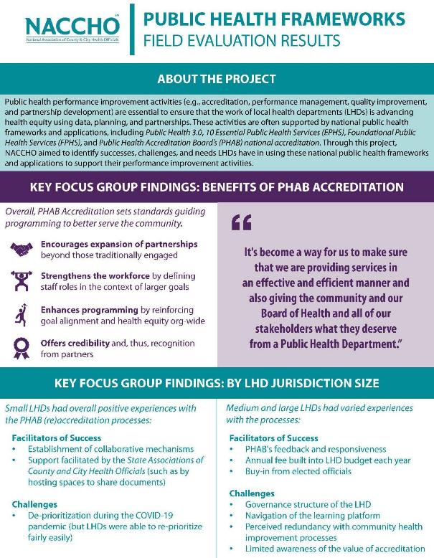
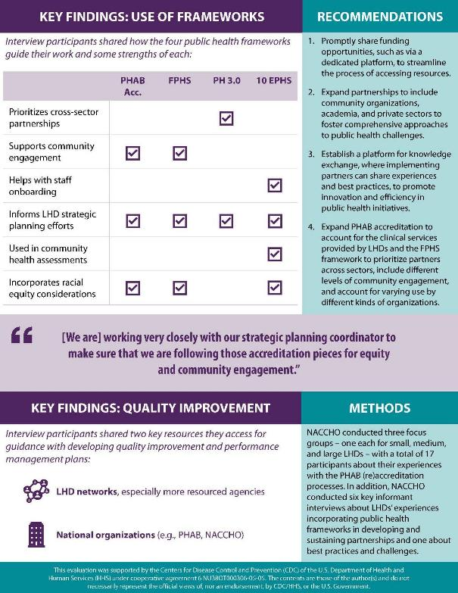

How The DHHS Participates: Local Public Health Strategic Development Informs National Efforts
DHHS Participates in NACCHO Key Informant Interviews (KII)

Slide 12


From Local Innovation to National Conversation

Slide 13


DHHS Prevention Programs and Outreach
State Without Stigma Media Campaign

Slide 14
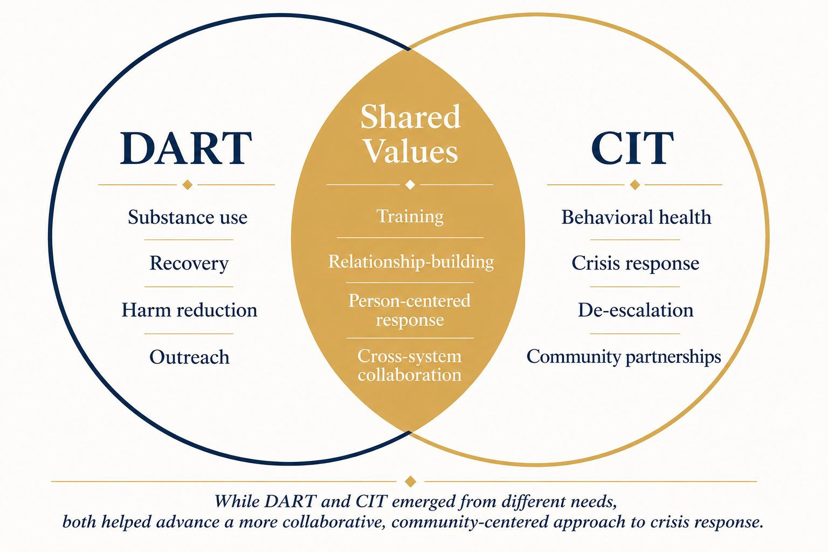

DART and CIT Grew Together
Chief Jennifer Gundersen, South Hadley - Data Sharing

Slide 15
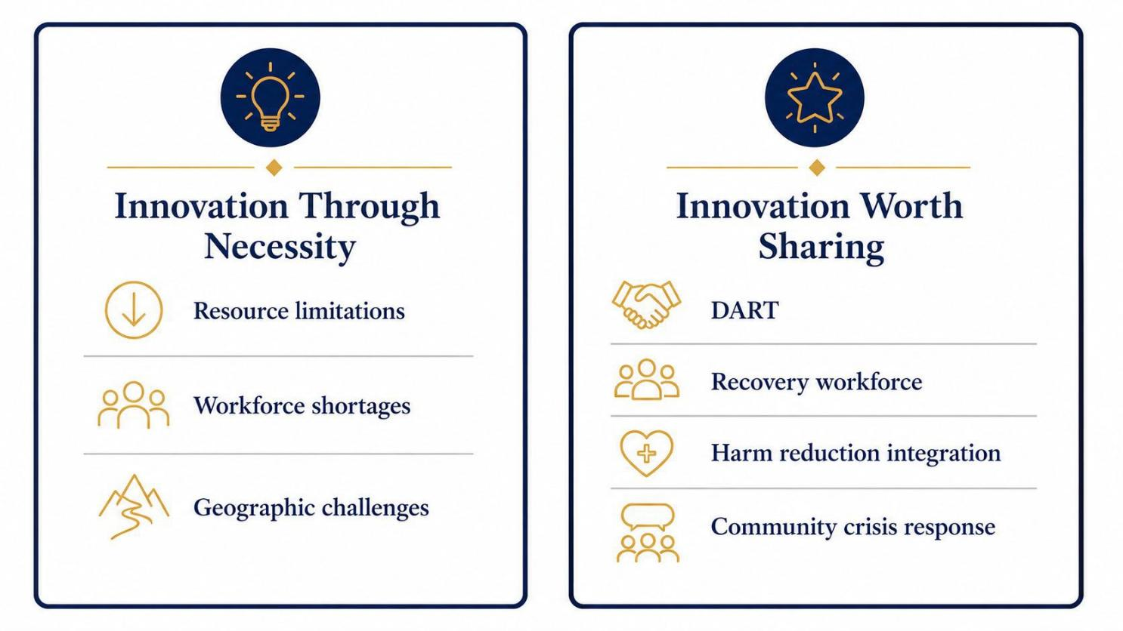

From local challenges to shared solutions.

Slide 16
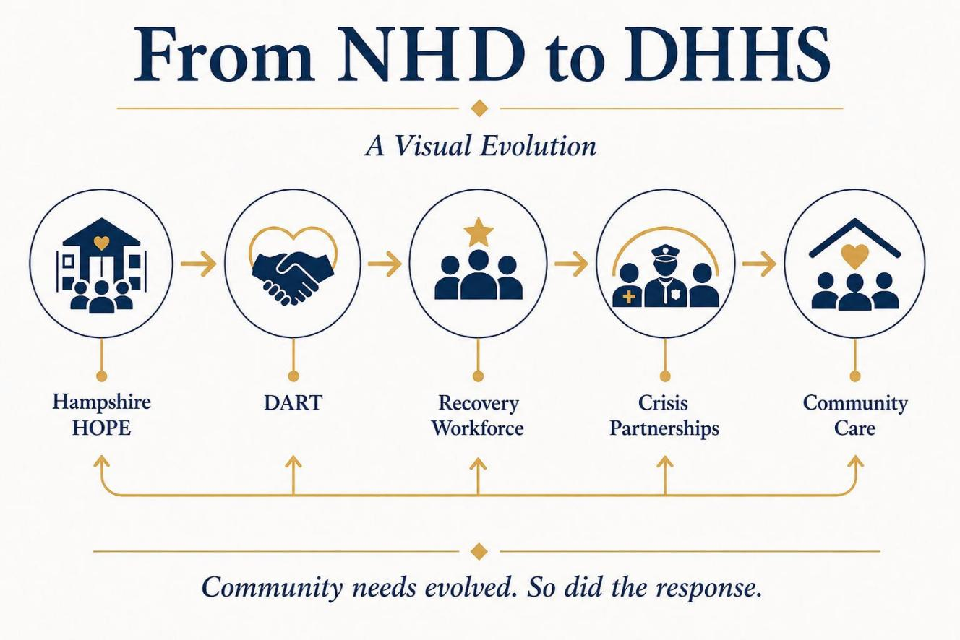
City leadership Strategic Development - The Role of Public Health Expanding

Slide 17

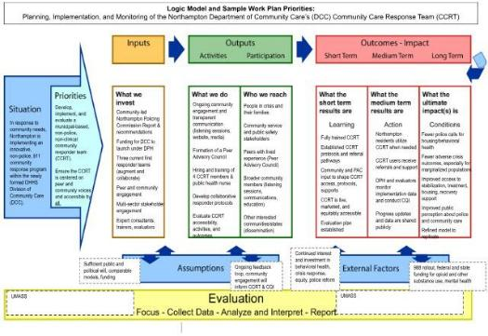
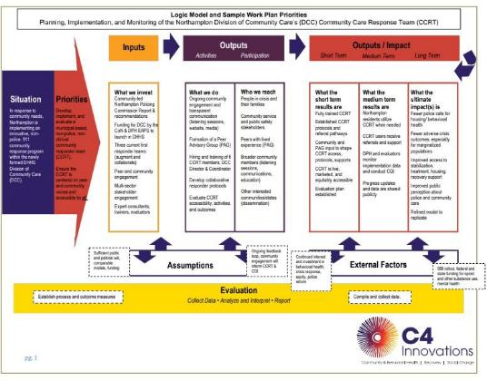
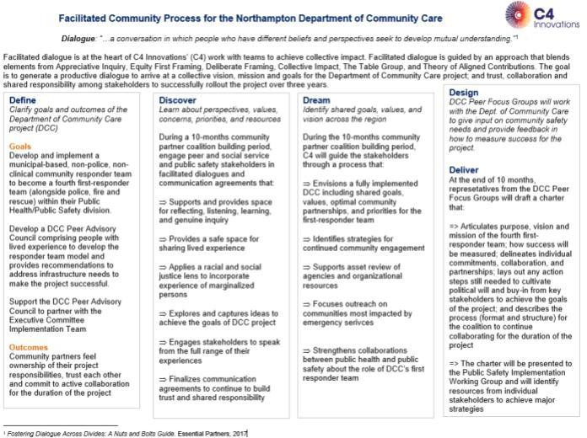
DHHS Includes and Elevates “Community Voices Data” Example of Primary Relationships and Trust Data Question - “Who is the 911 Caller and Why?”
Working with Public Health Systems Partners
Understanding policy and impacts “Good Samaritan Law”
Overdose data, EMS Massachusetts Ambulance Trip Record Information System (MATRIS) data, Dispatch 911 Data, engagement low-risk, high frequency calls from 911 and ED’s
Stabilization without criminalization or hospitalization - Public Health Doing Less Harm - Systems Change
Deﬁne, collaborate and innovate new data measures
Impacts using data to identify pathways that reduce repeat utilization through follow-up
Right sizes public safety response

Slide 18

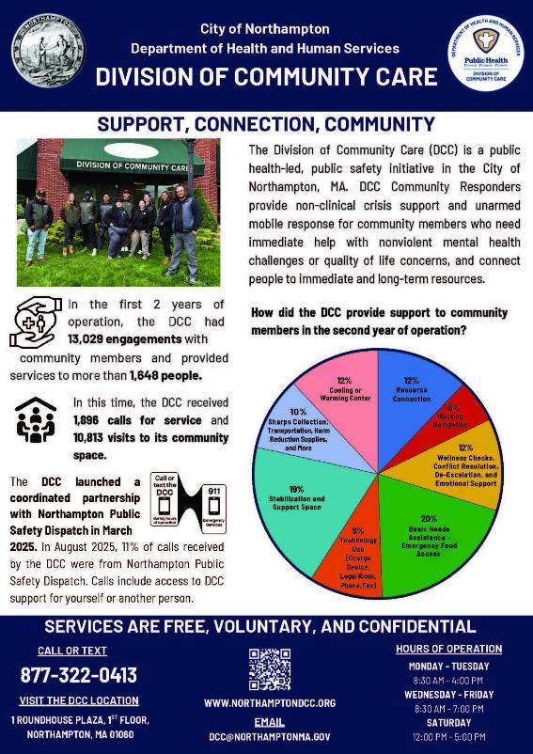
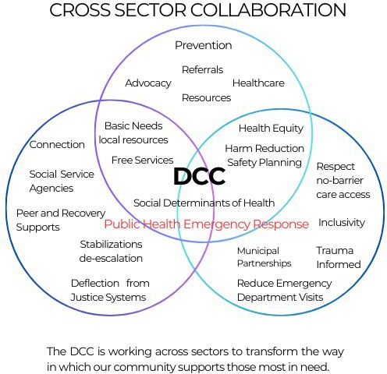

The Northampton Division of Community Care (DCC) Public Health Led 4th Tier Emergency Response Model
Public health - led Division of Community Care (DCC)
Freestanding, civilian community responder system
Multiple access point: walk-in, direct request, dispatch referral
Embedded cross-sector partnerships
Custom designed Electronic Case Management Systems and Dispatch CAD

Slide 19

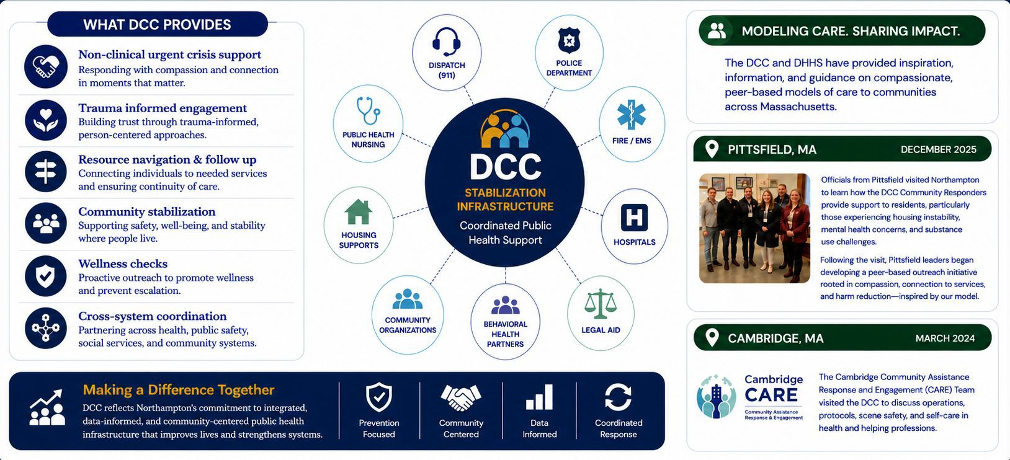
City of Northampton Approaches For Community Health and Safety - DHHS DCC

Slide 20
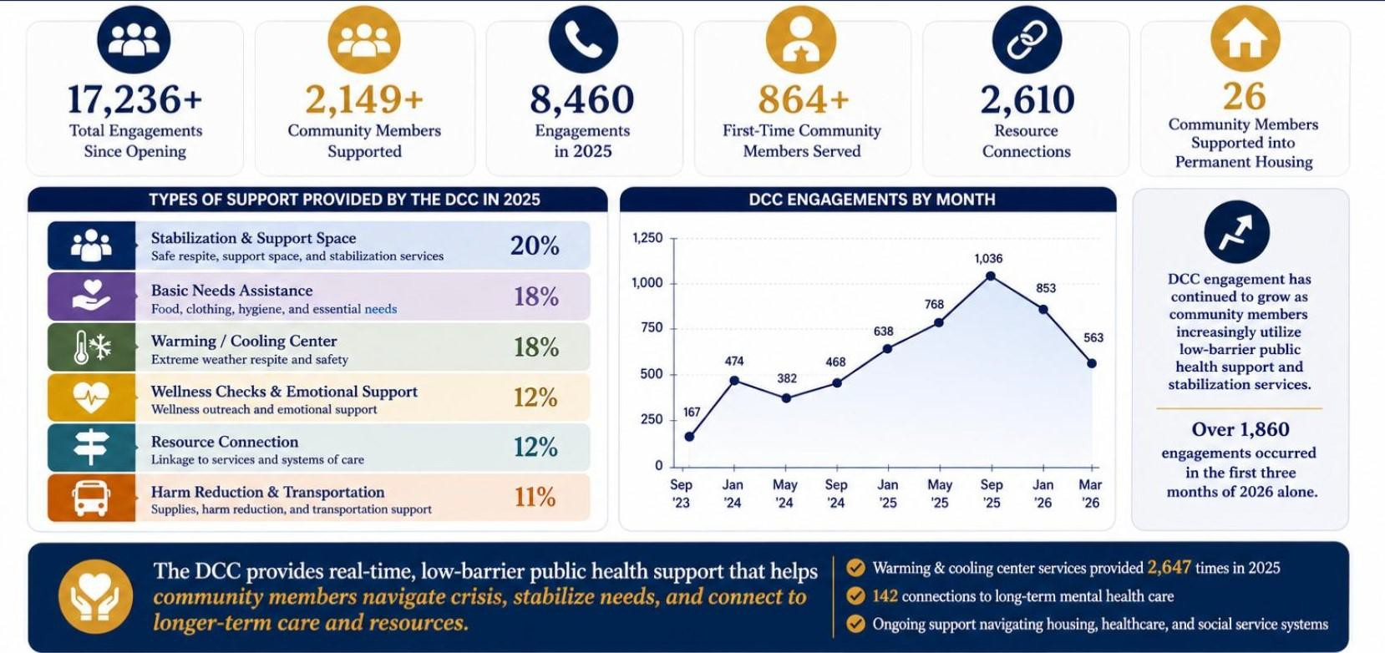
DHHS DCC Impacts and Engagement
Public health led community response, stabilization and coordinated care

Slide 21
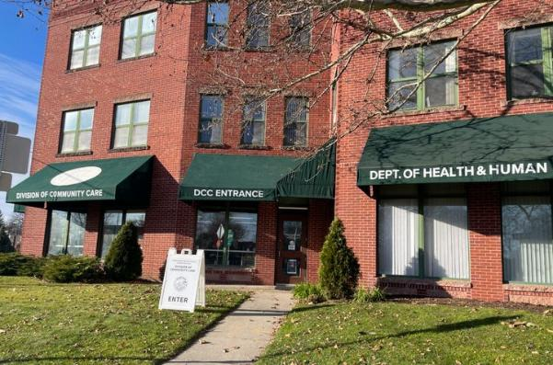


University of Massachusetts Amherst Center for Program Evaluation

Slide 22
Why Evaluation Was Embedded Early - Academic Partnership
- Transparency Create Accountability, Build Evidence, Measurable Impacts, Community Trust & PH Ethics - Municipal Role of Local Health Departments
Independent evaluation partner from launch
Focus on implementation, outcomes, and learning
Evaluation informs iteration - not just reporting
Designed collaboratively to support learning, accountability, and equity

Slide 23
Mixed-Methods & SDOH Lens
Quantitative Methods
Qualitative Methods
Surveys
Administrative Record Data
Interviews
Focus Groups
Ethnography
Document Review
Social Determinants of Health (SDOH) lens:
Looking beyond symptoms to conditions:
Housing, transportation, income, social isolation, behavioral health access
Ask: Who is missing from our data? Who is under-counted or misclassified?

Slide 24
Translating Findings Into Actions: From Data to Decisions
Operational changes informed by evaluation
Workforce & support decisions
Policy & Funding Implications
Evaluation can help programs claim:
Not just running a program, but studying, improving, and sharing what has been learned

Slide 25
Summary of UMASS CPE Evaluation
Evaluation Activity | Purpose | Data Collection Period | Evaluation Type | Data Type
Community Survey | Community awareness, priorities, and preferences | Baseline (pre-launch) | Formative Evaluation | Quantitative
Community Partner Interviews | Expectations, concerns, and system integration | Baseline (pre-launch) | Formative Evaluation | Qualitative
DCC Community Responder Interviews | Frontline perspectives during early implementation | Early Implementation (Year 1) | Process Evaluation | Qualitative
DCC Client Interviews | Client experiences of services, spaces, and relationships | Ongoing Implementation (Year 2) | Process Evaluation | Qualitative

Slide 26
Summary of UMASS CPE Evaluation continued
Evaluation Activity | Purpose | Data Collection Period | Evaluation Type | Data Type
Emergency Response Agency Interviews | System-level perspectives on collaboration, workflows, and DCC’s role | Ongoing Implementation (Year 2) | Process Evaluation | Qualitative
Dispatch Data Analysis | Patterns of call types, routing, and diversion to DCC | Ongoing Implementation (Year 2) | Process Evaluation | Quantitative
Client Record Analysis | Service utilization, follow-up, and client trajectories over time | Ongoing Implementation (Year 2) | Process Evaluation | Quantitative

Slide 27
Our Case Example From Northampton
BASELINE
Pre-Launch
LAUNCH / EARLY IMPLEMENTATION
ONGOING IMPLEMENTATION
What do people want and worry about?
What is actually happening?
How is this landing with clients & systems?
Community Survey: awareness, priorities, willingness to call a community responder
Responder Interviews: leadership transition, responder characteristics, burnout risk, documentation resource needs
Client Interviews:
value of safe physical space, mobile support, admin assistance
Emergency-Response Partner Interviews:
how DCC fits into 911 + EMS workflows
Dispatch Record Analysis:
patterns in call types and diversion
Community Partner Interviews:
hopes, fears, system-fit, data
Early Case-Note Review: referral source, call-types, what needs/work do the records reflect

Slide 28
Example: Community Responder Program Evaluation
Northampton’s DCC is part of a broader national trend toward community responder programs
These programs aim to:
⚬ Reduce unnecessary law enforcement involvement in non-violent crises,
⚬ Provide more appropriate supports, and
⚬ Improve equity and trust in public safety and health systems.
Spolum, M. M., et al. 2023. Police Violence: Reducing the Harms of Policing Through Public Health–Informed Alternative Response Programs.

Slide 29
Success Stories: Client Achievements with DCC Support
Anonymous Client A
Milestones reached:
Immediate Needs Fulfillment
Medical and Safety Assistance
Consistent Responsive and Positive Engagements
Legal and Housing Advocacy and Support
Stable Housing Achieved!
Mental and Physical Health Improvements
Long-term Goal Facilitation
Anonymous Client B
Milestones reached:
Initial Medical Care
Continuous Practical Assistance
Access to Specialized Care
Support During Legal Proceedings
Emotional and Safety Support
Long-term Needs Management
Comprehensive and Empathetic Support
Anonymous Client C
Milestones reached:
Financial Management and Planning
Access and Advocacy for Support Services
Emotional Support and Empowerment
Practical Assistance and Resource Connection
Healthcare Coordination and Support
Enhanced Community Integration
29

Slide 30

THANK YOU CPBHC Advisory Council for inviting us to share about our work.
We warmly extend an invitation to visit at the City of Northampton, DHHS and DCC!
It is our pleasure to now hear from
Sgt. David Burns, Palmer Police TA LEAD-CIT.

Slide 31

Post OD Outreach Evolving To At Risk Individuals Problem-Oriented-Policing In Action
Initial Implementation 2020
Community engagement
Identification of resources
  Expanded use of recovery coaches lit the path to evolving the role of DART/DCC
Relationship building
  Recognizing the necessity of partnerships
Advocacy
  Nalox Box installation in the community
Building trust and legitimacy

Slide 32
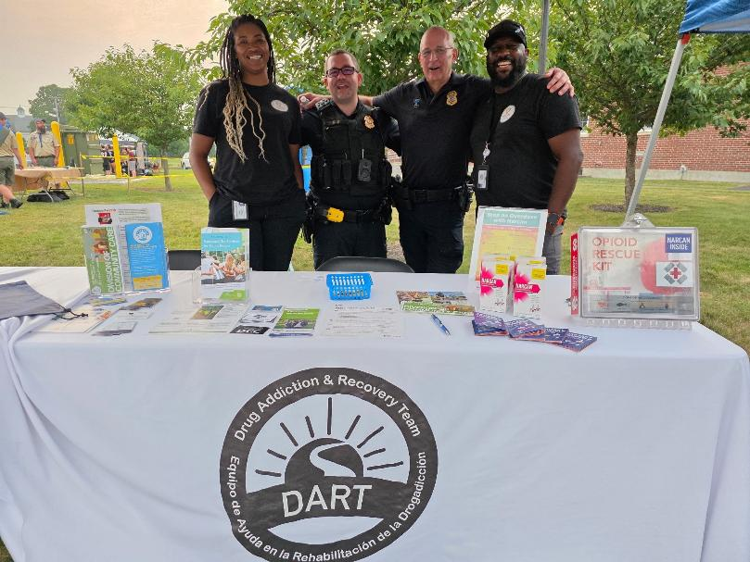
City of Palmer Police Initiative: Community Wellness
Identification of needs
Centralized hub
Increasing access to resources in a rural environment
Identifying stakeholders
  Relationships, learning, & shared knowledge
Creating a sense of belonging
Enhancement of public safety

Slide 33
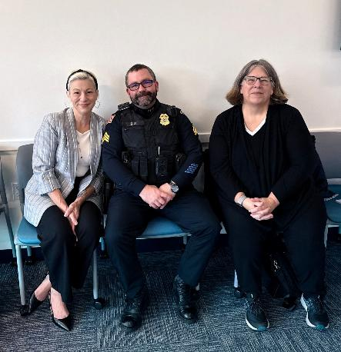
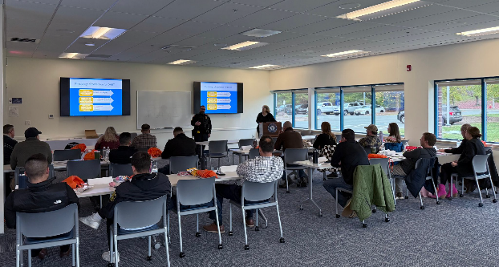
Continuing Education
CIT/TTAC Substance Use Disorder
Collaboration with Palmer, Three Rivers, Bondsville Fire Departments
Sharing of knowledge/information of resources at MPTC training

