Slide 1
Behavioral Health Crisis Services
September 2025

Slide 2
Agenda
Objective
Outline changes to the behavioral health crisis system as a result of the Behavioral Health Roadmap and discuss resulting potential patient transitions of care, system workflows, and how to help individuals in Massachusetts access these services.
Background
Roadmap Services
Successes
How to access services
Notes:
The MassHealth Office of Behavioral Health is excited to share with you a suite of changes to the behavioral health system of care intended to improve access and patient experience.
Our objective today is [read slide].
We will begin with welcome and introductions, then provide background on our work to gather feedback on the gaps and barriers in the behavioral health system of care. We will then discuss the new programs and services rolling out to address these gaps and barriers, and how you can support individuals with whom you work to seek the supports they need.

Slide 3
Historical and Structural Challenges in Behavioral Health
  The Commonwealth has implemented recent legislation, policy reforms, and substantial public investment, despite these efforts further improvement is needed.
  The Commonwealth’s Roadmap for Behavioral Health Reform is based upon statewide listening sessions and feedback. In statewide listening sessions, nearly 700 individuals, families, and others identified challenges and gaps in the system:
  Too many people struggle to find the right type of behavioral health treatment and clinical provider that accepts their insurance.
  Too often hospital emergency rooms are the entry point into seeking behavioral health treatment.
  Individuals often can’t get mental health and addiction treatment at the same location, even though mental health conditions and substance use disorder (SUD) often co-occur.
  Culturally competent behavioral health care for racially, ethnically and linguistically diverse communities can be difficult to find.
  These longstanding challenges were exacerbated by the pandemic.
Notes:
Emergency department boarding has been a large and increasing concern within the behavioral health field.
So in 2019, MassHealth solicited input across the state to identify the specific pain points within the behavioral health system of care. Nearly 700 individuals, families, and others identified challenges and gaps in the system at listening sessions across Massachusetts. The highlights of the feedback includes:
Hospital emergency departments are the only universal and commonly known front door to behavioral health care
People struggle to find the right behavioral health treatment with the right provider with the right insurance coverage for them – including providers with cultural and linguistic competency
Behavioral health services are siloed; mental health from addiction and both of these from physical health

Slide 4




The Behavioral Health Roadmap:
Community Behavioral Health Centers (CBHCs)
The vision for the Roadmap is to provide access to real-time urgent care, evidence-based, integrated mental health and addiction treatment for all ages, and 24/7 ​community crisis response and stabilization in communities. A key component of the Roadmap is the Community Behavioral Health Center, or CBHC.
27 CBHCs opened in 2023, covering every city and town throughout the Commonwealth.
Services include:
Mobile Crisis Intervention (MCI): Multidisciplinary crisis teams that evaluate individuals in their homes, at the CBHC location or in communities, 24 hours a day, 7 days a week.
CBHC Outpatient Services: Urgent and routine mental health and substance use disorder clinic services provided 8am-8pm on weekdays and 9am-5pm on weekends.
Community Crisis Stabilization (CCS): 24-hour bedded diversionary level of care able to provide days/weeks of stabilization in the community.
Early results show positive impact on Emergency Department boarding.

Slide 5
CBHC Background: Easier, more convenient access to behavioral health services
Behavioral Health Help Line (BHHL)
(833) 773-BHHL
Community Behavioral Health Centers (CBHC)
www.mass.gov/CBHCs
All ages.
Mental health and addictions.
Multi-lingual live response.
Call, text, chat.
24/7/365.
No insurance necessary.
All ages.
Mental health and addictions.
Crisis identification and action when needed:
  Dispatch Mobile Crisis Intervention.
  911 connection when needed.
  Follow-up within 48 hours.
Clinical assessment, triage and warm handoff to a provider with appropriate expertise.
Follow-up to ensure connection is made.
Mobile Crisis Intervention (MCI)
24/7/365.
No insurance necessary.
At your home or other community location.
At the CBHC.
Clinical assessment, de-escalation, safety planning and triage.
Urgent & ongoing clinic services
Available to all MassHealth members and may be available through commercial insurance.
Same day evaluation, assessment, group therapy, peer support.
Same or next day appointments, including psychopharmacology and medication for addiction treatment.
Care coordination and referral to needed services.
Extended hours:
8 AM – 8 PM week days
9-5 weekends
Adult & Youth Community Crisis Stabilization (CCS)
24-hour diversionary level of care for individuals in crisis who don’t need inpatient level of care.
No insurance necessary.
Behavioral Health Urgent Care (BHUC)
Available to all MassHealth members and may be available through commercial insurance.
Same/next day appointments for diagnostic evaluation for new clients and urgent appointments for existing clients.
Urgent psychopharmacology, medication for addiction treatment evaluation.
Non-urgent appointments within 2 weeks.
Extended hours.
www.mass.gov/BHroadmap

Slide 6
The Massachusetts
Behavioral Health Help Line
masshelpline.com | 833-773-2445 (BHHL)
A service of the Commonwealth of Massachusetts, operated by the Massachusetts Behavioral Health Partnership (MBHP)

Slide 7








Behavioral Health Help Line: Key Elements
Multi-Channel Access
Available 24/7/365
Multi-lingual live response
Phone (200+ languages)
Text & Chat (currently English only)
Includes informative website
Knowledgeable Clinical Team
Clinical providers with expertise in crisis identification & referral services in MA
MA clinicians, Peer Specialists, Follow-Up Specialists
Assessment & Triage
Formalized risk assessment tool supports appropriate triage pathway
Rapid determination of immediate crisis
& completion of appropriate handoff
Consistent Follow Up
Process to ensure Individual is successfully connecting with the right services
Within 48 hours for urgent handoffs
Within 14 days for outpatient referrals
Referral Match & Warm Handoff
Staff search for & identify providers with appropriate expertise
Warm handoff to referring provider whenever possible & appropriate

Slide 8





BH Roadmap Impact Since Launch January 2023, as of July 2025
Community Behavioral Health Centers (CBHC) have served >112k unique members in Outpatient Clinic, Mobile Crisis Intervention (MCI), and Community Crisis Stabilization (CCS) services.
CBHCs have provided over 1.4 million outpatient clinic visits, serving nearly 81k unique members (56k adults; 27k youth)
CBHC MCI teams have provided >66k crisis evaluations to >38k members (21k adults; 18k youth). 46% of MCI Crisis Evaluations have been completed in-person, in the community.
More than 11.7k admissions to CCS, 24-hour diversionary services, providing community-based crisis stabilization to >7.7k unique members (6k adults; 1.4k youth).
Police have transported >1.3k individuals directly to a CBHC for a BH Crisis Evaluation, diverting crisis services from the ED to the community, >700 drop offs occurred in 2024*.
CBHCs have completed >500 direct admissions to inpatient psychiatry, avoiding the ED for “medical clearance”. Across the CBHC network, there are an average of 18 direct admits per month*.
Note: CBHC Claims lag have been reported up to 10 months-post service. Standard claims lag is 6 months-post service date.
Source: EHS Claims Data Jan 2023 – March 2025: ^{*=} Site-Reported Data Jan 23 – June 25

Slide 9
Expedited Psychiatric Inpatient Admission (EPIA) Trends 2022-2024
Rates of EPIA admissions for members awaiting inpatient psychiatry beds for >48 hours for youth and 60 hours for adults continue to decline.
across all plans
EPIA referrals for all plans have decreased 62% from 2022 to 2024.
  Referrals for Non-dual MassHealth members (Managed & Unmanaged Medicaid) decreased 72% (2022 vs 2024).
EPIA referrals decreased by 44% for all plans (2023 vs 2024).
  For Non-dual MassHealth members, referrals decreased by 52% (2023 vs 2024).
62%
(↓ 72% for Non-Dual MassHealth)
(↓52% for Non-Dual MassHealth)
Note: EPIA protocol is codified into law. The EOHHS EPIA team is alerted of patients waiting for an inpatient psychiatric bed for longer than 48 hours for youth and 60 hours for adults to assist with advocacy.
Source: *= EPIA
CONFIDENTIAL – FOR INTERNAL PLANNING ONLY

Slide 10

Behavioral Health Roadmap Feedback Portal
https://s-us.chkmkt.com/?e=365251&d=l&h=4FD610BC164E15C
Portal for individuals, families, groups, and providers to submit issues and concerns related to behavioral health services including the Behavioral Health Help Line (BHHL), Community Behavioral Health Centers (CBHCs), and Behavioral Health (BH) Urgent Care.
This form is only monitored during normal business hours of Monday-Friday, 8:30 a.m. to 5 p.m. If you require immediate connection to services, please call the BHHL at 833-773-2445
Note to Providers: Please do not report formal adverse incidents and serious reportable events here.
Instead, follow your standard Provider/Payer/ DMH process for reporting adverse incidents and serious reportable events.

Slide 11
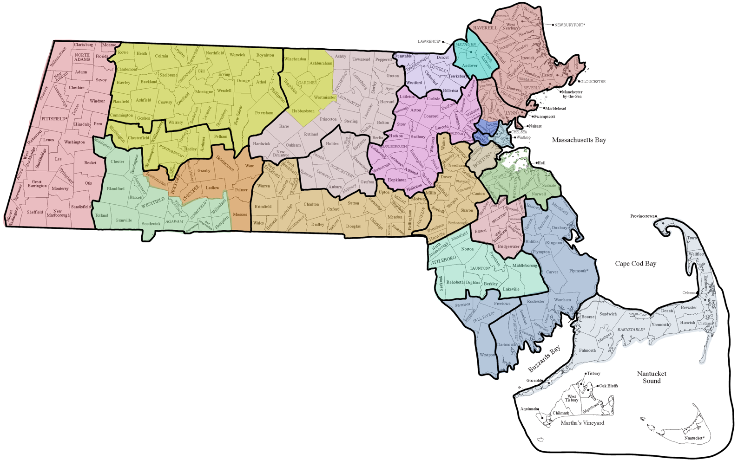

Community Behavioral Health Centers and their catchment areas
https://www.mass.gov/community-behavioral-health-centers
Community HealthLink
BILH Behavioral Services
The Brien Center
Clinical Support Options
Clinical Support Options
Advocates
Vinfen
NORTH ESSEX
Eliot Community Human Services
LAWRENCE
GREENFIELD
NORTH COUNTY
LOWELL
TRI-CITY
Cambridge Health Alliance
THE BERKSHIRES
METRO WEST
NORTHAMPTON
BOSTON/CAMBRIDGE/SOMERVILLE
WORCESTER
North Suffolk Mental Health Assoc.
Boston Medical Center
NORWOOD
SOUTH SHORE
Aspire Health Alliance
SOUTHERN PIONEER
High Point Treatment Center
SOUTH COUNTY
BROCKTON
Center for Human Development
Behavioral Health Network
Community HealthLink
Riverside Community Care
Child and Family Services
TAUNTON, ATTLEBORO
Community Counseling of Bristol County
SOUTHERN COAST
Bay Cove Human Services
FALL RIVER
Child and Family Services
CAPE COD & THE ISLANDS
Fairwinds
Martha's Vineyard Community Services

Slide 12
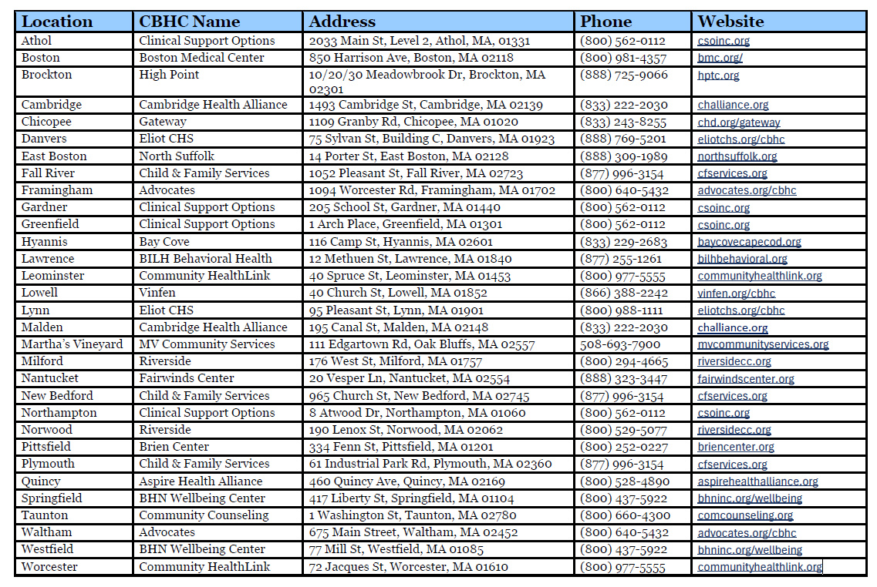
CBHC Contacts

