Slide 1


Introduction to

Slide 2
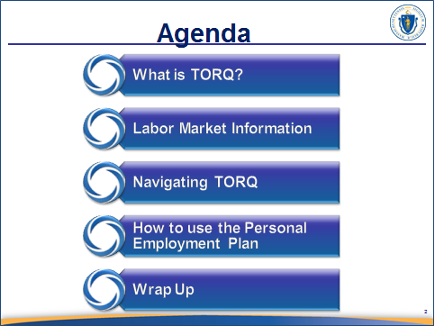
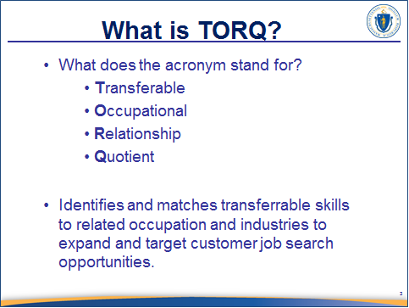
______________________________________________________________________________________________________________________________________________________________________________________________________
______________________________________________________________________________________________________________________________________________________________________________________________________

Slide 3


______________________________________________________________________________________________________________________________________________________________________________________________________
______________________________________________________________________________________________________________________________________________________________________________________________________

Slide 4
Navigating
for a
Targeted Job Search

Slide 5
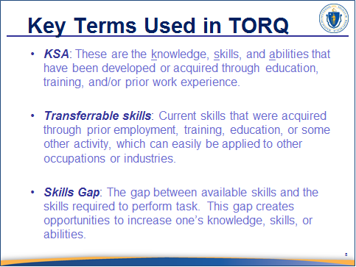
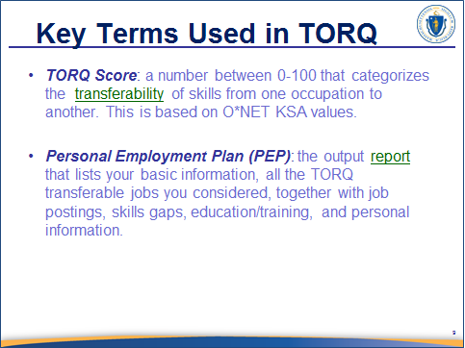
______________________________________________________________________________________________________________________________________________________________________________________________________
______________________________________________________________________________________________________________________________________________________________________________________________________

Slide 6
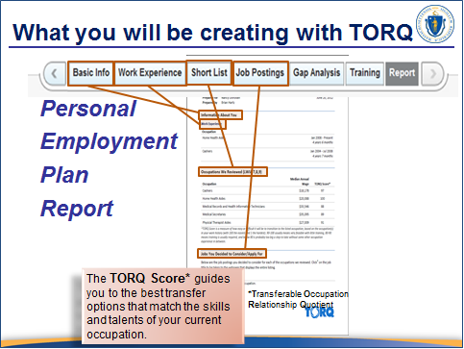
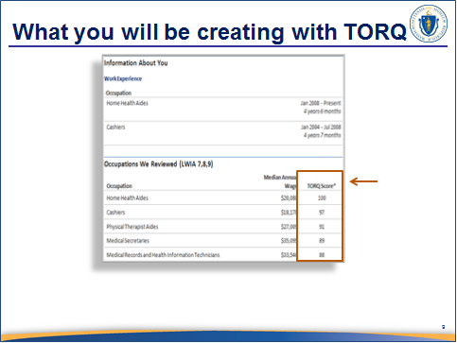
______________________________________________________________________________________________________________________________________________________________________________________________________
______________________________________________________________________________________________________________________________________________________________________________________________________

Slide 7
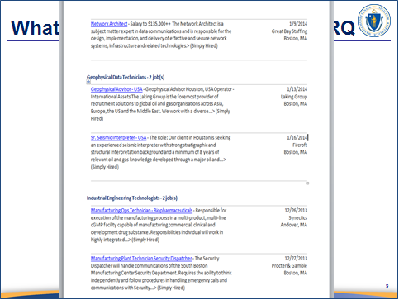
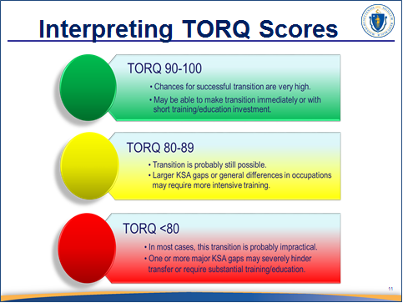
______________________________________________________________________________________________________________________________________________________________________________________________________
______________________________________________________________________________________________________________________________________________________________________________________________________

Slide 8
Let’s Get Started

Slide 9
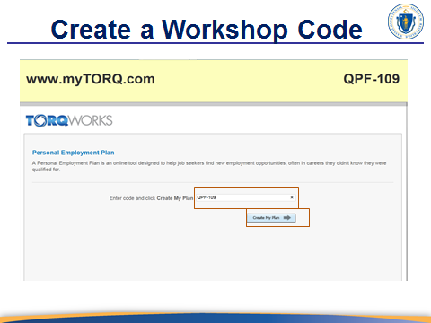
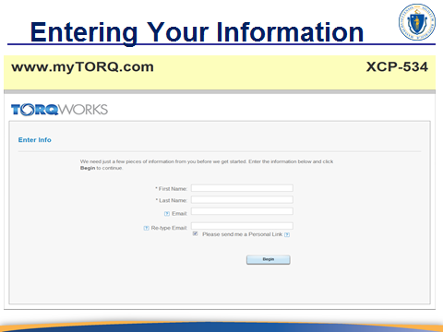
______________________________________________________________________________________________________________________________________________________________________________________________________
______________________________________________________________________________________________________________________________________________________________________________________________________

Slide 10
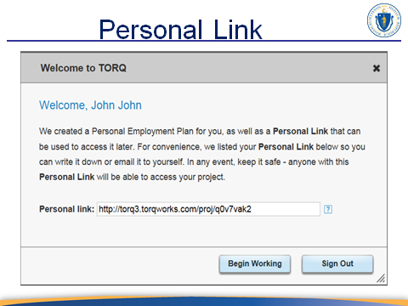
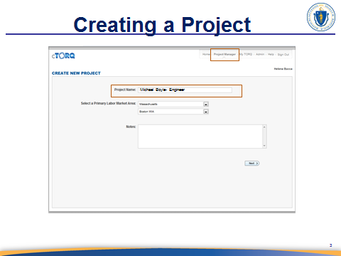
______________________________________________________________________________________________________________________________________________________________________________________________________
______________________________________________________________________________________________________________________________________________________________________________________________________

Slide 11
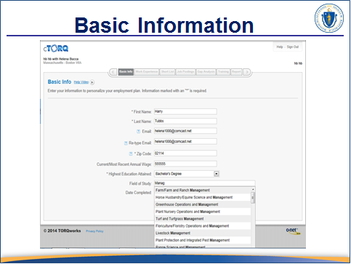
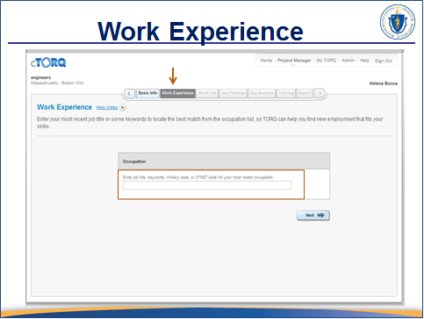
______________________________________________________________________________________________________________________________________________________________________________________________________
______________________________________________________________________________________________________________________________________________________________________________________________________

Slide 12
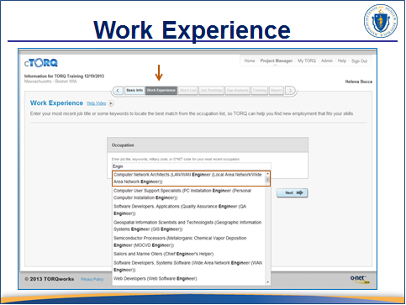
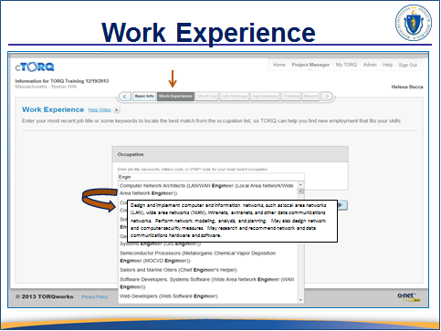
______________________________________________________________________________________________________________________________________________________________________________________________________
______________________________________________________________________________________________________________________________________________________________________________________________________

Slide 13
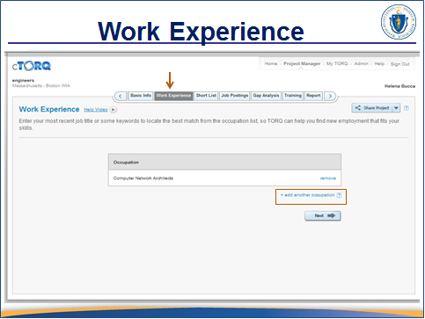
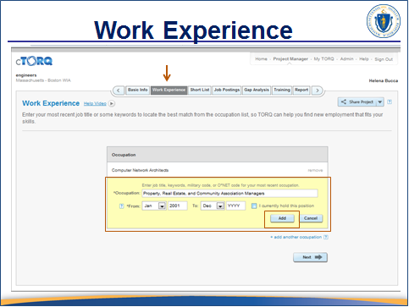
______________________________________________________________________________________________________________________________________________________________________________________________________
______________________________________________________________________________________________________________________________________________________________________________________________________

Slide 14
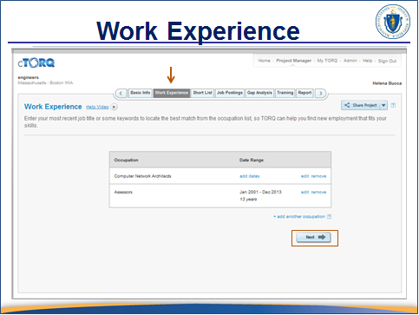
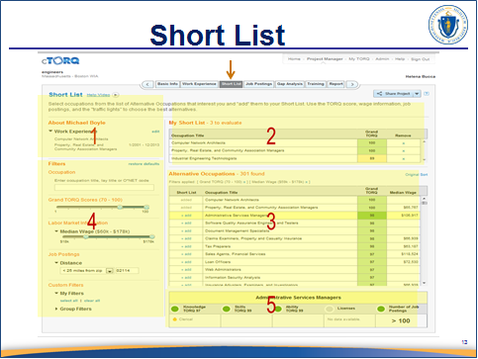
______________________________________________________________________________________________________________________________________________________________________________________________________
______________________________________________________________________________________________________________________________________________________________________________________________________

Slide 15
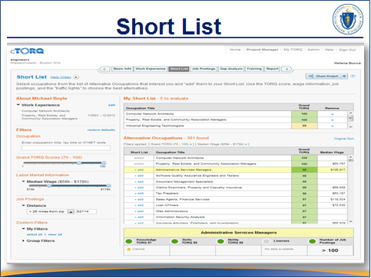
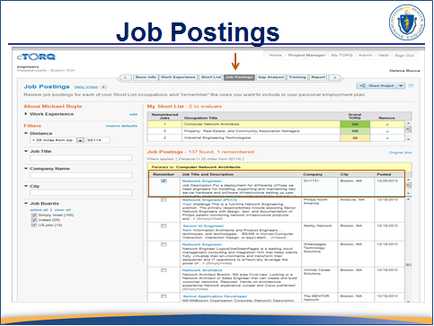
______________________________________________________________________________________________________________________________________________________________________________________________________
______________________________________________________________________________________________________________________________________________________________________________________________________

Slide 16
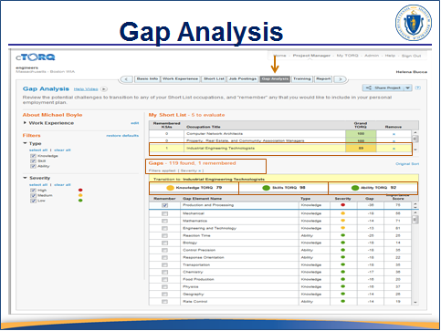
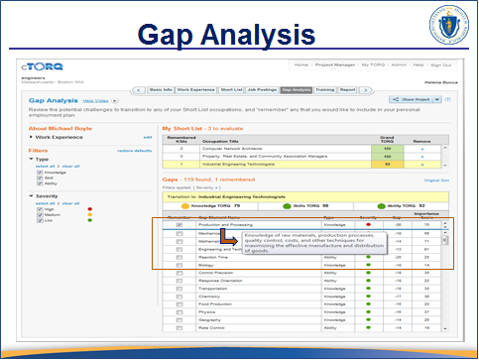
______________________________________________________________________________________________________________________________________________________________________________________________________
______________________________________________________________________________________________________________________________________________________________________________________________________

Slide 17
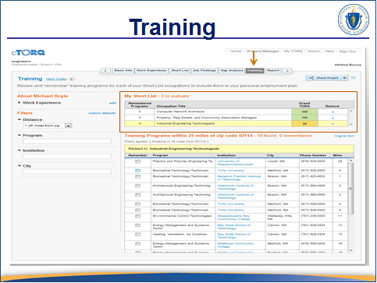
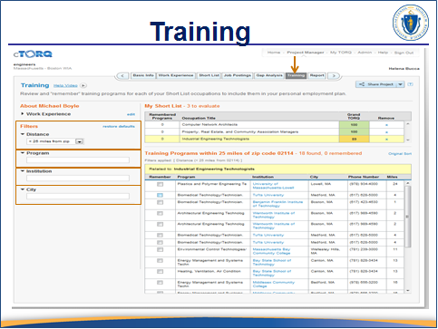
______________________________________________________________________________________________________________________________________________________________________________________________________
______________________________________________________________________________________________________________________________________________________________________________________________________

Slide 18
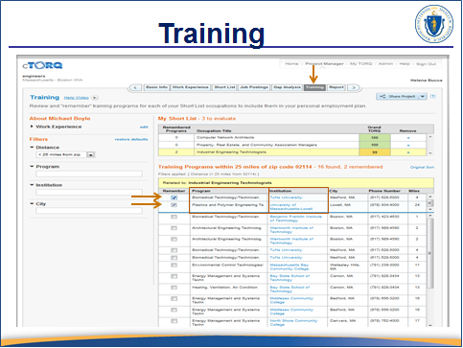
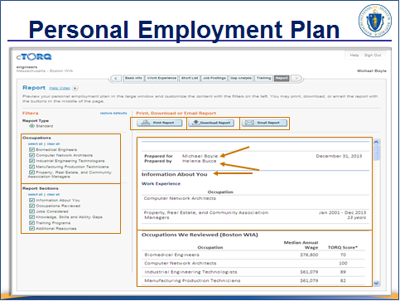
______________________________________________________________________________________________________________________________________________________________________________________________________
______________________________________________________________________________________________________________________________________________________________________________________________________

Slide 19
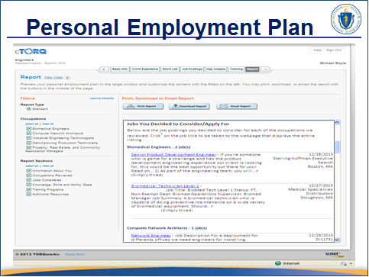
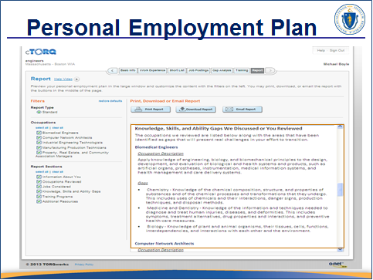
______________________________________________________________________________________________________________________________________________________________________________________________________
______________________________________________________________________________________________________________________________________________________________________________________________________

Slide 20
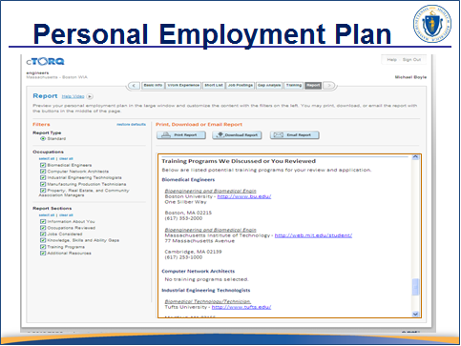
______________________________________________________________________________________________________________________________________________________________________________________________________
______________________________________________________________________________________________________________________________________________________________________________________________________

Slide 21
Next Steps:
Using the PEP

Slide 22




