Slide 1
Customizing CLM Templates
Instructional Guide
Notes:
OSD welcomes you to this CLM Instructional Training about Customizing CLM Templates. Consider this an Instructional Guide for Executive Branch buyers who have Document Manager permission in the Contract Lifecycle Management area of COMMBUYS CLM.

Slide 2
Objectives
Today You will Learn
What templates are and how they work in CLM
How to customize templates to fit Department needs
How to map Word bookmarks to CLM fields
How to deploy a newly customized template so that it replaces the global version
Notes:
This guide
Describes what templates are generally and how they work in CLM specifically;
Shows steps departments can take to customize global CLM templates to fit department needs;
Explains how to map something called “Bookmarks” in Microsoft Word to CLM fields.
And finally, how to replace the current template with the updated one so that any new CLM records employing the template will be using the customized version.

Slide 3
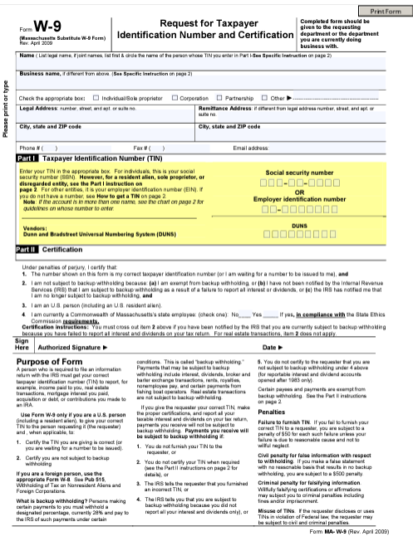
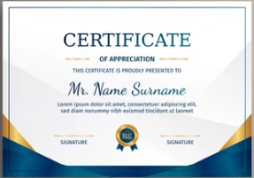
What Are Templates?
Template: A preset format for a document or file, used so that the format does not have to be recreated each time it is used
Time-saving!
Notes:
We encounter templates frequently in our lives.
A preset format for a document or file, used so that the format does not have to be recreated each time it is used. Forms are templates, where blocks are left blank for users to fill in with relevant data.
Templates are time saving and consistent. For instance, every w-9 form for a particular calendar year looks the same.

Slide 4
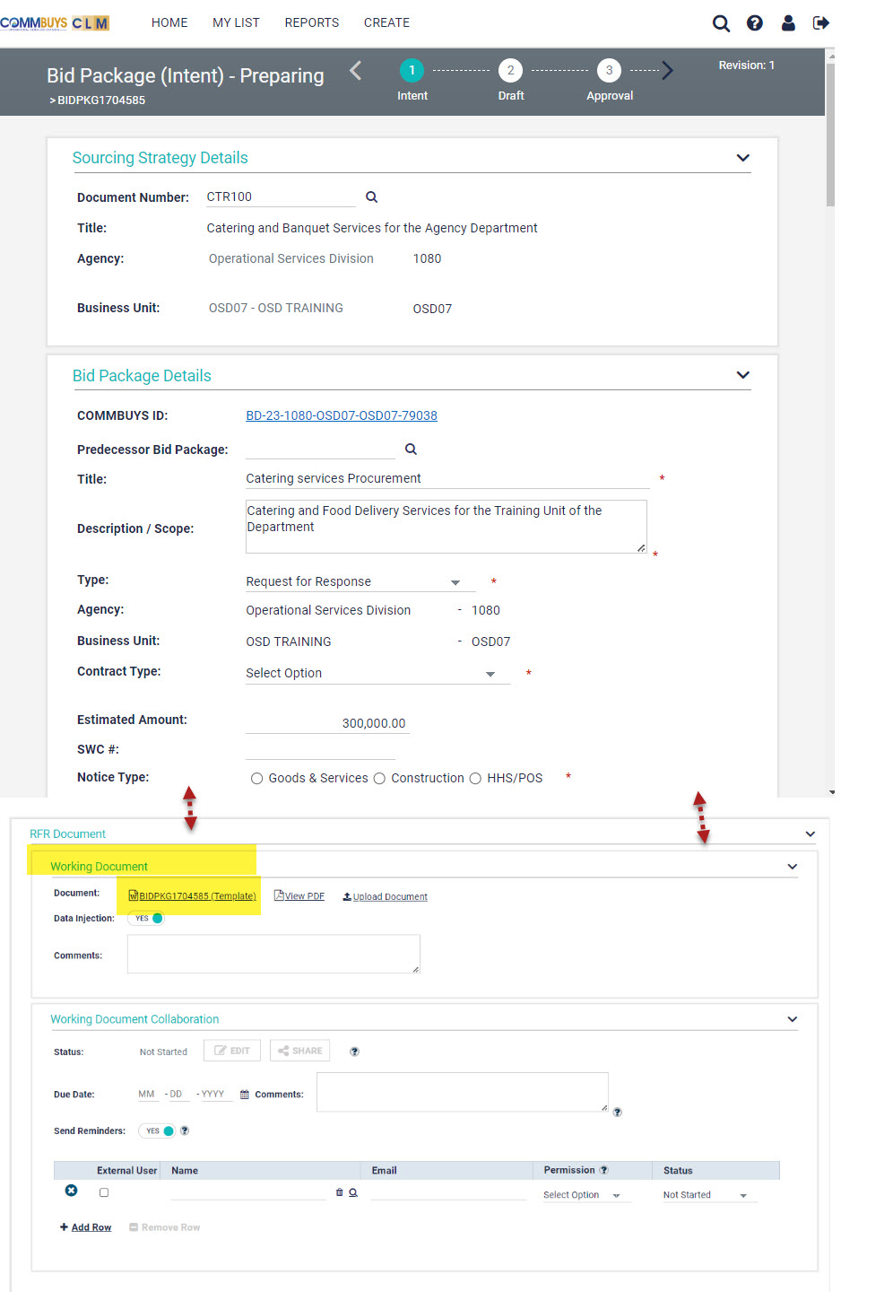
CLM Templates
The Working Document at each CLM phase is a Template.
Data entered into CLM fields injects into the Template to create a procurement document.
Usually, further editing is necessary before a document is ready for distribution.
Notes:
At each Phase in CLM… Strategy, Bid Package (announcement), Bid Package (RFR or Due Diligence), and Contract, a template is presented as the Working Document.
Data entered in CLM fields inject into templates to create procurement documents, contracts, and other associated documents. In this case, the depicted Template is for a Request for Response. Usually, further editing is necessary before the document is ready for distribution, but even using the globally provided version saves time and is consistent for each instance.

Slide 5
Available Pre-Award Templates
CLM Record Type | Associated Template (Working Document)
STRTGY | Sourcing Strategy Template
BIDPKG | RFI (Request for Information)
BIDPKG | Due Diligence
BIDPKG | Intent to Procure
BIDPKG | Request for Response
Notes:
The table here shows the templates that occur as Working Documents during pre-award stages in COMMBUYS CLM today.

Slide 6
Who can customize templates?
It would be cool to change a template to fit my department’s needs, reduce editing time, and be more efficient!
COMMBUYS Basic Purchaser
CLM Access
Document Manager
Advanced Microsoft Word user
Notes:
But wouldn’t it be cool to be able to alter a template to fit department needs, reduce editing time, and just be all around more efficient? Yes, it would.
COMMBUYS users with CLM access who are assigned Document Manager Permission can customize templates, starting with the RFR Template for now with more being developed and released for department customization in the future.
The COMMBUYS Organization Administrator for your department assigns these roles and permissions.
Advanced Microsoft Word knowledge will be really useful to Document Managers.

Slide 7
Step 1: Call the OSD Help Desk
Template for all
Template for your department
OSD Help Desk
1-888-627-8283
or
617-720-3197
8am - 5pm ET
Monday – Friday
Notes:
Before you can begin changing things, the OSD Help Desk must create a copy of the Global Template assigned to your department only. That way, changes you make to the template assigned to your agency stay with your agency.
Help Desk staff are available Monday through Friday from 8:00 am to 5:00 pm.

Slide 8
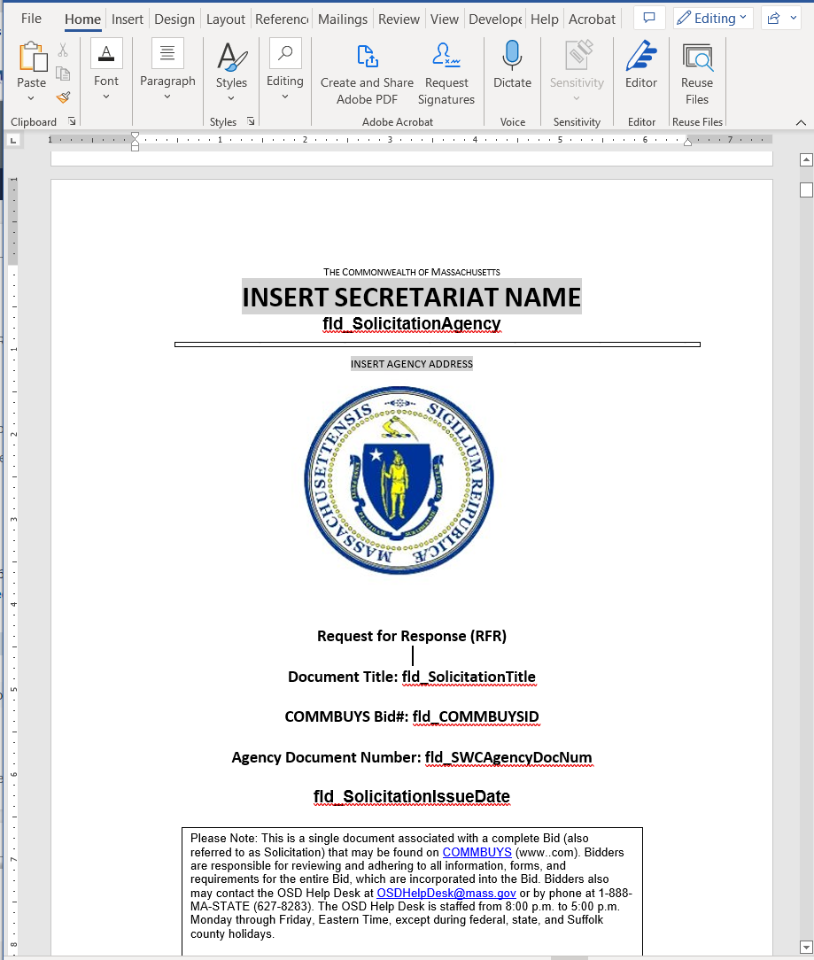
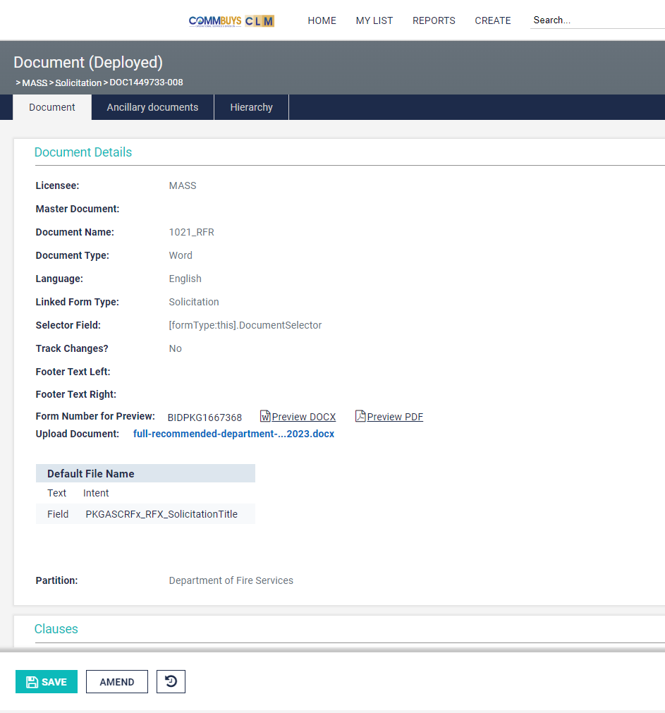
TIPS: Two Programs
Template editing occurs in
Microsoft Word
Amended template is uploaded into CLM
Notes:
Ok. Before we dive into the editing process, let’s review some tips that will help you keep your bearings.
First of all, template editing happens in Microsoft Word. The currently available templates are Word documents, so changes are made and saved in MSWord. Then the amended document is uploaded into CLM. You may toggle between Microsoft Word and CLM several times before the new template is just as you want it to be for your department.

Slide 9
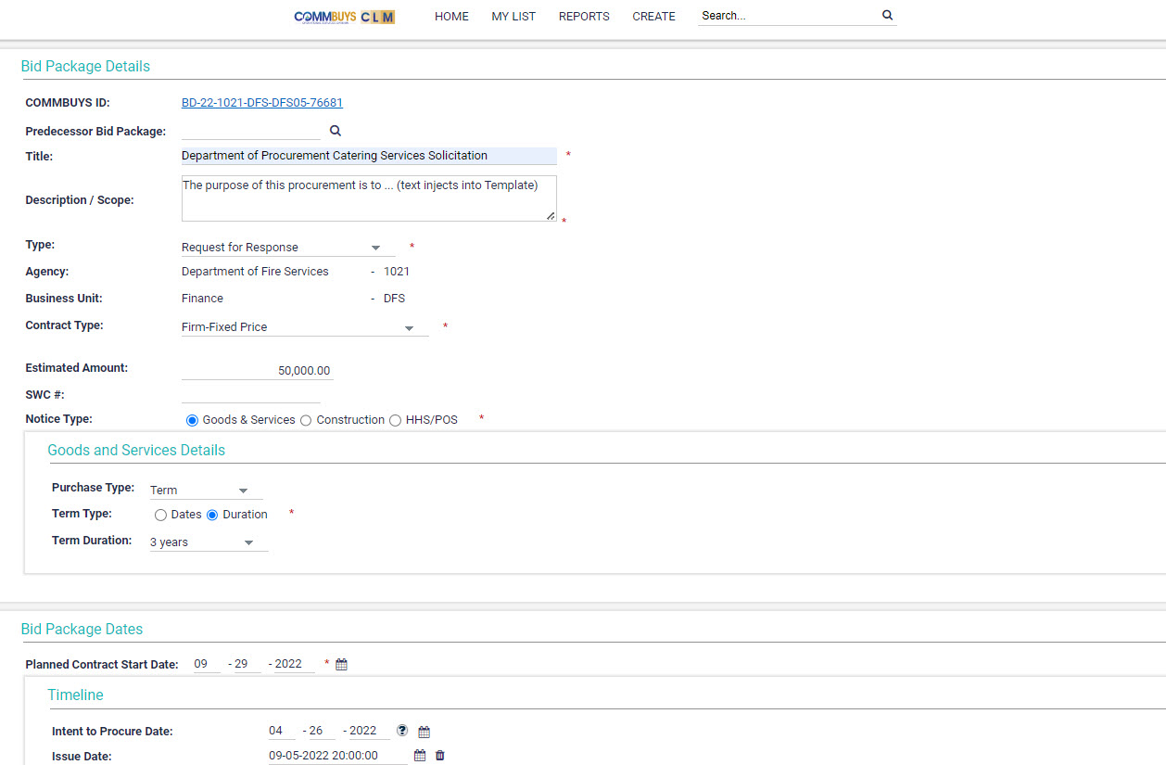
TIPS: Bookmarks and Fields
Templates include placeholders. Word calls these “Bookmarks”
CLM has fields.
CLM has Fields.
Fields have labels.
During Bid Package creation, data entered into fields inject into the bookmarked places in the Working Document (template).
Notes:
The templates include placeholders that Word calls bookmarks. Bookmarks that link up to Fields in CLM must be named with the prefix “fld_” and may include no spaces, special characters, or numerals at the end. The highlighted areas here are bookmarks. Word bookmarks have other functions, too, like section headings, but for our purpose today, we are focusing on those bookmarks that link up to CLM Fields.
During Bid Package creation, data entered into fields injects into to bookmarked places in the Working Document.

Slide 10
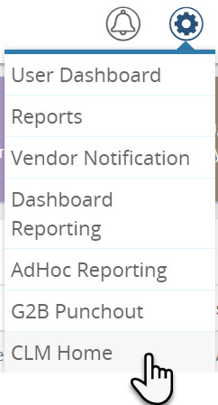
Single Sign On to CLM
Notes:
Now that we’ve established some background, let’s login to COMMBUYS CLM. Remember to use Single Sign On! Then go to the CLM Home page by selecting CLM Home from the Settings menu in COMMBUYS.

Slide 11
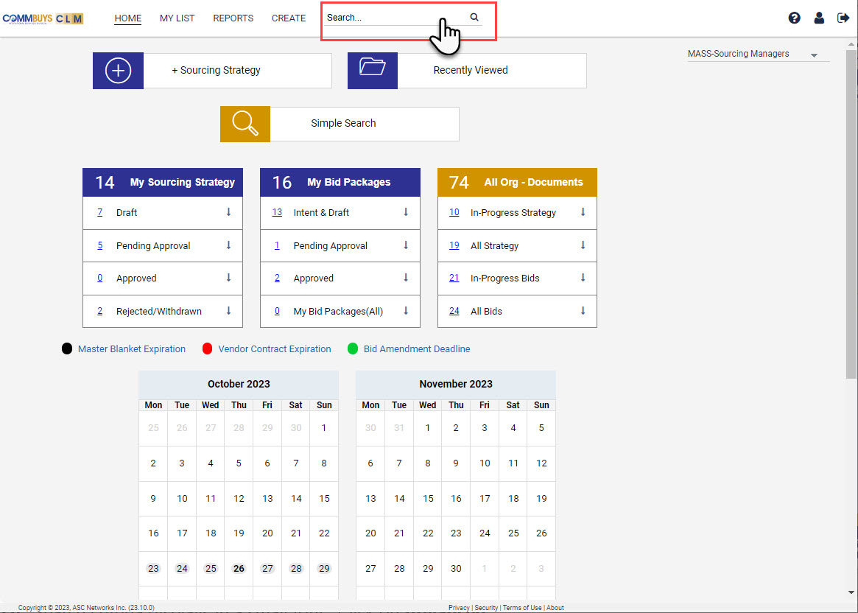
CLM Home Page – Select Search
Notes:
Next, we must find the RFR Template that the Help Desk has created for the Department. From the CLM Home Page, click on Search. Search criteria displays in a small font. Click on Advanced.

Slide 12
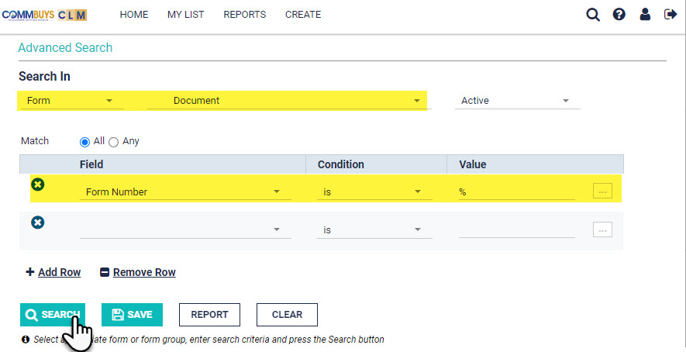
Advanced Search Selection
Under Search In select Form and Document from the drop-down menu.
Under Field select Form Number.
Set the Condition to is.
When the form number is unknown, type the Wildcard (%) into the Value field
Click the Search button.
% = wildcard
Notes:
The Advanced Search Selection box appears. This tool allows users to define what they are looking for. In our example, we will display all of the “documents” available to the user.
First, under Search In, select Form and Document from the drop-down menus.
Under Field select Form Number.
Set the Condition to is.
When the form number is unknown, type the Wildcard character into the Value field. CLM recognizes the percent symbol as the wildcard.
Then click Search.

Slide 13
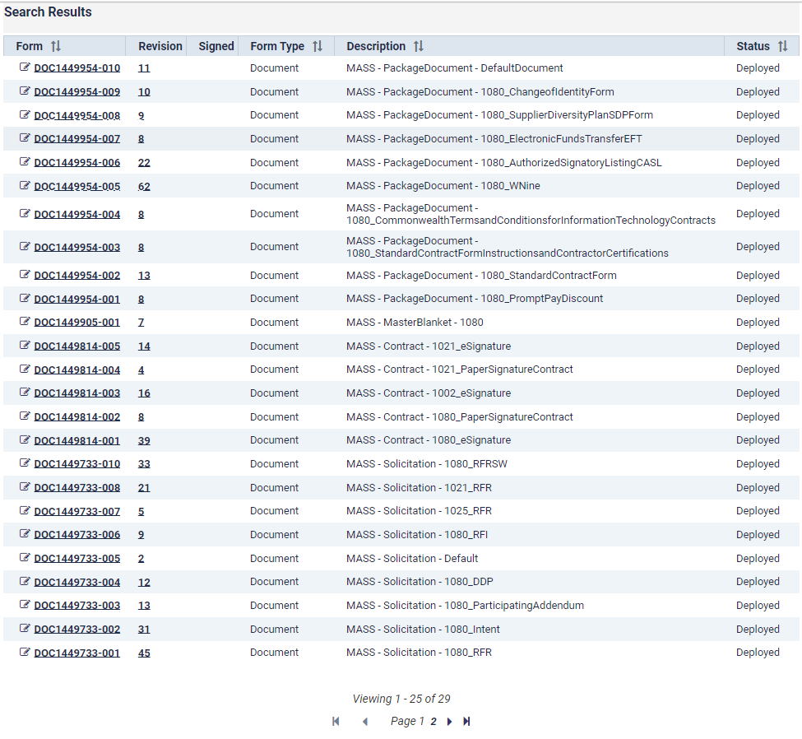
Search Results
Find the RFR document assigned to your agency.
Click the Form Number hyperlink.
Notes:
The Search Results show a list of all documents created in CLM. Listed in the far right column is the Status of each document. In our example, all of the listed documents are Deployed templates. Some of the listed templates are not complete. OSD will continue to roll out templates as they are ready.
Document descriptions follow a naming convention that includes the type of record it’s associated with, followed by a dash or hyphen, followed by a number..underscore…and a description of what the document is. The number represents your Agency. Many of these documents are “global”, available for all agencies to use but not to Amend. Some are issued to other agencies. While you may be able to open and look at these, only the Document Manager for the assigned agency can Amend a template. And, at this stage, only the RFR is available for departments to amend.
Look for the RFR document that includes the Agency Code for your department. These are the same as in COMMBUYS. OSD’s number is 1080 so almost all documents displayed here are assigned to OSD.
Notice there are 3 RFR documents in the black box, each assigned to a different agency. Once the Help Desk has copied the RFR template and assigned it to your agency, it will appear on this list.
In this example, we are selecting the Document Hyperlink for the RFR Template assigned to Agency Code 1021.

Slide 14
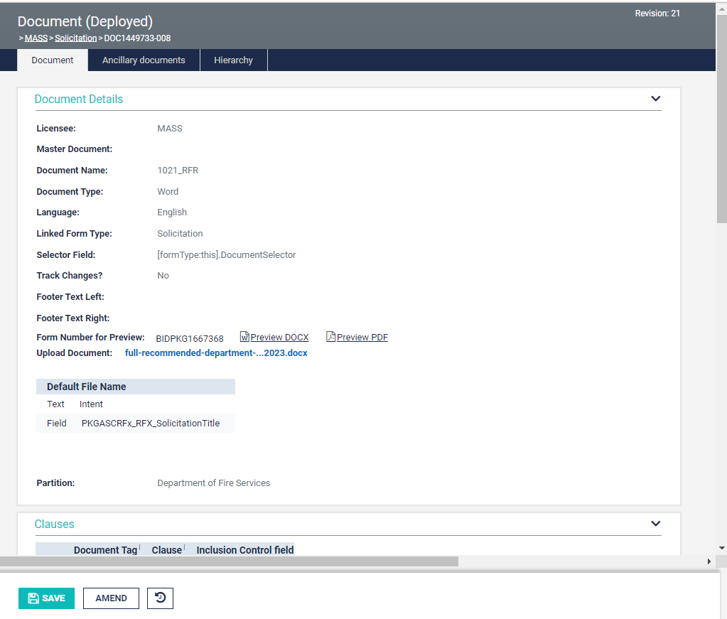
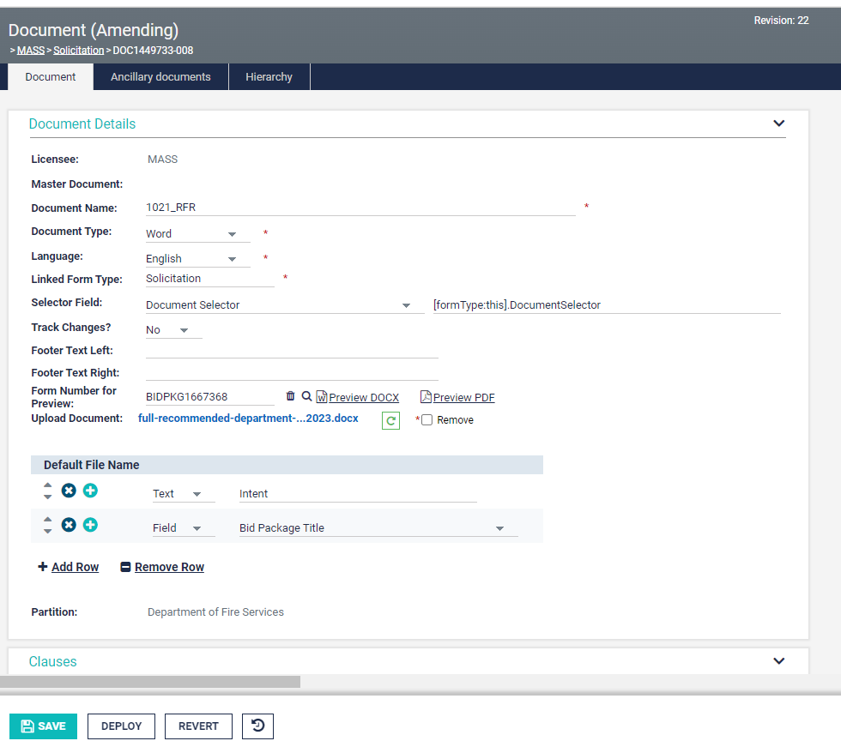
Document window
Notes:
The document window opens. Note the status in the gray ribbon at the top of the page is labeled “Deployed”.
Click the Amend button at the bottom of the page.
The document redisplays, this time showing the status "amending”.
Next, click the Hyperlink for the attached document, which will download to the destination your computer has designated for downloads.

Slide 15
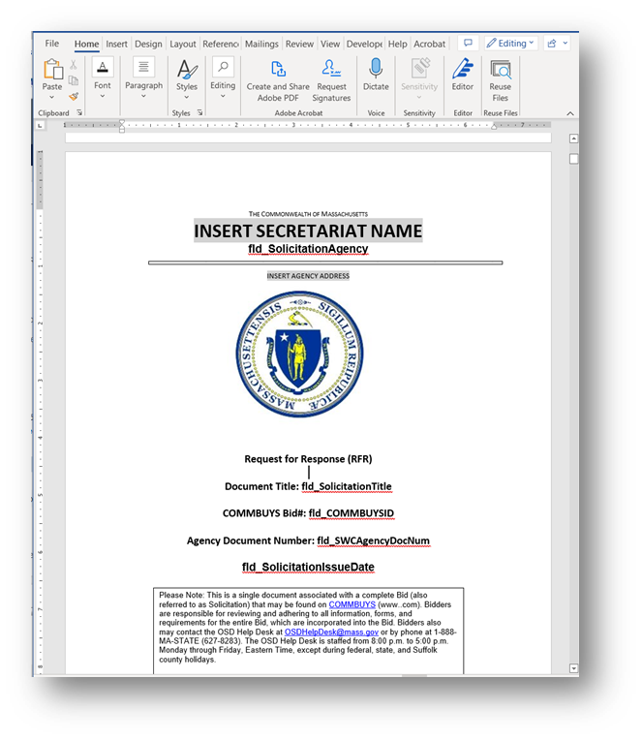
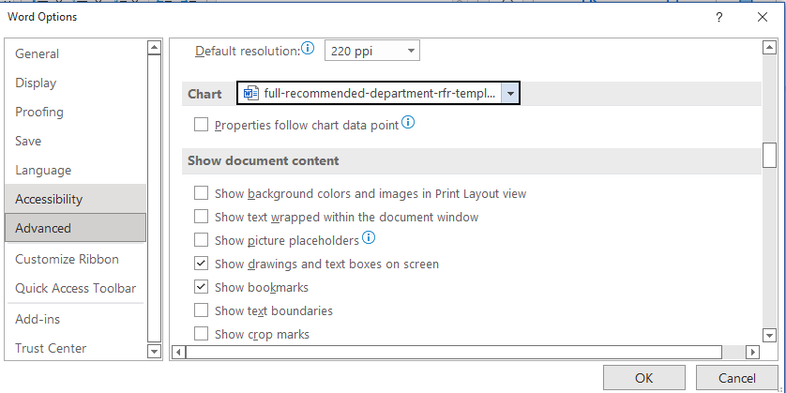
Amending in Word: Displaying Bookmarks
The template already includes many Bookmarks that are mapped to fields in CLM.
Make Bookmarks Visible:
Click Enable Editing at the top of the page.
Click the File menu, select Options, then select Advanced.
Scroll down to the section Show document content
Check the box to Show Bookmarks
Click OK at the bottom of the page.
Be sure to click “Enable Editing”
Notes:
Find the file location where the document downloaded and open it.
Click “Enable Editing” at the top of the page upon first opening.
The template already includes many Bookmarks that map to fields in CLM. One recommendation is to make sure your word settings are set to Show Bookmarks.
Click the File menu, select Options, then select Advanced.
Scroll down to the section Show document content
Check the box to Show Bookmarks
Click OK at the bottom of the page.

Slide 16
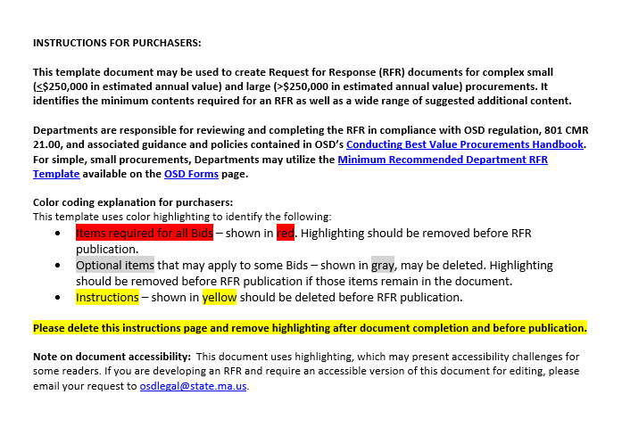
Begin Editing the Document
Changes to your Departmental RFR Template may be simple or complex. This guide will demonstrate how to :
replace the logo;
add text that will always be in the new template;
add a placeholder bookmark where you would like data entered in CLM to inject into the document;
map Word Bookmarks to CLM fields.
Notes:
The first page of the RFR template includes instructions. Remember, this template was created to be universal--all Executive Agencies can use it.
Items highlighted in red throughout the document must stay in your customized RFR.
Are there optional items that never apply to your department? The Document Manager may edit the template to exclude those items.
Your edit may be simple or more complex. Here we will demonstrate a few things you can do such as changing the Logo, adding text, removing text, and adding a bookmark as a placeholder where you want information from CLM to inject into RFR documents your agency issues. AND, how to map those new Bookmarks to CLM fields.

Slide 17
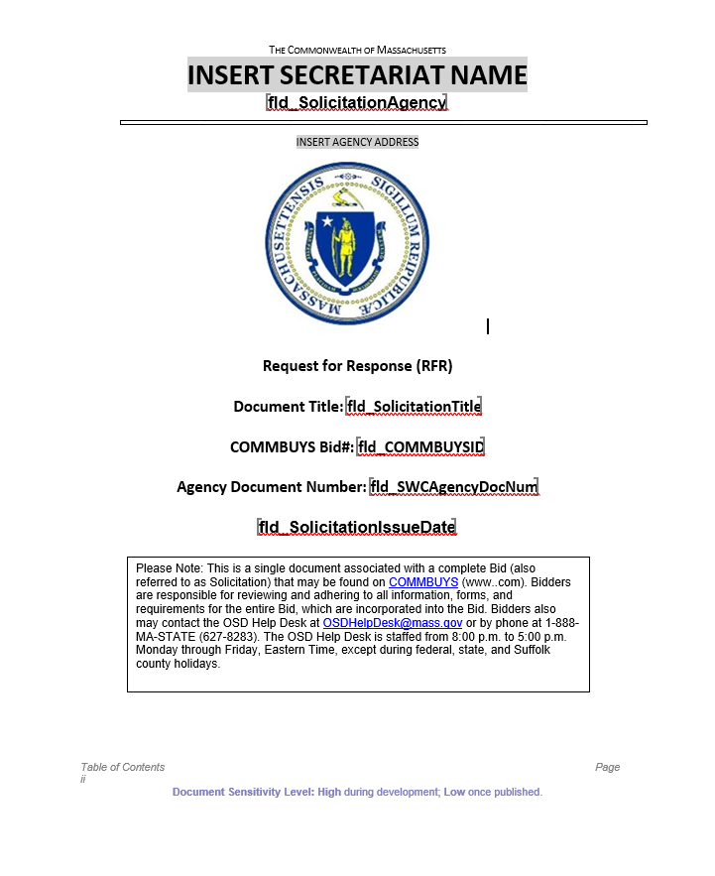
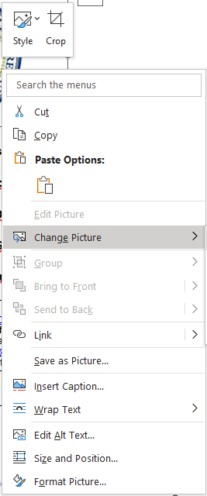
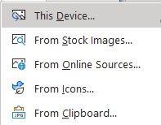
Add a Custom Logo
To substitute the official Commonwealth seal with one for your agency:
Right click on the logo
Select Change Picture from the menu
Select the location of the logo file from the menu.
Click SAVE in Word to save that change.
Notes:
The baseline RFR template includes the state seal. If your department or agency has an official seal of its own, your template can display that instead.
There are several ways to change the logo. Here’s one: Right click on the logo, CLOCK then select Change Picture from the menu. Finally, select the location of the logo file you want to use from the menu.
Click SAVE in Word to save that change. You may change the file name if you would like to, though changing it is not necessary.

Slide 18
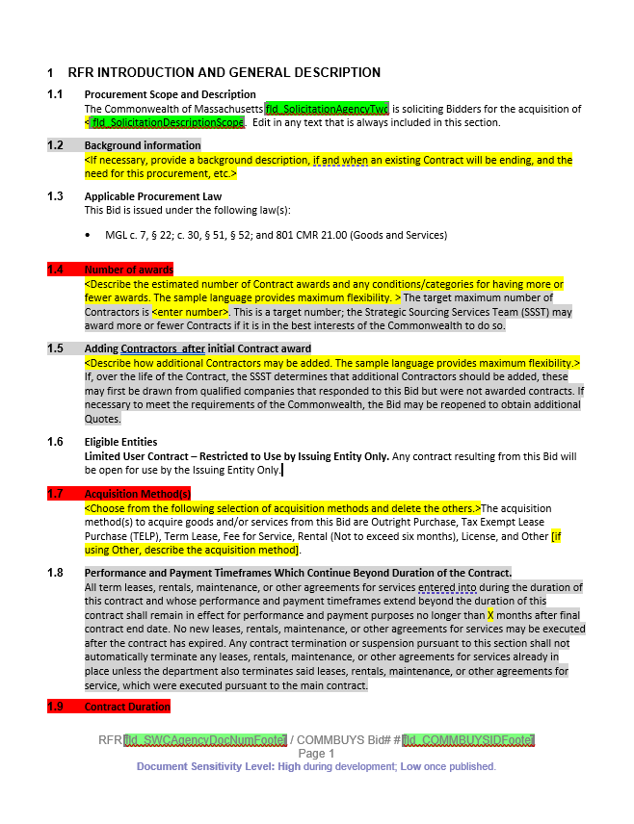
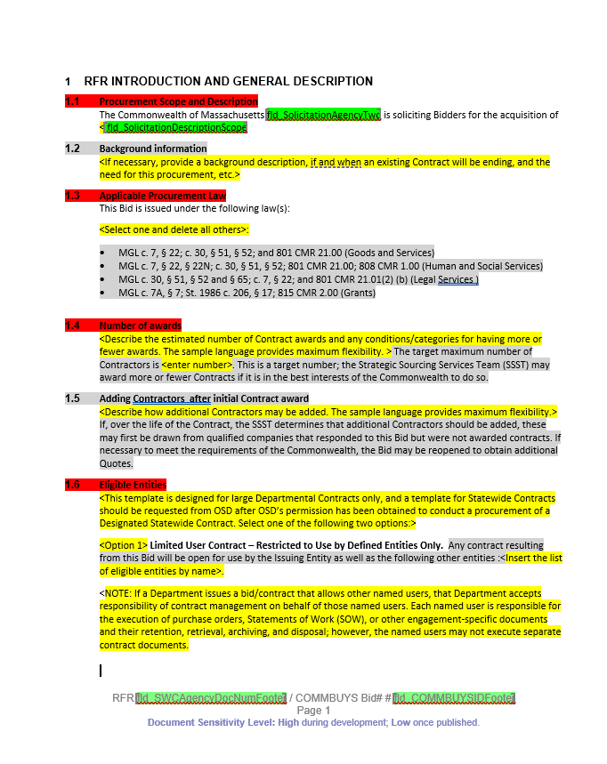
Add or remove text
Notes:
Displayed here is the first content page of the baseline template. Number 1 is unedited.
For number 2, we’ve eliminated the Red Highlights from section 1.1 and added text that will always be included in this department’s Procurement Scope and Description. Our example department only procures under MGL chapter 7 section 22, so we’ve eliminated the other options and removed the highlighting from section 1.3. Similarly, our example department never partners with other departments to procure. Section 1.6 now includes only the issuing entity.
As always, Click SAVE in Word to lock in those changes.

Slide 19
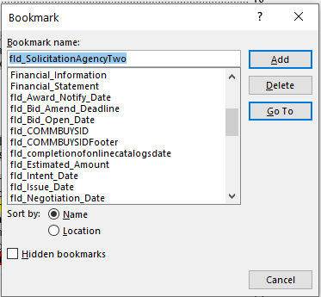
What bookmarks are already in the template?
Click the Insert tab on the Word Ribbon.
Click the Bookmarks icon.
Scroll to see all the bookmarks included in the template.
Highlight a Bookmark Name and click the GoTo Button to see where the bookmark leads.
NOTE: Only those bookmark beginning with fld_ are placeholders/injection points for data from CLM. Other bookmarks may be labels for Section Titles or other information.
Notes:
Ok. Before we go on, we’ll learn a bit more about Word Documents. What bookmarks are already in the template? To find out, click the Insert tab on the Word Ribbon.
Then, click the Bookmarks icon.
Scroll to see all the bookmarks included in the template.
Highlight a Bookmark Name and click the GoTo Button to see where the bookmark leads.
Note: Only those bookmark beginning with fld_ are placeholders/injection points for data from CLM. Other bookmarks may be labels for Section Titles or markers for other information.

Slide 20
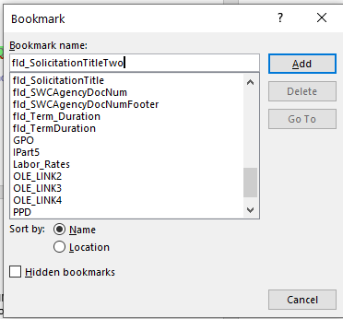
Adding Bookmarks… Easy as 1…2…3!
Scenario
A department wants the Procurement Title to appear in the Description area as well as on the Title Page.
Go to the spot in your document where you want to place a bookmark.
Type the name of the new bookmark, then highlight the text. Click CNTRL+C
Access the bookmarks (insert>bookmarks).
Paste the text into the name box. Click Add.
NOTES:
A bookmark may only point to 1 location in the document.
Bookmark name that link to CLM fields must begin with fld_
Bookmark names may not contain spaces, special characters, or numerals at the end.
Notes:
Here’s a What If Scenario for you. A department wants the Procurement Title entered into CLM during Bid Package creation to appear in the Description section as well as on the Title page. As it turns out, a bookmark can only point to one area in your document. Kind of like in real life; your bookmark goes to just one page. To mark other pages, you need other bookmarks.
Adding bookmarks is easy. Go to the point in the text where you want to place a bookmark. Type the name you want to give the bookmark. Be sure to follow the rules! The name must start with fld_ and cannot contain spaces or numerals at the end. In the example, we’ve typed fld_solicitationTitleTwo, that’s t-w-o. Now highlight the text you just typed. Click CNTRL+C to copy the text.
For The last step, access the bookmarks like we just did. Click Insert on the ribbon, then bookmarks button. Now click into the bookmark name box and paste the text in. Lastly, click the Add button. Now let’s see how that looked in the document.

Slide 21
How does that look in the document?
Text for new Bookmark typed and highlighted. CNTRL+C to copy.
Bookmark name pasted into the name box.
Click Add.
Brackets show that the text is now a Bookmark.
Notes:
First, we found the spot where we want the placeholder to go. We typed the new Bookmark Name, then Highlighted the text, and copied it.
Next we went to the Bookmarks box, pasted the text into the name box, and clicked ADD.
In the text, the bookmark is placed. We can see this because the text is bracketed, which is how bookmarks look.
Be sure to save the document again! Once editing is done, we will upload this new version into CLM. Remember, we left the document “container” page in Amending status.

Slide 22
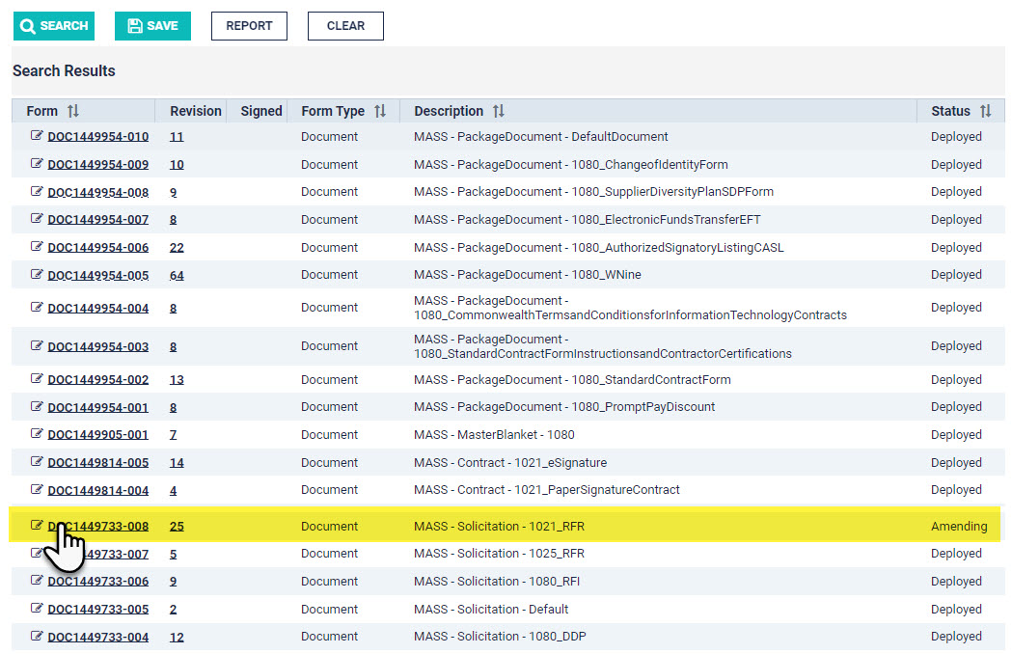
Uploading the Template to CLM
Notes:
Let’s go back to CLM to upload this customized template. Certainly, during all this editing, COMMBUYS CLM has logged you out, so log back in using SSO, Go to the CLM Home Page and select Advanced Search, select the same options as before. From the search results, Select the RFR template assigned to your department. It will be in amending status.
Click the Document link.

Slide 23
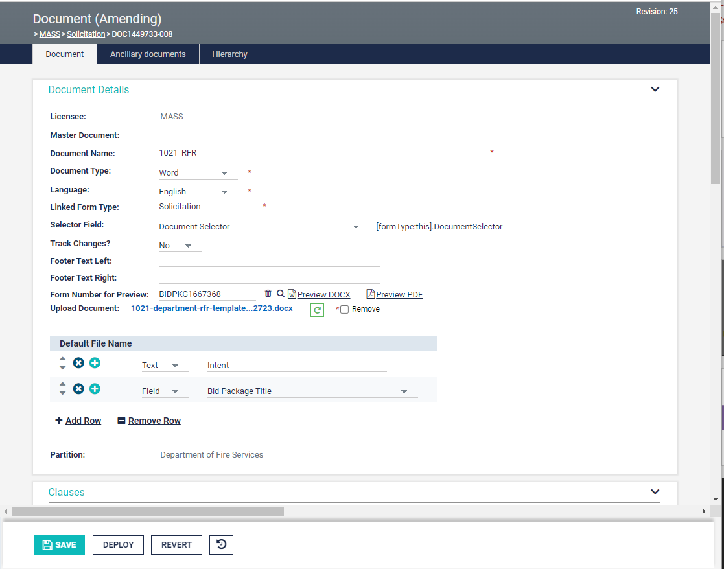
Uploading the Newly Edited Template
In the field labeled Upload Document is the current version which needs to be replaced.
Click the green icon to substitute the old document with the new one.
A document selection box displays. Select the newly edited document from the list and click open.
The new document title displays as the uploaded document.
Click Save. The document title now displays as a hyperlink.
Notes:
In the field labeled Upload Document is the current version which needs to be replaced.
Click the green icon to substitute the old document with the new one.
A document selection box displays. Select the newly edited document from the list and click open.
The new document title displays as the uploaded document.
Click Save. The document title now displays as a hyperlink.

Slide 24
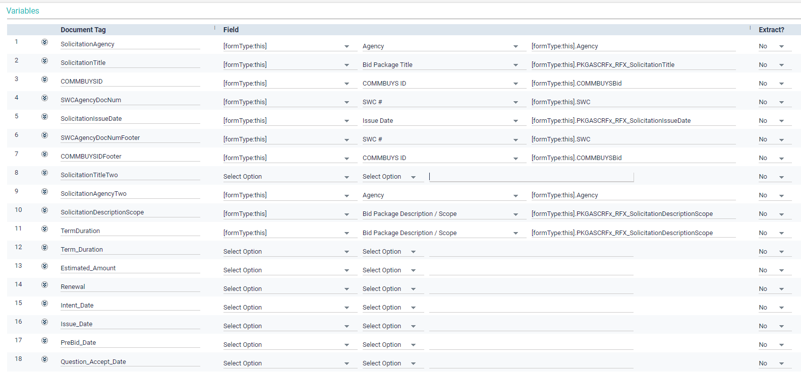
Mapping Word Bookmarks to CLM Fields
Notes:
Scroll down to the Variable section of the CLM Document screen. The first column, Document Tag, displays all the FLD_bookmarks from the Word Template document. Item number 8 is the bookmark we added earlier. Notice the Field column is blank for item 8. The third column is also blank. Options will be determined by the choice selected in the Field column. The 4th column will auto populate with information from the other columns.

Slide 25
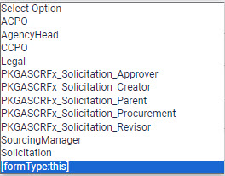
Mapping Word Bookmarks to CLM Fields – cont’d 1
Notes:
Sticking with Item 8, let’s click Select Option in the Field column.
There are several options. The document we are working in is part of a solicitation, so we could select that. However, the option Form Type This means to show options for the type of form that you are amending. That’s handy! Let’s choose that!

Slide 26
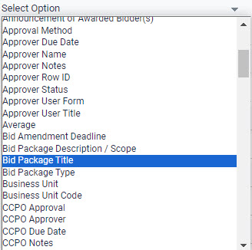
Mapping Word Bookmarks to CLM Fields – cont’d 2
In the scenario, bookmarks [fld_SolicitationTitle] and [fld_SolicitationTitleTwo] were place holders for the same CLM data: Bid Package Title
Notes:
Click the Select Option down arrow to see what the options are now that the Field column has been filled in. Remember in our scenario, we created a new bookmark [fld_SolicitationTitleTwo] as a second injection point for the Bid Package Title. So here, we would select Bid Package Title from the list.

Slide 27
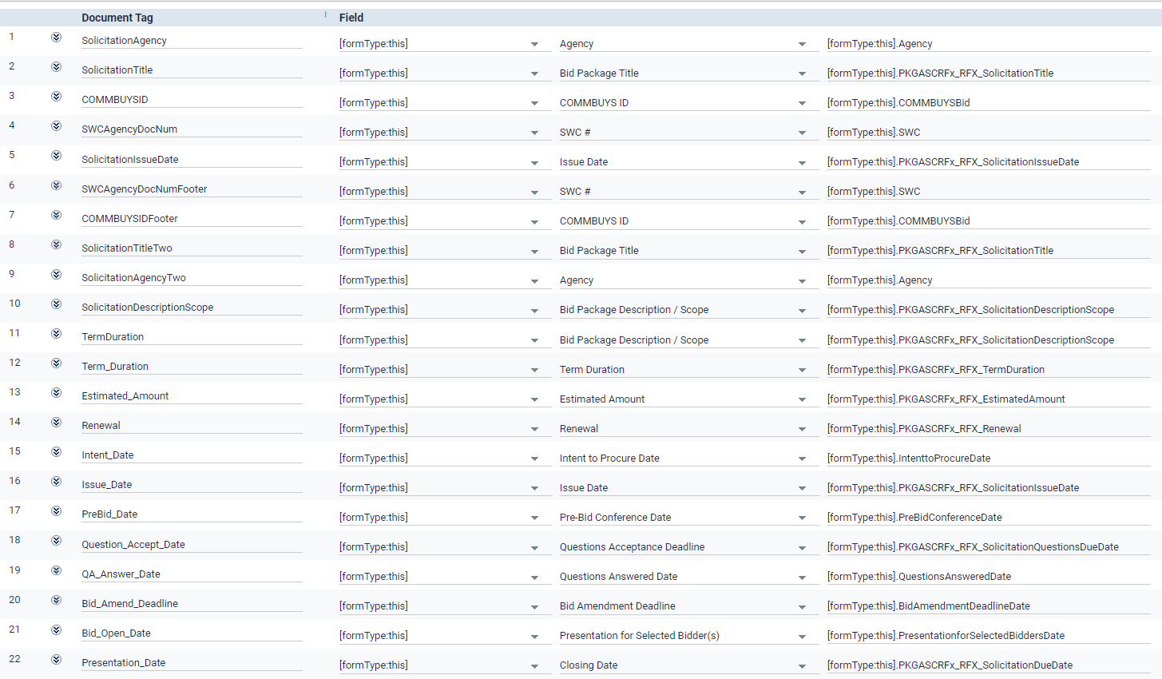
Mapping Word Bookmarks to CLM Fields – last
BEST PRACTICE
All Document Tags (Word Bookmarks) are linked to CLM fields.
The first four columns are complete for each item.
Notes:
As a best practice all document tags (or Word Bookmarks) are linked to CLM fields. The first four columns are complete for each item.
Remember to click the SAVE button at the bottom of the CLM Screen!

Slide 28
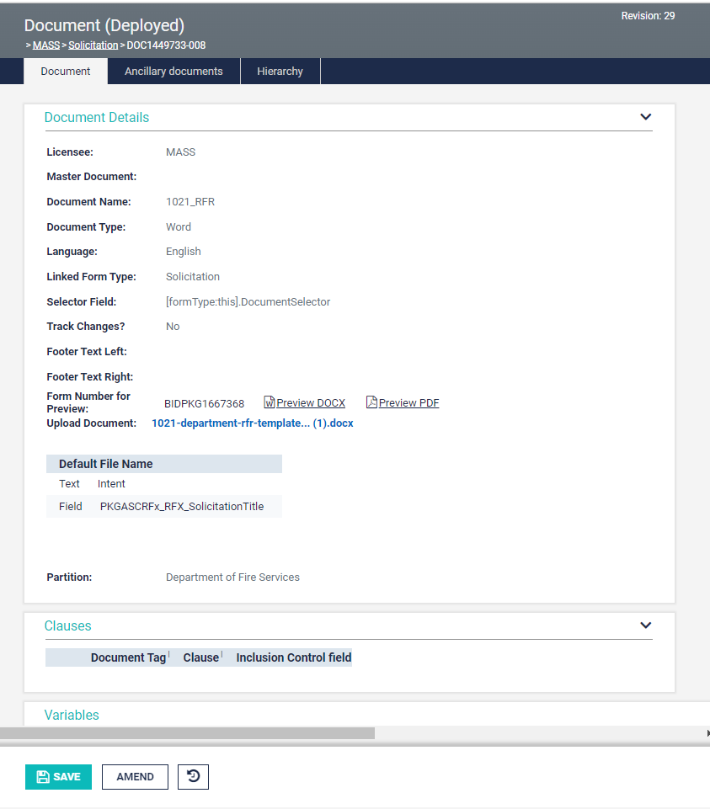
Deploy the Template
Click the DEPLOY button
Document status changes to Deployed.
All newly created Bid Packages will employ this new RFR Template.
Whenever additional customizations are needed, come back to the document screen, click AMEND, and start again
Each Agency gets just one customized RFR template
Notes:
Click the DEPLOY button
The document status in the gray ribbon at the top of the page changes to Deployed.
All newly created Bid Packages will employ this new RFR Template.
Whenever additional customizations are needed, come back to the document, screen, click AMEND, and start again.
Remember, changes you make to your department’s RFR template should not be so specific that they only apply to some of the RFRs you write. The changes should be specific enough to represent your agency but general enough to be usable agency-wide. Specific editing occurs when a procurement is underway. Then, the Working Document is edited to create an RFR that describes the qualities of that procurement.

Slide 29
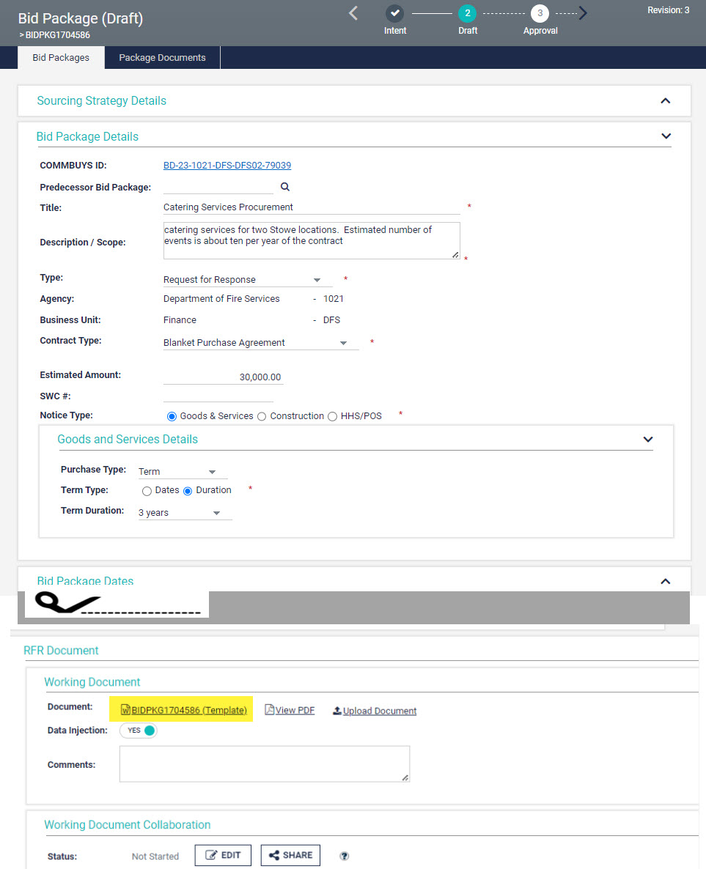
New Bid Packages
The Working Document employs the customized template (highlighted).
Data entered into Bid Package Details and other Bid Package Sections injects into the RFR template upon download.
The downloaded document should be further refined to reflect the needs of the specific procurement.
Notes:
This screen shot shows a new Bid Package in Draft status. (See that gray ribbon again). Procurement staff who create bid packages enter data into fields in sections like Bid Package Details, Bid Package Dates, etc. The data entered injects into the RFR template when it is downloaded from this screen. The downloaded document should be further refined to reflect the needs, conditions, and attributes of the specific procurement.

Slide 30
Creating Clauses Workflow
Basic Workflow for Customizing the RFR Template
Contact the Help Desk for initial Template deployment for your Department
Organizational Administrator assigns Document Manager (DM) permission to COMMBUYS CLM user
DM uses Advanced Search to locate the deployed Document. Naming Convention: Agency ID_ RFR
DM clicks Document link to access document details, then clicks AMEND at the bottom of the page.
DM returns to the Document (Amending) page in CLM and replaces the old template with the new one.
DM clicks the hyperlink for the document in the Upload Document field. Clicking the link downloads the document.
DM locates the downloaded file and opens it.
(Microsoft Word)
DM makes changes that apply to all procurements the department may undertake. Saves frequently.
DM maps all Document Tags (Word bookmarks) to CLM Fields, clicks SAVE, and then clicks DEPLOY.
Notes:
Here is a bird's eye view of the workflow we covered today. (1. Contact the Help Desk for Initial Template deployment for your Department. 2. Organizational Administrator assigns Document Manager (DM) permission to COMMBUYS CLM user 3. DM uses Advanced Search to locate the deployed Document. Naming Convention: Agency ID + RFR. 4. DM clicks Document Link to access document details, then clicks AMEND at the bottom of the page. 5. DM clicks the hyperlink for the document in the Upload Document field. Clicking the link downloads the document. 6. DM locates the downloaded file and opens it. (Microsoft Word) 7. DM makes changes that apply to all procurements the department may undertake. Saves frequently. 8. DM returns to the Document (Amending) page in CLM and replaces the old template with the new one. DM maps all Document Tags (Word bookmarks) to CLM Fields, clicks SAVE, and then clicks DEPLOY.)

Slide 31
Resources and Contact Information
Operational Services Division
Phone: 617-720-3300
Website: www.mass.gov/osd
OSD Helpdesk
Phone: 617-720-3197
Toll-free: 888-627-8283
Email: OSDHelpDesk@mass.gov
Website: www.commbuys.com
Resources
Best Value Procurement Handbook
COMMBUYS CLM Resource page
How to Use Templates in COMMBUYS CLM (Video Demo)
Notes:
We hope you found this resource useful!
If you have questions specific to your COMMBUYS account or want to get the ball rolling on customizing the RFR Template, or are having technical issues, contact the COMMBUYS Helpdesk.
And don’t forget, the OSD homepage offers tools and resources that you can access any time.
A key resource for all Executive Branch procurement staff is the Best Value Procurement Handbook. Likewise, we have a CLM Resource page, with job aids, guides, videos and more, including a document version of the presentation you’ve just watched.
If you would like to see the steps covered in this training in action, we have a video demo: How to Use Templates in COMMBUYS CLM

