Slide 1
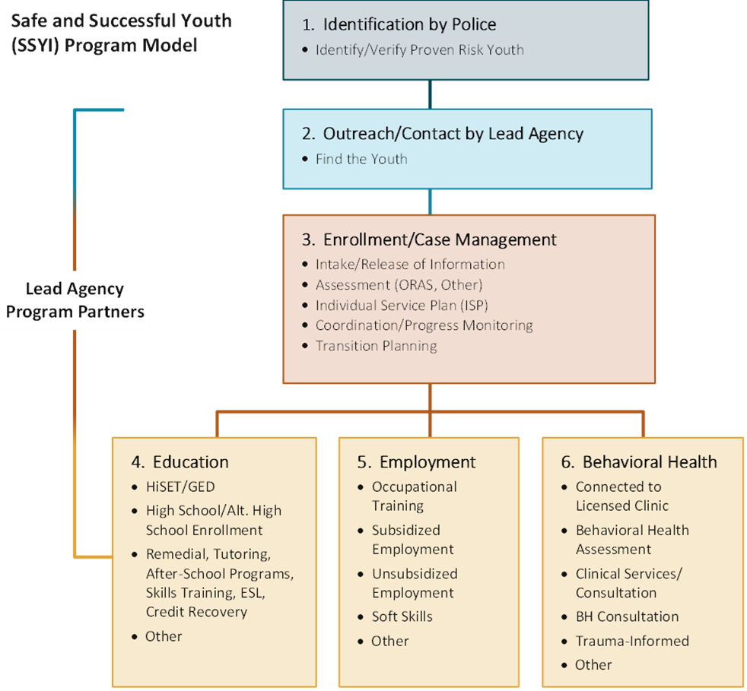
Claiming Federal Financial Participation (FFP) for Community Violence Prevention DRAFT not for distribution
Safe and Successful Youth Initiative (SSYI) structure
Line Item 4000-0005
FY25: $10,952,630
14 grantees
43 subcontractors
3 TA/IT/Eval contracts
Approximately 2,000 youth served

