Slide 1
CVS Health
Workforce Initiatives
Building Talent Pipelines for an Inclusive Workforce
Rick Laferriere
March 1, 2018

Slide 2
Workforce Initiatives – Overview
Who we are:
The CVS Health Workforce Initiatives team is a team of 26 dedicated colleagues, supported by a team of consultants, working under the CVS Health Workforce Strategies and Diversity Management umbrella.

Slide 3
Workforce Initiatives – Overview
What we do:
We enable our purpose of “helping people on their path to better health” by developing innovative pipelines that deliver diverse talent to CVS Health. In doing this we develop strong loyalty with our community partners, customers, and clients.

Slide 4
Workforce Initiatives – Overview
Why we do it:
We’re in search of great talent. It’s critical to our business that we reflect the communities and patients we serve and we believe our team provides CVS Health with a competitive advantage in seeking that talent.
We help break the cycle of poverty for people who may otherwise continue down the road of dependency which often spans generations.

Slide 5
Workforce Initiatives – Overview
How we do it:
We build partnerships with government agencies, community based organizations and educational institutions to source talent and to develop programs that prepare candidates for roles across our enterprise.
Our team is unique in that no other employer in the US has a team like ours.

Slide 6
Our approach
  Identify a talent need
  Work with our internal partners to identify talent needs and what differentiates the best candidates
  Find a partner
  Employer-friendly
  What can each side offer?
  Is there funding available?
  What’s the desired outcome?
  How much effort will it take?
Build a pipeline
  A pipeline is supported, scalable, successful and sustainable

Slide 7
MRC Total Store Training Program
Adults of all ages
8 weeks, 2 days a week, 4 hours per class
Locations across Massachusetts
Curriculum is part CVS, part MRC
Delivered by trainers contracted by MRC, supported by CVS
MRC chooses the students using CVS criteria
CVS presents to all classes

Slide 8
MRC - Recipe
MRC provides:
  Training sites
  Trainers
  Vetted candidates
  Job readiness curriculum & preparation
CVS provides:
  Our training curriculum & LMS access
  SMEs
  Additional job readiness preparation resources
  Jobs!

Slide 9
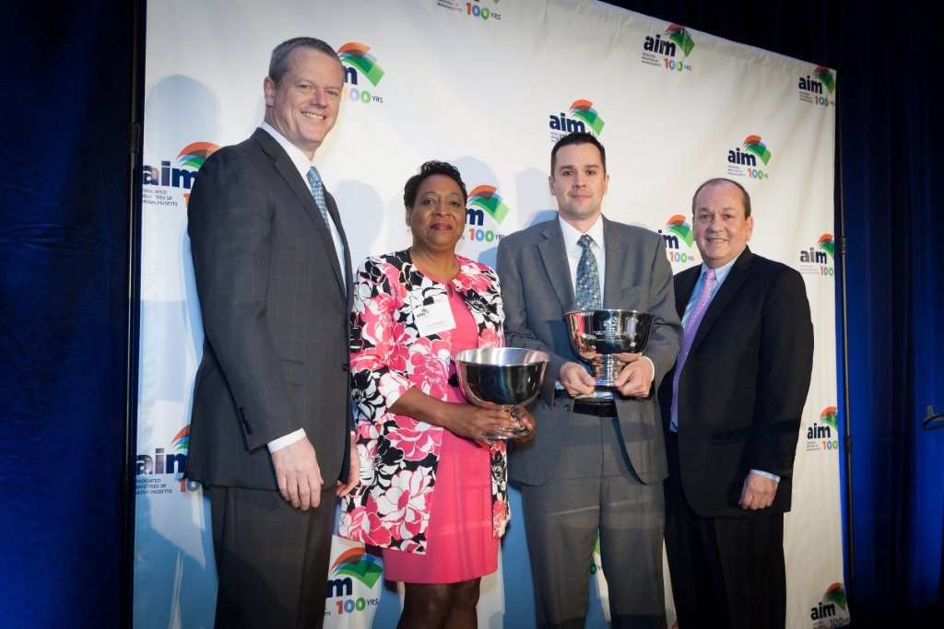
Champions!
2015 John Gould Education & Workforce Development Award

Slide 10
JVS Transitions to Work
Adults 18 to 35 with disabilities
9 weeks, 5 days a week
No cost to participants
Focus on transferable skills
Use our Regional Learning Center mock store
76% placement rate, 94% graduation rate
Support following the hire

Slide 11

Champions!
2016 IAJVS Corporate Partnership Award

Slide 12
Regional Employment Collaboratives
A solution to a common barrier to employment
10 weeks: 2-3 hour training sessions & a 40 hour externship in a CVS store
All 6 REC Regions across the state
Establish comfort with retail & cash register
Working interview
Goal: universal access to retail opportunities & career potential

Slide 13
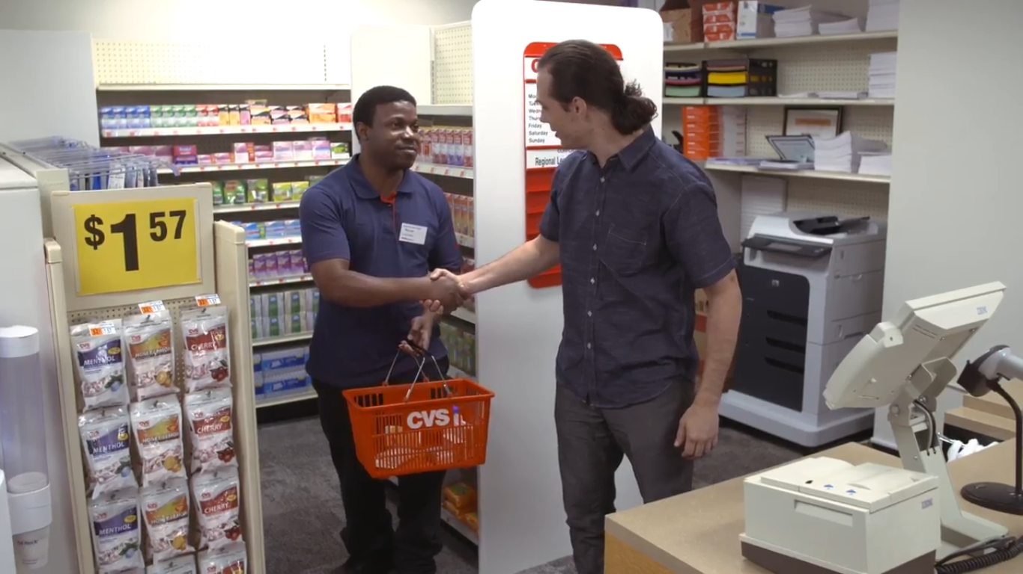
Success!
Malcolm Richardson, CVS colleague

Slide 14
Refer & influence - wins
My role: part recruiter, part TA, 100% influencer
  Also: protect against inadvertent/unnecessary disclosure
I asked why wouldn’t you hire this person & learned from that
Success is the fuel that makes this go
  Internal view:
    A solution to many business imperatives
  External view:
    A champion of public-private partnership
    An employer that cares about the community
    An employer of choice

Slide 15
Measuring success
Pharmacy Technician Annualized Retention
MRC Consumers who were hired through our customized Pharmacy Tech program nearly doubled our retention rate locally
  Average cost of turnover: $2,900 per Pharmacy Tech
  86 MRC consumers hired through this program.
  Total training cost savings to the company of over $160,000
  WOTC: potentially >$100,000
  Cost to CVS Health of 6 cycles of training to date: $5,000

Slide 16
The Business Case
Qualitative benefits:
  Internal view:
    A solution to many business imperatives
    A diverse, inclusive pipeline of sustainable talent
    A trusted and reliable source of talent
  External view:
    A champion of public-private partnership
    An employer that cares about the community
    An employer of choice
Quantitative benefits:
  Metrics key to HR professionals:
    Retention
    Promotability
    Engagement
    Compliance
  Metrics key to the C-Suite:
    Cost savings
    Monetary incentives
    Value add
    Company reputation

Slide 17
What’s next?
Leveraging our expertise with apprenticeship
  We are a national leader in the non-traditional apprenticeship space with our pharmacy tech RA
  Programs in 14 states, with Massachusetts the newest addition
  Pilot program now being developed with the Central MA WIB in conjunction with Quinsigamond CC
  Potential to replicate and expand across the state using pre-apprenticeship programming
  Fully supported by EOLWD

Slide 18
Thank You

