Slide 1
Cybersecurity and Privacy Awareness and Internal Controls
Retirement Boards
Jenny Hedderman Esq.
State Risk Counsel
Jenny.Hedderman@mass.gov

Slide 2
LEARNING GOALS
Speaking to Leadership about importance of cyber and privacy protections
Ascertaining your cyber perimeter
Developing a risk-based approach to mitigation.
Budgeting for Cybersecurity/Privacy (Should we have insurance?)
3rd party risk management
Privacy requirements
Incident response Business Continuity and Disaster Recovery
Road map of high level goals and tools to approach leadership and staff
Privacy and Cybersecurity Internal Controls

Slide 3
What do I do with the slides?
Slides can be used for basic Cybersecurity and Privacy Awareness Training
Individual Slides can be pulled out and sent to individuals with specific responsibilities (You don’t have to do it all!)
  We’ve taken the guess work out of what needs to be done
  We’ve identified the key questions to ask and steps to take
  Slides can be used as checklists – feel free to copy into other formats
Slides are designed to prompt internal discussions with Leadership and determine what Teams/Individuals will be responsible for compliance
Subset of slides can be used to support budget requests or dedicated funds for compliance
Slides can be used periodically throughout year to “remind” staff to be cautious and vigilant
Feel Free to rebrand slides with your Retirement Board logo and templates

Slide 4
Why is this Relevant TO Retirement Boards?
(Talking to Leadership)
Accounting and funds management are critical public duties
  Internal Controls are required for government accounting
  Expectation of the integrity of accounting and financial data
  You are expected to protect funds and personal data that you are managing
Accounting and other financial systems fall under IT Audits for data reliability, and are now standard parts of audits
  Government required to protect financial, tax and other data
  Cybersecurity and other IT internal controls are now baseline expectation
  Data, system, software, application inventories required
Fiscal Responsibility requires strong Tone from Top
  Everyone has a role in the internal control process
  No longer siloes between people, process, technology

Slide 5
Government CYBER CRIME
Cyber criminals seek access sensitive information and steal identities.
They manipulate and exploit human behavior to gain unauthorized access to systems and information.
Government information systems are “high value assets” and therefore prime targets.
Cyber criminals work daily to steal, disrupt, and manipulate IT systems at government agencies and redirect funds.

Slide 6
HOW Thieves Use Reconnaissance
Cyber criminals are highly organized and spy on you to exploit vulnerabilities by building an intelligence framework
Acquire publicly available information (public records, social media, internet searches)
Build organization charts and workflow processes
Develop character profiles of personnel and their interactions
Embed Inject malware/viruses into networks to attain website browsing history, login names and passwords
Manipulate people into divulging information

Slide 7
CYBERSECURITY BUDGETS MANDATORY
Funding cyber incidents is a critical consideration now for all government budgets (reserves or cyber insurance)
Funding is needed for (1) remediation costs and (2) expertise (cyber vendors, privacy attorneys – to determine if breach, etc.)
Funding cyber awareness and preparedness is also a critical ongoing funding requirement for government budgets.
Governments are increasingly reliant on technology and data which requires IT expertise for management and security
  Many governments do not have funding or have not funded IT professionals
  Outsourcing for IT networks or systems, clouds, can leave government vulnerable if 3rd party systems get hacked.
  Outsourcing for IT staff leave government vulnerable to expertise or action/inaction of 3rd party vendor
  Cloud vendors solely responsible for cloud security, not misconfigurations or hacks between your network and the cloud.

Slide 8
CYBERSECURITY BUDGETS MANDATORY
When speaking with leadership, articulate “why” it is critical to invest and prepare for incidents and work with IT and budget staff on plans that meet tight budgets.
  Oftentimes the best options to prevent incidents are not cost prohibitive but just take time to organize and implement
  Employee cyber awareness training can be developed with free trainings and low cost training options
  Reviewing contracts, MSPs (Managed Service Providers), 3rd party vendor relationships can identify weaknesses
  Establishing Risk Assessment process can identify key areas for preemptive protections
  Reviewing data storage, backup options and recovery procedures will force identification of needed remediation

Slide 9
What about Cyber Insurance?
One way that government can offset some of the risks and limit their exposure is through cyber liability or cybersecurity insurance.
Some damages that may be covered: legal fees, settlement, damages, fines, privacy attorney services, vendor remediation costs to repair networks, PCs and other security installations
Cyber insurance is not a silver bullet. It is not a replacement for good security practices, properly configured firewalls, strong passwords, employee cyber awareness training, or regularly patching systems, networks and mobile devices

Slide 10
Cyber Insurance
Cyber Insurance can be costly and pricing often goes up or coverage is cancelled in the event of an incident.
Cyber insurance costs have risen 50% - 1000% in last 6 months
Cyber insurance underwriters require significant security controls are in place before issuing the policy and pricing will increase with lower controls
Cyber insurance does not cover all the costs associated with an incident (ex. Misdirected payments, staff clicking on malicious links, changing payment information without validation)
Some insurers are now requiring that ransomware amounts be paid, rather than the costs for independent restoration (so you are on hook for restoring networks and cleaning up malicious code)

Slide 11
Common Cyber Insurance Coverage Exclusions
  Preventable security failures
  Falling for phishing scheme and changing bank account information that misdirects payment
  Inadequate firewalls
  Non-patched systems
  Careless mishandling of data
  “A hostile or warlike attack” by a state actor
Sample: “Failure to ensure that the computer system is reasonable protected by security practices and systems maintenance procedures that are equal or greater to those disclosed in the proposal”
Sample: “Failure to continuously implement the procedures and risk controls identified in the insured’s application”
  You may not be covered for the type of incident you have!

Slide 12
Sample Cyber Insurance Exclusions
Fraudulent transfer was ultimately caused by the over-riding of the company’s own security controls (State Bank) (user error)
Funds were transferred voluntarily or by natural persons with authority to enter the company’s computer system (Acqua Star & Medidata) (user error)
Fraudulent transfer request was carried out via phone as opposed to “directly from the use of a computer” (Apache Corp)
Language on “social engineering” losses vary greatly.
If a cyber incident could result in bodily injury or property damage, you should ensure that insurance portfolio contains the appropriate coverages in the event of a claim.
Lost Laptops may not be covered for claims, and some policies only exclude an unencrypted portable device.

Slide 13
But, I am not a Cyber Expert!
In reality, no one is a cyber expert. The changing landscape and emerging threats are changing daily.
The types of questions and analysis are not uniquely different from any other internal controls analysis:
Determine what needs to be protected by internal controls
Determine how to implement, test and train on internal controls
Prioritize resources based upon the biggest risks
Engage 3rd parties under contract to assist you with cyber hygiene

Slide 14
Cybersecurity Internal Controls are mandatory
Expect resistance and be prepared to challenge and push back.
  Inaction or inadequate action will be publicly viewed as unacceptable
Address the “I have no budget” argument head on:
  Cyber incidents often cost 10-100 times the amount it would have cost to implement simple protections.
  Ask the question: “Do you have several thousand to potentially hundreds thousands in reserves or cyber insurance to cover incidents? If not, where will you get the funding to cover these costs?
Government must continuously update their cyber defenses and fiscal staff can help with awareness of current cyber threats.
The more you communicate critical information, such as recent attacks and issues, the more value you provide.
Marketing Cyber preparedness is challenging and needs repetitive communication over a period of time.

Slide 15


Cybersecurity internal controls
WHERE DO WE START????

Slide 16
WHERE TO START????
Avoid falling down the rabbit hole and focus on high level, simple concepts.
  What cyber internal control standards apply to your organization? (Your IT audit standard)
    EOTS Enterprise Information Security Policies and Standards (state agency default)
    NIST

Slide 17
WHERE TO START????
Take advantage of tools that have already been developed to assist you.
The following slides identify several sources
If your Board is supported by a municipality, they may already have a process in place with tools

Slide 18
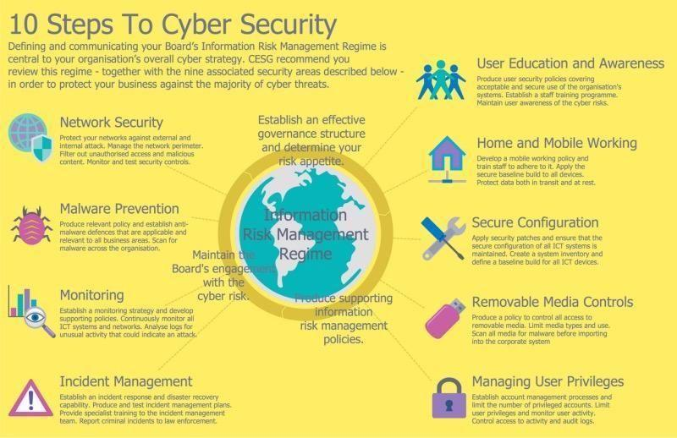
Notes:
This diagram identified the 10 steps to cybersecurity, but these are also considered targets/.

Slide 19
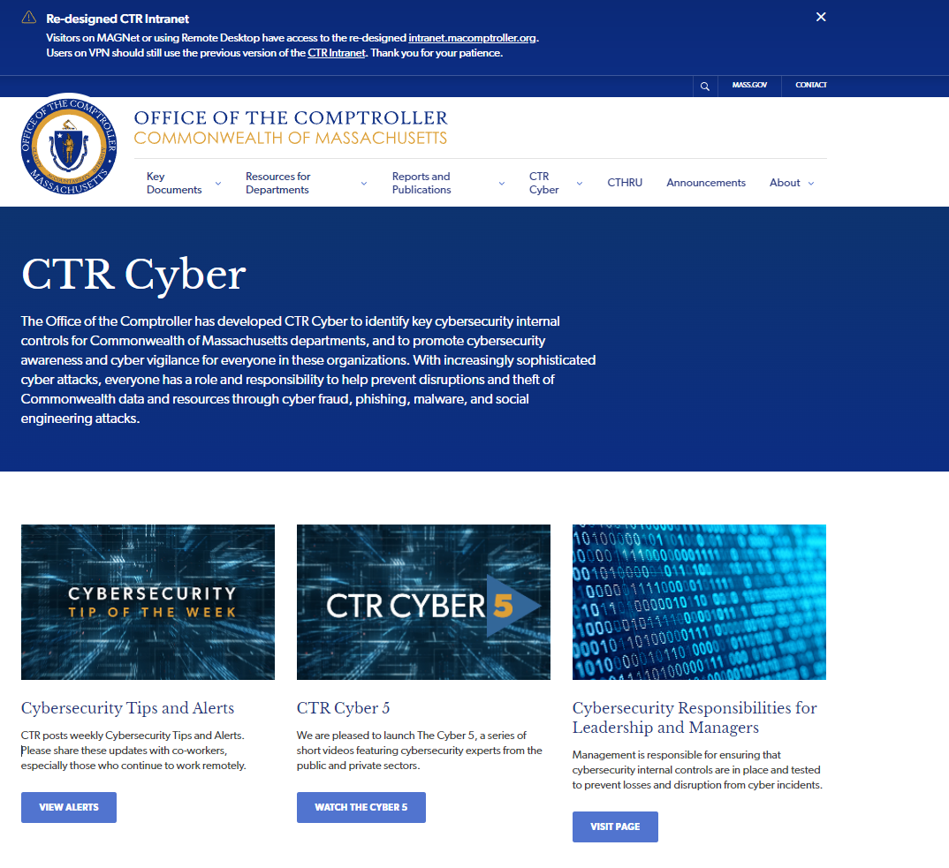
We’ve Got you!
https://www.macomptroller.org/ctr-cyber/
Designed for State Agencies and for any entity public entity looking for cyber internal controls

Slide 20
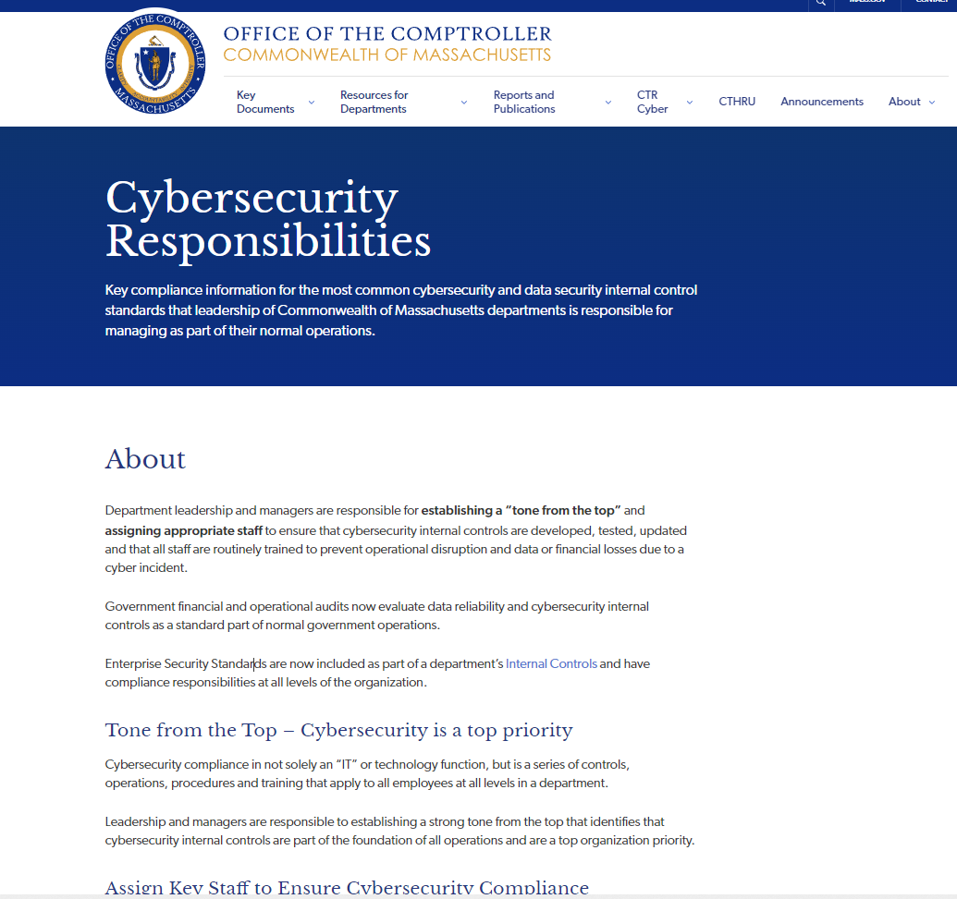
Cybersecurity Internal control Responsibilities

Slide 21
Cybersecurity Internal Controls
Tone from the Top – Cybersecurity is a top priority
  Cybersecurity compliance in not solely an “IT” or technology function, but is a series of controls, operations, procedures and training that apply to all employees at all levels in a department.
  Leadership and managers are responsible to establishing a strong tone from the top that identifies that cybersecurity internal controls are part of the foundation of all operations and are a top organization priority.

Slide 22
Assign Key Staff to Ensure
Cybersecurity Compliance
  As part of cybersecurity preparedness, leadership and managers must assign appropriate staff at all levels of the organization to ensure compliance with required cybersecurity and data protection internal Controls.
  Cybersecurity internal controls require collaboration across the organization including IT, HR, Legal, Policy, Fiscal, Budget, Payroll, Program and Operations staff and extend to any contractor or 3rd party supporting operations.

Slide 23
INTERNAL CONTROLS SHOULD INCLUDE:
Enterprise information security policies and standards (whichever apply to you)
Telework guidance and advisories (for remote and hybrid staff)
Ransomware preparedness and mitigation protocols
Compliance obligations for business and other entities handling personally identifiable information
Other unique data privacy standards
a. Credit card payment standards (if accepting credit cards)
b. Health care privacy (HIPPA) (health and medical records)
c. Protecting student privacy (FERPA)

Slide 24
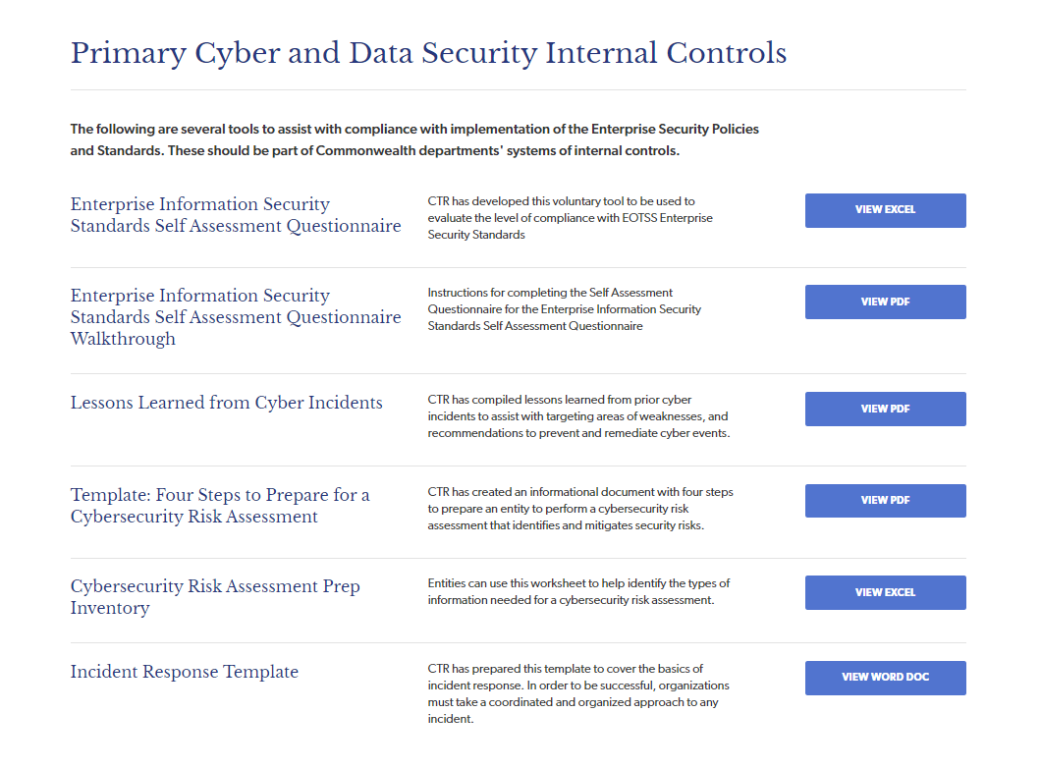
TOOLS TO HELP YOU!!
NEW
Lessons Learned
Risk Assessment
Incident Response

Slide 25
EOTSS Enterprise Information security policies and standards
Self Assessment Questionnaire (SAQ)
SAMPLE
EOTSS Standards are default Commonwealth information security internal controls for Executive Departments and Non-Executive Department that have not adopted a comparable standard. Developed from NIST and ISO.
Voluntary tool to assist with assessing compliance
Tool includes verbatim text of the standards
Tool can be used to identify level of completion of standards
Records % of completion with color codes (red, yellow, green)
Records location of documentation
Records periodic review of compliance (weekly, monthly, annually etc.)
Tool can be used to support budget requests for resources

Slide 26
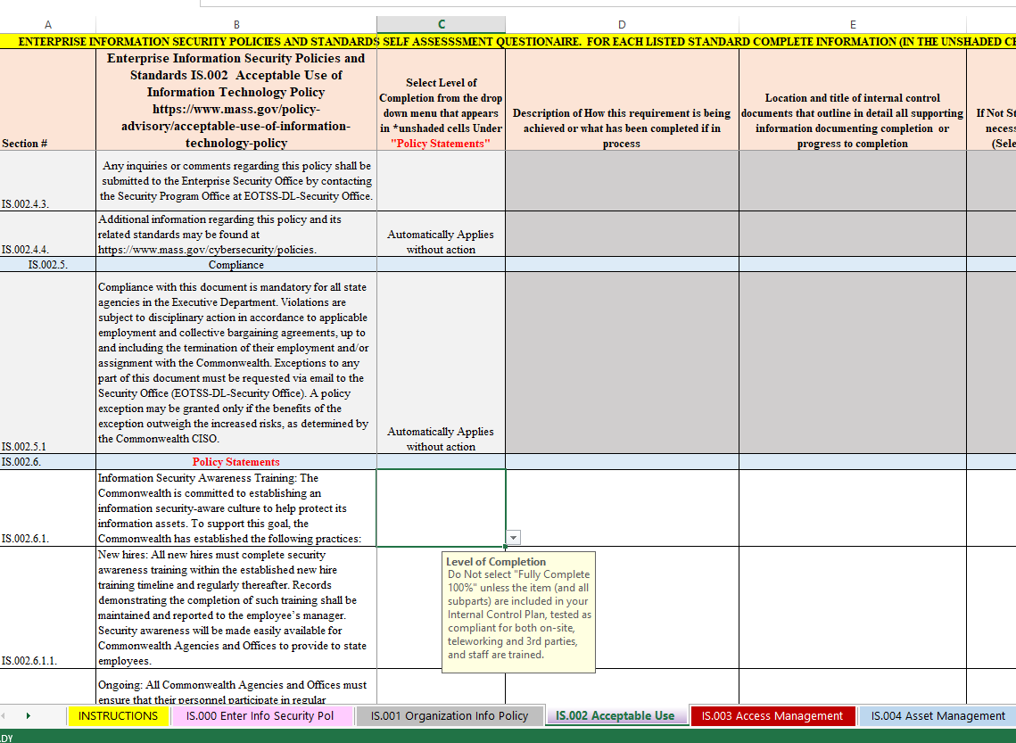
EOTSS Enterprise Information security policies and standards
Self Assessment Questionnaire (SAQ)

Slide 27
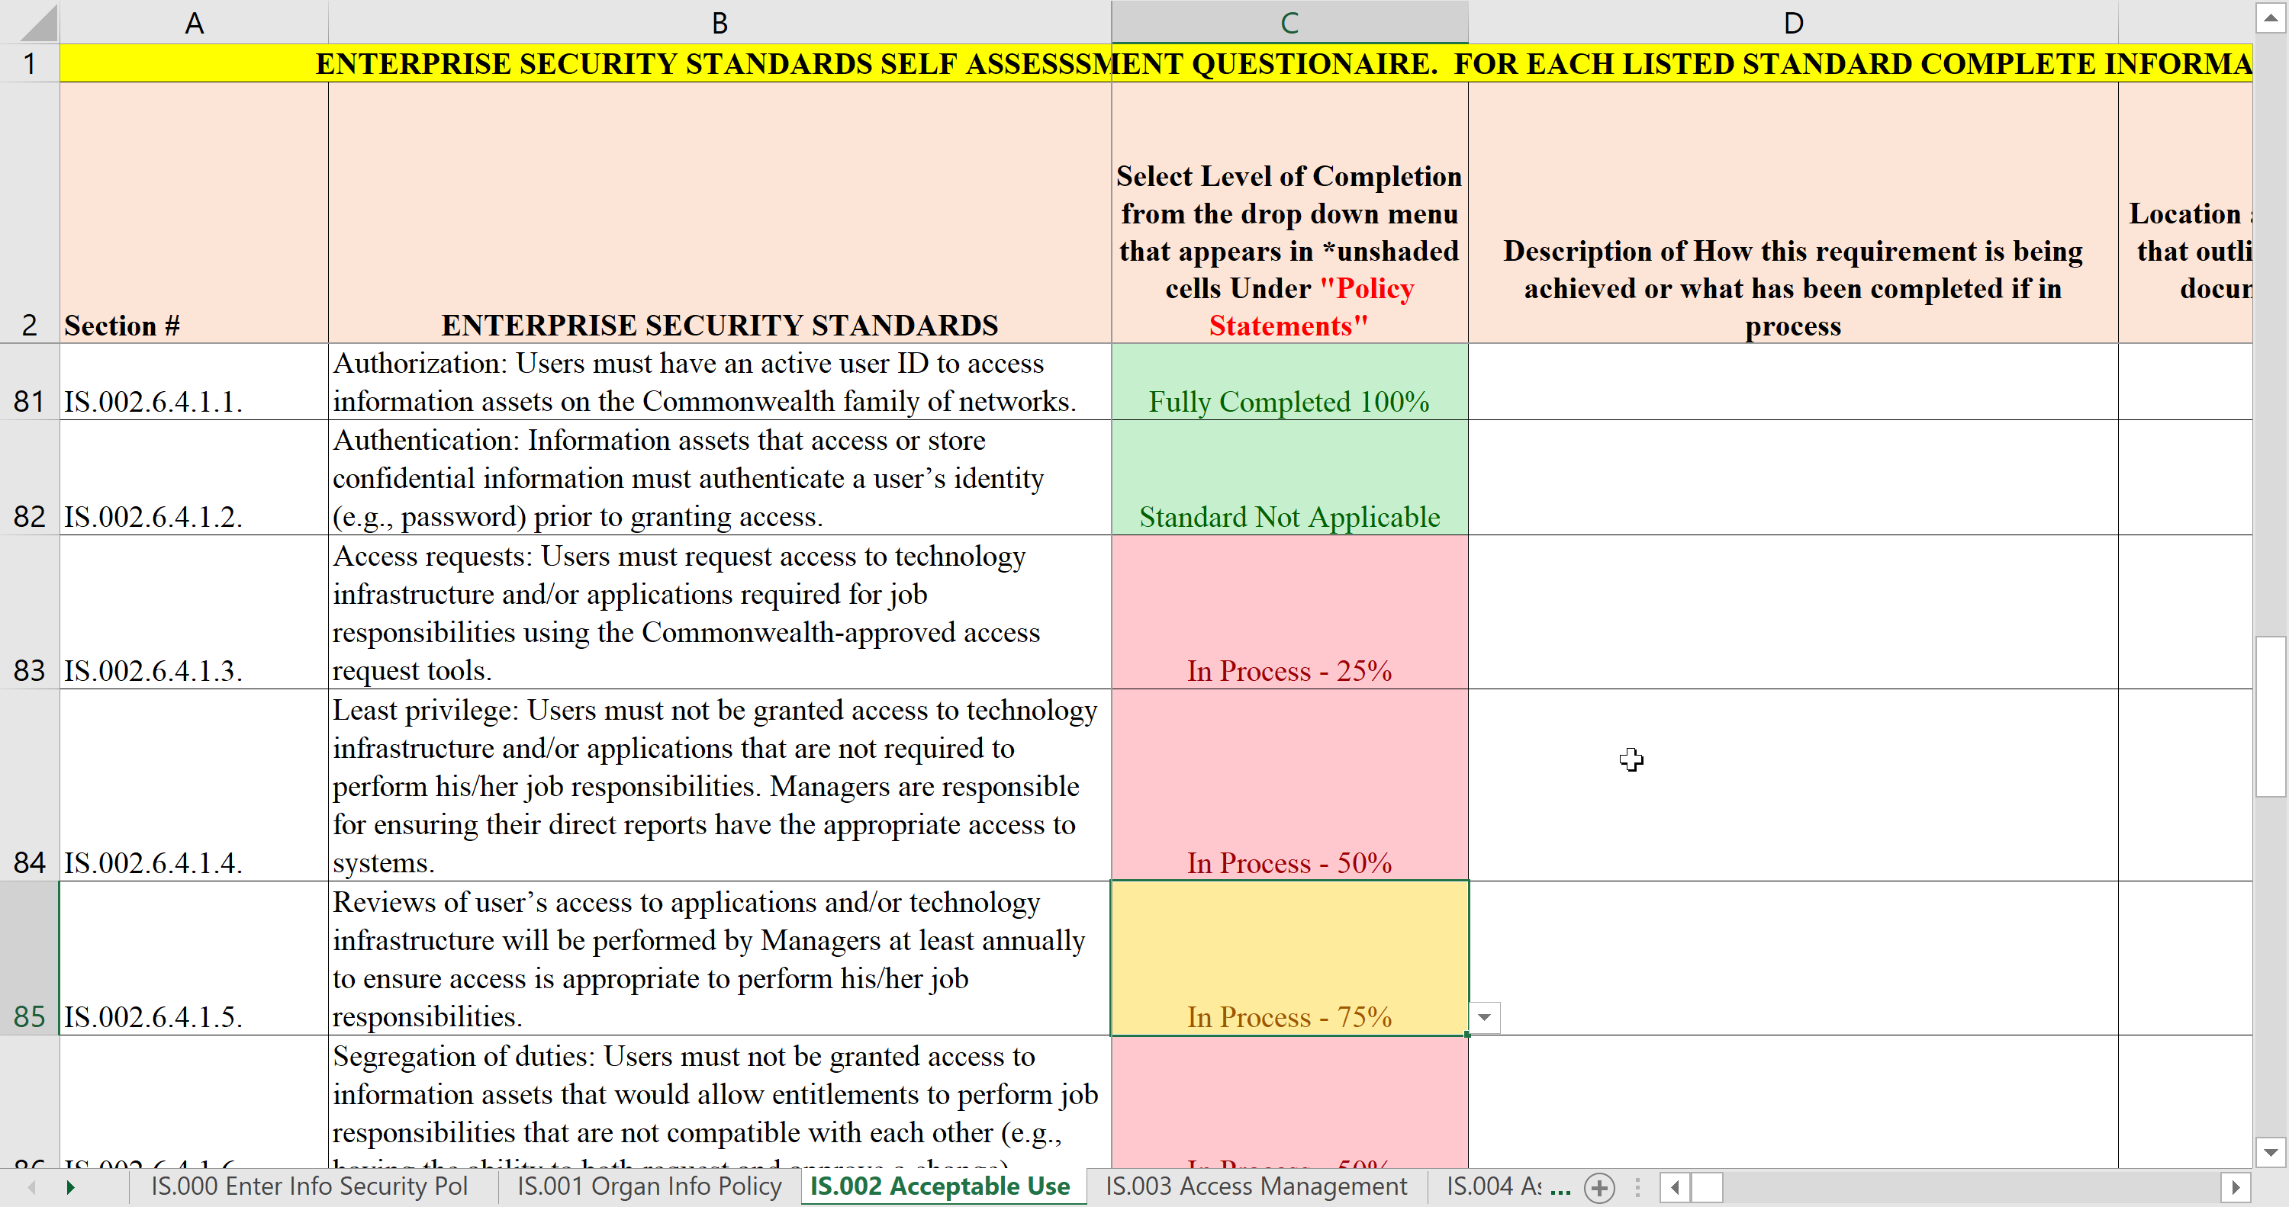
EOTSS Enterprise Information security policies and standards
Self Assessment Questionnaire (SAQ)

Slide 28

CISA Ransomware Self Assessment TOOL
https://www.cisa.gov/uscert/ncas/current-activity/2021/06/30/cisas-cset-tool-sets-sights-ransomware-threat
Self-assessment based on a tiered set of practices to help organizations better assess how well they are equipped to defend and recover from a ransomware incident.
Free tools are available to help you assess your vulnerabilities and what mitigation and preparation is necessary, and to support budgeting requests for resources
  (also supports due diligence efforts if you fall victim to an incident)

Slide 29
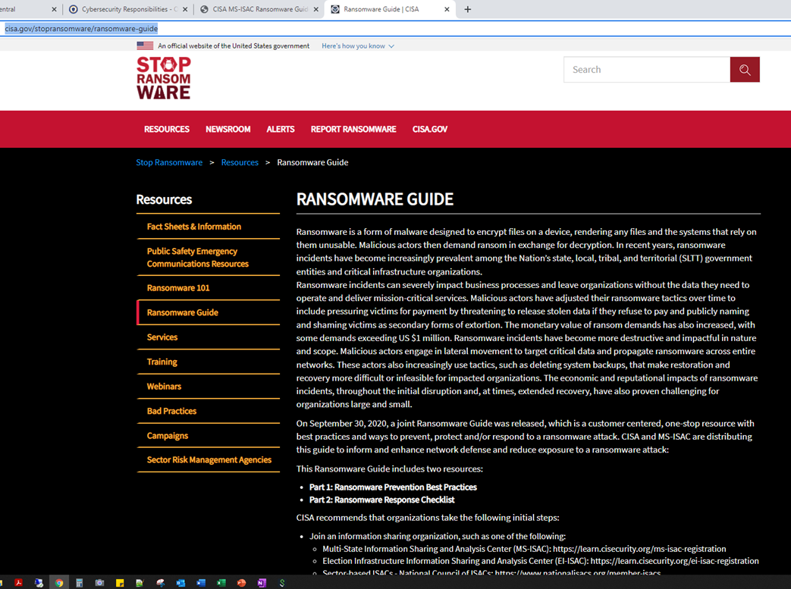
CISA Ransomware Guide https://www.cisa.gov/stopransomware/ransomware-guide

Slide 30
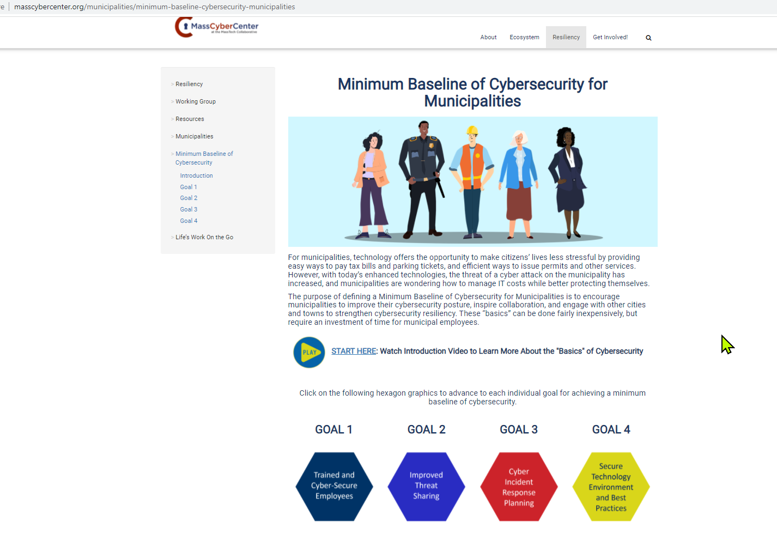
MassCyberCenter – Baseline for Municipalities
Find out if your Board is supported by a municipality for Cyber and Privacy

Slide 31
Data Security AND PRIVACY Overview
Data management and data systems
are the best first place to start.
Data Security is the protection of information and information systems from unauthorized access, use, disclosure, disruption, modification, or destruction in order to provide confidentiality, integrity, and availability.

Slide 32
DATA PRIVACY REQUIREMENTS
Most Common Government Data Privacy requirements:
  Data Subject Privacy M.G.L. c. 66A
  Personal Information – M.G.L. c. 93H (includes retirement accounts and retiree information)
  Credit Card Payments Standards (PCI Compliance)
  Health Care Privacy (HIPPA)
  Protecting Student Privacy (Family Educational Rights and Privacy Act)

Slide 33
DATA Lifecycle Management
Know WHAT data is being made or received
Know WHY that data is being made or received and do not collect PII or sensitive data unless required to do so
Know WHO (EVERYONE) has access to data, what data and WHY they have access to the data.
  Efficiency should be only ONE consideration
  Data privacy and security should be of equal or greater concern
  More access = More risk
Know WHERE the data resides, travels and is stored (map data from inception to wherever it travels until destruction)
Know HOW the data resides, travels and is stored and how the data is protected (encrypted, locked, masked)
Know RETENTION and DESTRUCTION schedules and ensure proper destruction of PII (M.G.L. c. 93I)

Slide 34
FOUR STEPS TO PREPARE FOR A CYBERSECURITY RISK ASSESSMENT
Entities deploy a wide array of information technology devices, systems, and applications across a wide geographic area.
While these physical assets can be labeled and tracked using bar codes and databases, understanding and controlling the cybersecurity resilience of those systems and applications is a much larger challenge.
Not being able to track the location and configuration of networked devices and software can leave an organization vulnerable to security threats that can cripple operations.

Slide 35
1. Inventory data security requirements
Inventory data security requirements of all statutes, standards, regulations, policies and procedures that apply to your entity related to the security, privacy and data retention and disposal of data collected, processed, transmitted and maintained by the entity.
Some standard data and security policies include acceptable use, access and asset management, business continuity, disaster recovery and incident response, network security, logging, and event monitoring, physical security, vulnerability and third-party requirements.
Determine what your data security standards are

Slide 36
2. Inventory all data
Inventory all data collected, created, processed, transmitted and maintained by the entity. Data Inventory should classify data based upon privacy and security requirements (personally identifiable information (PII), confidential, sensitive, security, public, etc.) and data retention and disposal requirements.
This inventory will be more effective if an entity identifies all the in-points of how the data is collected, who has access to the data, whether there are restrictions on access and the retention periods for the data (if applicable).

Slide 37
3. Inventory all equipment and infrastructure
Inventory all equipment and infrastructure for all mediums throughout the entity that manage the data identified in the Data Inventory.
Equipment and infrastructure includes all PCs, servers, hardware, software, operating systems, networks, third party applications, Wi-Fi, data repositories (directories, PST, network, cloud), cell, tablets, BYOD, cabling and wiring, switches, modems and any other medium that creates, collects, stores or transmits entity data.
Entities can start with their current asset inventories and then add security related details.

Slide 38
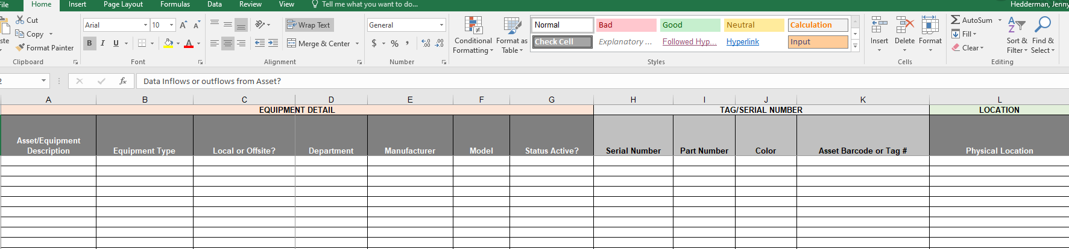
Sample Infrastructure Inventory

Slide 39
4. Create data maps or network diagrams
THIS IS YOUR CYBER PERIMETER!!!
Create data maps or network diagrams that show how the data identified in the Data Inventory flows throughout entity: data in-flows, data at rest, data archived, data in-transit and data outflows externally as listed in the Equipment and Infrastructure Inventory.
The network traffic diagrams should also identify all the physical and virtual security controls that are in place at each in-point, exit-point, perimeter, etc. for each asset in the inventory.
Physical and virtual security includes badge or key codes locks, alarms, security cameras, protections from physical damages (fire, water, electrical surges etc.), administrative access rights, segmentation, virus and malware protections, multi-factor authentication, logging and event monitoring, DMZ, firewalls, etc. used to protect data and assets from unauthorized access or physical damages.

Slide 40
But I don’t have Time!
Public Entities are expected to have security internal controls in place.
Duties can be supported by multiple staff and vendors
The inventories and data maps are critical for:
  Risk Assessments – needed to identify risks and mitigate
  Disaster Recovery, Business Continuity if an incident
  Audits – (you will be audited)
  Budget preparation
ITS78 Statewide Contractors are available to assist you to put protocols in place

Slide 41
3rd Party Vendors That handle
Know your vendors. Make sure you have validated that vendors have robust data management and security protocols and prove validation (ex. SOC1 SOC2 security evaluations or other security validation)
Have indemnification clauses in place in those contracts where the vendor pays the costs associated with breaches or attacks caused by their negligence
Remove vendor access immediately upon termination of a contract relationship. Require vendors certify destruction of all data that may have been held or processed by vendor
Have a plan to verify that vendors are following your cybersecurity policies and practices

Slide 42
3rd Party Vendors
(Holding your data or supporting your systems)
Know where your data travels or resides in “the cloud”. PII should not travel outside the continental US. It may cost more but breaches may trigger additional legal nightmares.
If you are using MSPs (Managed Services Providers) they should be following industry standard security protocols (min. EOTS standard or NIST). Must provide validation.
MSPs or any location of stored data must reside in two separate back up locations (preferably in two different regions – ex. Eastern, Midwestern)
Validate that MSPs can recover all data in accessible format and test. MSPs must ensure that secondary back up is protected incase primary back up location is hit with ransomware.

Slide 43
How to prioritize Disaster and Business continuity Prep
Identify Mandatory Operational Performance of critical functions:
  Essential Functions that must be completed? (Public safety, Payroll entry, revenue collection, management of funds, payments etc.)
  Essential infrastructure required for performance of critical functions?
    Include Dependencies on 3rd party infrastructure (3rd party vendors)?
      Backup if 3rd party infrastructure unavailable? Work- arounds, contingency plans?
    Dependencies on 3rd party staff related to functioning of critical infrastructure?
      Backups if assigned staff unavailable?
      Communication protocols to 3rd party related to infrastructure or operations to perform essential function

Slide 44
Disaster and Business continuity Prep
Assigned Key staff personnel to perform critical function (key, backup, 2ndary and 3rd backup)?
  Can function be performed remotely?
  What is needed for personnel to perform remotely? (Equipment, w-fi, phones, security?)
  Do assigned staff (internal, 3rd party vendor, department) have necessary tools security to perform functions remotely?
Communication protocols to perform essential function (Internal management, communication management to staff, assignments)

Slide 45
Disaster and Business continuity Prep
Communication protocols for external communications related to Department operational performance
Has disaster recovery functionality, contingency plan been tested or performed remotely in past 6 months?
If a network is compromised, do you have a mirror image of the network that can be stood up quickly?
Risks and Risk level if not performed timely or correctly?
Gap analysis: Remediation steps to perform disaster or business function properly.

Slide 46
Do you have 3-2-1 Backups?
Maintenance of offline, encrypted backups of data and critical systems (3) types of media, (2) separate locations
Have at least (1) copy of data that is offline or “air gapped” (not connected to the network or internet) because newer ransomware may have the capability to locate and infect all accessible backups.
Organizations should also maintain updated image templates of operating systems and software applications of critical systems in case these have to be rebuilt.
Test backups on a regular basis
Testing of backups should include review of the accessibility and integrity of data that is stored, and testing the strategy for rebuilding critical systems if compromised by ransomware

Slide 47
How to mitigate risk of RANSOMWARE ATTACK!!!
What happens if you get hit? Can you still operate? Can you meet regulatory and reporting obligations. If not, then you need to ensure you protect that data and systems.
  Daily backups and multiple locations that are not on the same network (3-2-1 backups).
  Having multiple, encrypted and segregated backups must be treated as a mandatory and normal operational requirement. It is not optional.
If your key databases are compromised, how will you switch over to business continuity to prevent interruption of services at every stage in your business process?
Where are the silos and single points of failure? Who do you depend upon to get your work done internally or externally?
  Lags in critical services, and payments, especially to vulnerable populations can’t wait days or weeks for resolution. Their lives literally depend upon continuity of services and payments.

Slide 48
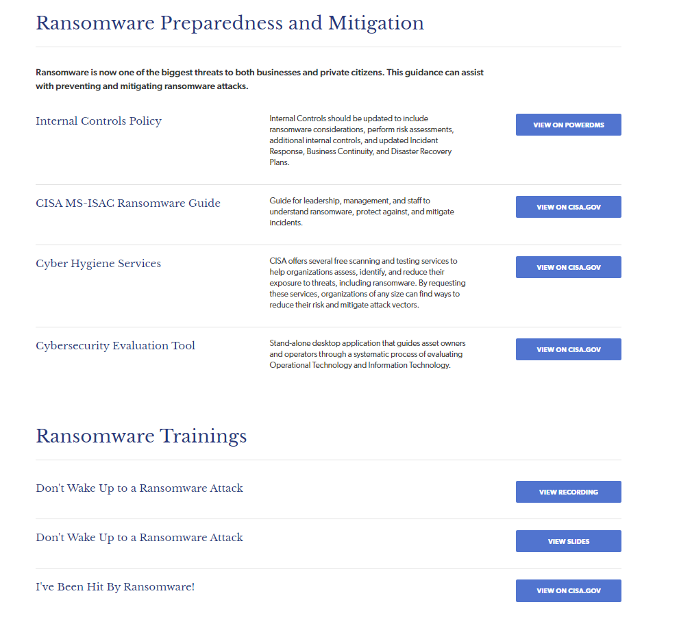
Ransomware tools
See CTR Cyber Center

Slide 49
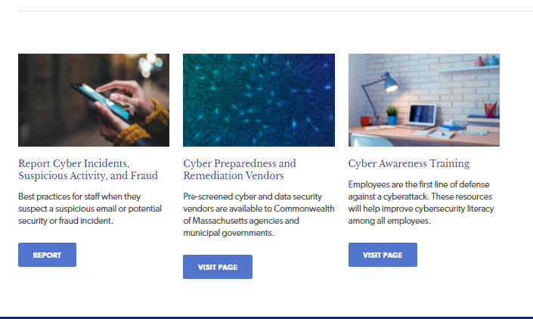
Cyber Statewide Contractors and Cyber Awareness Training

Slide 50
Employees NEED TRAINING and constant reminders!!!
Currently employees unknowing are triggering the most common cyber incidents:
  Clicking on malicious links
  Opening malicious attachments
  Enabling macros
  Changing bank accounts without validating that the user is legitimate
  Relying solely on electronic paperwork to make changes or payments
Cybercriminals are becoming increasingly sophisticated at targeting employees with schemes
  Attractive emails or links “you have won a prize”, “look at what your co-worker did this weekend!”, “Coronavirus death in your neighborhood!”

Slide 51
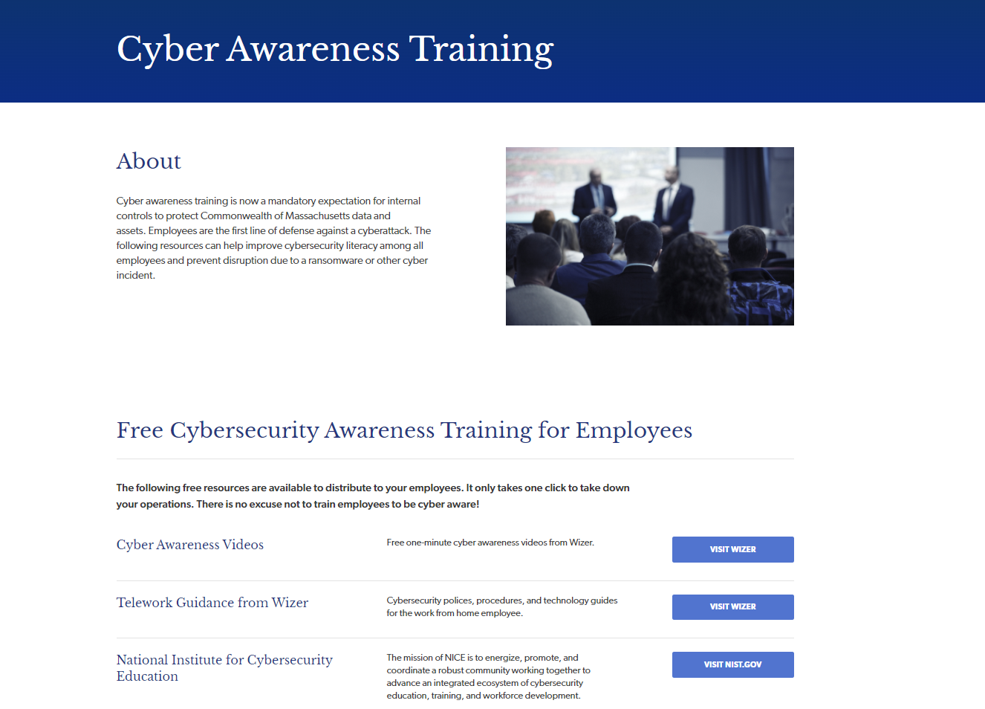
Cyber Awareness Training

Slide 52
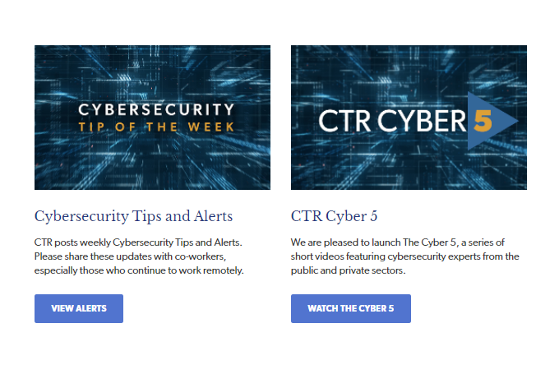
Cyber Tips and CTR Cyber 5

Slide 53
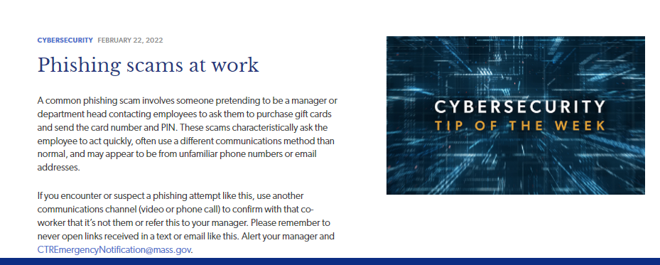
Current Tip of the Week
EXAMPLE

Slide 54
Train, REMIND, REMIND Again!
Cyber criminals RELY on the fact that it is difficult to train employees to keep them up to date with cyber crimes and tactics.
The two best concepts for employees to remember:
  1. Be professionally skeptical of all incoming requests (email, calls, texts)
  2. NOTIFY identified IT or other staff IMMEDIATELY if there is anything suspicious or unusual activity

Slide 55
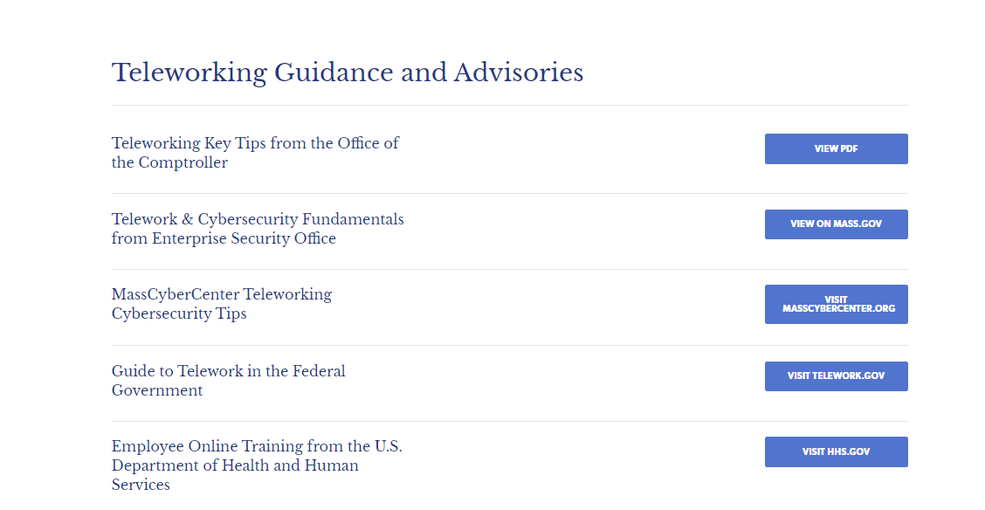
Teleworking Guidance

Slide 56
Be cautious WHEN TELEWORKING!
When teleworking, be cautious about unintentionally triggering a cyber incident that can crash your equipment, networks, applications or Enterprise Systems. Please take your time and verify before you click!!
  Do NOT click on links or attachments unless you know these are safe. Hover over links and virus check attachments first to be safe.
  Do NOT “enable macros” in documents (often malicious).
Practice “Professional Skepticism” and be suspicious of all incoming emails and phone calls
Cybercriminals are becoming increasingly sophisticated at targeting employees with schemes
  Do NOT open emails or click on links for “eye-catching” subjects like “you have won a prize”, “look at what your co-worker did!”, “Coronavirus death in your neighborhood!” Biggest scams going around now involve emails involving “coronavirus” or “COVID-19” so be careful!!
  Do NOT reply to or click on links in any email from providers asking you to “validate” your account, “there was an unauthorized login attempt” or “your account will be closed”. Providers will not ask you to validate through email, but will require you to log in to your account.

Slide 57
Professional Skepticism
Do NOT rely solely on electronic paperwork or phone calls when making employee/vendor/retiree bank account or address changes.
Always validate major changes separately with on-file contact information and independently contacting the requester to make sure they are legitimate.
  Cybercriminals are counting on you to respond quickly without validating or double checking identity.
  You must delay completing a request until you can separately validate and identify the legitimacy of a request and requester with information you have on file. Most fraud happens when “changes” to addresses and bank accounts are made from email requests or phone calls.
Fraudsters OFTEN pose as colleagues, contractors, bank officials or others that you already know, so be especially vigilant when a caller is friendly and acts as if they know you. Unless you are certain of their identity, validate first or check with your supervisor.

Slide 58
Never use free wi-fi, ever
Do NOT perform work business, banking or bill paying using your laptop, cell or mobile device on ‘free’ Wi‐Fi (ex. Airport Wi‐Fi, coffee house, trains while commuting)
  Employees performing business functions, especially transactions and banking should be using VPN on a secured network
Do NOT “plug in” your work devices or BYOD used for work to “free” USB charging portals or using free charging cables, which can be loaded with malware.
Never provide PII, business credentials, login or account information to gain access to ‘free’ Wi‐Fi or ANY application
Use unique “strong” passwords and don’t use same password on multiple applications
Make sure operating systems, virus and malware protections are up-to-date according to your Department security requirements

Slide 59
COVID-19 Cyber Threats
EXAMPLE
Pandemic Lessons Learned
Coronavirus Phishing Activity: Most organizations reported a mass flooding (600%) of COVID Phishing Email campaigns & Business Email Compromise – Stimulus Check Scams
Fake Websites & Infection Tracking Sites: Numerous fake & fraudulent domains and Website immediately stood up including fake infection tracking sites to instill fear.
Remote Access & Virtual Collaboration platforms being targeted: As agencies worked to increase VPN and remote collaboration tools malicious cyber actors worked to exploit misconfigurations or vulnerabilities. Zoom Bombing
Increase in Coronavirus-related Cyberattacks: Malware (COVIDLock, Emotet, AZORult, Qbot, Trickbot, FormBook, Nanocore RAT,Ransomware, DDOS, Malspam) and credential harvesting malware. Criminal to Nation-state Activity
Insider Threats: Primarily from the non-malicious insider who inadvertently exposed the agency to a breach or leaked agency credentials to malicious actors
      .
Notes:
Criminals target any event. Coronavirus-Themed Phishing Emails – Most organizations reported a mass flood of phishing related traffic and had to work quickly to make users aware and block links.
Fake Coronavirus related Websites and infection map tracking sites
Malicious / Fake COVID-19 related websites attempting to harvest user credentials
Increase in Coronavirus-related Cyberattacks included Ransomware and DDOS attacks
Cyberattacks directed at Healthcare organizations including publishing sensitive agency data

Slide 60
Tips for Spotting Fraud Emails
Appearance
Grammatical errors and/or misspellings
Low quality or disorganized graphics or logos
A generic greeting instead of your name
Only a link appearing in the body
Sender’s Identity
Sender’s name does not match email address.
Sender’s email domain does not match the company the party claims to represent.
Email domains read from right to left. @boston.gov is the email domain for the City of Boston. @boston.hackers.com is not.
Message/Tone
Phishing attempts will often involve demands and language requiring urgent action to get you to react.
Requests can include opening an attachment, clicking a link, or providing sensitive information.
Other Caveats
Be cautious of emails that warn that “your account will be closed” or “there was an unauthorized login attempt”.
Never reply to an email with your account information or password.
If an email includes a link that asks you to “click here to change your password” it may not be legitimate. Instead of clicking the link, open your browser and manually type in the address of the web site and see if it is valid
Inform your systems security officer of any suspicious activity
* (Source: Comm. Of Mass., EOTSS)
As hackers have become more sophisticated, their phishing emails have too and have started to look more professional. Be extra careful!!

Slide 61
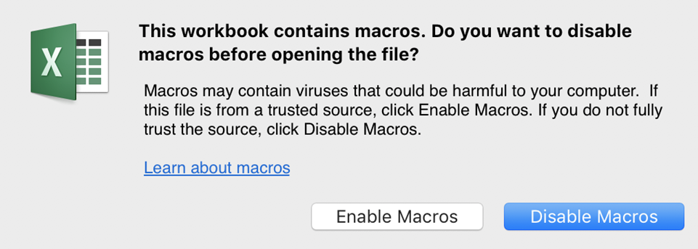


Do Not Open Attachments From Strangers – NO MACROS!
Microsoft phasing out macros

Slide 62
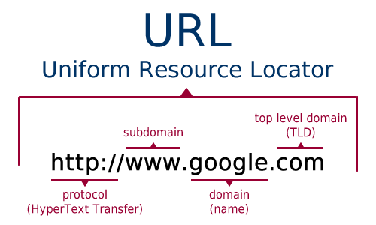
Uniform Resource Locator
Can you spot the red flag here????
Notes:
It should be https. If http, may be malicious.

Slide 63
Sample “SAFE” CAPECOD.EDU
Top Level Domain:
Primary Domain:
Sub Domain / Server Name:
Subdirectories:
(folders) within an organization

Slide 64
Example: Suspect CAPECOD.EDU Links
Don’t Click red blocks show false content
Top Level Domain?
Primary Domain?
Sub Domain / Server Name?
Numbers hide ownership?
Spelling errors?

Slide 65

Think About Who Is requester?
Good customer service does not require you to IMMEDIATELY respond but to respond to LEGITIMATE requests.
Do you readily recognize the sender’s email address?
Have you had any past business relationships or communications with this sender?
Is the email from someone outside your organization?
Is the sender’s email address from a suspicious domain?
Recent scams from DocuSign sending attachments and links for signature

Slide 66
Think About the DATE/TIME
Did the email arrive at an unusual time, outside of regular business hours (like 3am )?
  Often bots are sending these phishing emails out after hours.
Does the email seem out of sequence?
  For example, stating they are following up from another email or call you did not receive

Slide 67
Think About the SUBJECT LINE
Is the subject line irrelevant;
Look to see if the subject doesn’t match the message content or is even blank?
Is the email message a reply to something you never sent or requested?

Slide 68
IS the request urgent?
Scams often pressure the receiver to take immediate action
There may be a threat of disaster or time sensitive emergency
MOST issues are NOT emergencies, so PAUSE and VALIDATE that the sender is LEGITIMATE with information ON FILE or contact the sender by phone/zoom/facetime to validate the request and their identify (using an official phone number, not the one in the email.
Ask for official identification (driver’s license, passport, etc. to verify identify). Some departments are using a pin or passcode to verify identity that the vendor will receive through the normal process (contract, grant, procurement)
When in DOUBT, THROW IT OUT!

Slide 69

Think About ATTACHMENTS
Is the attachment:
Unexpected
Irrelevant to the email message
Not a file type I would expect from this sender
The most safe file is a .txt (text) file
Have all attachments scanned before opening??
How? Save to folder on desktop and scan the folder.
Or ask IT for proper protocol to scan attachments.
Even if email system scans through a spam filter like Proofpoint.

Slide 70
Think About HYPERLINKS
When you hover over link, does Hyperlink display a link-to address to different website?
Does the email contain only a hyperlink?
Watch out for images in email, bar codes and QR codes.
Does the hyperlink have a misspelling?
For example, to trick you.. www.bankofarnerica.com — the “m” is really two characters — “r” and “n”

Slide 71
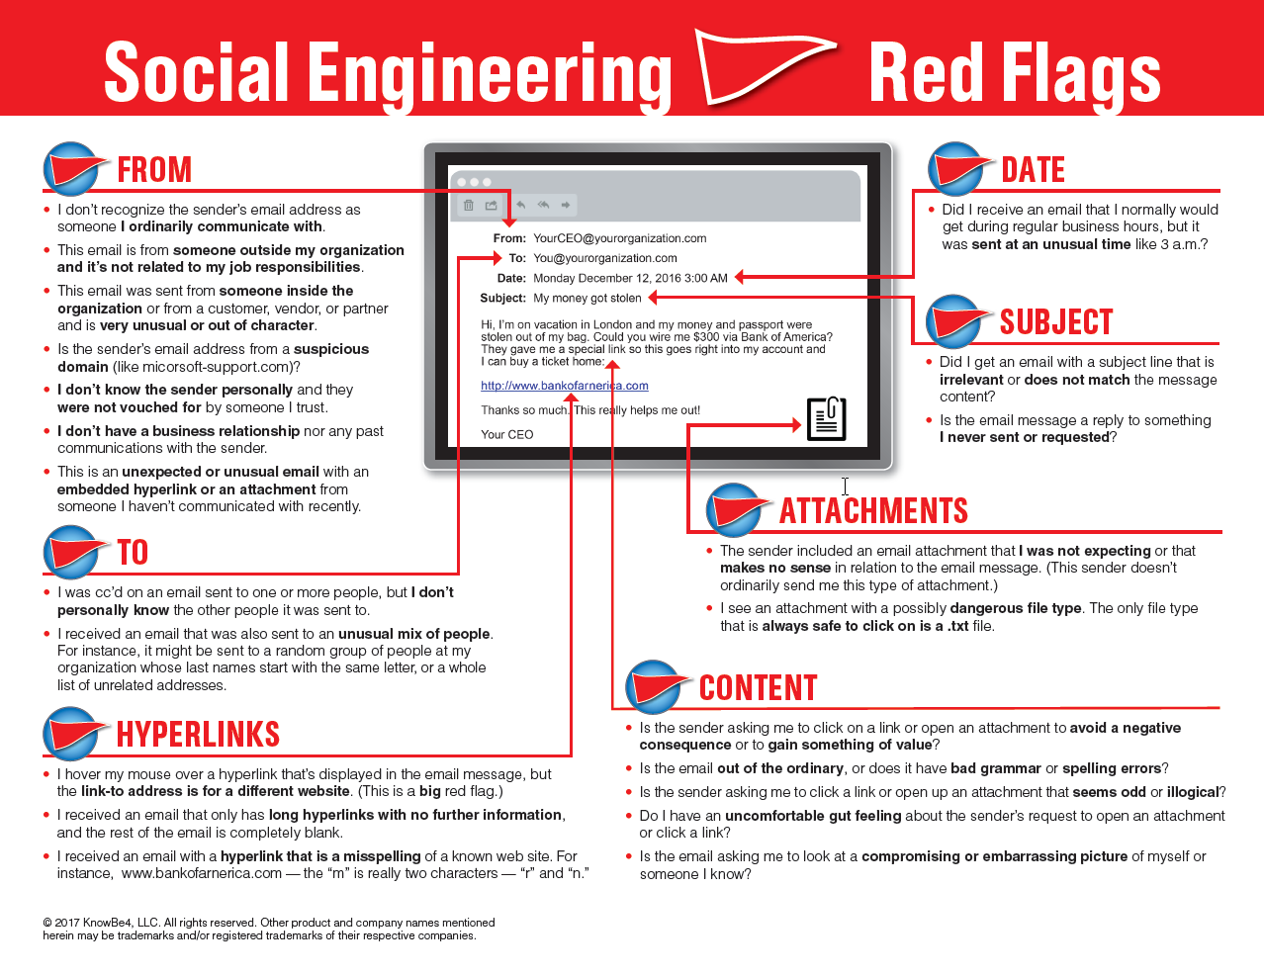
EMAIL Red Flags

Slide 72
LATEST Texting scams
Here are some examples of texting scams!!
Great job! You paid your ATT bill on time and we have a $25 credit waiting for you! Click here to claim it now!
Please call XYZ Financial immediately at 1-888-5000 regarding a recent restriction placed on your account. (Be wary of any text from a shortened phone number such as “5000.”)
Congratulations! You have just won a $500 gift card! Click here to claim your prize!
Your Orange ID account has been locked due to unauthorized login attempts. Please log in here to verify your account.
From Horizon Bank: We have detected some unusual account activity and ask that you immediately follow this review here
Check with your providers about how they communicate

Slide 73
CYBER AND FRAUD RISKS
Real Attempted Payroll Fraud Example
REQUESTER | PAYROLL STAFF RESPONSE
From: [employee name] me00101167300@gmail.com] Sent: Tuesday, August 31, 2021 11:24 AM To: [Payroll Staff] Subject: EXT: I would like to make a change Hello [Payroll Staff] Hope you are doing okay today? I just changed banks and I would like to make a change to my direct deposit information before the coming pay period. Please let me know if you are available to help me take care of that today ?and please forward the form so I can fill in the new information and scan back to you. Thank you, [Employee name] [Bureau] Department Sent from my iPhone | On Thu, Sep 2, 2021 at 9:32 PM [Payroll Staff] wrote: Hi [employee name] Sorry for my delay reply, I was out for a few days. Please find attached the direct deposit form. Thanks, [Payroll Staff]

Slide 74
CYBER AND FRAUD RISKS
Real Attempted Payroll Fraud Example
REQUESTER | PAYROLL STAFF RESPONSE
From: [employee name] message.me00101167300@gmail.com] Sent: Friday, September 03, 2021 11:38 AM To: [Payroll Staff] Subject: EXT: Re: EXT: I would like to make a change Hello [Payroll Staff], Thanks for your assistance. Here you go, My current account should be deleted and my entire net amount should go to this new account below. GoBank Routing #: ####03162 Account #: ####30506371 Account Type: Checking I also attached the voided check. I would like to override pre-note (Live Check) so the change can be effective for the current pay cycle. Kindly advise as soon as the change is made and also confirm the pay cycle that this change will occur. Thank you, [employee name] | On Mon, Sep 6, 2021 at 9:39 PM [Payroll Staff] > wrote: Hi [employee name], Your bank account info was updated. [Payroll Staff]

Slide 75
CYBER AND FRAUD RISKS
REQUESTER | PAYROLL STAFF RESPONSE
From: [Employee name] <message.me00101167300@gmail.com> Sent: Tuesday, September 7, 2021 3:21 PM To: [Payroll Staff] Subject: EXT: Re: EXT: Re: EXT: Re: EXT: I would like to make a change Thank you. Sent: Tuesday, September 7, 2021 12:08 PM To: [Payroll Staff] How are you doing today? Can you please confirm the pay cycle that the new account would be effective? On Tue, Sep 7, 2021 at 12:04 AM [employee name] <message.me00101167300@gmail.com> wrote: Hello [Payroll Staff], Thanks for the assistance. Can you please confirm the pay date that the change would be effective? | On Tue, Sep 7, 2021 at 8:11 PM [Payroll Staff] wrote: Hi [employee name] Sorry if I have not responded to you, I have been extremely busy. It should be effective for 09/17 paycheck. Thanks, [Payroll Staff]

Slide 76
RED FLAGS!!!
Fraudster was sophisticated!
  Familiar with payment process using normal verbiage for making a payroll change
  Acted friendly like they were the employee
  Email sent from “Gmail” account from iPhone and not official work email account (although work accounts can be spoofed)
  Banking information sent in email (and official attachment with cancelled fraudulent check)
  GoBank accounts are usually suspect to launder fraudulently stolen funds since these can not be recovered
  Multiple emails pressuring for response (note one sent at 12 am outside normal employee hours)
Payroll Staff – Multiple Staff made changes as simple transactions, w/o enough controls
  All activity done solely through email
  Relied solely on email and failed to perform any validation that requester was the actual employee
  Payroll staff responses demonstrate very busy so pressured to get requests done both before and after request
GOOD NEWS - CTR PAYROLL STAFF CAUGHT THIS BEFORE PAYROLL RAN BECAUSE WE CONFIRM ALL CHANGES!!!

Slide 77
PAYROLL/RETIREMENT FUNDS STAFF REMINDERS
Payroll data is one of the most sensitive data that a Department manages (includes retiree data and funds)
Payroll staff obligated to protect Personally Identifiable Data (PII) such as banking info under M.G.L. c. 93H
Payroll change requests by email can be hidden cyber phishing emails with malware or ransomware in attachments
THE BAD NEWS: Payroll fraud and theft results in significant harm (not an “oops”)
  Loss of employee funds (fiscal harm)
  Data Breach under M.G.L. c. 93H (fiscal harm for notices, credit reporting costs)
  Office (public reputational harm) and potential financial audit findings (federal findings if federal funds)
  Cyber breach or incident if attachments contain malware or ransomware and can halt Department or secretariat operations for weeks
  Significant personal and financial stress to employee
    Identify theft
    potential theft of all funds in bank account
    financial and personal stress of not being able to pay bills
    having to file police report
    Having to change bank accounts
    future financial and personal costs due to future theft attempts

Slide 78
INTERNAL CONTROL PROTECTIONS!!
Teach staff to practice “Professional Skepticism” and “ZERO TRUST” and be suspicious of all incoming requests for financial, bank account, direct deposit, personal information or other changes through emails and calls
Have written validation and processing procedures and checklists for staff to follow when entering new or updated personal, banking, address or financial changes
Staff who make changes to payments (bank accounts, addresses, moving from existing direct deposit to a check and new address) must validate that the request and the requester are legitimate through rigorous validation
Always VALIDATE major changes PERSONALLY with the requester with on-file contact information (NOT from email) to make sure these are legitimate before opening attachments.
Personally validating requests includes:
  in person, Zoom or Facetime (versus just a phone call) to “see” employee, validate official ID )drivers license) and record video call
  If you do not know the employee, or what they look like, they must produce and official ID for you to screen shot
Do NOT rely solely on electronic paperwork or phone calls when making employee payments, bank account or address changes

Slide 79
Thank You!

