Slide 1
Implementation Council
Building a Dashboard to monitor One Care and inform stakeholders

Slide 2
Objective
Learn about what other states are doing to monitor their Medicaid programs and inform stakeholders using data.
Review information that has been shared by MassHealth related to One Care
Develop action steps for proposing a transparent and easy to use dashboard in MA
Notes:
Recent report from Center for Health Care Strategies - Communicating Early Results of Integrated Care Efforts for Dually Eligible Individuals: State Approaches. http://www.chcs.org/media/INSIDE_Communicating_Results_Brief-1-22-16-3.pdf

Slide 3
“Demonstrating early achievements and positive beneficiary/provider experiences in new integrated care programs is essential to both maintain support from legislators, providers and advocacy groups and increase beneficiary enrollment.”
Center for Health Care Strategies from “Communicating Early Results of Integrated Care Efforts for Dually Eligible Individuals: State Approaches.”
Notes:
Recent report from Center for Health Care Strategies - Communicating Early Results of Integrated Care Efforts for Dually Eligible Individuals: State Approaches. http://www.chcs.org/media/INSIDE_Communicating_Results_Brief-1-22-16-3.pdf

Slide 4
Purpose and Use of Dashboards

Slide 5
What is a dashboard?
Easy to read program management tool
Snapshot of current status and historical trends for key performance indicators
Helps to identify potential operational issues
Informs stakeholders (consumers, providers, legislators) about the program

Slide 6
California’s Managed Care Dashboard
Source: http://www.dhcs.ca.gov/services/Documents/MMCD/March162016Release.pdf
Notes:
From CA website: The Managed Care Performance Dashboard (Dashboard) is a monitoring tool produced quarterly by MCQMD. The Dashboard contains comprehensive data on a variety of measures including enrollment, health care utilization, appeals and grievances, network adequacy and quality of care. Information contained in the Dashboard assists DHCS and its stakeholders in observing and understanding managed care plan (MCP) performance statewide, by plan model, and by MCP.

Slide 7
Minnesota Interactive Dashboard

Slide 8
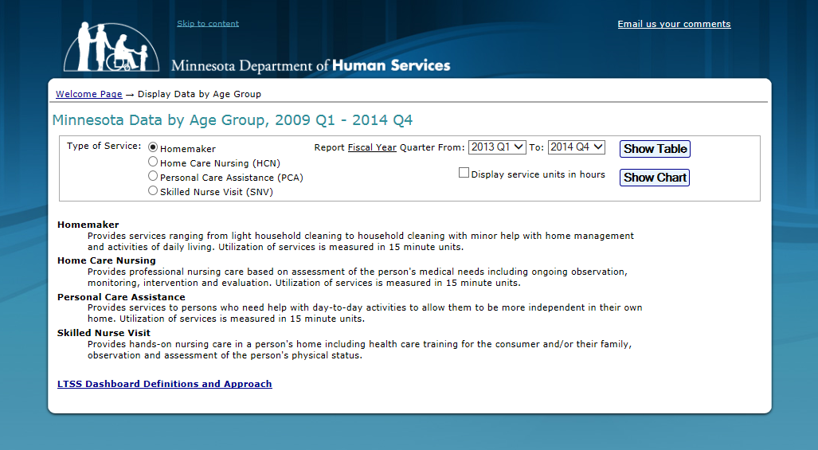
Minnesota LTSS Dashboard

Slide 9
Duals Demonstration Dashboards

Slide 10
What data has MA shared?
Assessment Completion Rates
IL-LTSS Coordinator data
One Care Ombudsman data
Monthly enrollment reports
Aggregate One Care plan financial data
Self-reported member data from Early Indicators Project Customer Service data

Slide 11
What data are other state’s sharing in dashboards for Duals Demonstrations?
Contract management information
Claims processing data [encounter data]
Call center feedback
Appeals and grievances activity
Health Risk Assessment and Plan of Care completion rates
Enrollment data

Slide 12
Action Steps
Create a short-term Subcommittee to:
Understand what MassHealth is collecting
Determine what other states are collecting
Propose dashboard for Massachusetts demonstration
Notes:
Other states like Texas, Virginia, Maryland and Oregon will be reviewed

