Slide 1

JVSG Standard Operating Procedures Training
Day 1: Introduction to JVSG
https://www.mass.gov/masshire-career-centers

Slide 2
Housekeeping
Keep
Please keep you lines muted
Use
You can use the chat, raise your hand or unmute your line to ask a question
Hold
Please hold questions until the end of the session to ensure we cover all content
Locate
The slide deck will be located on the JVSG Veterans Programs Resources page early next week
Introduce
Please introduce your self in the chat

Slide 3
Topics
JVSG Staff Positions and Functions
Veteran Status and Priority of Service
Eligible Veterans and Populations
Barriers to Employment
Review of the DD-214

Slide 4
Acronyms
DVOP: Disabled Veterans Outreach Program
LVER: Local Veterans Employment Representative
CODL: Consolidated DVOP/LVER staff
JVSG: Jobs for Veterans State Grant
VA: Veterans Affairs
VR&E: Veteran Readiness & Re-employment
POS: Priority of Service
POW: Prisoner of War
MIA: Missing in Action
TAP: Transitional Assistance Program

Slide 5
JVSG Staff Positions and Functions

Slide 6
JVSG Positions
Disabled Veterans Outreach Program (DVOP)
Provide individualized career services and facilitate placements to meet the employment needs of eligible Veterans and eligible persons.
Local Veterans Employment Representative (LVER)
Conduct targeted outreach to employers to assist Veterans in gaining employment
facilitate employment, training, and placement services for Veterans
Consolidated DVOP/LVER Staff (CODL)
Consolidated JVSG Staff positions perform the duties of both a DVOP specialist and an LVER. – MA does not have consolidated positions.

Slide 7
Hiring Preference
DVOP Specialist
a. First, qualified disabled Veterans, as defined by 38 U.S.C. 4211(3)
b. Second, qualified Veterans, as defined by 38 U.S.C. 101.
LVER/Consolidated
a. First, qualified service-connected disabled Veterans, as defined by 38 U.S.C. 4211(3).
b. Second, qualified eligible Veterans, as defined by 38 U.S.C. 4211(4)
c. Third, qualified eligible persons, as defined by 38 U.S.C. 4101.
Note: JVSG Staff positions may not be filled by contracted personnel

Slide 8
JVSG Staff
JVSG Program Coordinator Responsibilities:
the Ch. 31 VA VR&E program
Functional supervision over the Massachusetts State Veterans Employment Program
Disseminating state and federal policy; providing guidance to JVSG and career center staff related to serving Veterans
Federal guidance addressing DVOP and LVER roles and responsibilities; related items: Priority of Service, licensure and certification, or other Veteran related policy
Manager for JVSG staff assigned to MassHire Career Centers: Boston, Brockton, Hampden County, and Metro North
scheduling training for DVOP and LVER staff at the National Veterans Training Institute (NVTI)
drafting Veterans’ policy
JVSG central point of contact
provide technical training on the JVSG Program to all MassHire Career Center Operations Managers/Career Center Directors
Veterans Caseload Data Analysis Sheet (VCDAS) form
Submission of required reports:
Technical Performance Narrative
Quarterly Manager Reports on Services to Veterans,
VR&E Quarterly Tracking Report

Slide 9
JVSG Staff
Disabled Veterans Outreach Program Specialist (DVOP)
provides intensive services, facilitates placements to meet the employment needs of Veterans, prioritizing service to special disabled Veterans, other disabled Veterans, and other categories of Veterans in accordance with priorities and determined by the Federal Secretary of Labor.
DVOP specialists are required to:
Carry out individualized career services and facilitate placements to meet the employment needs of eligible populations.
According to 38 U.S.C. § 4103A(a), deliver those services to eligible Veterans in the
Following priority order:
First: to special disabled Veterans;
Second: to other disabled Veterans;
Third: to other eligible Veterans in accordance with priorities determined by the Secretary.
Place maximum emphasis on assisting eligible populations who are economically or educationally disadvantaged.

Slide 10
JVSG Staff
Local Veterans Employment Representative (LVER) inform employers, employer associations, and business groups of the advantages of hiring Veterans.
Integrated into the MassHire business service delivery system.
Active members of the local area business service teams
Integral part of the MassHire workforce system; will work with other service providers to promote Veterans and additional populations as job seekers with highly marketable skills and capabilities
Coordinators for WIOA and Veteran services within the MassHire workforce delivery system, working with Veteran job seekers, service providers, and employers to assist Veterans in career realization

Slide 11
Veteran Status and Priority of Service

Slide 12
Veteran Status
Veteran status:
A person as defined in Title 38 U.S.C. §4211 who:
Served on active duty for a period of more than 180 days and was discharged or released there from with other than a dishonorable discharge: or
Was discharged or released from active duty because of a service-connected disability; or
As a member of a reserve component under an order to active duty pursuant to section 12301(a) (d) or (g), 12302, or 12304 of Title 10, served on active duty during a period of war or in a campaign or expedition for which a campaign badge is authorized and was discharged or released from such duty with other than a dishonorable discharge; or
Was discharged or released from active duty by reason of a sole survivorship discharge (as that term is defined in (§1174(i) of Title 10).
Note: Veteran categories are defined in the definitions section of the SOP

Slide 13

Priority of Service
Priority of Service regulations refers to: Veterans and spouses who are eligible for priority of service as “covered persons” and refer to those not eligible for priority of service as “non-covered persons”
NOTE: in applying POS to daily MSCC Operations, Veteran status is determined via “self-attestation” (self-identification), and the covered person is not required to provide any proof of status or documentation.
Proof “may” only be required for enrollment into certain programs or training
Massachusetts Priority of Service (Mass Workforce Issuance 100 DCS 15.100.1

Slide 14
Priority of Service
38 U.S.C. 101(2). Under this definition, the term “Veteran” means a person who served at least one day in the active military, naval, or air services, and who was discharged or released under conditions other than dishonorable.
of “active service” does not include full-time duty performed strictly for training purposes (i.e., that which often is referred to as “weekend” or “annual” training), nor does it include Full-time active duty performed by National Guard personnel who are mobilized by State rather than Federal authorities (State Mobilizations usually occur in response to events such as natural disasters).
“Eligible spouse” as defined at section 2(a) of the JVA (38 U.S.C. 4215[a]) means the spouse of any of the following:
  Any Veteran who died of a service-connected disability
  Any member of the Armed Forces serving on active duty who, at the time of application for POS is listed in one or more of the following categories and has been so listed for a total of more than 90 days:
      Missing in action; or ii.
      Captured in the line of duty by a hostile force;
      Forcibly detained or interned in the line of duty by a foreign government or power
  c) Any Veteran who died while a disability was in existence. A spouse whose eligibility is derived from a living Veteran or service member (i.e., categories b. or c. above) would lose his or her eligibility if the Veteran or service member were to lose the status that is the basis for the eligibility (e.g., if a Veteran with a total service- connected disability were to receive a revised disability rating at a lower level). Similarly, for a spouse whose eligibility is derived from a living Veteran or service member, that eligibility would be lost upon divorce from the Veteran or service member.
  d) Any Veteran who has a total disability resulting from a service-connected disability, as evaluated by the Department of Veteran Affairs.

Slide 15
Eligible Veterans and Populations

Slide 16
Eligible Populations
DVOPs are limited to serve only Eligible Veterans and Eligible person Populations:
  Must be interested in receiving Individualized Career Services:
    If answer is NO: Stop Don’t go any further
    If answer is YES: Continue going with questions
  Must meet one of two criteria:
    Eligible Veteran or Eligible Veteran with Qualifying Barriers
    Additional Eligible populations Authorized by Annual Appropriations Act

Slide 17
JVSG Eligible Veterans
38 U.S.C. § 4211(4) Eligible Veteran is a person who meets the following Criteria:
Active-Duty Service
180 days or more for other than initial training
Discharge status with other than Dishonorable Discharge
Barrier to Employment
Discharged or released from Active-Duty due to service-connected disability or other employment barrier

Slide 18
Eligible Veterans
Reserve component
Member of the Reserve component called to active-duty under Title 10 orders
Served on Active-duty during a period of war or in a campaign/expedition for which a campaign badge is authorized
Discharged or released with other than dishonorable discharge
Sole Survivorship
Discharged or released from Active-Duty to a sole survivorship discharge

Slide 19
Eligible Persons
38 U.S.C § 4101 (5) Spouse who meets one or more of the following criteria:
  Spouse of a deceased service member
  The Spouse of a person who dies because of a service-connected disability
  Spouse of a missing (MIA), captured (POW), or detained service member
  Spouse of an Active-Duty service member that is currently listed for 90 days as MIA, Captured in the line of duty, or forcibly detained by a foreign government

Slide 20
Additional Populations
Authorized by Annual Appropriations Act
  Transitioning Service Members – currently participating in TAP
  Wounded, ill or injured service members receiving treatment at military facilities or Warrior Transition Units
  Spouses or caregivers of wounded, ill or injured service members receiving care in military facilities or Warrior Transition Units

Slide 21

Employment Barriers
Disability
  Special Disability
    30% or more rated by the VA
    10 to 20% with serious employment handicap
    Discharged due to a service-connected disability
  Disabled
    Receives disability compensation from the VA (or would receive except for military retired pay)
    Discharge due to a service-connected disability
    Other disabled
    Self-identified disabled per ADA definitions (42 USC § 12102)

Slide 22
Other Barriers
Other Barriers to employment
  Vietnam Era Veterans
  Recently Separated within the last 3 years
  Referred over by the VA for employment services
  Homeless or risk of being homeless
  Justice involved
  Educationally disadvantaged: lack of High School or equivalent
  Economically disadvantaged
    Meets WIOA Low income
    Unemployed
    Heads a single-parent household with dependents

Slide 23
Participant Eligibility and Privacy Guidelines
MassHire Career Center staff must respect privacy while verifying eligibility:
Accept verbal, written, or electronic confirmation of eligibility Cleary explain that:
Information is used solely for determining eligibility and prioritization
Participation is voluntary and refusal to provide information has no negative consequences
Guarantee confidentiality and legal compliance in information handling

Slide 24

MOSES Documentation
Eligible Veteran, or Eligible Person status and Qualifying Employment Barriers must be documented in MOSES. Eligibility barriers must be checked off in the barriers tab.
There should also be a note in the “barriers” tab as to how it will be addressed.

Slide 25
Review of the DD-214

Slide 26
DD-214
DD-214 is the primary and sole document to properly determine Veteran Status
DVOP or LVER should be solely responsible to make DD-214 verification entries in MOSES
In the event of an absent DVOP/LVER; Operations Managers/Career Center Directors/other designated staff can verify
Should further questions arise the JVSG Program Coordinator can assist in determining eligibility
For JVSG eligibility: a copy of the DD-214 DOES NOT need to be collected, however a note MUST be added to MOSES upon verification, and DD-214 box is checked under the military tab, the rest of the military information must be completed, to include HVRP Grant (if applicable)

Slide 27
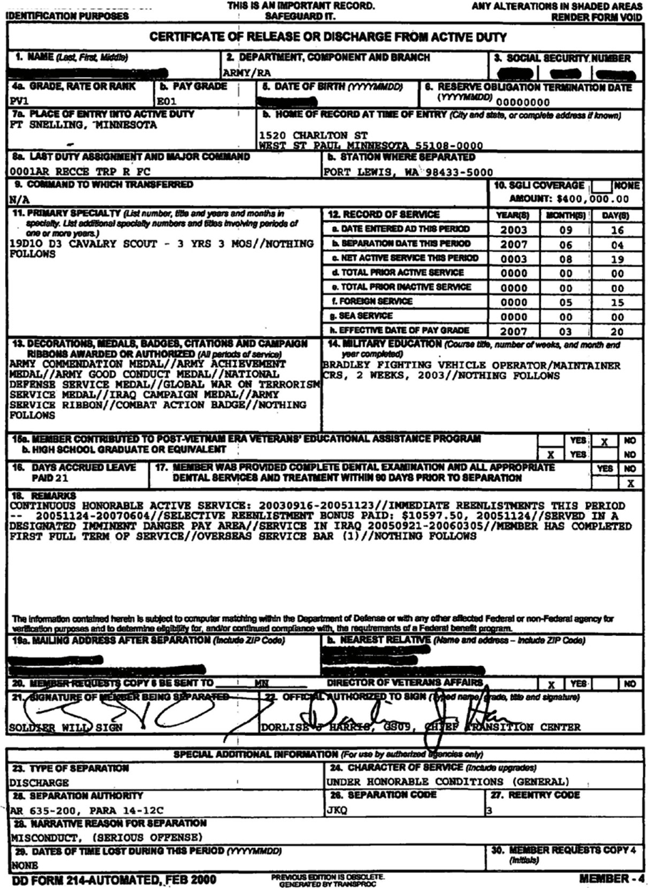
Reading the DD-214
  Personal Information
  Time in Service, Grade, Active Duty, Job Title
  Awards and Military Education
  Additional Remarks/Awards
  Discharge status/Type of Discharge

Slide 28
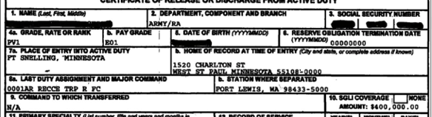
DD-214 Personal Information
Name Last, First Middle | 2) Military Component and Branch | 3) Social Security number | 4a) Grade, Rate or Rank
4b)Pay Grade | 5) Date of Birth | 6) Reserve Obligation (yyyymmdd) | 7a) Place of entry into Active Duty
7b) Home of Record at Entry | 8a) Last Duty assignment/Major Command | 8b) Station where Departed | 9) Command to which Transferred

Slide 29
DD-214 Time in Service
11) Primary Military Occupational Skill (MOS) Years/months in MOS | 12) Record of Service (total time on active duty)
13) Awards and Decorations | 14) Military Education Courses

Slide 30
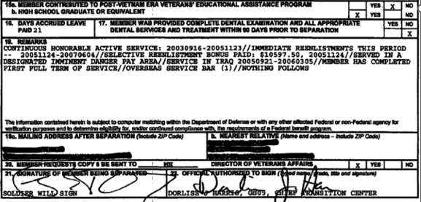
Reading the DD-214
15a) GI Bill contributions | 15b) High school graduate/equivalent | 16) Days of Leave Paid
17) Dental exam prior to separation | 18) Remarks/addition awards/Special pay | 19a) Mailing address after separation
19b) Nearest relative | 20) Copy of DD-214 sent to State | 21) Signature of Service Member
22) Signature of Official

Slide 31
DD-214 Character of Discharge
23) Type of Separation | 24) Character of Service
25) Separation Authority | 26) Separation Code
27) Reentry Code | 28) Narrative Reason for Separation
29) Dates of Time lost during this period (yyyymmdd) | 30) Member request Copy 4 (initials)

Slide 32
References
Federal Guidance
38 USC Chapter 41 and Chapter 42
Veterans Program Letter 05-24: Jobs for Veterans State Grants Staff Roles and Responsibilities and Coordination with the Workforce Innovation and Opportunities Act Services to Veterans
TEGL 03-24:Jobs for Veterans’ State Grants (JVSG) Program Reforms and Roles and Responsibilities of American Job Center (AJC) Staff Serving Veteran
Standard Operating Procedures: MWI Issuance 100 DCS 15.105.1 Issued 7/2/2025

Slide 33


