Slide 1

JVSG Standard Operating Procedures Training
Day 2: MassHire Career Centers' Role in the JVSG program
https://www.mass.gov/masshire-career-centers

Slide 2
Housekeeping
Keep
Please keep you lines muted
Use
You can use the chat, raise your hand or unmute your line to ask a question
Hold
Please hold questions until the end of the session to ensure we cover all content
Locate
The slide deck will be located on the JVSG Veterans Programs Resources page early next week.
Introduce
Please introduce your self in the chat

Slide 3
Topics
Career Center Roles and Responsibilities in Serving Veterans
JVSG Eligbility Screening and Referrals
Comprehensive Assessment
Caseload Management
Outreach
Data Validation
Required Reports

Slide 4
Acronyms
EEO: Equal Employment Opportunities
CCS: Career Center Seminar
POS: Priority of Service
HFVVWF: Homeless Female Veterans and Veterans with Families Program
IVTP: Incarcreated Veterans Transition Program

Slide 5
Career Center Roles and Responsibilities in Serving Veterans

Slide 6

Career Center Responsibilities in Serving Veterans
MassHire Career Centers play a key role in helping Veterans successfully transition to employment:
  Implementation of POS for the whole Career Center
  Establishing goals in collaboration with the Workforce Boards for serving Veterans customers, accurately reporting Veterans served
  Career Center Staff training to identify Veteran customers and implement POS as required by federal law

Slide 7
Operations Manager/Non-State Managers
Career Centers are implementing POS for all identify Veterans or Eligible persons or Additional populations
Providing supervision/oversight of program regarding daily Career Center operations of MDCS staff and DVOPs with regards to eligible veterans
Monitoring and tracking DVOP outreach and efforts
Tracking veterans that are determined eligible for the JVSG program, those not eligible and working with non-JVSG staff
Designate staff to determine JVSG eligibility

Slide 8

Operations Managers/Non-State Managers
Monthly review meetings between DVOPs/Ops Managers for caseload review, veteran case management, and that data entry follow MOSES and Program eligibility
Review case plans prior to closure
DVOP staff should participate in local area Staff meetings
Review Veteran service career center activity reports

Slide 9
Functional Supervision
Please reference MWI: 100 DCS 08.110: Functional Guidance by Non-State Management / Supervisory Personnel of DCS Employees Assigned to MCC’s on non-state managers responsibilities.
Functional Service areas
Distinct Service categories to support job seekers and businesses
Include: Career counseling, job search assistance, education and training programs, and employer recruitments
POS applies to all Functional Service areas funded by Department of Labor

Slide 10
Front Desk/Point of Entry
All customers entering Career Center should be asked if they served in the US Military or are a spouse of a Veteran
  Self-identified Veterans should receive POS
  Veteran customers must be screened prior to working with DVOP
  DVOP must redirect any Veteran not screened for Eligibility to non-JVSG Staff for screening
  Any Veteran interested in receiving individualized services must be screened by non-JVSG staff
  Non-JVSG staff must enter in initial assessment service and note into MOSES
    Not eligible/refuses individualized services, will be referred to Career Center employment services
    Determination and willingness to receive services will be referred to DVOP, DVOP will enroll in case management and conduct comprehensive assessment

Slide 11
Career Center Seminar
Veterans are not exempt from attending CCS
  All jobseekers are required to create profile on JobQuest
  Veterans will not be turned away for not completing CCS requirement, but must complete JVSG eligibility by non-JVSG Staff
    If not eligible, Veteran will be served by Career Center Staff
  On Demand CCS via JobQuest may be used to fulfill CCS requirement
  If Veteran returns within one calendar year, they do not need attend a CCS, however, is they exit the JVSG program, they must redetermined eligible for services.
  If Veteran returns outside of one calendar year, they will need to attend the CCS and eligibility for JVSG services, prior to working with DVOP

Slide 12
Career Center Seminar
Veterans are not exempt from being on time for CCS
  Veterans cannot be denied services if unable to complete the CCS requirement
  Veterans who self-identify during CCS, should be triaged first, in accordance with POS
    Determine eligible for JVSG and initial assessment service and note added to MOSES
    If determine ineligible, should be referred to Career Center Counselor, with service for Initial assessment and a note for does not qualify for JVSG services
    If Veteran declines services, under the Administrative tab in MOSES, DVOP/LVER services were offered but declined by Veteran should be selected along with a note and date of service

Slide 13

EEO Policy
EEO policy should be reviewed during the CCS
  DVOPs will review EEO policy with Veterans on their case load
  The EEO policy for MassHire should be discussed and documented with all Veterans working with DVOP staff
  EEO service and note will be added in MOSES
  The EEO policy must be reviewed by DVOP with Veterans on their caseload every year. This includes Veterans with or without breaks in services from the DVOP.

Slide 14
Career Center Staff role in JVSG
MassHire Services to Veterans
Referrals of non-eligible/non-interested Veterans should be referred to other programs as appropriate
Screening/Referral of Customers
Confirm customer interest in receiving one or more individualized career service before DVOP referral
Veteran customers not interested, should not be referred to DVOP
Ascertain customer’s eligibility
The JVSG eligibility screening tool must be used prior to referral to DVOP

Slide 15
JVSG Eligibility Screening and Referrals

Slide 16
Screening and Referrals through MassHire JobQuest
Veterans must create an account on JobQuest
  Indicate interest in receiving individualized career services.
  Self-attest by entering data into MJQ of status, covered person, or participating in VR&E.
  If eligibility is met, and interest in services, referral will be made to DVOP.
  Crystal Report is generated by MJQ and run by the ISC, referrals to closest DVOP will be made with Operations/Career Center Manager copied on email.
  JVSG Program Coordinator/Ops/Career Center Manager will monitor caseloads of DVOPs to ensure DVOPs are not overloaded, and quality services are being provided.

Slide 17
DVOP Unavailable
Reasons why a DVOP may be unavailable:
  Full caseload, absence, or other commitments
    Not present (either physically or virtually) or engaged in meetings at the time of referral
    When a DVOP is unavailable:
  MassHire Career Center staff may provide appropriate services and referrals to meet the needs of the individual and POS
  Schedule an appointment for the Veteran customer to meet with the DVOP
  The Veteran may decide to see the DVOP later, while participating in other programs offered by the Career Center, or, due to a full caseload DVOP may be unable to serve Veteran

Slide 18
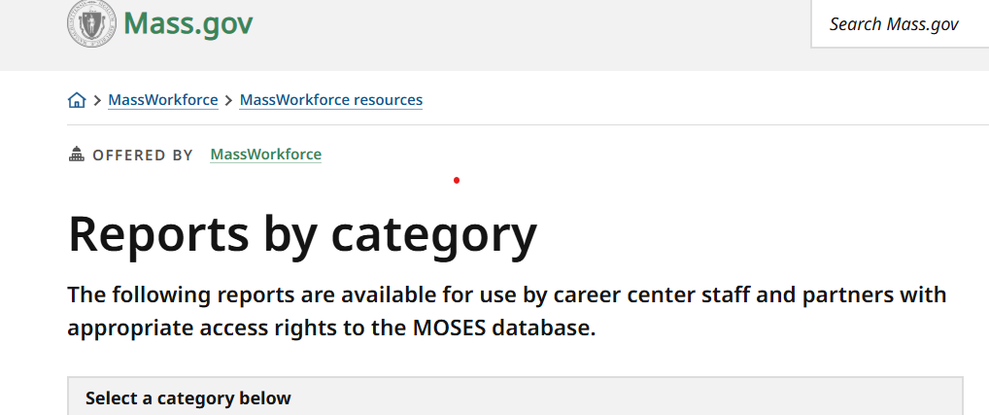
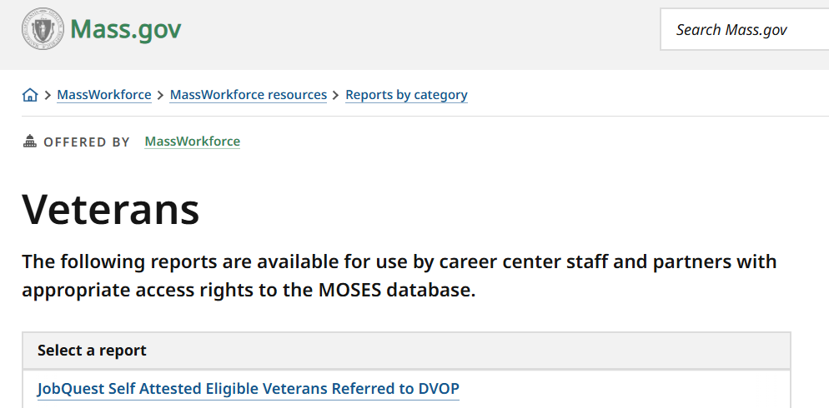
Self-Attested Eligible Veterans Report

Slide 19
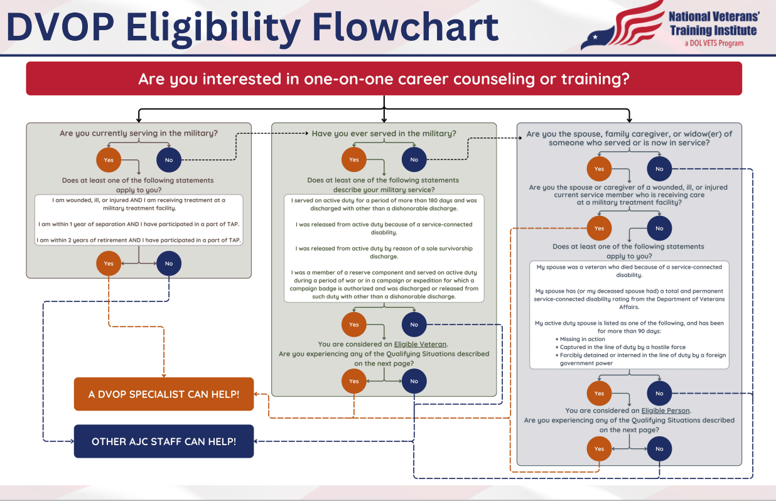
Link to: DVOP Eligibility Flowchart

Slide 20
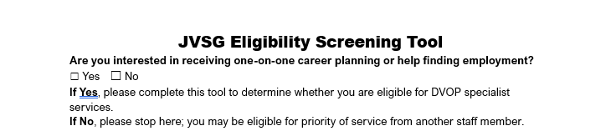
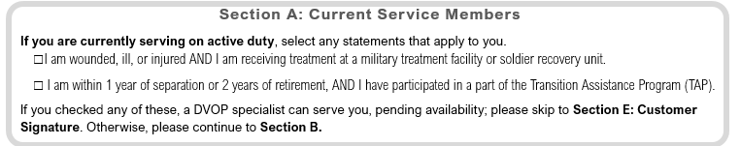
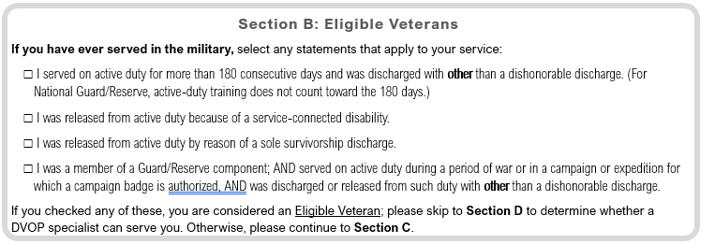
Eligibility Screening Tool

Slide 21
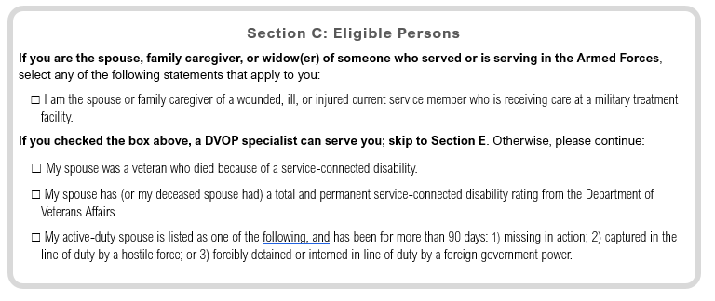
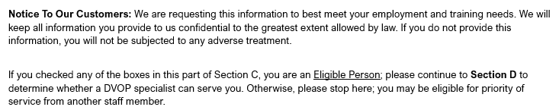
Eligibility Screening Tool

Slide 22
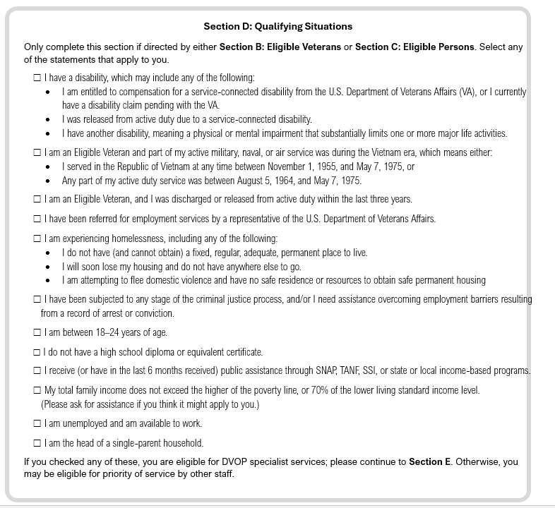
Eligibility Screening Tool

Slide 23
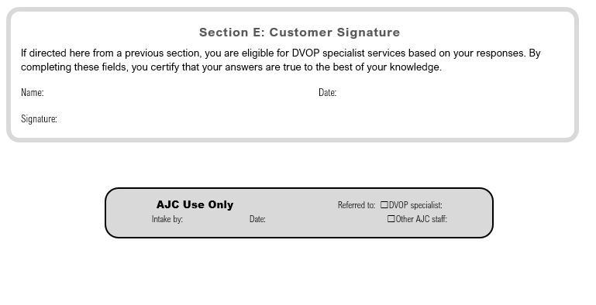
Eligibility Screening Tool
Issuance: 100 DCS 15.141 Issued: 10/10/2024
DVOP Eligibility Flowchart and DVOP Eligibility Screening Tool

Slide 24

DVOP Serving Veteran Customers
Will provide intensive services (at least once every 30 days) to eligible Veterans on Caseload
Use MOSES Career Planning tool to create Career Action Plan to assist in successful employment
DVOPs are SME on matters of Veteran Benefits and military matters; must be available to staff questions and assist Career Center Management with understanding laws, regulations surrounding POS, and JVSG
JVSG eligible Veterans will now be ID by Striped Star
Collaboration between BSRs/LVERs to promote job ready Veterans with job placement, Apprenticeships, OJTs in alignment with WIOA, local and state plans and local SOPs

Slide 25
Intake
Veterans attend CCS, determined eligibility by non-JVSG staff using JVSG Eligibility tool, initial assessment service and note are added to MOSES.
First meeting: DVOP will review MOSES, update info on Veteran, review JVSG Eligibility tool for accuracy.
Eligibility Screening via MassHire JobQuest: Self-ID Veterans to DVOP must have DD-214 verified, then referred to CCS prior to services.

Slide 26
Intake
DD-214 available, DVOP will verify DD-214 and enroll in the JVSG Program, if re-entry DD-214 must be re-verified and MOSES note added reflecting re-verification.
DVOPs will conduct a Comprehensive Assessment- Add services and detailed notes to MOSES.
EEO policy must be reviewed with each Veteran added to DVOP Caseload and MOSES note reflecting must be added. EEO policy must be refreshed every calendar year with corresponding note.

Slide 27
Comprehensive Assessment

Slide 28
Comprehensive Assessments
Not a one-time process, continuous process to assess JVSG Veterans
Assist with current resources
Discover possible obstacles/Barriers
Guide in the development of employment plan
Four step process
Rapport Building
Fact gathering
Interviewing
Closing

Slide 29
Comprehensive Assessment
Individualized/multi-faceted process by gathering information through:
Observations
Documents
Questions
Whole Person Concept
Everyone is unique
Experiences vary from influences based on life, goals, abilities
Gather as much information as possible on Veteran, could all have an impact on barriers
Employ intensive services and employment plan to determine steps needed for solid employment

Slide 30
Job Readiness
Job Ready – Possess the skills required to gain employment with minimum assistance from outside sources
Considered Job Ready by following criteria:
Possesses appropriate interviewing skills
Updated resume targeted to individuals desired industry
Understands Labor Market Information
Skills/abilities to conduct appropriate job searches
If not Job Ready: Continue to provide core and intensive to enhance skills to become job ready

Slide 31
Outreach

Slide 32
Expectations of Conducting Outreach
DVOPs are required to track outreach conducted each quarter via Outreach Plan Tracker
Established Outreach Standards
Weekly Partner Outreach:
Monthly Community Presence:
Example: Attend at least one in-person event a month (stand downs, job fairs,
Quarterly Meetings:
Example: Team or partner meetings, once a quarter to discuss outreach and veteran engagement strategies
Examples: VA, Homeless shelters, VSOs, correction agencies, workforce partners
hiring events)

Slide 33

Expectations for Conducting Outreach
Best practices for outreach goals
  Set clear measurable goals on weekly, monthly and quarterly basis
  Utilize outreach tracker to include intended contact purpose of outreach, outcomes, and next steps
  Add calendar follow ups, reminders, and check-ins to maintain relationships
  Review outreach goals at end of each week to track progress

Slide 34
DVOP Outreach
Outreach: interactive conversation between DVOP/LVER and stakeholder where information is shared about services to Veterans in a two-way conversation
Includes reaching out to organizations that provide services to Veterans and providing information about MassHire Services
Develop Partnerships in the local community
Maximize the number of participants to MassHire workforce system, that may be eligible to benefit from DVOP services
Enhance outcomes for Veterans that DVOPs refer to providers
Strengthen community awareness of the array of services through the MassHire system

Slide 35
DVOP Outreach
DVOPs must not serve any individual that has yet to be screened:
DVOPs can provide GOOD CUSTOMER SERVICE at events and encourage customers to come to MassHire Career Centers or JobQuest
DVOPs statutory purpose is to “carry out intensive services and facilitate placements” to eligible Veterans
No matter the source All Veterans must attend a Career Center Seminar and JVSG eligibility must be determined by non-JVSG Career Center Staff

Slide 36

Outreach Sites
Outreach sites include:
  VR&E sites
  HVRP, HFVVWF, IVTP grantees
  VA hospitals
  Homeless shelters
  Stand Downs
  Military installations
  National Guard/Reserve stations
  WIOA Partners including local Community Colleges
  City/Town VSO

Slide 37
Outreach Plans
Plans developed and agreed upon between Operations Managers/Career Center Directors and DVOPs
Plans must be submitted every year by July 1, signed by DVOP and Career Center manager
Veterans record outreach activity in the Outreach Tracker: highlights to be added to Quarterly Reports
DVOPs are required to do outreach and will inform managers of events and outreach activities.

Slide 38

DVOP Outreach
DVOPs participating in events outside of the Career center should have the following items:
  State laptop/Cell phone or equivalent
  JVSG Tablecloth
  Priority of Service Signage
  MOSES Event added to system
  Career Center flyers and informational events
  JVSG Polo/Jackets

Slide 39
Caseload Management

Slide 40
Case Assignment
Two forms of Case Assignment:
Self-Assigned – DVOPs must have supervisor/management oversight, especially prior to case closure
Manager Assigned
DVOP will continuously work with Veteran until one of the following:
Outcome is attained
Veteran no longer wishes to utilize Career Center services

Slide 41
Follow Up
If a Veteran is not following through:
Current process requires 3 separate attempts to reach out to Veteran, all 3 attempts must be documented in MOSES
3 attempts can include:
Telephone calls
Email communications
Letter via postal service or email with read receipt
Upon attainment of goal, Veteran must be followed up for 12 months, or until Veteran no longer wishes to receive services

Slide 42
Case Closure
DVOPs must meet with managers/supervisors to review case before closure
Manager/supervisor should sign VCDAS form to approve case closure
DVOP must document in MOSES of management approval to close case file
Once closed, Veteran should soft exit from all programs, no recordable blue services should be entered on case plan

Slide 43

Data Validation
Field Management and Oversight updates the Data Validation policy on a yearly basis.
Link: MassHire WIOA FMO Policy Issuances
VCDAS forms are a part of the Data Validation process for the JVSG Program.
DVOPs should continuously reference the VCDAS forms to ensure data accuracy in MOSES

Slide 44
Managers Report
JVSG goes by the Federal Quarters
October to December Q1
January to March Q2
April to June Q3
July to September Q4
Reports are due by the 15th of the following month after the end of each Quarter
Example: Q1 report will be due by January 15 after the close of Q1 in December
Managers report focuses on employment and training services provided to Veterans/Eligible persons by the local services area DVOP

Slide 45
References
Issuance: 100 DCS 15.139 Issued: 09/11/2024
Roles and Responsibilities of MassHire Career Center Staff Serving Veterans: TEGL NO. 03-24: Jobs for Veterans’ State Grants (JVSG) Program Reforms
Issuance: 100 DCS 15.141 Issued: 10/10/2024
DVOP Eligibility Flowchart and DVOP Eligibility Screening Tool

Slide 46

Questions

