Slide 1

JVSG Standard Operation Procedures Training
Day 4: Reports, Programs, and Services for Eligible Veterans
https://www.mass.gov/masshire-career-centers

Slide 2
Housekeeping
Keep
Please keep you lines muted
Use
You can use the chat, raise your hand or unmute your line to ask a question
Hold
Please hold questions until the end of the session to ensure we cover all content
Locate
The slide deck will be located on the JVSG Veterans Programs Resources page early next week.
Introduce
Please introduce your self in the chat

Slide 3
Topics
Training for JVSG Staff
JVSG Program Reports
Referral Process for via the ISC
Chapter 115 Referrals
Caseload Management
Federal Programs to Support Service Members
DVOP and the VSO

Slide 4
Acronyms
ISC: Intensive Service Coordinator
EOVS: Executive Office of Veteran Services
VPL:Veteran Program Letter
MGL: Massachusetts General Law
VSO: Veterans Services Office
VR&E: Vocational Readiness and Employment Services

Slide 5

Training DVOP/LVER
NVTI offers initial training for all DVOPs, LVERs, and Consolidated positions
In accordance with VPL 05-18 attachments 1 & 2; JVSG staff have 18 months to complete initial NVTI training
Additional Career Development tracks are offered for:
Veteran service providers
DVOP
LVER
Consolidated
NVTI trainings are offered and available to all staff, not just JVSG. Please contact the JVSG Program Coordinator for more information

Slide 6
NVTI Training
JVSG staff need to coordinate NVTI trainings with both JVSG Program Coordinator and Career Center management staff.
JVSG Program Coordinator will keep a record of all training completed by DVOPs.
JVSG Program Coordinator will share DVOPs training records with Operations Managers
Trainings offered:
  In-person, virtual, podcast, mini sessions

Slide 7
Crystal Reports
JVSG program has primary Crystal Reports to assist DVOPs:
JobQuest self-attested Eligible Veterans Referred to DVOP
Veterans with Barriers
Veterans Caseload report
Veterans receiving Career Center Services
Veterans 90-day warning report
Each of these reports, should be run at least once a month, to support DVOP efforts

Slide 8
Referral Process via the ISC
Intensive Services Coordinator (ISC) – will screen VR&E, HVRP, DOL, VA, and MassHire JobQuest referrals
ISC will refer to closest DVOP to where Veteran resides
DVOP will contact Veteran
DVOP will warm hand off Veteran to Career Center to create registration and attend a CCS
Veteran will then be assigned to DVOP for services

Slide 9
Referral Process via the ISC
Veterans not eligible for DVOP services – indicated by ISC – Operations Managers/Career Center management will be notified by email to provide services
Non-JVSG staff will continue to facilitate intake of Veterans who visit career centers to access services virtually or in-person

Slide 10
MGL Chapter 115 Benefits
Needs base tested program that assists Veterans with access to food, medical assistance, shelter, clothing or fuel.
All sources of income are used to determine need- based income
Dependents are eligible and are based as if veteran were still alive

Slide 11
MGL Chapter 115 Referrals
VSO evaluates CH115 Recipient
Depending on need and capability of work
Then referred to DVOP
Criteria for CH 115 to work with DVOP
Ready and willing to work
Registered in JobQuest
Must attend CCS and be determined eligible by non-JVSG staff
90 days with DVOP + 3 30-day extensions before sanctions to CH 115 benefits
DVOPs and VSO determine training plan/work search together

Slide 12
MGL Chapter 115 Referrals
VSO and DVOP should meet on a regular basis to discuss co-enrolled Veterans
EOVS send a monthly tracker to the ISC on referred Veterans, ISC will coordinate with DVOPs to ensure follow up is conducted
DVOPs should be meeting with their local VSOs to discuss CH 115 referrals
DVOP staff will not sign-off on work search logs. Veterans must be enrolled in MHJQ prior to sending work search activity to the VSO.

Slide 13
DVOP and the VSO
Veteran Service Officer – VSO, is mandated by the Commonwealth of Massachusetts, that each city/town must represent Veterans in their community.
DVOPs and VSOs should work collaboratively and develop a strong partnership to ensure co-enrolled Veterans are assisted to the best of their abilities
Activities with the VSO include, but not limited to:
On site or virtual case conferencing meetings
Veteran Resume Development and job search activities
Discuss opportunities to develop shared workshops
Joint job fairs or employer events
Round table/Panel discussions for employers and Veterans

Slide 14
Caseload Management

Slide 15
Caseload Management
Career Center Managers – ensure DVOP caseloads are manageable, prioritize quality services over quantity
Caseload Sizes will vary across the state for three reasons:
Veteran population density
Number of Veterans with employment barriers
Geographic considerations
DVOPs are required to do Outreach - refer to Outreach Section of SOP for further details

Slide 16
Caseload Management
No official minimum or maximum of caseloads for DVOPs; MDCS recommends 15-40
Ensures regular and meaningful contact with Veterans
Progress is tracked in individual employment plan
Services are completed effectively, leading to employment or measured progress
Sufficient time to deliver high-quality individualized services through case management
Active caseloads – does not mean customers are just enrolled in MOSES, Customers should actively be receiving staff assisted services: Career planning, job prep, job search assistance

Slide 17
Caseload Management
Caseload | Case Management | Outreach
15-25 | 60% | 40%
25-35 | 75% | 25%
35-40 | 85-90% | 10-15%
Caseloads below 15, 60% of time should be focused on outreach
Caseloads should not exceed 40

Slide 18
Caseload Management
Caseload reviews – should be conducted no less than quarterly by managers and DVOPs
Receive an update on active caseloads
Caseload volume to support balanced workload to align with high-quality services
Review MOSES documentation, confirm within 30 to 60 days
Ensure Veterans are progressing towards employment
Veterans Crystal Reports

Slide 19
Federal Programs

Slide 20
Vocational Readiness & Employment
VR&E Chapter 31 – Veterans Readiness and Employment Services.
All VR&E participants must be screened for JVSG eligibility: not all VR&E participants meet the JVSG Standards.
All screening will be handled by the ISC; those that do not qualify for JVSG services will be referred to local MassHire Career Center for assistance.
All VR&E participants must be registered in MOSES.

Slide 21

Intensive Service Coordinator and VR&E
ISC will conduct the following with VR&E clients:
  Central POC between VA and MassHire
  Initiates all referrals to DVOPs, conduct LMI, and employment services referrals
  Registers in MOSES and conducts JVSG initial assessments
  Conducts monthly meeting with VA’s VR&E team on all active participants

Slide 22
DVOP and VR&E
ISC will send referrals to local area DVOPs
DVOPs must complete the following tasks:
Contact with VR&E referral within 10 days or referral
Have referral attend a CCS and register on JobQuest
Report Outreach results within 14 days of referral
Conduct a comprehensive assessment, record all contacts in MOSES, add to case load after enrolling them into the JVSG program
In accordance with MOU between MassHire, VA, US DOL VETS: DVOPs must make contact twice a month with VR&E Veterans
VR&E Naming Convention in MOSES
In MOSES all Career Centers will name the VR&E program under the same name VETS-VR&E

Slide 23
DVOPs and VR&E
Case Closures can be conducts for the following reasons:
  Financial hardships
  Family responsibilities
  Medical issues
  Moved out of area
  Successful employment
All case closures must have management approval and be documented in MOSES
Follow up on successful employment goals; must be conducted at 30- and 60-day intervals, in accordance with VR&E policy

Slide 24
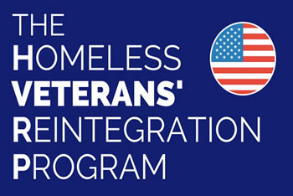
DOL VETS GRANTEES
Homeless Veterans Re-integration Program (HVRP)
  5 Grantees in Mass
Incarcerated Veterans Transition Program (IVTP)
  1 Grantee in Mass
Current list of Grantees/Areas of responsibilities can be found at:
https://www.mass.gov/doc/homeless-veterans-reintegration-program/download

Slide 25
HVRP
HVRP Eligibility:
Homeless Veterans, such as:
Veterans who were homeless but secured housing within 60 days before HVRP enrollment.
Veterans at risk for homelessness within 60 days at the time of enrollment.
Participants in HUD-VA Housing Programs, including:
HUD-VA Supported Housing programs under Section 8 (o)(19) of the U.S. Housing Act of 1937 Tribal HUD-VASH. Recipients of Housing Assistance, such as:
Veterans receiving assistance under the Native American Housing Assistance and Self Determination Act of 1966.
Transitioning Veterans, including:
Veterans described in 38 U.S.C. § 2023(d), or those transitioning from incarceration. 6) Participants in VA Rapid Rehousing Programs, authorized under 38 U.S.C. § 2044.

Slide 26
HVRP Referral Process
ISC will determine Eligibility for JVSG services and send referral to DVOP.
If not qualified for JVSG services, Veteran will be referred to local Career Center Operations to assist Veteran.

Slide 27
Transitional Assistance Program (TAP)
TAP is a collaborative effort for transitioning service members with the following agencies:
Department of Labor
Department of Defense (War)
Department of Education
Department of Homeland Security
Veterans Affairs
Small Business Administration
Office of Personnel Management
Two-day workshop teaching:
Building effective resumes
Networking and job search activities
Interview skills
Understanding negotiation techniques

Slide 28
JVSG Role in TAP
In accordance with Vow to Hire Heroes Act (Public Law 112-56) mandates the following:
DOL VETS curriculum is delivered by contracted staff
JVSG has no role in delivering TAP workshops
TAP participants are encouraged to visit local MassHire Career Centers for employment services
TAP programs MassHire JVSG currently works with:
US Coast Guard – Boston, Cape Cod
Fort Drum, NY – returning services members to Massachusetts

Slide 29
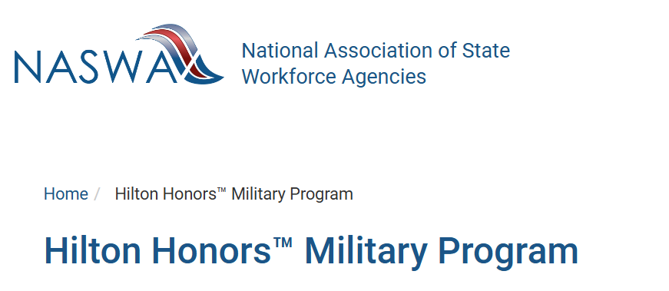
Hilton Honors
Designed for Veterans/TSMs to have a hotel stay for attending job interviews
Veteran Criterion
  Enrolled in MOSES
  Currently receiving employment services
  Proof of Veteran Eligibility/TSM status
  Must have a Hilton Honors Account
Requirements:
  Veteran must agree to provide feedback on employment outcomes
  Feed back on services provided
  Identification for Success Stories using Hilton Honors

Slide 30


