Slide 1



MOTOR VEHICLE AUTOMATED CITATION AND CRASH SYSTEM (MACCS)
State and Local Law Enforcement
Agency grant program
Michaela Dunne Joseph Demers
Deputy Commissioner MACCS Coordinator
Commonwealth of Massachusetts
Executive Office of Public Safety and Security
Department of Criminal Justice Information Services
“Enhancing Public Safety Through Information Exchange”

Slide 2
WHAT IS MACCS?
The Motor Vehicle Automated Citation and Crash System (MACCS) was developed in 2017 by the Executive Office of Public Safety and Security (EOPSS) through partnerships with:
  Massachusetts Department of Transportation (MassDOT)
  Executive Office of the Trial Courts (Courts)
  Registry of Motor Vehicles (RMV)
  Merit Rating Board (MRB)
  Massachusetts State Police (MSP) and;
  Municipal Police agencies

Slide 3
WHAT IS MACCS?
Developed as a result of 2016 legislation allowing for the issuance of electronically generated citations and the use of officers’ electronic signatures
Browser-based module in CJISWeb
Electronic crash and citation data collection and reporting tool
Allows for real-time submission of citations and crash reports
The MACCS project was managed by EOPSS until transferred to DCJIS in 2019 and us currently funded with 405(c) funds

Slide 4
Goals of MACCS
Improve officer safety
Streamline data collection
Improve data quality
Eliminate redundant data entry processes across agencies
Improve timeliness of reporting to state and federal entities
Make data available to law enforcement agencies

Slide 5
Benefits of MACCS:
Provides enforcement of standard business rules to help ensure accuracy and consistency of data
Collects minimal data to quickly produce the Crash Motor Vehicle Exchange Form
Electronically issues motor vehicle citations and maximizes automatic pre-filling of many data elements to eliminate human errors when keying information
Requires connection to CJIS Broker which manages the data exchanges between law enforcement agencies and RMV/MRB/Courts
Allows citizens who receive an eCitation to find and pay their citation via MASSRMV.com more quickly than those receiving a traditional carbon copy paper citation
Allows law enforcement agency users to quickly re-produce a copy of the Motor Vehicle Crash Police report when requested by the public without searching through paper files

Slide 6
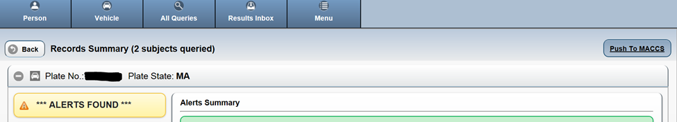
System Highlights
Eliminating the re-keying of information
When a MACCS user runs a vehicle or person query in CJISWeb, the response data can be pushed to MACCS (“Push to MACCS” key) to populate the relevant fields
This avoids double entry and possible errors in person and vehicle information transmitted to MRB.

Slide 7

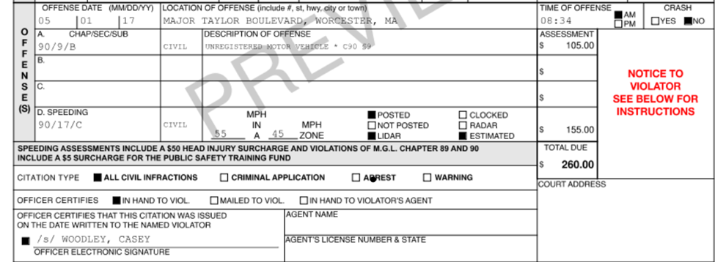
MACCS automatically calculates assessments based on M.G.L. and automatically applies the Brain Injury Fund and Municipal Police Training Fund surcharges where applicable.
The application also calculates appropriate speeding assessments based on miles per hour over the designated speed limit.

Slide 8

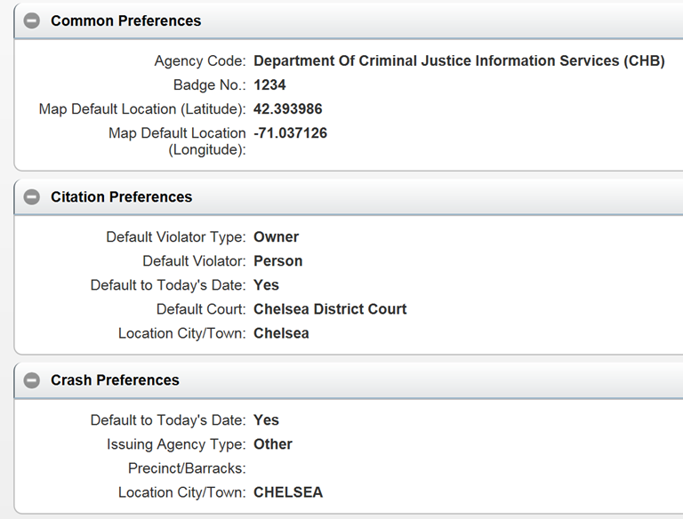
MACCS includes functionality to allow the user to set frequently cited metrics, such as their ID number, the current date and time, and their general location.

Slide 9
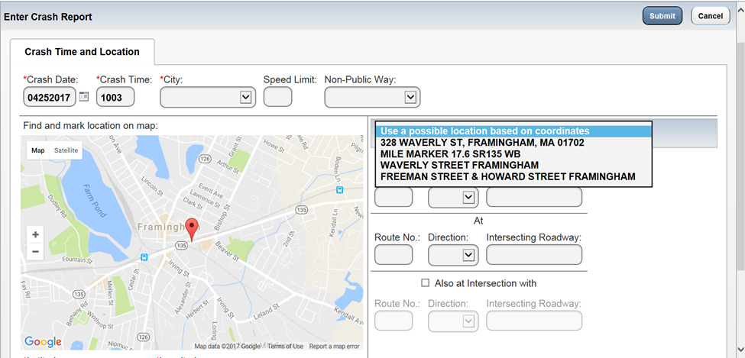
MACCS includes a Google map from which a user can drop a pin to indicate the location of the incident and to capture the latitude and longitude.
MACCS then calls the Commonwealth’s MassGIS database which provides a drop-down list for automated address selection.

Slide 10
What our grant provides agencies:
In-vehicle printer, cords and associated power cables
Printer mounts
Paper (thermal paper preferred by MRB in the new 8 ½ by 11 format)
Installation services for hardware
Training in the use of the application and printer
Technical support

Slide 11
DEPLOYMENT HIGHLIGHTS
Installation at 247 of 351 municipal police departments and one state university police department
51 additional municipal police departments are pending installation of printers or grant award
Massachusetts State Police has all 8 barracks operating on MACCS e-citation

Slide 12
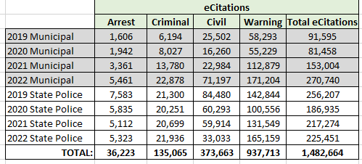
USAGE HIGHLIGHTS
Citations issued via MACCS 2019-2022

Slide 13
USAGE HIGHLIGHTS
Citations issued quarterly via MACCS 2019-2022

Slide 14
NOTABLE DEVELOPMENTS
Five RMS vendors have developed MACCS integration:
  IMC
  End2End Public Safety
  ProPhoenix
  Caliber Public Safety
  Nexgen Public Safety

Slide 15
What’s Next?
PROJECT GOALS:
Install approximately 275 printers at 52 police departments.
Provide additional printers for agencies that did not outfit full fleet.
Continue to make necessary MACCS software updates and enhancements.

Slide 16
What’s Next?
CHALLENGES:
COVID-19 pandemic stalled progress
6-8 week lead time for new equipment orders
Increased interest in program but not enough funding
38 departments indicate no interest in the program

Slide 17
What’s Next?
GOALS:
Continued outreach to remaining departments using paper citations
Increase usage of electronic citations at some MACCS agencies

Slide 18
Thank you for your time and consideration
Michaela Dunne Joseph Demers
Michaela.Dunne@mass.gov Joseph.Demers@mass.gov

